Slide 1
2024 Long-Term Reliability Assessment
Mark Olson, Manager, Reliability Assessments
Presentation for National Association of State Utility Consumer Advocates
January 22, 2025

Slide 2
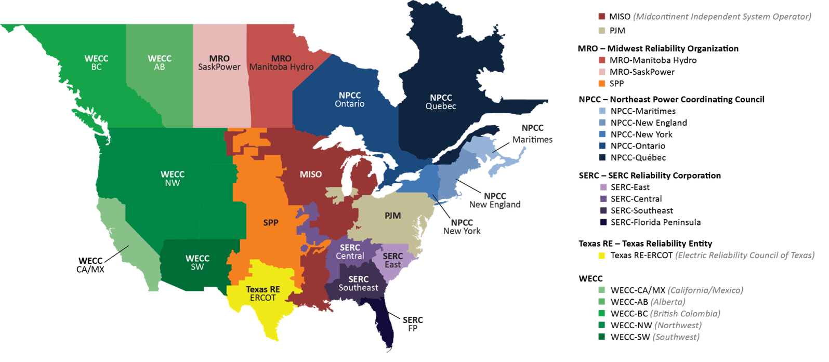
Long-Term Reliability Assessment (LTRA)
10-year assessment of resource capacity and energy risks
Uses industry’s demand and generation forecasts and transmission projections
Coordination and review with Region Entities and stakeholders
Includes emerging issues that can impact future reliability

Slide 3
Key Findings
Over half of North America is at risk of energy shortfalls over the next 10 years
Projected generator retirements remain at high levels and accelerate the need for resources
Demand growth is rising rapidly driven by electrification, data centers, and industrial load
Projections of future resources reflect slower rate of additions
Transmission development is increasing, with more projects in planning
Assessment
Assessment
Trend
Trend
Trend

Slide 4
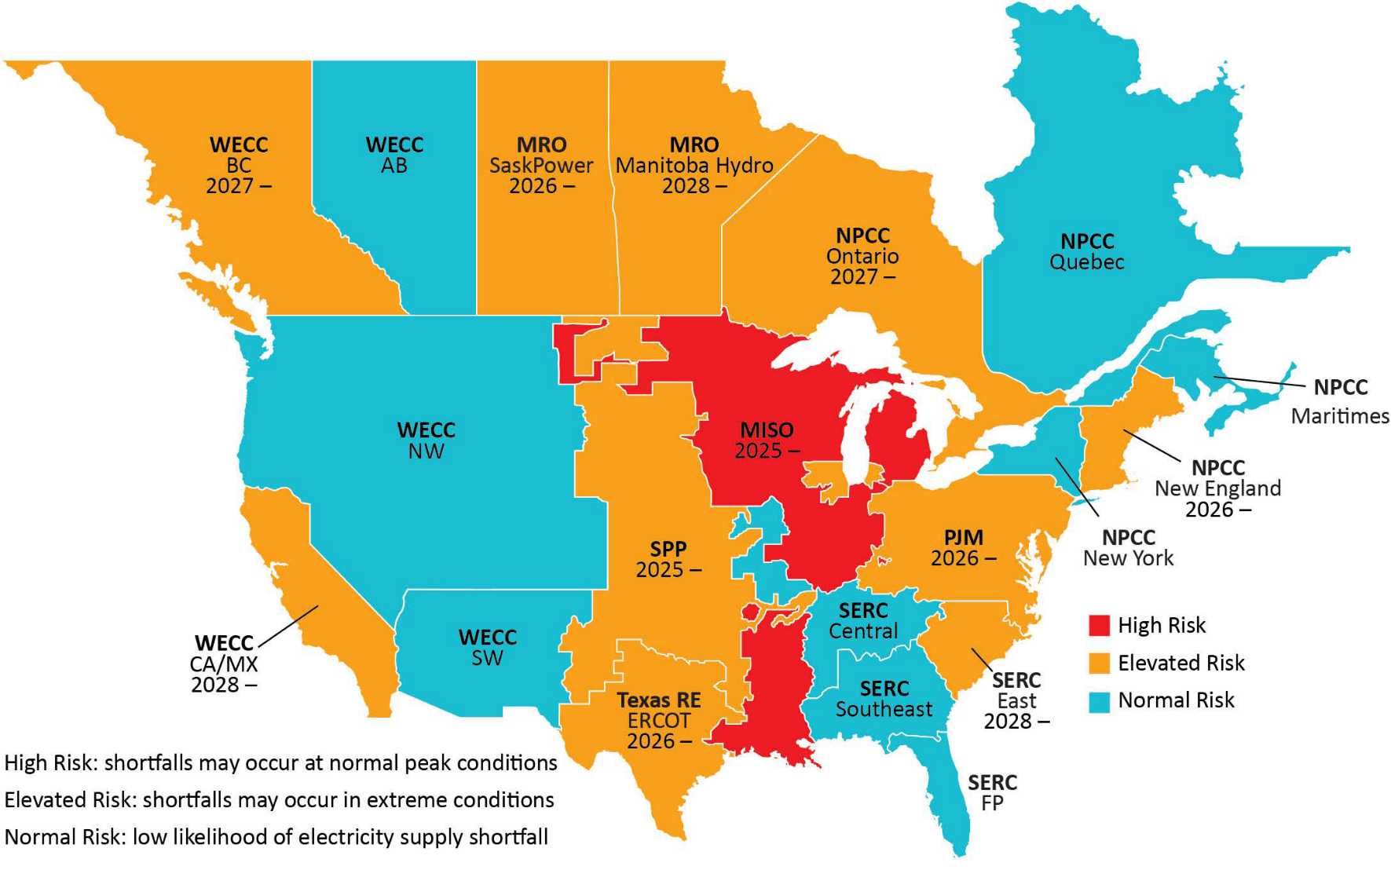
Increasing Energy Risks
Over The Next 5 Years
Limited Imports in Extreme Cold Weather
Demand Growth
Assessment Inputs:
Probabilistic Assessment (Studied Years 2026 and 2028)
Planning Reserve Margins (2025 through 2029)
Risk determination based on established resource adequacy criteria (1-day-in-10 years) and NERC-National Academy of Engineering Workshop Report criteria for load-loss and unserved energy
NPCC
Quebec
Generator Retirements
High Risk – Shortfalls occurring in normal peak conditions
Elevated Risk – Shortfalls occurring in extreme conditions
Normal Risk – Shortfalls not expected under studied conditions
Limited Dispatchable Generation
Risk Map | with Risk Drivers and Initial Shortfall Years
Notes:
Big risks and trends from the LTRA’s energy and capacity assessment

Slide 5
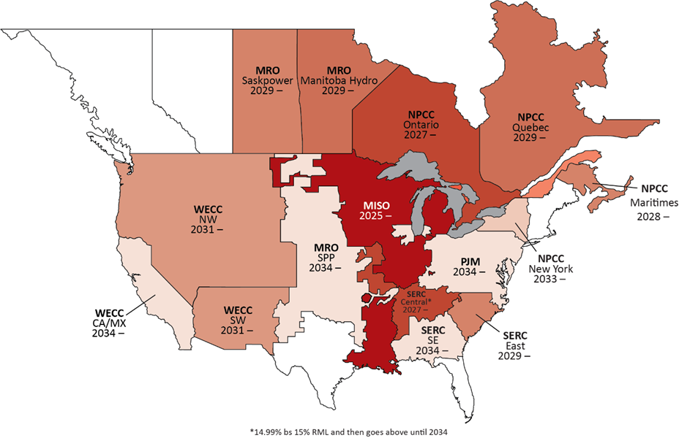
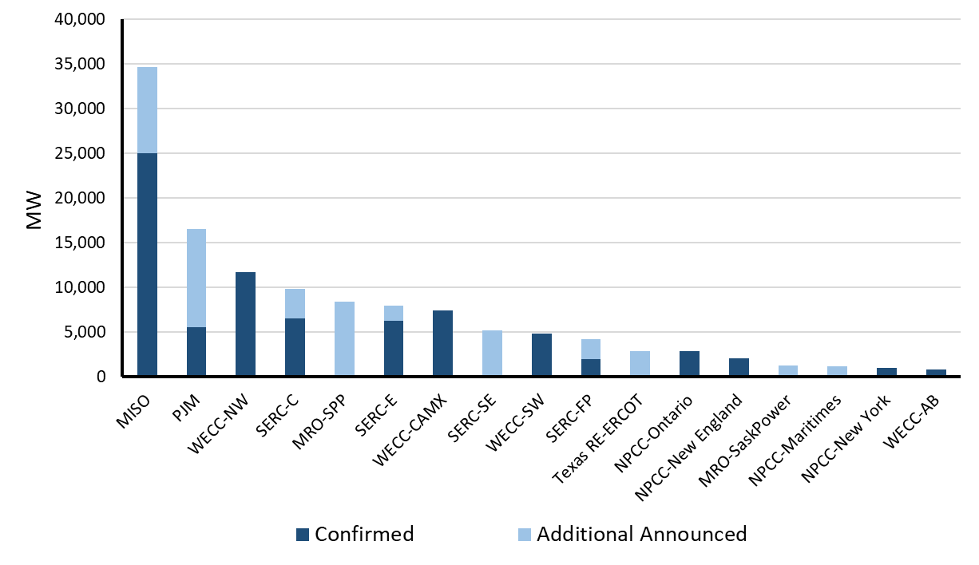
More Resources Are Needed To Meet Expected Retirements
Areas are projected to fall short of reserve margin requirements as generation retirements continue at rapid pace
Generator retirements through 2034 (thermal): 78 GW confirmed + 37 GW announced
2025
2034-
Beginning of Reserve Shortfall
Fossil-fired and Nuclear Generator Retirements by 2034
Reserve Margin Shortfall Projections Over the 10-Year Period
Source: Energy Ventures Analysis, Inc and LTRA Data

Slide 6
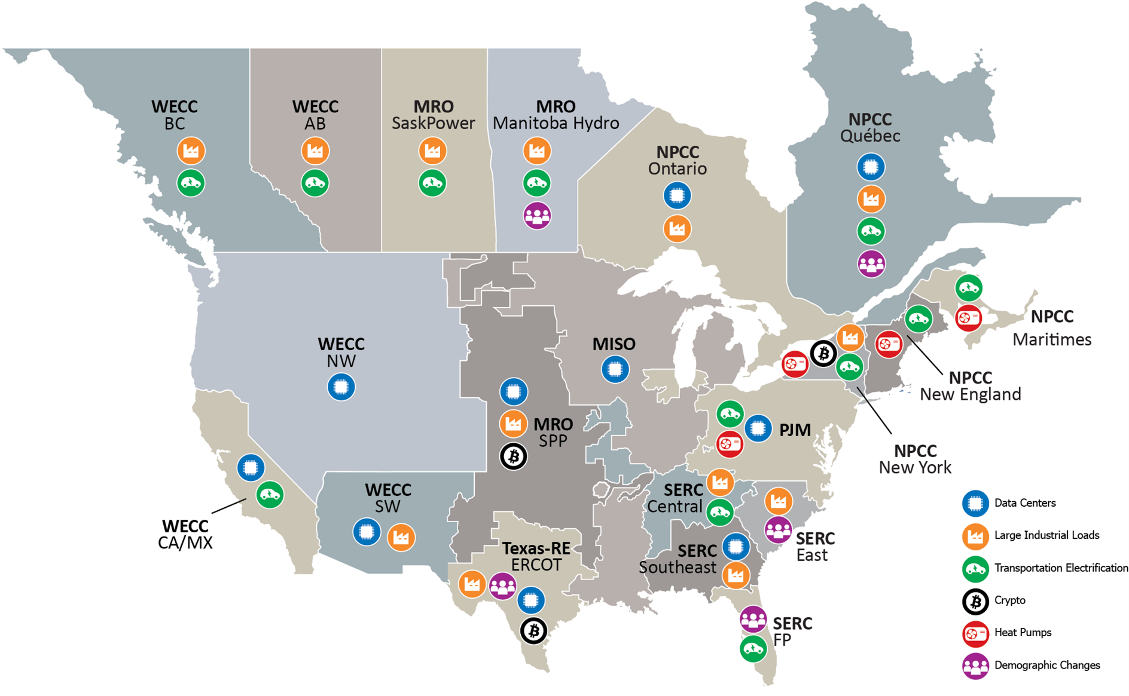
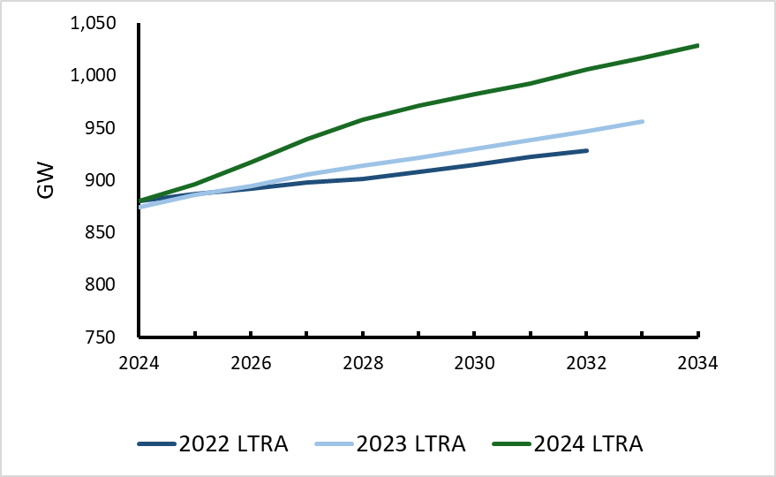
Demand Growth Is Accelerating
15%
9%
6%
10-year BPS Summer Peak Demand Growth
With 10-year Growth From Previous LTRA
Demand Growth Drivers
Notes:
Demand continues to be a big focus for the long-term. Looking at 2023, the 10-year peak demand was increasing at the highest rate in last three decades. Further growth was projected in part due to increases in electrification and EV adoption. Now in 2024’s early look, we see Peak demand growth is increasing at an even higher rate than in 2023 and 2024 records the highest CAGR in the last 20 years. Lots of this increased growth in demand can be attributed to data centers, large commercial and industrial loads, vehicle electrification, and heat pumps showcasing as the predominant drivers. NERC is studying the impacts on some of these new demand drivers, such as large commercial and industrial loads. A new RSTC task force has been created to address this.

Slide 7
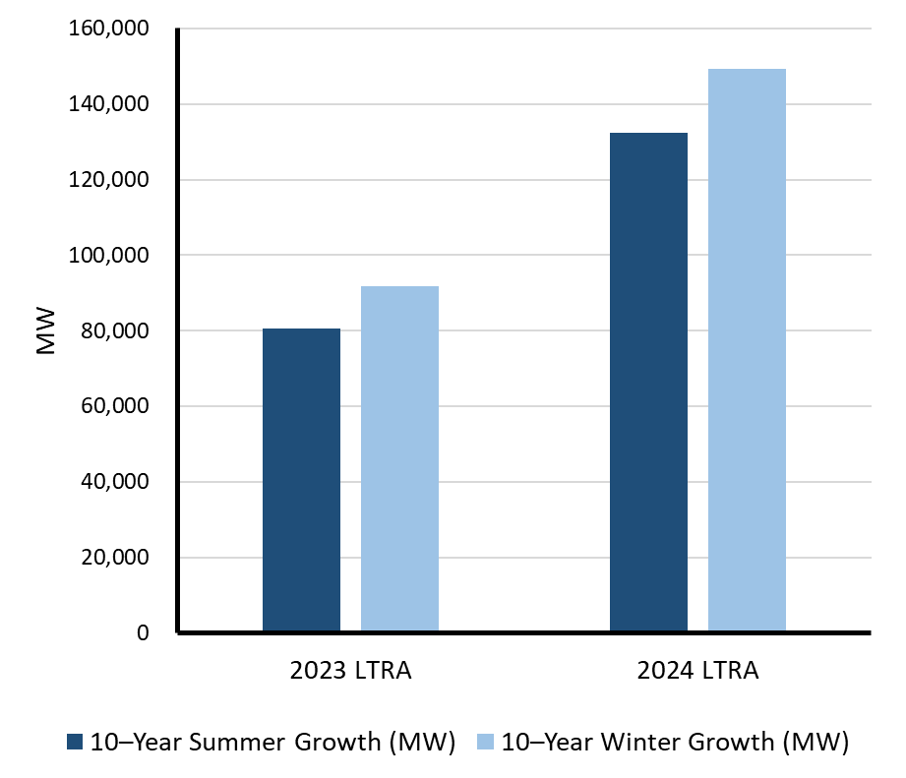
Demand Growth | Winter Is Outpacing Summer
Winter peak demand continues to rise faster than summer peak demand
This trend is driven by electrification and increasing amounts of solar PV distributed energy resources
In 10 of 14 summer-peaking assessment areas: winter demand growth rates > summer growth rates
Resource planning must increasingly focus on winter fuel and energy risks, generator performance, and load forecasting
149 GW
18% Growth
10-year Peak Demand Growth

Slide 8
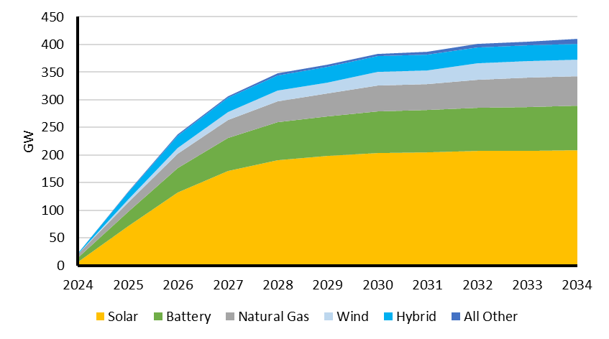
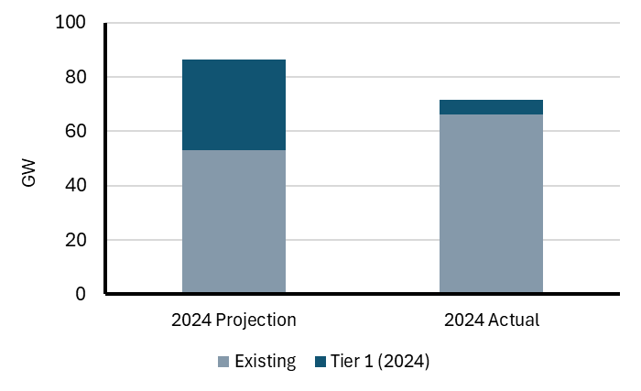
Resources Projections Reflect Slower Rate of Additions
Resources in the interconnection process continue to grow
Project delays and cancellations are causing resource growth to fall short of projections
Total size increase of 44 GW (12%) since 2023 LTRA
Projected in 2023 LTRA
2024 LTRA Updated Projection
Largest increase in Solar PV and Battery projects
14 GW lower than projected
Resources in Interconnection Process
Tier 1 (Signed Agreements) and Tier 2 (Processing)
Solar On-Peak Capacity | prior-year projection v. current year actual

Slide 9
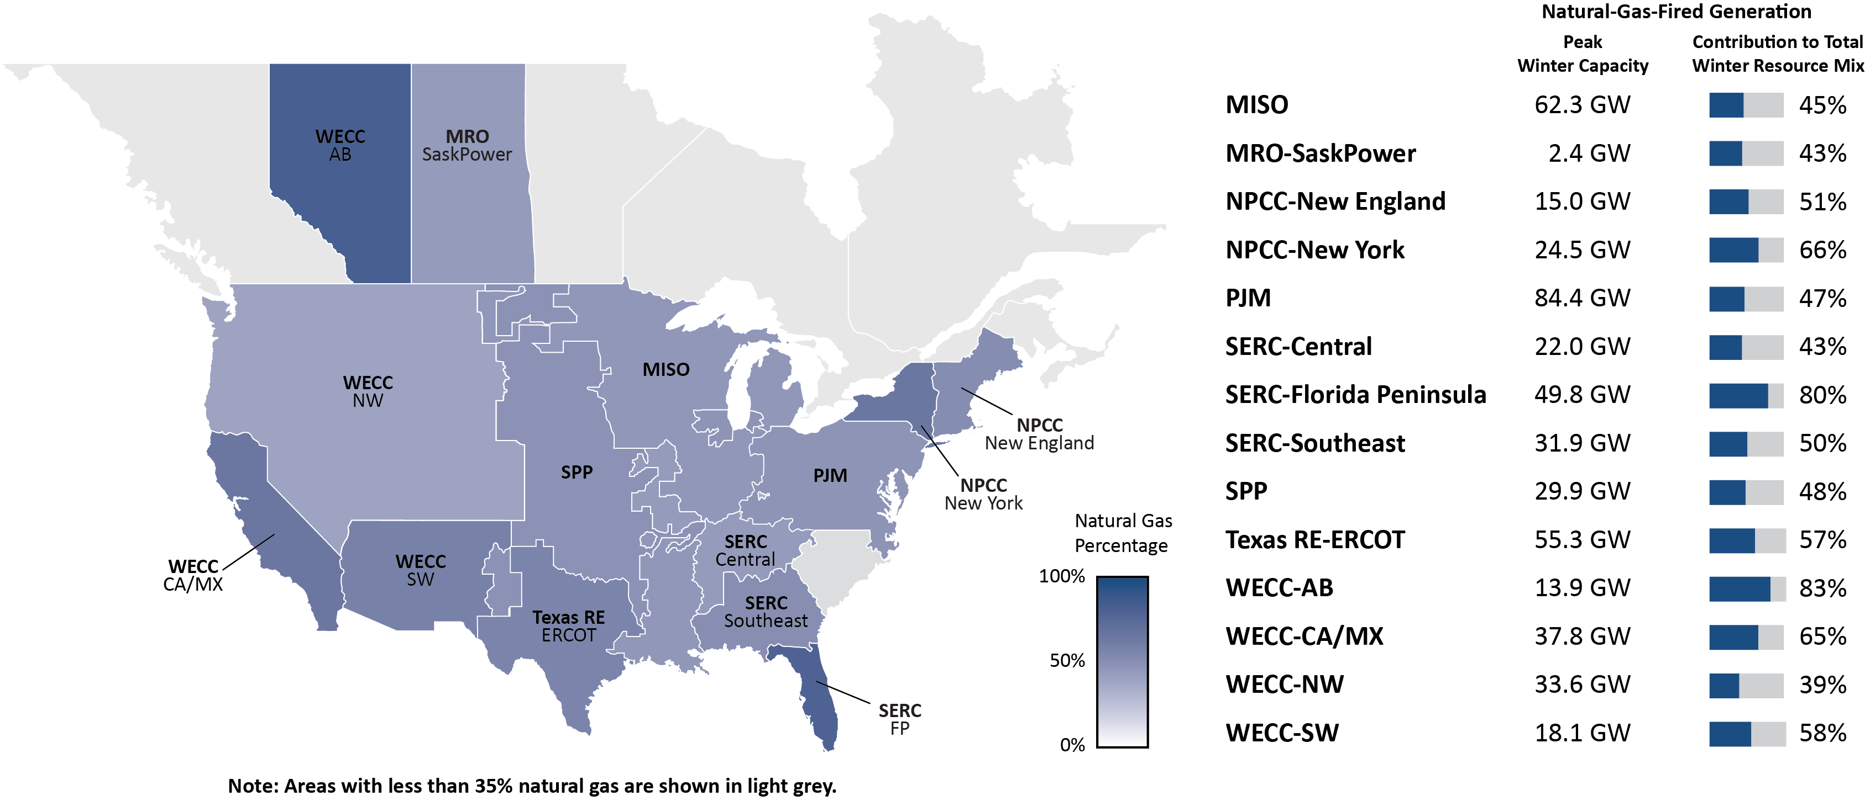
Criticality of Natural Gas Intensifies

Slide 10
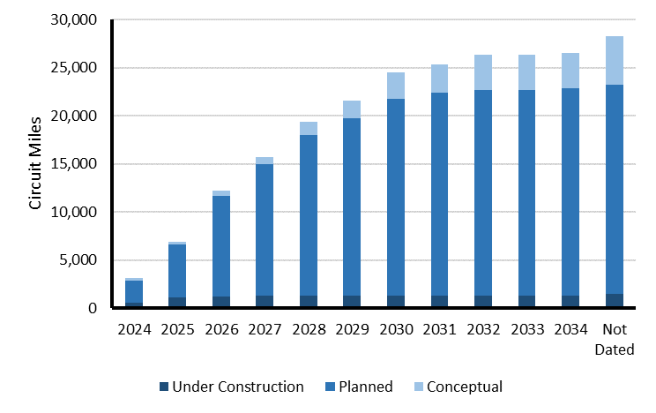
Transmission Development Is Increasing
Increase in transmission development: Miles of transmission in-development have risen vs. past LTRA average
Miles of new transmission projects under construction have not increased
Siting and permitting issues continue to delay projects (affects over 1,200 miles of transmission)
Assessment areas report significant investment in transmission development including projects to increase transfer capability
Average from past LTRAs
2024 LTRA Cumulative Transmission Projects >100 kV
2024 LTRA Transmission Project Primary Driver
Notes:
2023 LTRA: Little change in transmission miles projections over the course of the 10-year assessment period. 2024 LTRA Preliminary Information: Indicators point to more investment and enhancements to regional planning processes to support expansion. The amount of BPS transmission projects reported to NERC as under construction or in planning for construction over the next 10 years has increased, indicating an overall increase in transmission development. Siting and permitting challenges continue to inflict delays in transmission expansion planning. Regional transmission planning processes are adapting to manage energy transition, but impediments to transmission development remain.
Implications: Assessments should evolve to evaluate transfer capability and benefits to reliability. The Interregional Transfer Capability Study (ITCS) will create a foundation for transmission assessment that will shape the transmission assessment within the LTRA.

Slide 11
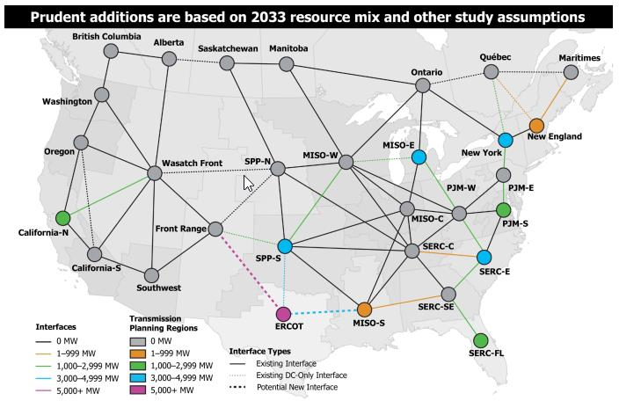
Increasing Transfer Capability Can Reduce Energy Shortfalls
NERC Interregional Transfer Capability Study (ITCS) finding: additional 35 GW transfer capability in the U.S. would improve energy adequacy in extreme weather
Transmission alone will not resolve all identified shortfalls → supply resources are needed
ITCS recommendations to planners include considering all options to address system needs:
  Transmission and transfer capability
  Local generation and storage
  Demand side management
ITCS Prudent Additions to Transfer Capability
NERC performed the ITCS to meet the requirements of the Fiscal Responsibility Act of 2023. Study information and results can be found on NERC’s ITCS Webpage

Slide 12
Emerging Issues
Data Centers and Large Industrial Load
Growth in large load parcels like data centers and industrial facilities pose various challenges for system planners and operators.
Battery Energy Storage Systems (BESSs)
Poor visibility of BESSs’ state-of-charge poses risks for operators who expect energy available for dispatch.
Electric Vehicles and Electric Load
With increased adoption of Electric Vehicles (EVs) there is a need to understand the impact of battery charging on system performance.
Energy Drought
More reliance on wind, solar, and hydro resources in the resource mix has the potential to expose the electricity system to supply shortages under abnormal weather patterns.

Slide 13
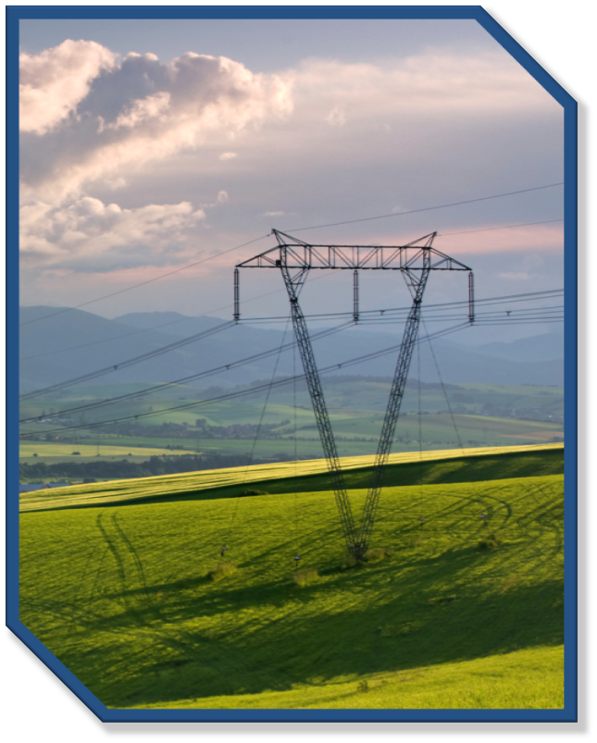
Recommendations
Resource planners, market operators, and regulators| carefully manage generator deactivations
NERC and Regional Entities| improve the LTRA with energy metrics, consistent methods, and wide-area energy analysis
Regulators and Policymakers| streamline siting and permitting to remove barriers to resource and transmission development
Regulators, industry, and gas industry| implement a framework for addressing reliability needs of the interconnected energy system
ISOs/RTOs, regulators| continue steps to ensure sufficient Essential Reliability Services

Slide 14
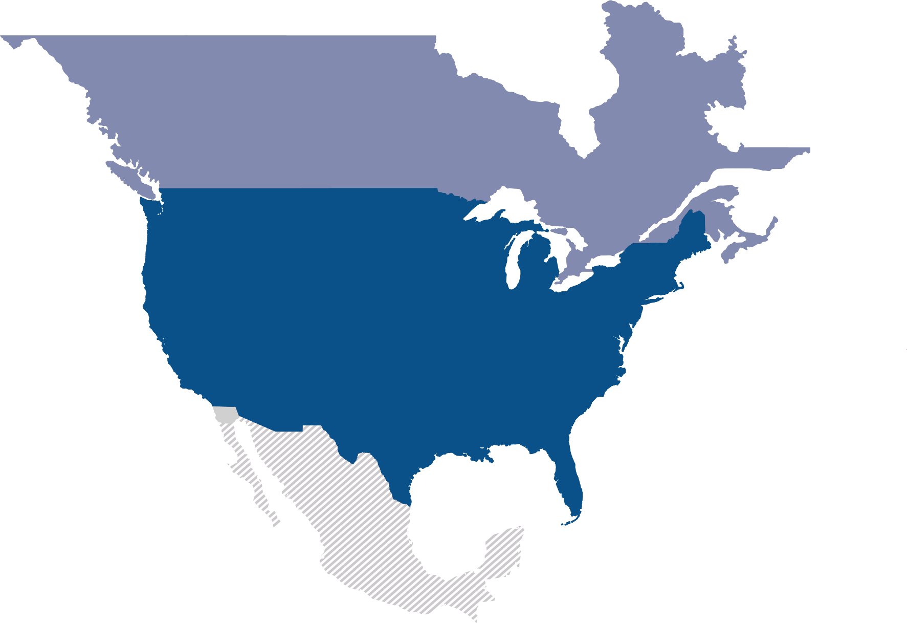
Questions and Answers

