Slide 1


Overview of Public Utility
Holding Companies
NASUCA Committee
on Accounting and Finance
October Virtual Training
Presentation by:
  Enrique Bacalao
  Patrick Sullivan
Regulatory Reserves Network
Madison, Wisconsin

Slide 2
Overview
What is a public utility holding company and how have they evolved?
History of federal regulation of public utility holding companies (Holdcos).
Applications for auditing public utility holding companies.
Financial implications of public utility holding companies and retail ratemaking.
Select provisions of the Wisconsin Utility Holding Company Act.

Slide 3
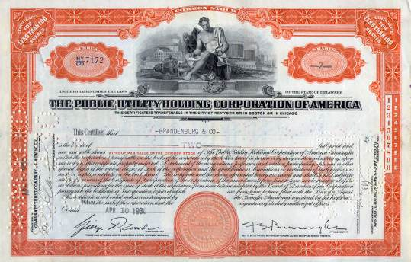

What is a public utility holding company and how have they evolved?

Slide 4

A Public Utility Holding Company
The Public Utility Holding Company
In plain English
A public utility holding company exercises a controlling interest in another company which either directly or indirectly controls an operating public utility.
Legal Definition (as defined by PUHCA in 1935)
“Any company which directly or in directly owns, controls, or holds with power to vote, 10 percent or more of the out standing voting securities of a public utility holding company or of a company which is a holding company by virtue of this clause... unless the [Securities and Exchange] Commission declares such a company not to be a holding company.... [Any] person which the Commission determines, after notice of an opportunity for hearing, directly or indirectly to exercise (either alone or pursuant to an arrangement or understanding with one or more other persons) such a controlling influence over the management or policies of any public utility or holding company as to make it necessary or appropriate in the public interest or for the protection of investors or consumers that such person be subject to the obligations, duties, and liabilities imposed in this title upon holding companies.”
(Public Utility Act of 1935, Public Law No. 333, Sec. 2(a)(7)(1935))

Slide 5
The Public Utility Holding Company
In the 1930’s, public utility holding companies typically took four forms:
  The diversified investment type: This type of holding company owned utilities which generated and distributed electricity over a wide geographical area, but did not have contiguous territories and were generally not interconnected.
  The large connected type: These holding companies were also widespread geographically. In almost all instances, the operating companies within the large connected type were interconnected with each other. Like the diversified investment type, the large connected type of utility holding companies primarily served small- and medium-sized communities.
  The large city type: This type of holding company was established primarily to serve large cities and to consolidate service areas within the large city which in the past had been served by many small generating and distribution entities.
  The super holding company: This type of holding company was established to hold other holding companies, which could have been any one of the three types mentioned above. During the 1920's and 1930's, most of the concern was with the super holding company, as detailed below.

Slide 6
Samuel Insull and his Enormous Impact
Born in London in 1859, emigrated to the U.S., aged 22, to work with Thomas Edison.
Gained Edison’s confidence, established General Electric’s main plant in Schenectady, NY.
As a result of a merger in 1892, he moved to Chicago to develop Midwestern electric operations.
In Chicago, Insull took over a power station, one of about 20 that served just 5,000 customers in a city of one million people. Electricity was a high-cost luxury. It was also a risky business venture.
Risking a personal loan of $250,000, Insull bought out his competition, then built the largest power plant in the world, the Harrison Street Station.
To maximize output and economies of scale, he adopted time-of-use tariff structures to encourage the use electricity outside of the most popular evening hours and allowed him to lower retail prices in order to attract small businesses and households.
Insull expanded his business interests, creating a diverse and complex holding company.
Insull’s business assets totaled $500 million with only $27 million in equity.
His holding company collapsed during the Great Depression, affecting 600,000 shareholders.
Charged with fraud, Insull escaped to Europe before being extradited back to the U.S.
He was tried in 1934 and acquitted of the various charges.
However, his reputation was destroyed, and he and his wife, Gladys, left the country for good.
Four years later, he died of a heart attack in the Paris subway with $1,000 left in his estate.

Slide 7
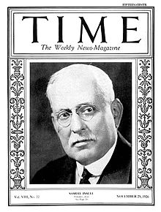
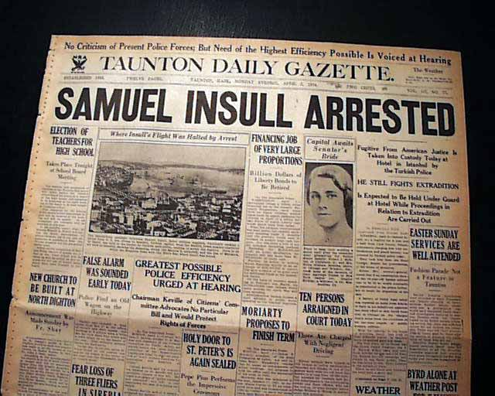
Samuel Insull – His Evolving Public Image

Slide 8
History of Federal Regulation

Slide 9

Prior to 1935, Holding Company Abuses
The holding company approach led to pyramiding. The result of pyramiding was the extensive use of bonds and preference shares which paid fixed returns as a means of financing the acquisition of operating companies and other holding companies. This growth in debt and the fixed interest payments required to service the debt made the holding companies more vulnerable to any downturns in the business cycle.
Holding companies were also felt to have abused the system by the use of questionable intercompany transactions and the charging of exorbitant service fees to subsidiary companies.
These excessive fees (e.g., construction charges) were then capitalized into the accounts of the holding company, which in turn inflated the operating utility's book value and caused the rates charged to the customers to increase unreasonably.
These also resulted in unrealistic pricing levels for the holding company securities.

Slide 10

Public Utility Holding Company Act of 1935 (PUHCA)
The primary objective of PUHCA, as summarized by one authority, was to “eliminate the evils connected with the public utility holding companies which are engaged in interstate commerce or in activities which directly affect or burden interstate commerce.”
The Securities and Exchange Commission (SEC) was created in parallel with PUHCA. The jurisdiction of the SEC was extended to any gas or electric utility holding company which participated in interstate commerce or made use of the U.S. mails. The responsibility of the SEC was to bring about the geographic integration and simplification of the holding company system. Under the legal structure thus provided, control of the public utility holding companies operating in interstate commerce was given to the SEC.
Perhaps the most important feature of PUHCA was that the SEC was empowered to eliminate the large interstate holding companies by forcing them to divest of their holdings until they be came a single integrated system serving a limited geographic area.

Slide 11

Select Provisions of PUHCA
Holding companies were required to register with the SEC beginning October 1, 1935, but not later than December 31, 1935. The holding companies' registration statements had to contain:
  Copies of the charter or articles of incorporation, plus any partnership agreements, by-laws, trust indentures, mortgages, underwriting arrangements, and voting trust arrangements.
  Full revaluation of the financial structure of the company.
  A list of all officers and directors.
  Explanations of any bonus and profit sharing arrangements.
  Divulging of the provisions of any contracts for materials, services, or construction
  Present consolidated balance sheets and comparable information.
The Act provided guidelines for the SEC to follow when regulating the issuance of securities by the holding companies and for revision of the rights of the current security holders.

Slide 12
Select Provisions of PUHCA (Continued)
Under the Act, public utility holding companies were not allowed to acquire securities of other utilities unless the SEC had previously approved the acquisition.
The Commission was given the authority in the Act to require the holding companies to keep and preserve any records which the SEC felt were necessary to promote the public interest and to protect the investors and consumers of the utility.
The Act also prohibited the holding companies from being involved financially in the promotion of any candidate either for election or appointment to a public office.
The Act required that all holding companies be integrated into an efficient system. Integration meant that the system had to be physically interconnected or capable of that interconnection. It also had to be economically operated as a single interconnected and consolidated system.
The Act also provided that needless complexities in corporate structure be eliminated and that the voting power be fairly distributed among the security holders. In addition, the holding company was to be confined solely to conducting business which was necessary and appropriate for the operation of a single integrated utility.

Slide 13
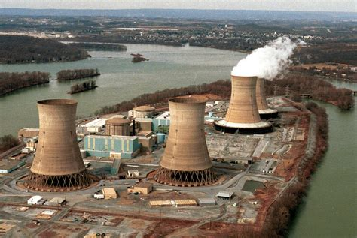
PUHCA from the mid 1970’s through the 1980’s
Utility Companies Fall on Financial Hard Times
What caused these financial tribulations?
  Large construction projects (primarily nuclear plants) with long construction schedules and mushrooming costs, beginning in the late 1960’s and early 1970’s.
  Increased state commission oversight led to many partial disallowance of the excess capacity investments in rate base.
  These lead to increasing proportions of debt used to finance public utility operations at a time of increasing interest rates.
  Fuel cost increased quickly through this period, which lead to a dampening of demand for electric service.
  The environmental compliance costs associated with these new plant investments also began to increase.

Slide 14
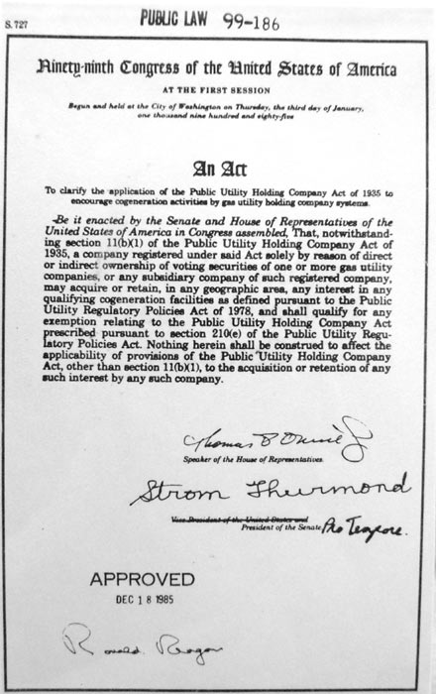
PUHCA-Related Legislation passed in 1985 and 1986
Public Law 99-186 (Cogeneration Activities by Gas Utility Holding Company Systems) allowed registered public utility holding companies to acquire in any geographical area any qualifying coal generation facility as defined in the Public Utilities Regulatory Policies Act (PURPA). This law exempted any holding company from specific provisions in PUHCA to allow them to acquire qualifying coal generation facilities, but did not exempt the remaining holding company restrictions from the Act.
Public Law 99-648 (Securities and Exchange Commission Exemptive Authority) was designed to exempt from PUHCA any holding company with only one gas utility subsidiary if the holding company or its subsidiaries were not operating utilities and the gas company was incorporated to operate only as a utility company as of June 16, 1986. In addition, the holding company had to own all of the voting securities of the gas utility, and neither the holding company nor any of its subsidiaries were to sell or service residential or commercial heating, plumbing, refrigeration, or air conditioning.

Slide 15

The Energy Policy Act of 2005: Repeal of PUHCA
The Federal Energy Regulatory Commission (FERC) essentially replaced the SEC in the supervisory role it had under PUHCA, and is mandated to adopt certain rules to implement the new regime created by the Act.
The 2005 Act gives FERC broader authority to review and approve utility holding company and public utility investments, mergers and acquisitions under specific circumstances, replacing the SEC in that role.
It was hoped that FERC’s transaction review process will be less cumbersome than the SEC’s requirements under PUHCA.
The Act also required that each holding company and its associated companies maintain and make available to FERC such books and other records as FERC determines are relevant to costs incurred by an associate public utility or natural gas company, and necessary or appropriate for the protection of customers with respect to jurisdictional rates.

Slide 16
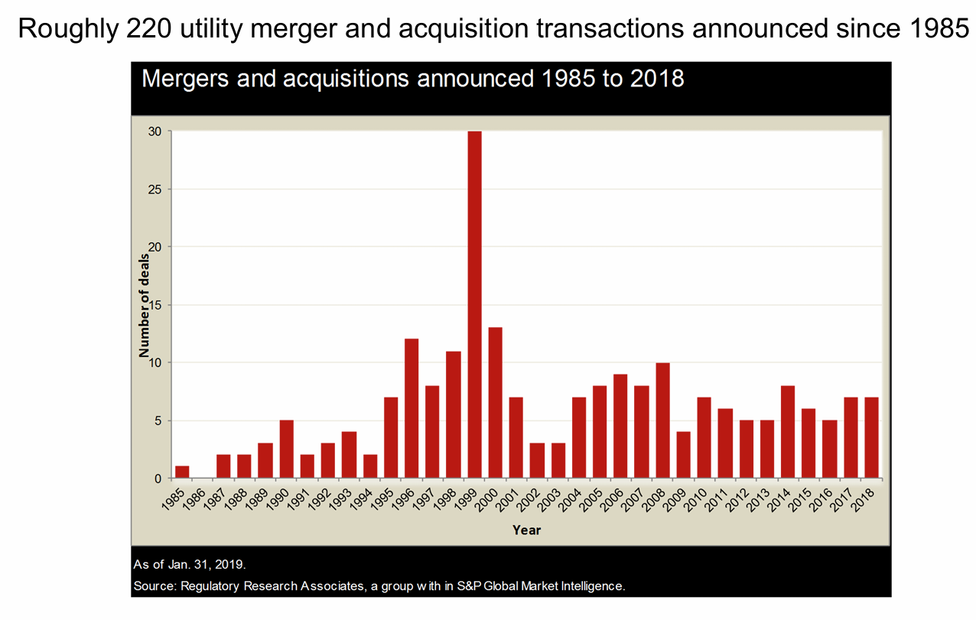
Public Utility Industry Consolidation

Slide 17
Public Utility Industry Consolidation
NiSource Inc. closed the sale of a 19.9% equity interest in its subsidiary Northern Indiana Public Service Co. LLC on January 2, 2024. Blackstone Infrastructure Partners LP purchased the equity interest for $2.15 billion. Blackstone Inc.’s infrastructure group committed to fund an additional $250 million in equity for Northern Indiana Public Service Co., LLC to fund ongoing capital investments.
NiSource Executive Vice President and CFO was quoted to be, “open-minded on how you source capital that you’ll need to execute a utility plan such as NiSource’s [capex plan].”
Source:
  US utility M&A likely 'all but dead' in 2024 as sector focuses on growth plans | S&P Global Market Intelligence (spglobal.com)

Slide 18
Public Utility Holding Company Audit Issues

Slide 19
A Public Utility Holding Company
Public Utility Holding Company Audit Issues
Cost Allocation Methodology Topics:
Affiliated cost allocation methodology manuals
Evaluations completed for compliance of cost allocations
Monthly summaries of all allocations and direct charges
Market pricing studies for basis of HC charges
Guidelines for Cost Allocations and Affiliate Transactions:

Slide 20
A Public Utility Holding Company
Public Utility Holding Company Audit Issues
Affiliated Transaction Pricing Data Topics:
Affiliated pricing and competitive bills policies and procedures
Evaluations completed for compliance of pricing policies
Studies of alternatives in markets for services or products
Cost-benefit studies completed for goods and services provided to affiliates or received by a public utility
External audit reports related to affiliated relationships
Internal Audit activities for inter-company billings, cost allocations, or affiliated relationships

Slide 21
A Public Utility Holding Company
Public Utility Holding Company Audit Issues
Effect of Affiliated Relationships Topics:
Operating utility and any service company management structure
List of utility employee transfers to and from subsidiaries
Cost of capital structure calculations with and with out the affiliated relationships
Policies and procedures for sharing technology with affiliates.
Policies and procedures for affiliate access to utility customer data
Policies and procedures for compensating utility for an affiliate’s use of intangibles, such as trademarks

Slide 22

  Public Utility Holding Company Audit Issues
Income Taxes In Ratemaking:
Stand-alone treatment:
  Customers pay taxes via rates as if the Holdco did not exist.
  Risks lie with Holdco, therefore so should the tax benefits
Consolidated tax adjustments
  Retail customers are allocated a portion of any Holdco tax benefits.

Slide 23
  Public Utility Holding Company Audit Issues
Holding company versus operating company priorities:
  System-wide objectives vs. local service objectives
  Misalignment between local retail shareowners and institutional ones
  Allocation of opportunities and risks within the Holdco system
  Diversification into non-regulated activities
  An inclination to homogenize the various operating companies
Scarcity of senior management time and attention:
  Due attention to local regulatory bodies, government and stakeholders
  Anticipating and managing local opportunities and challenges
  Pressure to have the Holdco to “stick to its knitting”
  Examples from Alliant Energy Corporation, 1998 to 2002

Slide 24


Financial Implications of Public Utility Holding Companies for Retail Ratemaking

Slide 25
Financial Implications of Public Utility Holding Companies for Retail Ratemaking
Regulators may want to consider using hypothetical capital structures for operating companies owned by public utility holding companies.
  In contrast to using GAAP-compliant reported capital structures
  Risks investor difficulties in analyzing financial conditions and risks
Hypothetical capital structures can be justified when:
  The operating company has incurred debt-like obligations that are not recognized as debt under GAAP rules and guidance
  The holding company has funded the operating company significantly
  The operating company benefits significantly from holding company system-wide tax, pension and similar contingent obligations

Slide 26
Financial Implications of Public Utility Holding Companies for Retail Ratemaking
The application of hypothetical capital structures requires judgement:
  This should not be an automatic rule for ratemaking purposes
  Like any good rule, it can be used, misused or abused
  It should be applied if it would render a more accurate reflection of the regulated operating company’s marginal cost of capital (its after-tax WACC)
Examples of fair and appropriate imputation of hypothetical capital structure:
  Recognition of imputed off balance-sheet leverage (e.g., leases, PPAs)
  Cases of holding company efficiencies achieved in managing system-wide contingent obligations (e.g., pension obligation funding, consolidated taxes)

Slide 27
Financial Implications of Public Utility Holding Companies for Retail Ratemaking
Misuse and abuse of imputing a hypothetical capital structure:
  Double leverage can be a prime example of misuse and abuse.
  It can be imputed to a an operating company with a holding company parent that has issued debt in its own name and subsequently contributed equity to that operating company subsidiary.
  The presumption is that the holding company is using cheaper borrowed funds to earn a higher return on the equity of its operating company subsidiary – hence the term “double leverage”.
  The double leverage imputation could be extended to multiple levels of corporate ownership in a complex holding company structure.

Slide 28
Financial Implications of Public Utility Holding Companies for Retail Ratemaking
Double leverage can be nonsensical if it distorts the cost of capital. The economic concepts that double leverage can violate:
The required return is a function of the risk of the investment
The cost of equity is the risk-adjusted opportunity cost faced by the marginal investor
The risk is determined by the use of funds, not the source of funds
Equity is equity, regardless of its ownership or funding source
The cost of equity is based on future expectations, not on historical events
The risk profiles of its subsidiaries sets the risk profile and cost of capital for the holding company, not the other way around
The business risk profile of various subsidiary companies is different, leading to different optimal capital structures
Consequently, the cost of capital should differ among the members of the system

Slide 29

Financial Implications of Public Utility Holding Companies for Retail Ratemaking
Ringfencing utility operating companies:
To insulate rate regulated subsidiaries from business practices and credit risks of sometimes highly speculative, non- regulated affiliates in a holding company system.
  Pro-active regulatory oversight
  Financial restrictions
  Structural separations
  Operational Controls
Ring Fencing Mechanisms for Insulating a Utility in a Holding Company System

Slide 30
Financial Implications of Public Utility Holding Companies for Retail Ratemaking
Standard and Poor’s three elements of package of special enhancements required to create a ring fence:
A special structure, often including a special purpose entity, structured in a way that reduces the risk of a subsidiary being pulled into bankruptcy with its parent.
A tightly drafted set of covenants, including dividend tests, negative pledges, non-petition covenants, prohibitions from creating new entities, restrictions on asset transfers and inter-company advances, that collectively preserve the financial well-being and autonomy of the ring-fenced subsidiary.
The third element is collateral. If the debt is fully secured by a pledge of all or substantially all of the assets of the subsidiary, the parent, in principle, has less freedom to deal with the assets of the subsidiary. Financial restrictions.

Slide 31

Wisconsin Public Utility Holding Company
(WUHCA) Statute

Slide 32
Wisconsin Statute 196.175
The underlying premise in WUHCA is that interests of Wisconsin’s ratepayers, investors in Wisconsin utility holding companies, and the general public are deemed to benefit when public utility holding companies:
  Conduct and expand substantial business activities;
  Attract new business;
  Provide investment capital for new business ventures; and
  Promote employment and commerce.

Slide 33
Wisconsin Statute 196.175
  The public interest could be protected if:
    Affiliated transactions were subject to review and approval;
    Non-utility activity does not lessen competition;
    Public utility operations remain subject to regulation;
    Holding company books and records are subject to review;
    Non-utility business does not adversely affect utility rates, reliability, and cost of or ability to raise capital; and
    Provision of reasonably priced, reliable energy services remains the predominant business of a public utility holding company.

Slide 34

Wisconsin Statute 196.175
Subsection Three: Take-overs
Commission must find any 10% voting owner of public utility holding company:
    Must be in the best interests of:
        Utility customers
        Investors
        Public
Commission investigation
Opportunity for hearing
Link to Statute

Slide 35

Wisconsin Statute 196.175
Subsection Four: Capital Impairment
The Commission can limit or cease dividends paid from the public utility company to the holding company if dividend payments could impair a public utility affiliate’s capital.
Link to Statute

Slide 36

Wisconsin Statute 196.175
Subsection Five: Regulation of Holding Company Systems
Access to books and records
Operations must not prevent sound operation of public utility subsidiaries.
Controls for exchanges of data in the system.
Prevention of subsidies within the system.
Ensure public utility subsidiaries shall be considered to have stand alone treatment for capital structure and tax-related issues.
Link to Statute

Slide 37

Wisconsin Statute 196.175
Subsection Six M: Asset Cap
A holding company may not have more that 25% of its consolidated assets invested in non-utility investments (the “asset cap”).
Requires annual reporting for calculations of the asset cap.
Link to Statute

Slide 38

Recent Public Utility Holding Company News Items

Slide 39


Regulatory Reserves Network
Enrique Bacalao Bacalao Consulting Services, LLC enrique@bacalaoconsultinservice s.com www.bacalaoconsultingservices.com | Randel Pilo Econwerks LLC randal@econwerks.com www.econwerks.com | Patrick Sullivan Sullivan Economic Consulting, LLC pp.sullivan@sullivanconsultingwi.com www.sullivanconsultingwi.com

