Slide 1
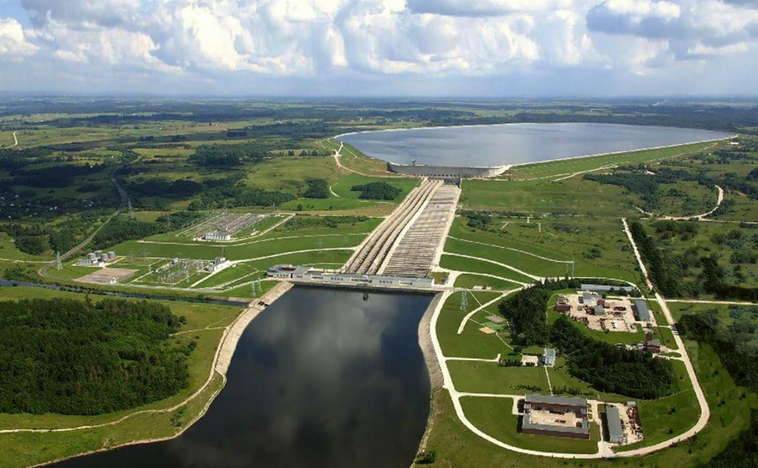
The value of long duration energy storage for improving grid reliability and resilience
Patrick balducci and Neal Mann
Argonne National Laboratory
NASUCA Webinar on long-duration storage
October 15, 2024

Slide 2
Long duration energy storage (LDES) is required for deep decarbonization
Renewable Energy Penetration Necessitates LDES Investment
Renewable Energy Penetration Necessitates LDES Investment
LDES
Source: Albertus et al. Joule (2020). Long-Duration Storage Applications, Economics, and Technologies.
Source: U.S. Department of Energy. (2020). Pathways to Commercial Liftoff: Long Duration Energy Storage.

Slide 3
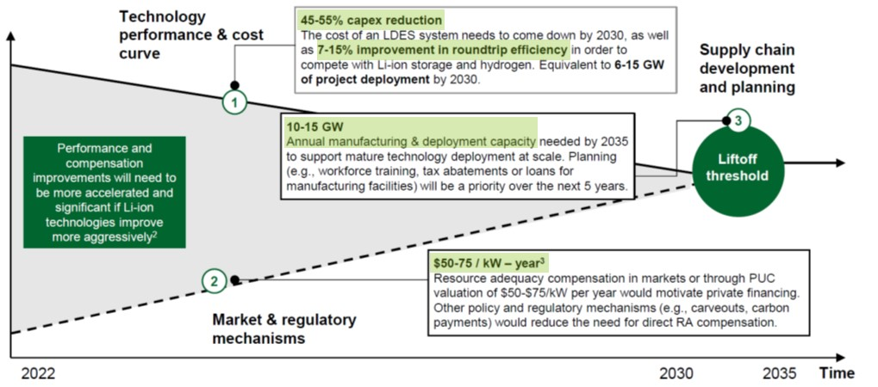
Pathways to commercial liftoff: long duration energy storage
U.S. grid will need 225-460 GW of LDES capacity by 2060, representing $330B in capital
Net-zero pathways that deploy LDES result in $10-20B in annualized savings in operating costs and avoided capital expenditures (by 2050)
LDES Pathways Report
Improvements Needed in Technology, Cost, Regulation, and Supply Chain

Slide 4
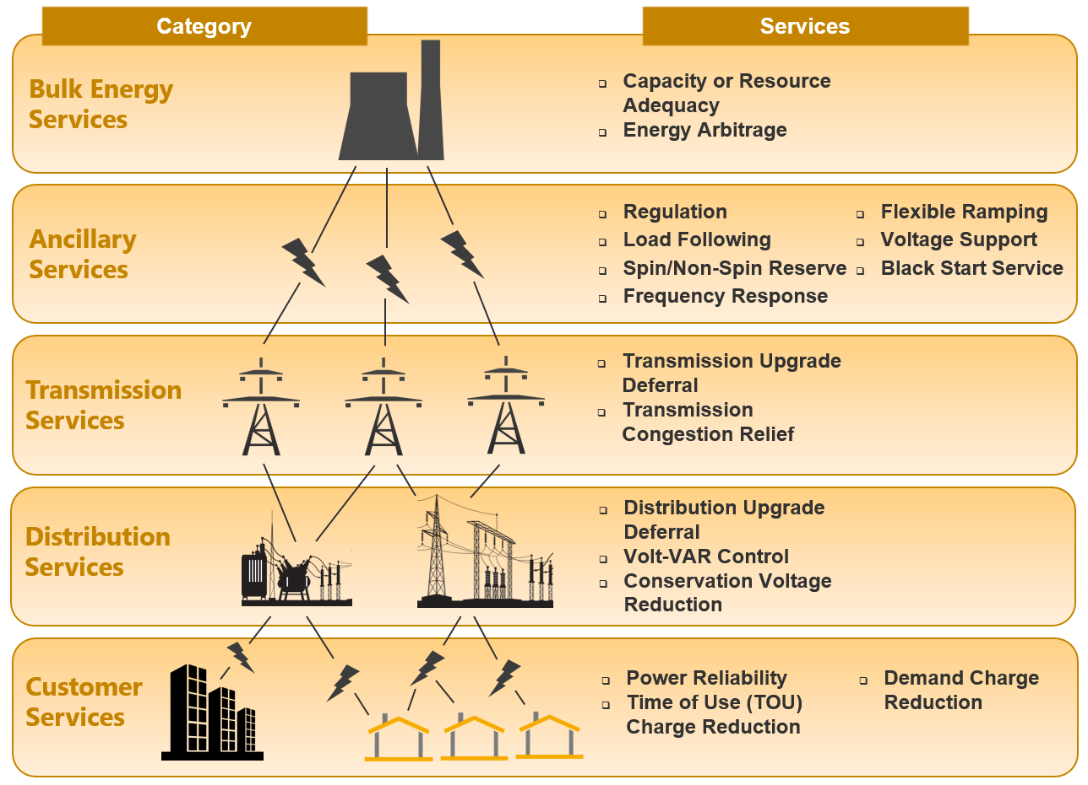
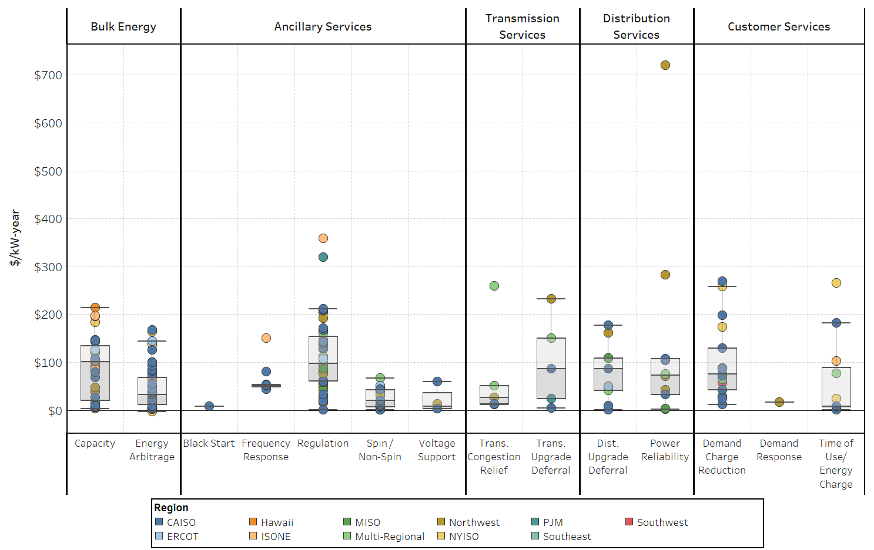
Energy storage holds tremendous value
Source: Balducci, Patrick, Mongird, Kendall, and Weimar, Mark. Understanding the Value of Energy Storage for Power System Reliability and Resilience Applications. Germany: N. p., 2021. Web. https://doi.org/10.1007/s40518-021-00183-7.

Slide 5
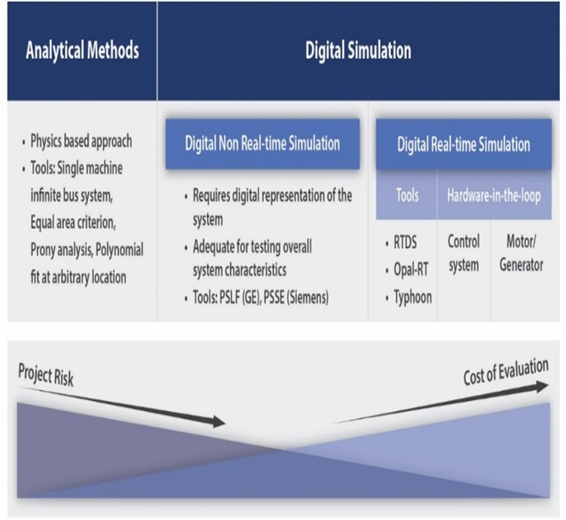
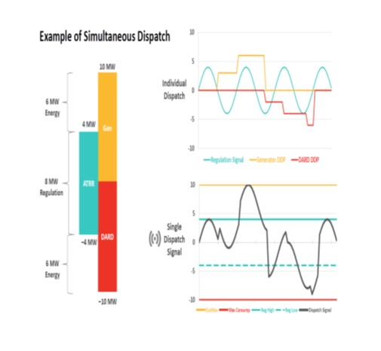
Challenges to accurately estimating Reliability/resilience benefits
Multidimensional competition for energy – not all services can be provided simultaneously and there exists intertemporal competition for energy
Most models cover small subset of hours in year and don’t reflect future climate and extreme scenarios well
Markets are complex and common practices of assuming perfect foresight into prices, price-taker position, and consistent performance lead to overestimation
Resilience often captured indirectly
Battery degradation is an important consideration
Absence of a market to capture reliability/resilience benefits
Co-Optimization of Services
Addressing Computational, Data, and Cost Challenges
Modeling Future Climate and Extreme Conditions
Market Complexities

Slide 6
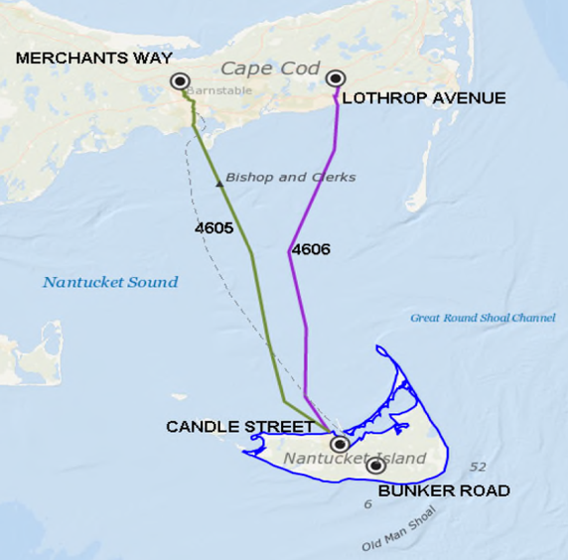
Nantucket Island Energy Storage System
Nantucket Island located off the coast of Massachusetts
Small resident population of 11,000; population swells to over 50,000 in summer
Nantucket’s electricity supplied by two cables with a combined capacity of 71 MW and two small on-island combustion turbine generators (CTGs) with a combined capacity of 6 MW
Rather than deploying 3rd cable, National Grid is replacing two CTGs with a single, large (16 MW) combustion turbine generator (CTG) and a 6 MW / 48 MWh Tesla Li-ion battery energy storage system (BESS.)
Use cases evaluated
Non-market operations
Transmission deferral
Outage mitigation
Conservation voltage reduction
Volt-VAR optimization
Market operations
Forward capacity market
Arbitrage
Regulation
Spinning reserves
Nantucket Supply Cables
Source: Balducci, Patrick J., Alam, Md Jan E., McDermott, Thomas E., Fotedar, Vanshika, Ma, Xu, Wu, Di, Bhatti, Bilal Ahmad, Mongird, Kendall, Bhattarai, Bishnu P., Crawford, Aladsair J., and Ganguli, Sumitrra. Nantucket Island Energy Storage System Assessment. United States: N. p., 2019. Web. doi:10.2172/1564262.

Slide 7
Nantucket Island Conclusions
Total 20-year present value benefits of BESS and CTG operations at $145.9 million exceed revenue requirements and energy costs at $93.9 million with an ROI ratio of 1.55
Benefits largely driven by the transmission deferral use case, $109 million (75%) in present value terms.
Regulation services - $18.8 million, 13% of total benefits
Regulation service dominates the application hours, 7,900 hours each year
Benefits of Local and Market Operations (Base Case) vs. Revenue Requirements

Slide 8
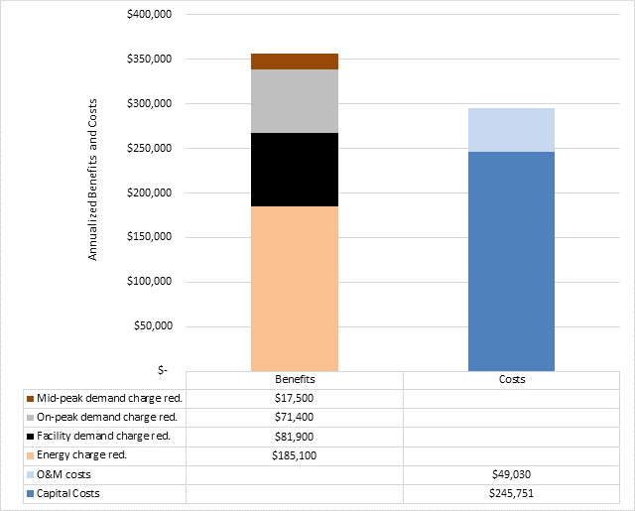
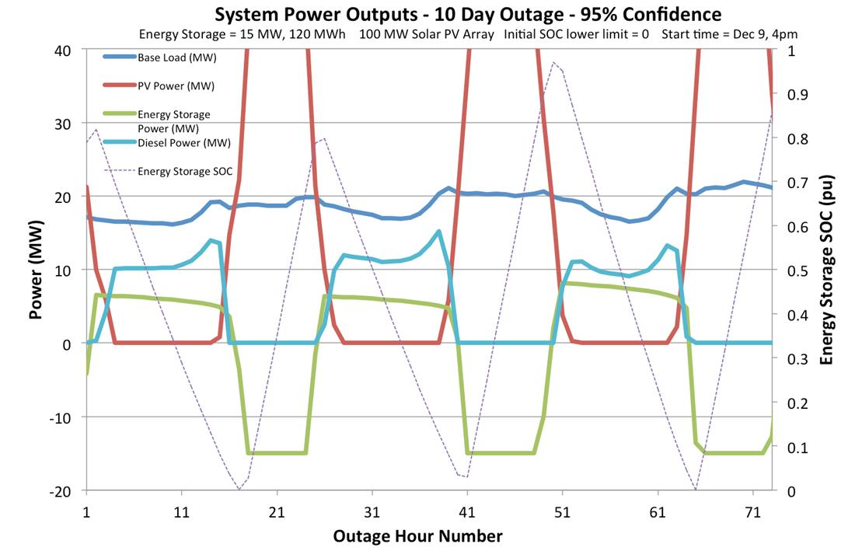
Joint forces training base los alamitos
JFTB Los Alamitos Microgrid Assessment
Resiliency goal – 90% survivability rate for a two-week outage
Energy assets – Photovoltaics, diesel gen sets, energy storage
Charge to analysts – Meet resiliency goal and maximize economic benefits given fixed budget
Optimal Microgrid Scale Required to Achieve Energy Security and Operational Goals:
Gen Set – 1,150 kW
Photovoltaics – 1,224 kW
Energy storage – 408 kW / 510 kWh

Slide 9
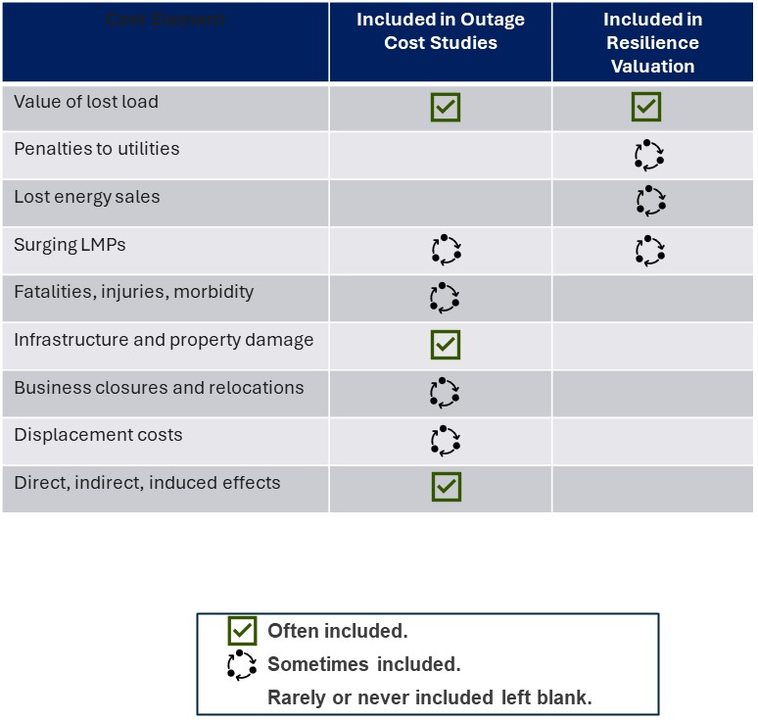
Valuing resilience
Energy storage has demonstrated the capacity to enhance grid resilience
Resilience benefits are poorly defined and generally ignored in energy storage valuation studies
Resilience benefits are typically evaluated using customer damage functions and interruption cost studies, sometimes evaluated using willingness to pay studies (e.g., contingent valuation method) and input-output analysis
Resilience value can be embedded in other value streams, including transmission deferral, voltage sag compensation, and outage mitigation
Treatment of Various Cost Elements Included in Outage Cost and Resilience Valuation Studies
Multi-hazard risk analysis that relies on expected value calculations based on probabilistic analysis, while addressing a broad range of hazards and values tied to lost economic productivity, infrastructure damage, and injuries/fatalities is required – annual risk premium
More research is needed to properly value resilience
Source: Balducci, Patrick, Mongird, Kendall, and Weimar, Mark. Understanding the Value of Energy Storage for Power System Reliability and Resilience Applications. Germany: N. p., 2021. Web. https://doi.org/10.1007/s40518-021-00183-7.

Slide 10
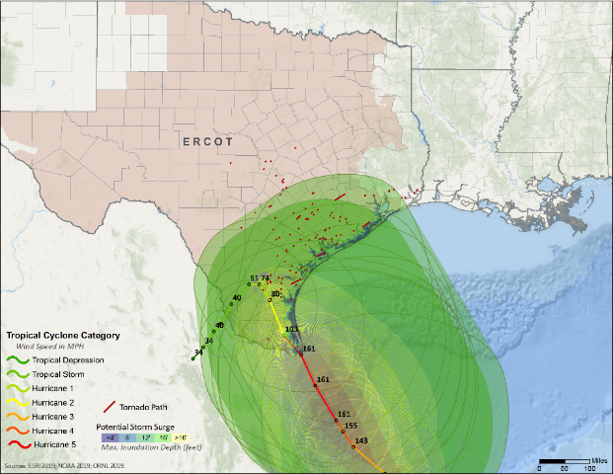
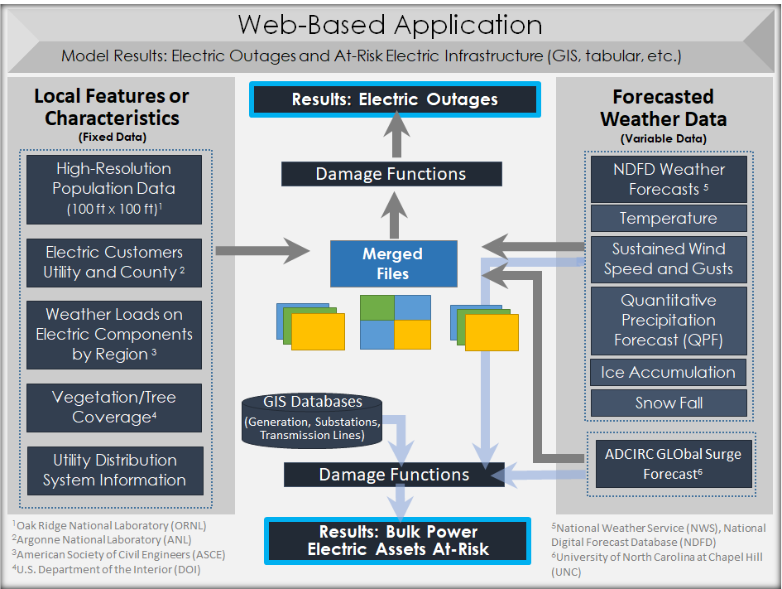
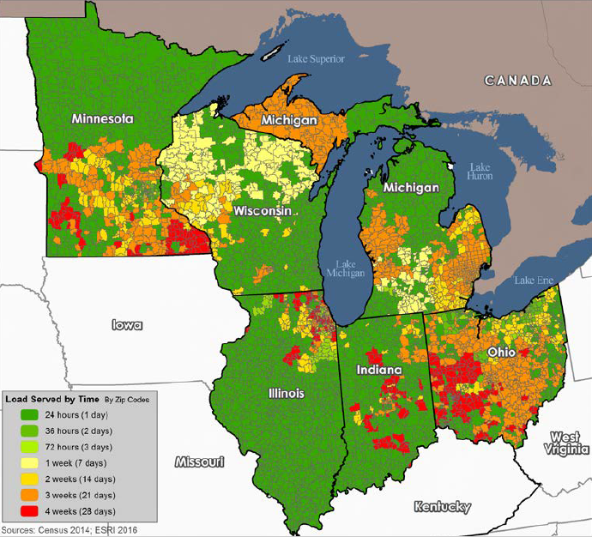
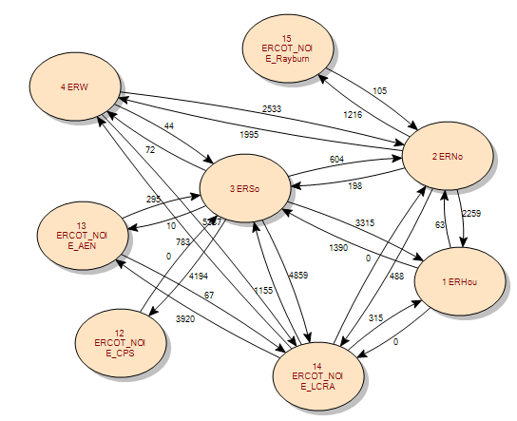
Multi-hazard risk analysis
LDES has demonstrated the capacity to enhance grid resilience, but resilience benefits are poorly defined and generally ignored in energy storage valuation studies and market structures.
Reliability benefits are often evaluated using system models with inconsistent assumptions governing individual service values while resilience benefits are typically evaluated using customer damage functions and interruption cost studies, or sometimes evaluated using willingness to pay studies and input-output analysis.
Multi-hazard risk analysis that relies on expected value calculations and an annual risk premium approach like the type used by insurers, while addressing a broad range of hazards and values tied to the value of lost load, surging locational marginal prices and potentially reduced economic productivity, would represent a significant advancement in the state of the art.
Argonne has a suite of tools that can be used to evaluate the annualized risk premium associated with LDES’ impact on resilience & reliability.
Threat Identification
Impact Assessment
Response & Recovery
Economic Valuation

Slide 11
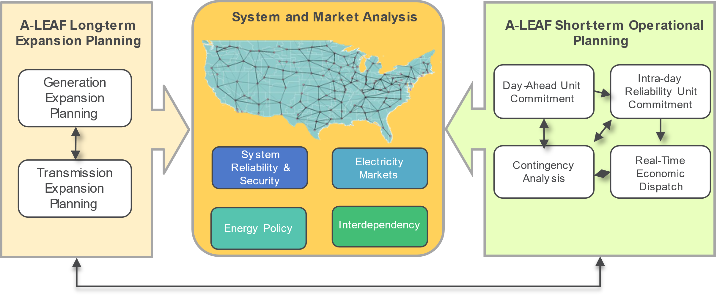
Argonne Low-carbon Electricity Analysis Framework (A-LEAF)
Integrated national-scale power system simulation framework developed at the Argonne National Laboratory, used to analyze various issues related to the evolution of the nation’s power system
Suite of least-cost generation & transmission expansion, unit commitment, and economic dispatch models
Determine system optimal generation portfolio and hourly or sub-hourly unit dispatch under a range of user-defined input assumptions for technology characteristics and system/market requirements
Embedded A-LEAF Tool
11

Slide 12

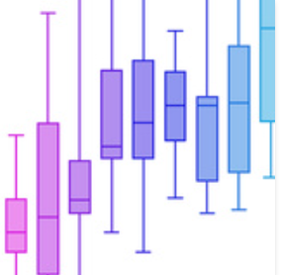
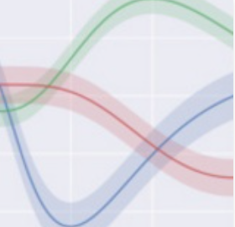
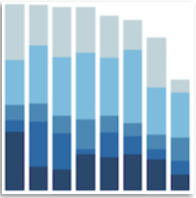
From Climate Science to Capacity Expansion
Future Climate Scenarios
Climate to Grid Translation
Power System Planning with LDES Study
High-Frequency & High-Spatial Resolution Climate Model
Climate to Grid Translation Model
Argonne Low-carbon Electricity Analysis Framework (A-LEAF)
Analyze and screen possible future weather patterns
Generate probabilistic grid event scenarios
Power system capacity expansion planning and production cost simulations
Temperature
Precipitation
Wind/solar availability
Extreme weather events
Electricity demand
Wind/solar profile
Fuel supply constraints
Grid asset de-rating
Grid asset outage
Value of LDES
Generation portfolio
Generation scheduling
Load curtailment
Energy prices
Argonne’s Low-carbon Electricity Analysis Framework being Used to Evaluate the Role of LDES under Future Climate Scenarios and Extreme Weather Events

Slide 13
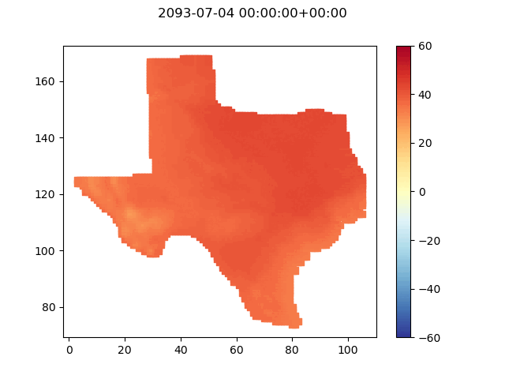
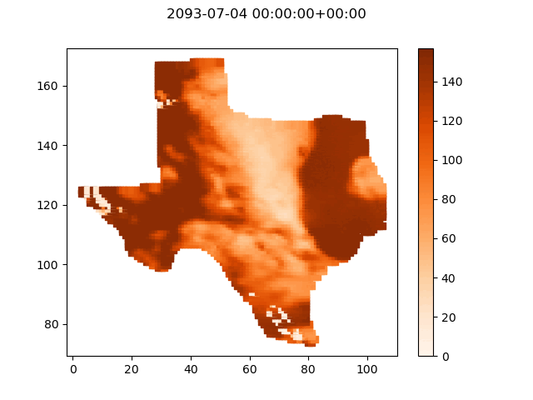
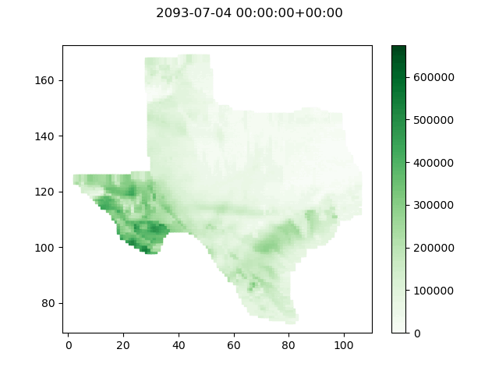
identified multiple heat- and cold-driven events
Hot: 2093 GFDL RCP8.5
Air Temperature [°C]
PV Output [MW]
Wind Output [kW]
13

Slide 14
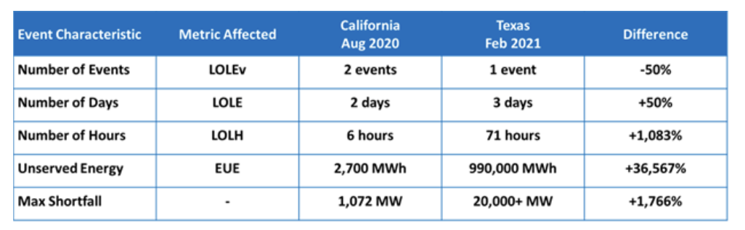
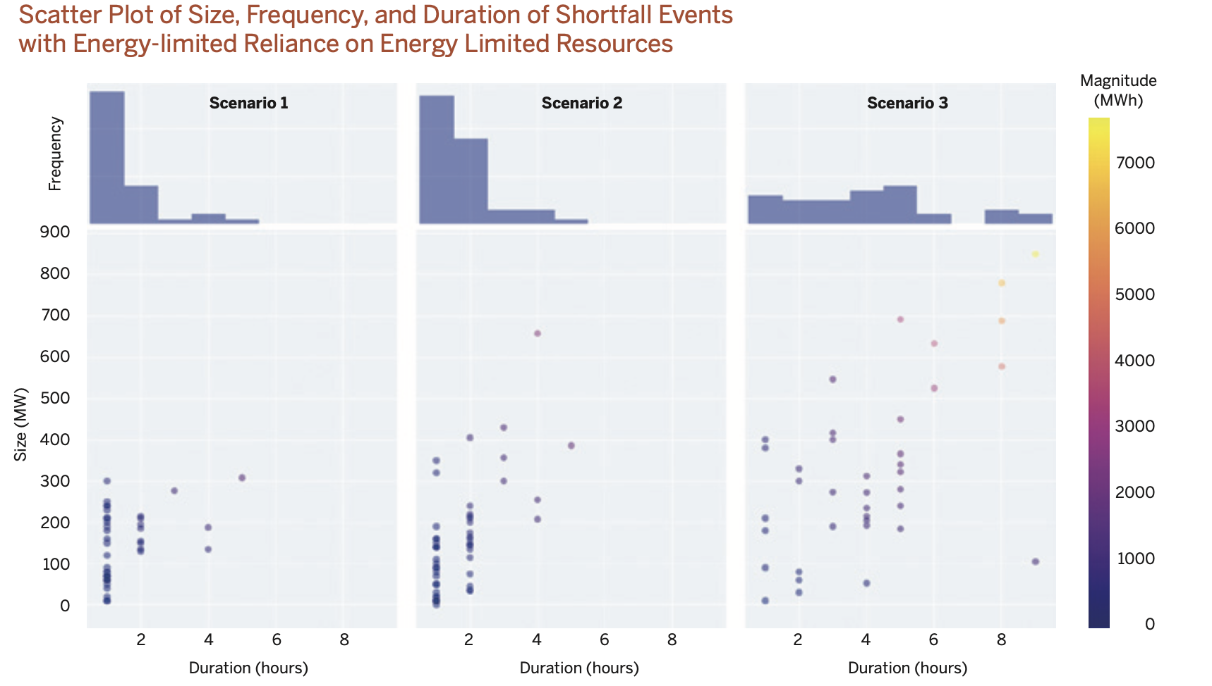
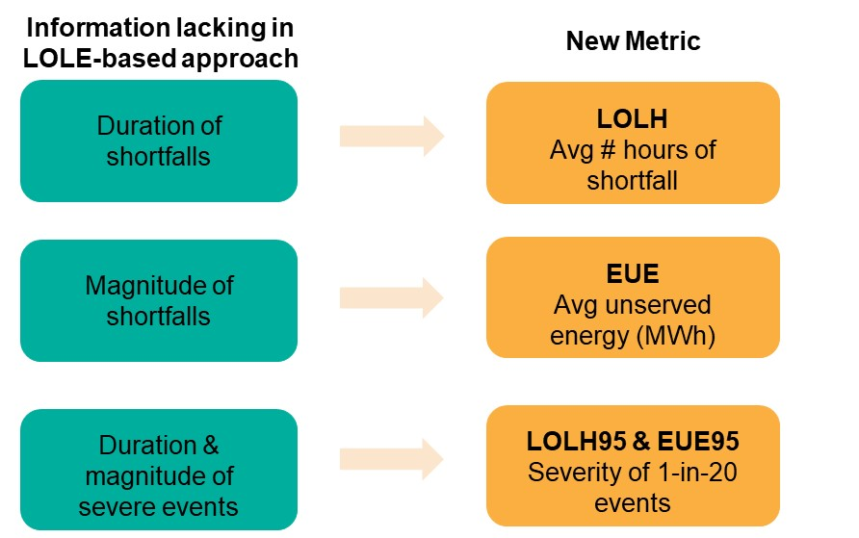
New resource adequacy metrics would more closely capture role ldes can play in supporting reliability
Three Scenarios with the Same LOLE but Varied Reliability Needs
Beyond 1-day-in-10-years: : Measuring Resource Adequacy for a Grid in Transition. November 29, 2021 by Derek Stenclik - Telos Energy. https://www.esig.energy/beyond-1-day-in-10-years-measuring-resource-adequacy-for-a-grid-in-transition/
Redefining Resource Adequacy for Modern Power Systems (ESIG, 2021)
Balducci, P. and P. Levi (2024). Improved Reliability and Resilience Valuation: Approaches and Metrics. LDES National Consortium Annual Workshop. Commerce, CA.

Slide 15
Conclusions – key considerations
Siting/Sizing Energy Storage
Siting/sizing of LDES by capturing/measuring location-specific benefits is key prior to LDES deployment
Nearly all storage benefits today are tied to energy and ancillary services; reliability and resilience service values are not adequately or consistently compensated
Benefits will differ by region, market structures/rules, and variable renewable energy penetration rates
Models require greater granularity and fidelity in identifying days/hours when LDES will be required for reliability services
New metrics (e.g., LOLH95) and compensation mechanisms (e.g., 20+ hour capacity resource) are better suited to capture reliability risks and identify the role of LDES
Valuing Reliability and Resiliency
Regional Variation
Model Considerations
Market / Regulatory Evolution

Slide 16
acknowledgments
Dr. Imre Gyuk, Eric Hsieh, and Caitlin Callaghan DOE ‒ Office of Electricity, Energy Storage Program
Contact information
Patrick Balducci
pbalducci@anl.gov
(503) 679-7316

Slide 17
Contact information
Patrick Balducci
pbalducci@anl.gov
503-679-7316

