Slide 1
FERC Docket No. RM24-6-000
Implementation of Dynamic Line Ratings
Julia Selker, Executive Director, WATT Coalition

Slide 2
Meeting agenda
Agenda
Why DLR matters + history
What is in the ANOPR
Key issues
Timeline

Slide 3
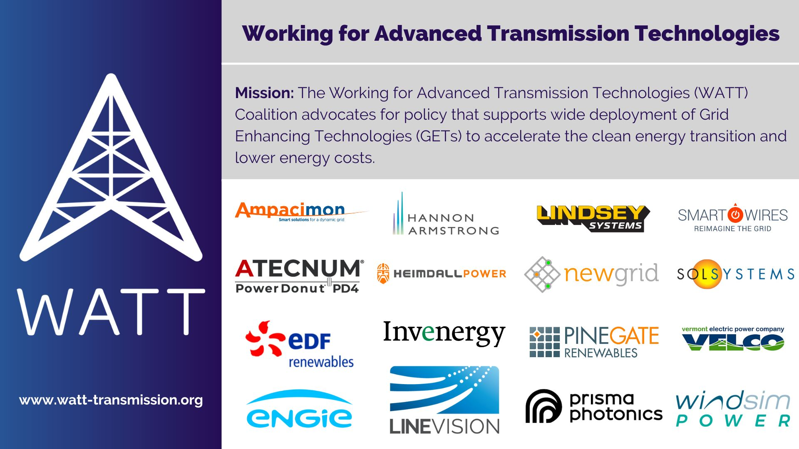





Notes:
WATT formed informally in 2017 – here we are 6 years later. The coalition has grown, which is good, but it still exists because the fundamental policy barriers to grid efficiency are still very relevant. GETs are catching on, but not quickly enough for California’s clean energy goals, for instance.

Slide 4
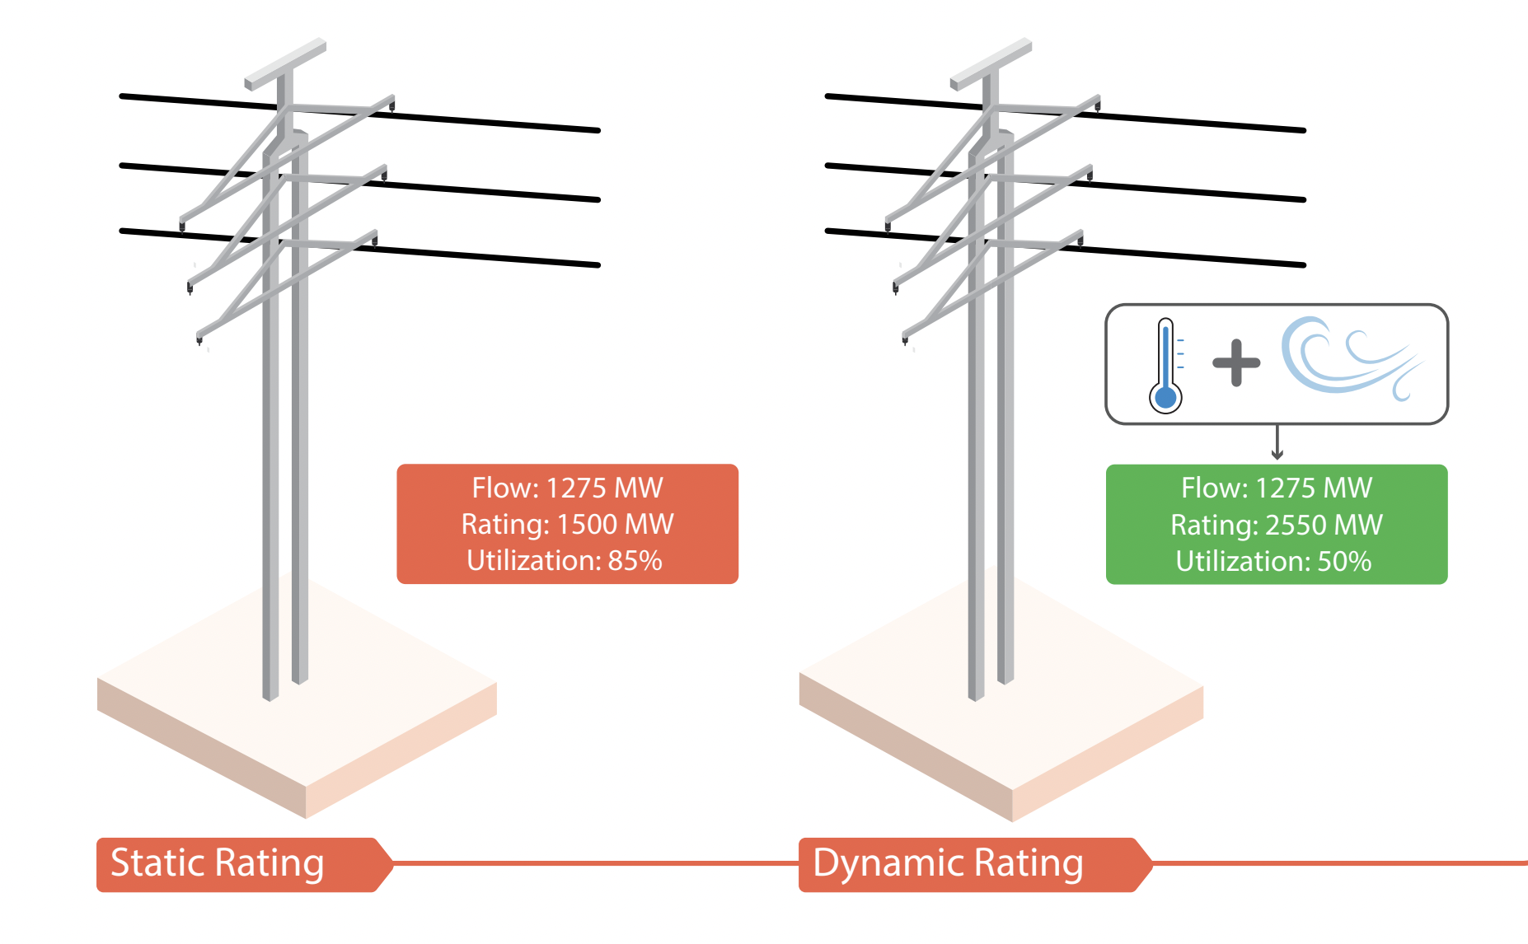


Dynamic Line Ratings
Results from 2021 deployment across 3 states
  DLR exceeded static reference ratings by:
  9-33% in winter
  26-36% in summer
  DLR exceeded static ratings over 85% of the time
From A Guide to Case Studies of Grid Enhancing Technologies
Case study examples:
2022 Pennsylvania:
DLR increases line capacity by 25% on average
2012 Belgium:
DLR increases capacity by 20%+ over 90% of the time
4
© 2023 WATT Coalition

Slide 5
History
Fall 2019: Managing Line Ratings technical conference
2021: Managing Line Ratings Rulemaking comments
December 2021: Order 881
  Utilities must use hourly temperature-adjusted ratings and RTOs must accept up to 15-minute DLR
Spring 2022: Implementation of Dynamic Line Ratings NOI comments and reply comments
June 2024: Implementation of Dynamic Line Ratings ANOPR
July 2025: 881 compliance deadline

Slide 6


ANOPR Proposal – to improve accuracy of line ratings
Hourly (more granular allowed) normal and emergency ratings, potentially with default confidence level
Include solar heating impacts in all line ratings for transmission service 10 days out based on sun angle/cloud cover
  Required everywhere because of low cost
  Will help in evenings – peak demand/duck curve
  Required in day-ahead and real-time markets, not required for point-to-point service in RTOs
  Required 12 months after final rule

Slide 7

ANOPR Proposal – to improve accuracy of line ratings
Include wind speed impacts on some lines 48 hours out
  Only lines that exceed a windspeed and congestion threshold
    Yearly rate of deployment to cover all subject lines over time
    No wind direction – data not available
  Propose requirement to install sensors
  Utilities can make exceptions if DLR would not be cost-effective, otherwise no benefits analysis
  TO will post line rating with and without windspeed impact on OASIS
  Required in day-ahead and real-time markets AND point-to-point and seams transactions in RTOs
  1 year to collect congestion data, then 6 months to implement on required lines

Slide 8


ANOPR Proposal – to improve accuracy of line ratings
Standardize congestion reporting in RTOs
New metric for congestion in non-RTO regions
  Limiting Element Rate = MWh/yr impact of limiting element
  Track 5-6 triggering events leading to service denial
  Alternatively: share currently non-public redispatch costs or combination
  Post congestion data on OASIS

Slide 9



Consumer Priorities in DLR ANOPR
Economic imperative for just and reasonable rates
  FERC needs to justify cost to implement vs benefits
    Reducing congestion by increasing capacity (examples from PA, MA, NY)
    Unlocking lowest-cost resources (see Brattle, RMI studies)
    Improving investment and maintenance data and outcomes (AES)
Reliability improvements through increased awareness and capacity, and preventing overloads
Need for transparency for all stakeholders to engage and be protected
It is useful for FERC to hear that the ANOPR proposal supports these values!

Slide 10
One level deeper: issues in the ANOPR
Could thresholds be OR rather than AND?
  Average windspeed threshold excludes lines that may benefit from accuracy to support reliability, in addition to congestion
  Congestion threshold is TBD – PJM proposed $2m+ historic AND $1 million projected
Slow deployment timeline - .25% of lines per year maximum
Non-RTO congestion-equivalent
Aligning implementation timelines for solar and wind-based DLR deployment

Slide 11
Timeline
June
July
  June 27 – ANOPR Announced
  July 15 – ANOPR published in Federal Register
August
  We are here
September
  September 10/11 – Generator Interconnection Technical Conferences
October
  October 14 – Indigenous Peoples’/Columbus Day
  Initial comments due
November
  October 15 – Initial Comments Due
  November 5 – Election!
  Reply comments due
  November 12 – Reply Comments Due

Slide 12
Working for Advanced Transmission Technologies
For more information contact
Julia Selker / jselker@gridstrategiesllc.com
www.watt-transmission.org

