Slide 1

Disconnections for Nonpayment: Stepping Back to Consider the Issue, then Forward to Solutions
Kaja Rebane
NASUCA Mid Year Meeting
June 10, 2024
Notes:
Mosaic: https://pixabay.com/photos/multicoloured-art-mosaic-188270/

Slide 2

How We Think About Disconnections for Nonpayment?
The way a problem is defined shapes the solution set, and it suggests how we should select among solutions
In general, it is helpful to:
  Understand how we think about a problem
  Understand how others may think about it
Understanding different perspectives can help people communicate more effectively
  Bridging the differences
  Shifting the conversation
Notes:
Yellow tile: https://pixabay.com/photos/facade-clinker-tile-background-3291499/

Slide 3
People Take Different Perspectives on The Use of Disconnections
“Basic Economics”
“Equity & Justice”
“Net Benefits”
“Everyone should pay their fair share / no free rides!”
Based on total cost allocation
Implication: Disconnections are appropriate if someone doesn’t pay
“Energy is a human right!”
“As temperatures rise, those who contributed least should not suffer the most”
The risk of disconnection is not equitable (e.g., racial disparities)
Not directly tied to costs
Implication: Disconnections for nonpayment are not appropriate
“Let’s look at the net benefits of this policy…”
Based on avoidable costs
Implication: Disconnections for nonpayment may be appropriate, depending on the net benefits

Slide 4
What Might the “Net Benefits” of a Disconnections Policy Be?
Benefits to other customers:
  Avoided costs from discontinuing service
    Avoidable costs are less than bills (or arrearages)
    Because a large share of bills recover the utility’s “fixed” costs (i.e., those that don’t vary in the short term)
  Increased revenues from discouraging free ridership
    But evidence suggests free-ridership is likely low for low-income customers
Benefits to disconnected customers:
  None

Slide 5
What Might the “Net Benefits” of a Disconnections Policy Be? (Cont.)
Costs to other customers:
  Utility administrative costs related to disconnection & reconnection
  Financial costs that flow through avenues other than utility bills (e.g., taxes to pay for increased social service use, less economic activity)
Costs to disconnected customers:
  Financial costs include lost wages/jobs & increased medical bills
  Many other costs - including higher risk of sickness, hospitalization, and premature death; fire risk from unconventional heating & lighting; greater housing insecurity (including eviction/foreclosure); negative impacts on child development; stress from institutional interventions (e.g., police, child protection services); losing child custody & families being torn apart

Slide 6

To summarize the “net benefits”…
Disconnecting a customer produces few direct savings
Discouraging free-ridership may not be that big a benefit either
Disconnections have some costs to other customers (via bills, taxes)
The costs to disconnected customers are huge
Based on this, likely best to find ways to:
Enable struggling customers to pay what they can (even if it’s substantially less than other customers)
Avoid use of disconnections
Notes:
Flower mosaic: https://pixabay.com/photos/mosaic-background-pattern-texture-6980998/

Slide 7
What Makes a Utility Bill Affordable?
The bill is not too high
The customer’s financial resources are not too low
+
Consumer advocates have more influence over this one
Than this one

Slide 8


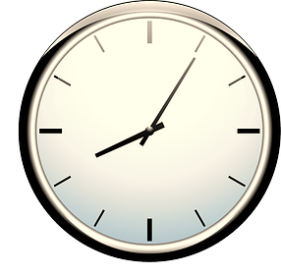
On the Bill Side, Affordability is Driven by Three Things
1. Revenue requirement
(“the size of the pie”)
2. Cost recovery
(“how the pie is sliced”)
3. Predictability
(“how big will the slice be tomorrow?”)
Notes:
Pie: https://pixabay.com/illustrations/pie-citrus-food-drawing-dessert-7504376/
Pie slice: https://pixabay.com/illustrations/pie-citrus-food-drawing-dessert-7504378/
Clock: https://pixabay.com/vectors/clock-calendar-day-time-29008/

Slide 9

1. Revenue Requirement
(Strategies to Keep Total Costs Down)
Multiyear rate plans (MRPs). A well-designed MRP can create a strong cost-efficiency incentive.
Reduce the allowed ROE. Bringing the ROE closer to the true cost of equity can save $.
Revenue Decoupling. More efficient system use can reducing energy costs in the short run and “fixed” costs in the longer run.
Notes:
Gold tile: https://pixabay.com/photos/gold-wall-background-template-3892797/

Slide 10

2. Cost Recovery
(Strategies to Reduce the Burden on Those Least Able to Pay)
Decrease usage (e.g., weatherization)
Decrease rates/fees (e.g., low-income discount rates)
Increase flexibility (e.g, payment plans)
Safeguards for when any bill isnunaffordable / the dangers of disconnection are too great
  Weather-related moratoria
  Arrearage forgiveness
Notes:
Blue tile: https://pixabay.com/photos/blue-grid-mosaic-pool-1867568/

Slide 11

3. Predictability
(Strategies to Reduce Surprises)
Various rate designs and payment arrangements (e.g., PIPPs)
Fuel-cost sharing mechanisms. Requiring the utility to bear a share of fuel-cost volatility risk gives it some “skin in the game” - and an incentive to reduce reliance on price-volatile fuels (e.g., natural gas) over time.
Notes:
Gray tile: https://pixabay.com/photos/tiles-baroque-pattern-texture-554601/

Slide 12
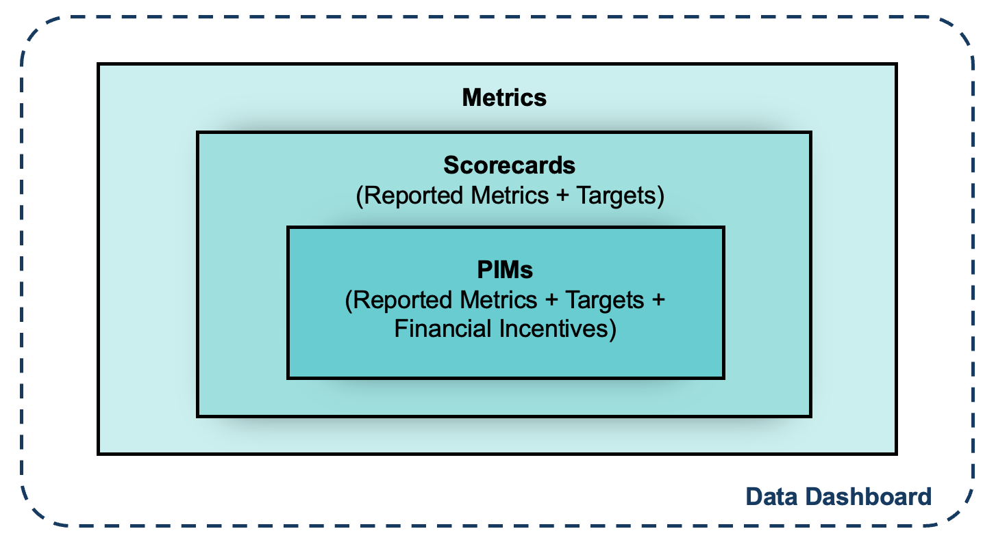
Another Strategy: Create an Incentive for the Utility to Take the Initiative
Illinois. ComEd and Ameren have upside/downside PIMs to reduce disconnections for nonpayment in the 20 zip codes with the highest historical rates.
New York. There were PIMs for multiple utilities to reduce disconnections, uncollectible expense, and arrears.

Slide 13
RMI Resources
The Nuts and Bolts of Performance-Based Regulation: Tools to Build a More Affordable, Reliable, and Clean Grid (coming mid-June)
How To Restructure Utility Incentives: The “Four Pillars” of Comprehensive Performance-Based Regulation (coming mid-July)
PIMs Database: Emergent Performance Mechanisms Across the United States (https://pims.rmi.org/)
Strategies for Encouraging Good Fuel-Cost Management: A Handbook for Utility Regulators (https://rmi.org/insight/strategies-for-encouraging-good-fuel-cost-management/)

Slide 14


