Slide 1
Declining Reserves for U.S. Electric Grid —
Blackouts Predicted
Presentation to NASUCA on June 10, 2024
Thomas Popik, Chairman and President
thomasp@resilientsocieties.org

Slide 2
Agenda
Executive Summary
Disorderly Generation Retirements
PJM Resource Retirements, Replacements, and Risks (4 R’s)
PJM 4 R’s “High Entry” Scenario with Updated Load Growth
Blackouts Predicted for PJM
Potential Blackouts in Other RTO/ISO
Summary Conclusions
Advantages of Modeling with GridClue.com
More Information

Slide 3
Executive Summary
Disorderly Retirements of Coal and Gas Plants: 2024-2030
PJM 4 R’s Report: Unit-By-Unit Research on Retirements
Our PJM Case Study: Good Modeling of Intermittent Resources Requires Calculations for 8,760 Hours of Year
  Solar: For Each Hour of the Day in Each of 12 Months
  Wind: For Each of 12 Months Due to Large Seasonal Variations
  Alternative Averaging—“Effective Load Carrying Capacity” (ELCC) or “Technology Factors”—Implies Solar Resources at Midnight
PJM Coal and Natural Gas Retirements with Wind and Solar Replacements Will Likely Result in Blackouts
Societal Risks From Continual and/or Persistent Blackouts
Other RTO/ISO Have Similar Issues with Dispatchable Resources Replaced by Intermittents

Slide 4
Disorderly Retirements
Reasons for Fossil Fuel Generator Retirements:
  Environmental Regulations—Both EPA and State-Specific
  Court Approved Settlements after NGO and EPA Lawsuits
  Worn-Out Plants, Especially Pre-1975 Steam Turbines
  Uneconomic Operation in Electricity Markets
  Government Initiatives to Reduce Greenhouse Gases
Major Environmental Regulations Already Implemented
  EPA “Acid Rain Program” to Reduce Sulfur Dioxides
  Mercury & Air Toxics Standard (MATS)
  Nitrogen Oxides/Ozone—For Example, EPA “Good Neighbor” Rule
EPA Regulations with 2028 Compliance Dates
  Coal Combustion Residuals (CCR)—i.e., Coal Ash Ponds
  Wastewater Effluents, Especially Flue Gas Desulfurization (FGD)

Slide 5
Source: U.S. EIA Form 860-M, Resilient Societies research of future retirements at generating unit level

Slide 6
PJM 4 R’s Report
Source: “Energy Transition in PJM: Resource Retirements, Replacements & Risks,” February 24, 2023

Slide 7
PJM 4 R’s “High Entry” Scenario
With Updated Load Growth

Slide 8
Projected PJM Load Growth by 2030
February 2023 PJM 4 R’s Report (2022-2030):
  2023 Forecast: 11 GW
  Electrification Forecast: 13 GW
Updates on Causes of PJM Load Growth:
  Data Centers, Especially Northern Virginia and Columbus, Ohio
  Newly Announced Manufacturing Facilities
  Electrification, Including EV Charging
  Semiconductor Chip Fabs in Columbus, Ohio
PJM’s Revised Projections for 2024-2034, as of Jan. 2024
  Summer Peak Load Growth: 1.6% per year ⇨ 12% by 2030
  Winter Peak Load Growth: 1.9% per year ⇨ 14% by 2030
  Net Energy for Load Growth: 2.3% per year ⇨ 17% by 2030
Sources: PJM report, “Energy Transition in PJM: Resource Retirements, Replacements & Risks”; GridStrategies report, “The Era of Flat Power Demand is Over”; Congressional testimony; “January 2024 PJM Load Forecast Report”

Slide 9
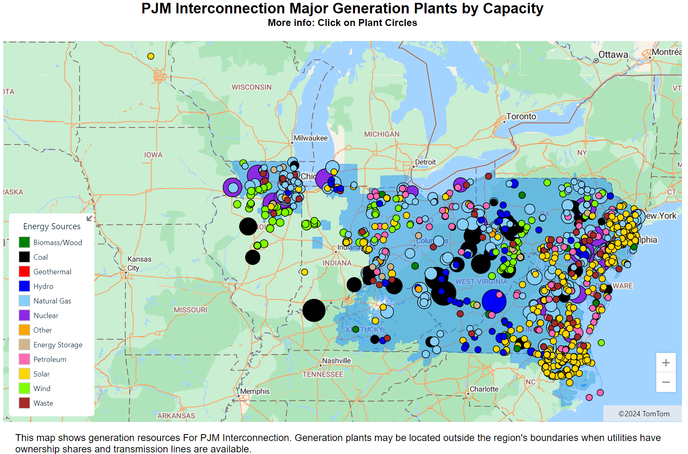
Source: U.S. EIA data; GridClue.com

Slide 10
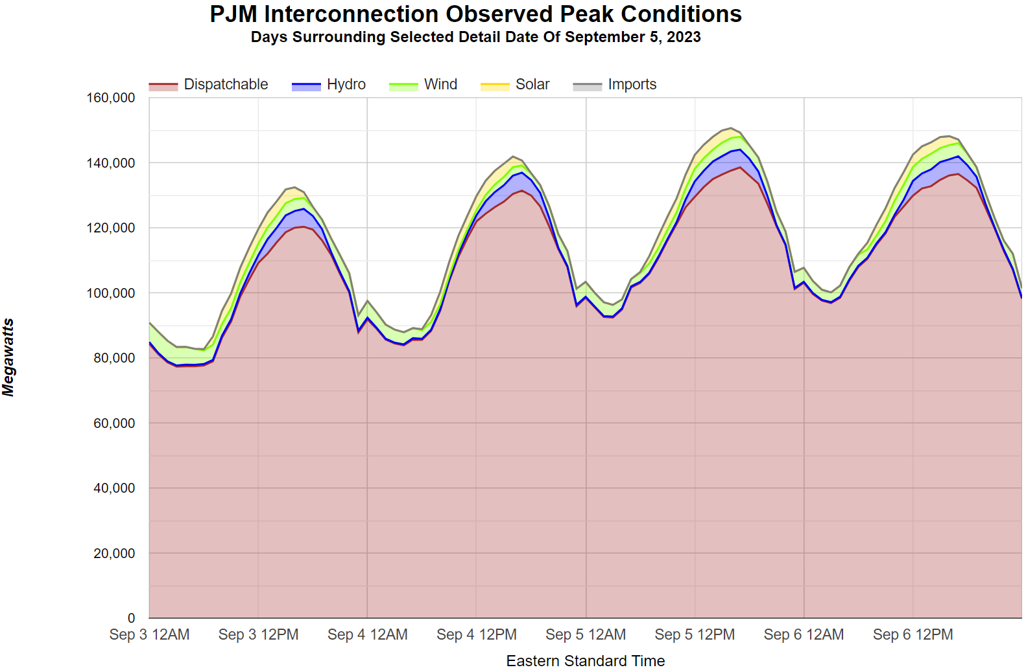
Source: U.S. EIA data, GridClue.com

Slide 11
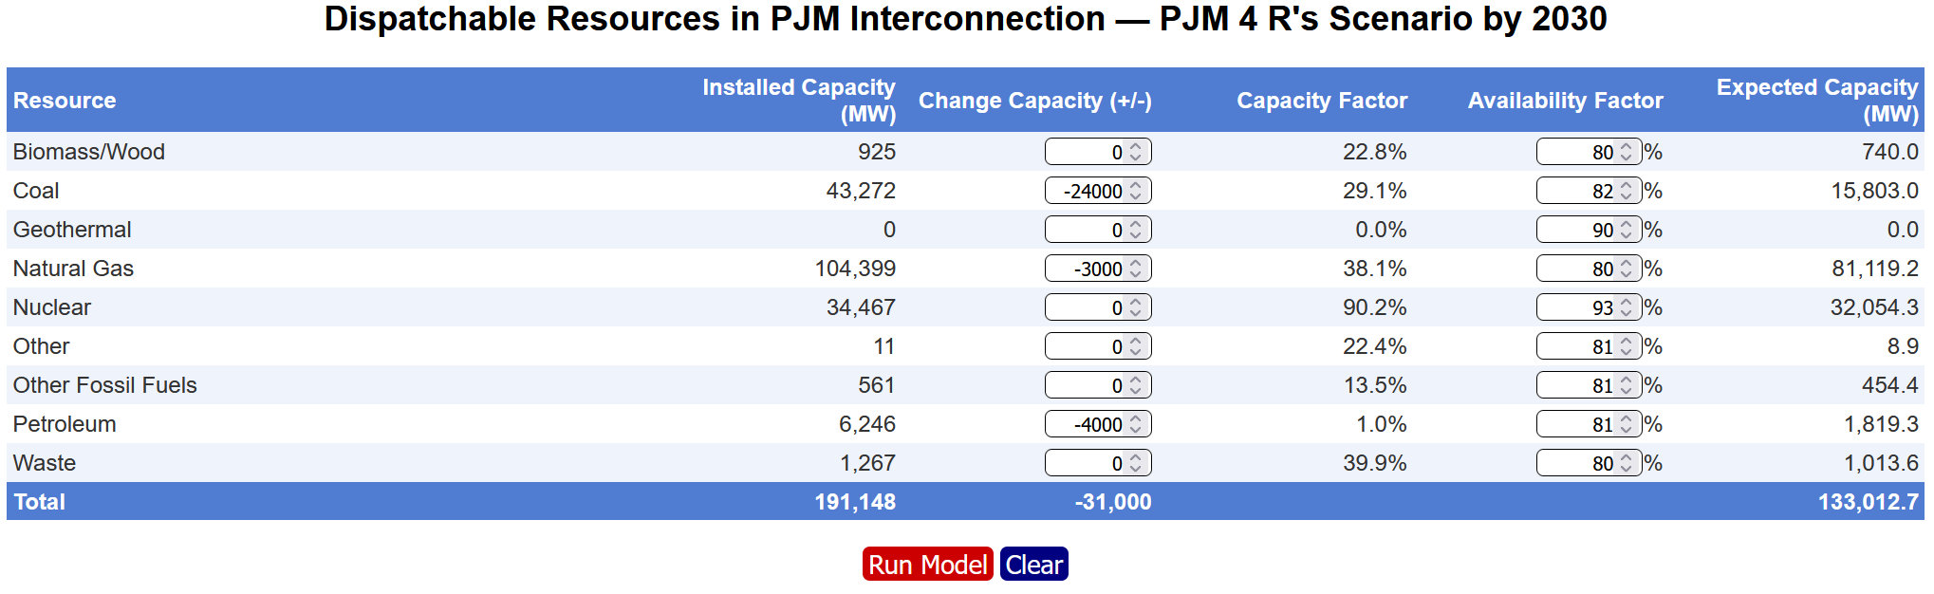
Net Loss of Dispatchable Resources in PJM—31 GW
Source: U.S. EIA data; NERC GADS data, GridClue.com modeling

Slide 12
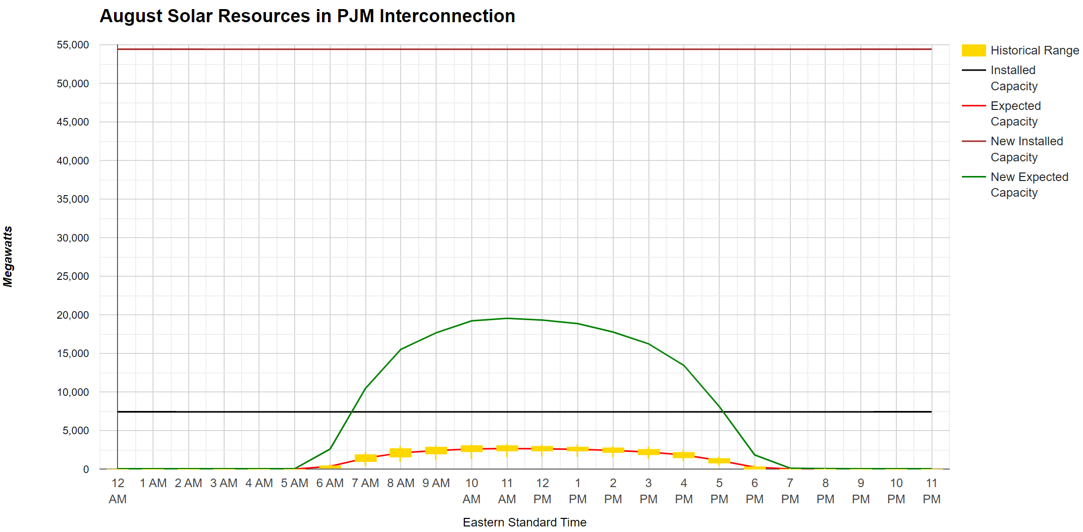
Modeled Addition of Solar in PJM—47 GW
Source: U.S. EIA data; GridClue.com modeling

Slide 13
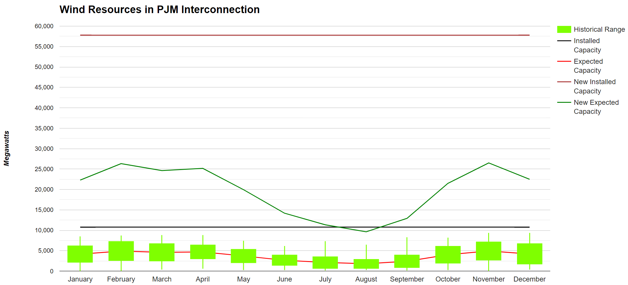
Modeled Addition of Wind in PJM—47 GW
Source: U.S. EIA data; GridClue.com modeling

Slide 14
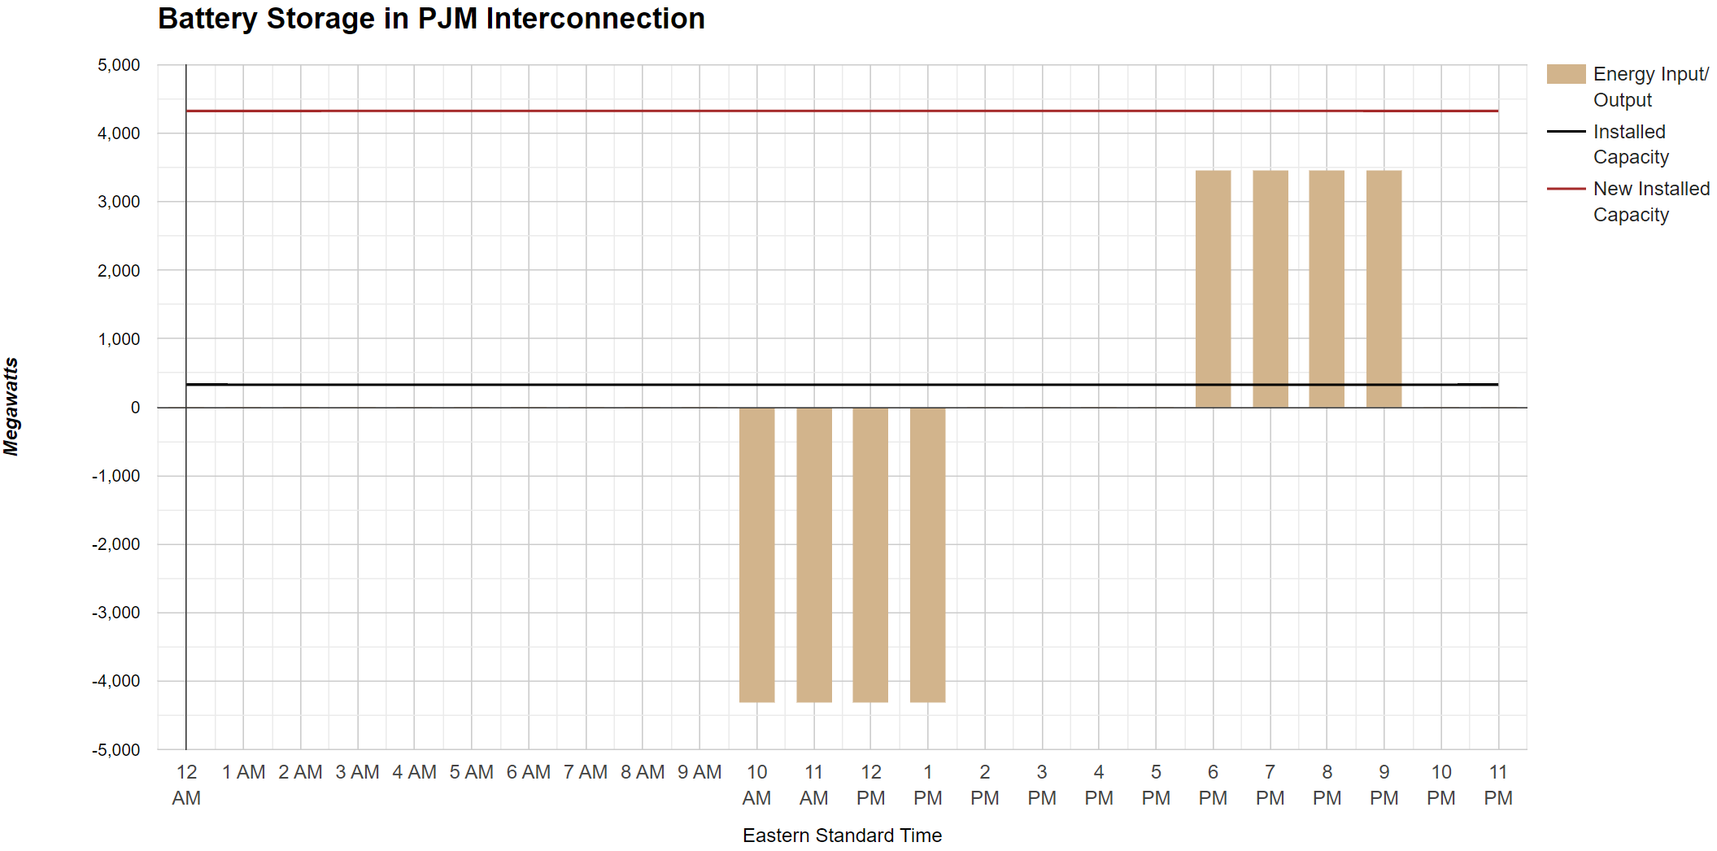
Modeled Addition of Batteries in PJM—4 GW
Source: U.S. EIA data; GridClue.com modeling

Slide 15
Blackouts Predicted for PJM

Slide 16
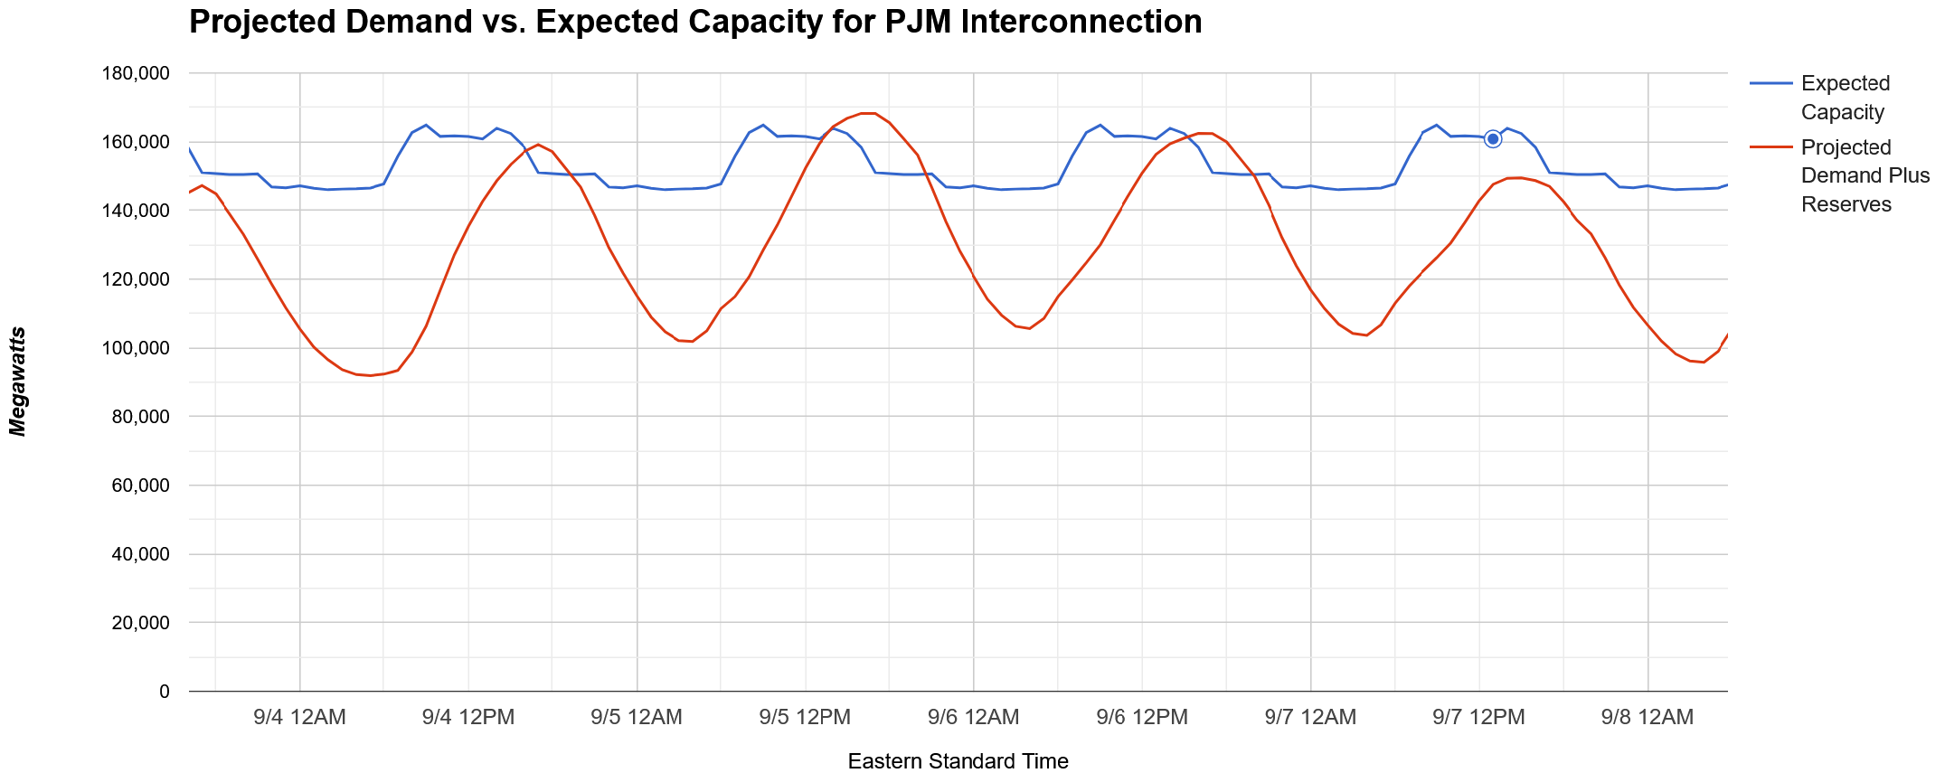
PJM—12% Summer Peak Load Growth by 2030
Source: U.S. EIA data; GridClue.com modeling

Slide 17
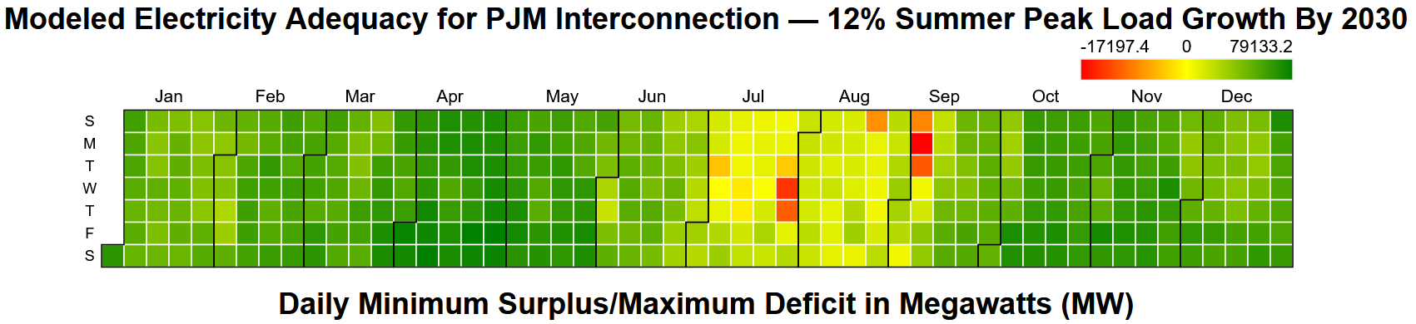
PJM—12% Summer Peak Load Growth by 2030
For the modeled “High Entry” scenario in PJM Interconnection, expected generation capacity and imports minus demand (also subtracting necessary reserves) is estimated to be -17,197 megawatts, 10.2% below demand, at the critical hour of 5 PM EST on September 5.
For all of the 365-day Demand Profile, the estimate is 41 Loss of Load Hours (LOLH) over 10 days and 250,566 megawatt-hours of Expected Unserved Energy (EUE).
Scenario Assumptions: -24 GW coal retirements, -3 GW net natural gas retirements and replacements, -4 GW petroleum retirements; +47 GW solar, +47 GW wind, +4 GW batteries; 12% load growth; 5% operating reserves

Slide 18



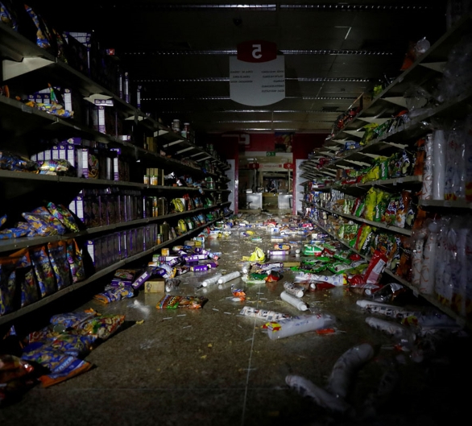
Societal Risks from Continual and/or Persistent Blackouts
Disrupted Economy
Opportunistic Looting
Unexpected Load Sheds
Cascading Grid Failures
Wide-Area Outages
Loss of Clean Water
Spoiled Food
Workers Leaving Posts
Stranded Refugees
Civil Disturbances
Nuclear Accidents
Photo Credits, Top to Bottom & Background: Fernando Liano-AP, Reuters, The Atlantic, Getty Images

Slide 19
Potential Blackouts in Other RTO/ISO

Slide 20
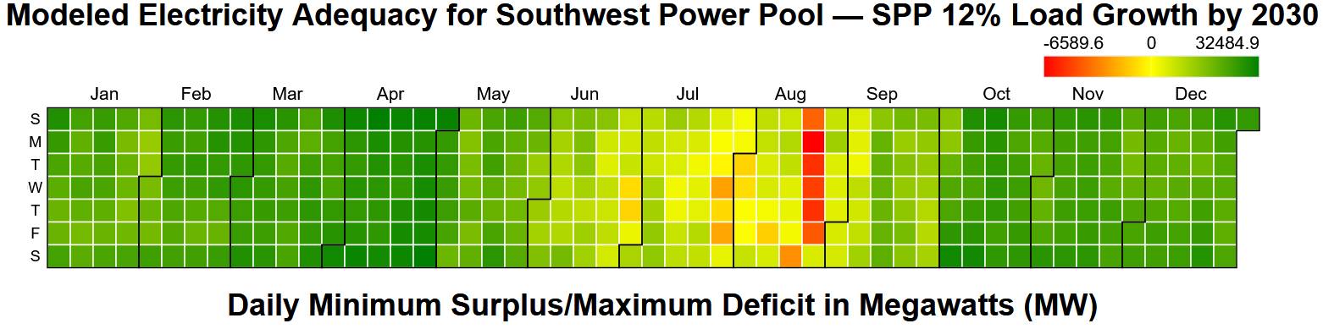
Southwest Power Pool—12% Load Growth by 2030
For the modeled scenario in Southwest Power Pool, expected generation capacity and imports minus demand (also subtracting necessary reserves) is estimated to be -6,590 megawatts, 10.3% below demand, at the critical hour of 4 PM CST on August 21.
For all of the 365-day Demand Profile, the estimate is 93 Loss of Load Hours (LOLH) over 16 days and 235,591 megawatt-hours of Expected Unserved Energy (EUE).
Scenario Assumptions: -7.7 GW coal retirements, -1.2 GW net natural gas retirements and replacements, 0 GW petroleum retirements; +3.6 GW solar, +4.3 GW wind, +1 GW batteries; 12% load growth; 5% operating reserves

Slide 21
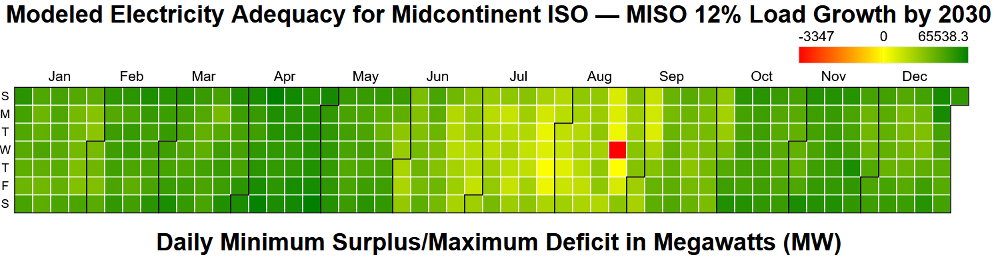
Midcontinent ISO—12% Load Growth by 2030
For the modeled scenario in Midcontinent ISO, expected generation capacity and imports minus demand (also subtracting necessary reserves) is estimated to be -3,347 megawatts, 2.6% below demand, at the critical hour of 7 PM CST on August 23.
For all of the 365-day Demand Profile, the estimate is 4 Loss of Load Hours (LOLH) over 1 day and 6,376 megawatt-hours of Expected Unserved Energy (EUE).
Scenario Assumptions: -32 GW coal retirements, -1.9 GW net natural gas retirements and replacements, -0.6 GW petroleum retirements; +25 GW solar, +4.5 GW wind, +1.2 GW batteries; 7% load growth; 5% operating reserves

Slide 22
Summary Conclusions
By end of decade, load will dramatically increase
Large retirements of fossil fuel units, especially in 2028
  Environmental regulations and initiatives
  Uneconomic plants in markets with subsidized renewables
  Equipment worn out by decades of use and over-ramping
Optimistic expectations for replacements; e.g., PJM
  18 GW of PJM wind and solar operational through 2023, but added 94 GW wind and solar by 2030?
  75% of PJM natural gas retirements replaced 2024-2030?
Likely Result: Deep load sheds over many days and hours
Policy changes at both state and federal level needed
  No single policy change will fix this problem
Will policymakers act before blackouts are upon us?

Slide 23
Advantages of Modeling with GridClue.com
Complete: Pre-Loaded EIA data for all of Continental U.S.
Simple: Basic arithmetic for all 8,760 hours of year
Transparent: Easily validated with export to Excel
Quick: Scenarios run in seconds
Understandable: Colorful graphs and data displays
Free: Available online without password
  Saved scenarios for government-accredited users

Slide 24
More Information
The Foundation for Resilient Societies is a 501(c)(3) nonprofit with the mission of boosting critical infrastructure resilience and recoverability
Our GridClue.com tool enables hour-by-hour modeling of resource adequacy for U.S. electric grids
Thanks to our project sponsor, William Kaewert of Stored Energy Systems LLC (SENS)

