Slide 1

Cocktails to Convictions
Regulatory Capture in the 21st Century
Office of the Ohio Consumers’ Counsel
Deputy Consumers’ Counsel Angela O’Brien
June 10, 2024

Slide 2
REGULATORY CAPTURE
“Capture can be manifested in the ‘iron triangles’ that may form among agencies, legislators, and regulated industries. . . Socially responsible participants in regulation across the board, including regulated interests, share a commitment to upholding the integrity of the process by shunning unlawful and inappropriate activities.”
“The Prudent Regulator: Politics, Independence, Ethics, and the Public Interest”
Energy Law Journal Vol. 29:577 p. 590 (2008)
Janice A. Beecher, Director of the MSU Institute of Public Utilities
“A case can be made that the General Assembly and the Public Utilities Commission of Ohio (PUCO) are suffering from ‘regulatory capture,’ and this leads to the need to reform the PUCO.”
“Reforming the PUCO” (2020)
Former OCC Governing Board Chair (and Former Ohio Legislator) Gene Krebs

Slide 3
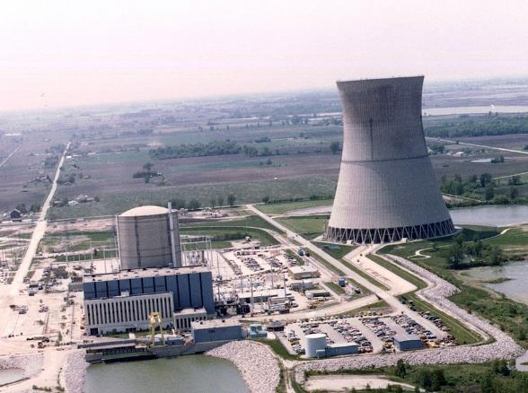
Ohio House Bill 6
Scandal
Office of the Ohio Consumers’ Counsel
3

Slide 4
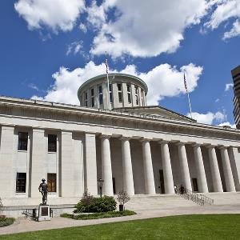
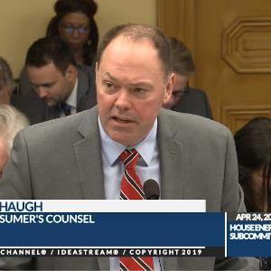

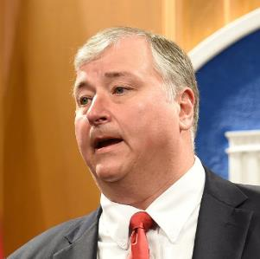
House Bill 6 Scandal Timeline
4/12/2019
4/24 to 6/29/2019
7/23/2019
7/21/2020
HB 6 introduced
OCC opposes
HB 6 Passes, Signed By Governor
OHIO Speaker Householder arrested
OCC Testifies 6 times in opposition to HB 6 (and later 11 times for its repeal).
House Bill 6 is introduced.
HB 6 passes; Gov. DeWine signs despite testimony against and veto request by OCC and others
US Attorney indicts former Ohio House Speaker Larry Householder and four others.

Slide 5
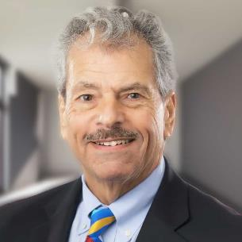
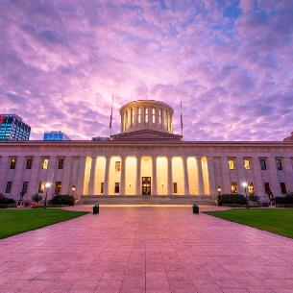
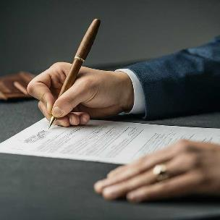
House Bill 6 Scandal Timeline
9/8/2020
11/16/2020
3/31/2021
7/22/2021
Occ asks for investigations
FBI RAIDS PUCO Chair's HOME
HB 128 Partially Repeals HB 6
FirstEnergy
Acknowledges wrongdoings
OCC files motions to open investigations into the HB 6 Scandal at the PUCO.
FBI raids home of Public Utility Commission Chair Sam Randazzo.
Governor signs HB 128 repealing portions of HB 6, but coal subsidies remain
FirstEnergy files Deferred Prosecution Agreement – Pays $230 million fine.

Slide 6

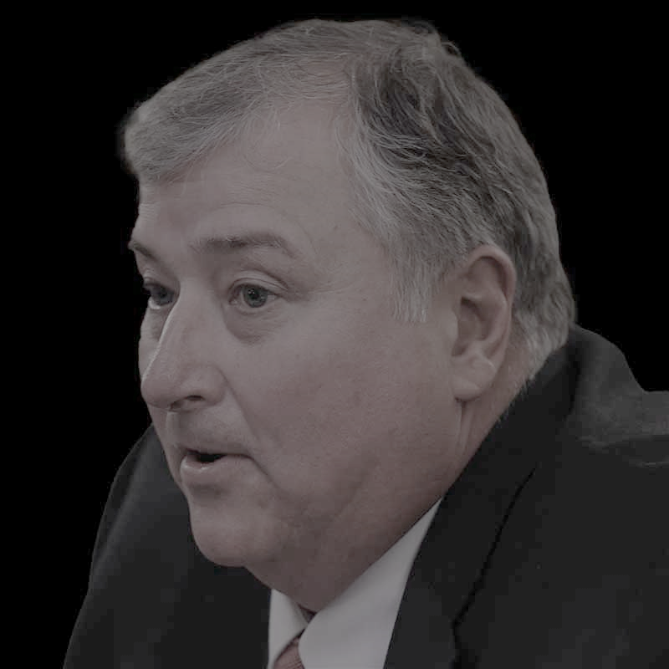
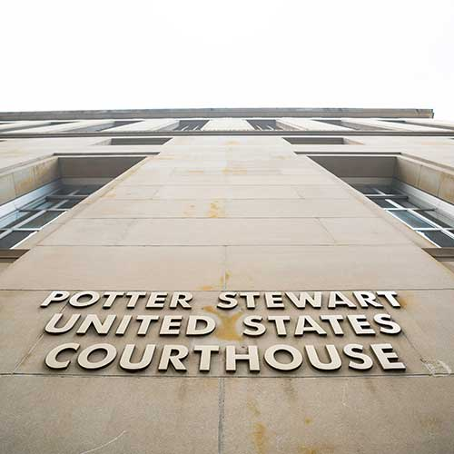
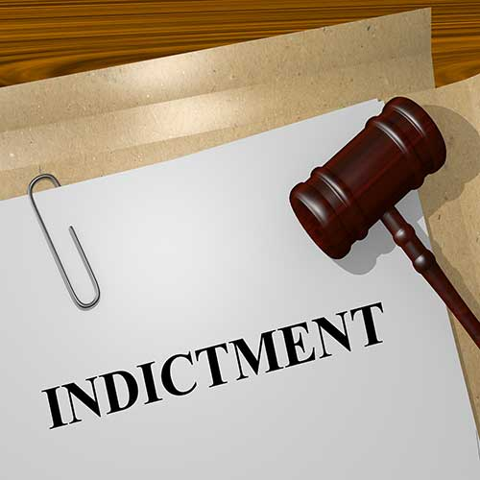
House Bill 6 Scandal Timeline
8/24/2022
4/9/2023
12/4/2023
2/12/2024
PUCO STAYS CONSUMER INVESTIGATIONS
Householder Found Guilty
PUCO Chair Indicted on 11 federal counts
Former Speaker Householder and former Ohio GOP Chair found guilty of federal racketeering.
PUCO stays FirstEnergy investigations for six months at request of US Attorney.
Former PUCO Chair Randazzo indicted on 11 federal counts for allegedly accepting a $4.3 million bribe from FirstEnergy
State Indictment of RANDAZZO, FirstEnergy Executives
AG Yost announces state indictment of former PUCO Chair Randazzo and FirstEnergy Execs. Jones and Dowling on criminal charges.

Slide 7

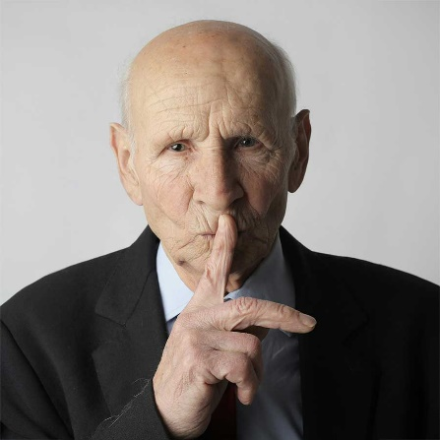
House Bill 6 Scandal Timeline
2/21/2024
Now
PUCO ALLOWS INVESTIGATIONS TO RESUME
FIRSTENERGY SEEKS TO HIDE INTERNAL INVESTIGATIONS
After a year and a half of stays, the PUCO allows FirstEnergy consumer investigations to resume.
FirstEnergy seeks to block release of internal investigations that led to firings of executives

Slide 8
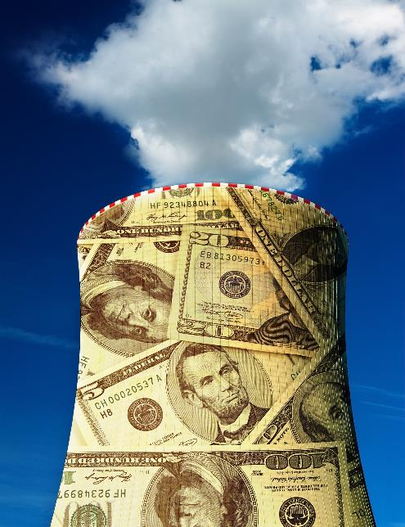
HB 6 Overview
Nuclear subsidies
  $150 million annual subsidy for FirstEnergy (later FirstEnergy Solutions) Nuclear Power Plants
Coal Power Plant Subsidies
  Subsidies for two coal power plants (one in Ohio and one in Indiana) up to what is now estimated to be more $800 million by 2030.
Decoupling Charge
  What FirstEnergy’s former (fired) CEO described as recession-proofing for FirstEnergy
Roll back of energy efficiency standards for Ohio Utilities
8

Slide 9


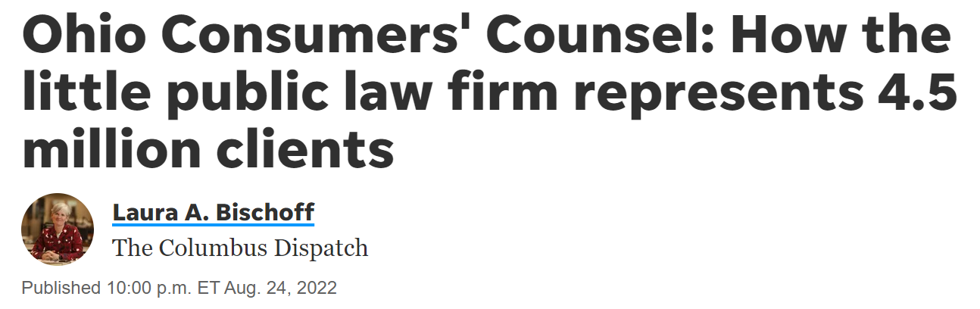

The consumers’ counsel testified seven times against House Bill 6 and 11 times for its repeal. On its website is a running tally of how much remaining subsidies are costing Ohio consumers. Within weeks of FBI agents arresting Householder and others, the consumers' counsel asked the PUCO to dig into who at FirstEnergy knew what when and look at whether the utility improperly billed customers.

Slide 10
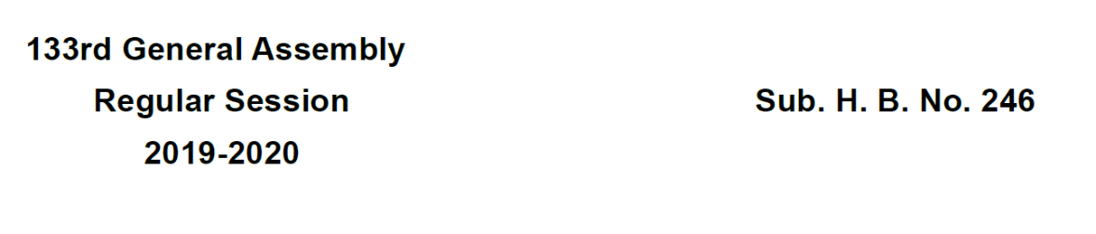

Retaliation?
After the effective date of H.B. 246 of the 133rd general assembly, three members of the board shall be appointed by the attorney general, three members shall be appointed by the speaker of the house of representatives, and three members shall be appointed by the president of the senate. The attorney general, speaker, and president shall appoint one person from each of the organized groups representing labor, residential consumers, and family farmers.

Slide 11

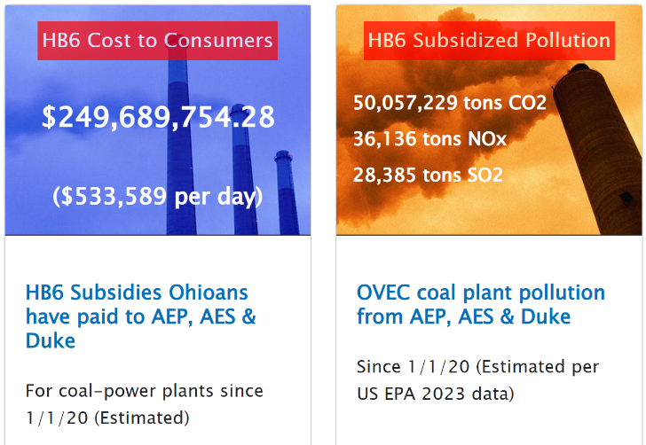
3/31/21
Governor signs HB 128 repealing portions of HB 6, but coal subsidies remain

Slide 12

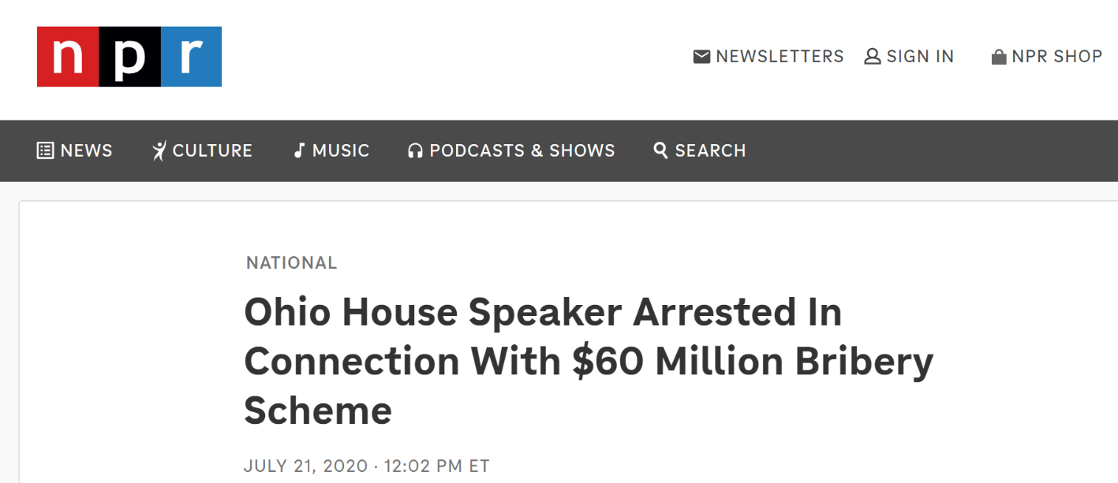
House Speaker Arrested: “Likely the largest bribery money laundering scheme ever perpetrated against the people of the state of Ohio”

Slide 13
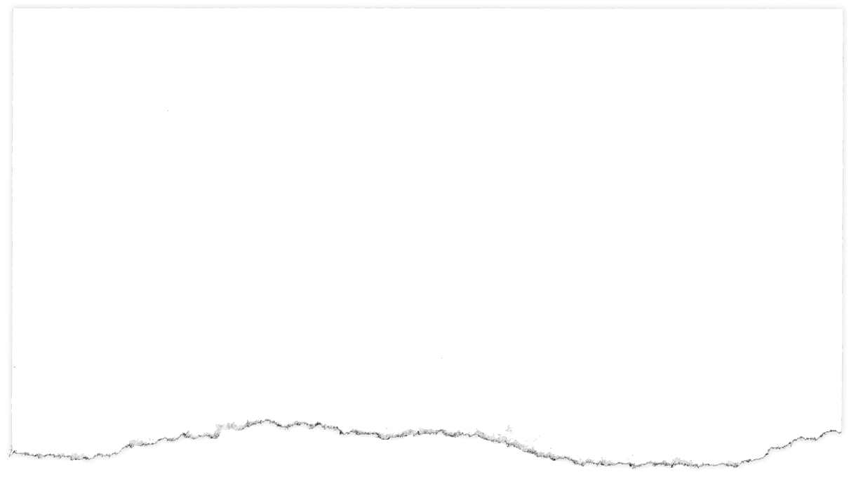

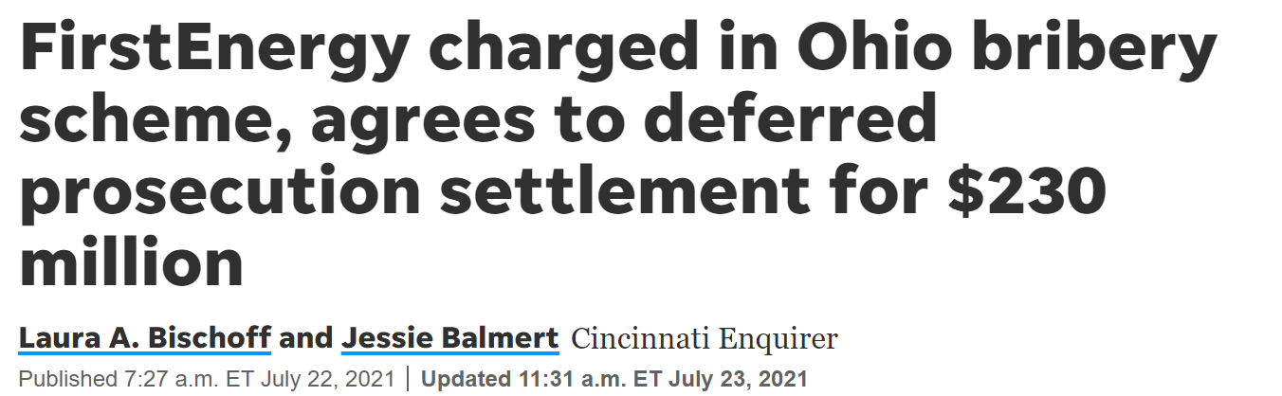

Slide 14

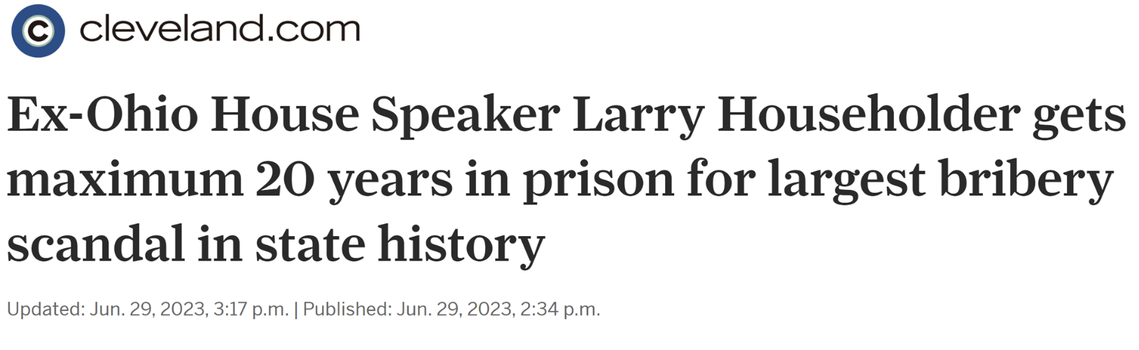
Judge Sentences Householder in
Federal Corruption Trial

Slide 15
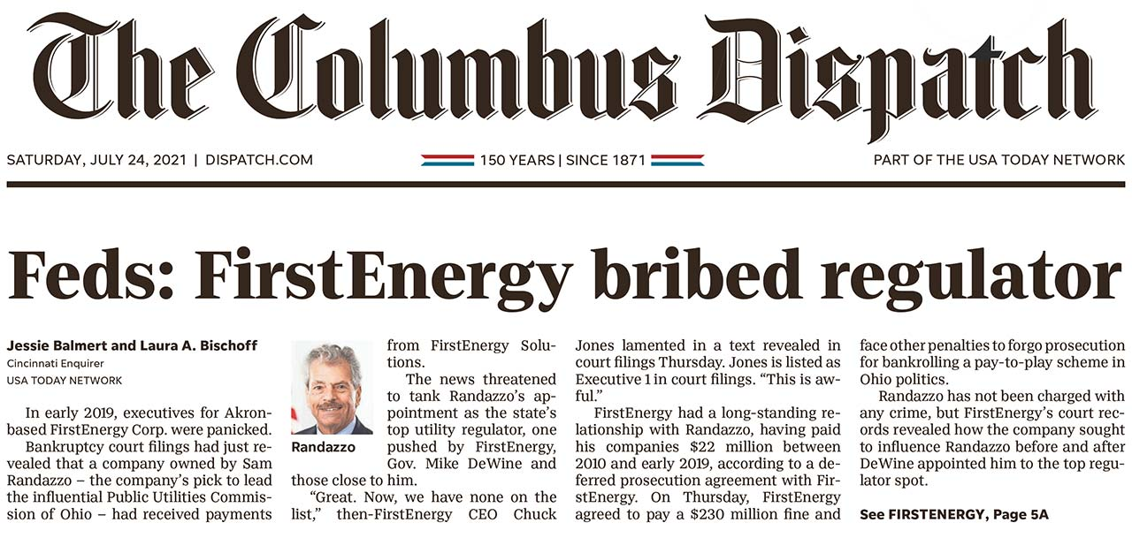

Slide 16
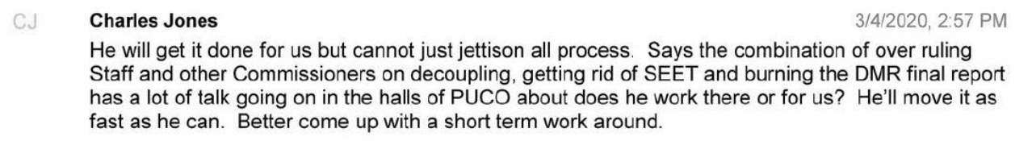
Shocking FirstEnergy Texts

Slide 17


‘A giant lobbying firm that runs a utility’: FirstEnergy’s involvement in Ohio politics dates back decades
Oct. 31, 2021
Laura A. Bischoff & Jessie Balmert
For decades, FirstEnergy Corp. played a successful game of political chess to get what it wanted from Ohio power brokers – until FBI agents started investigating the Akron company's role in a $1.3 billion nuclear plant bailout.
In July, the company agreed to pay a $230 million fine after admitting its role in a nearly $61 million bribery scheme to pass the bailout in House Bill 6 into law.
But before the FBI came knocking, prolific contributions, extensive lobbying and an insular culture were the hallmarks of FirstEnergy's approach to politics, both in Columbus and across the nation. The company, which invested in nuclear and coal rather than natural gas or renewable energy, has used connections to bail itself out of unprofitable situations time and time again, longtime observers of FirstEnergy say.

Slide 18
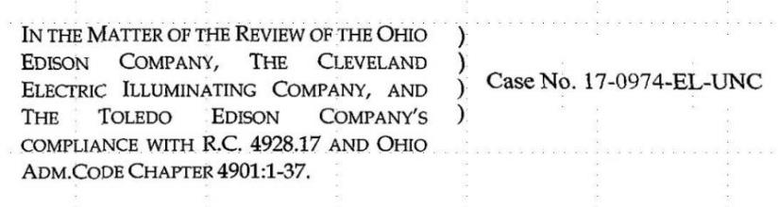
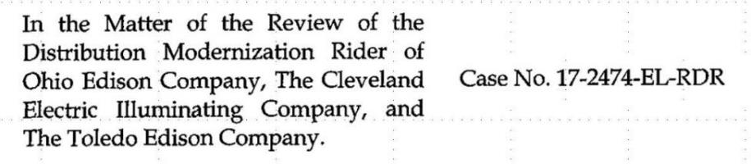
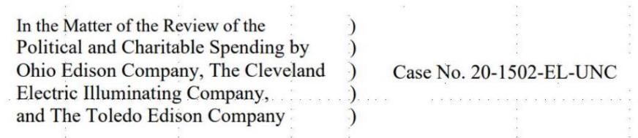
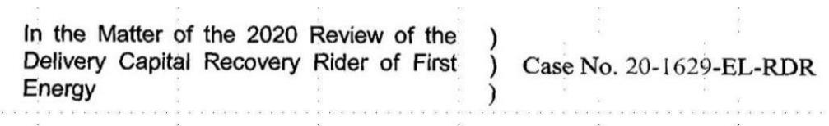
FirstEnergy Consumer Investigations
18

Slide 19
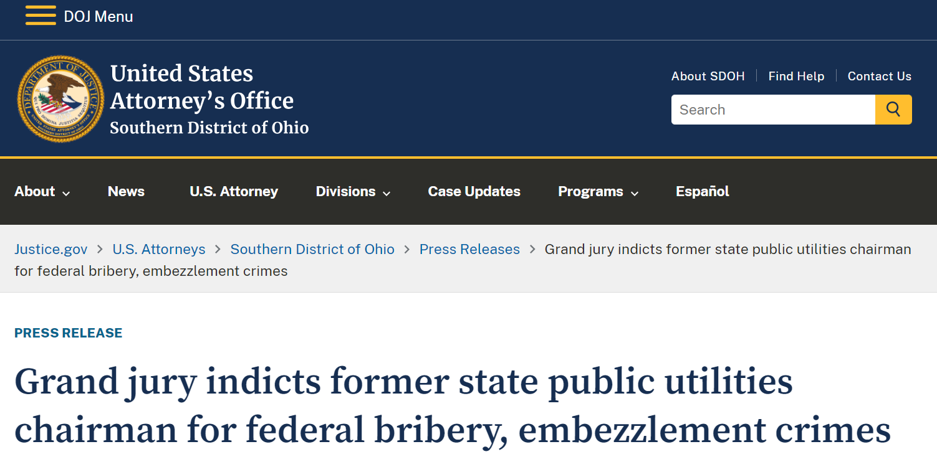

Slide 20

FirstEnergy Rate Case 2024
  From United States of America v. Samuel Randazzo:
  Overt Acts of the Conspiracy
  FE Executives texts:
  “Stock is gonna get hit with Ohio 2024. Need Sam to get rid of the ‘Ohio 2024’ hole.”
  “I spoke with Sam today. Told me 2024 issue will be
  handled next Thursday*** he's going to make the requirement to file go away, but I do not know specifically how he plans to do it.”
  PUCO Opinion and Order
  “We find it is no longer necessary or appropriate for the Companies to be required to file a new distribution rate case at the conclusion of the Companies’ current ESP.”
  Case No. 19-361-EL-RDR 11/21/2019

Slide 21


Ohio Attorney General Files State Criminal Indictment
Former FirstEnergy Executives and Former Public Utility Official Indicted in Ohio
Ohio’s attorney general alleges a previous state utilities chairman received more than $4.3 million from FirstEnergy
Feb. 12, 2024
Sam Randazzo
Chuck Jones
Michael Dowling
“It [the $4.3 million] was not a gift: Randazzo would work hard for FirstEnergy from inside the government.”
– State of Ohio Indictment for Engaging in a Pattern of Corrupt Activity
      February 12, 2024
21

Slide 22

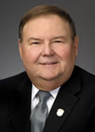

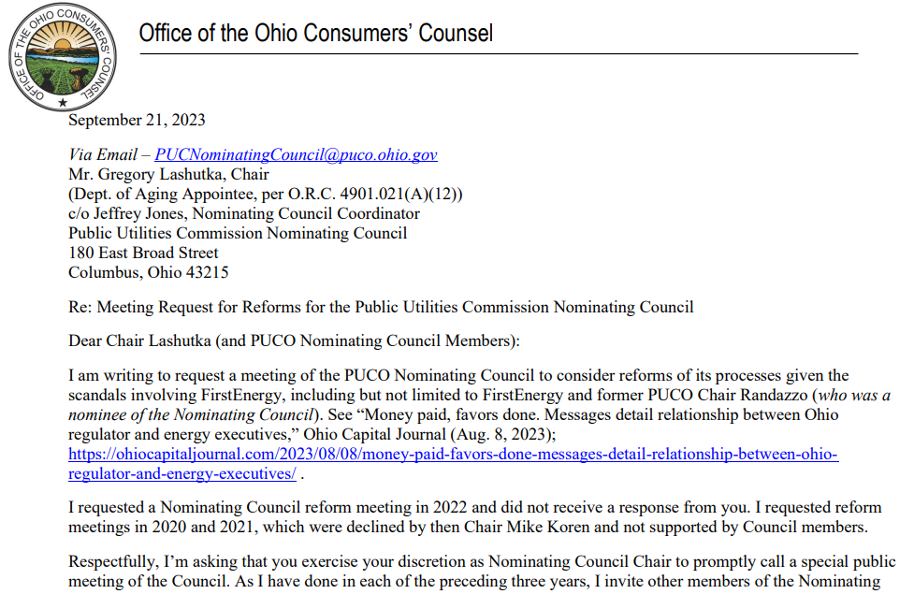
22

Slide 23

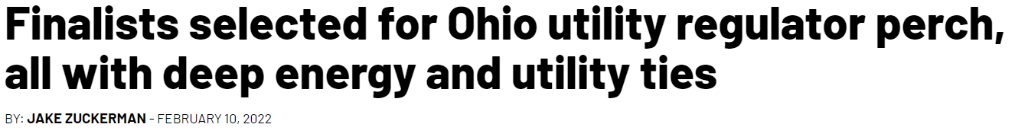
A nominating council sent a list of four candidates to Gov. Mike DeWine to appoint as a member of the board that regulates Ohio’s public utilities.
All four have deep ties to the natural gas and or utility industries, according to a review of their cover letters, resumes, and court records.
The nominee would fill one of five seats on the Public Utilities Commission of Ohio. PUCO commissioners oversee utility companies, adjudicating disputes between residential, industrial, commercial, and utility interests. The commission makes regulatory decisions on things like whether utility companies can increase gas and electric costs, whether they’re using their monopolistic power to generate “significantly excessive” profit margins, or whether companies can add extra fees on top of customers’ bills in the form of “riders.”

Slide 24
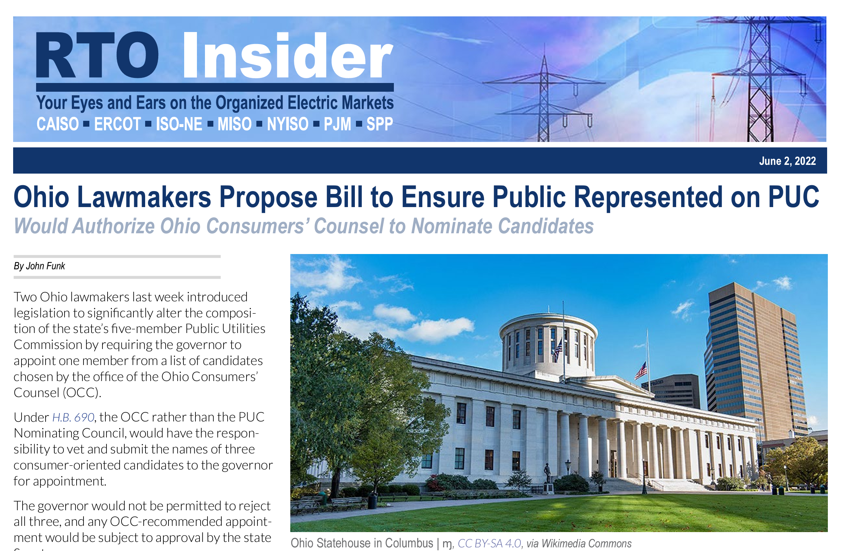

Slide 25
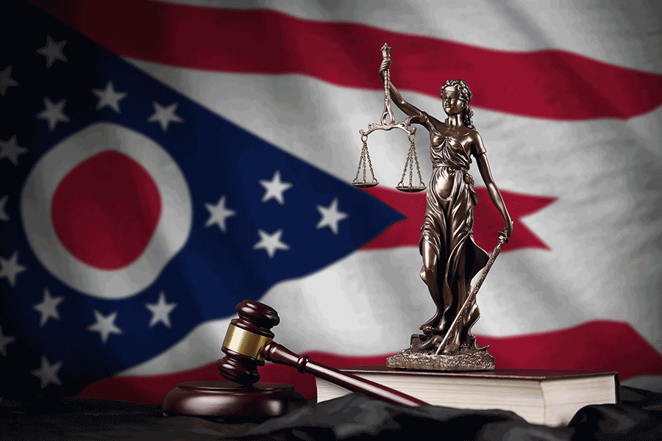
House Bill 363 (Rep. Troy)
Reform of PUCO Selection Process
  One commissioner must be a bona fide consumer representative
  No new commissioner or member of the nominating
  council if past affiliation with regulated utility
  Qualifications expanded for PUCO commissioners
  Public process for PUCO Commissioner interviews
  Public disclosure of nominating council members’
  information, meetings, applicant biographies
  Opportunity for public comment on applicants and the nominating process

Slide 26

Thank You

