Slide 1

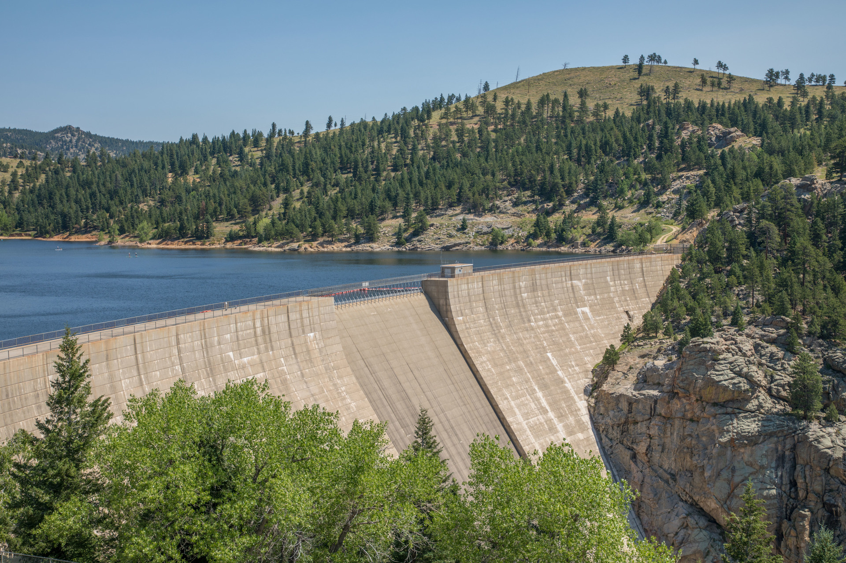
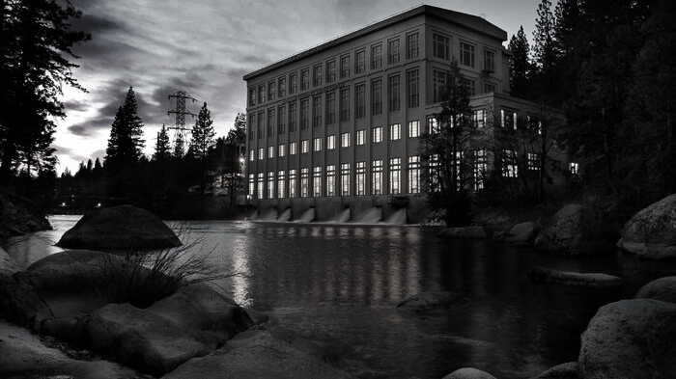

GRID RELIABILITY AND HYDROPOWER
2024 Energy Outlook
BARBARA TYRAN
DIRECTOR,
EXTERNAL RELATIONS
NATIONAL HYDROPOWER ASSOCIATION

Slide 2
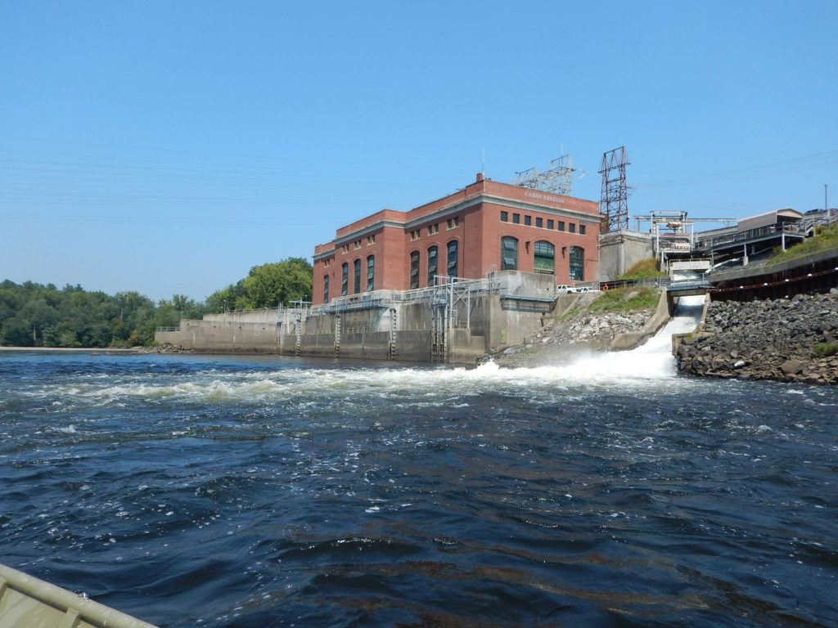
STATE OF THE U.S. HYDROPOWER INDUSTRY IS STRONG
  31% of U.S. renewable energy
  Over 6% of all electricity generated
  96% of current U.S. long duration energy storage
  80 GW of hydropower capacity
  22 GW of pumped storage hydropower capacity

Slide 3

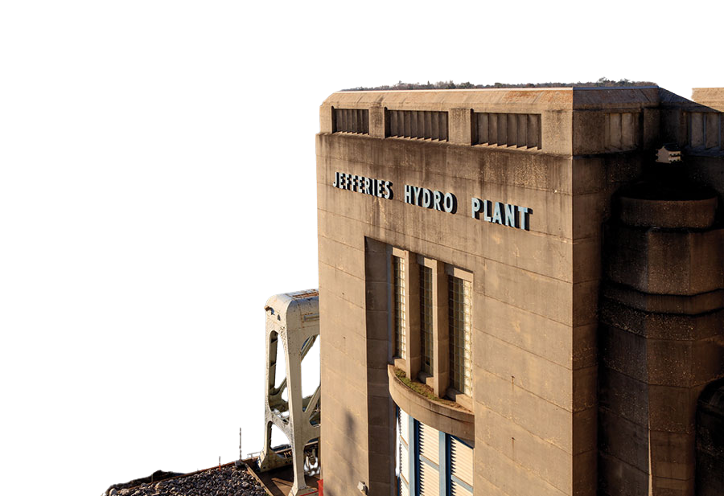
CLEAN ENERGY GRID AT RISK DUE TO POTENTIAL WAVE OF RETIREMENTS
  Licenses for 459 hydropower facilities, representing 17 GWs, are set to expire by 2035.
  Relicensing takes, on average, 7.6 years to complete
  Projects of greater than 10 MW reporting licensing costs exceeding $1M, and projects more than 100 MW reporting cost around $10M or more
  Survey: 36.4% of hydropower industry asset owners said that they were "actively considering" decommissioning a facility

Slide 4
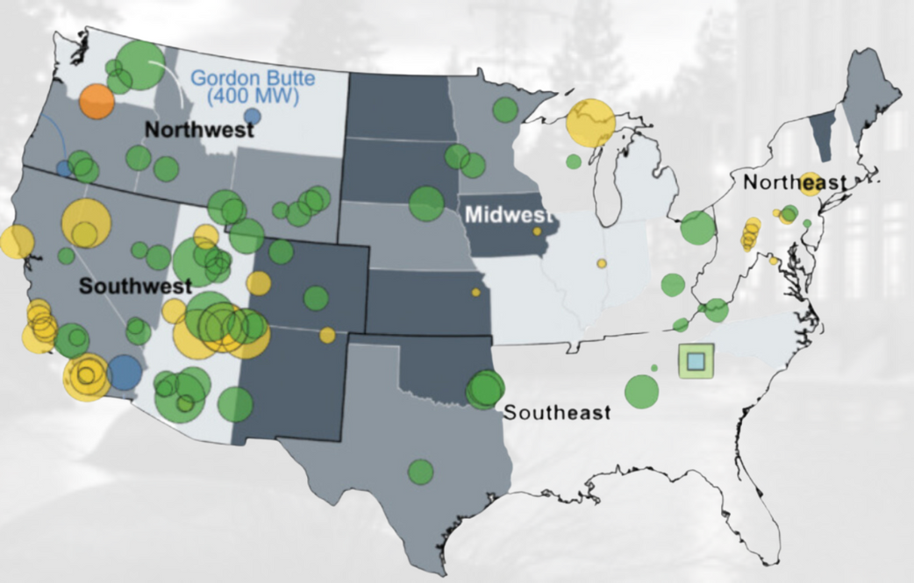
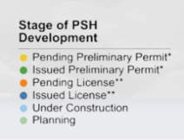
HYDROPOWER HAS POTENTIAL FOR GROWTH
US Pumped Storage Development Pipeline 2023
  95+ pumped storage projects in FERC pipeline (over 50 GWs)
  Almost 1 GWs of new, carbon-free electricity from the existing fleet from DOE’s recent $72M investment
  DOE funded only 34% of requests so lots of additional growth from existing fleet possible

Slide 5
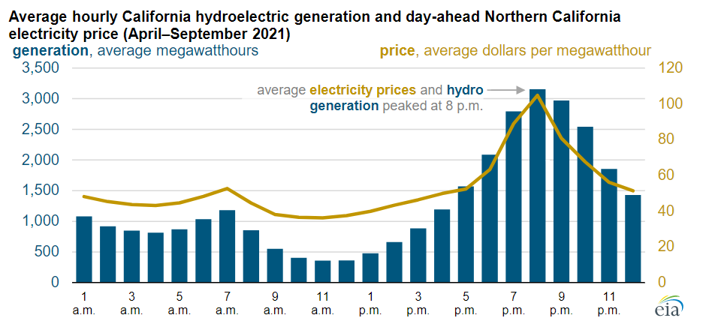
HYDROPOWER & RELIABILITY
Even during drought, hydro is still there when we need it the most.
The overall western hydropower fleet sustains about four-fifths of the average power generation during severe droughts.

Slide 6
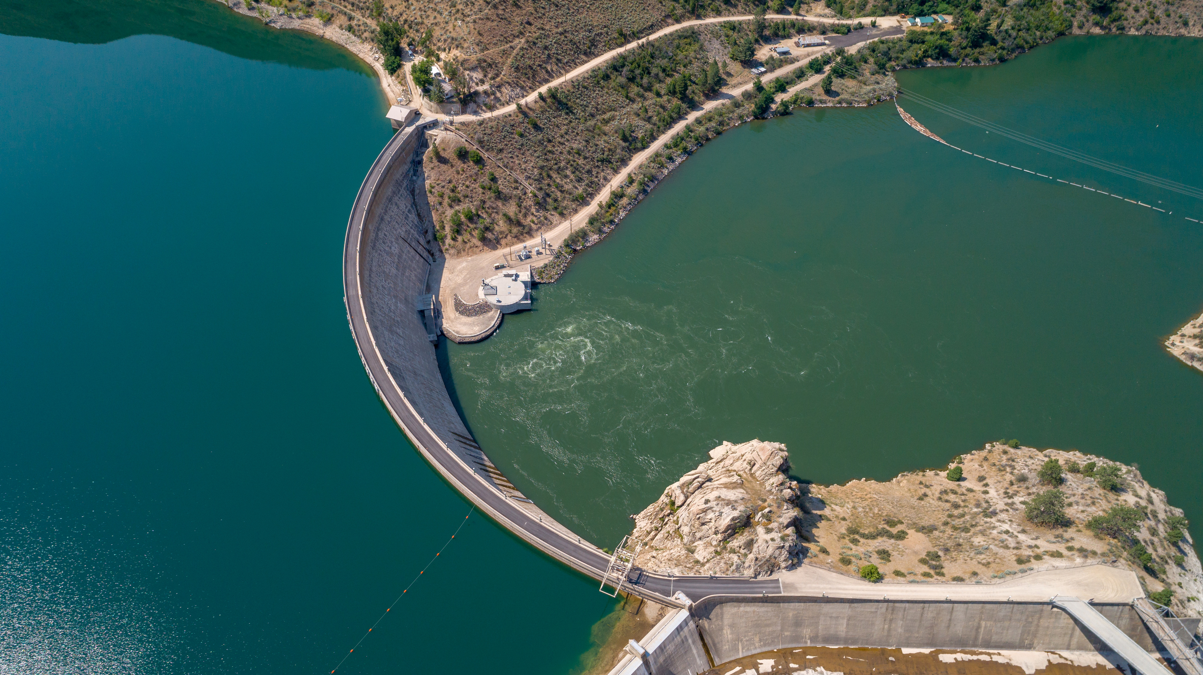
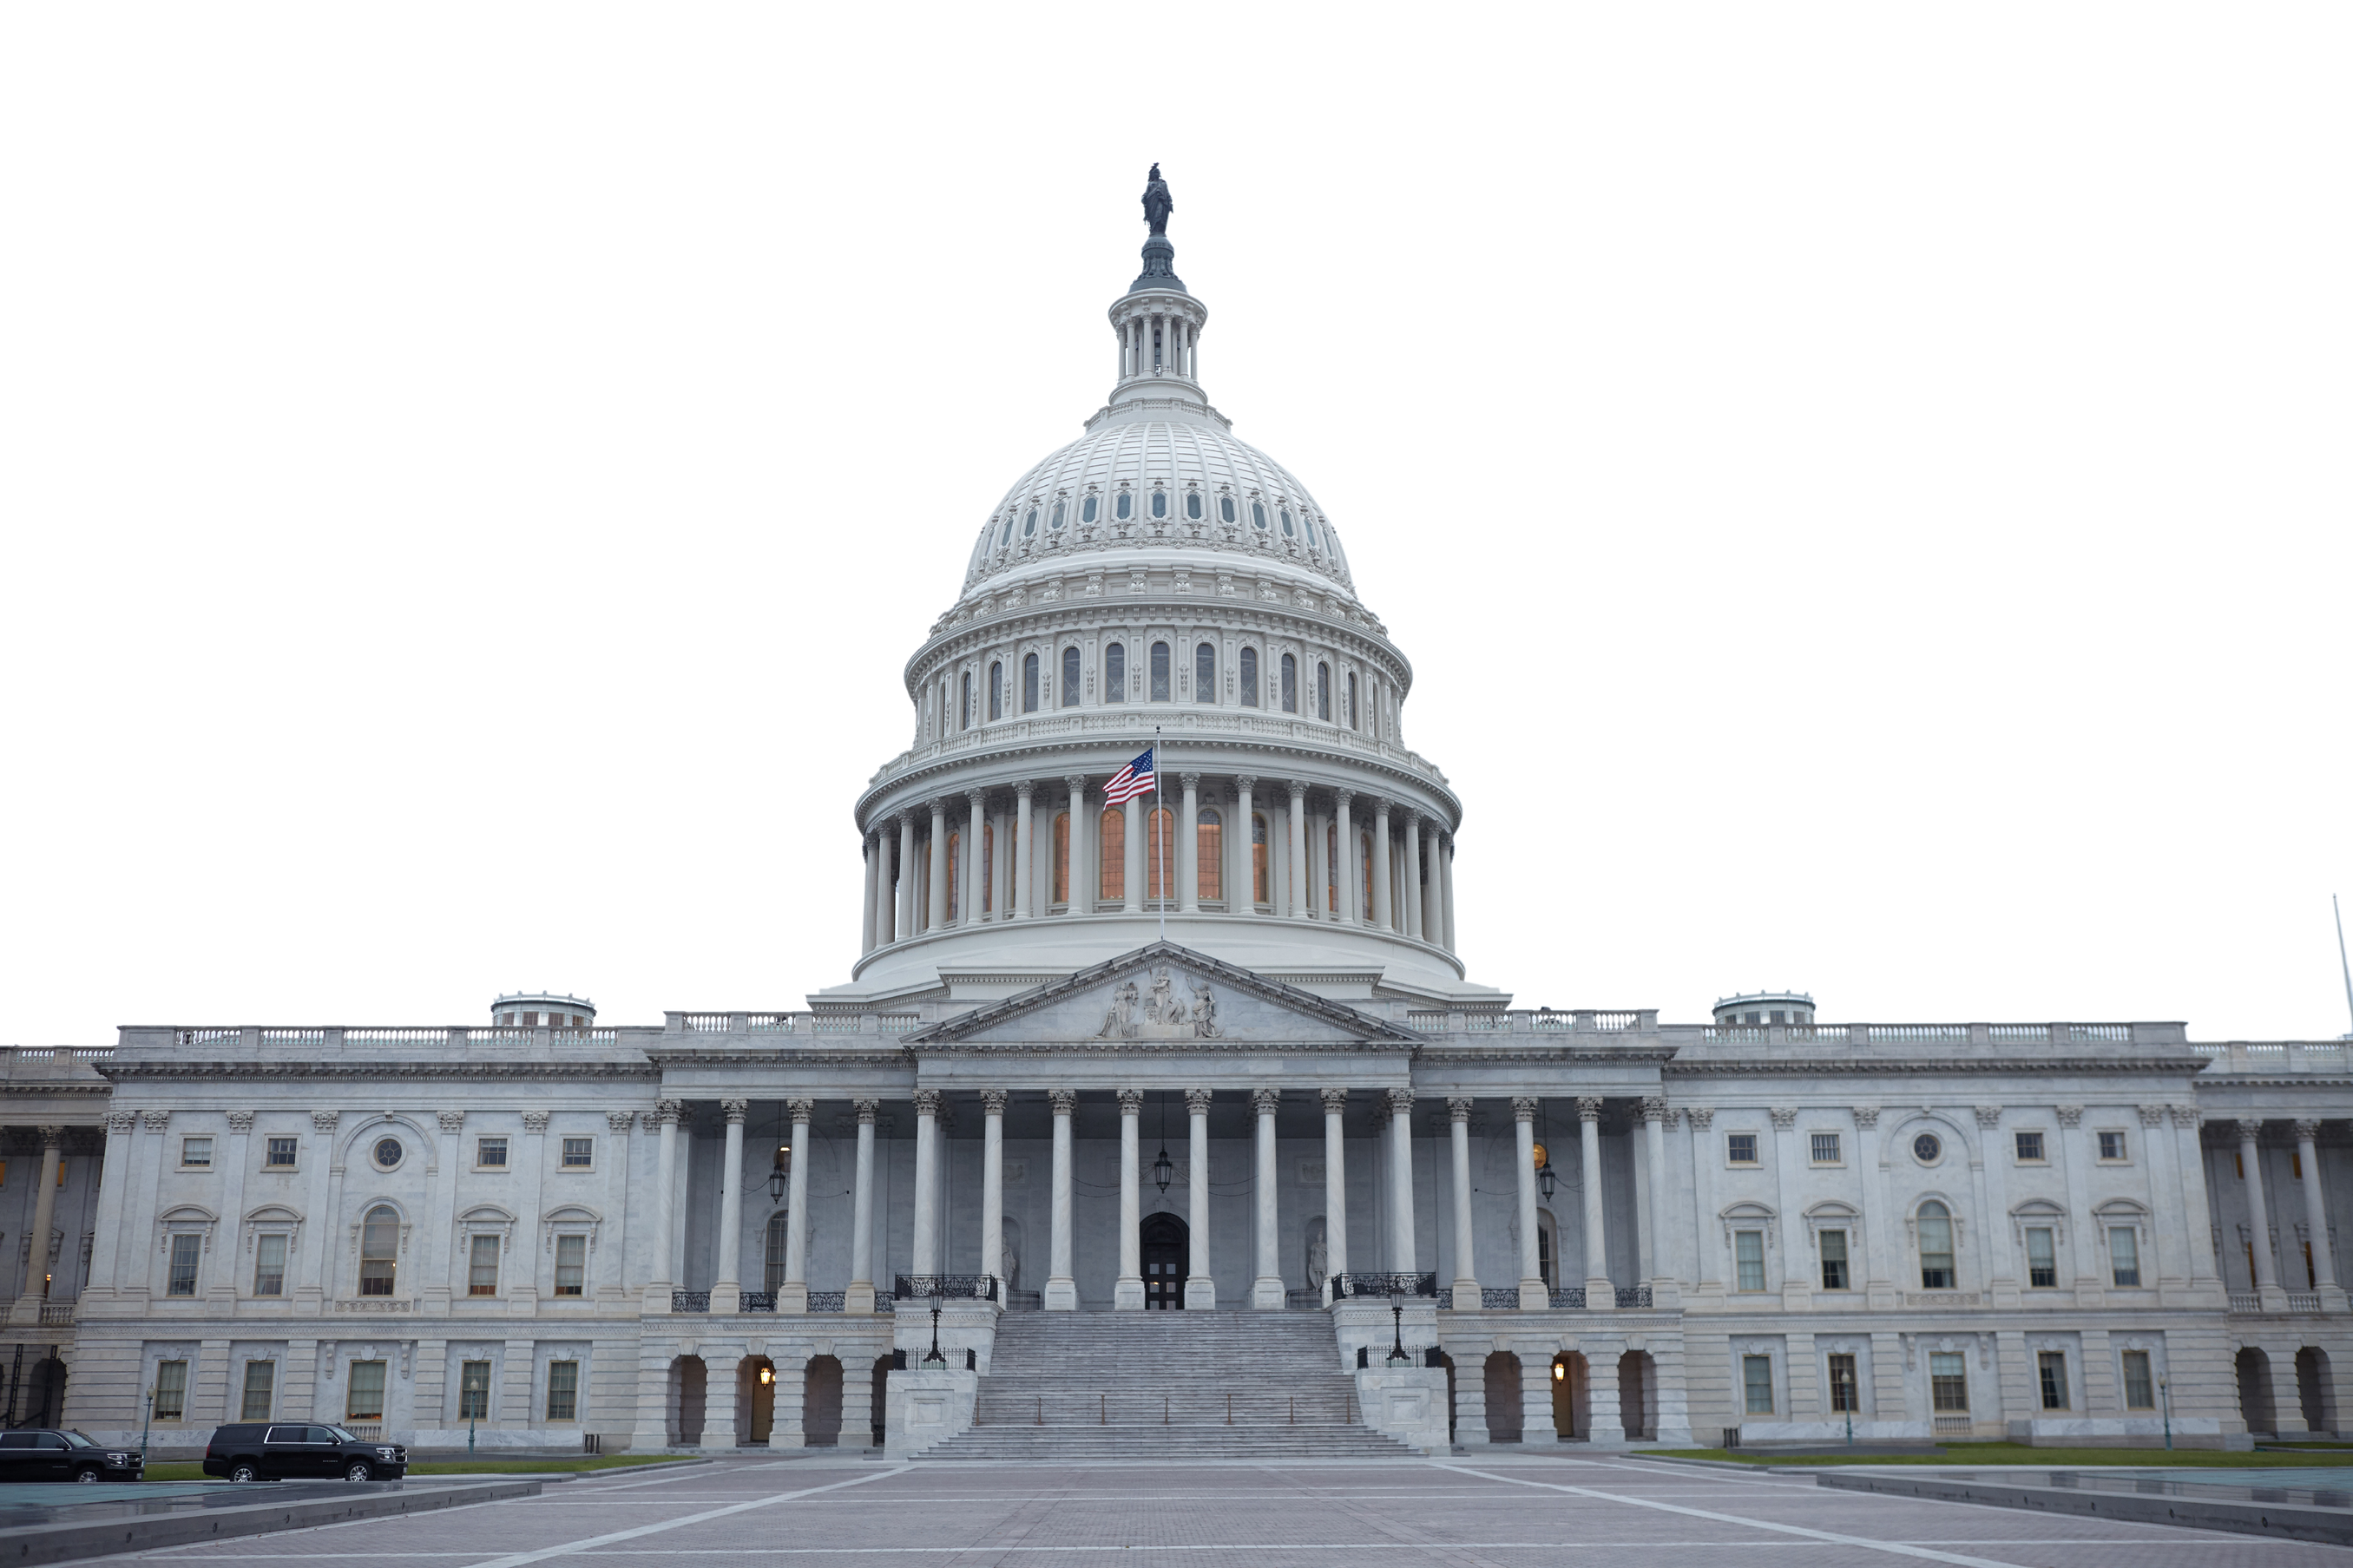
CURRENT CHALLENGES
Lack of Support for
Existing Hydropower
Antiquated Licensing
Process
Market Design
Failures

Slide 7








Dear Senator Daines and Senator Cantwell:
We, the [neighboring] labor unions, representing over five million skilled professionals in the various represented trades and industries write in strong support of S. 1521, the Community and Hydropower Improvement Act. The hydropower industry in the United States employs an estimated 73,000 people, according to the Department of Energy, and includes skilled professionals in diverse fields including carpenters, millwrights, operating engineers, electrical engineers, linesman, dam safety officials and energy industry professionals generally.

Slide 8

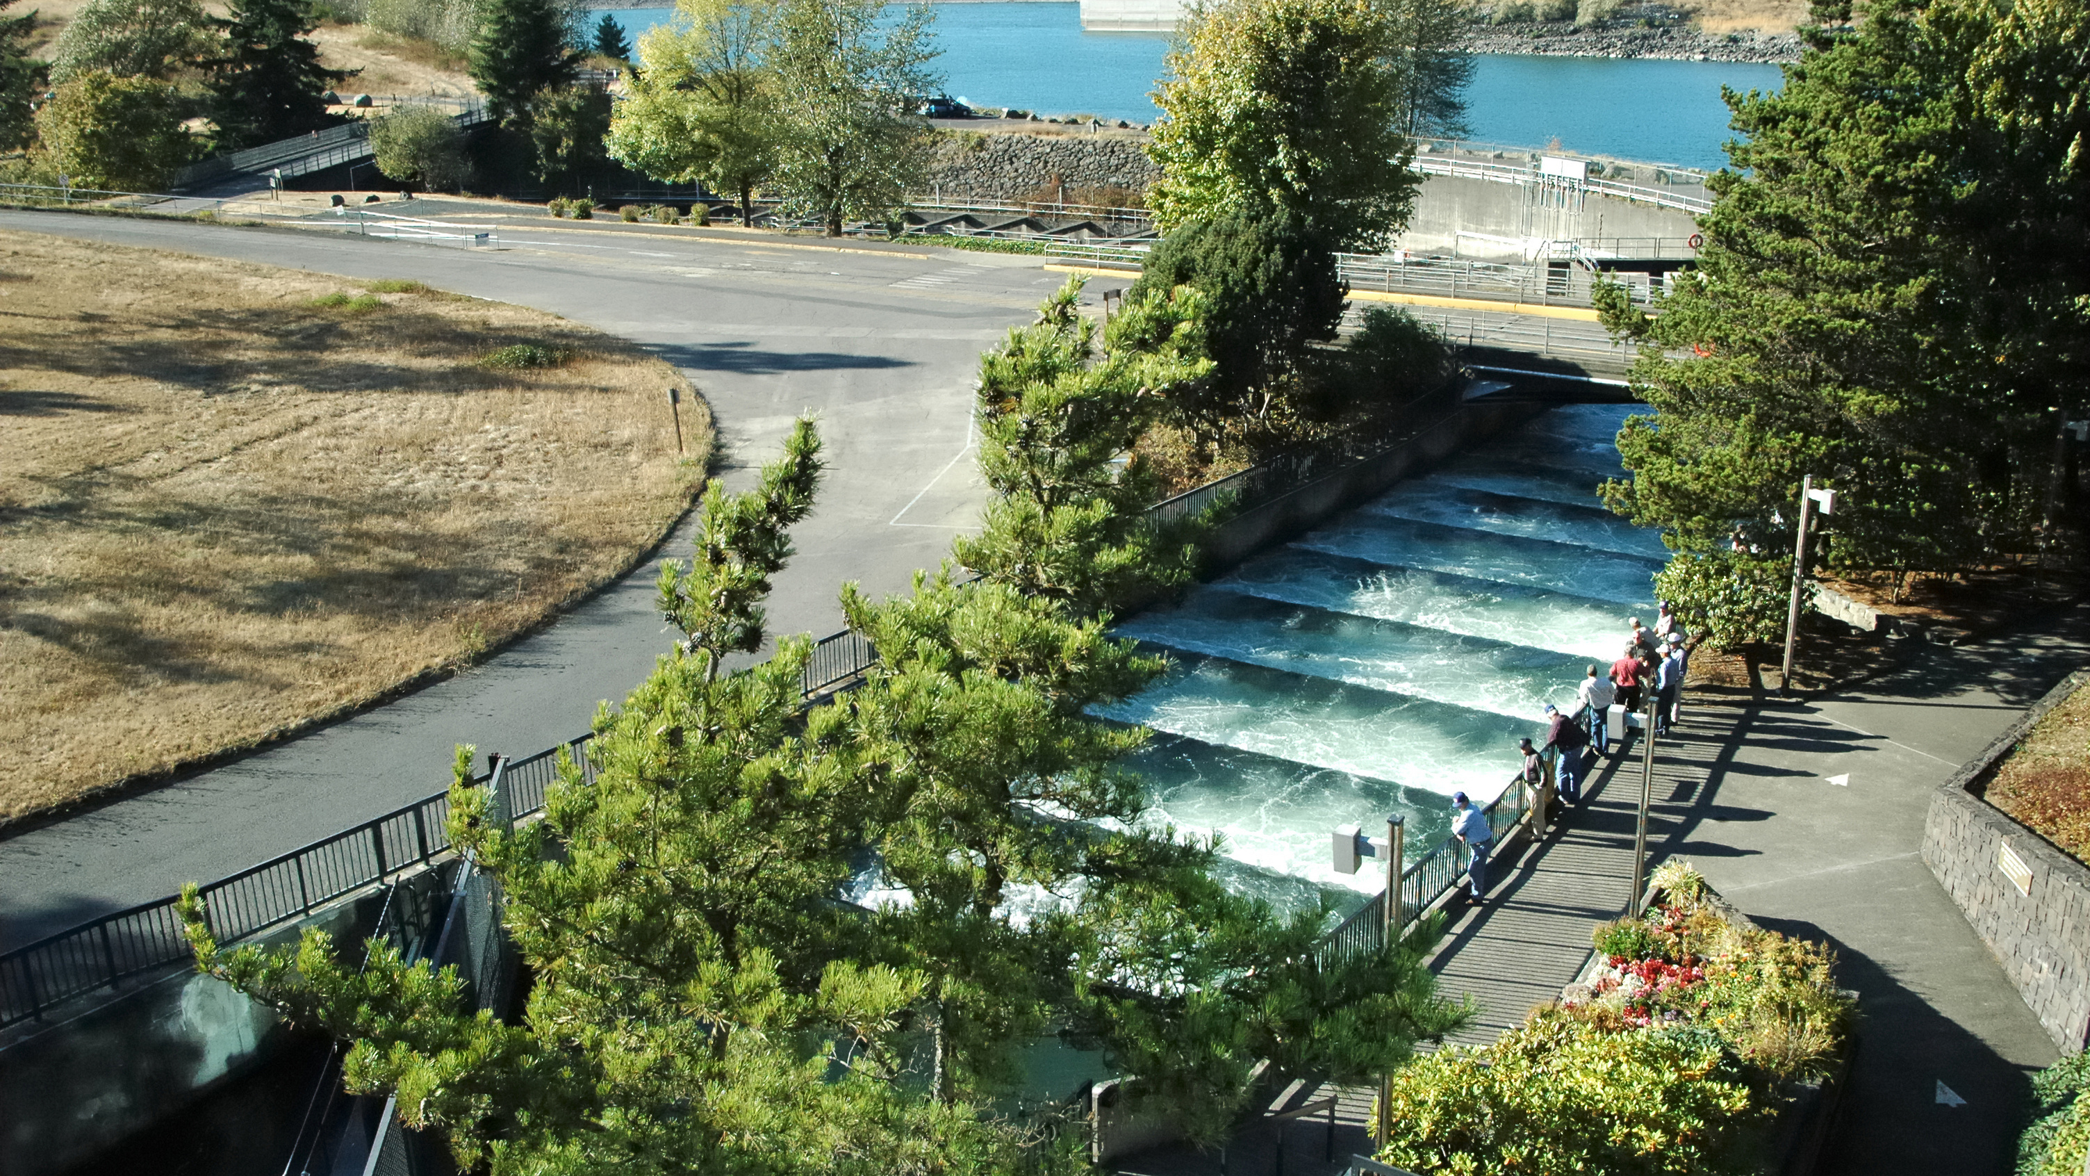
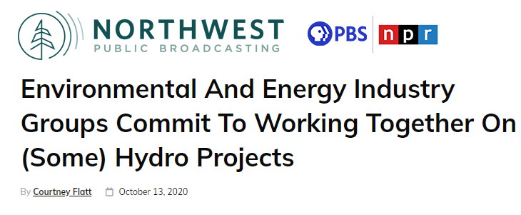
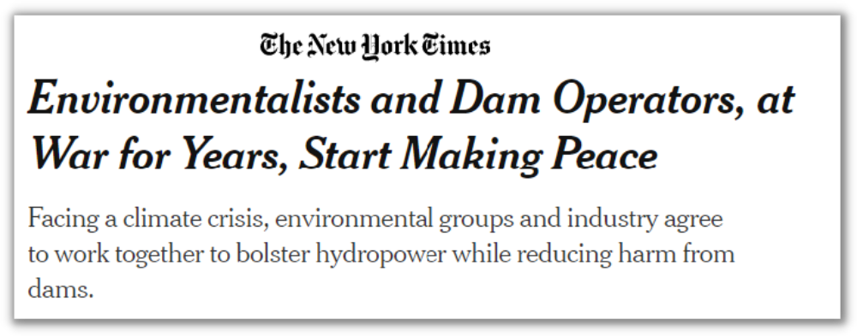
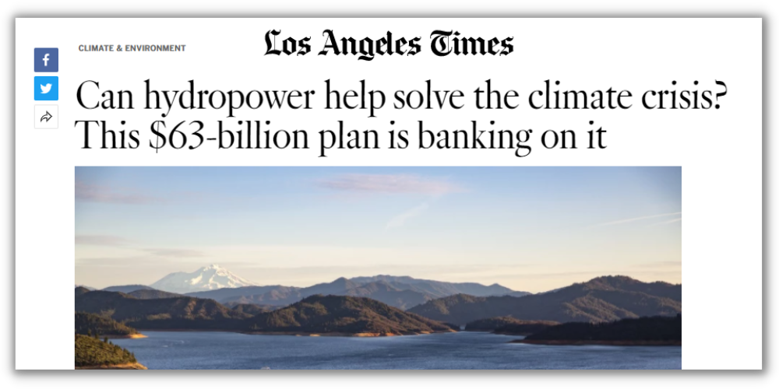
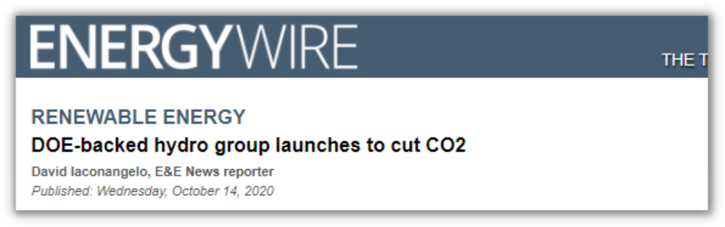
UNCOMMON
DIALOGUE
“U.S. Hydropower: Climate Solution and Conservation Challenge”
HYDROPOWER + RIVER + CLIMATE

Slide 9
ba
THANK YOU!

