Slide 1

TM
Presentation for NASUCA on eRoadMAP
Katherine Stainken
Jamie Dunckley
Mike Rowand
January 25th, 2024

Slide 2
Background and Objectives
Government, Industry, and Fleets are increasingly aligning on aggressive 2030 vehicle electrification goals
The pace of needed year-over-year action and investment to prepare charging sites and the grid is not clear
Consumers and fleet operators must have confidence in charging availability, reliability, and affordability
Consumers and fleets operators are increasingly looking to the utility industry to scale up efforts to support charging solutions, ensure the grid is capable of meeting vehicle loads
THIS TRANSITION IS UNPRECEDENTED AND COMPLEX. IT REQUIRES:
Extraordinary collaboration and partnering across all the major EV stakeholder groups
Redesigned processes, useful tools, and increased standardization to simplify the planning and complex interactions between major stakeholder groups
An evaluation of regulatory/board oversight that may not be conducive to driving actions on the pace and scale required to meet 2030 targets

Slide 3
Addressing some headlines first
“EV sales down.”
Plug-in EV Sales in December of 2023 Rose to 9.8% of All Light-Duty Vehicle Sales in the U.S. [energy.gov]
New EV Sales In America Have Nearly Quintupled Since 2020.” Final EV sales for the U.S. in 2023 estimated to be 1.189M. That’s about 7.4% of sales (preliminary).
“Hertz is selling 1/3 of its fleet of EVs.”
CEO noted customers are trying out EVs, but they may have overestimated demand, Scherr said . Tesla decision to lower their vehicle prices also factored into their decision given the impact on depreciation.
“Teslas struggling to charge in Chicago.”
Li ion batteries susceptible to extreme cold. Tesla says to maintain a charge of at least 20%. Tesla has a cold weather best practice guide.
Need more charging stations!

Slide 4
Addressing the Barriers to Achieving EVs at Scale A Three-Pillar Strategy to Address the Key Industry Gaps
1
2
3
COALITIONS & ROADMAPS
STRUCTURAL SYSTEM REFORMS
UNIFYING TOOLS & PILOTS
Bilateral Convening Series
Utility-OEM Forum
Utility-Fleet Forum
Charging Infrastructure
Reliability: Benchmarking, Standards
Charging innovation & affordability
Vetted Product List (VPL)
NEVI/NEHC Coordination with EEI
National EV Driver Research Board
Grid Readiness
50-state eRoadMAPTM to 2030 outlining EV loads, grid impacts, leadtimes, workforce, costs
Streamlined Grid Interconnect
Expedited Interim Charging Solutions
Managed Charging at Scale
Interconnect Standards for V2H/V2B/V2G
GridFASTTM Online Data Exchange
OEM/Utility V2H/V2B Pilot
EV Resilience/Evacuation Pilot
Enabling Regulatory and Oversight Framework
Equity Blueprint & Workforce Development

Slide 5
Addressing the Barriers to Achieving EVs at Scale A Three-Pillar Strategy to Address the Key Industry Gaps
1
2
3
COALITIONS & ROADMAPS
STRUCTURAL SYSTEM REFORMS
UNIFYING TOOLS & PILOTS
Bilateral Convening Series
Utility-OEM Forum
Utility-Fleet Forum
Charging Infrastructure
Reliability: Benchmarking, Standards
Charging innovation & affordability
Vetted Product List (VPL)
NEVI/NEHC Coordination with EEI
National EV Driver Research Board
Grid Readiness
50-state eRoadMAPTM to 2030 outlining EV loads, grid impacts, leadtimes, workforce, costs
Streamlined Grid Interconnect
Expedited Interim Charging Solutions
Managed Charging at Scale
Interconnect Standards for V2H/V2B/V2G
GridFASTTM Online Data Exchange
OEM/Utility V2H/V2B Pilot
EV Resilience/Evacuation Pilot
Enabling Regulatory and Oversight Framework
Equity Blueprint & Workforce Development

Slide 6
eRoadMAPTM

Slide 7
EV load is coming – but where and when exactly?
We need granular level data from the fleets themselves.
DMV data doesn’t work.
Buying data sets doesn’t work.
County level, census tract level data isn’t granular enough.
The eRoadMAP data builds confidence and shows clear signals for where and when EV load is coming.

Slide 8





















ANALYTICS
DATA
Other:

Slide 9
ANALYTICS
DATA
Other:

Slide 10
Interactive eRoadMAP Session
Pick a state
Pick a city
Zoom in!
Questions:
What color is the hex?
What is the split between LD and MHD?
How does the load change over time?
What does google satellite show for that hex?
eroadmap.epri.com

Slide 11



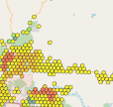


At a high level - a layered data approach
H3 – Level 8 Maps
LD Vehicles
Registrations
Travel Models
MDHD Vehicles
OEM data
Fleet data
Travel Data
Other Vehicle Sectors
Transit/School Buses
Government Fleets
Ports/Airports
Vocational Fleets
Other Load Data
EVSPs/Fueling Retailers
Individual layer
+
Individual layer…
+
+
=
One map with energy needs (power is coming)
+
+
+

Slide 12
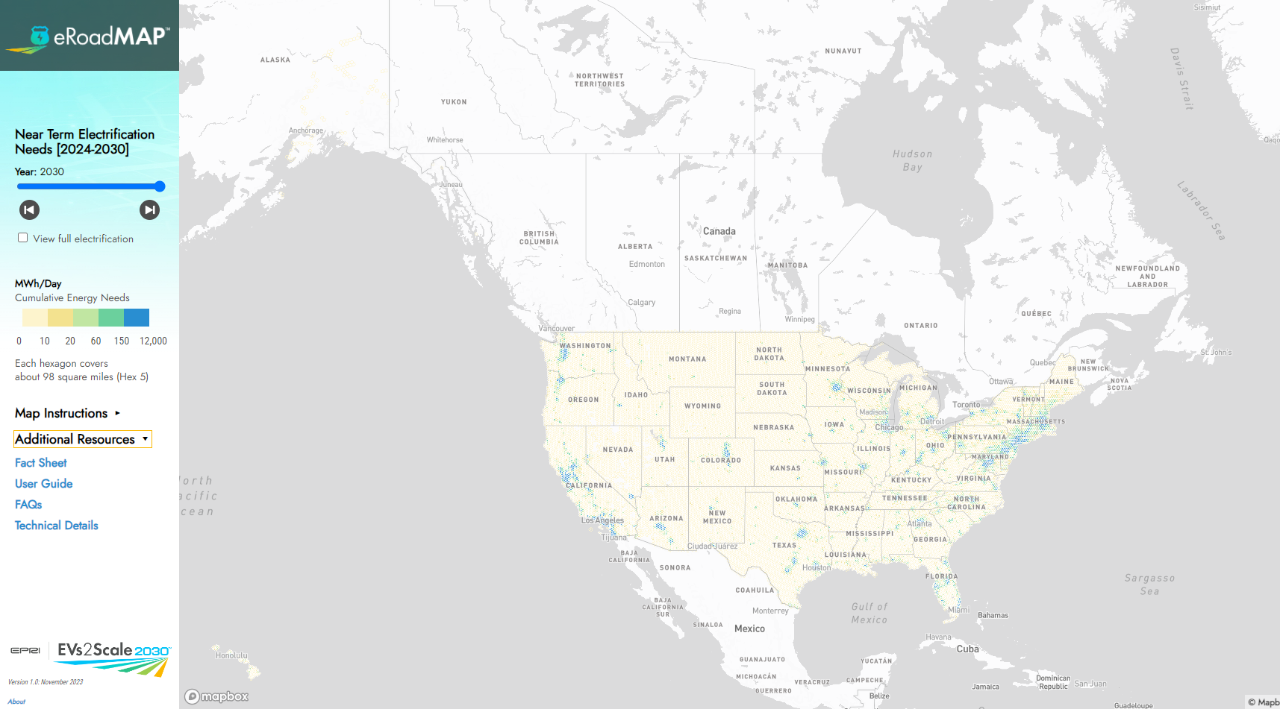
Going deeper - Where can I find more on the assumptions and approach?
U.S. = Hex 5 (98 mi²)

Slide 13
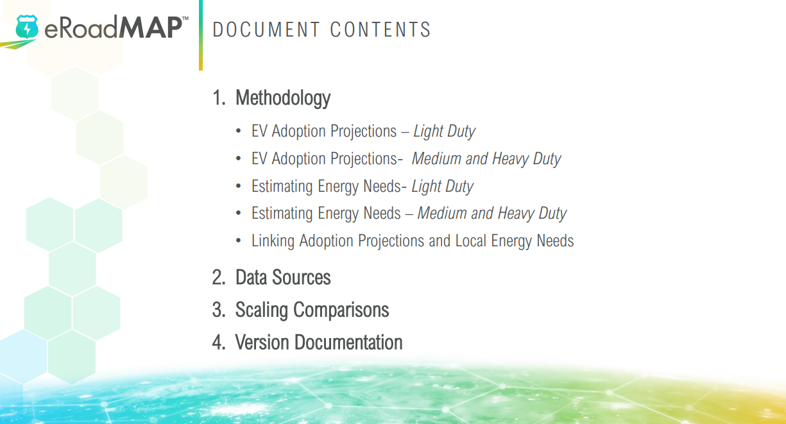
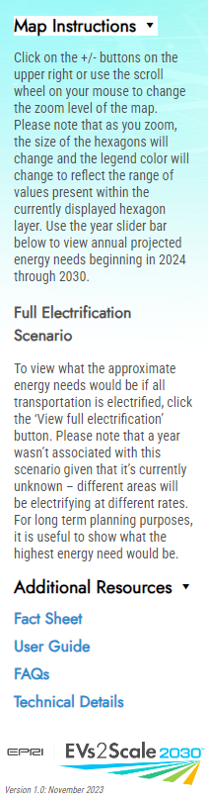
Light-duty and MHD Methodology and Granularity
Found in the Technical Details

Slide 14
Interactive eRoadMAP Session
Click on full electrification scenario.
Zoom in and out!
Put reactions in the chat.
Questions:
What do you see appearing along corridors?
Trends appearing for rural vs. urban loads?
Breakdown of hotspot areas in IOU vs. muni vs. coop service territories?
How many hexes are greater than 32 MWh?

Slide 15
Interactive eRoadMAP Session
Maybe you’re asking yourself the question now, “Where do I start with this data?”
5 Ideas on where to start:
Consider the context for why EV loads may require different consideration and treatment than other loads.

Slide 16
Interactive eRoadMAP Session
Maybe you’re asking yourself the question now, “Where do I start with this data?”
5 Ideas on where to start:
Consider the context for why EV loads may require different consideration and treatment than other loads.
New load is generally easily addressed by utilities through long-standing processes. EV load is different:
Timing mismatch: Fleets can receive vehicles in a much shorter timeframe than electric service upgrades can be completed. This is impacting EV adoption today.

Slide 17
Interactive eRoadMAP Session
Maybe you’re asking yourself the question now, “Where do I start with this data?”
5 Ideas on where to start:
Consider the context for why EV loads may require different consideration and treatment than other loads.
New load is generally easily addressed by utilities through long-standing processes. EV load is different:
Timing mismatch: Fleets can receive vehicles in a much shorter timeframe than electric service upgrades can be completed. This is impacting EV adoption today.
Utilities should not be impeding early adoption efforts.

Slide 18
Interactive eRoadMAP Session
Maybe you’re asking yourself the question now, “Where do I start with this data?”
5 Ideas on where to start:
Consider the context for why EV loads may require different consideration and treatment than other loads.
New load is generally easily addressed by utilities through long-standing processes. EV load is different:
Timing mismatch: Fleets can receive vehicles in a much shorter timeframe than electric service upgrades can be completed. This is impacting EV adoption today.
“Energy density” increasing: Load increases at fleet depots of 10x or more will be common, frequently exceeding distribution infrastructure capacity – no comparable precedent.

Slide 19
Interactive eRoadMAP Session
Maybe you’re asking yourself the question now, “Where do I start with this data?”
5 Ideas on where to start:
Consider the context for why EV loads may require different consideration and treatment than other loads.
New load is generally easily addressed by utilities through long-standing processes. EV load is different:
Timing mismatch: Fleets can receive vehicles in a much shorter timeframe than electric service upgrades can be completed. This is impacting EV adoption today.
“Energy density” increasing: Load increases at fleet depots of 10x or more will be common, frequently exceeding distribution infrastructure capacity – no comparable precedent.
CIAC & Line Extension policies: competition for distribution capacity will result in perceived and real inconsistencies that stress existing practices in many jurisdictions.

Slide 20
Interactive eRoadMAP Session
Maybe you’re asking yourself the question now, “Where do I start with this data?”
5 Ideas on where to start:
Consider the context for why EV loads may require different consideration and treatment than other loads.
New load is generally easily addressed by utilities through long-standing processes. EV load is different:
Timing mismatch: Fleets can receive vehicles in a much shorter timeframe than electric service upgrades can be completed. This is impacting EV adoption today.
“Energy density” increasing: Load increases at fleet depots of 10x or more will be common, frequently exceeding distribution infrastructure capacity – no comparable precedent.
CIAC & Line Extension policies: competition for distribution capacity will result in perceived and real inconsistencies that stress existing practices in many jurisdictions.
EPRI research coming end of Q1

Slide 21
The Timeline Challenge
Electric Trucks (and other vehicles) can be ordered and delivered in 4-6 months or less
Utility infrastructure upgrades to serve the new charging load can take 18 – 24 months or longer
This mismatch in timelines is affecting adoption of EVs, especially class 6-8 trucks.
Due to policy drivers and market forces, this will become more prevalent in 2024 and beyond
This will increasingly position utilities as a “barrier” to MHD vehicle adoption
What can be done to bridge this timeline gap?

Slide 22
Interim Charging Solution Options
Customer-side / BTM options
1) Utilize existing facility spare capacity
2) DERs installed on temporary basis
Utility-side options
Temporary/Construction service for partial capacity
Acceptance of CMS to limit power to agreed capacity
Short-term circuit switching to increase distribution capacity
Utility side DER
What are best practices today?
Can a recommended practice and architecture be established?
What documentation and approvals would be needed?

Slide 23
Interactive eRoadMAP Session
Maybe you’re asking yourself the question now, “Where do I start with this data?”
5 Ideas on where to start:
Consider the context for why EV loads may require different consideration and treatment than other loads.
Identify what pops out as a “no regrets” investment area.

Slide 24
Interactive eRoadMAP Session
Maybe you’re asking yourself the question now, “Where do I start with this data?”
5 Ideas on where to start:
Consider the context for why EV loads may require different consideration and treatment than other loads.
Identify what pops out as a “no regrets” investment area.
Corridors
LD
MHD Depots
School Buses
Coming soon:
Ports
Is there a method for prioritization?
i.e. look at DACs / Justice 40 requirements?
i.e. look at other policy drivers in the state?
Electrifying Airport Ecosystems by 2050 Could Require Nearly Five Times the Electric Power Currently Used (enterprisemobility.com)

Slide 25
Interactive eRoadMAP Session
Maybe you’re asking yourself the question now, “Where do I start with this data?”
5 Ideas on where to start:
Consider the context for why EV loads may require different consideration and treatment than other loads.
Identify what pops out as a “no regrets” investment area.
Understand if your state / utility has a method for getting access to granular fleet data for their service territory.

Slide 26
Interactive eRoadMAP Session
Maybe you’re asking yourself the question now, “Where do I start with this data?”
5 Ideas on where to start:
Consider the context for why EV loads may require different consideration and treatment than other loads.
Identify what pops out as a “no regrets” investment area.
Understand if your state / utility has a method for getting access to granular fleet data for their service territory.
State: i.e. a fleet database, a one-time reporting requirement for fleets
Utility: process for outreach to customers on fleet electrification plans
EPRI’s GridFAST tool

Slide 27
Interactive eRoadMAP Session
Maybe you’re asking yourself the question now, “Where do I start with this data?”
5 Ideas on where to start:
Consider the context for why EV loads may require different consideration and treatment than other loads.
Identify what pops out as a “no regrets” investment area.
Understand if your state / utility has a method for getting access to granular fleet data for their service territory.
State: i.e. a fleet database, a one-time reporting requirement for fleets
Utility: process for outreach to customers on fleet electrification plans
EPRI’s GridFAST tool
“Affordability comes with proper planning and design.” – Sujit Mandal, Amazon

Slide 28
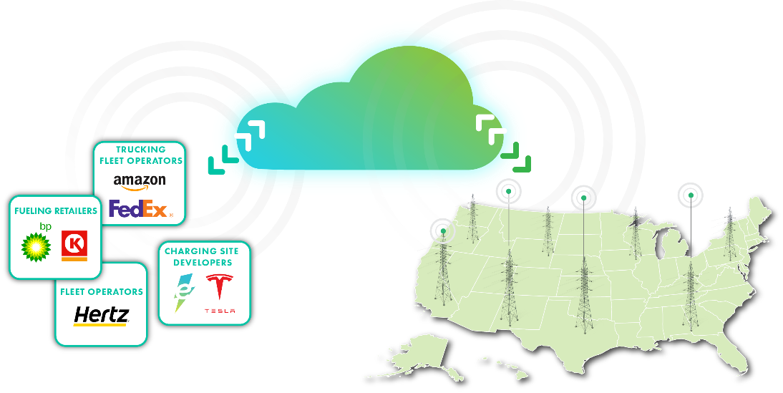
GridFAST
Goal: Improve transparency in EV charging planning to inform grid investments and accelerate grid interconnects
For big and small fleets.
Complementary to eRoadMAPTM ; continues the communication across all parties.
Complementary to fleet advisory services.
2023-2035 plans defining loads, locations, timing
GridFAST Secure online data exchange platform
Utility hosting capacity – or proxies – indicating grid readiness, timing to support EV charging loads

Slide 29

Enable EV customers and utilities to have actionable transportation load information earlier in the utility planning process.
GridFAST
Vision
Plan
Fund
Design
Procure
Build
Deploy
EV CUSTOMER
Close communication between fleets & utilities
Close communication between EV customers & utilities
Opportunity
Opportunity
Service Request
Service Request & Refinement
Design
Construction
Distribution Planning Cycle
UTILITY
Transmission Planning Cycle

Slide 30
Interactive eRoadMAP Session
Maybe you’re asking yourself the question now, “Where do I start with this data?”
5 Ideas on where to start:
Consider the context for why EV loads may require different consideration and treatment than other loads.
Identify what pops out as a “no regrets” investment area.
Understand if your state / utility has a method for getting access to granular fleet data for their service territory.
Consider which current utility policies and processes may need to change; where additional policymaker support and/or help is needed.

Slide 31
Interactive eRoadMAP Session
Maybe you’re asking yourself the question now, “Where do I start with this data?”
5 Ideas on where to start:
Consider the context for why EV loads may require different consideration and treatment than other loads.
Identify what pops out as a “no regrets” investment area.
Understand if your state / utility has a method for getting access to granular fleet data for their service territory.
Consider which current utility policies and processes may need to change; where additional policymaker support and/or help is needed.
Forecasting practices
Cost recovery practices
Frequency of utility filings
State funding availability
Federal funding availability

Slide 32
Interactive eRoadMAP Session
Maybe you’re asking yourself the question now, “Where do I start with this data?”
5 Ideas on where to start:
Consider the context for why EV loads may require different consideration and treatment than other loads.
Identify what pops out as a “no regrets” investment area.
Understand if your state / utility has a method for getting access to granular fleet data for their service territory.
Consider which current utility policies and processes may need to change; where additional policymaker support and/or help is needed.
Forecasting practices
Cost recovery practices
Frequency of utility filings
State funding availability
Federal funding availability
EPRI research; ATE whitepaper coming end of Q1/early Q2

Slide 33
Interactive eRoadMAP Session
Maybe you’re asking yourself the question now, “Where do I start with this data?”
5 Ideas on where to start:
Consider the context for why EV loads may require different consideration and treatment than other loads.
Identify what pops out as a “no regrets” investment area.
Understand if your state / utility has a method for getting access to granular fleet data for their service territory.
Consider which current utility policies and processes may need to change; where additional policymaker support and/or help is needed.
Be aware of next phase of EPRI work

Slide 34
Next Phase of EPRI Work:
Features:
Data:
Power
Grid Capacity
Hosting capacity maps
Substation capacity analysis
Demographic layers
Justice 40, HH income, MDU %
Fueling stations (EV and gasoline)
Separation of long-haul trucks and other refined segmentation
Fleet Data (ongoing)
School Buses
Transit Buses, Airports, Ports, Vocational
Charging Provider Plans

Slide 35
Power
What managed charging scenarios should be assumed?
Plug in when the vehicle gets to its destination. (5pm)
Managed charging so the vehicle is ready. (7am)
Perfectly managed charging- minimized power over maximum time. This scenario also represents potentially multiple TOU scenarios together.

Slide 36
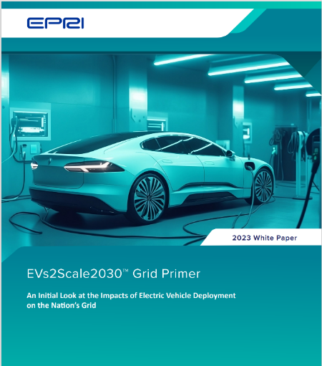
Capacity
EPRI’s EVs2Scale 2030 Grid Primer report:
Provides an initial look at how various levels of load at the distribution feeder level drives distribution system upgrades, lead-times, and more.
The report represents the first step to better understanding how we might estimate on a national level the utility costs and efforts required to support transportation loads.

Slide 37
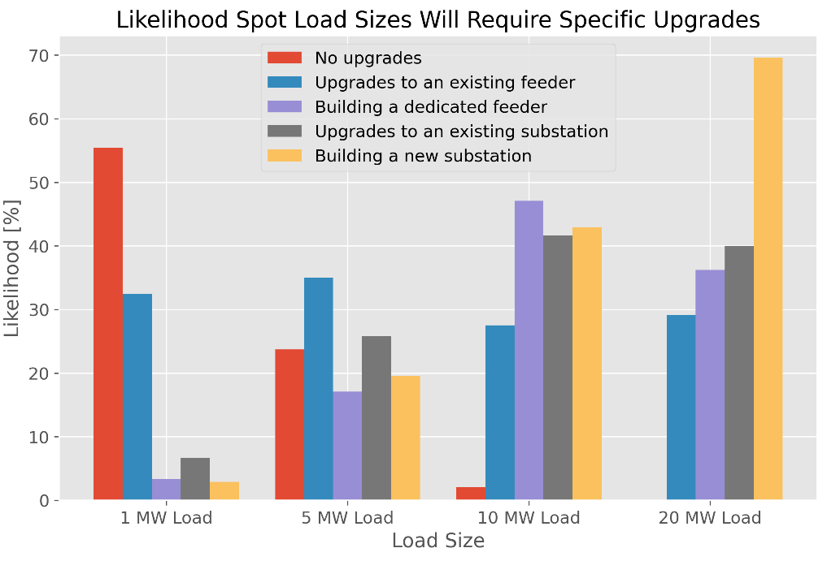
Grid Primer
The utility grid, as a system, is relatively well positioned to serve EV charging – however challenges exist in some locations.
Preliminary Findings:
5MW load – 30% likely to need a feeder upgrade
10MW load – 48% likely to need a dedicated feeder, 42% likely to need substation
20MW load – 70% likely to need a new substation

Slide 38
Thank You
Mike Rowand
Mike.Rowand@outlook.com
Katherine Stainken: kstainken@epri.com
Jamie Dunckley: jdunckley@epri.com

Slide 39
Extra Slides

Slide 40
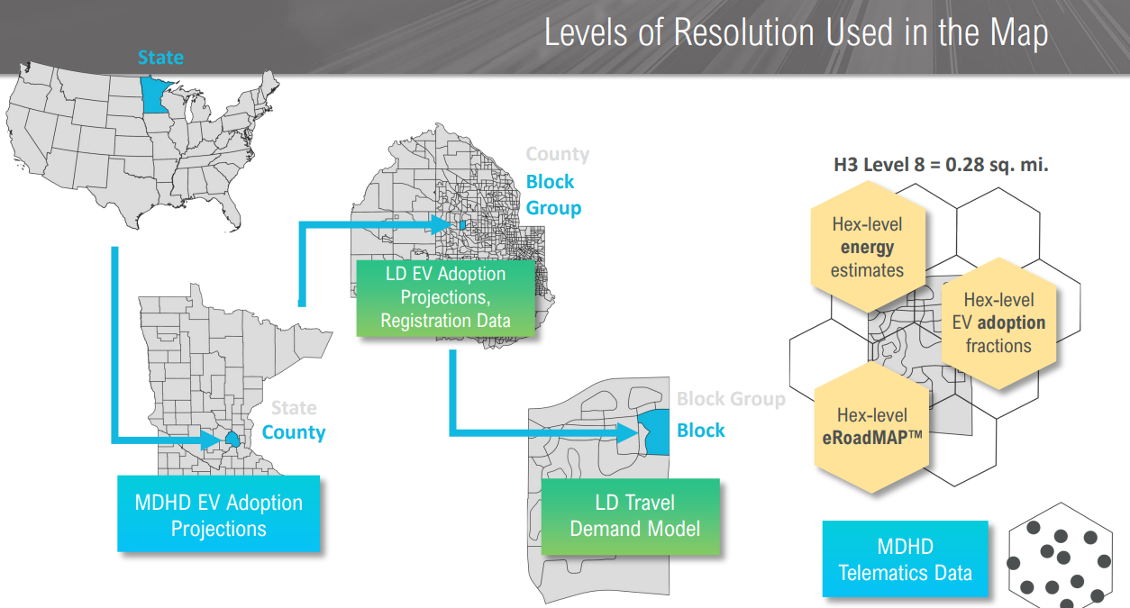
Data Granularity
Found in the Technical Details

Slide 41
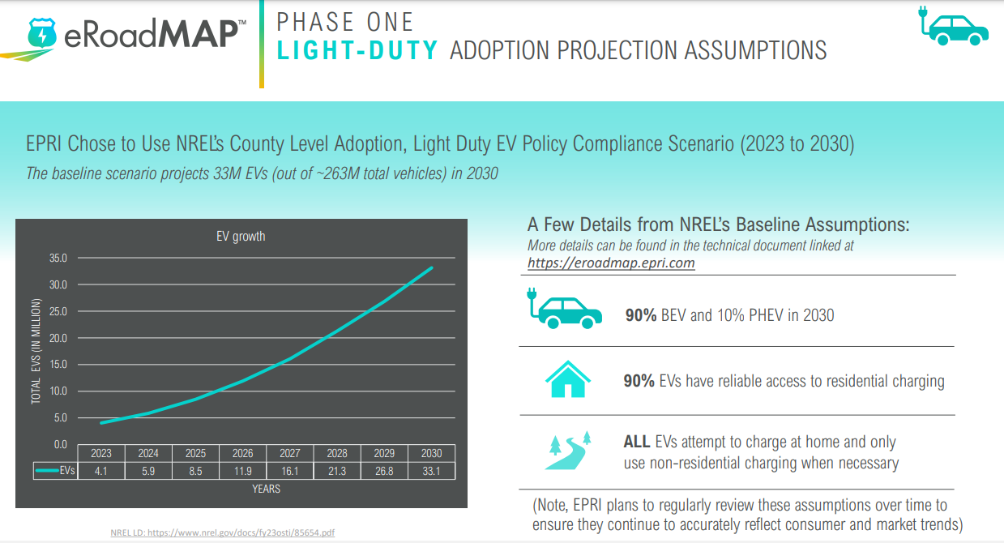
Light-duty Assumptions
Found in the User Guide

Slide 42
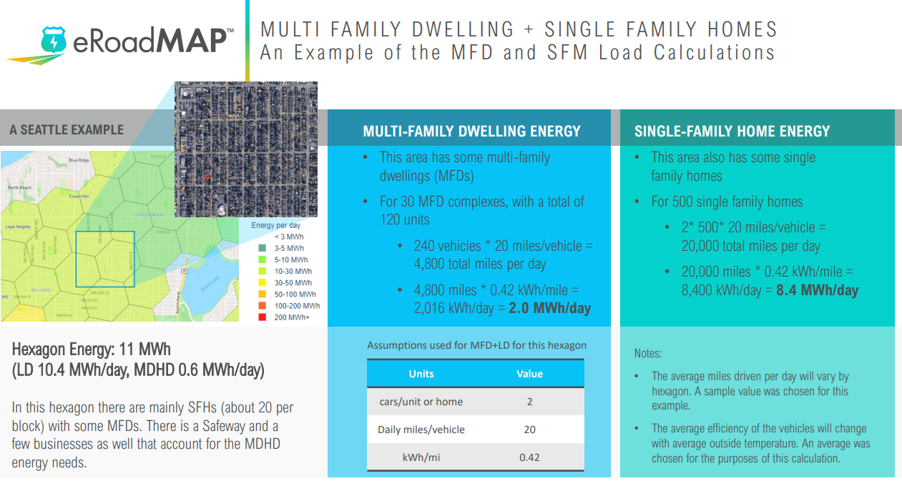
Light-duty Assumptions
Found in the User Guide

Slide 43
Light-duty Assumptions
Found in the Technical Details
Residential vs Non-Residential Charging:
85% of energy is replenished at home, 15% elsewhere [this includes workplace].
In full electrification scenario, 75% of energy is replenished at home
Non-home charging energy locations were assigned based on ‘charging at every stop’ to replenish the miles traveled in the trip before the stop.
Efficiency Assumption:
Local Temperature impacts will be addressed in v2.0. In v1.0, temperature effects are included via average efficiency across all vehicles, but not localized.
Local Adoption - NRELs projections only go to county level. We used conventional vehicle registration age to allocate EVs in a more granular level- ie a county with newer vehicles currently, will likely adopt new EVs earlier.

Slide 44
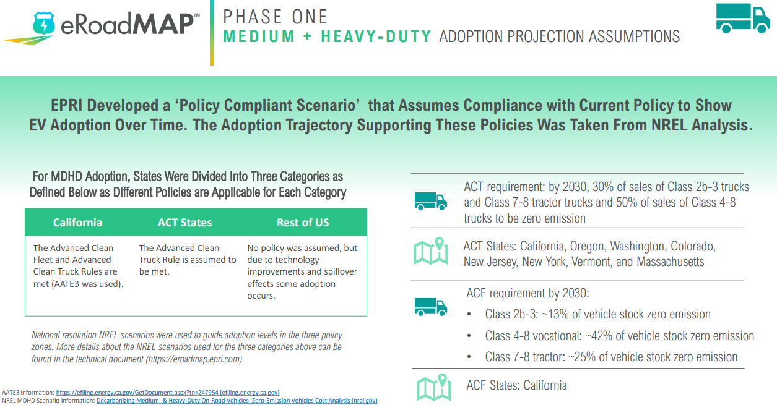
MHD Assumptions to Accompany Data
Found in the User Guide

Slide 45

MHD Assumptions to Accompany Data
Found in the Technical Details
Adoption over time is constant over a county
We are working to get direct fleet plans, but absent that, MDHD adoption in a county is uniform.
Slide 25 - shows adoption assumptions by state (3 types- CA, ACT states, Non-ACT States)
Efficiency Assumption (will be updated over time):
Depot vs Non-depot Charging: Constant across MDHD vehicles (to be updated in v2.0 by VMT segments)
85% at depot, 15% at non depot
85% of energy assigned to the longest dwell time in a day. 15% assigned to the rest of the stops proportional to the miles driven before each stop.
Minimum stop length varies between 20 min and 1 hr.

