Slide 1
Solar Compensation Evaluation Strategies
Vignette for NASUCA Mid-Year Meeting, June 2024
Madison, WI
Tuesday June 11th, 2024
Aidan Glaser Schoff (he/him/his)

Slide 2
Synapse Energy Economics
Founded in 1996 by CEO Bruce Biewald
Leader for public interest and government clients in providing rigorous analysis of the electric power and natural gas sectors
Staff of 40+ includes experts in energy, economic, and environmental topics
Testimony supporting Clean Wisconsin in Wisconsin Power and Light’s most recent rate case
  Eric Borden, Principal Associate
Testimony supporting the New Hampshire Office of Consumer Advocate in a docket focused on changes to net metering
  Eric Borden, Principal Associate
  Tim Woolf, Senior Vice President of Consulting
Notes:
Synapse is a consulting group focused on providing analysis in the electric power and natural gas sector

Slide 3
Motivation
Residential solar technologies and their costs are much different now compared to when net energy metering (NEM) was adopted
It may now be appropriate to review whether a different compensation mechanism or compensation price is better suited for the current context
This analysis highlights how to compare the status quo to proposed alternatives
Notes:
NEM credits solar generation at the retail rate

Slide 4
Outline
Summary of steps taken when reviewing residential solar compensation
Customer Adoption Analysis
  Bill Savings and Lost Revenue
  Payback Period
Rate and Bill Impact Analysis
  Avoided Costs
Regulatory Considerations
  Policy Implications
  Periodic Updates
Notes:
Bill Savings and Lost Revenue
Non-Solar Customer Perspective
Payback Period
Solar Customer Perspective
Avoided Costs
Non-Solar Customer Perspective
Non-Participant Effects / Cost Shifts
Non-Solar Customer Perspective
Policy Implications
Societal / Regulatory Perspective
Periodic Updates
Regulatory Perspective

Slide 5
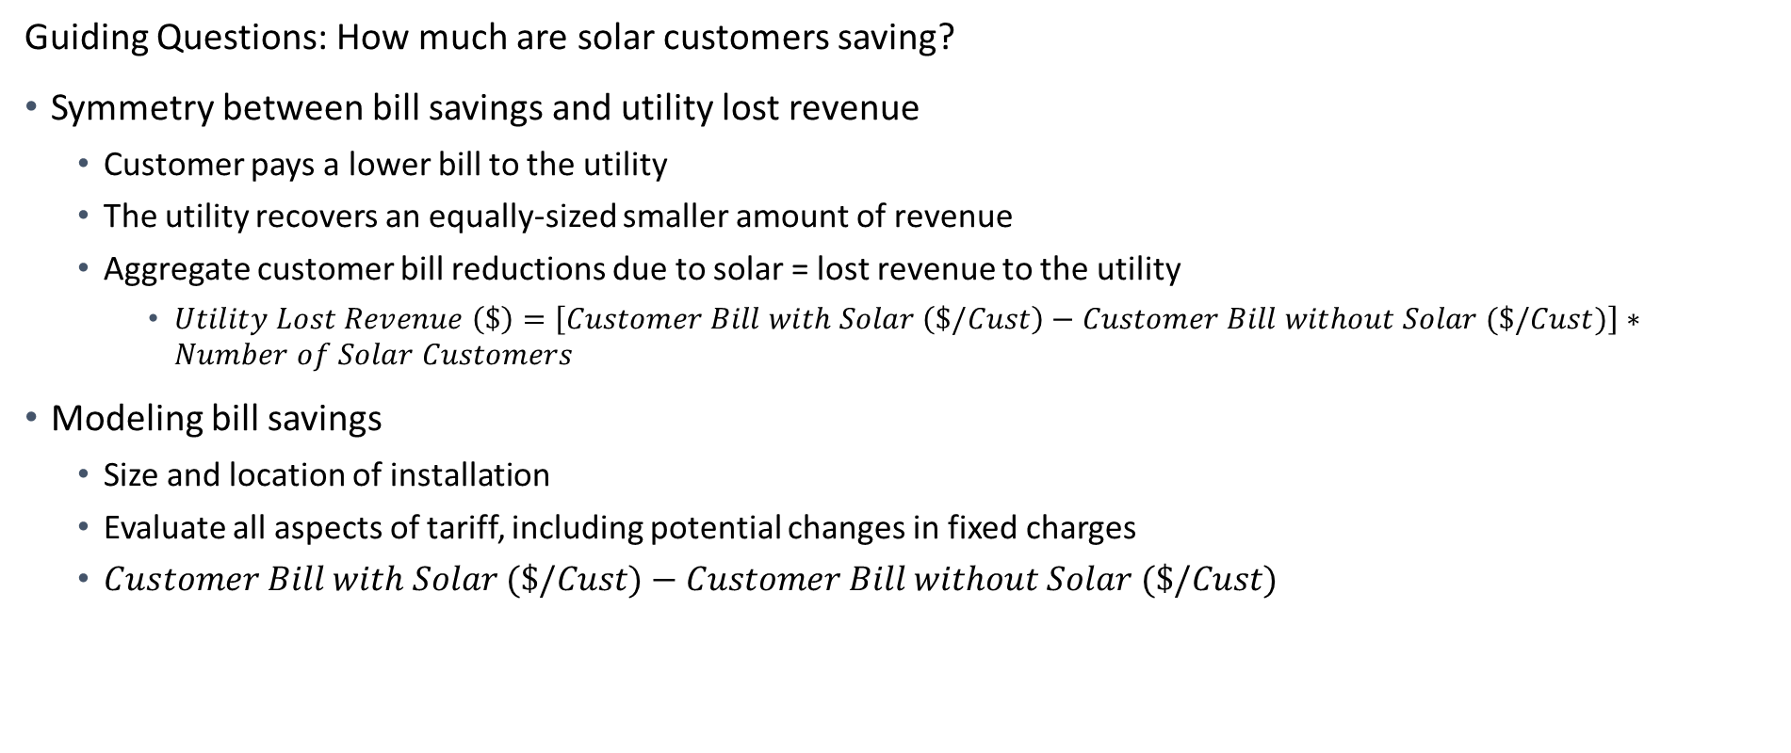
Bill Savings and Lost Revenue
Guiding Questions: How much are solar customers saving?
Symmetry between bill savings and utility lost revenue
  Customer pays a lower bill to the utility
  The utility recovers an equally-sized smaller amount of revenue
  Aggregate customer bill reductions due to solar = lost revenue to the utility
    $Utility Lost Revenue \left(\$\right)=\left[Customer Bill with Solar \left(\$/Cust\right)−Customer Bill without Solar (\$/Cust)\right]∗Number of Solar Customers$
Modeling bill savings
  Size and location of installation
  Evaluate all aspects of tariff, including potential changes in fixed charges
  $Customer Bill with Solar (\$/Cust)−Customer Bill without Solar (\$/Cust)$

Slide 6
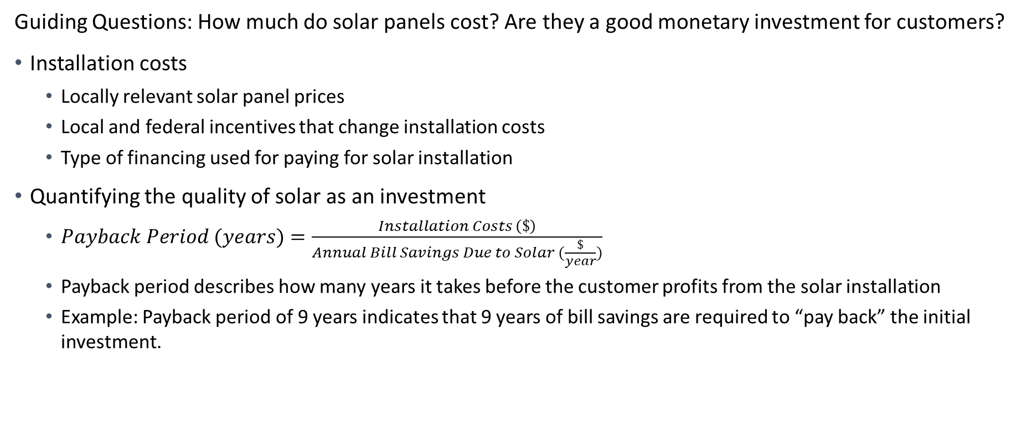
Payback Period
Guiding Questions: How much do solar panels cost? Are they a good monetary investment for customers?
Installation costs
  Locally relevant solar panel prices
  Local and federal incentives that change installation costs
  Type of financing used for paying for solar installation
Quantifying the quality of solar as an investment
  $Payback Period (years)=\frac{Installation Costs \left(\$\right)}{Annual Bill Savings Due to Solar (\frac{\$}{year})}$
  Payback period describes how many years it takes before the customer profits from the solar installation
  Example: Payback period of 9 years indicates that 9 years of bill savings are required to “pay back” the initial investment.
Notes:
Type of financial vehicle used for purchasing solar panels
Simplifying assumption that solar customers pay cash upfront for solar
More specifically, customers incur interest costs while paying off loans for solar panels

Slide 7
Rate and Bill Impacts - Overview
Guiding Question: How does the implementation of a solar policy affect the rates and bills of non-solar customers?
Solar customers and non-solar customers have different demographic characteristics
  Generally, the average household with residential solar is:
    More likely to identify as non-Hispanic white
    Have a higher income
    Own a single-family home
  Transferring revenue collection between solar and non-solar households is a transfer across demographic groups
Process of conducting rate and bill impact analysis
Compare lost revenue to avoided costs
Allocate revenue appropriately among the residential class
Divide revenue ($) by sales (kWh) to determine rate impact ($/kWh)

Slide 8
Avoided Costs
Avoided cost: Cost that is not borne due to an action taking place; not bearing the cost is a benefit
Relevant avoided costs guided by regulator
  Example avoided costs include:
    Avoided generation, transmission, and/or distribution capacity costs
    Distribution Line losses
Quantification of avoided costs
  Requires external study and/or support from utilities
  Example: Avoided Energy Supply Costs in New England
Input to analysis is a list of avoided costs and their appropriate values

Slide 9
Rate and Bill Impacts - Calculation
Revenue not collected due to solar (Lost revenue)
  The amount of money that is not recovered because customers with solar generation have reduced sales and bills
Revenue that does not need to be collected due to solar (Avoided costs)
  The utility does not need to recover this amount of money because utility costs are avoided
Difference between lost revenues and utility avoided costs represents how much revenue is being under- or over-collected by the utility
  Rate impact for non-solar customers is the over-/under-collection divided by total non-solar sales
  Bill impact considers how this rate impact affects bills of non-solar customers
After calculation for one solar compensation mechanism, these are recalculated for alternative solar compensation mechanisms
  The difference is the key result of the analysis

Slide 10
Policy Implications
Guiding Questions: What policies related to renewables, carbon emission reduction, and/or solar generation are applicable?
Potential policies include:
  State-specific renewable portfolio standards
  Utility-specific carbon emission and/or renewable targets
When reviewing status quo vs. proposed alternative(s), the compensation level in proposed alternatives can be adjusted
  Stronger solar adoption targets or regulations suggest higher solar compensation
  Price elasticity research provides more precise estimates
Notes:
Complicating factors:
Material and installation costs change over time
Federal incentives may change over time

Slide 11
Periodic Updates
Guiding Question: How frequently will these rules be updated?
Outlined analysis
  Bill Savings and Lost Revenue
  Payback Period
  Avoided Costs
  Rate and Bill Impacts
  Policy Implications
All analytical components discussed today change over time
  Analysis should also be periodically updated to reflect these changes over time
  Large unexpected changes are easier to adapt to if regulatory infrastructure for updating compensation is already in place
Notes:
In NH: Provided testimony in 2023, suggested review by 2025
In WI: Asked for solar to be looked at on a state-wide level rather than for each utility.

Slide 12
Questions?
Contact:
Synapse Energy Economics
Aidan Glaser Schoff (aglaserschoff@synapse-energy.com)

