Slide 1
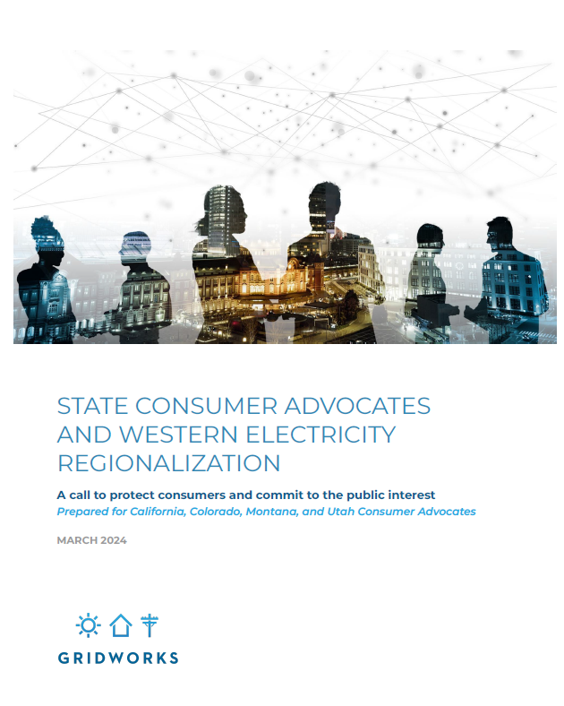
Western Regional Organization Governance Proposal
Michele Beck
Director, Utah Office of Consumer Services
Presented to:
NASUCA 2024 Mid-Year Meeting
June 10, 2024

Slide 2
Background: Regionalization in the West
Transmission operations and planning, reliability, resource adequacy, and energy markets are developing incrementally with multiple organizations providing similar functions and competing for utility support
Common functions are performed by different types of organizations than you may see in the Eastern Interconnection
The following slides are intended to simply give a “flavor” of the size and scope of electric regionalization in the West

Slide 3
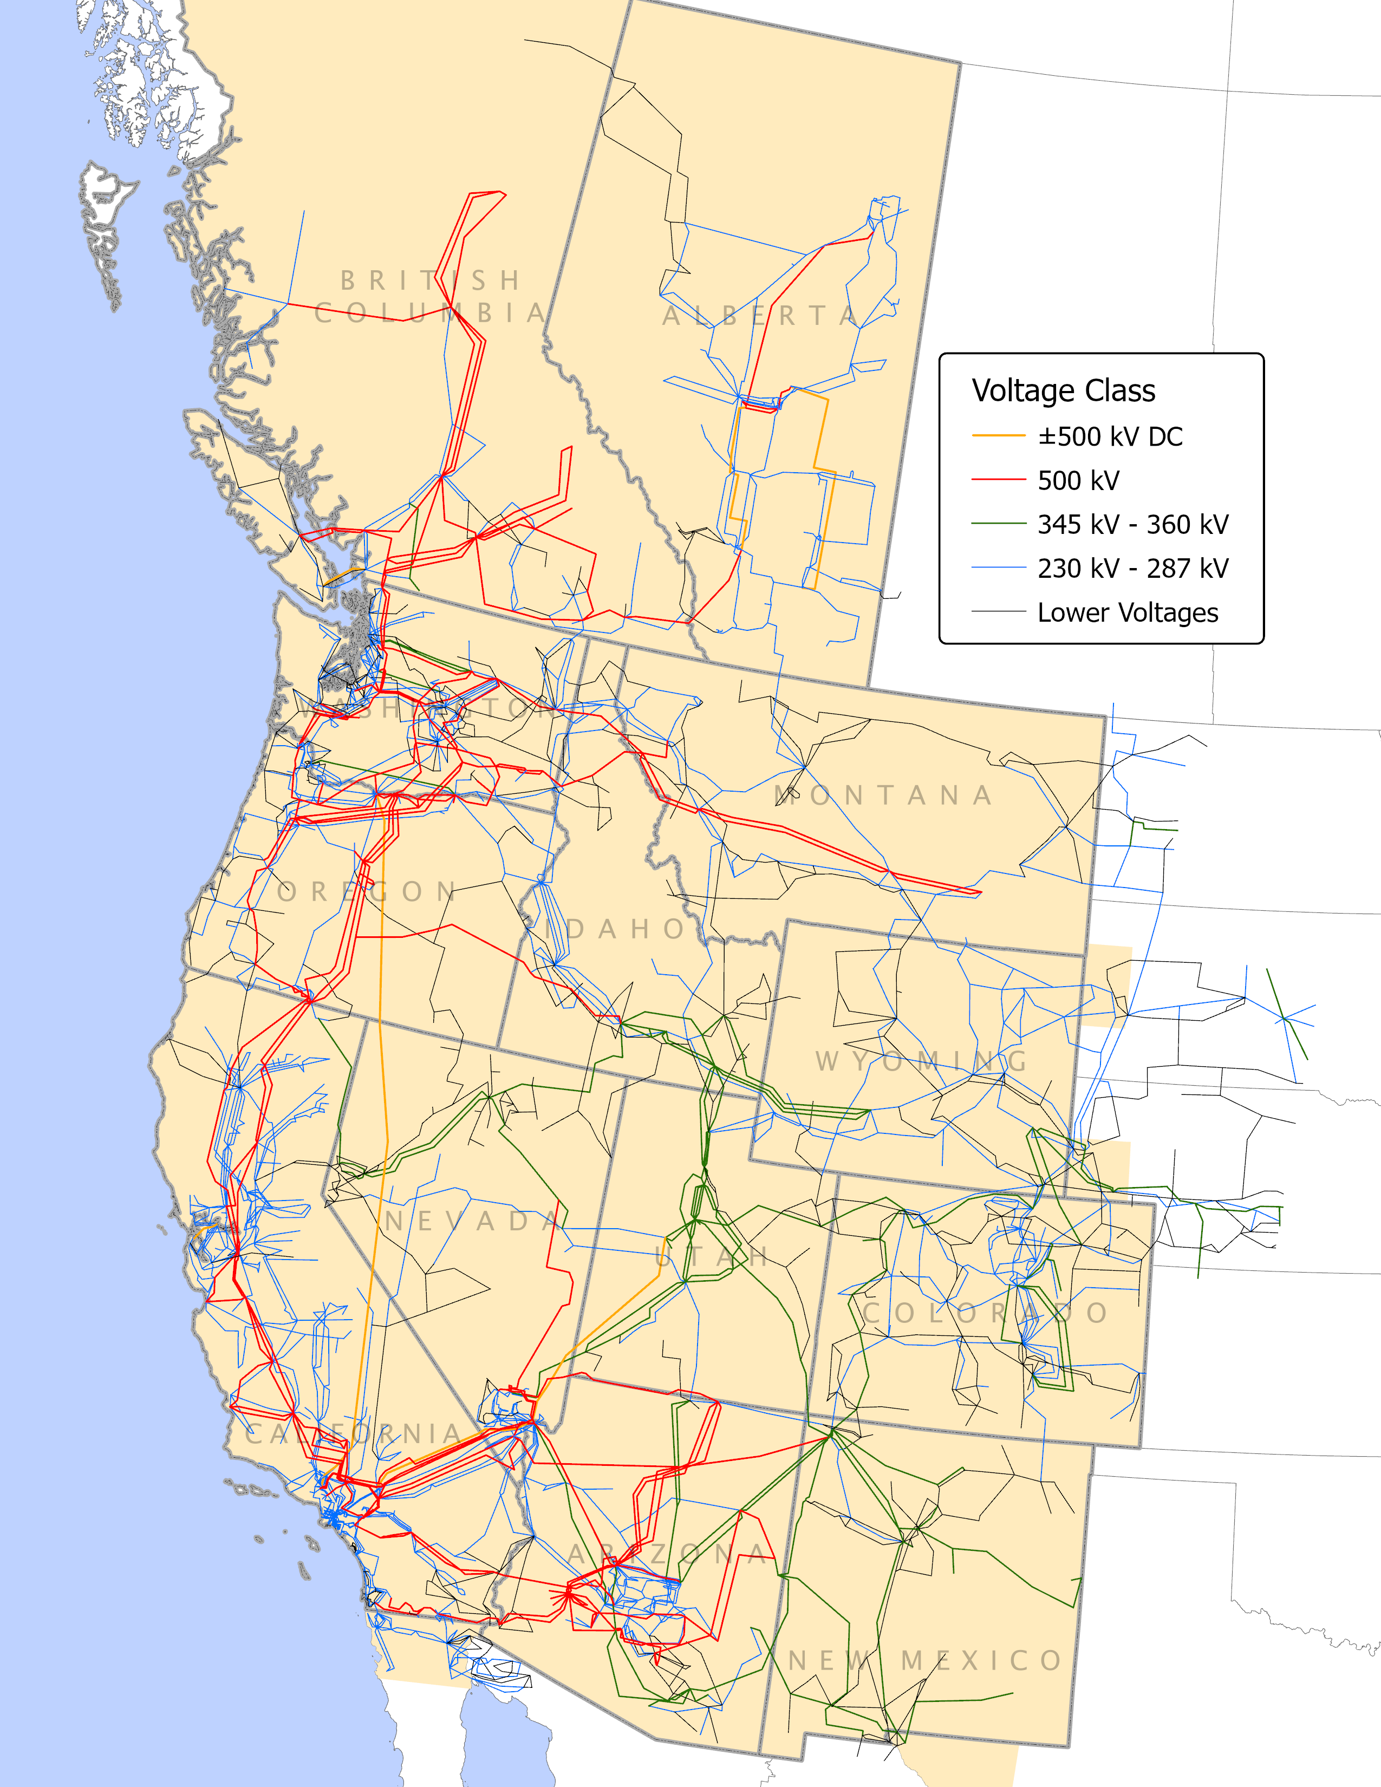
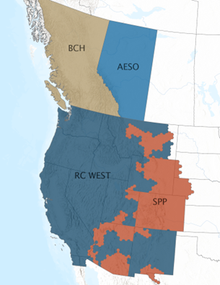
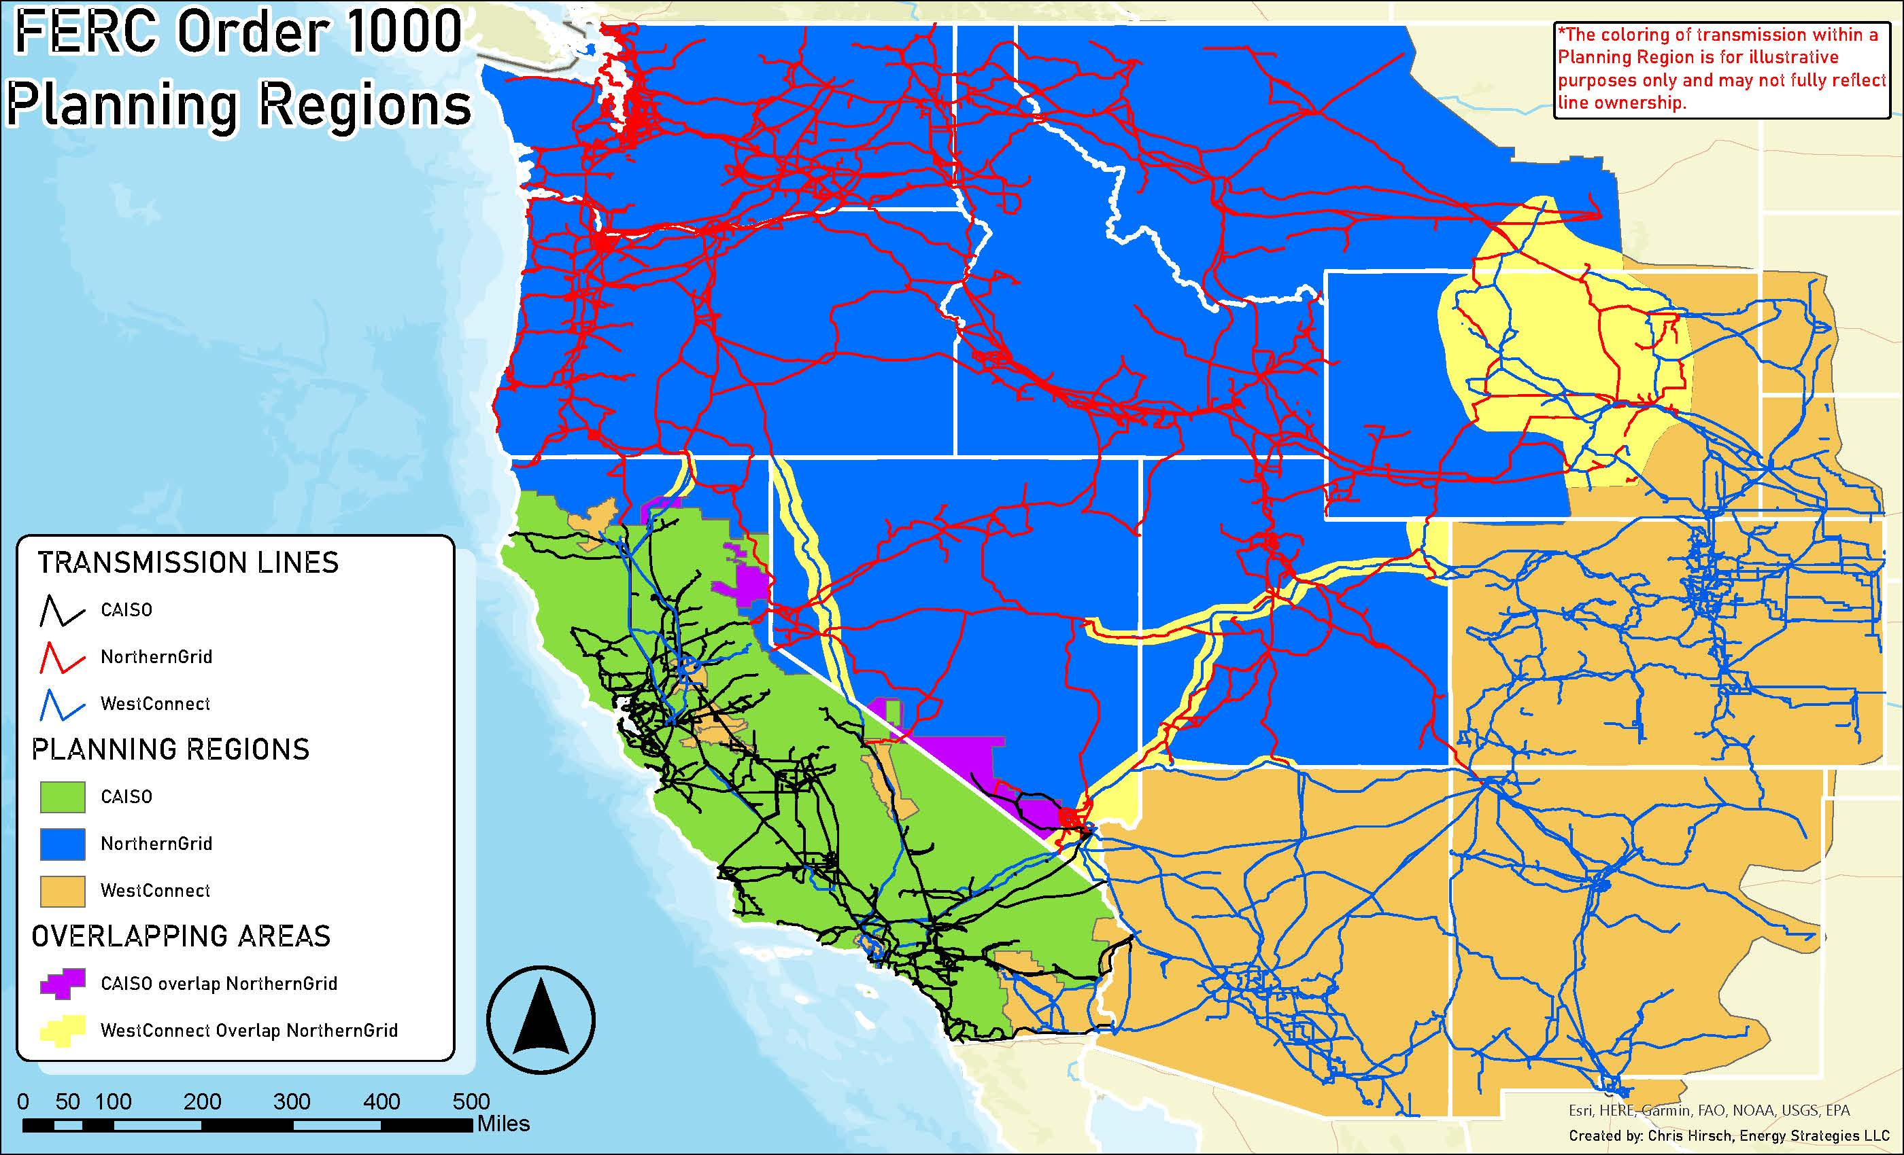
Background: Transmission and Reliability
Transmission and reliability functions are divided up differently than in the Eastern Interconnection.
Multiple transmission planning regions with interspersed territory. No regional transmission projects have been built.
Western Transmission Expansion Coalition (WestTEC):
Industry led
Inclusive stakeholder process
West-wide 20 yr transmission study (not a FERC process)
(See “program” tab on westernpowerpool.org)
WECC is the Regional Entity (RE) with NERC-delegated authority but also carries out other functions like developing the anchor data set used by the Regional Transmission Planning Groups and other studies.
Multiple Reliability Coordinators with overlapping territory.

Slide 4
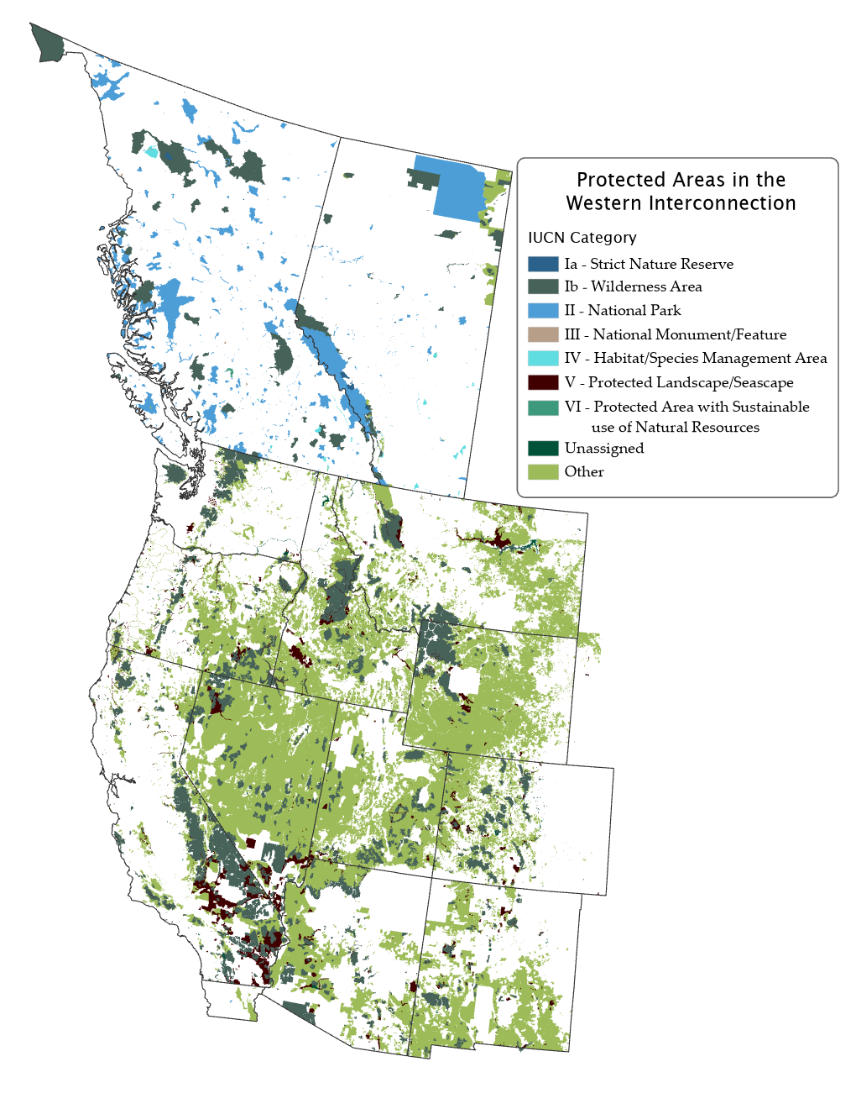
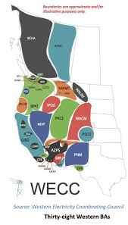
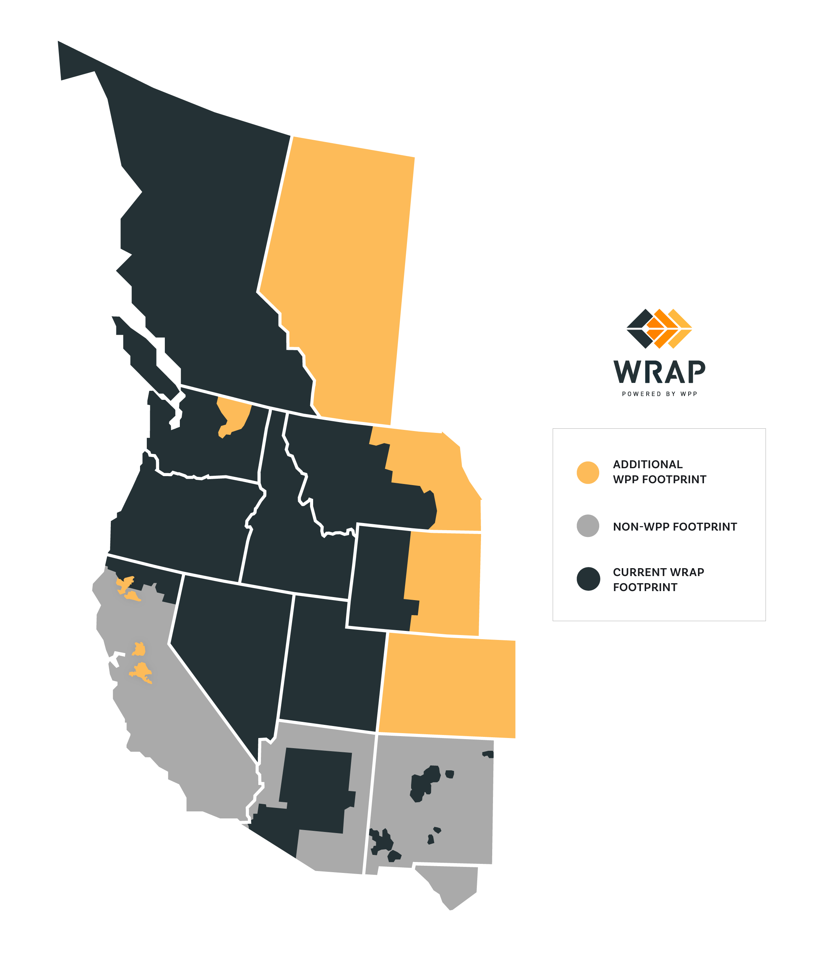
Other Interesting Differences about the West
Nearly 87% of the Western Interconnection is public or protected land, compared to just 27% in the combined Eastern, Texas, and Quebec interconnections.
WRAP (Western Resource Adequacy Program) is a voluntary program formed by utilities, with a FERC-approved tariff and a relatively robust stakeholder process.
There are 38 Balancing Authorities in the Western Interconnection.

Slide 5
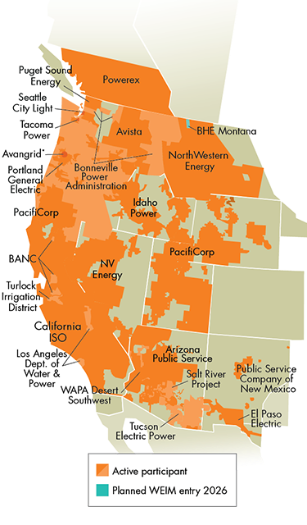
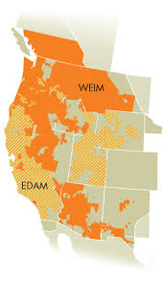
Background: WEIM and EDAM (CAISO operated)
Pathways Initiative:
Initiated by group of state regulators & energy officials
stakeholder driven
Goal: to explore governance changes that could overcome independence concerns about expansion of CAISO markets and promote a possible West-wide regional organization.
CAISO runs a real-time energy imbalance market (Western EIM, or WEIM) which covers a large portion of the Western Interconnection. Some of these companies are exploring different options for day-ahead markets currently under development.
Only CAISO and PacifiCorp have signed participation in the day-ahead market proposed by CAISO (EDAM.) Other utilities have given an indication of their preference to join the EDAM: Balancing Authority of Northern California, Los Angeles Department of Water and Power, Portland General Electric, and NV Energy.

Slide 6
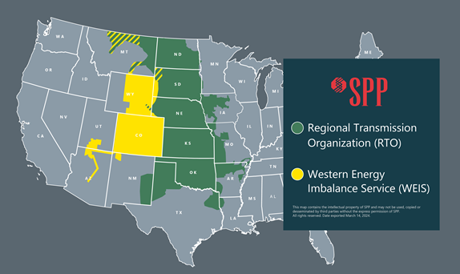
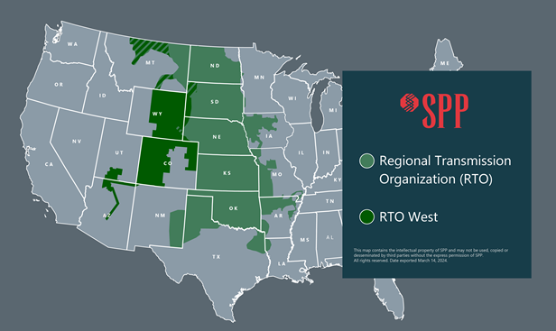
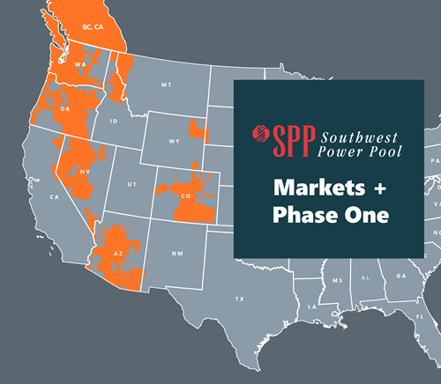
Background: SPP-operated markets/RTO
SPP began managing the Western Energy Imbalance Service (WEIS) market in February 2021. The participants are primarily public and cooperative power companies, with the addition of Xcel Energy in 2023.
Some utilities, primarily public and cooperative power, are evaluating the benefits of placing western facilities under the terms and conditions of SPP's Open Access Transmission Tariff.
Utilities exploring a different day-ahead market (Markets+) run by SPP. Many already participate in the WEIM run by CAISO.

Slide 7
Gridworks Project Introduction and Team
Led by Gridworks, who facilitated the monthly discussions over the course of about nine months and were the primary authors of most sections of the study.
Consumer advocates:
  Matt Baker, California Public Advocates Office
  (until he was sworn in as a Public Service Commissioner, then Julie Halligan helped finalize the project)
  Michele Beck, Utah Office of Consumer Services
  Joseph Pereira, Colorado Office of the Utility Consumer Advocate
  Jaime Stamatson, Montana Consumer Counsel
GridWorks team:
  Jeff Ackermann, Senior Fellow
  Cathy Boies, Director
  Mike Florio, Senior Fellow
  Claire Halbrook, Director
  Sarina Soor, Senior Project Manager

Slide 8
Key Aspects of the Publication
Explanation and history of the key role played by utility consumer advocates
“Call to action” cites how promises of markets have often gone unrealized leading consumer advocates to now call for a cautious approach that maintains focus on the public interest as well as consumer benefits and protections.
“Needed Outcomes and Consumer Protections” lays out six principles which together form the position statement of the consumer advocates regarding basic elements that must be in place for regional organizations.
Note: Regional Organizations are intentionally vaguely defined given the current nature of electric regionalization development in the West.

Slide 9
Needed Outcomes and Consumer Protections
Expand the unique purpose and function of consumer advocacy to the regional level
No net increase in retail electricity rates/bills for residential/small commercial consumers as a result of utility participation in a Regional Organization. In simplest terms: “Do No Harm!”
Strong Market Oversight; Data Access and Transparency
Fair and Transparent Decision-Making
Adopt Established Good Governance Principles
States Retain Resource Planning and Retail Rate Authority

Slide 10
What Next?
Letter of support from Western Consumer Advocates
Consider how to create adequate resources to keep consumer advocates relevant in the multiple regionalization discussions
Collaboration with other sectors to find common priorities
Explore incremental regionalization development that brings benefits to consumers without mandating all elements of an RTO
For a copy of the full document, please see gridworks.org/publications

