Slide 1
Decarbonizing the Natural Gas System Meta-Analysis of U.S. Economy-Wide Studies & Technology Solutions
Daniel S. LeFevers, Director State & Consumer Programs
GTI Energy
dlefevers@gti.energy

Slide 2

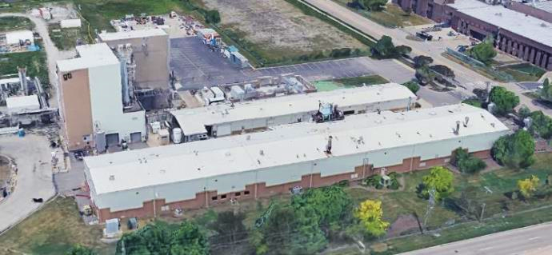




We are a Top Workplace
500
Enterprise Employees
World-class piloting facility in Chicago area
Notes:
Independent, not-for-profit established by the natural gas industry
GTI Energy tackles tough energy challenges turning raw technology into practical solutions
Downhole to the burner tip including energy conversion technologies

Slide 3




Working across the energy value chain
Source
Make
Move & Store
Use
Expanding supplies of affordable, clean energy
Subsurface production of hydrogen
Enhanced geothermal systems
Unconventional natural gas and oil production
Geologic modeling and reservoir characterization
Hydraulic fracturing diagnostics and optimization
Hydraulic fracturing and reservoir flow modelling
Enhanced recovery
Transforming natural resources into clean energy
Hydrogen production
Integrated biofuels technology R&D
Syngas generation and processing
Carbon management
CO₂ capture and utilization
Chemical research and process development
Renewable natural gas and gas quality
Gasification process development
Ensuring safe and reliable energy infrastructure
Methane emissions, monitoring, mitigation, and reduction
Data integrity and risk management
Infrastructure rehabilitation and improvements
Environmental matters, enabling renewable gas, and gas quality
Smart utility information technology tools
Materials and analytical testing
CO₂, H₂, and natural gas underground storage
Delivering solutions for efficient and environmentally responsible energy use
Residential/commercial appliances, equipment, and building systems
Industrial process heat and steam
Power generation and combined heat and power
Alternative transportation fuels
Natural gas-solar thermal hybrid equipment
CO₂ capture and utilization

Slide 4












GTI Energy’s Excellence in Collaborations

Slide 5
Meta NZ Study
5
independent,
economy-wide
studies
Meta-Analysis of Leading U.S. Economy-Wide, Net-Zero Studies
1. Low Carbon Resources Initiative (EPRI, GTI Energy)
2. Open Energy Outlook (Carnegie Mellon University, NC State)
3. Evolved Energy Research
4. Princeton University
5. Decarb America (Bipartisan Policy Center, Clean Air Task Force, Third Way)
ALL scenarios achieve net-zero by leveraging:
Low-carbon fuels
Expanded electrification
Renewable energy
Pipeline gas
Existing infrastructure
23
scenarios for
least cost paths
to net-zero
full report available at: gti.energy/meta-nz/
Notes:
In this study, we set out to look at everything that has been published on US economy-wide, net-zero analyses
It has only been in the last few years that studies have been performed to evaluate both economy-wide AND net-zero
The 5 studies listed here are “the” 5 leading studies on this topic – most comprehensive and granular to date
Across these 5 independent studies, there are 23 different net-zero scenarios
Each of these scenarios evaluates least-cost pathways to achieve net-zero greenhouse gas emissions across the entire U.S. economy
These 5 independent studies represent a broad array of perspectives, assumptions, and analytical frameworks
We collaborated with the authors of each of these 5 studies to pull together a like-for-like comparison of results
What we find is a variety of solutions and pathways to get to net-zero – there is no single design for net-zero energy systems
And, we also find that across these 5 independent studies there are some common and consistent findings
…pipeline gas, low-carbon fuels, and existing infrastructure are used in all 23 net-zero scenarios
This is not near-term decarbonization. This is not partial emissions reduction. This is economy-wide, net-zero.
…and with that, these studies consistently point to the enduring role of pipeline gas,

Slide 6
The Enduring Role of Fuels in Net-Zero Systems
2050 End-Use Energy Consumption by Scenario (% of EJ)
Pipeline
Gas
100%
90%
80%
70%
60%
50%
40%
30%
20%
10%
0%
~60%
of energy consumed
in net-zero scenarios
is underpinned
by fuels
1 2 3 4 5 6 7 8 9 10 11 12 13 14 15 16 17 18 19 20 21 22 23
U.S. Net Zero Scenarios
fuels include natural gas, RNG, SNG, hydrogen, ammonia, petroleum-derived fuels, biofuels, synthetic fuels, ammonia, biomass, coal and nuclear
Notes:
Electricity accounts for roughly half of final end-use energy across net-zero systems
that’s a considerable increase from where we’re at today – yes, electricity
[CLICK 1 – chart builds fuels]
And, fuels continue to have play a central role in net-zero energy systems
fuels deliver the other half of all final energy to end-use customers – yes, fuels
And that’s not all, a portion of the electricity at net-zero will still be generated by fuels
[CLICK 2 – chart adds hashed bar segments]
And, fuels continue to play a key role in power generation
When accounting for fuels-based electricity fuels underpin roughly 60% of all final energy in net-zero energy system
Fuels are ubiquitous today, and they continue to be ubiquitous in net-zero energy systems
And, pipeline gas continues to have an enduring role in delivering energy to customers in net-zero systems
[CLICK 3 – reveals pipeline gas bar segments]
Pipeline gas is used in EVERY net zero scenario
…used for electricity generation, industry, and buildings in all 23 scenarios
Pipeline gas is used, even in scenarios where fossil fuels (natural gas) are explicitly excluded
…in such scenarios pipeline gas entirely comprised of low-carbon molecules
…in all scenarios, there is some level of blending of low-carbon gases into the pipeline gas supply
And, while the consumption of pipeline gas declines in most net-zero scenarios, the throughput capacity of gas used remains relatively high
…in these net-zero systems, gas continues to be used to meet peak demands (peak electricity, peak building heating)
Pipeline gas and its infrastructure have a central role in these net-zero systems
…this isn’t necessarily the talking point that gets highlighted from these studies
…but it’s a consistent finding across 5 independent studies and 23 different net-zero scenarios

Slide 7

Pipeline Gas in Net-Zero Energy Systems
low-carbon molecules are blended into the gas supply in every net-zero scenario
carbon capture and sequestration is coupled with gas-fired activities to abate emissions
carbon dioxide removal is leveraged to balance remaining positive emissions
Notes:
To fully leverage this infrastructure, we need to move beyond business-as-usual
When we look across these net-zero scenarios, there are a few key elements that drive the use of pipeline gas
One. Low-carbon molecules are blended into the gas supply in every net-zero scenario
(discuss RNG, SNG, and H2)
Two. Carbon capture and sequestration are leveraged to abate emissions from gas-fired activities.
There’s a direct correlation in these studies between the level of natural gas use and the level of CCS deployed
Three. Carbon dioxide removal is used to balance remaining positive emissions from costly-to-abate activities in all net-zero scenarios.
(discuss carbon dioxide removal)
These negative emissions flows allow for unabated use of natural gas (i.e. for buildings space heating)
The more these approaches are deployed, the greater the role of pipeline gas in net-zero energy systems

Slide 8
Why Pipeline Gas?
Infrastructure
today, gas underpins one third of total U.S. final end-use energy consumption
gas storage capacity capable of meeting
average U.S. demand for 8 weeks
3 million miles of gas pipelines
Notes:
Why does pipeline gas continue to have an enduring role in these net-zero energy systems? → INFRASTRUCTURE
Its certainly true that the U.S. has large reserves of low-cost natural gas
…and those resources are indeed leveraged in many net-zero scenarios…
But a major part of why pipeline gas is consistently leveraged in net-zero scenarios is because of the value of our existing infrastructure
Today, this infrastructure accounts for delivery of over 1/3 of all energy delivered to end-use customers in the U.S.
…that’s both the gas delivered directly to end use customers as well as the gas used for gas-fired power generation
And, we have VAST storage capacity – enough storage capacity to meet average U.S. demand for 8 weeks
…we’re talking about enough storage to deliver 1/3 of all end-use energy for 8 weeks – that’s jaw-droppingly large
…if we stopped producing any gas today, we could continue operate gas power plants, fuel industrial processes, and heat homes for 2 months
We also have 3 million miles of gas pipelines
…they provide long distance energy transport, direct to customer delivery…
…and the ability to reliably, and cost-effectively meet peak energy demands
These assets are consistently leveraged as part of least-cost pathways to reach net-zero emissions in these economy-wide studies

Slide 9
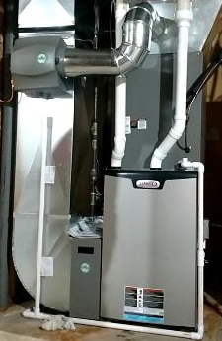
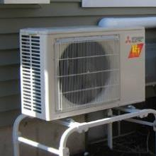


Residential Space and Water Heating: Hybrid or Dual Fuel Heat Pumps
“Hybrid” space conditioning systems
1. Replace conventional air conditioner with electric heat pump (electric EE programs)
2. Retain/use high-efficiency gas furnace as appropriate (natural gas EE programs)
3. Smart thermostat chooses electric or gas space heating depending on outdoor temperature, operating cost, or other factors
“Hybrid” space conditioning systems create opportunities for consumers to improve efficiency and reduce costs and emissions.
Notes:
Now, we’ll transition to technologies that can help us realize a net zero future.
One great solution that is ready today is hybrid heat pumps.
A hybrid or dual fuel heat pump pairs an electric heat pump with a gas furnace.
A very cost effective and scalable solution to decarbonizing buildings is to replace your air conditioner with a heat pump that can cool and heat, while retaining your gas furnace.
Your thermostat can switch between systems based on system capacity, outdoor air temperature, operating cost, or even carbon
GTI Energy is currently testing a hybrid system in our Chicago area lab. When a call for heating is made, the thermostat selects the furnace or heat pump based on carbon emissions- utilizing RMI’s WattTime that tracks actual emissions of the local electric grid.
- In the net zero studies that included hybrid systems, they are widely adopted because of their low first cost, operating cost, and decarbonization potential.

Slide 10
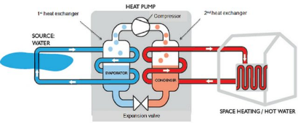
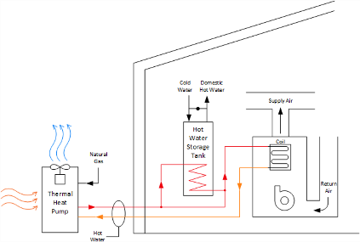
Residential Space and Water Heating: Gas Heat Pumps
10
Electric Drive Energy
OR
Gas Drive Energy
What is a Gas Heat Pump?
Just like an electric heat pump, it sits outside and extracts heat from the outside air.
The difference, it uses heat instead of an electric compressor to drive process
Why do we need Gas Heat Pumps?
Best-in-class operating efficiency
Condensing furnace is 95-98 AFUE vs GHP is 140 AFUE
GTI Energy field demos showed 33-46% therm savings (space and water heat)
Systems operate during the coldest days, meeting the heating load without back-up resistance heating
Commonly use natural refrigerants with low/no GWP
30-50% reduction in operating GHG emissions, with combustion outside
Typical Residential Installation
Image Source: Ninikas, Konstantinos & Hytiris, N & Emmanuel, R & Aaen, Bjorn & McMillan, S. (2014). A renewable heat solution for water ingress in the Glasgow subway tunnel system. 161-171. 10.2495/ESUS140141.
Notes:
GHPs are another important solution for decarbonizing residential space heating
What is a Gas Heat Pump?
Just like an electric heat pump, it sits outside and extracts heat from the outside air.
The difference, it uses heat instead of an electric compressor to drive the heat pump process
Why do we need Gas Heat Pumps?
Best-in-class operating efficiency
Condensing furnace is 95-98 AFUE vs GHP is 140 AFUE
GTI Energy field demos showed 33-46% therm savings (space and water heat)
Systems operate during the coldest days, meeting the heating load without back-up resistance heating
Commonly use natural refrigerants with low/no GWP
30-50% reduction in operating GHG emissions, with combustion outside
After years of research and development, residential gas heat pumps are hitting the market. With roughly 40% reduction in emissions and energy, GHPs can support significant decarb in the residential sector. GTI is working across the US and Canada to support deployment. We have demonstrations planned across Chicago and Chicagoland.

Slide 11



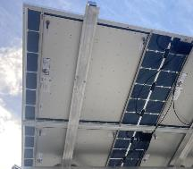
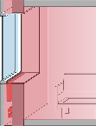
Building Space Conditioning Energy Use: Envelopes
Skinny R30 Wall Retrofit Systems - InSoFast
(NYSERDA, UTD, NEEA)
Taking existing commercialized ICF panel and fabricating with R-50 VIP inserts for area-weighted R30 in 3.5" thick retrofit
Advancing from feasibility testing to prototype development; demonstration in NY planned late 2024
Comm-INDOWS
Advanced secondary window system (SWS) (CEC, NEEA, SoCalGas)
Targeting commercial buildings
Laboratory testing with field validation
Triple-pane, aerogel, and vacuum glass options
Alpen, Inovues, AeroShield, V-Glass, LBNL
Robotics in Deep Energy Retrofits
NYSERDA, National Fuel
Increase cost-effectiveness with robotics
Reduce time for panelized retrofits
USACE – Advanced Glazing Systems
Evaluating commercialized products working with Alpen and Inovues
Testing both double-pane and vacuum glass
Solar Cogeneration
Solar thermal behind PV (PVT)
Heat sink improves kWh generation (perhaps ~5% / yr)
PVT + heat pumps can assist cold-climate capacity
Capable of nighttime heat rejection for cooling savings
Integrated Envelope+Mech - Hydronic Shell
Water-based heat/cooling/vent
Paired with rooftop A2W heat pump
Non-invasive install w/ R30 wall retrofit
Notes:
According to the EIA, over 50% of residential energy consumption in Illinois serves space conditioning loads. While not as high, space conditioning also makes up a significant portion of commercial building energy use
More than 20% of US house-holds face hardships due to high energy costs
Upgrading envelopes is one of the most effective ways to improve comfort and reduce HVAC energy use
Building envelope retrofits coupled with basic HVAC and other EE measures can reduce building energy use by 50% or more.
High performance envelope solutions are available but are lacking implementation. GTI’s growing portfolio of building envelope work includes wall systems and glazing with several IL based demonstration projects. Our focus is on reducing complexity and cost, in particular labor costs, which make up the majority of building envelope retrofit project costs

Slide 12
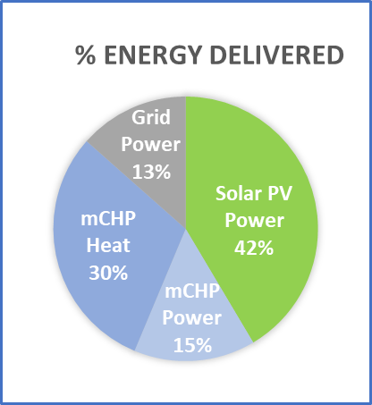
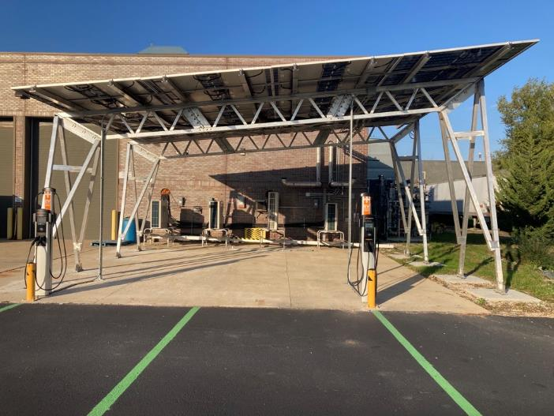

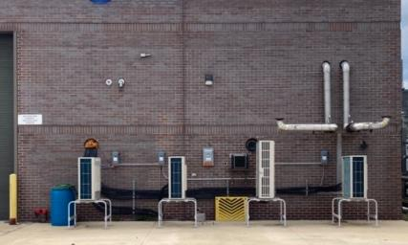
Whole Building Integrated Solutions: GTI Energy’s Microgrid Test Bed
Solar PV
Solar Thermal
Cold-climate ASHPs
EV Charging
Notes:
At our Chicago area lab, GTI’s microgrid test bed has realized deep carbon emission reductions through the integration of on-site renewables, batteries, fuel-fired CHP, and efficient cold climate HPs.
This solution, among others, offers a pathway to building decarbonization with built-in resiliency through complimentary distributed generation assets. Solutions like this will be increasingly important as we move from fixed to variable electricity sources like wind and solar. Buildings that can respond to grid signals, be it demand or available renewable generation, will be increasingly important to realizing a more cost-effective decarbonized electric grid.

Slide 13
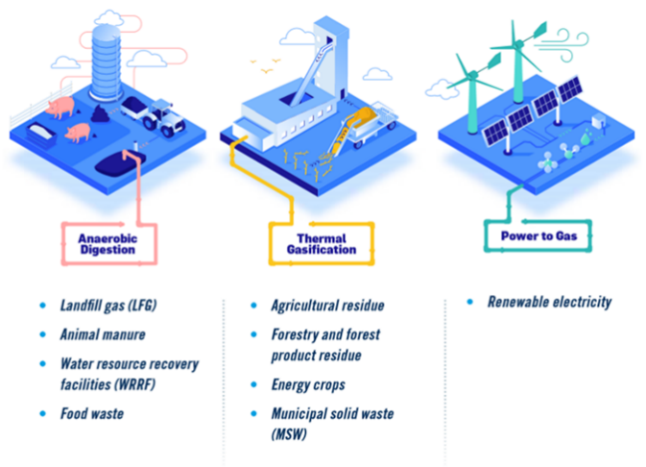
Decarbonizing Pipeline Gas
Using Renewable Gas or Clean Hydrogen
RNG and clean hydrogen can have carbon intensities (CI’s) that are low, zero or negative depending on production process and feedstocks
Renewable gases can be used to decarbonize gas space heating or gas power generation and production processes can be coupled with CO2 sequestration to achieve negative CI’s
Notes:
As we reduce gas use through improved building systems, and ramp up clean fuel development, we can rapidly accelerate the decarbonization of our pipeline gas.
RNG and clean hydrogen can have carbon intensities (CI’s) that are low, zero or negative depending on production process and feedstocks.

Slide 14
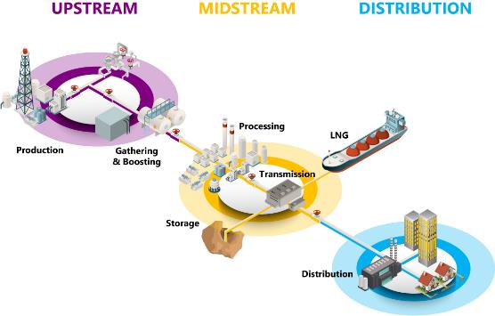
Veritas: Measurement to Reduce Methane Emissions
Veritas has four Technical Protocols
Measurement & Reconciliation: Describe how to take measurements and reconcile emission-factor inventories with actual measurements
Methane Emissions Intensity: Define methane intensities
Value Chain Summation: Add multiple segments to reach a total emissions intensity
Assurance: Provide guidance for verifying emissions inventory
Veritas covers six segments of the natural gas supply chain:
https://veritas.gti.energy/
Notes:
As methane has a higher GWP than CO2, addressing its emissions are important. The industry has ramped up its efforts to reduce methane emissions. Accurate measurement of methane emissions is the first step toward effective, credible reductions. GTI’s Energy’s Veritas’ provides companies and countries with methane emission reduction targets with a credible, consistent, verifiable, and transparent methodology to measuring methane emissions.

Slide 15
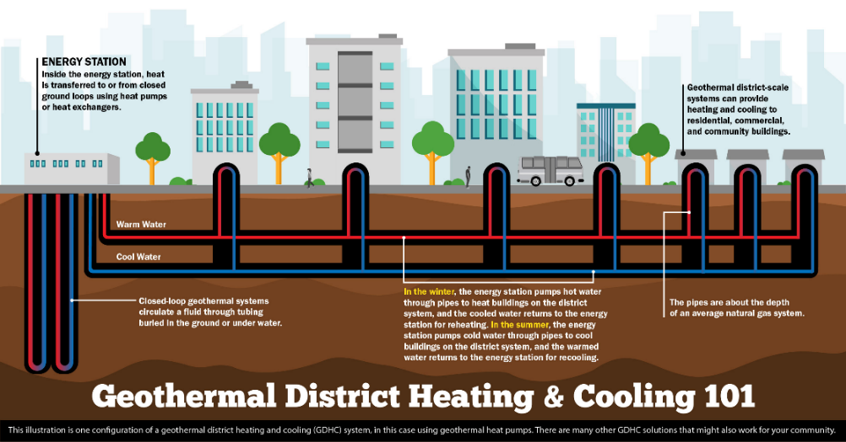
What is Network Geothermal?
Source: U.S. DOE
Notes:
As HEET highlighted, network geothermal is a compelling opportunity to decarbonize thermal energy loads without burdening the grid with additional peak loads. In cooperation with HEET, GTI is leading a DOE project with a Vermont utility as they explore new business models to serve their new and existing customers as a thermal utility.

Slide 16
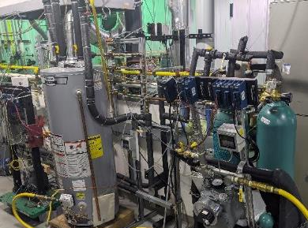
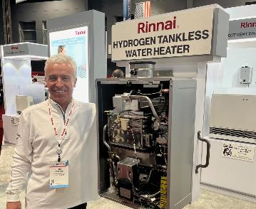
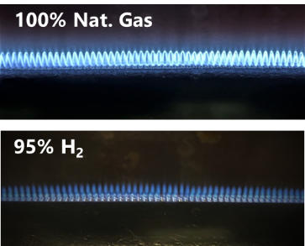
Hydrogen Pathways for Gas Decarbonization
Centralized Hydrogen Production
Dist. H₂ Generation
Blending into Current Grid
Convert to Hydrogen Dist.
Hydrogen Microgrids
How do H₂/NG blends impact existing customer gas assets and gas-fired equipment?
How can we assure that new gas equipment and retrofits are hydrogen-ready?
How do we design and prepare for hydrogen fuel-flexible systems?
Studying the blended hydrogen safety/efficiency/emissions impacts
RD&D/Tech Transfer with equipment and sensors for hydrogen end use
Developing and demonstrating fuel-flexible combustion/CHP systems
Notes:
H2 is a compelling solution because it can be a direct replacement for liquid and gaseous fuels and can be made with no or little carbon.
GTI’s research is helping to ensure its use in any application is safe and reliable. We’re investigating effects on equipment and testing pipeline materials.
And we’ve been here before- Our gas system was originally fed with town gas, which was roughly 50% H2. We’ve transitioned before, and without the aid of today’s technology and knowledge.

Slide 17




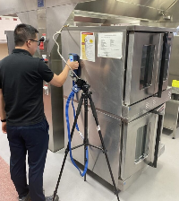
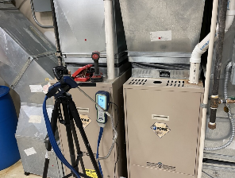
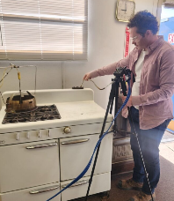








Hydrogen Economy – Utility Investments
RNG/Biomethane, Bio-LPG, available in many markets to reduce GHG emissions
SNG/E-methane projects underway, H₂ with captured CO₂
Numerous States/Provinces have one or more H₂/NG blending demo projects in planning/underway
Several involving 100s – 1,000s of utility customers
H₂ distribution projects are ramping up in US/Canada
Many North American natural gas companies have active H2 demo projects
GTI Energy H₂ Blending Field R&D
Notes:
Utilities and governments are investing to advance the development and use of clean H2.

Slide 18
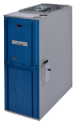



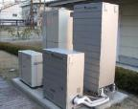



Buildings – Project Portfolio by GHG Savings
Near-Term (25-50+%)
Expanded use of high-efficiency gas equipment
Hybrid natural gas furnace/ boilers and electric heat pump systems
Next-Gen (40-60+%)
Heat pumps for space & water heating
Micro CHP systems
Renewables (Added 10-30%)
Building envelope improvement
Renewable gas blends (bio-methane, hydrogen)
Solar thermal/natural gas space & water heating systems
Deep building retrofits
Lower Methane Emissions (5-10%)
Reducing full-cycle natural gas methane emissions
Notes:
Deploying higher efficiency technologies, optimized building envelopes and systems coupled with lower carbon gases and electricity will lead to net zero buildings.
GTI Energy’s research is covering the waterfront of decarbonization. We’re deploying better technologies today, developing next gen technologies for tomorrow, and supporting the development and integration of renewable fuels and electricity as well as enabling industry-wide methane emission reductions.

Slide 19
Summary
Meta NZ analysis shows gases and fuels will be used in 2050 net zero scenarios
Natural gas is a very large portion of our nation’s energy mix
All decarbonization solutions have costs
Which ones will be most cost effective in short, medium and long term?
Continued analysis and R&D needed
Decarbonization opportunities
Hybrid natural gas/electric space heating systems
Thermal heat pumps
Building envelope & deep EE retrofits
Micro CHP – onsite renewables and power
Decarbonizing pipeline gas (renewable gas, H₂, CO₂ capture)
Network or community geothermal
Reduction of upstream methane emissions
Notes:
In summary, our aim is to support the energy transition toward decarbonization in the most efficient, affordable, and equitable manner possible. Our research focuses on how to transition our existing electricity and gas system, built on fossil fuels, to one that is increasing fed by clean energy sources and more efficient end use processes.
We would welcome an opportunity to do a deeper dive into the decarbonization pathways discussed here today.

