Slide 1
Arizona’s Summer Shutoff Moratorium
Erin Ford Faulhaber
Deputy Director
Residential Utility Consumer Office
NASUCA Consumer Protection Panel
June 2024

Slide 2
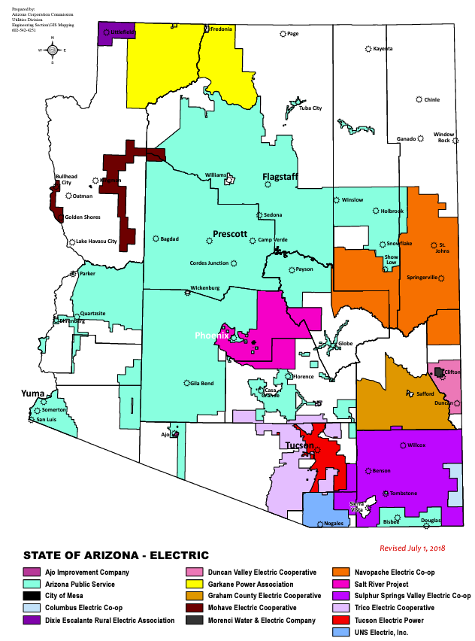
RUCO and Arizona Utility Landscape
RUCO was established by the Legislature in 1983 to represent residential ratepayers in rate and policy proceedings before the Arizona Corporation Commission (ACC).
In 2019, the ACC adopted a moratorium on summer electric shutoffs for residential customers.
The moratorium runs from June 1st to October 15th each year.

Slide 3
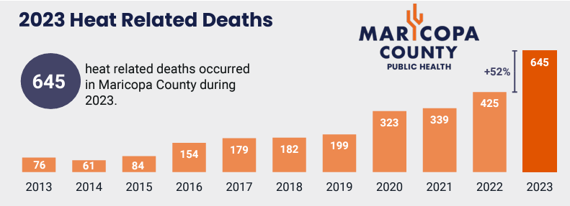
Why consider a moratorium?
Last summer, Phoenix had 54 days of Excessive Heat Warnings, or days above 110° F.
  July 2023: 31 straight days over 110° F.

Slide 4
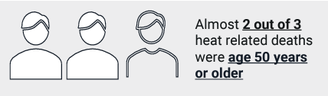
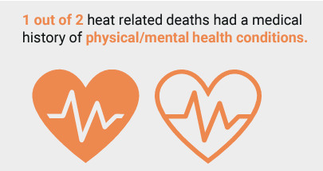
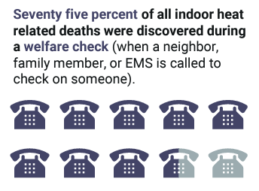
What was the catalyst?
September 2018
A 72 year old woman dies in her home in a west Phoenix retirement community after her power was cut off by APS over a $51 arrearage. The temperature outside was 107° F.
Year | Total Heat Deaths | Indoor Heat Deaths | Percentage Indoor
2014 | 61 | 17 | 28%
2015 | 84 | 33 | 39%
2016 | 154 | 60 | 39%
2017 | 179 | 71 | 40%
2018 | 182 | 51 | 28%

Slide 5
How did the ACC address the issue?
The Commission issued an emergency moratorium for the 2019 summer and proceeded with rulemaking.
  Structure of the moratorium;
  Termination procedures including notice and deferred payment plans;
  Customer third party designee;
  Waiver of late fees and interest;
  Raising the arrearage threshold for shutoff from $25 to $300;
  Reporting requirements.
Year | Indoor Heat Deaths with A/C
 | Broken A/C | A/C Off | No Electricity
2014 | 5 | 2 | 1
2015 | 14 | 7 | 2
2016 | 32 | 11 | 5
2017 | 34 | 16 | 1
2018 | 30 | 6 | 3

Slide 6
The Moratorium on Electric Shutoffs
The Arizona Administrative Code gives utilities two options for termination of service:
  A utility shall adopt only one of the following conditions under which it shall not terminate residential service:
  a. During any period of time for which the local weather forecast, as predicted by the National Weather Service, indicates that the weather in the area of the customer’s service address:
  i. Will include temperatures that do not exceed 32° F;
  ii. Will include temperatures that exceed 95° F; or
  iii. Will include other weather conditions that the Commission has determined, by order, are especially dangerous to health; or
  b. During the calendar days of June 1 through October 15 of each year, which shall be specified as non-termination dates in a utility’s tariffs.
A.A.C. R14-2-211(A)(11).

Slide 7
Is the moratorium working?
Health Impacts
Year | Indoor Heat Deaths with A/C
 | Broken A/C | A/C Off | No Electricity
2019 | 38 | 4 | 2
2020 | 28 | 12 | 0
2021 | 52 | 13 | 2
2022 | 51 | 10 | 3
2023 | 117 | 17 | 4
Percentage of indoor deaths are down overall by 5 to 15% each year.
Year | Total Heat Deaths | Indoor Heat Deaths | Percentage Indoor
2019 | 197 | 48 | 24%
2020 | 323 | 49 | 15%
2021 | 339 | 82 | 25%
2022 | 425 | 86 | 20%
2023 | 645 | 156 | 25%
No clear change in the deaths associated with no electricity.

Slide 8
Is the moratorium working?
Financial Impacts
APS Bad Debt Expense (2010 to Date)
Rate Case Docket | Allowed in Rates
E-01345A-11-0224 | $6.8M
E-01345A-16-0036 | $4.1M
E-01345A-19-0236 | $14.7M
E-01345A-22-0144 | $18.9M

Slide 9
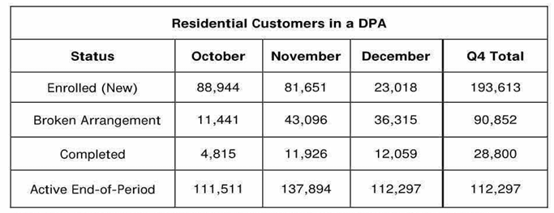
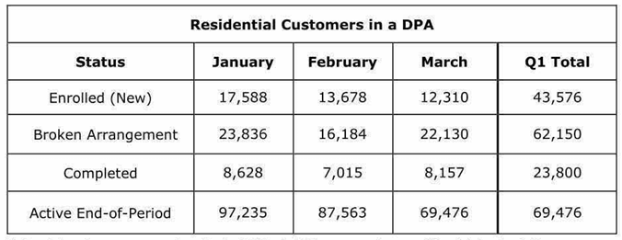
Is the moratorium working?
Deferred Payment Arrangements
APS Residential Deferred Payment Arrangements
October 2023 - March 2024

Slide 10
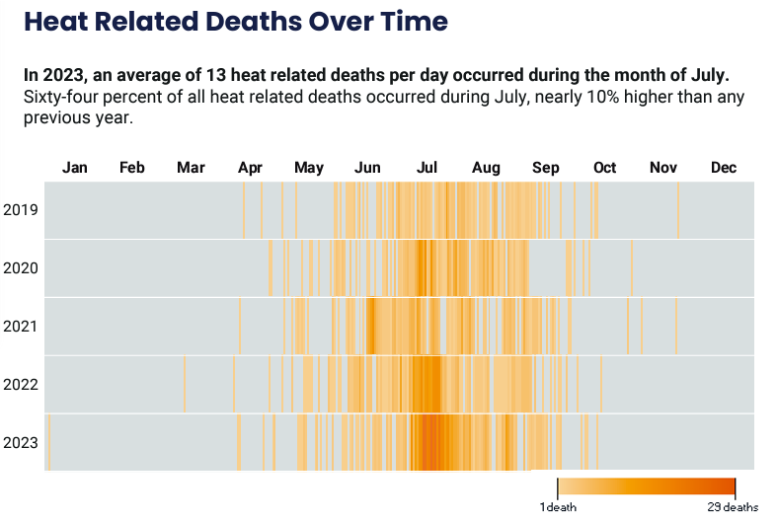
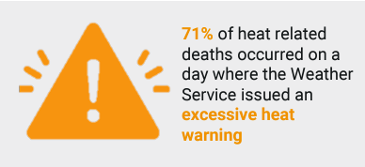
What are the ongoing concerns for RUCO?
Is the moratorium properly tailored?

Slide 11
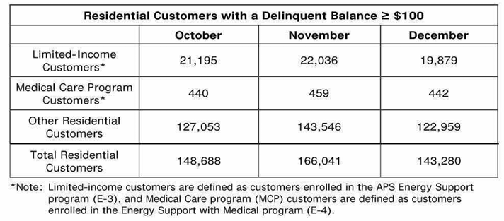
What are the ongoing concerns for RUCO?
Does the moratorium help or hurt affordability?
The average delinquent amount for an APS residential customer coming out of the 2023 moratorium was $648.00.

Slide 12
What are the ongoing concerns for RUCO?
Is the moratorium treating a symptom but not the disease?
  Limited Income Programs
  Weatherization
  A/C Repair and Replacement Incentives
  Third Party Designees
Year | Indoor Heat Deaths
 | Broken A/C | A/C Off | No A/C
2019 | 38 | 4 | 4
2020 | 28 | 12 | 9
2021 | 52 | 13 | 13
2022 | 51 | 10 | 21
2023 | 117 | 17 | 18

Slide 13
Thank you!

Slide 14
Citations
Arizona Administrative Code R14-2-210 through R14-2-212, R14-2-215
2023 Heat Related Deaths Report, Maricopa County, Department of Public Health, Division of Epidemiology and Informatics (April 2024).
  2014-2022 Heat Related Death Reports, Maricopa County, Department of Public Health, Division of Epidemiology and Informatics
  All Reports available at https://www.maricopa.gov/Archive.aspx?AMID=103
ACC Disconnection Docket E-00000A-19-0128 https://edocket.azcc.gov/search/docket-search/item-detail/22652
ACC Reporting Docket for Termination of Service Rules R14-2-215 https://edocket.azcc.gov/search/docket-search/item-detail/26308
  Statistics on past-due accounts, residential customer delinquency dollars, and payment plans.

