Slide 1

Emissions Reduction Potential of Certified and Renewable Natural Gas
Brad Cebulko, Partner
June 11, 2024

Slide 2
There is limited potential to decarbonize through CNG
Upstream emissions are a small proportion of natural gas wmissions
Source: EPA Inventory of U.S. Greenhouse Gas Emissions and Sinks: 1990-2022

Slide 3
It is difficult to measure and verify CNG emissions reductions
There are numerous bodies that provide certification, but no single industry-wide standard, scope, or framework
          Each entity has own quantification and verification method.
          Project Canary Trustwell, Equitable Origin EO100, MiQ, GTI Vertias
          Scope of emissions varies by entity (Scope 1, 1 & 2, or 1 – 3) as does certification eligibility time frame (1 – 3 years).
There is risk for cherry-picking
          Most certificates are for individual wells rather than the entire company gas production.
          There is an incentive for companies to only certify their top performing wells.
Unclear how the certification process will overlap with new EPA Standards
          It appears likely that 3rd parties will need to adjust their standards and grading mechanisms to maintain their role in promoting exceptional environmental practices beyond the new regulatory baseline.

Slide 4
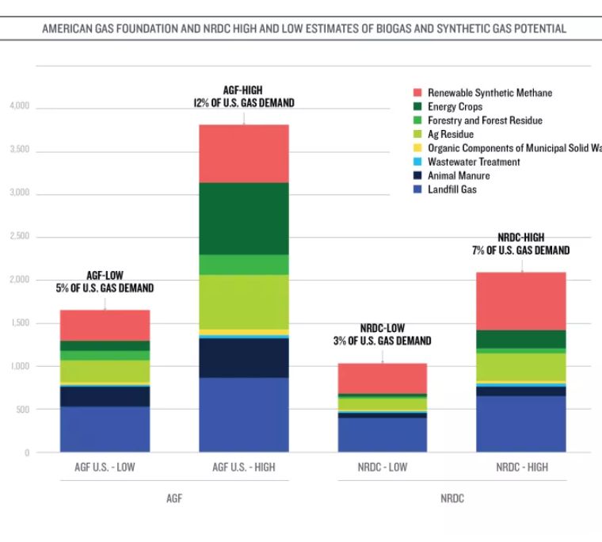
Renewable natural gas has limited technical and economic potential
Source: NRDC, “Renewable” Gas – A Pipe Dream or Climate Solution?” June 15, 2020. ICF “Renewable Sources of Natural Gas: Supply and Emissions Reduction Assessment” An American Gas Foundation Study Prepared by ICF. December 2019.

Slide 5

Synthetic methane and thermal gasification are not yet commercially available
Synthetic methane/Power-to-Gas (15 – 18% of potential) is not broadly commercially available nor cost-competitive
          Several assumptions need to fall into place to be cost-competitive
                Sufficient excess renewable energy to enable green hydrogen
                Green hydrogen production becomes cost competitive
                Carbon capture becomes cost competitive
                Methanization process becomes cost competitive
                Electricity prices are low
Thermal Gasification (25 – 38% of potential) is not broadly commercially available nor cost-competitive
          “Gasification process typically yields a residual tar, which can foul downstream equipment”
          Efficiency is around 60% - 65%
          Relatively few pilot projects

Slide 6
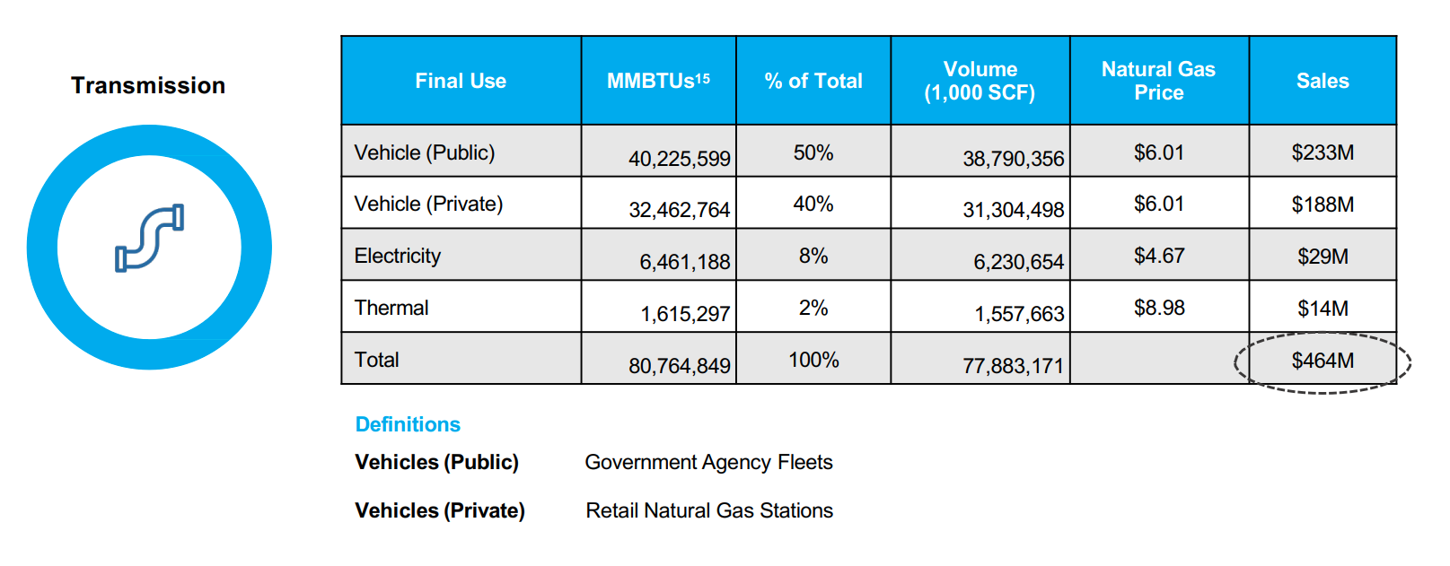
90% of RNG in transmission system is used for transportation fuel
Source: Renewable Natural Gas Coalition, “Economic Analysis of the US Renewable Natural Gas Industry” December 2022.

Slide 7

What Questions Should a Consumer Advocate Ask?
What are the objectives of the program?
    10%, 50%, Net-Zero, 100%?
    Are emissions reductions voluntary or involuntary?
    Is participation voluntary or involuntary?
Are the reductions real and is the program scalable?
    Is the utility using lifecycle emissions or combustion emissions accounting framework? Important for RNG and CNG.
    Are upstream emissions included in the utility emissions baseline?
    Is the verification source reputable and using best practices?
    If using MiQ, what grade level is permissible?
    What are expectations of emissions reductions in the near- and long-term?
    Will competition restrict availability of the resource?
What are the near- and long-term costs and price risks?
    What are the lost opportunities (opportunity cost)?
    How does the cost of emissions reduction compare to alternatives (i.e., $/metric ton of CO2e)
    How will competition from other industries impact short- and long-term prices?
    Is the utility showing you production costs or market prices?
    Are the costs volatile?
    What are the risks of stranded assets?
How is the gas utility marketing and communicating the program’s emissions reductions to customers?

Slide 8
Contact Information bcebulko@currentenergy.group
(317) 519-3165
Brad Cebulko, Partner

