Slide 1
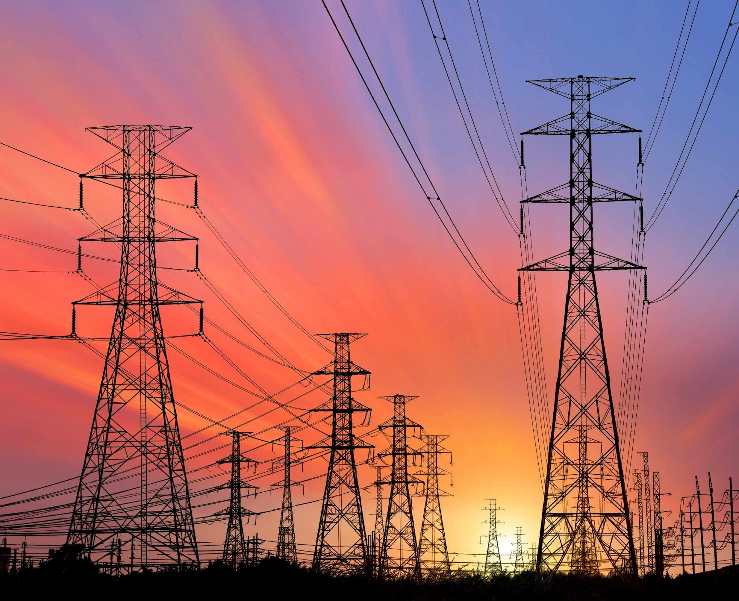


Causes and Impacts of Grid Outages, Metrics for Measuring Resilience, and Valuing and Prioritizing Strategies
Peter Larsen
Leader, Electricity Markets and Policy Department
Berkeley Lab
Presentation to NASUCA, September 14
Funding for this technical assistance provided by U.S. Department of Energy

Slide 2

Agenda
Goals for today
Causes and impacts of outages
Metrics for measuring resilience
Valuing and prioritizing strategies

Slide 3
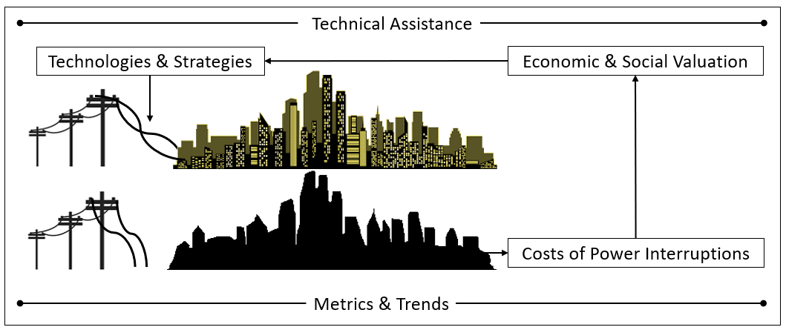
Goals for today
Review recent reliability trends and causes of power interruptions
(Re)Introduce metrics to track reliability and resilience
Present a few examples of valuing and prioritizing a resilience strategy
Provide links to references and a glossary

Slide 4

Causes and Impacts of Outages

Slide 5
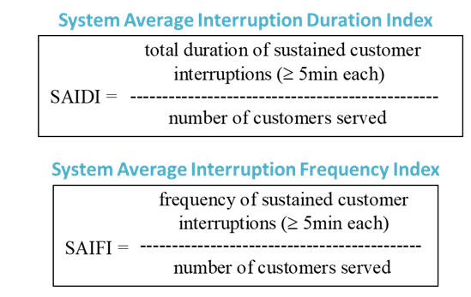
Example: Recent trends for TX--SAIFI (with MEDs)
Uri (!)
Reliability is getting worse across Texas even if after excluding 2021…
MED = Major Event Days
Utilities are required to submit annual reliability statistics to the U.S. Department of Energy via Form 861.
Source: U.S. EIA (2023)

Slide 6
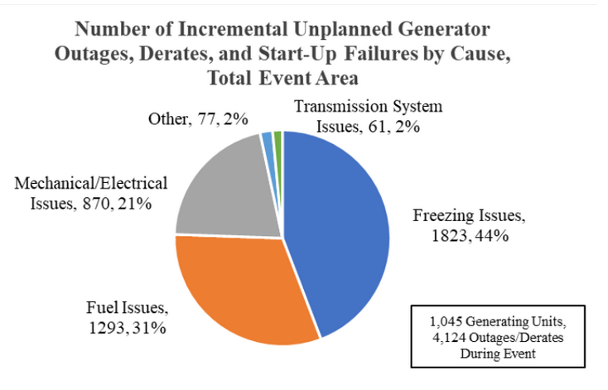
Recent reliability trends for TX--SAIDI (with MEDs)
Winter Storm Uri highlighted the risk to interdependent infrastructure (gas+elec.)
Source: FERC (2021)
Source: U.S. EIA (2023)

Slide 7
Cause of outages in Texas
Since the early 2000s, utilities have reported electric disturbance information using U.S. DOE Form 417.
Utilities are required to file DOE-417 if there is:
Complete loss of monitoring/control capability
Complete operational failure
Electrical system separation
Fuel supply emergencies that could impact electric power system adequacy or reliability
Loss of electric service to more than 50,000 customers for 1 hour or more
Load shedding of 100 MWs or more implemented under emergency operational policy
Physical or cyber attacks, both actual and suspicious
Public appeal to reduce electricity consumption
System-wide voltage reductions of 3 percent or more
Uncontrolled loss of 300 MWs or more of firm system loads for more than 15 minutes from a single incident
Source: U.S. DOE-CESER (2023)

Slide 8
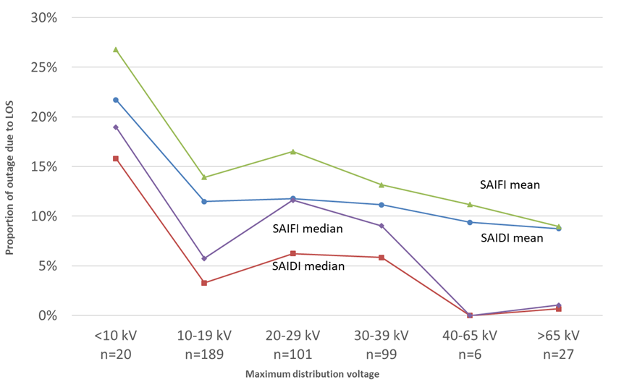
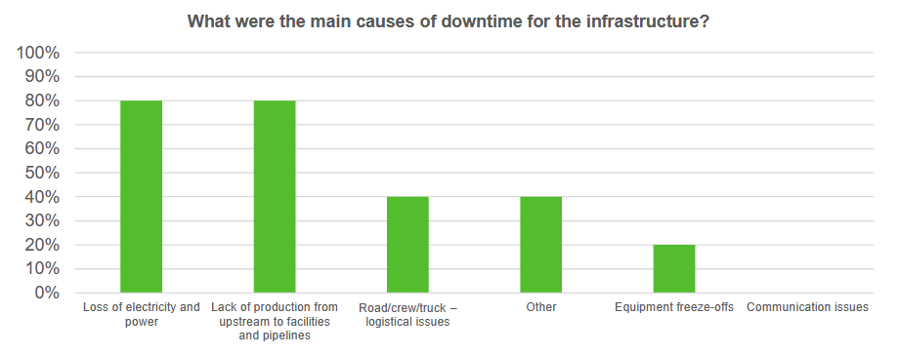
Nationally, 90+% of outages occur in the distribution system, but…
…events like Winter Storm Uri demonstrated that fuel shortages, among other issues affecting the bulk power system, can lead to widespread, long duration power interruptions
Survey of mid-stream natural gas providers after Winter Storm Uri
Source: Eto et al. (2019)
Source: Enverus (2021)

Slide 9
Discussion Question #1
Are there any emerging threats to the power system that are of concern to you?

Slide 10
Metrics for Measuring Resilience

Slide 11
“What’s measured improves”
-Peter Drucker
“Not everything that can be counted counts, and not everything that counts can be counted.”
-Albert Einstein

Slide 12
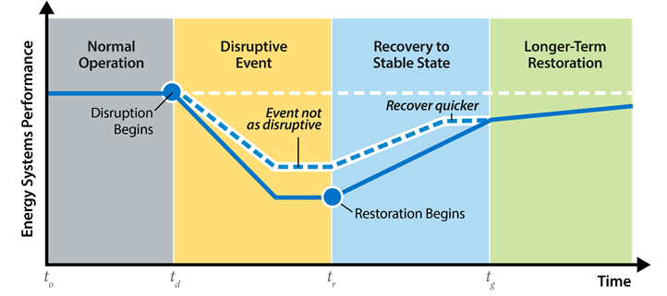
Reliability and resilience
Reliability
NERC defines power system reliability based on two concepts: (1) adequacy and (2) operating reliability:
“Adequacy is the ability of the electric system to supply the aggregate electric power and energy requirements of the electricity consumers at all times, taking into account scheduled and reasonably expected unscheduled outages of system components. Operating reliability is the ability of the electric system to withstand sudden disturbances such as electric short circuits or unanticipated loss of system components.”
Resilience
“The ability to anticipate, prepare for, and adapt to changing conditions and withstand, respond to, and recover rapidly from disruptions”
Sources: LaCommare et al. (2017) and PPD-21 (2013)

Slide 13
Reliability vs. resilience: features, metrics, actions
 | Reliability | Resilience
Common features | Routine, expected, normally localized, shorter duration interruptions of electric service Larger events will make it into the local headlines | Infrequent, unexpected, widespread/long duration power interruptions, often with significant corollary impacts Almost always “event” based Always national headline worthy
Metrics | Well-established, annualized (SAIDI, SAIFI, MAIFI), with provisions for “major events” Rarely include non-electricity impacts | Familiar, but non-standardized, and generally event-based (number of customers affected; hours without electric service) Routinely also include non-electricity impacts (e.g., costs to firms; health and safety impacts)
Actions to improve | Plan and prepare Manage and endure event(s) Recover and restore Assess, learn, and update plan | No qualitative difference But generally larger in scope/cost

Slide 14
Reliability vs. resilience: decision-making
 | Reliability | Resilience
Entities involved | Electric utility and its regulator/oversight board, primarily | Electric utility and regulator/oversight board; sometimes acting in response to State legislative direction or Governor’s orders Routinely in conjunction with parties that have responsibilities for other critical infrastructures, including local/regional/state/federal authorities, and elected officials
Factors affecting decisions | Actuarial records on frequency of exposure – widely understood risks: insurable Well-understood/tested practices/approaches Understood to be an expected cost of doing business | No actuarial basis to establish likelihood of occurrence – widely varying perceptions of risk/exposure: “un-insurable” risk Limited opportunities to test strategies Large dollar amounts/extraordinary expenditures may require special approval/vote Political judgements essential

Slide 15
A bit more about resilience
Resilience can be measured as a system’s performance subject to acute shocks and/or chronic stresses.
Types of shock and stress:
Natural
Human-caused
Systemic
Types of systems:
Engineered (e.g., power grid)
Social (e.g., community, economy)
Geographically-defined (e.g., military base)
A system resilient to one type of hazard may not be resilient to another.
Considerations when selecting or applying metrics include:
Attribute- versus performance-based
Qualitative versus quantitative
Chronic versus acute
Extent and type of consequences
Note: Next nine slides adapted from Jeffers et al. (2023)

Slide 16
Metrics terminology: attribute vs. performance
Attribute-based Metrics | Performance-based Metrics
What are the features of a system that make it more or less resilient? | How resilient is/was the system?
Things you can assess now on a “normal” day | Things you can measure only during a disruption
Often compiled using surveys or checklists | Often based on data collected during an event (or a modeled event)

Slide 17
Some examples
Attribute-based
Metric | Units
Number of community resilience hubs in disadvantaged communities (DACs) | Unitless (count)
Size of community resilience infrastructure deployed in DACs | MW or MWh
NIMS Certification | Total number and percent of National Incident Management System 100, 200, and 300 certification trainings among utility employees, annually
Performance-based
Metric | Units
SAIDI, SAIFI, CAIDI, and CAIFI (with MEDs) | System Average Duration, Frequency, or Customer Average Duration, Frequency during Major Event Days
Total prolonged outages | Total number of unique customers with interruptions exceeding X hours
Cumulative customer energy demand not served | kWh of demand that would have been served if not for outage conditions

Slide 18
Metrics terminology: qualitative vs. quantitative
Qualitative-based Metrics | Quantitative-based Metrics
Subjective description of system resilience | Objective, numerical assessment of system resilience
Information comes from people, including opinions and attitudes | Data is often measured, but occasionally based on objective human judgment

Slide 19
Some examples
Qualitative
Metric | Units
City resilience index | Index based on 52 indicators of people, organization, place, and knowledge
Quantitative
Metric | Units
Mortality rate | Mortality above baseline due to outage
Social burden | Effort (time and money) expended by a population to obtain lifeline services during disruptions
Cumulative Customer-Hours of Outages | Sum of customers impacted multiplied by duration for each outage

Slide 20
Metrics terminology: chronic vs. acute
Chronic | Acute
Is the system resilient to slow-moving hazards? | Is the system resilient to fast-moving hazards?
Often termed “stresses” (e.g., long-term increase in cooling degree-days) | Often termed “shocks” (e.g., physical attack on substation)
Hazards span months to decades | Hazards span seconds to months

Slide 21
Some examples
Chronic
Metric | Units
Energy burden | Energy cost divided by household income (based on electricity + heat + transportation or subset)
Job creation | Total number of construction or project-related jobs created
Heat exhaustion rate | Number of incidents per month/year
Acute
Metric | Units
Recovery cost | Total costs accrued by entity (utility, state, federal, etc.) to recover the system to a stable state
Total outage hours by cause | Total annual outage hours by cause
Loss of utility revenue | Annual utility revenue lost due directly to outages

Slide 22
Extent and type of consequence
System | Description | Pros | Cons
Physical | Power system | Extension of reliability metrics already accepted by industry | Does not fully consider consequences to other systems that society values
Economic | Economy | Captures consequences that society values | Social, environmental, and national security metrics are not easily monetizable; not clear that industry always has a responsibility to address all of these consequences
Social | Societal health and well-being
Environmental | Natural environment
National security | Complex of mission-based organizations

Slide 23
Some examples
Physical
Metric | Units
Average restoration speed | Restoration unit (kW, customers, etc.) divided by time
Major event days | Total number of major event days per unit of time
Average response time to electric emergency | Total response time divided by number of electric emergencies
Economic, Social, Environmental, National Security
Metric | Units
Total economic losses per event | Interruption-related costs, lost gross output (business revenue), lost gross domestic product, and/or lost household consumption
Critical load without power* | Total amount of time or kWh that critical loads are without power in a year
FEWSION Resilience Index | Number of energy input sources per county

Slide 24
Selected metrics in practice in South Atlantic states (1)
State | Metric | Comments
Florida | IEEE 1366 reliability metrics | SAIDI SAIFI CAIDI MAIFI (see glossary)
Florida | L-Bar | Average time it takes to restore power to all customers
Florida | Customer-specific reliability metrics | Customers experiencing multiple interruptions (customers experiencing more than X outages of 1 minute or more per year) Customers experiencing multiple momentaries Customer momentary events (customers affected by a momentary event)
Florida | Customer interruption cost | Florida Power and Light uses Berkeley Lab’s ICE Calculator to estimate benefits of reducing SAIDI/SAIFI
Sources: Florida PSC (2013), FPL (2004), Florida PSC (2021)

Slide 25
Selected metrics in practice in South Atlantic states (2)
State | Metric | Description
North Carolina (Duke) | Customer interruption cost | Duke used Berkeley Lab’s ICE Calculator to estimate benefits of Grid Improvement Plan
North Carolina (Duke) | IEEE 1366 reliability metrics | SAIDI SAIFI
North Carolina (Proposed Performance Incentive Mechanisms recommended by NC Energy Regulatory Process participants) | Reliability metrics | SAIDI (excluding MEDs) SAIFI CEMI-4 (customers experiencing more than four outages of 1 minute or more per year) Miles of vegetation management
 | Resilience metrics | Number of critical assets without power for more than N hours Critical asset energy demand not served Critical asset time to recovery
Sources: NCUC (2018), NCUC (2020), and RMI/RAP (2020)

Slide 26
Selected metrics in practice in South Atlantic states (3)
State | Metric | Description
Georgia | IEEE 1366 reliability metrics (for ranking) | Feeder-level and company-wide SAIDI Feeder-level and company-wide SAIFI
Georgia | Loss of Load Expectation (for most planning processes) | Expected number of loss-of-load days with events (Loss of Load Expectation; 1 day in 10 years)
Sources: Georgia Power (2019) and Georgia PSC (2022)

Slide 27
Discussion Question #2
What new metrics might be needed to better prepare for emerging threats?

Slide 28
Valuing and Prioritizing Resilience

Slide 29
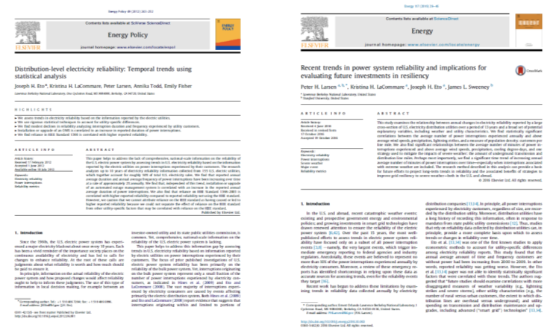
Example #1: Valuing a resilience strategy
Berkeley Lab research into factors that impact long-term reliability of the U.S. power system led to research on the value of undergrounding power lines.
Increase in % share of transmission and distribution lines that are underground has a statistically significant correlation with improved reliability (Larsen et al. 2020).

Slide 30
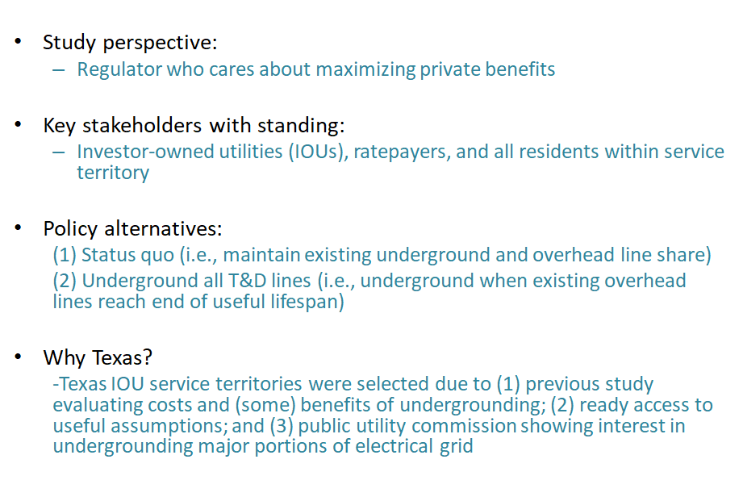
Valuation framework (1)
Despite the high costs attributed to power outages, there had been little or no research to quantify both the benefits and costs of improving electric utility reliability/resilience—especially within the context of decisions to underground T&D lines.
Source: Larsen (2016)

Slide 31
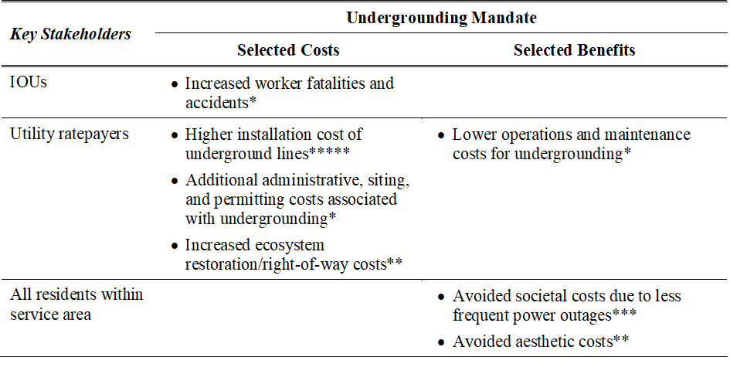
Valuation framework (2)
Can you spot the metrics included in this valuation framework?

Slide 32
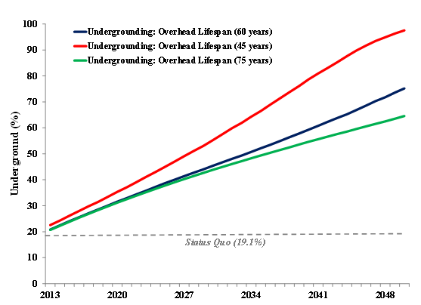
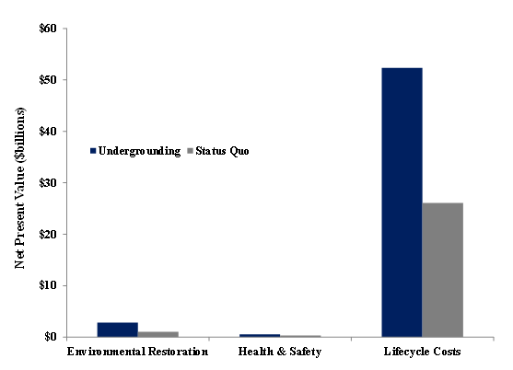
Estimated costs

Slide 33
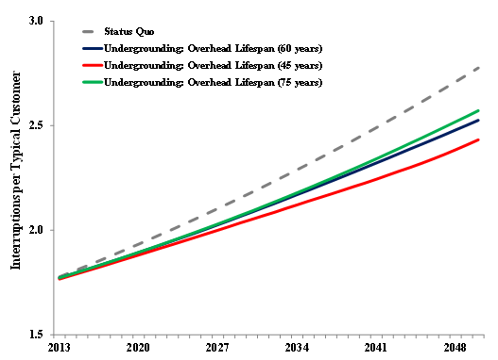
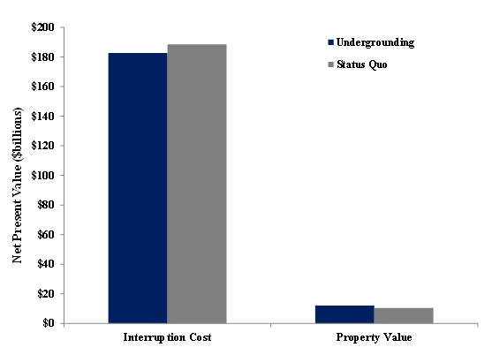
Estimated benefits

Slide 34
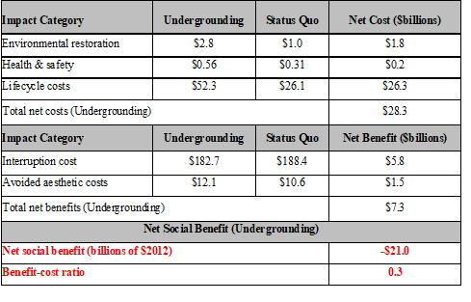
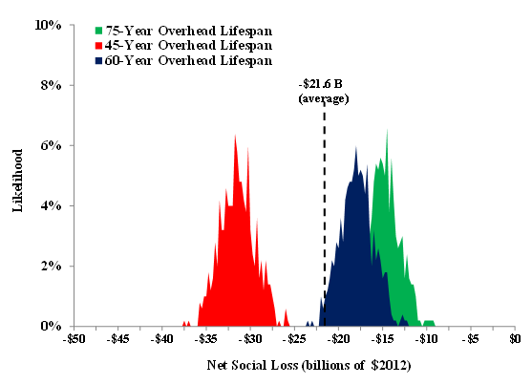
Valuation results

Slide 35
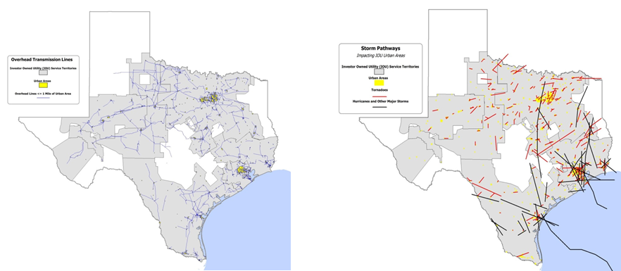
Estimated benefits
The initial valuation indicated that broadly mandating undergrounding when overhead T&D lines have reached the end of their useful life is not cost-effective for Texas IOUs.
What are the minimum conditions necessary for a targeted undergrounding initiative to have positive net benefits?

Slide 36
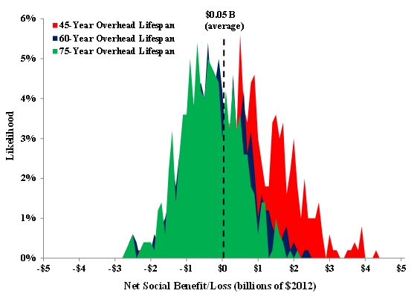
Possibility of net benefits
Texas policymakers should consider requiring that all T&D lines be undergrounded in places where:
there are a large number of customers per line mile (e.g., greater than 40 customers per T&D line mile)
there is an expected vulnerability to frequent and intense storms
there is the potential for economies of scale for installing underground T&D lines (e.g., installation costs decrease each year)
overhead line rights-of-way are larger than underground line rights-of-way (i.e., less environmental footprint)

Slide 37
Discussion Question #3
What challenges do you foresee when attempting to value and/or justify a resilience investment?

Slide 38
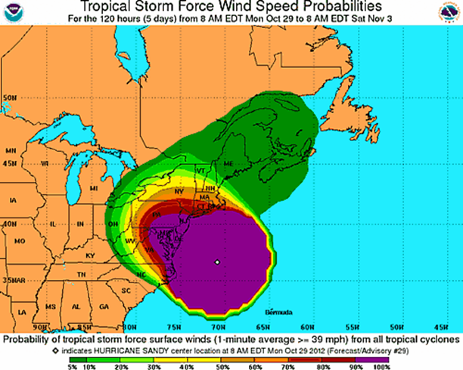
Example #2: Prioritizing a strategy among a portfolio of options
The U.S. Department of Energy Grid Deployment Office is sponsoring the development of “Resilience Spotlights” that feature examples of how organizations value and prioritize a specific project among a portfolio of proposed projects.
The first spotlight focuses on activities in New York City in the immediate aftermath of Super Storm Sandy.
Resilience spotlights will be accessible at the DOE-GDO website.

Slide 39
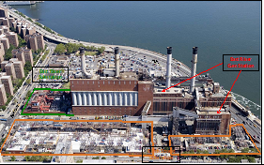
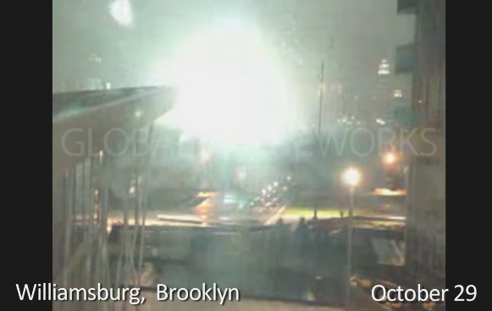
Super Storm Sandy
20% of the city’s land area was flooded, exceeding FEMA’s “100-year” floodplain boundaries
Loss of power to > 2 million Con Ed customers
Full restoration took ~14 days
Major equipment failure: Con Ed’s East 13th Street Substation flooded and failed due to record levels of storm surge.

Slide 40
Regulator and utility processes
January 2013 (three months after storm): Con Ed proposed a portfolio of storm hardening projects in a general rate case filing.
Many stakeholders in rate case had opposing views:
Hardening plan was too ambitious and expensive
Utility should develop a bigger “comprehensive and longer-term approach”
Key point of dispute: What criterion should Con Ed use to evaluate hardening against flooding risks?
Summer 2013: NYPSC ordered formation of a Storm Hardening and Resiliency Collaborative to work in parallel to rate case proceedings and consider:
Design standards
Approach to risk assessment and cost-benefit analysis

Slide 41
Project prioritization and valuation (1)
►The Collaborative developed a procedure for ranking the storm hardening projects that considered the following:
Probability: estimate likelihoods of significant storms and damage to infrastructure
Consequence: characterize physical and economic impacts of damage
Priority: run potential projects through models to rank them
Models | Key Inputs
Risk Assessment and Prioritization Model | Location-based flood probabilities provided by proprietary New York City inundation models Wind damage probabilities derived from historical wind gust frequency distributions Costs of storm hardening measures Estimated power interruption durations with and without hardening measures
Cost-Benefit Model | Costs of storm hardening measures (from the Risk Assessment and Prioritization Model) Estimated power interruption durations with and without hardening measures (from the Risk - Assessment and Prioritization Model) Extrapolated avoided cost (i.e., value of lost load) estimates based on Lawrence Berkeley National Laboratory’s ICE Calculator

Slide 42
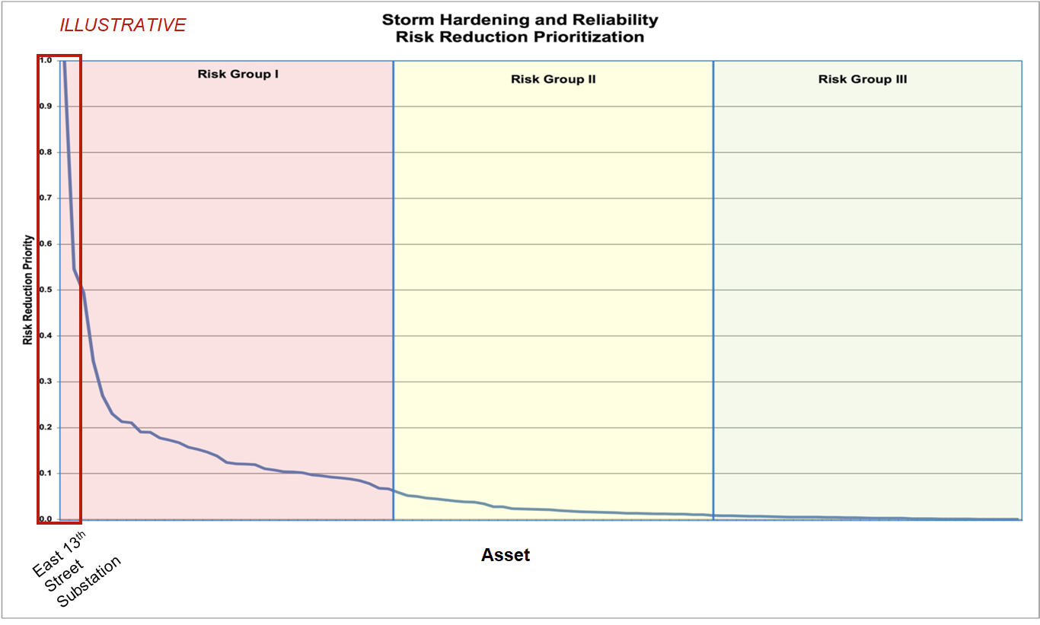
Project prioritization and valuation (2)
Source: ConEd (2013)

Slide 43
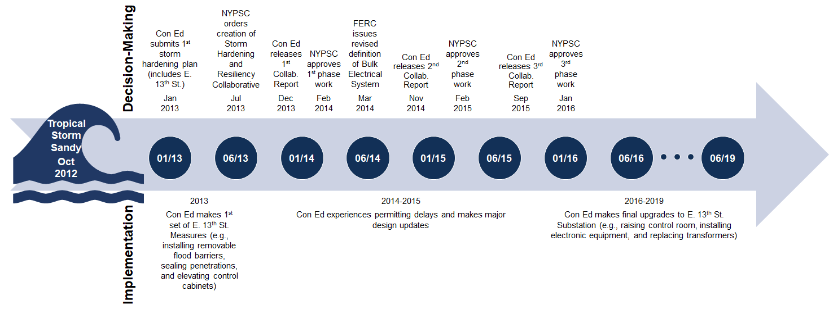
Response timeline
PETE

Slide 44
Lessons learned that may be useful for NASUCA members
Most utility reliability and resilience investments are developed, proposed, and adjudicated in the context of a general rate case. This process is not always well-suited to addressing novel, complex technical problems.
The need to address low-probability/high-consequence events requires flexibility in regulatory processes.
The Resiliency Collaborative was an important institutional innovation that enabled Con Ed to substantially expand and improve its storm hardening planning methods and practice.
The cost-benefit analysis used could inform similar activities in other parts of the country.

Slide 45
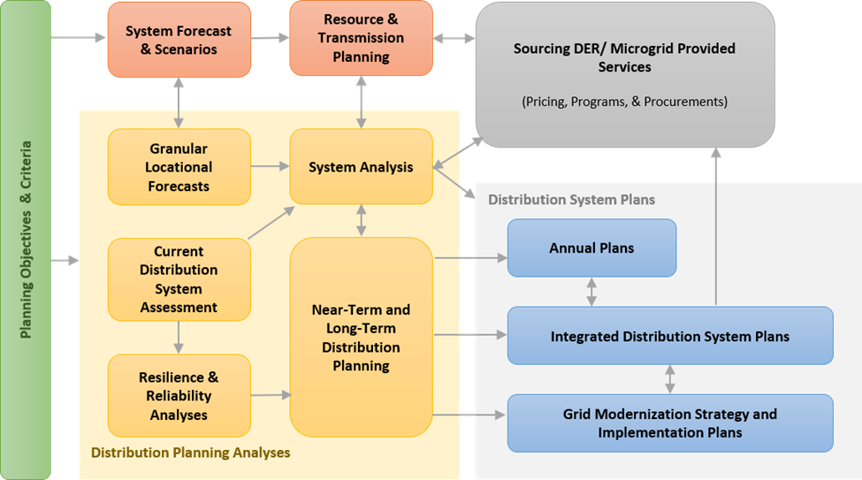
Importance of objectives-based planning
Creating a shared understanding among stakeholders of strategies for incorporating objectives and priorities into current planning practices is essential. Without clear objectives, it becomes difficult to assess whether resulting plans are responsive and if key stakeholders will accept them.
Planning objectives, metrics, and priorities are derived from state & community policies and customer needs
Regulators review and approve plan(s) with input from stakeholders
State Energy Security Plans & Threat-Based Risk Assessments
Foundational Investments (e.g., asset management informed via climate forecasting)
Source:
PNNL (2020)

Slide 46
Discussion Question #4
What is the most important criteria for prioritizing one resilience strategy over another?

Slide 47


Contact
Peter Larsen
Leader, Electricity Markets and Policy
Berkeley Lab
Em: PHLarsen@lbl.gov
Ph: (510) 486-5015

Slide 48
Glossary of selected performance-based metrics
Metric | Description | Interpretation
SAIFI | System Average Interruption Frequency Index | Total number of interruptions that an average customer experiences over some time period
SAIDI | System Average Interruption Duration Index | Total number of minutes that an average customer is without power over some time period
CAIFI | Customer Average Interruption Frequency Index | Average number of interruptions per customer interrupted over some time period
CAIDI | Customer Average Interruption Duration Index | Time required to restore service for an average customer over some time period
MAIFI | Momentary Average Interruption Frequency Index | Total number of momentary interruptions (< 5 minutes) that an average customer experiences over some time period
MED | Major Event Day | Any day with a daily reliability metric that exceeds a statistically-defined threshold based on the previous five years of daily data (e.g., IEEE 1366 standard)
Source: CPUC (2021)

Slide 49
Useful references (1)
Consolidated Edison Company of New York Inc (ConEd). 2013. Substation Hardening. Presentation; Appendix G in Consolidated Edison Company of New York Inc Storm Hardening and Resiliency Collaborative Report, December 4. Link
California Public Utilities Commission (CPUC). 2021. Electric System Reliability. Prepared by Julian Enis from the CPUC Energy Division, February 17. Link
Eto, J., K. Hamachi-LaCommare, H. Caswell, and D. Till. “Distribution System vs. Bulk Power System: Identifying the Source of Electric Service Interruptions in the U.S.” IET Generation, Transmission, and Distribution, Volume 13, Issue 5, 12 March 2019, p. 717 – 723. Link
Florida Public Service Commission (PSC). 2013. Grid Reliability and Integrating Intermittent Energy Sources in Florida. Prepared by Commissioner Eduardo Balbis, May 21. Link
Florida Power and Light (FPL). 2004. Distribution Engineering Reference Manual, December. Link
Florida Public Service Commission (FPSC). 2021. Petition for Rate Increase by Florida Power and Light Company, September 21. Link
Georgia Power. 2019. Georgia Power’s Strategic Overhead-to-Underground Conversions. Prepared by Robert Reepe for IEEE Insulated Conductors Committee Education Program, October 23. Link
Georgia Public Service Commission. 2022. Direct Testimony of Peter Hubbard of the Georgia Center for Energy Solutions, May 5. Link
Jeffers, R., Hotchkiss, E., Hart, O., Jones, K., Shepherd, R. (2023) GDO Technical Assistance: Resilience Objectives and Metrics. Presentation to the US DOE Grid Deployment Office, National Renewable Energy Laboratory. February 2023. Future Link

Slide 50
Useful references (2)
LaCommare, K., P. Larsen, and J. Eto. 2017. Evaluating Evaluating Proposed Investments in Power System Reliability and Resilience: Preliminary Results from Interviews with Public Utility Commission Staff. LBNL Report 1006971. Link
Larsen, P., M. Lawson, K. LaCommare, and J. Eto. 2020. Severe weather, utility spending, and the long-term reliability of the U.S. power system. Energy: The International Journal 198 (2020). Link
Larsen, P. 2016. A method to estimate the costs and benefits of undergrounding power systems. Energy Economics 60 (2016): 47-61. Link
North Carolina Utilities Commission (NCUC). 2018. Direct Testimony of Caroline Golin on Behalf of the North Carolina Sustainable Energy Association, January 23. Link
North Carolina Utilities Commission (NCUC). 2020. Docket No. E-7, Sub 1213 and Docket No. E-7 Sub 1214 within Application for General Rate Case, February 18. Link
Office of Regulatory Staff (ORS). 2021. Report on the Resiliency of South Carolina’s Electric and Natural Gas Infrastructure Against Extreme Winter Storm Events. Prepared by Guidehouse for the South Carolina Office of Regulatory Staff, December. Link
Presidential Policy Directive 21 (PPD-21). 2013. Critical Infrastructure Security and Resilience, February 12. Link
Rocky Mountain Institute/Regulatory Assistance Project (RMI/RAP). 2020. North Carolina Energy Regulatory Process, December 22. Link
U.S. Department of Energy Office of Cybersecurity, Energy Security, and Emergency Response (U.S. DOE-CESER). 2023. Electric Disturbance Events (DOE 417). Link

Slide 51
Useful references (3)
U.S. Department of Energy Energy Information Administration (U.S. DOE-EIA). 2023. Annual Electric Power Industry Report (EIA 861). Link
Rocky Mountain Institute/Regulatory Assistance Project (RMI/RAP). 2020. North Carolina Energy Regulatory Process, December 22. Link
U.S. Department of Energy Office of Cybersecurity, Energy Security, and Emergency Response (U.S. DOE-CESER). 2023. Electric Disturbance Events (DOE 417). Link
U.S. Department of Energy Energy Information Administration (U.S. DOE-EIA). 2023. Annual Electric Power Industry Report (EIA 861). Link
Federal Energy Regulatory Commission (FERC). 2021. The February 2021 Cold Weather Outages in Texas and the South Central United States. FERC, NERC, and Regional Entity Staff Report. Link
Enverus. 2021. Winter Storm Uri-Natural Gas Analysis. Prepared for the Texas Oil and Gas Association, April. Link
Pacific Northwest National Laboratory (PNNL). 2020. Modern Distribution Grid Project. Link

