Slide 1
Quantifying the Financial Impacts of Electric Vehicles on Utility Ratepayers and Shareholders
Andy Satchwell
with contributions from Juan Pablo Carvallo, Peter Cappers, James Milford, and Hadi Eshraghi
September 6, 2023 – NASUCA Webinar
This work was funded by the U.S. Department of Energy’s Office of Energy Efficiency and Renewable Energy Strategic Analysis Team under Contract No. DE-AC02-05CH11231.
Report and supplemental information available at: https://emp.lbl.gov/publications/quantifying-financial-impacts

Slide 2
Policy and regulatory context – why does this matter?
Including customer EV adoption and balance among customers with and without EVs
Including how utility collects revenues and provides value to investors, as well as scope of utility roles and responsibilities
Ratepayer Impacts
Utility Shareholder Impacts

Slide 3
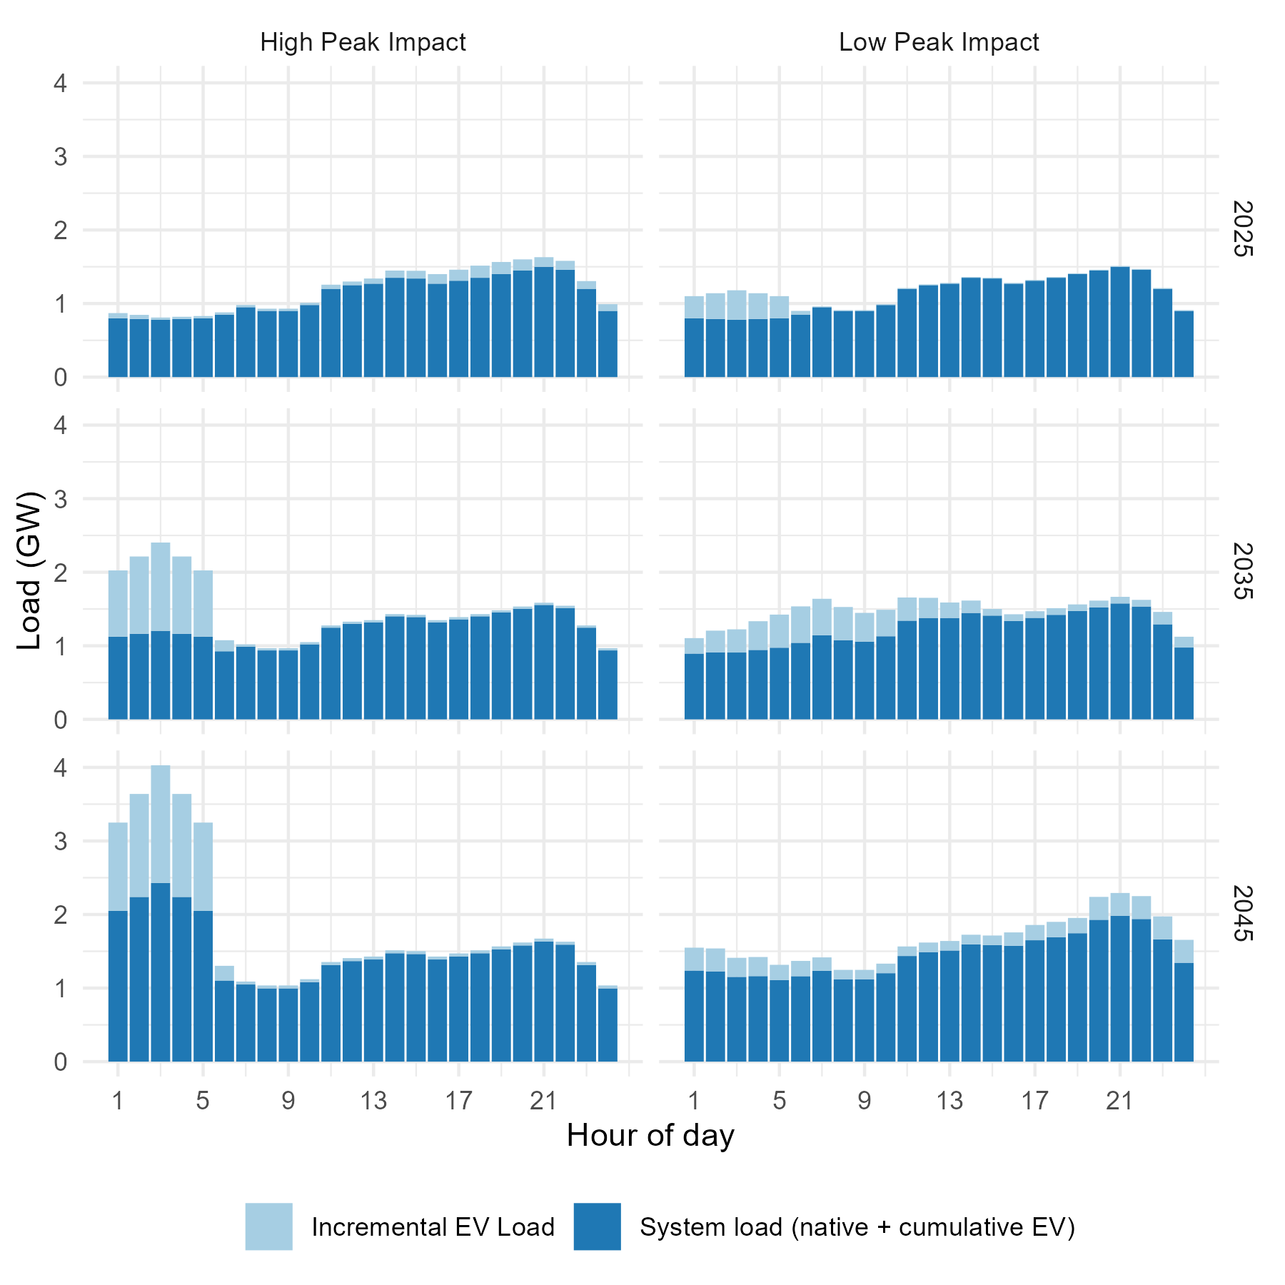
Bookend charging strategies used in this study are characterized by system peak impacts
Low Peak Impact is the charging strategy that minimizes EV impacts on peak demand.
High Peak Impact is the charging strategy that maximizes EV impacts on peak demand.
The charging strategies adapt over time to achieve the performance objective.

Slide 4
Summer-peaking, vertically integrated utility characterization

Slide 5
How do we represent EV impacts on utility sales?
High VMT
(~14.0% increase 2040 retail sales)
High EV penetration (~9.0% increase in 2040 retail sales)
Low EV penetration (~1.5% increase in 2040 retail sales)

Slide 6
How do we characterize EV impacts on utility generation and supply costs?
Generation capital, operations and maintenance (O&M), and FPP costs are modeled endogenously in FINDER using a built-in capacity expansion and dispatch logic.
Utility hourly load adjusted for incremental EVs
Hourly forecasts transformed into energy requirements by time period
Contributions of variable renewable energy and hour-to-hour ramp rates determined
Forward-looking capacity expansion that minimizes portfolio investment and operating costs
Weekly and hourly generation dispatch that minimized operating costs

Slide 7
How do we characterize EV impacts on utility distribution and program costs?
Distribution CapEx Costs
Expert-elicited probability of feeder upgrades and costs driven by EV impacts on coincident peak and non-coincident peak
EV Charging Infrastructure Costs
EV Program Costs
Regulatory filing data to inform ratepayer-funded EVSE and control costs, as well as caps on program size
Regulatory filing data to inform ratepayer-funded EV program implementation and administrative costs, as well as caps on program size
Exogenous characterization

Slide 8
Financial metrics
Metric
Calculation
Representation
Earnings
Revenues - Costs
Quantifies future utility earnings opportunities
All-in Average Retail Rate
Revenues / Sales
Quantifies total rate impacts across all utility ratepayers
Quantifies average incremental annual utility cost impact of integrating EVs (inclusive of utility generation, distribution, EV program, and charging control costs)
Annual Cost per EV
Costs / EVs
All financial metrics are discounted over 20 years assuming a 7% nominal rate for utility earnings (representing average utility weighted average cost of capital) and a 5% nominal rate for average all-in retail rates and costs per EV.

Slide 9
What are the financial impacts of EVs under High Peak Impact charging? Comparison point: Utility without any incremental EV deployment

Slide 10
EVs generally increase shareholder earnings and retail rates remain roughly unchanged

Slide 11
Rate impacts are driven by timing of infrastructure investments and increase in sales

Slide 12
How does a Low Peak Impact charging strategy affect financial impacts, and how robust are results to different deployment assumptions? Comparison point: Utility with incremental EVs deployed with High Peak Impact charging

Slide 13
Low Peak Impact charging reduces rates and earnings

Slide 14
Financial impacts of Low Peak Impact charging are directionally consistent across sensitivities

Slide 15
Managed charging strategies reduce the incremental annual cost of integrating EVs by ~38-62%

Slide 16
Key findings and discussion
Ratepayers are almost always better off and more so if EVs are deployed with managed charging strategies.
Compared to a future without EVs, shareholder are also better off, but managed charging erodes some of the incremental earnings.
A forward-looking and long-term perspective is necessary to make large initial utility infrastructure investments that enable greater EV deployment and result in later rate decreases.
Impacts are overall quite small on a total utility basis; but, they could be more significant for particular customer classes depending on cost allocation and cost recovery, which were not explored in the study.
To trigger managed behavior we model requires dynamic infrastructure planning process and/or flexible managed charging strategy to reflect how the utility load shape evolves inclusive EV load (e.g., EV TOU periods will change from overnight to middle-of-day as coincident peak EV load impacts build).

Slide 17
Future research opportunities
Assume different EV penetration levels and adoption rates.
Explore additional charging strategies and profiles, utility characterizations, and customer-class impacts.
Model medium-duty and heavy-duty EVs (MDVs and HDVs).
Incorporate a more detailed distribution cost model.
Model EV-specific rate designs and quantify cost shifts between EV owners and non-EV owners.

Slide 18
Contacts
Andrew Satchwell | ASatchwell@lbl.gov
For more information
Download publications from the Electricity Markets & Policy: https://emp.lbl.gov/publications
Sign up for our email list: https://emp.lbl.gov/mailing-list
Follow the Electricity Markets & Policy on Twitter: @BerkeleyLabEMP
Acknowledgements
This work was funded by the U.S. Department of Energy (DOE) Office of Energy Efficiency and Renewable Energy (EERE) Strategic Analysis Team (SA) under Contract No. DE-AC02-05CH11231. We would like to especially thank Ookie Ma and Kara Podkaminer (DOE) for their support of this work. For reviewing the study and providing valuable feedback, we thank Michelle Levinson (World Resources Institute), Galen Barbose (Berkeley Lab), and Kara Podkaminer, Noel Crisostomo, and Paul Spitsen (DOE).
The views and opinions of authors expressed herein do not necessarily state or reflect those of the United States Government or any agency thereof, or The Regents of the University of California.

Slide 19
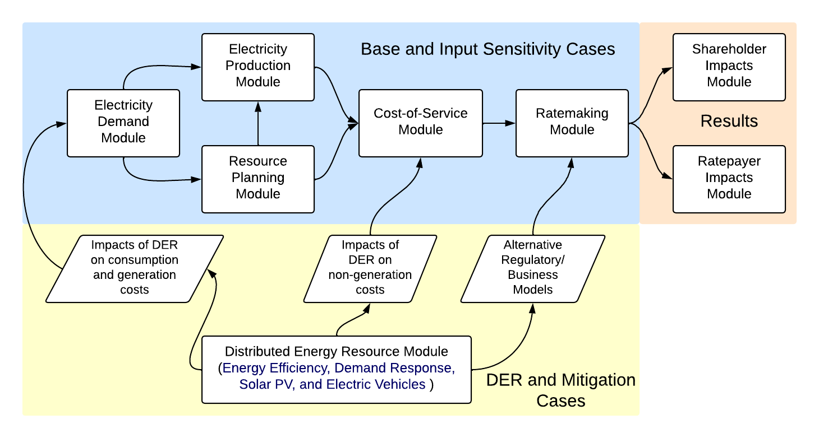
Berkeley Lab’s FINDER model
The FINDER model is a pro-forma financial model of changes in utility costs and revenues with the addition of DERs.
Model outputs include shareholder metrics (achieved return-on-equity (ROE) and earnings) and ratepayer metrics (average retail rates and bills).
The FINDER model has been developed over more than 14 years and used to support foundational research and state technical assistance in seven states and two regions.
For more information on the FINDER model and related publications, see: https://emp.lbl.gov/projects/finder-model

Slide 20
Distribution CapEx
Problem: estimate physical and monetary distribution system expansion based on EV load
Existing solutions are based on a simple $/EV value with very little empirical support
Our solution:
Leverage expert elicitation for cumulative probability of distribution system upgrades produced by CalETC
Convolve with normal distribution for EV load distribution across feeder. Use CP load for substation and primary system, and NCP load for secondary system
Determine the share of feeders requiring an upgrade
Monetize based on CalETC’s expert elicitation using high/low ranges given the uncertainty; scale up to the size of the representative utility

Slide 21
Utility EV charging infrastructure and program costs
Scenario Element | Low value | Medium value | High value | Managed charging adder | Accounting treatment
L1 charger cost ($/L1 charger) | $0 | $0 | $0 | $0 | N/A
L2 charger cost ($/L2 charger) | $1,529 | $7,143 | $15,829 | $1,200 per residential charger and $2,200 per workplace charger | Capitalize
DCFC charger cost ($/DCFC charger) | $38,320 | $66,250 | $149,753 | $0 | Capitalize
Annual program cost | $70,800 | $619,500 | $2,494,800 | $0 | Expense
Program cap | 1/3 total charger deployment | 1/6 total charger deployment | 1/12 total charger deployment | N/A | N/A

