Slide 1
The Duck and its Bill: Potential Impacts of Dynamic Electricity Pricing on California Utility Customers Marius Stuebs, Sarah Smith, Brian F Gerke, Samanvitha Murthy, Peter Cappers, Richard E Brown, Mary Ann Piette Lawrence Berkeley National Laboratory
September 2023

Slide 2
Study overview
CPUC staff have proposed a new tariff structure, UNIDE, that recovers a variety of utility costs through a time-varying rate that attempts to reflect real-time marginal grid costs
Here we assess potential impacts on customer bills and bill volatility from a UNIDE-like dynamic tariff that recovers all utility costs through a single rate structure applied to all customers
Specifically, we consider bill impacts in an inelastic scenario, where customers do not modify their consumption in response to the dynamic rate: these are “worst case” impacts
We also consider the effectiveness of hedging against bill volatility by pre-purchasing a load-shape subscription at a defined rate
To assess the impacts, we leverage hourly load data from 2018-2019 for ~400k California IOU customers, acquired as part of the California DR Potential Study
Sampled from a set of demographic data for all ~13M IOU customers

Slide 3
Rate Design

Slide 4
Basic principles of the UNIDE-like tariff design
A purely volumetric ($/kWh), time-varying retail tariff
A universal tariff, which applies to all customers
Constant volumetric adder to achieve overall revenue-neutrality computed across all customers.
Energy costs
Marginal capacity costs
Other costs
Wholesale price of delivered electricity
Wholesale price of system losses associated with delivered electricity
Delivery infrastructure (distribution system)
Generation capacity
Flexible generation capacity
Transmission infrastructure (FERC jurisdiction)
Public-purpose programs
Billing and meter reading
Wildfire mitigation
Etc.

Slide 5
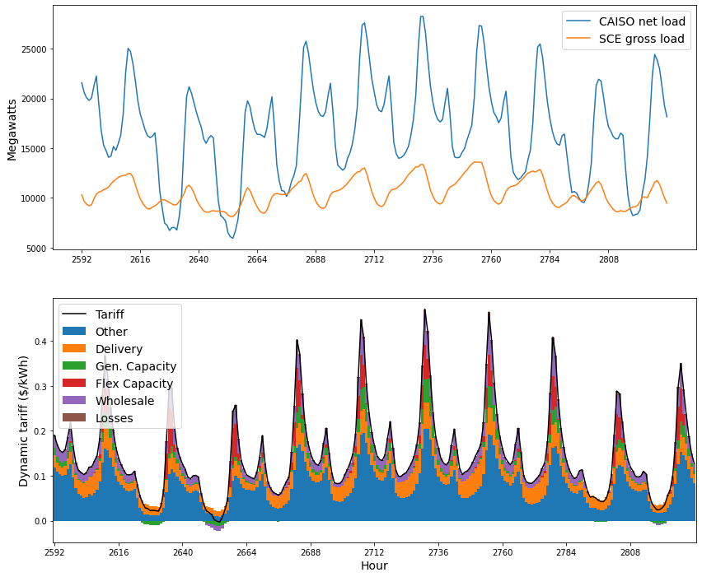
Final dynamic tariff
Energy costs
Marginal capacity costs
Other costs

Slide 6
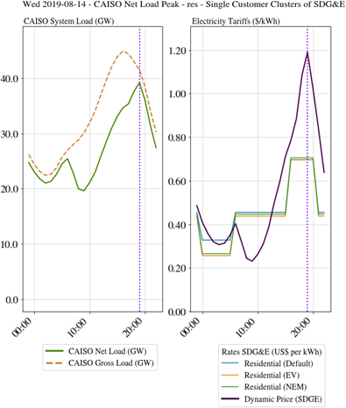
Dynamic Rate on extreme Event days

Slide 7
Annual variation
2018 and 2019 were very different years in CAISO, with heat waves and high prices in 2018, with relative quiescence in 2019
This study should be reasonably representative of the range of expected outcomes across different years
Dynamic rate across both years:

Slide 8
Customer Sample

Slide 9
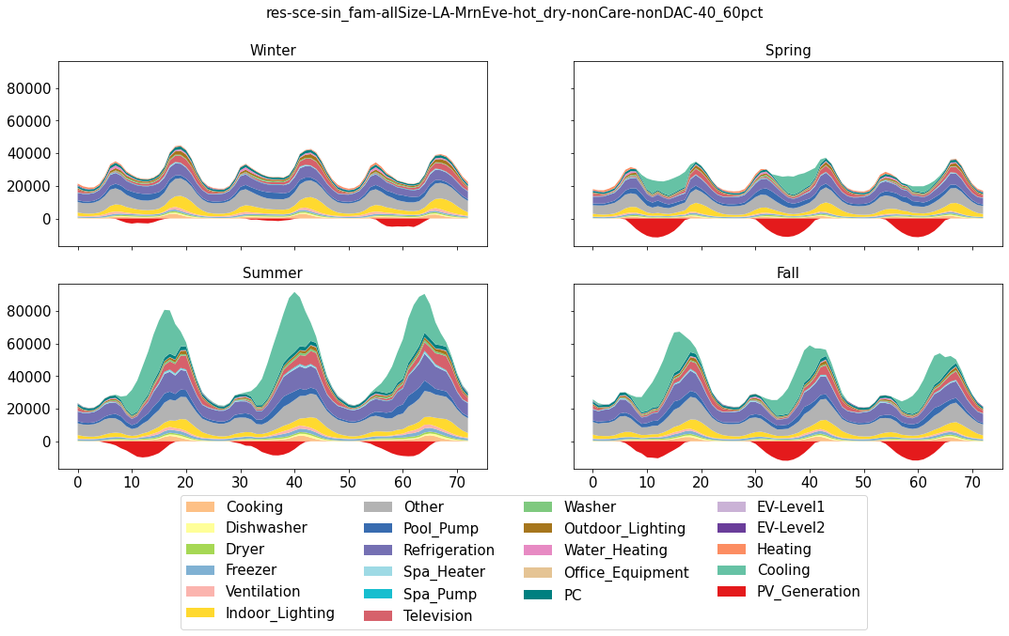
Customer clusters
More than 2600 residential and more than 1700 commercial and industrial (C&I) customer clusters

Slide 10
Business-as-usual tariffs
To compute dynamic tariff bill impacts in a consistent way, we first compute customer monthly and annual bills on a set of representative business-as-usual (BAU) tariffs
Sector | Utility | Customer Type | Tariff Name (short)
Res | SCE | Default | TOU-D-4-9PM
 |  | NEM | TOU-D-4-9PM
 |  | EV | TOU-D-PRIME
 | PG&E | Default | E-TOU-C
 |  | NEM | E-TOU-C
 |  | EV | EV2A
 | SDG&E | Default | TOU-DR-1
 |  | NEM | DR-SES
 |  | EV | EV-TOU-2
Note— Residential customers who are both EV owners and NEM customers were assigned to an EV tariff.
Each selected BAU tariff is applied to the relevant subset of customers

Slide 11
Residential Sector Results

Slide 12
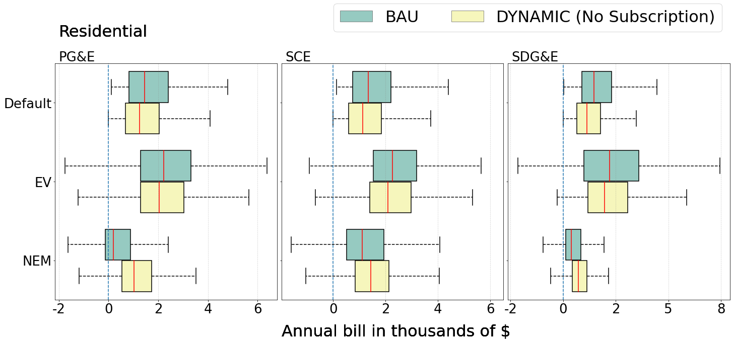
Residential bill impacts (absolute)
Residential annual customer bills are in the low thousands for most customers—higher for EV customers and considerably lower for NEM customers

Slide 13
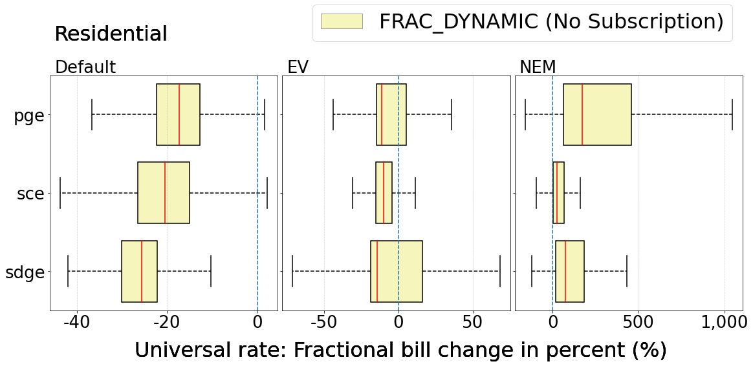
Residential bill impacts (fractional)
Nearly all non-NEM customers see bill reductions under dynamic-only tariffs
Subscriptions tend to erase bill savings and can increase bills
NEM customers mostly experience bill increases under dynamic pricing, regardless of subscription
Across all customer types, the self-load-shape subscription yields the smallest impacts

Slide 14
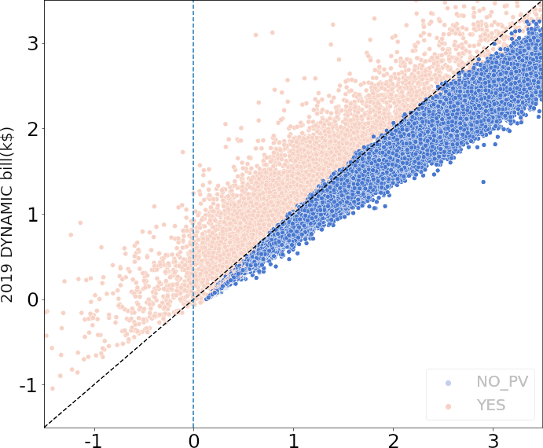
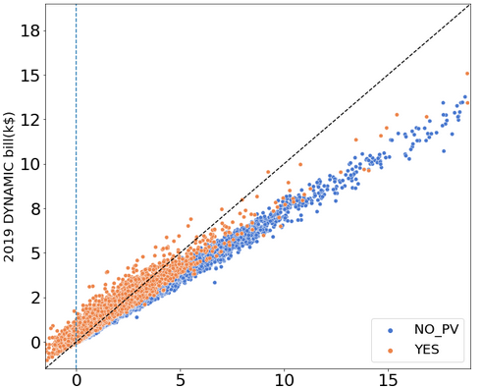
BAU vs. DYN Scatter Plot
Individual Non-PV customers are almost all saving (Plots are SCE customers)
Why are savings distributed?
CARE customers?
Load shapes?

Slide 15
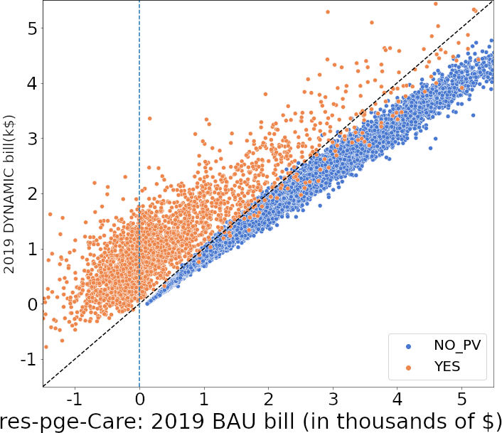
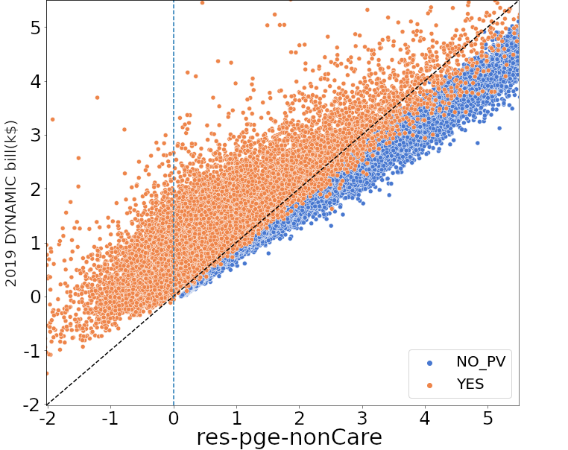
CARE Customers?
No strong structural difference.

Slide 16
Customer Loadshape Clusters

Slide 17
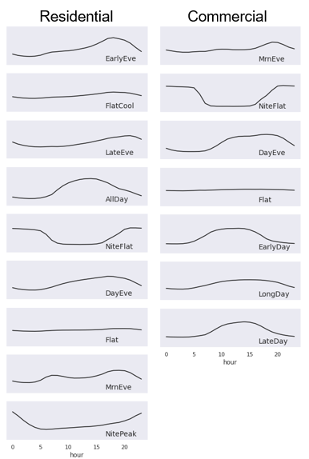
Load shape clustering
We used statistical and machine-learning techniques to cluster residential and commercial customers according to similar load shapes
This yielded nine residential and seven commercial load shape clusters
The clusters consider similarities in customer consumption patterns both throughout the day and throughout the year

Slide 18
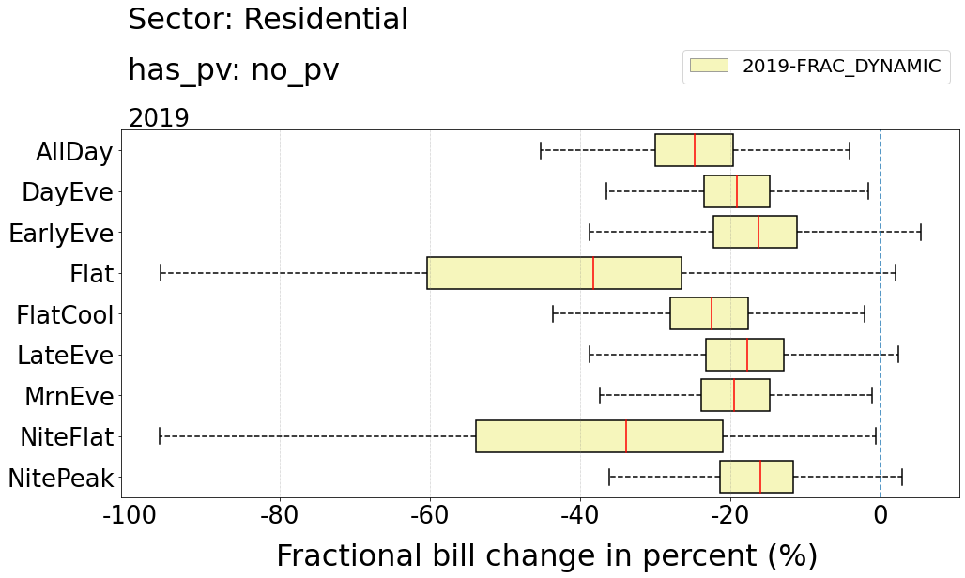
Residential load shape bill impacts (fractional)
Bill impacts vary for customers in different load shape categories
“Solar-friendly” shapes with significant daytime load (Flat, AllDay) have the most savings
Shapes with significant morning and evening loads (EarlyEve, LateEve) save less
This may have implications for opt-in rates

Slide 19
Bill Volatility

Slide 20
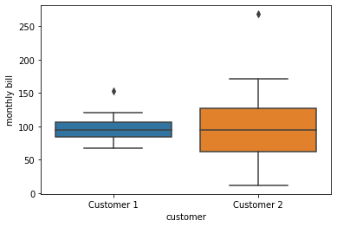
Bill Volatility Impact
Annual bill impacts
We compute each customer’s total annual bill for 2018 and 2019 under the BAU tariff, the dynamic-only tariff, and each of the subscription options
We examine the distribution of customer bills under each tariff option
We also consider the distribution of changes in customer bills, under each dynamic tariff option, relative to the BAU bill
Bill volatility impacts
We measure bill volatility as the range from highest to lowest monthly bill, as a fraction of the mean bill, over the full 24-month analysis period.
Measuring volatility: example
Volatility = 2.7
Volatility = 0.9

Slide 21
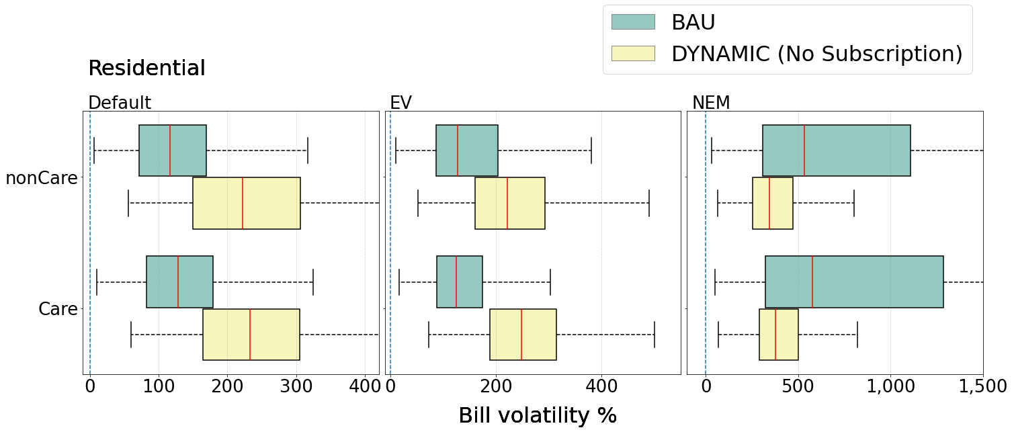
Bill Volatility for CARE customers
Independently of CARE status, volatility for customer under Default rate goes up.

Slide 22
Subscriptions

Slide 23
Subscription-based tariffs
We consider two different dynamic tariff structures:
A one-part, or dynamic-only tariff, in which all load is charged at the hourly dynamic rate
A two-part, or subscription tariff, in which customers pre-purchase a particular load shape at their BAU tariff as a hedge against volatility, with any divergence from the subscription billed (or credited) at the hourly dynamic rate
We compute subscription-based bills for each customer for three different load shapes, spanning the range from highly informed to highly uninformed:
A flat load-shape subscription
A cluster load-shape subscription, based on the load shape of the customer’s detailed cluster
A self load-shape subscription, based on the customer’s load shape in the “wrong” year (i.e., swapping 2018 for 2019 and vice-versa)
Each subscription load shape is scaled to match the customer’s average annual energy consumption in 2018-2019.

Slide 24
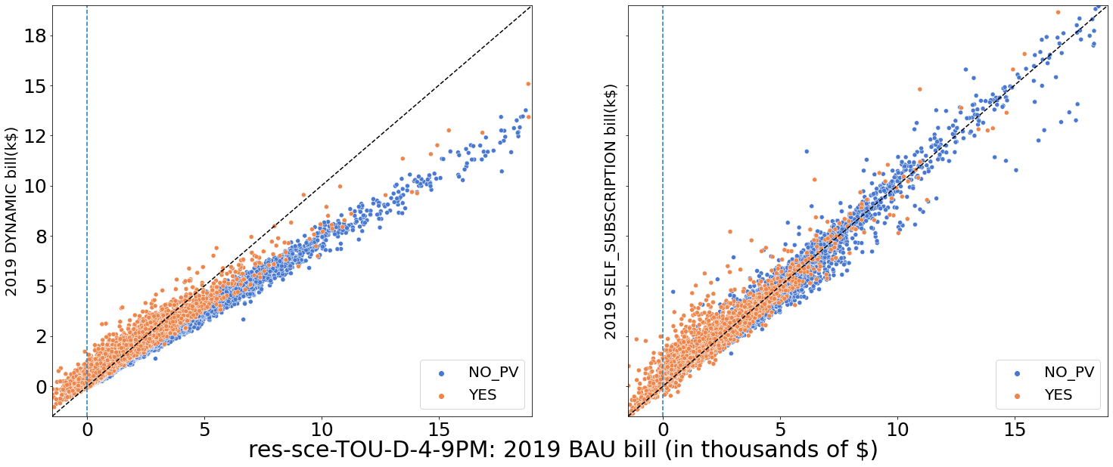
Subscription effect

Slide 25
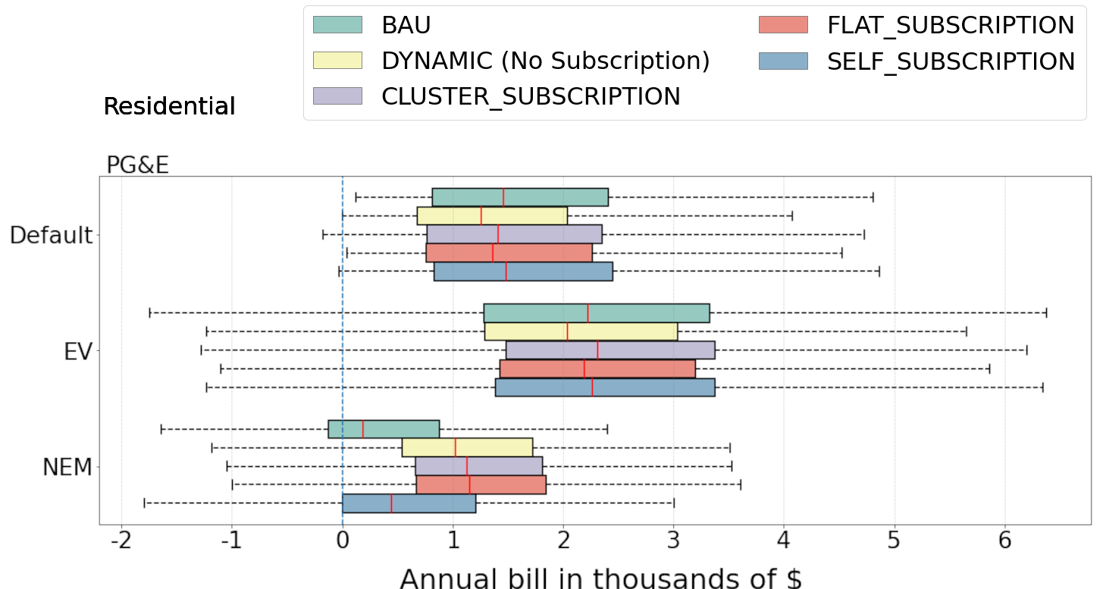
Absolute Bills

Slide 26
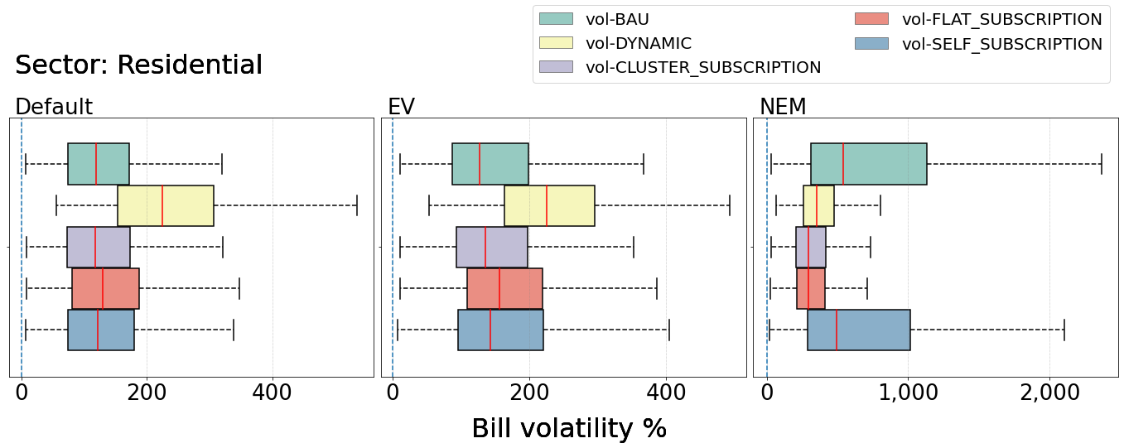
Residential bill volatility impacts
Non-NEM customers have typical BAU volatility a bit above 100% (e.g., a $100 average bill, with low bills around $50, and high bills around $160)
The dynamic-only tariff roughly doubles the typical bill volatility
All three subscription options are very effective at mitigating the volatility increase
NEM customers have very high BAU volatility, and all dynamic tariffs decrease the volatility, likely by increasing the lowest bills

Slide 27
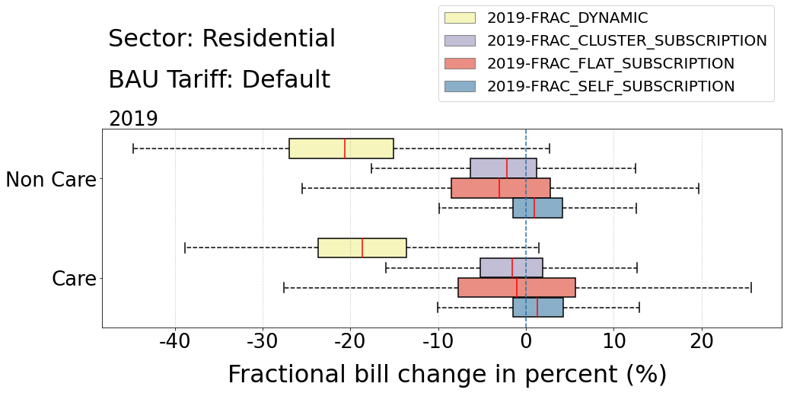
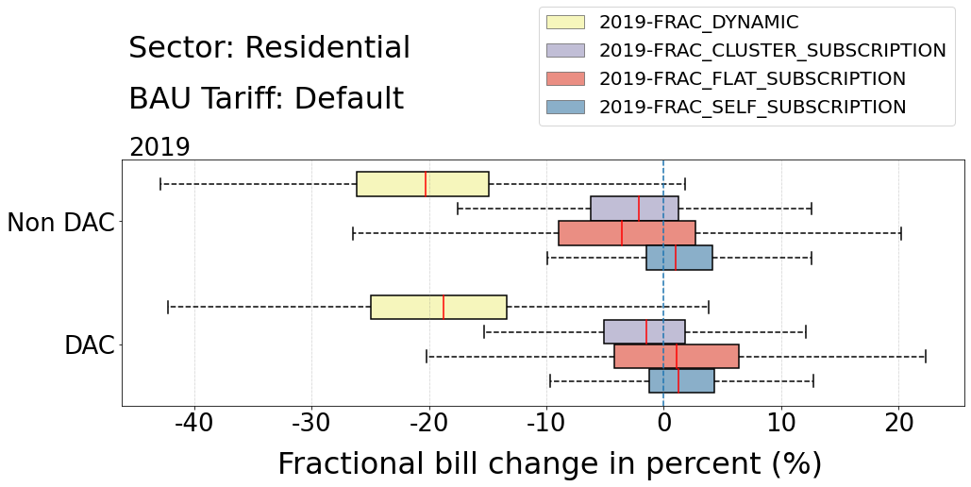
CARE and DAC bill impacts
CARE and DAC customer subgroups have similar bill impacts to non-CARE/DAC customers
Savings on dynamic-only tariff are marginally smaller for both groups

Slide 28
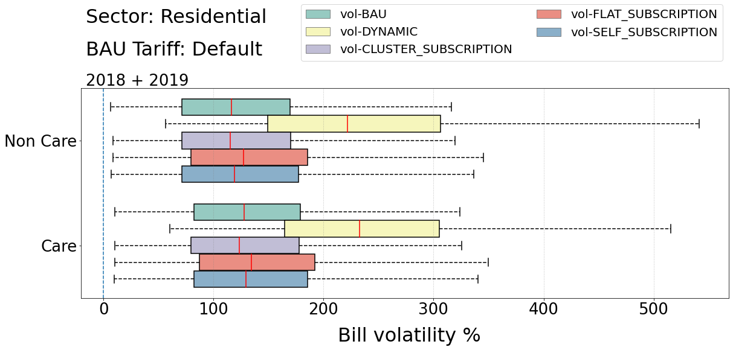
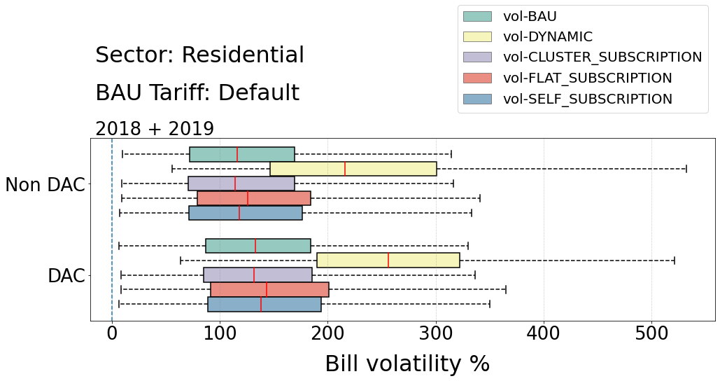
CARE and DAC customer bill impacts (volatility)
CARE and DAC customers have slightly higher BAU volatility than non-CARE/DAC
CARE customers see similar volatility impacts to non-CARE customers
DAC customers experience a larger volatility increase, possibly due to climate effects
Subscriptions are an effective hedge for all categories

Slide 29
Summary of findings
Most residential (and small C&I customers) would realize bill savings from the dynamic tariff, but increased volatility
There is a clear trade-off between bill size and bill volatility
CARE and DAC customer impacts are similar to other customers
There is variation in impacts by load shape; solar-friendly shapes have a structural advantage
Response to dynamic rate was not modeled. Only “worst case” scenario with no response. This is our upcoming study.
A universal rate might lead to cross-subsidizing across customer classes. We are applying revenue neutrality on a class-base in our upcoming study.
What is a “fair” rate? Is volatility a good measure?
Subscriptions can mute down volatility, but also eat up bill savings

Slide 30
Questions and discussion

