Slide 1
DSIRE | DSIRE Insight NASUCA Annual Meeting November 6, 2023
Brian Lips
Sr. Project Manager for DSIRE
bclips@ncsu.edu

Slide 2
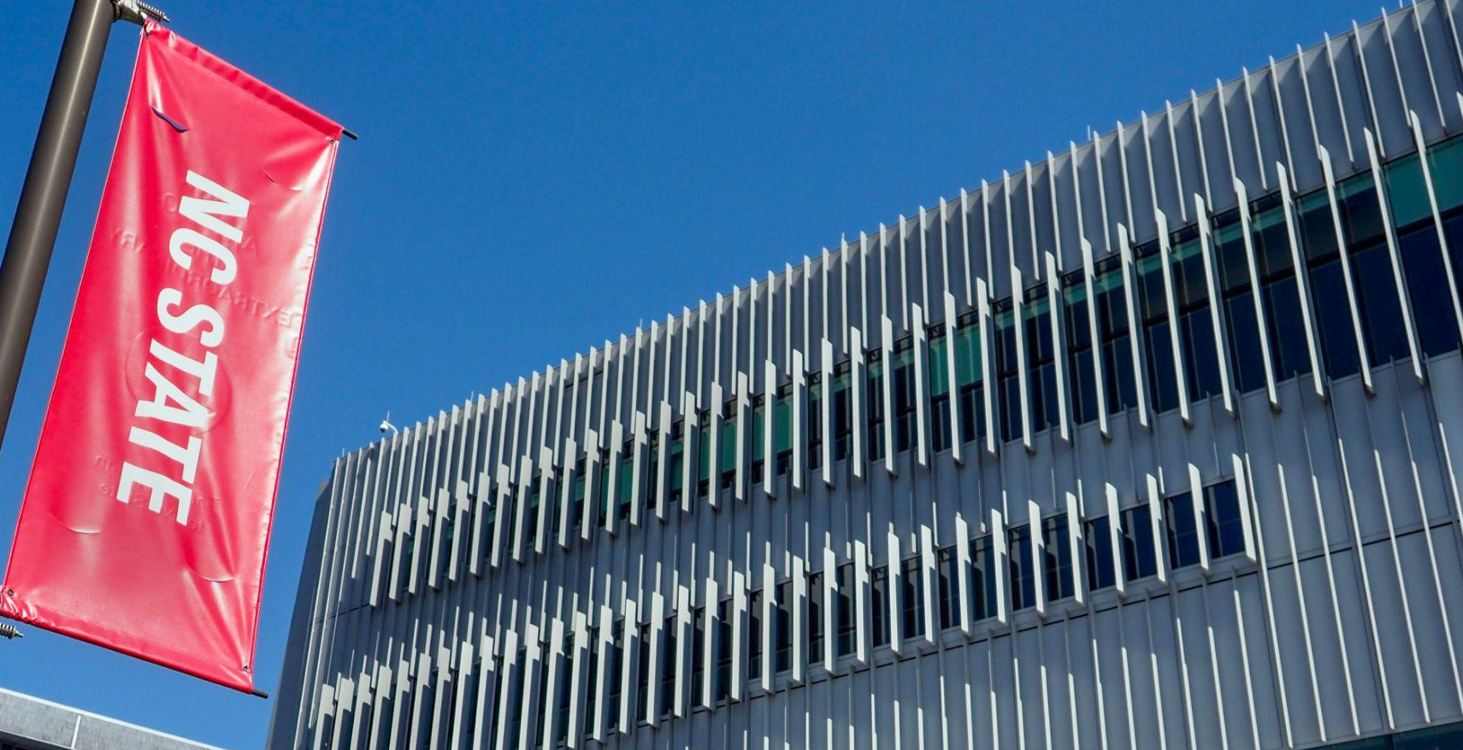
Our Mission
The N.C. Clean Energy Technology Center, at N.C. State University, advances a sustainable energy economy by educating, demonstrating and providing support for clean energy technologies, practices, and policies.
For over 30 years, the Center has worked closely with partners in government, industry, academia and the non-profit community.

Slide 3
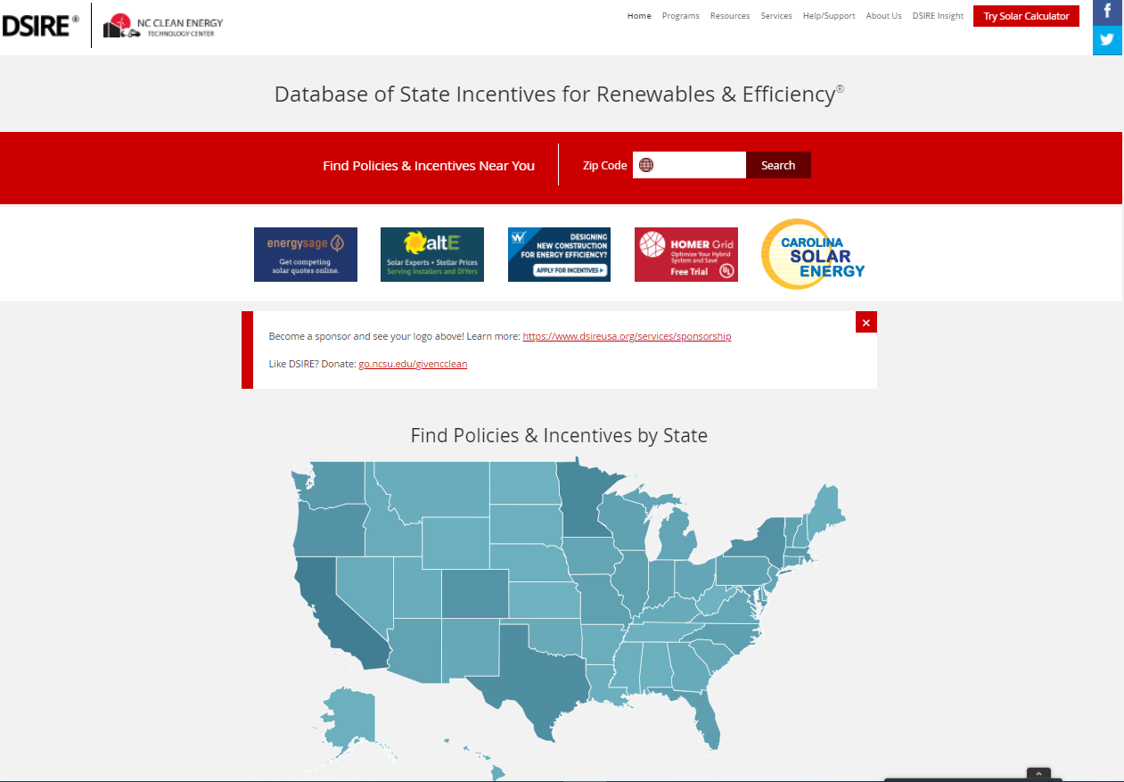
https://www.dsireusa.org/

Slide 4
DSIRE Content
>2,600 policy/incentive summaries
All federal and state administered policies and incentives
All incentives provided by utilities with >30,000 customers
All policies and incentives implemented by the top 50 cities and counties by population, plus examples of innovative local policies and incentives

Slide 5
Technology Types
Renewable Energy Technologies – 34 sub-technologies
Energy Efficiency Technologies – 54 sub-technologies
Energy Storage Technologies – 1 sub-technology
Electric Vehicle Technologies – 12 sub-technologies

Slide 6
Policy Types
Interconnection
Net Metering
Renewable Portfolio Standards
Solar Access Laws
Solar / Wind Contractor Licensing
Line Extension Analysis
Mandatory Greenpower Purchasing Requirement
Appliance Standards
Building Energy Codes
Community Solar Rules
Energy Efficiency Resource Standards
Energy Standards for Public Buildings
Energy Storage Targets
Generation Disclosure

Slide 7
Incentive Types
Corporate Tax Credits
Corporate Tax Deductions
Corporate Tax Exemptions
Feed-In Tariffs
Grant Programs
Green Building Incentives
Loan Programs
Performance-Based Incentives
PACE Financing
Personal Tax Credits
Personal Tax Deductions
Personal Tax Exemptions
Property Tax Incentives
Rebate Programs
Sales Tax Incentives
Utility Rate Discounts

Slide 8
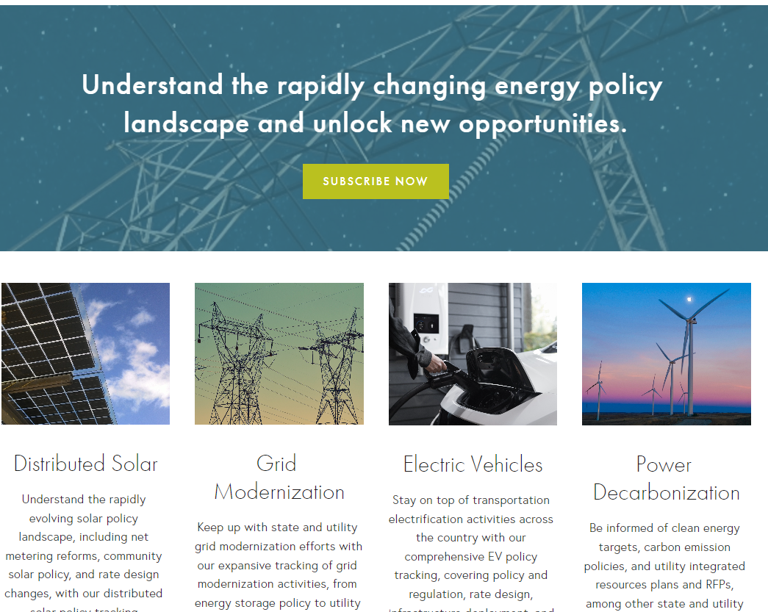

Slide 9
DSIRE Insight Subscription Content
Biweekly Legislative and Regulatory Tracking
Quarterly Policy Reports
Policy Data Sheets
Monthly Curated Policy Update Emails
Free to policymakers (you!)

Slide 10
DG Compensation Policy
Value of Solar Studies
Community Solar Policy
Fixed Charges and Minimum Bills
Demand and Solar Charges
Third-Party Solar Ownership
Utility-Led Rooftop Solar Programs
Currently Tracking 108 Dockets, 60 Rate Cases, 112 Bills

Slide 11
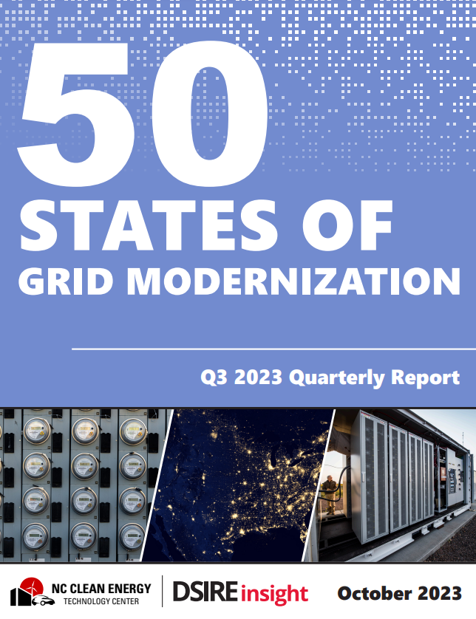
Studies and Investigations
Planning and Market Access
Utility Business Model and Rate Reforms
Grid Modernization Policies
Financial Incentives
Deployment of Grid Modernization Technologies
Currently Tracking 392 Grid Modernization Dockets, 300 Bills

Slide 12
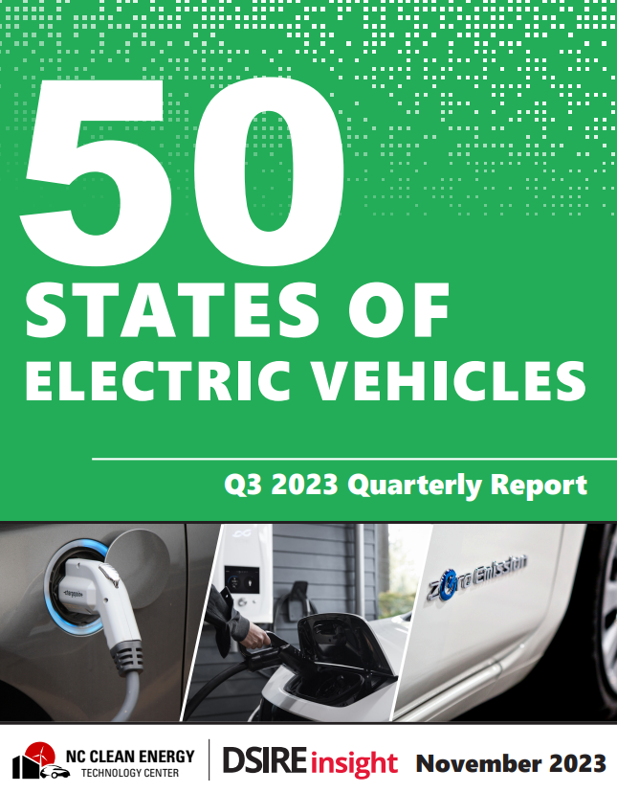
Studies and Investigations
Electric Vehicle Regulation
Electric Vehicle Rate Design
Electric Vehicle Market Development
Financial Incentives
State and Utility Deployment
State NEVI Planning and Implementation
Currently Tracking 159 Dockets and 460 bills

Slide 13
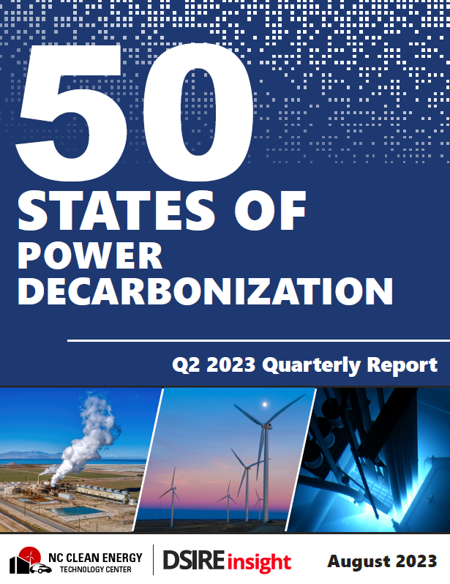
Studies and Investigations
Clean Energy Targets
Emission Targets and Carbon Policies
Planning and Procurement Rules
Integrated Resource Plans and Generation Capacity Changes
Q3 Report Coming Soon

Slide 14
Questions?
Brian Lips
Senior Project Manager, DSIRE
NC Clean Energy Technology Center
bclips@ncsu.edu

