Slide 1
Alternative Ratemaking: Unintended Consequences and Recommendations for Consumer Advocates
Reducing the Cost of the Energy Transition
NASUCA Annual Meeting, Charlotte
November 7, 2023
Paul Alvarez, President, Wired Group

Slide 2
Alternative Ratemaking:
Ratemaking practices intended to reduce regulatory lag
These approaches all involve the review of investment plans presented in advance
Rider/Tracker Cost Recovery
Future Test Years
Multi-Year Rate Plans
Also:
“Indexed” Rates (HI, ME, MA)
Rate = Current + Inflation – productivity + unexpected (storms)
Performance-based Rewards and Penalties
Formula Rates (AL, LA, MS; IL 2011-2021)
Revenue Decoupling

Slide 3
Alternative Ratemaking Prevalence
Rider/Tracker Cost Recovery: All but 10 states.
Future Test Years: FL; MI; MN; OR; WI
Multi-year Ratemaking: CA (1985); NY (1987); GA (1996); CT (2016); MD (2020); IL (2021); WA (2021); NC (2022)
Multi-year Ratemaking: Determining rates in future years based on spending forecasts and investment plans. Like other AR practices, reduces regulatory lag.
Primary Source: Kirsch L and Morey M. Alternative Electricity Ratemaking Mechanisms Adopted by Other States. Christensen Associates Report for PUC Texas. May 25, 2016.

Slide 4
Multi-Year Ratemaking:
Unintended Consequences of Advance Plan Review
Issue | Consequence
Once an investment Plan is approved, cost disallowance risk falls to zero.* | Advance prudence determination eliminates utility incentive to actively govern capital spending.
Prudence burden shifts from utility (which must prove, in a rate case, that $ spent were prudent) to stakeholders (who must prove that the $ a utility proposes in a plan will not be prudent). | Stakeholders suffer from asymmetries (information, resources, expertise) and procedural schedules that preclude effective execution of this new responsibility.
“Moral Hazard” is introduced into investment plan development. | Whereas cost disallowance risk was formerly available to penalize over-spending, no such penalty exists for “over-proposing”.
Result: Investment Plans with premature and cost-ineffective spending
* Note that this is true despite legislative language or regulatory orders that specifically reinforce regulators’ authority to disallow costs.

Slide 5
What Can Advocates Do?
Stop AR before it starts. Educate regulators/legislators on the need for balance between customer & shareholder interests in monopoly regulation.
Prefer Rider/Tracker cost recovery over other AR approaches, because it can be limited to certain investment types, timeframes, or $. (MYP and forward test years reduce governance on ALL capital spending.)
Prohibit inter-MYP rate adjustments (MD, IL)
Reduce riders through defined, related offsets (O&M $, productivity %)
Reduce rates of return (to reflect shareholder risk reductions)
Require that excess earnings (in $ or %) be shared with customers

Slide 6
If You Are Stuck With Advance Planning:
Demand outcomes-based performance targets from spending, with $ penalties for non-performance.
Demand stakeholder participation in Plan development (NARUC-NASEO grid planning process). Note that this is more than ‘stakeholder engagement’.
Define control processes that utilities must use during Plan development, and enforce their application.
Demand risk-informed benefit-cost analyses for all discretionary* investments. Risk reduction benefits from investments should be translated into dollar values.^
* Not strictly required for safe and reliable service per the Regulatory Compact. Variation is available as to the solutions deployed, their timing, and geographic extent.
^ See California PUC decision dated 12-15-22 in R.20-07-013

Slide 7
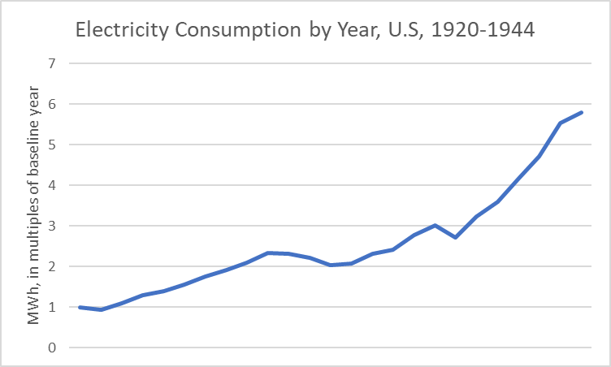
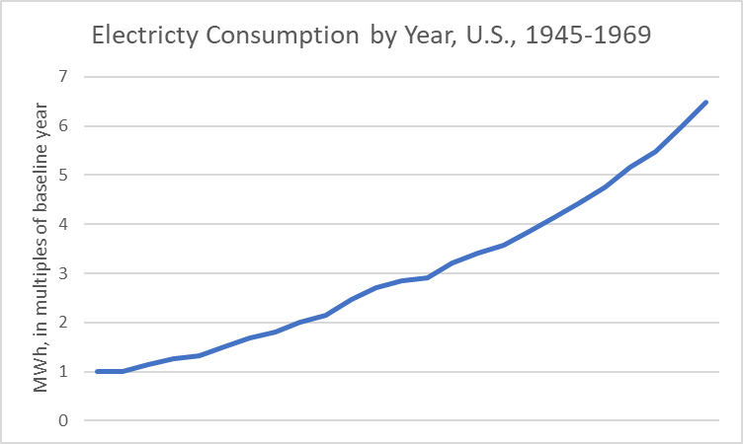
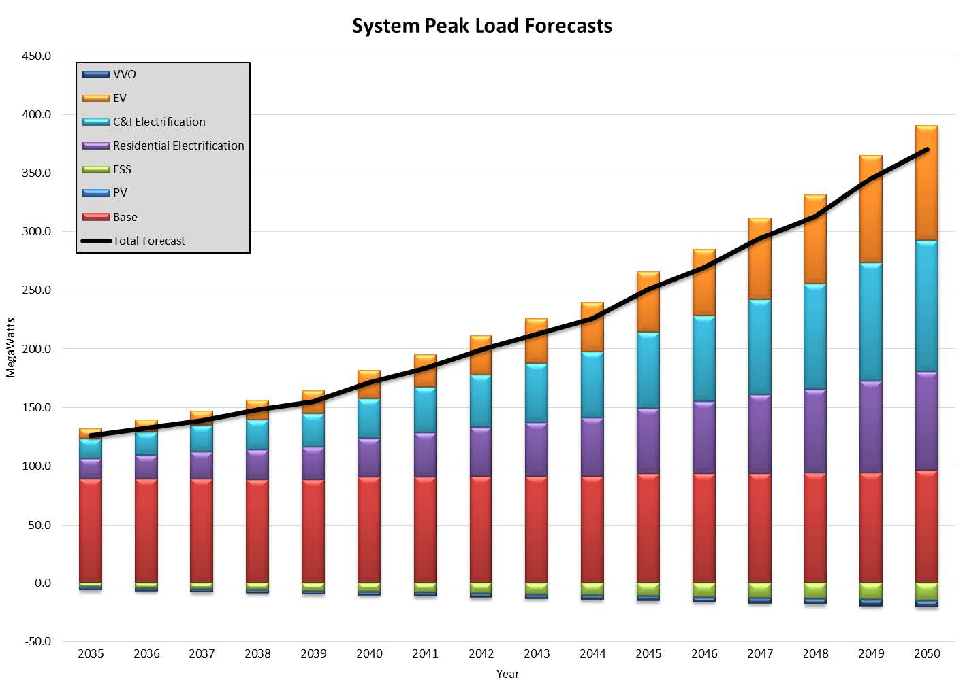
Standard Ratemaking Has Cost-Effectively Accommodated Rapid Load Growth in the Past!
Cleveland CJ et al. United States Electric History in Four Charts. Institute for Global Sustainability, Boston University. Available at http://visualizingenergy.org
Pitting jurisdictions against one another: The Energy Policy Act of 1992 repealed the prohibition against cross-state utility ownership in place since 1935.
Unitil Electric Sector Modernization Plan (draft). Peak load forecast 2035-2050. September, 2023. Page 119.

Slide 8
Appendix
Reducing the Cost of the Energy Transition
NASUCA Annual Meeting, Charlotte
November 7, 2023
Paul Alvarez, President, Wired Group

Slide 9
Excess/Premature Investment Examples
Replacing “aging” substation equipment*
Circuit “hardening” (thousands of $ per premises)
Undergrounding lines currently overhead (tens of thousands of $ per premises)
Premature installation of ADMS and DERMS
Accommodating “two-way power flow” from DER
Complying with “standards” (official or utility-specific)
Smart meters (insufficient post-deployment value)
Proprietary (vs. rented) communication networks
* Replacing equipment that has passed objective functional and diagnostic tests simply because the equipment is fully depreciated and earning no rate of return.

Slide 10
Performance Accountability
Establish performance targets and/or benchmarks
Establish financial penalties (and incentives?) based on performance targets and/or benchmarks
Performance targets/benchmarks MUST REFLECT OUTCOMES, NOT PROCESSES
Process: “ABC Co. will equip 200 circuits with Distribution Automation”
Outcome: “ABC Co. will reduce system-wide SAIDI to 80 Minutes”
Performance targets/benchmarks MUST BE EXPRESSED AS OBJECTIVE VALUES (#) WITH DATES (by when?)
- SAIDI in Minutes
- DER Hosting Capacity in MW
- Customer Participation in # or %
- Demand Response in MW
- Energy Conservation in MWh
Without objective, outcomes-oriented performance targets and/or benchmarks, with penalties for non-performance, AR transfers 100% of investment risk from shareholders to customers. Where is a utility’s incentive to deliver $ value in excess of costs to customers from investments?

Slide 11
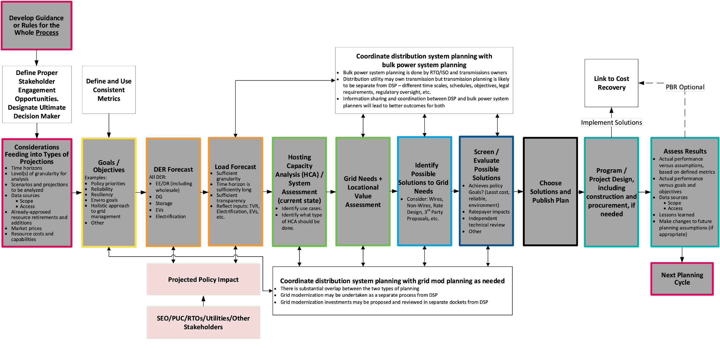
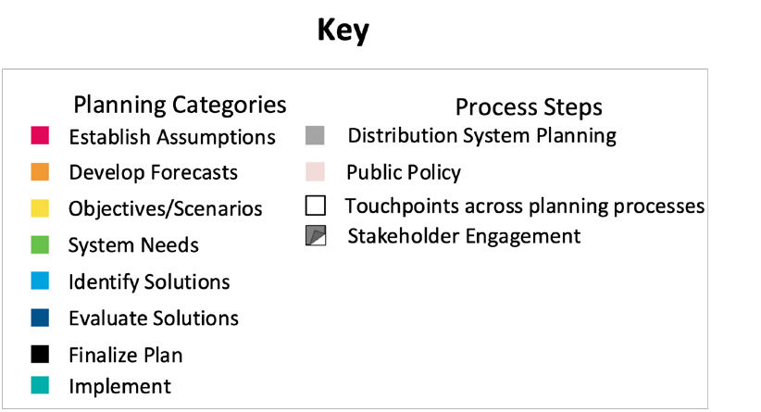
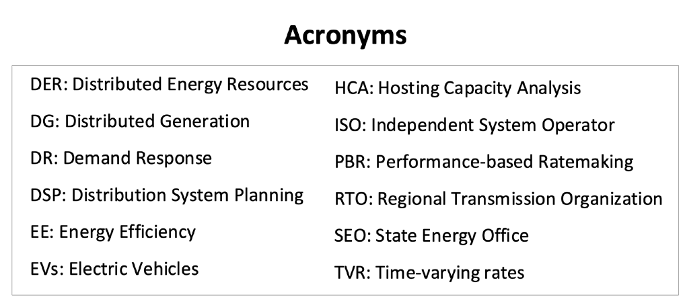
Jade Cohort Flowchart of Idealized Comprehensive Electricity Planning Process
A Distinct Grid Mod Process Is Not Necessary!
Jde Cohort Roadmap — NARUC-NASEO Task Force on Comprehensive Electricity Planning | 5

Slide 12
“RIDS” Benefit Estimate Example
Reduction in Risk of an Outage (%)
Customer Consequence of an Outage ($)
Customer Value
Annual Risk before Investment: 5%^
- Annual Risk after Investment: 3%^
Risk Reduction from Investment: 2%
Res (8000) x Cost per Outage ($6.10*)
+ Large C&I (500) x Cost per Outage ($21,277*) Consequence of Outage: $10,687,300
Customer Value per Year = $213,746 ($10.687 million x 2% risk reduction)
$213,746/yr. over 40 years, inflated at 2%/year, discounted into PV at 10.5%
Present Value over 40 Years = $2,412,330
^Both risk before and risk after should be informed by actual historical or pilot data
*Cost to customers of a 1-hour outage per 2013 DOE Study (used in DOE’s online Interruption Cost Estimator tool) inflated 9 years at 2% per year. With pre/post SAIDI/SAIFI inputs, and other utility & program or project inputs, ICE can compute the present value to customers of reliability improvements.
SEE California PUC decision dated 12-15-22 in R.20-07-013

Slide 13
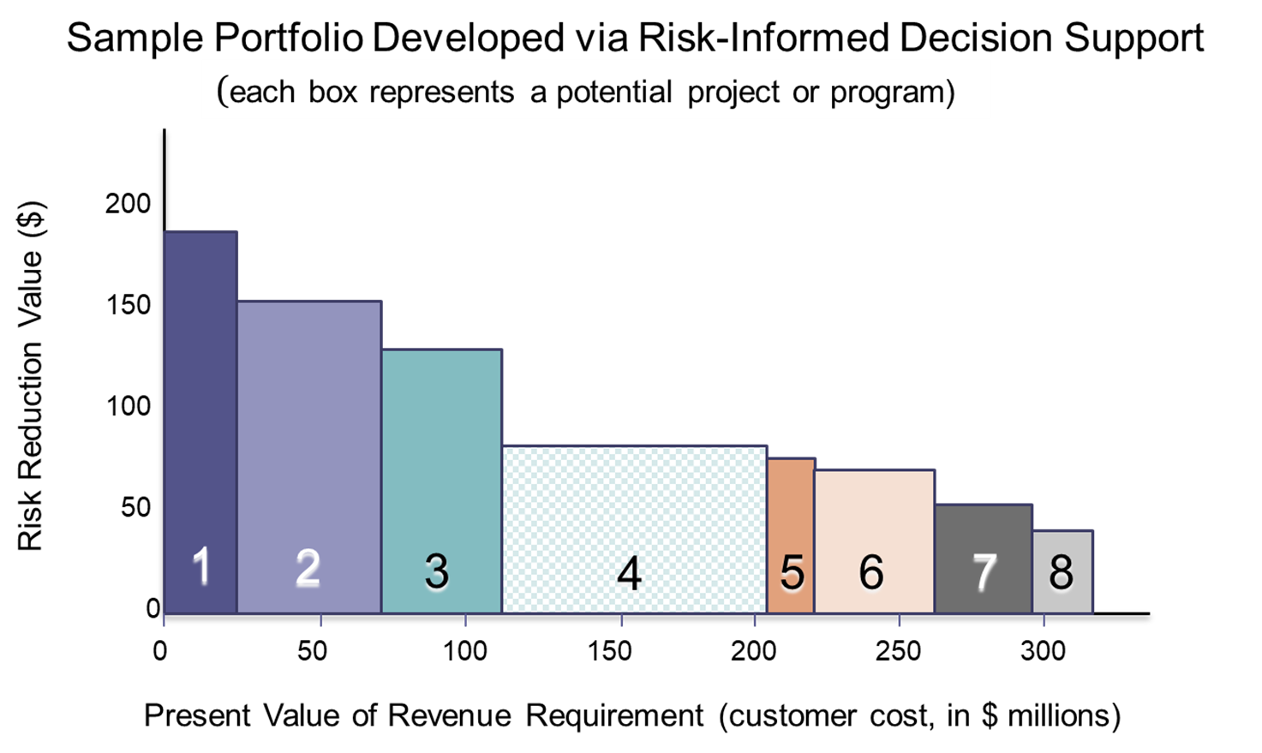
How to use risk-informed benefit estimates

Slide 14
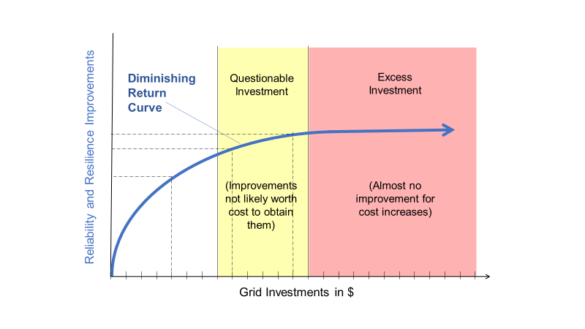
Grid Reliability/Resilience
It is indeed possible to invest too much in reliability (or safety)

Slide 15
Grid “Readiness”

Slide 16
Thank You!
Paul Alvarez, Wired Group, palvarez@wiredgroup.net
Ken Costello, costellonewmexico@gmail.com
Dennis Stephens, Wired Group dstephens@wiredgroup.net

