Slide 1
Grid Planning for Vehicle Electrification
Evolving Grid Planning Practices for Electric Vehicles ESIG DER Working Group
NASUCA Annual Meeting
Presentation by
Sean Morash, Telos Energy
7 November 2023

Slide 2
Agenda
About the Task Force
Set the Stage
4 High-level Steps to Grid Planning
Processes and Wrap Up
Q&A
Forecast EV Futures
Characterize Locational and Temporal Impacts
Develop Roadmaps & Grid Plans
Mitigate the Largest Impacts

Slide 3
Grid Planning for Vehicle Electrification Task Force

Slide 4
Grid Planning for Vehicle Electrification an ESIG DER Working Group Task Force Funding by U.S. Department of Energy, project management by Berkeley Lab
Project Objective
Outcomes & Key Questions
Develop, evolve, and standardize best practices and next steps for power system planning with respect to vehicle electrification. Emphasis on distribution planning, while considering the bulk power system & operational impacts.
Forecasting Electrified Future
Adoption rates, fleets impact, pace of change in electrification and T&D investments
Locational Aspects
Where should EV charging take place?
“No Regrets” approaches to electrification that also ensure asset utilization
Temporal Aspects
Integrating charging timing and flexibility of EVs into planning
Planning on the influence of price signals, software, and hardware controls
Prioritized Industry Needs within a Holistic Electrification Framework
Reference framework for broad electrification planning considerations
What gaps do we need to fill today? Are there blind spots likely to cause problems?
Task Force Members
Project Timeline & Deliverables
Find out More
Consortium of regional grid planners, distribution utilities, researchers, manufacturers, charging operators, fleet owners, etc.
Special task force sessions from November 2022 – September 2023
concluding with whitepaper and webinar on key insights
https://www.esig.energy/distributed-energy-resources-der-working-group/
Contact: sean.morash@telos.energy

Slide 5
Timeline & Deliverables
Kickoff & Determine Tracks
ESIG WG, Tucson
Report Drafting
Nov
Mar
Apr
Feb
Jun
Jul
Aug
Sep
Oct
May
Dec
Jan
Forecasting
Utilities OEMs
Locational
Utilities CPOs
Temporal
Utilities Research
Holistic
Industry

Slide 6
Set the Stage

Slide 7
EVs 10x near-term Stationary Battery Market
Nearly unprecedented change:
EVs are first major load growth since air conditioning in the 1960s.
Demand from 1 EV ≈ 1 house
Concentration of EVs can overwhelm local distribution system capacity.
Adoption rates to vary significantly across communities
Cumulative distribution investment across the country could be $200B by 2050 to facilitate EVs.¹
ISO-New England forecasts that by 2032:
Transportation electrification will increase annual energy requirements for the region by 10% and contribute between 8% and 12% to system peaks.²
1,200 GWh
Storage in 33M EVs on road by 2030
120 GWh
Utility-scale batteries planned through 2025
Sources: 1. Cutter, 2021. 2. Black, 2023
Notes:
Image Top: Data on storage by 2025 from EIA, Data on EV Energy uses 33M vehicle baseline from Wood, 2023 (NREL report)

Slide 8
Widening Gap Between Vehicles and Chargers
T&D infrastructure could become a limiting factor for future EV adoption

Slide 9
Big Money for Distribution Upgrades With wide error bars
Potential costs for grid upgrades have large uncertainty bands.
One study’s high- and low-cost cases differed by a factor of 10.
High case estimated $200 billion in distribution grid upgrades needed for EVs across the country by 2050.¹
Big impacts on a per customer basis:
$50 billion = $2,500 per customer in CA
New EV loads can help spread the costs of new infrastructure across more electricity usage, with the potential to put downward pressure on electricity rate
T&D infrastructure could become a limiting factor for future EV adoption
Electrification Impact Study
2022 CEC Statewide Forecast
Sources: 1. Cutter, 2021. 2. Kevala, 2023. 2. Public Advocate’s Office, 2023

Slide 10
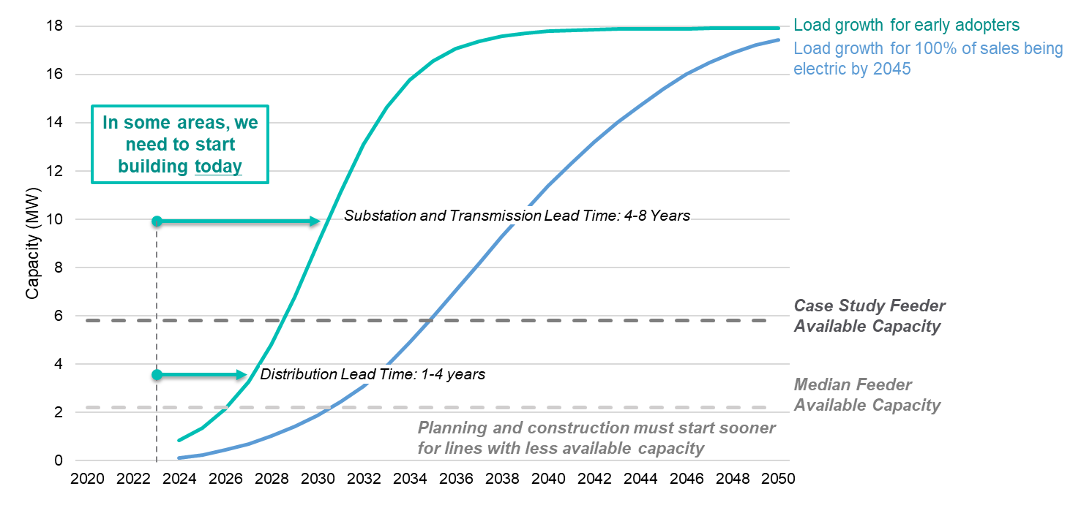
Impacts of Near-term Decisions on Long-term Load Growth
Given lead times, decisions are needed today to support electrification targets in some areas.
Long lifecycles mean that grid equipment is used for 45-50 years.
Right-Sizing under
High Uncertainty
Underbuilt Grid
Overbuilt Grid
Risks:
Unreliable grid
Stunted public interest in EVs
Long waits for charger installs
Risks:
Expensive underutilization
Inequitable burden of costs
Sources: Image left : National Grid. The Road to Transportation Decarbonization: Readying the Grid for Electric Fleets. 2023. Image Right: ESIG

Slide 11
4 Steps to Grid Planning

Slide 12
Focus: Best Planning Practices to Support EVs
Forecast EV Futures
Develop Roadmaps and Grid Plans
Mitigate the Largest Impacts
Characterize Locational and Temporal Impacts
Priorities for de-risking Grid Planning for EVs
Get better at forecasting
Use smart charging
Build EV impacts into every planning practice
Consider process suitability

Slide 13
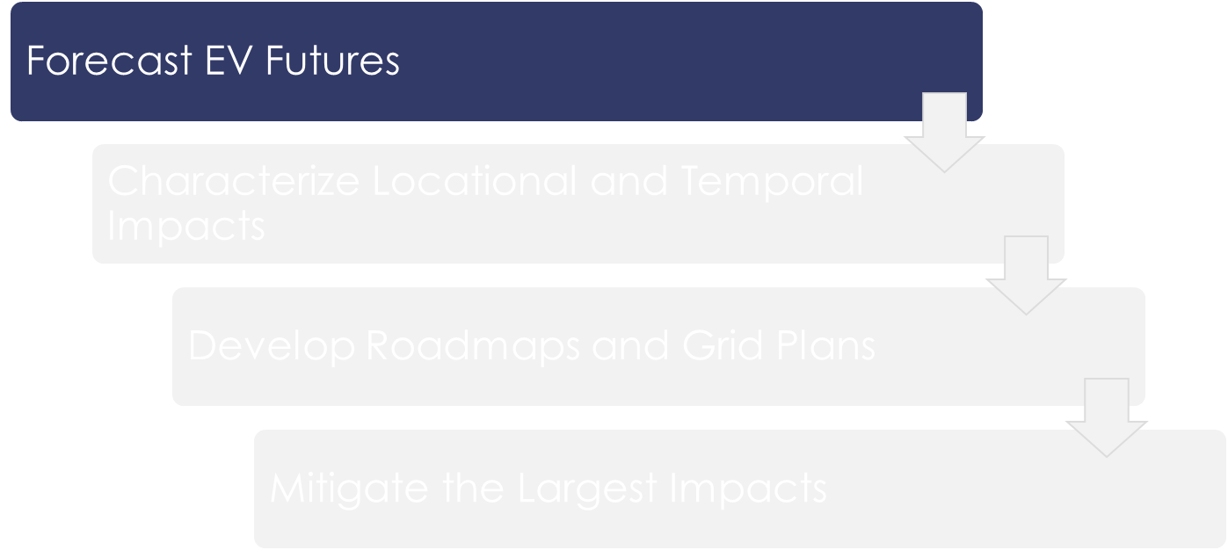
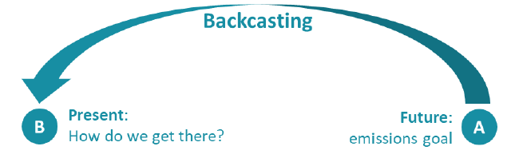

Forecast EV Futures: Understand EV Trends
Adoption: how many and when will people switch to EVs?
Use Case: Differentiate how a particular vehicle will be used across the year
School buses vs. city buses
Commuter vs. secondary vehicles
Technology
Larger batteries with faster charging
Potential future technology development
Different rates across state of charge
Start with an endpoint and work backwards
Sources: Image top: Axios; Image Bottom: INL Caldera, 2023

Slide 14
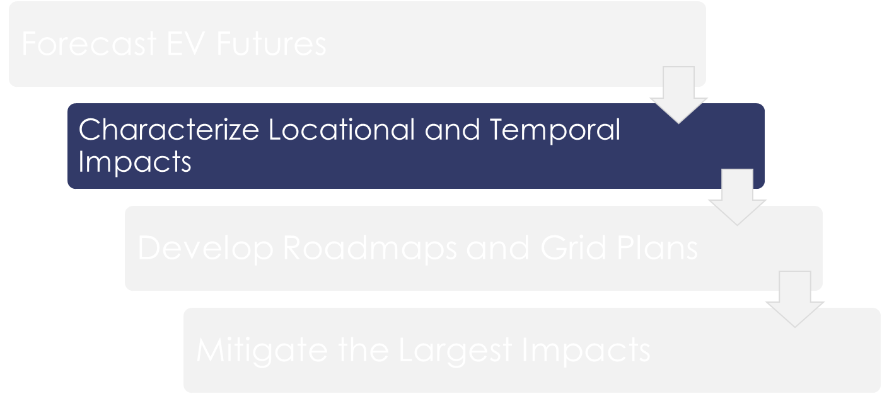
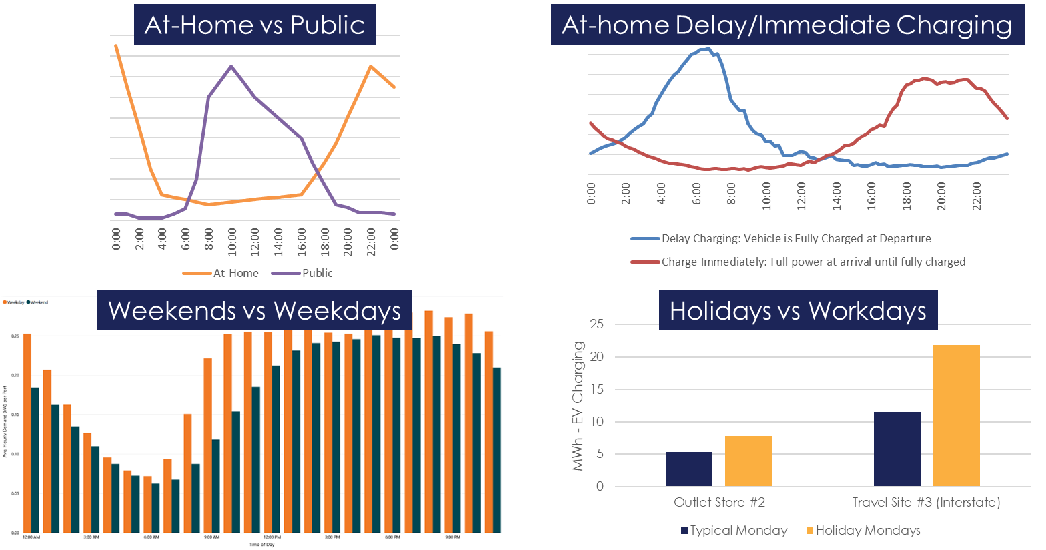
Characterize Impacts: Timing
Uncertainty Abounds in Charging Timing
Variables have dramatic impact on the naïve charge profile:
At-home vs. public charging
Customer settings for charge urgency
Weekday, holidays and seasonal traffic patterns
Weather can affect EV charging needs:
Battery charge efficiency
Occupant comfort
Transportation needs
Data Sources: Top Left: EVI-lite-Pro, 2023; Top Right: Powell, Cezar, Rajagopal, 2023; Bottom Left: EV-Watts, 2023; Bottom Right: Tesla.

Slide 15
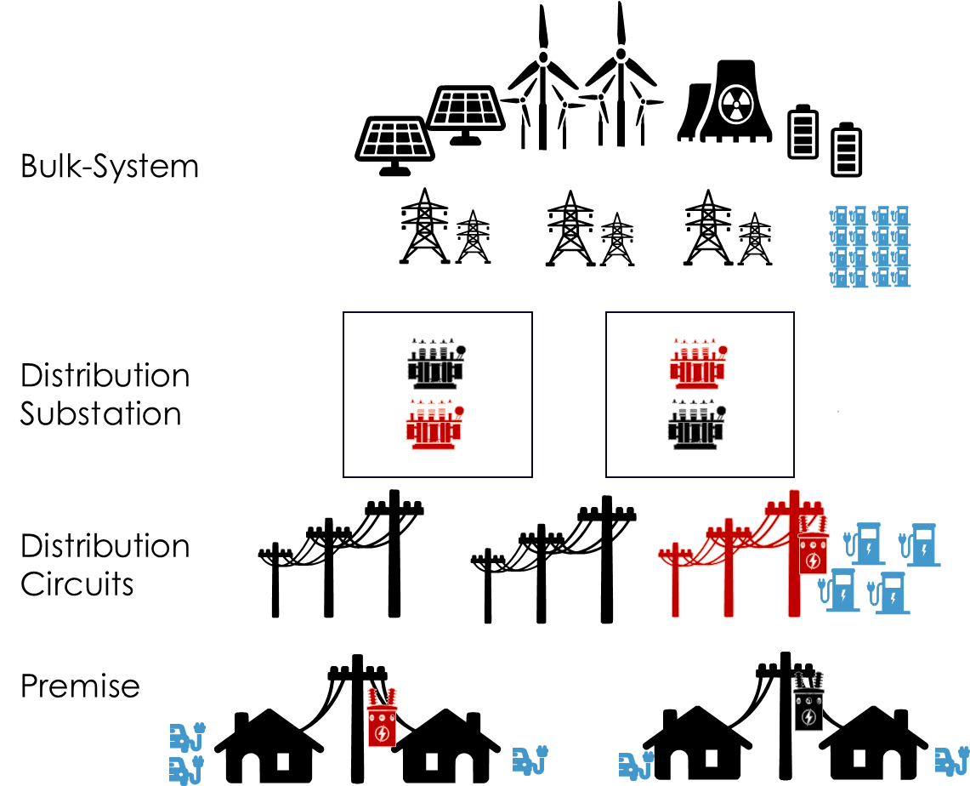
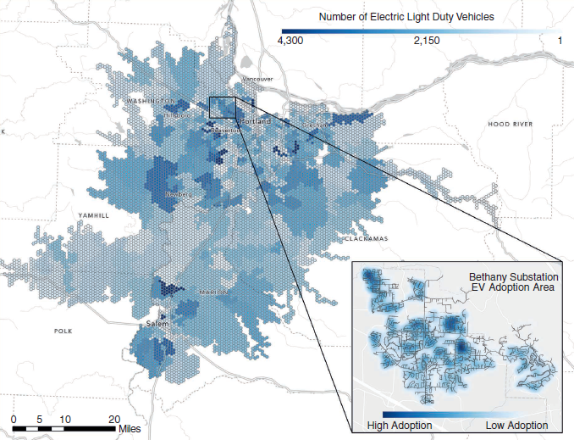
Characterize Impacts: Location
Topological Location
Grid constraints can limit charging availability at each topological location
Consider access to public charging in areas with multi-family housing and higher percentages of renters
Geographic Location
Concentration of EVs in a specific city
Eversource used GPS data to understand that winter traffic was roughly 10% higher than summer in Cambridge, Massachusetts, due to local universities
Image Sources: Left: ESIG. Right: PGE, 2023.

Slide 16
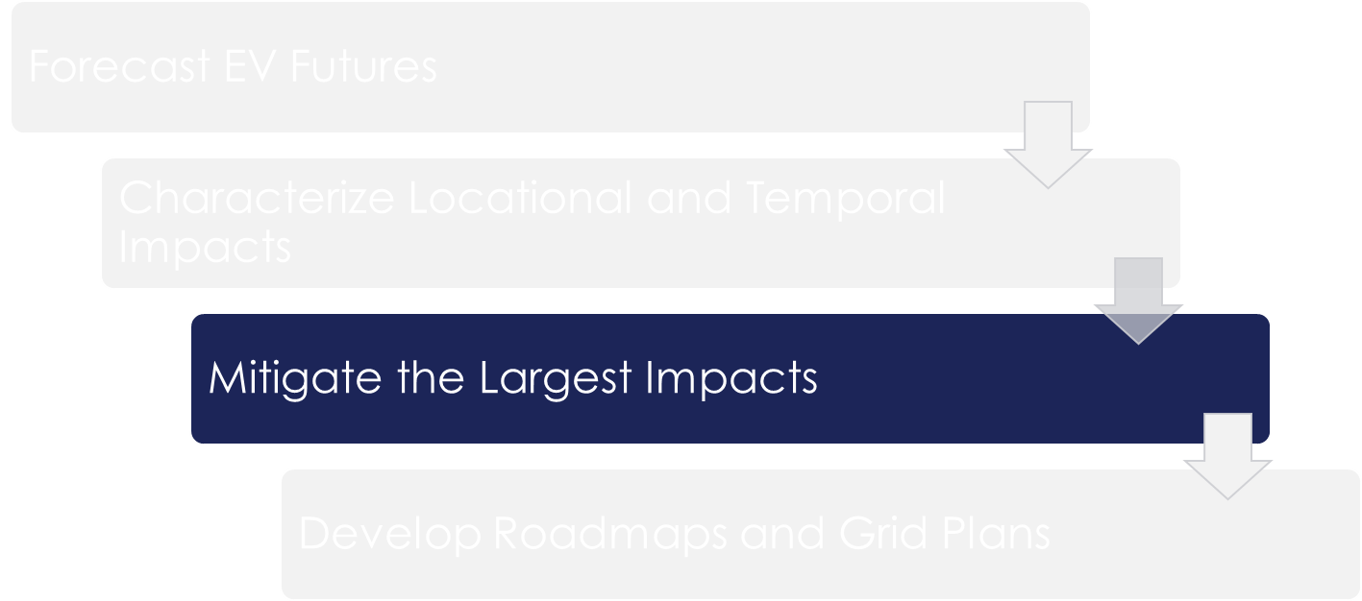
Mitigating the Largest Impacts
Historically, load profiles = static inputs
Even impacts of TOU or DSM = static
EV loads ≠ static
Smart EV charging can address various grid needs based on value
EVs can evolve demand-side planning
Demand management to address multiple needs depending on situation
Not a static input that requires a specific grid solution
Not a silver bullet: EV-related infrastructure will still be needed
Recent Work in California highlights the importance of smart charging for the cost of distribution upgrades
DSM = Demand-side management
Source .Energy Systems Integration Group; data courtesy of Kevala, 2023; Public Advocates Office, 2023.

Slide 17
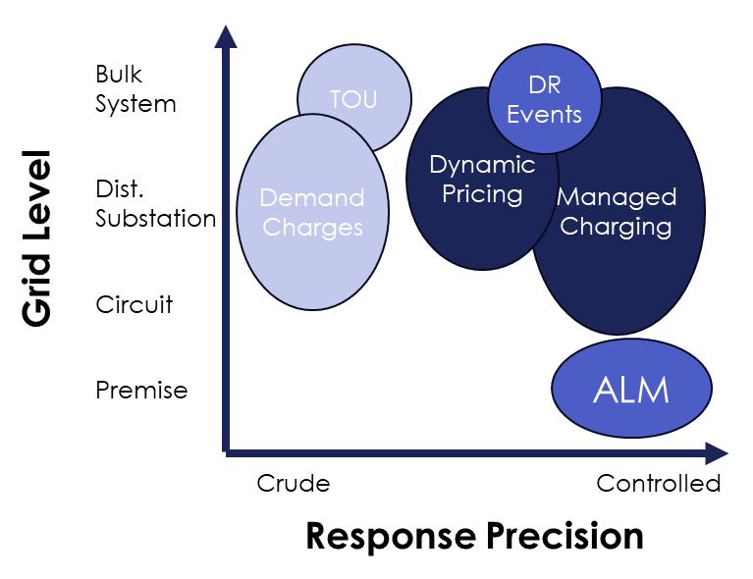
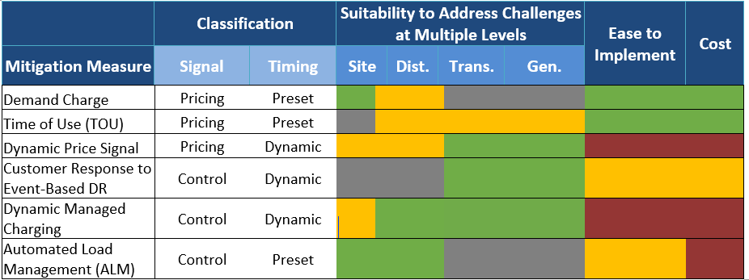
Mitigating the Largest Impacts Many Flavors of Smart Charging
Smart charging can be accomplished through pricing or control programs, with preset or dynamic definitions, to address grid challenges at different levels.
Cost and ease to implement smart charging measures are characterized relative to each other and should be evaluated against alternatives, such as infrastructure improvements.
Source .Energy Systems Integration Group

Slide 18
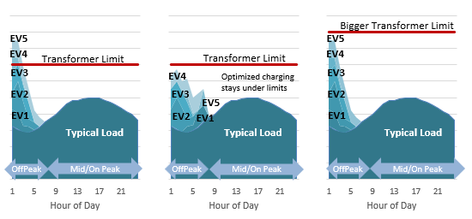
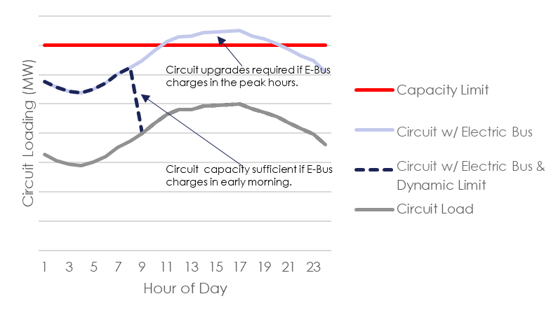
Mitigating the Largest Impacts EVs Responding to Changing Grid Conditions
Care should be given to avoid unintended consequences in the design of programs, with costs evaluated against traditional upgrades
Managed charging allows dynamic limits with restrictions on when the EV can charge.
Source .Image left: Green Mountain Power. Right: ESIG

Slide 19
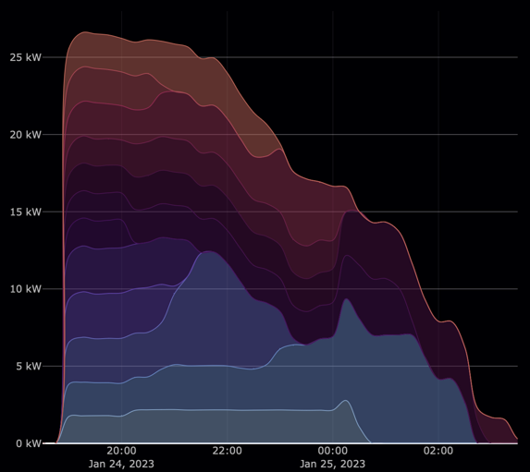
Mitigating the Largest Impacts Automated Load Management
Automated Load Management (ALM) is software that schedules and prioritizes EV demand at a given point of interconnection (POI) to remain within a specified range over time.
ALM in Action
The Irish Post uses ALM to manage infrastructure constraints. In this example, the total nameplate rating of the supply equipment is 88 kW, while the site interconnection limit is 28.9 kW. By using ALM to charge the vehicles at different times of night, the aggregate vehicle profile remains under the interconnection limit.
POI
5x15 = 75kW
POI
50kW
ALM manager
15 kW
15 kW
15 kW
15 kW
15 kW
15 kW
15 kW
15 kW
15 kW
15 kW
The CPUC found that “utilization of ALM will help lower program costs and promote efficient use of electric grid infrastructure.”¹
When using ALM, PG&E observed cost savings ranging from $30,000 to $200,000 per project.²
Source . 1. Decision Authorizing Pacific Gas and Electric Company’s Electric Vehicle Charge 2 Program, 2022; 2. Opening Brief of Pacific Gas and Electric Company, 2022; Image right courtesy The Mobility House AG

Slide 20
Mitigating the Largest Impacts Challenges and Coordination
Challenges:
Customer Participation - Convincing customers to participate, incentivized by the value stream that the utility or aggregator can monetize, can prove unsuccessful.
Preserving Benefits of Load Diversity - Smart charging can disrupt diversity by concentrating charging during specific time periods.
Communication and Control - The architecture to enable smart charging requires data exchanges across multiple software systems designed by different vendors with different risk tolerances.
Pricing Sensitivity and Reliability - Pilots point toward the potential of smart charging, but work remains to understand the extent to which grid planners should rely on it, and its overall cost-effectiveness.
Modeling - Even after data on smart charging is widely available, grid planning tools and processes will need to be updated to consider smart charging as an option.
Coordination:
The effects of distributed solar+storage and EVs should be analyzed together.
Bi-directional charging is important because of the potential scale of storage accessible in EVs.

Slide 21
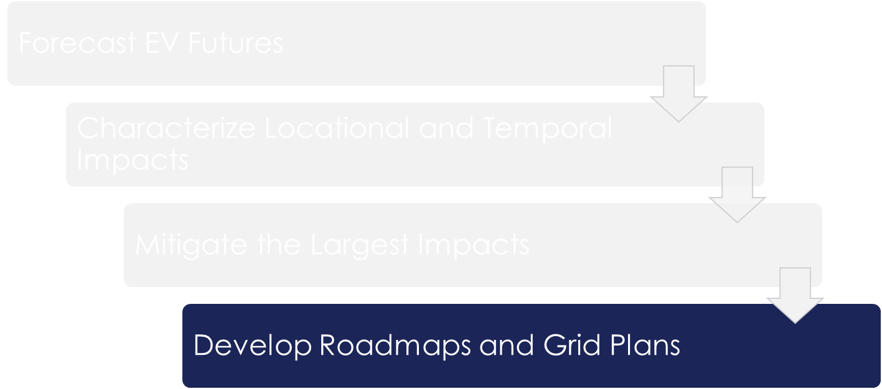



Developing Roadmaps and Grid Plans
Overarching Goal: Long-term study findings are integrated in the medium- and short-term plans to avoid widespread interconnection constraints. Too often, long-term study results are left in isolation.
Future-ready plans
Targeted system upgrades
Interconnection plans
Start now; spread costs of labor and infrastructure upgrades over many years.
Occur where forecasting scenarios or historical data show grid needs at specific locations.
Deal with discrete near-term requests to interconnect new loads.

Slide 22
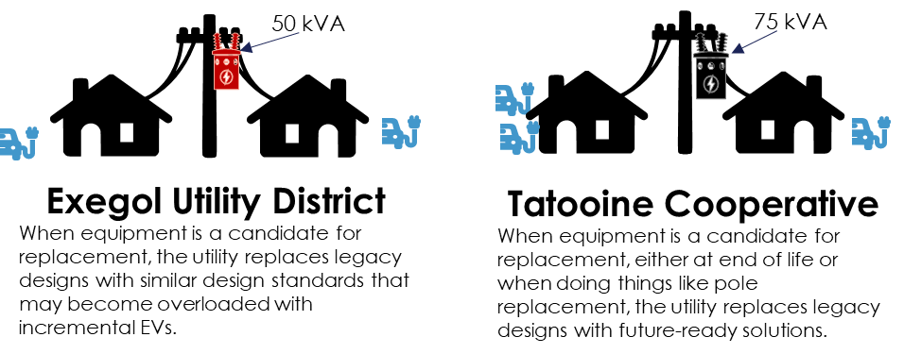
Developing Roadmaps and Grid Plans Future Ready Plans
Equipment Standards
Equipment Standards are used to streamline inventory, installations, engineering, etc.
Can direct decisions about:
Voltage class: 4kV->12kV->26kV
Equipment sizing: 50 kVA ->75kVA transformer for 10 customers
Land parcel procurements: square footage required for substations
Evaluate increased system equipment capacity instead of building more undersized network
Diversity of Loads inform equipment sizing
Example: Pat charges on Tuesday, Sam on Wednesday, so grid equipment is sized for one EV
EVs are new, so diversity needs to be calculated
Coordinate with smart charging designs
Coordinate with loss of equipment life strategy
Diversity of Loads
Image Sources: Top: ESIG; Bottom: Data from Vector

Slide 23

Developing Roadmaps and Grid Plans Targeted System Upgrades Amid Uncertainty
Longer planning horizons
Distribution planning typically looks out 5-10 years, but largest impacts of EVs are 10+ years out
By proactively identifying areas, we can more evenly distribute rate impacts.
By waiting, we risk infeasible timelines to address needs.
Adaptability
Short-term solutions may look different than the long-term answers as we learn more about customer behavior and adoption rates.
Overbuilt Grid
Storage Deployed for EV Integration:
SCE is planning to use relocatable storage as a short-term solution to facilitate a timely customer interconnection while a permanent solution (wires or non-wires solution) is being constructed. Attempting to serve customers that are asking for large service upgrade in short lead times, SCE plans to procure thirty-seven 1MW/4MWh energy storage units over the next 5 years and anticipates a large need for these to facilitate MHD electrification.
Data Sources: SCE

Slide 24
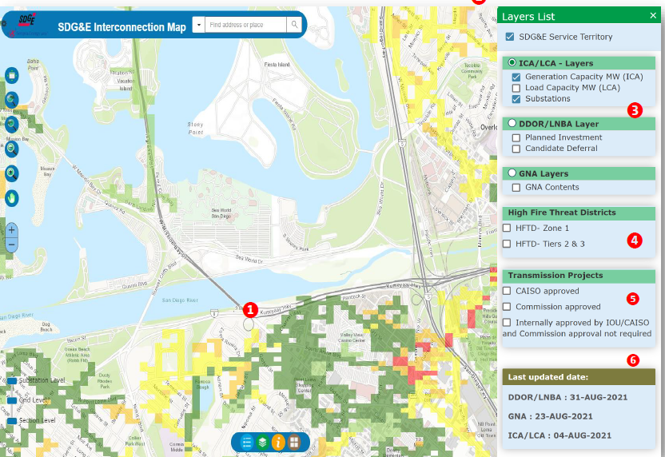

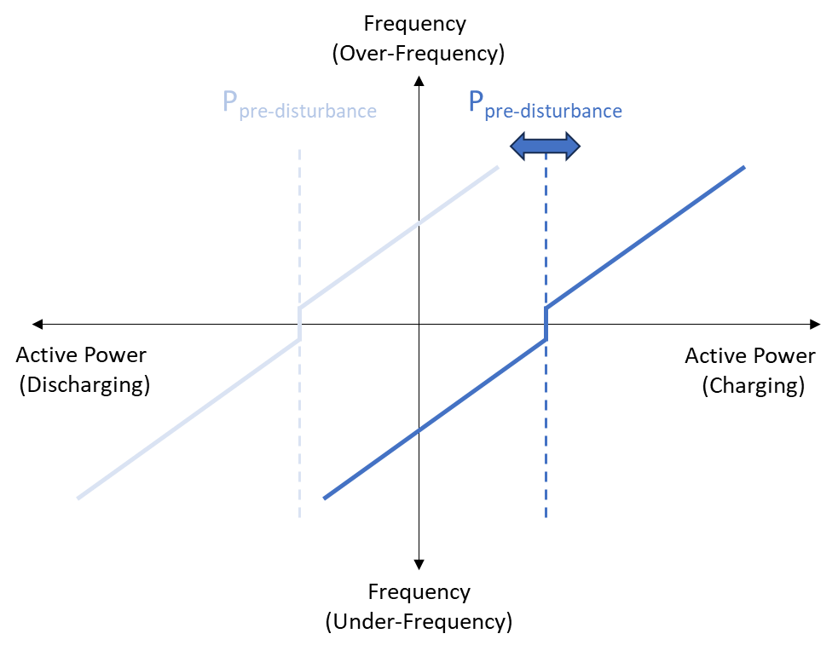
Developing Roadmaps and Grid Plans Interconnection Plans
Learn from recent developments in rooftop PV
Orange Button
Solar Data Standard*
Interconnection Capacity Maps / Queues
Articulate Process and
Data Requirements
Define Grid Friendly
Behavior
*used to facilitate the exchange of data among PV stakeholders
Data Sources: Left: SDG&E, Center: Orange Button logo, Right: ESIG

Slide 25
Process Improvements and Wrap-Up

Slide 26
Aligning the Grid Planning Process with the Need
Given the scale of grid planning for vehicle electrification, new processes could be helpful
Existing Processes
While today’s grid planning processes vary across the country, they generally include:
Annual system reviews
Regularly updated grid plans with a medium-to-long-term planning horizon
Isolated evaluation of interconnection requests
Customer-Collaborative Processes
The grid planning process is a collaborative effort between planners and customers which allows:
Multiple options for interconnection
Multiple locational alternatives
Open communication
Proactive Multi-Stakeholder Processes
With the volume and multiple use cases of EVs, proactive processes are sometimes best-suited to address challenges with:
Ensuring equity
Facilitating regional networks
Providing clear roadmaps for electrification planning progression

Slide 27
When to Use Which Process Shading indicates suitability of process to address EV Need
Managed Light-Duty Vehicles
Highways & Corridors
Existing
Processes
Daily/routine charging
L2 demand charging
Elastic demand
Customer-Collaborative
Processes
Perceived charging deserts
Service provider request
Proactive
Processes
Heavy deployment
Existing grid heavily loaded
Inflexible demand
Existing
Processes
Minimal highway throughput
Customer-Collaborative
Processes
Private highways
Proactive Processes
Grid capacity limited along highways
Regional EV growth
MHD vehicles
Fleets
Underserved Communities
Existing
Processes
Small fleets
Sufficient highway charging
Customer-Collaborative
Processes
EV timing & location inflexible
Large fleets
Proactive
Processes
Multiple fleets competing for capacity
Limited land availability
Existing
Processes
Planning processes include equity layer
EV & smart charging incentives
Customer-Collaborative
Processes
Multi-family housing developers
Proactive
Processes
Avoid charging paradox
Heavy industry adjacent

Slide 28
Coordinating Equitable Plans
Who pays for grid upgrades?
Electrification may make electricity more affordable on a dollar per kilowatt-hour basis due to the increased consumption of electricity. At the same time, infrastructure investments will exert upward pressure on rates.
Uncertain costs for electricity will need to be balanced with uncertain costs for fossil fuels as policy makers aim for equitable energy burdens.
What happens if the load doesn’t show up?
Improper planning and cost allocation could inequitably burden low-income ratepayers with the costs from affluent early adopters.
Multiple dimensions to equity:
Distributional equity will help protect vulnerable customers from undue energy burden.
Transitional equity will ensure that the shift to vehicle electrification happens at a pace that communities can handle.
Procedural equity promotes inclusive engagement of affected parties in the decision-making process.

Slide 29
Summary and Key Points
Lots of uncertainty, but decisions are needed today
Opportunities to improve forecasting
Opportunities to proactively shape customer perception
Demand management will likely be needed, particularly in the short term
Learn if we can rely on it throughout grid planning
Prioritize infrastructure where demand management cannot defer investment
Many grid planning improvements are outside of normal processes:
Future-ready systems – reconsidering design standards
Using demand side management as a grid solution
Collaborative and multi-stakeholder processes

Slide 30
Sean Morash
Sean.morash@telos.energy

Slide 31
Backup Slides

Slide 32
Characterize Impacts: Scenarios
Given all these variables and uncertainty, using scenarios can bound the problem
Grid Planners can evaluate bookends to think through the processes and implications of key assumptions on local trends
Scenarios that target the medium-term (10ish years) can be informative, rather than overly speculative
Scenarios should highlight different plausible ways that the grid might be stressed:
Stressor on the charge-time expectations from consumers, such as customers prioritizing rapid 15-minute charging
Stressor on MHD growth
Stressor on strong customer preference for at-home charging
Data Sources: Top Left: EVI-lite-Pro, 2023; Top Right: Powell, Cezar, Rajagopal, 2023; Bottom Left: EV-Watts, 2023; Bottom Right: Tesla.

Slide 33
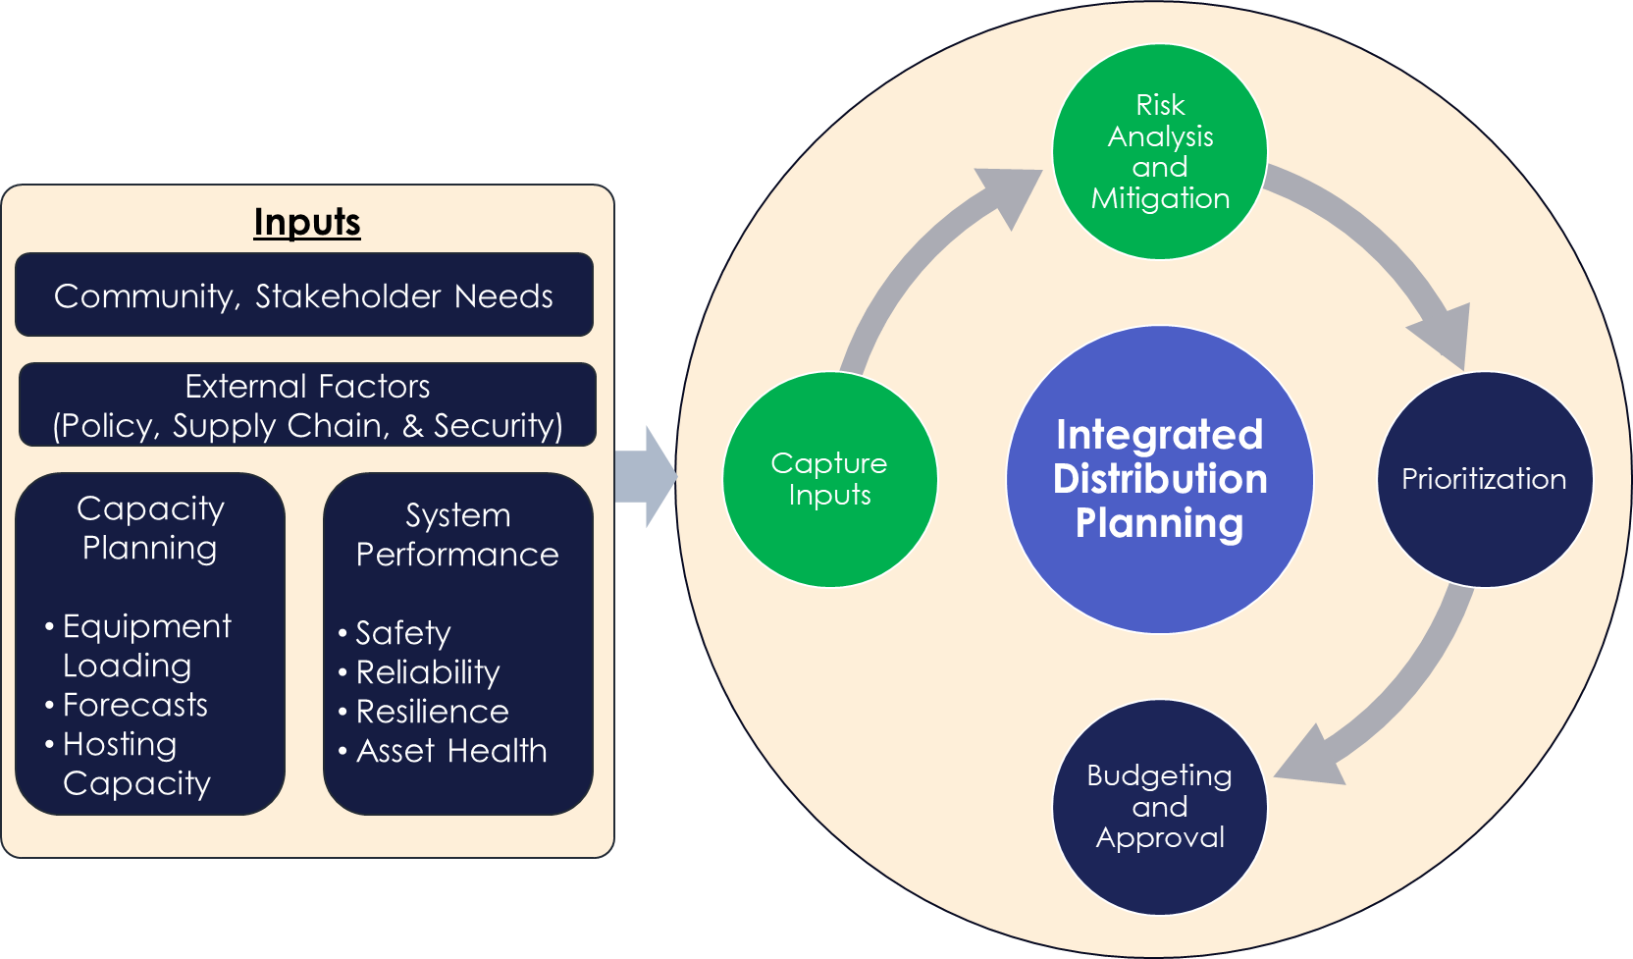
Grid Planning in the Context of EVs
How should planners address EVs alongside other distribution planning considerations?
EVs are among multiple considerations for customer-centric grid planning.
Many states are adopting an integrated distribution system plan (IDSP) process.
Some require dedicated sections within the IDSP for electrification.
Some require separate plans addressing electrification.
Out of Scope for this effort. State-to-State priorities vary.
Source: Image: ESIG

Slide 34
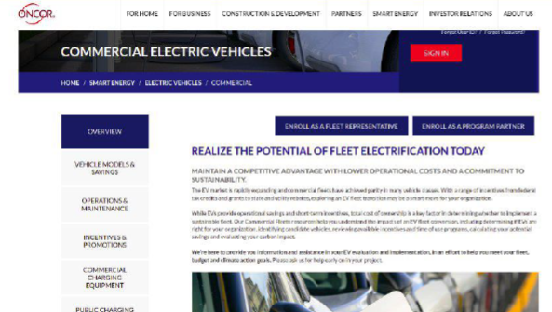
Forecast EV Adoption
Adoption Trends
Light-Duty Stock Turnover Models
Incorporate historical trends, policy and economics
Backcasting from stated policy objectives
Medium- and Heavy-Duty (MHD) vehicles can introduce large loads with highly variable needs
Location, Location, Location
Electrification likelihood models capture local trends and key indicators at levels granular enough to help prioritize grid upgrades
Better Data Collection
Start with DMV, but it may not be enough
Systemic data collection on behalf of grid planning at the time of vehicle purchase
Surveys and Fleet Partnership Programs
Sources: Image top: Jones, 2023; Image Bottom: Oncor, 2023

