Slide 1
TM
NASUCA
6 November 2023
Britta Gross – EPRI, Director of Transportation
Katherine Stainken – EPRI, Transportation Policy/Regulatory Lead

Slide 2
Background and Objectives
Government, Industry, and Fleets are increasingly aligning on aggressive 2030 vehicle electrification goals
The pace of needed year-over-year action and investment to prepare charging sites and the grid is not clear
Consumers and fleet operators must have confidence in charging availability, reliability, and affordability
Consumers and fleets operators are increasingly looking to the utility industry to scale up efforts to support charging solutions, ensure the grid is capable of meeting vehicle loads
THIS TRANSITION IS UNPRECEDENTED AND COMPLEX. IT REQUIRES:
Extraordinary collaboration and partnering across all the major EV stakeholder groups
Redesigned processes, useful tools, and increased standardization to simplify the planning and complex interactions between major stakeholder groups
An evaluation of regulatory/board oversight that may not be conducive to driving actions on the pace and scale required to meet 2030 targets

Slide 3
Addressing the Barriers to Achieving EVs at Scale A Three-Pillar Strategy
1
2
3
COALITIONS & ROADMAPS
STRUCTURAL SYSTEM REFORMS
UNIFYING TOOLS & PILOTS
Bilateral Convening Series
Utility-OEM Forum
Utility-Fleet Forum
Charging Infrastructure
Reliability: Benchmarking, Standards
Charging innovation & affordability
Approved Product List (APL)
NEVI/NEHC Coordination with EEI
National EV Driver Research Board
Grid Readiness
50-state eRoadMAPTM to 2030 outlining EV loads, grid impacts, leadtimes, workforce, costs
Streamlined Grid Interconnect
Expedited Interim Charging Solutions
Managed Charging at Scale
Interconnect Standards for V2H/V2B/V2G
GridFASTTM Online Data Exchange
OEM/Utility V2H/V2B Pilot
EV Resilience/Evacuation Pilot
Enabling Regulatory and Oversight Framework
Equity Blueprint & Workforce Development

Slide 4
Addressing the Barriers to Achieving EVs at Scale A Three-Pillar Strategy
1
2
3
COALITIONS & ROADMAPS
STRUCTURAL SYSTEM REFORMS
UNIFYING TOOLS & PILOTS
Bilateral Convening Series
Utility-OEM Forum
Utility-Fleet Forum
Charging Infrastructure
Reliability: Benchmarking, Standards
Charging innovation & affordability
Approved Product List (APL)
NEVI/NEHC Coordination with EEI
National EV Driver Research Board
Grid Readiness
50-state eRoadMAPTM to 2030 outlining EV loads, grid impacts, leadtimes, workforce, costs
Streamlined Grid Interconnect
Expedited Interim Charging Solutions
Managed Charging at Scale
Interconnect Standards for V2H/V2B/V2G
GridFASTTM Online Data Exchange
OEM/Utility V2H/V2B Pilot
EV Resilience/Evacuation Pilot
Enabling Regulatory and Oversight Framework
Equity Blueprint & Workforce Development

Slide 5
Collaboration + Partnerships Ongoing Outreach
UTILITY INDUSTRY
AUTO & TRUCKING INDUSTRY
FLEET OPERATORS
CHARGING PROVIDERS AND FUELING RETAILERS
NGO &
STANDARD-SETTING ORGANIZATIONS
GOVERNMENT
Joint Office of Energy & Transportation (JOET)
US DOE
US DOT
National Labs
FERC/NERC
State DOEs, DOTs, DEQs
State PUCs
League of Cities
Climate Mayors

Slide 6
EVs2Scale2030 Advisory Board
Chair: Xcel, Brett Carter
Co-Chair: PG&E, Patti Poppe
AAI, John Bozzella
Amazon, Sujit Mandal
Ameren, Mark Fronmuller
APPA, Paul Zummo
ATE, Phil Jones
ComEd, Gil Quiniones
Daimler Truck, Diego Quevedo
EEI, Kellen Schefter
GRE, Jeff Haase
JOET, Rachael Nealer
LCRA, Khalil Shalabi
NARUC, Katherine Peretick (Michigan PSC)
National Grid, Rudy Wynter
NRECA, Angela Strickland
NYPA, Fabio Mantovani
Southern Company, Chris Cummiskey

Slide 7
PROJECT PARTNERS BROAD INDUSTRY SUPPORT

Slide 8
Regulatory/Board Oversight Workstream: Why is proactive grid infrastructure build so challenging?
Utilities not confident in the timing/pace of EV adoption across their service territories (demand varies across the U.S.)
Regulators not confident
in the timing/pace of EV adoption (hearing only the voice of utilities); want to avoid stranded assets. Unclear on the cost impacts to ratepayers of proactive grid infrastructure build vs. later build
Ratepayer advocates not confident in the timing/pace of EV adoption and the need for proactive grid build; concerns on the cost impacts
EVs2scale2030 data will send clear demand signals, building confidence, and enabling utilities (and regulators) to prioritize
“no regret” investments.

Slide 9
TM
eRoadMAPTM

Slide 10
ANALYTICS
DATA
Other:

Slide 11
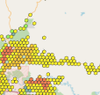
Improved Data Resolution Techniques
LAYERED DATA APPROACH
1
2
H3 – Level 8 Maps
LD Vehicles
Registrations
Travel Models
MDHD Vehicles
OEM data
Fleet data
Travel Data
Other Vehicle Sectors
Transit/School Buses
Government Fleets
Ports/Airports
Vocational Fleets
Other Load Data
EVSPs/Fueling Retailers
Individual layer
Res | Average Hexagon Area (km²) | Average Hexagon Area (mi2)
0 | 4,357,449.42 | 1,682,419.93
1 | 609,788.44 | 235,440.54
2 | 86,801.78 | 33,514.34
3 | 12,393.43 | 4,785.13
4 | 1,770.35 | 683.53
5 | 252.90 | 97.65
6 | 36.13 | 13.95
7 | 5.16 | 1.99
8 | 0.74 | 0.28
9 | 0.11 | 0.04
10 | 0.0150 | 0.0058
11 | 0.0021 | 0.0008
12 | 0.0003 | 0.0001
+
Individual layer…
+
+
+
Where Hex8 ~ 1 or 2 feeders
+
+
=
One map with energy + power needs
*EV Service Providers
Notes:
Where one hex8 ~0.28 sq. mi
(roughly one feeder circuit)

Slide 12
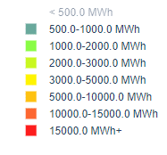
LD + MDHD | 100% Electrified Hex4 (each hexagon is 684 square miles)
MWh/Day
<500 MWh
500-1,000 MWh
1,000-2,000 MWh
2,000-3,000 MWh
3,000-5,000 MWh
5,000-10,000 MWh
10,000-15,000 MWh
15,000+ MWh

Slide 13
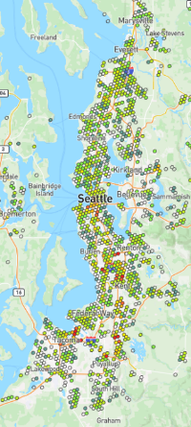
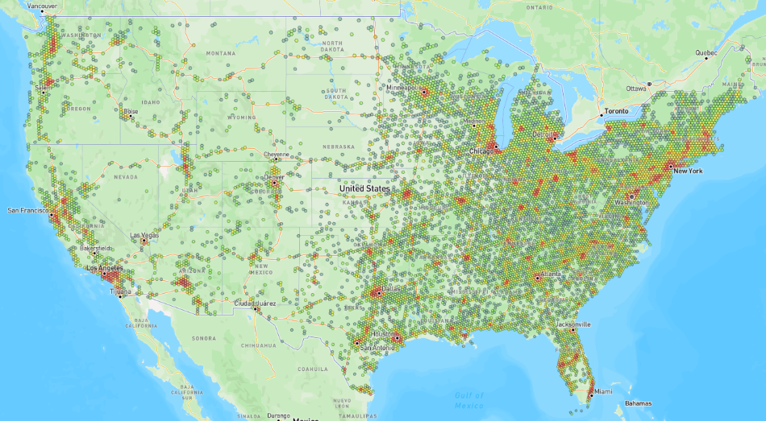
LD + MDHD | 100% Electrified
< 50 MWh
50-100 MWh
100-300 MWh
300-500 MWh
500-1,000 MWh
1,000-1,500 MWh
1,500-2,500 MWh
2,500 + MWh
H8 – 0.28 sq miles per hex
H5 – 98 sq miles per hex

Slide 14
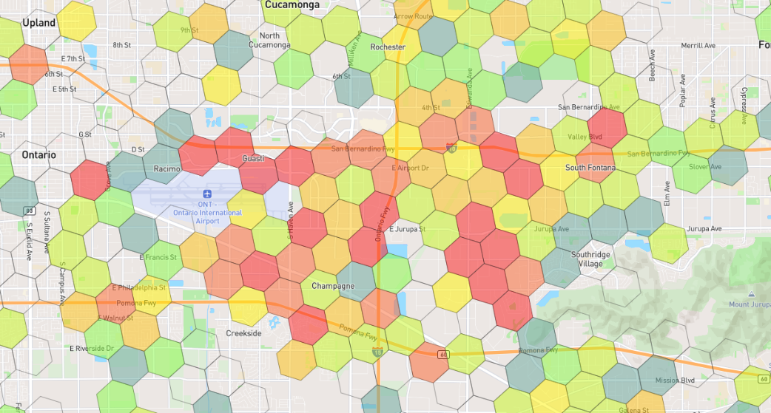
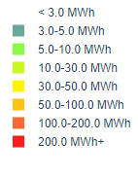
MDHD Depot Case Study - 100% Electrified
MWh/Day per Hex

Slide 15
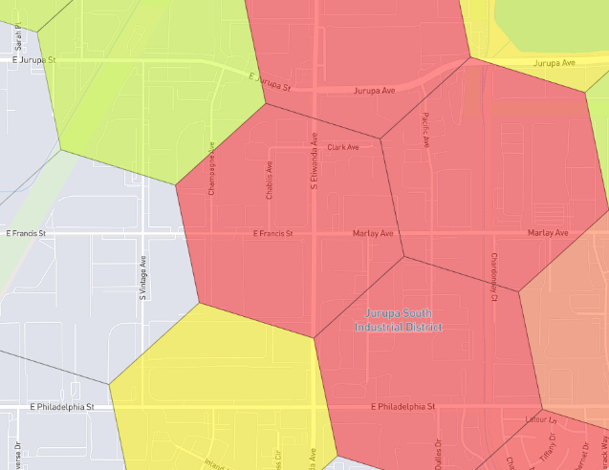
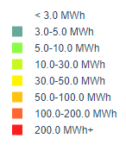
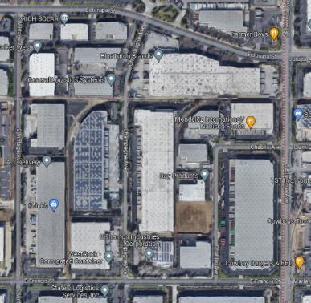
MDHD Depot Case Study - 100% Electrified
MWh/Day per Hex
Companies:
Pacific Urethanes -
Blue Triton Brands – drink company
Nabisco Foods
West Rock Corrugated Container
IIT Champagne – Champagne delivery
Ray Products- Plastic company
Bishamon Industries – metal handling
RICH solar
Coca Cola Co

Slide 16
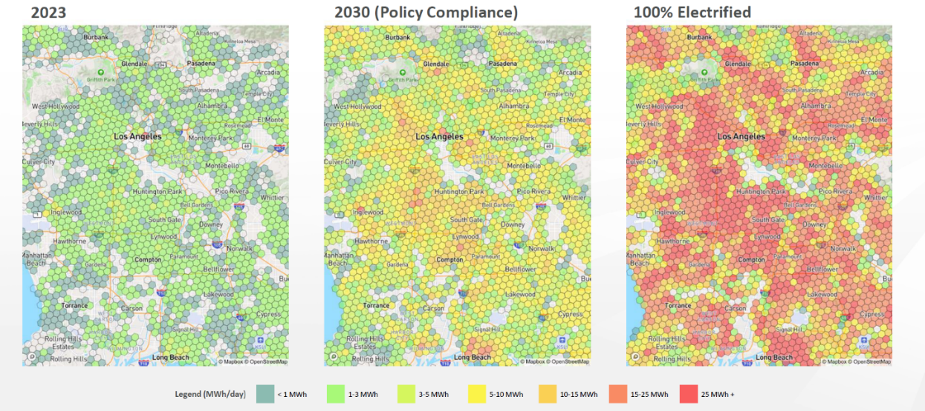
Light-Duty Residential Charging Energy Required Over Time

Slide 17
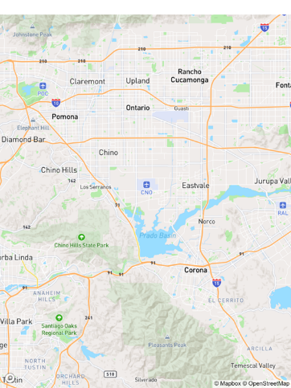
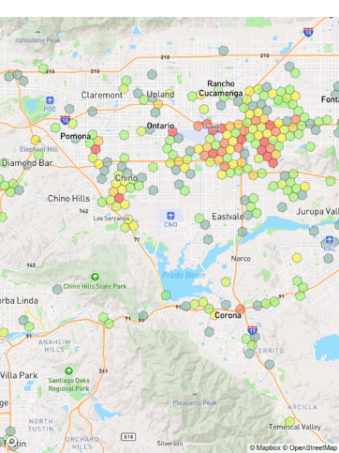
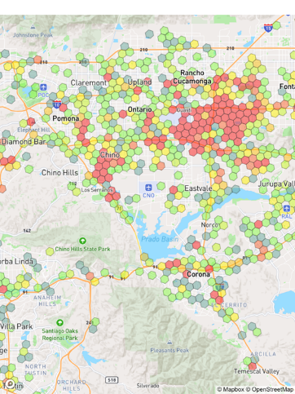
Medium and Heavy-Duty Return to Depot Charging Energy Required Over Time
2023
2030 (Policy Compliance)
100% Electrified
Legend (MWh/day) |  | < 1 MWh |  | 1-3 MWh |  | 3-5 MWh |  | 5-10 MWh |  | 10-15 MWh |  | 15-25 MWh |  | 25 MWh +

Slide 18
What these Load Forecast Maps Are (and Aren’t)
Goal
Provide as much certainty as possible to utilities, regulators/oversight bodies, and other key stakeholders about where and when transportation loads are arriving on the grid
Messaging
This is eRoadMAP Version 1.0
It reflects a transparent and collaborative process between utilities, fleets, many other data providers
It is meant to represent the best data available to date and the means to start communicating, prioritizing, and planning for grid-side, no-regret investments
It provides near-term, mid-term, and long-term planning horizons

Slide 19
Load … but what about Capacity?
< 50 MWh
50-100 MWh
100-300 MWh
300-500 MWh
500-1,000 MWh
1,000-1,500 MWh
1,500-2,500 MWh
2,500 + MWh
H5 – 98 sq miles per hex

Slide 20
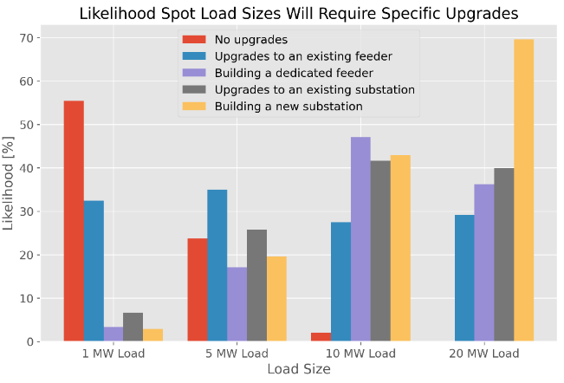
Utility Grid Survey Preliminary Responses
The utility grid, as a system, is relatively well positioned to serve EV charging – however challenges exist in some locations
Preliminary Findings:
5MW load – 30% likely to need a feeder upgrade
10MW load – 48% likely to need a dedicated feeder, 42% likely to need substation
20MW load – 70% likely to need a new substation

Slide 21
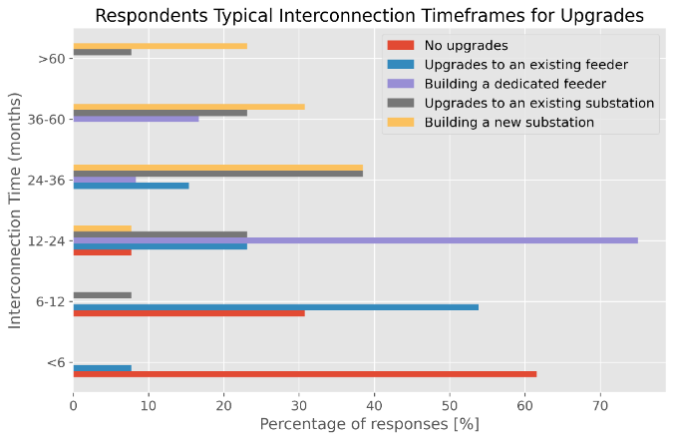
Utility Grid Survey Preliminary Responses
Preliminary Findings:
Upgrades to an Existing Feeder: 6-12 months
Dedicated Feeder Lead Time: 12-24 months
Build a new Substation: 24-36 months

Slide 22
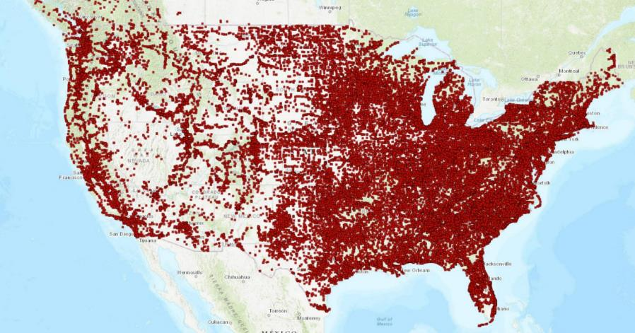
Database of Substations Already Exists
Includes
Substation name
Lat/Long coordinates
Max/Min voltage
Does not include
Rated capacity
Load
Geospatial Energy Mapper (GEM), Argonne National Laboratory, https://gem.anl.gov/

Slide 23
How might we help EV customers and utilities get actionable transportation load information, earlier into the utility planning process?
Role of GridFAST
Vision
Plan
Fund
Design
Procure
Build
Deploy
EV CUSTOMER
Close communication between fleets & utilities
Close communication between EV customers & utilities
Opportunity
Opportunity
Service Request
Service Request & Refinement
Design
Construction
Distribution Planning Cycle
UTILITY
Transmission Planning Cycle

Slide 24
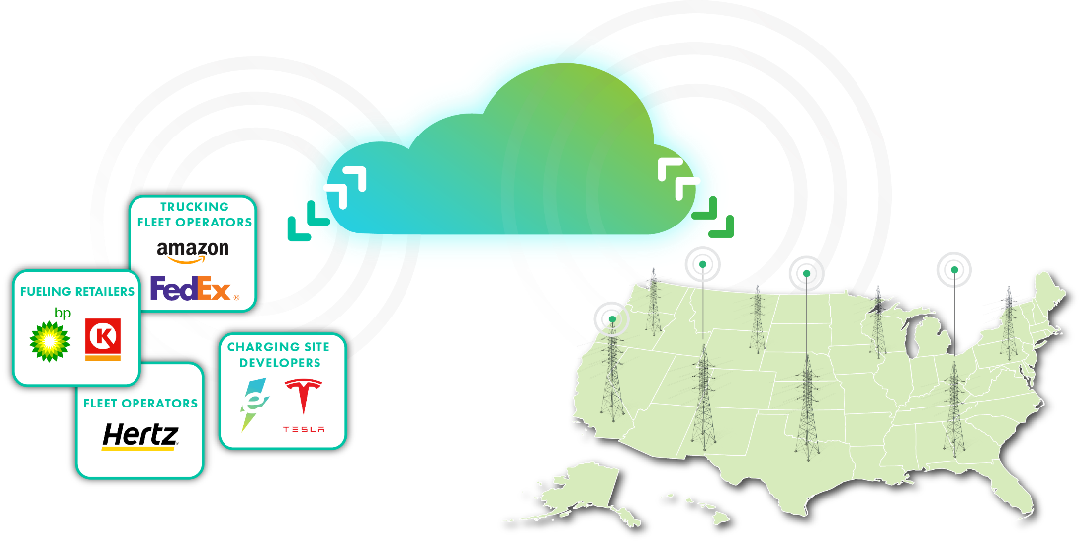
GridFAST vision
Improve transparency in EV charging planning to inform grid investments and accelerate grid interconnects
2023-2035 plans defining loads, locations, timing
GridFAST Secure online data exchange platform
Utility hosting capacity – or proxies – indicating grid readiness, timing to support EV charging loads

Slide 25
Enabling Regulatory and Oversight Framework
TM

Slide 26
Addressing the Barriers to Achieving EVs at Scale A Three-Pillar Strategy
1
2
3
Red: Expected to heavily inform the regulatory workstream
COALITIONS & ROADMAPS
STRUCTURAL SYSTEM REFORMS
UNIFYING TOOLS & PILOTS
Bilateral Convening Series
Utility-OEM Forum
Utility-Fleet Forum
Charging Infrastructure
Reliability: Benchmarking, Standards
Charging innovation & affordability
Approved Product List (APL)
NEVI/NEHC Coordination with EEI
National EV Driver Research Board
Grid Readiness
50-state eRoadMAPTM to 2030 outlining EV loads, grid impacts, leadtimes, workforce, costs
Streamlined Grid Interconnect
Expedited Interim Charging Solutions
Managed Charging at Scale
Interconnect Standards for V2H/V2B/V2G
GridFASTTM Online Data Exchange
OEM/Utility V2H/V2B Pilot
EV Resilience/Evacuation Pilot
Enabling Regulatory and Oversight Framework
Equity Blueprint & Workforce Development

Slide 27
Key Regulatory Areas of Focus to Advance Timely Grid Investment for Scale Levels of EV Charging Infrastructure
Establish Model Processes Across the Utility Industry
Justify Which Policies Need to be Addressed
Provide Policy & Regulatory Awareness
Justify the Need to Act
Industry provided data & 50-State Roadmap
Regulatory Workstream
GridFAST Tool & Interconnection Workstreams
Collaborative NGO outreach and industry support

Slide 28
Regulatory/Policy Outreach
BY STATE:
NATIONALLY:
Economic Opportunities (battery plants, assembly plants, EVSE,…)
In-State Revenue Opportunities (electricity sales/taxes, downward pressure on rates)
Industry Support (letters of support, PUC hearings,…)
Load Forecasting Data Analysis (near-term priorities) eRoadMAPTM
Grid Impact Analysis (substation and feeder level priorities) eRoadMAPTM
Leadtime Impacts
Costs (potential solutions and approaches to who pays)
Supply Chain Impacts (transformers, switch gear,…)
Grid-Side Costs (potential solutions and approaches to who pays)
IOU vs. Public Power vs. Rural Coop
PROPOSED DELIVERABLE: A 50-State/National Outreach Package for regulators, legislators, consumer advocates,
and federal agencies that leverages eRoadMAPTM and GridFASTTM to build a case for proactive grid investment that enables timely scale

Slide 29
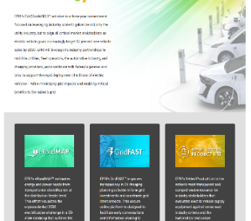
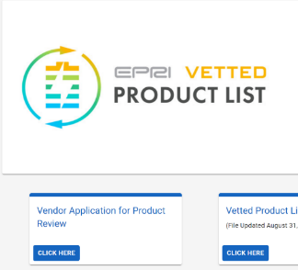
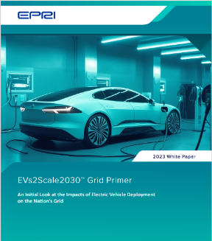
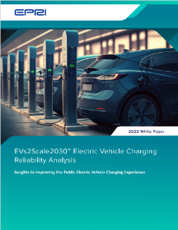
Released Reports + Tools
1
2
3
4
EV Charging Reliability Analysis
EVs2Scale Website
VPL (Vetted Product List)
Grid Primer
EVs2Scale2030 | EPRI -- https://msites.epri.com/evs2scale2030
https://www.epri.com/vpl
Mark your calendars:
EPRI’s “Electrification 2024” Conference in Savannah, GA 12-14 March, 2024

Slide 30
Thank You

