Slide 1
Possible changes to Department of Energy Rules on Appliance Efficiency and Impacts on energy Efficiency Programs
NASUCA Annual Meeting
11/6/2023

Slide 2
EPA – Energy Star Removes Gas Furnaces
EPA’s ENERGY STAR program is proposing to sunset the certification pathway to the ENERGY STAR label for residential gas furnaces and central air conditioners (CACs). EPA sees an unprecedented opportunity for the ENERGY STAR program to support a national transition to electrification of residential space conditioning.
Notes:
Energy Efficiency Programs
Natural gas utilities administer over 125 natural gas efficiency programs across 42 states, which collectively invest more than $1.4 Billion annually, in part to assist customers with the purchase and installation of these efficient gas appliances.
Natural gas utility efficiency programs promote the use of ENERGY STAR home heating equipment and often rely on ENERGY STAR certification when determining eligibility for utility-provided incentives including appliance rebates.
The steady improvement in residential natural gas use per customer directly results from energy efficiency improvements, including tighter building envelopes, more efficient appliances and equipment, behavioral changes in energy consumption, and the effectiveness of natural gas utility efficiency programs, including those that utilize ENERGY STAR.
Energy Consumption/Emissions
Today’s natural gas and coal-fired power plants have a typical 30-50% fuel conversion efficiency, which is a significant loss of efficiency
A large portion of the electric generation fleet is powered by fossil fuels and the percentage only increases during colder periods
The natural gas delivery system is 92% efficient from production to the customer. Hence, direct use of natural gas is more efficient and has emissions benefits.

Slide 3
DOE - Residential Gas Water Heating
DOE is proposing more stringent annual fuel utilization efficiency (AFUE) standards for gas-fired and oil-fired boilers while maintaining the current standards for electric steam and hot water boilers. DOE has tentatively concluded that the proposed standards represent the maximum improvement in energy efficiency that is technologically feasible and economically justified and would result in the significant conservation of energy.
Notes:
For reasons of safety and code compliance, condensing boilers cannot be vented by standard atmospheric systems.
Because the proposed standards can only be met by condensing gas boilers, homeowners replacing existing non-condensing gas boilers would be forced to modify their homes to accommodate products for which they were not architecturally designed. There are many cases in which such modifications would have adverse impacts on the venting of other gas products in the home, would have undesired impacts on the occupied space or aesthetics of the home, or would substantially increase the time and expense associated with boiler replacement.
“Unavailability” Provisions
Energy Policy and Conservation Act (EPCA) precludes the adoption of standards that would leave purchasers without products suitable to their needs.
In particular, the statute includes provisions that ensure the standards do not deprive purchasers of “product choices and characteristics, features, sizes, etc.,” and that energy savings are achieved “without sacrificing the utility or convenience of appliances to consumers.”
Information presented by boiler manufacturers at the public meeting and in written comment in this proceeding establishes that non-condensing boilers offer a level of reliability that condensing products cannot achieve, and that difference in “reliability” is a “performance characteristic” expressly protected by the Unavailability provisions.
Economic Justification for Proposed Standard
DOE’s numbers suggest that over 31% of potential investments in gas-fired hot water boilers efficient enough to satisfy the proposed standards (i.e., “Standards-Compliant” boilers) are cases in which such products have a lower installed cost than less-efficient boilers and would thus be the low-cost option to start with. These are “windfall benefit” cases that provide efficiency benefits without the need for any “investment” at all, and they account for nearly 86% of the net life-cycle cost (“LCC”) savings claimed to justify the proposed standard.
DOE’s numbers suggest that about 40% of potential investments in Standards-Compliant boilers would not pay off for more than a decade, and that about a quarter of all potential installations would impose net costs, leaving consumers “in the red” even after DOE’s entire assumed product life of 26.5-years.
Installation
DOE assumed installation costs for “new owner” cases that are consistent with its costs for new construction installations instead of replacement installations.
DOE has substantially underestimated the costs associated with cases in which a Standards-Compliant (i.e., condensing) boiler is replacing an atmospherically-vented boiler.
As one installer explained:
“Here in the northeast we have houses with finished basements with the units in the middle of the house. To replace the unit you have to rip apart the basement for the venting and intake. Also many houses do not have the window clearance and/or ground clearance for direct vent. And the chimney can't be lined for it because it is being used for multiple appliances.”
DOE’s analysis of installation costs is arbitrary and dramatically understates the cost of replacements in which existing non-condensing boilers would need to be replaced with Standards-Compliant (i.e., condensing) boilers. A survey of heating professionals found very different costs than DOE uses in their analysis. Another problem is that the model does not reasonably account for the fact that differences in building characteristics can have a dramatic impact on the cost or even feasibility of such replacements.
There are buildings – particularly in the context of multifamily housing – in which it can be difficult or impossible to install condensing products, yet DOE’s analysis assumes that replacements are always feasible because every building can be modified at a reasonable cost.
There are other common scenarios (e.g., replacements of boilers located in finished basements, as discussed above) in which boiler replacements would be particularly expensive, yet DOE’s modeling approach makes no effort to assign such costs to trial cases representing the kinds of buildings in which those costs are likely to be experienced.
DOE addressed differences in installation costs by randomly assigning various cost adders, including a purported “difficult installation” adder with a maximum of $500 and an average of only $242.38.
Impact to Manufacturing
Manufacturers have noted that the proposed rule would have a disproportionate effect on domestic manufacturers and foundries.
Joint Commenters estimate that the production of cast-iron boilers will drop from 200,000 per year to 75,000 per year, which will not support the current number of foundries.
Manufacturers have noted there will be a net loss of American jobs as a consequence of this proposed rule, which DOE acknowledges. Manufacturers note that while 90% of non-condensing boilers are manufactured in the United States, only 60% of condensing boilers are manufactured in the United States. Simply put, the proposed rule seeks to export United States manufacturing jobs and capacity, and will have significant effects throughout the boiler supply chain.

Slide 4
Recent EPA & DOE Proposals Impacting Consumers
EPA – ENERGY STAR
Removes Gas Furnaces
DOE - Residential
Gas Water Heating
DOE - Commercial
Gas Water Heating
Proposes phase out of ENERGY STAR for residential gas furnaces
EPA did not issue federal register notice
EPA did not provide technical analysis or support
95% minimum efficiency – for boilers, requires condensing technology
Violates unavailability provisions of Energy Policy & Conservation Act
Replacing non-condensing boilers will be problematic for consumers
95% thermal efficiency for gas storage HWH condensing units
96% thermal efficiency for gas instantaneous HWH
Final Rule Effective December 5, 2023 (equipment - October 6, 2026)
For General Informational Purposes Only – No Warranty of Completeness or Accuracy

Slide 5
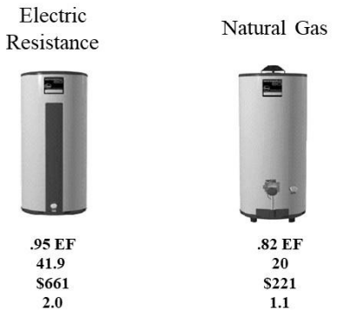
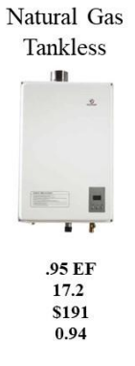
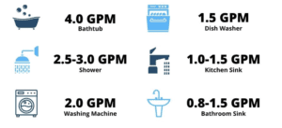
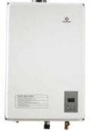
Water Heaters
Electric Tankless
$690
Life (Yrs.)
GPM
Recovery
10
3.2
Up to 3 Hrs
$600
10
3.2
Up to 1 Hr
$900
20
Up to12
Instant
$600 - $1,500
20
Up to 5
Instant
$600 - $1000
Non-Condensing
>.80 EF

Slide 6
For General Informational Purposes Only – No Warranty of Completeness or Accuracy

Slide 7
Recent EPA & DOE Proposal Consumer Impacts
ENERGY STAR Removes Gas Furnaces
DOE – Residential Gas Water Heating
Homeowner
DOE – Residential Gas Water Heating Renter
Gas furnaces would no longer be eligible for rebates for lower efficiency and bill savings. 52% of US households us gas heating today. (Approximately $1.4 Billion today)
Homes are certified today with Energy Star ratings using points from a gas furnaces.
Creates an un-educated narrative in the public and may mislead the consumer to make inefficient, higher cost choices.
95% minimum efficiency – water heaters requires condensing technology.
A consumer is confined to an electric TL option, Storage Tank, or condensing TLGW.
Moving from non-condensing to condensing TLGW requires plumbing, electrical, and mechanical construction to the home and may not even be possible.
Not all homeowners can afford upgrading to a condensing TLWH but still want the lifestyle, comfort, and bill savings it brings.
A Storage Tank Water Heater may not fit in areas tankless water heaters are installed subjecting a consumer to an Electric TL option or Condensing. Both require Electric, Plumbing and Mechanical cost and possibly structural work to the home. All increase cost to the homeowner.
Electric TLWH are not Energy Star certified.
Supply chain constraints on non-US parts (motors)
Jobs
The owner can choose lowest cost option for replacement or new build.
The renter is impacted by long lead time supply constraints.
Lower cost decisions like electric tankless and tank water heaters have higher bill impacts to the renter.
Lower cost decisions have realized lifestyle impacts on the renter in the form of hot water recovery, temperature, and gallons per minute.
Jobs
For General Informational Purposes Only (Averages and Current Market Conditions Vary)

Slide 8
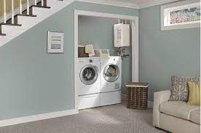
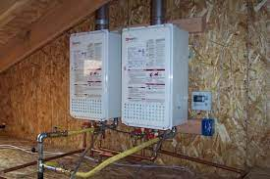
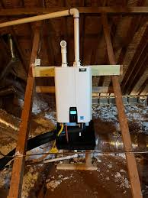
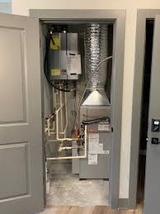
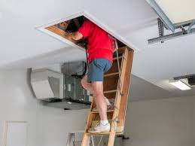
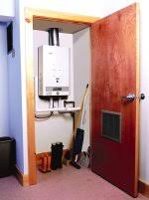
Perspective
For General Informational Purposes Only (Averages and Current Market Conditions Vary)

Slide 9
Questions?
For General Informational Purposes Only (Averages and Current Market Conditions Vary)

