Slide 1
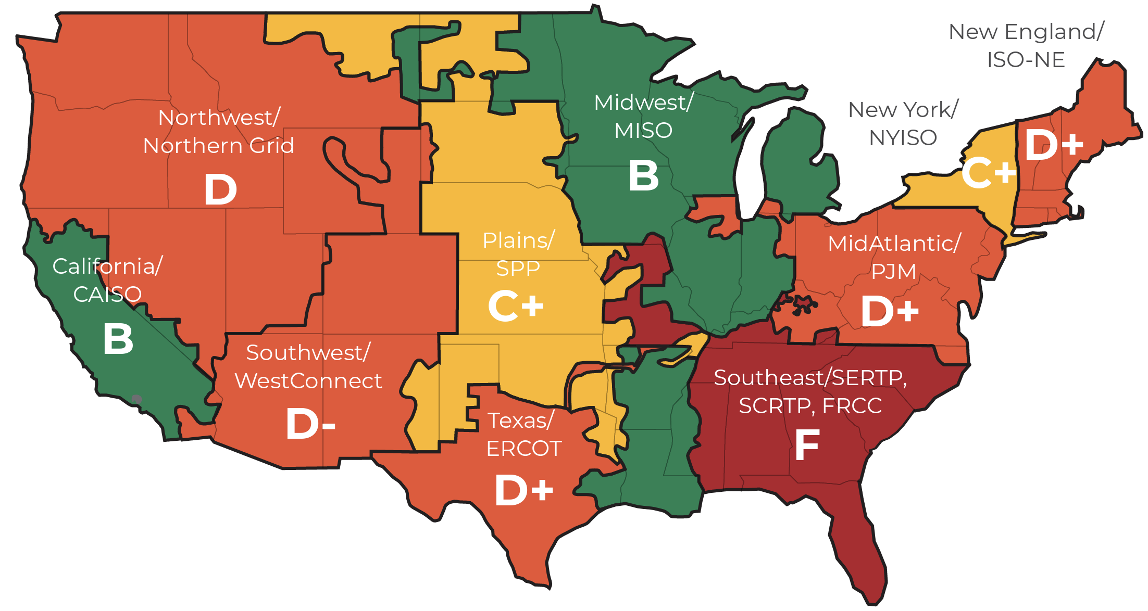
Summary of Grades by Region
The report grades regions, defined by Order No. 1000 boundaries, not specific entities. Evaluation included actions taken by states or utilities within those regions for transmission planning and development, because many parties bear responsibility for performance.

