Slide 1
Alternative Ratemaking and Grid Modernization: Considerations for Consumer Advocates
Unleashing Latent Value in Distribution Utility Businesses
NASUCA Webcast December 7, 2022
Paul Alvarez, President, Wired Group
Ken Costello, independent economist & consultant
Dennis Stephens, Sr. Technical Consultant, Wired Group

Slide 2
Preview
Practices Encompassing “Alternative Ratemaking”
AR Eliminates Grid Investment Controls
Lessons Learned/Examples of Abuses
Reliability
“Readiness” (EV, DER, etc.)
Typical manifestations in grid modernization plans
Pragmatic Options Available to Advocates
Consumer protections for Alternative Ratemaking
Performance assurance through metrics and financial penalties
Participatory grid investment planning/benefit-cost analyses/RIDS*
National Venues for Raising Advocate Concerns
*Risk-informed decision support, also known as risk-informed decision making

Slide 3
Alternative Ratemaking Practices
Rider/Tracker Cost Recovery
Future Test Years
Multi-Year Rate Plans
Formula Rates
Performance-based Rewards and Penalties
Revenue Decoupling
These approaches practically eliminate the only major controls available over grid investment: regulatory lag and cost disallowance risk*
*Note that this is true despite legislative language or regulatory orders that specifically reinforce regulators’ authority to disallow costs, or the need for investments to be cost effective.

Slide 4
AR Eliminates Grid Investment Controls
Concurrent cost recovery eliminates regulatory lag
Presentation of investment plans for review or approval^ in advance practically eliminates cost recovery risk
Once a grid plan is “approved”, or even just reviewed, the potential consequence of over-investment (cost disallowance) essentially becomes zero
When there is no consequence to over-investment, a utility will propose more investment than needed for safe & reliable service*
Though practically impossible, Alternative Ratemaking thus requires parties to challenge investment plans in advance
Information asymmetry
Expertise asymmetry
Resource asymmetry
Administrative limitations (discovery process)
* Economists call this “Moral Hazard”
^ Known in some states as precertification, preauthorization, preapproval, informational, or administrative

Slide 5
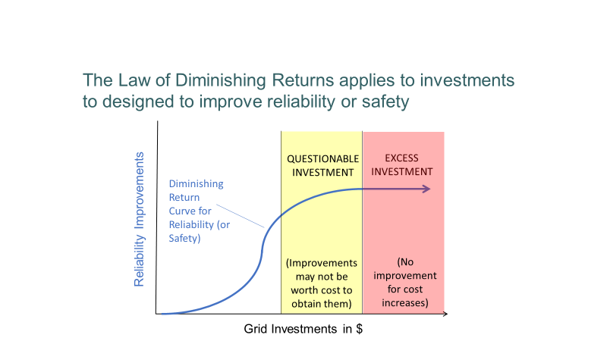
Lesson/Example 1

Slide 6
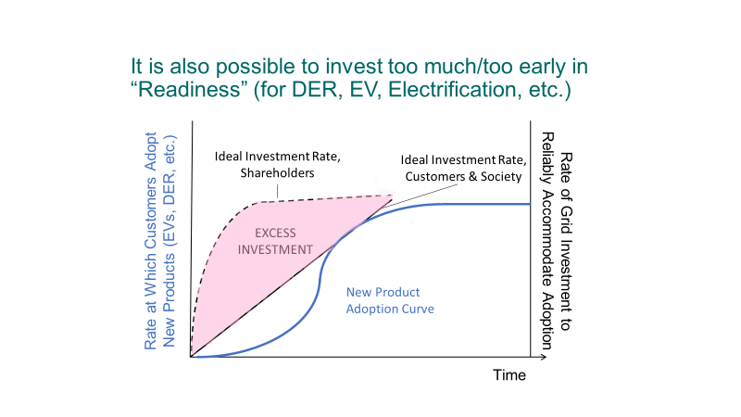
Lesson/Example 2

Slide 7
Manifestations in Grid Modernization Plans
Replacing “aging” substation equipment*
Circuit “hardening” (thousands of $ per premises)
Undergrounding lines currently overhead (tens of thousands of $ per premises)
ADMS and DERMS
Accommodating “two-way power flow” from DER
Complying with “standards” (official or utility-specific)
Smart meters
Proprietary (vs. rented) communication networks
* Replacing equipment that has passed objective tests simply because the equipment is fully depreciated and earning no rate of return

Slide 8
What Can Advocates Do? Protections
Stop AR before it starts (educate regulators, legislators regarding loss of control over investment). At a minimum, put consumer protections in place:
Limit AR to certain scopes (capabilities; investment $; investment types*)
Limit AR to certain time frames (sunset provisions)
Cap annual rate increases (%) or investments ($) subject to AR
Limit or prohibit deferrals/carrying charges on amounts over caps
Reduce rates through defined, related offsets (O&M $, productivity %)
Reduce rates of return (to reflect shareholder risk reductions)
Excess earnings (in $ or %) outside of band are shared with customers
* For example, apply AR only to discretionary-type investments while leaving traditional cost recovery intact for investments required for safe and reliable service

Slide 9
What Can Advocates Do? Performance
Establish performance targets and/or benchmarks
Establish financial penalties (and incentives?) based on performance targets and/or benchmarks
Performance targets/benchmarks MUST REFLECT OUTCOMES, NOT PROCESSES
Process: “ABC Co. will equip 200 circuits with Distribution Automation”
Outcome: “ABC Co. will reduce system-wide SAIDI to 80 Minutes”
Performance targets/benchmarks MUST BE EXPRESSED AS OBJECTIVE VALUES (#) WITH DATES (by when?)
- SAIDI in Minutes
- DER Hosting Capacity in MW
- Customer Participation in # or %
- Demand Response in MW
- Energy Conservation in MWh
Without objective, outcomes-oriented performance targets and/or benchmarks, with penalties for non-performance, AR transfers 100% of investment risk from shareholders to customers. Where is a utility’s incentive to deliver $ value in excess of costs to customers from investments?

Slide 10
What Can Advocates Do? Benefit-Cost Analyses
Establish participatory grid planning and investment process (NARUC-NASEO Task Force on Comprehensive Electricity Planning, Jade Cohort)
Distinguish between investments “required” for safe & reliable service and “discretionary” investments
For discretionary investments, ensure that benefits to customers exceed costs to customers (rate increases)
Consider “risk-informed” benefit-cost analyses*
* Also known as risk-informed decision support (RIDS) or risk-informed decision-making (RIDM)

Slide 11
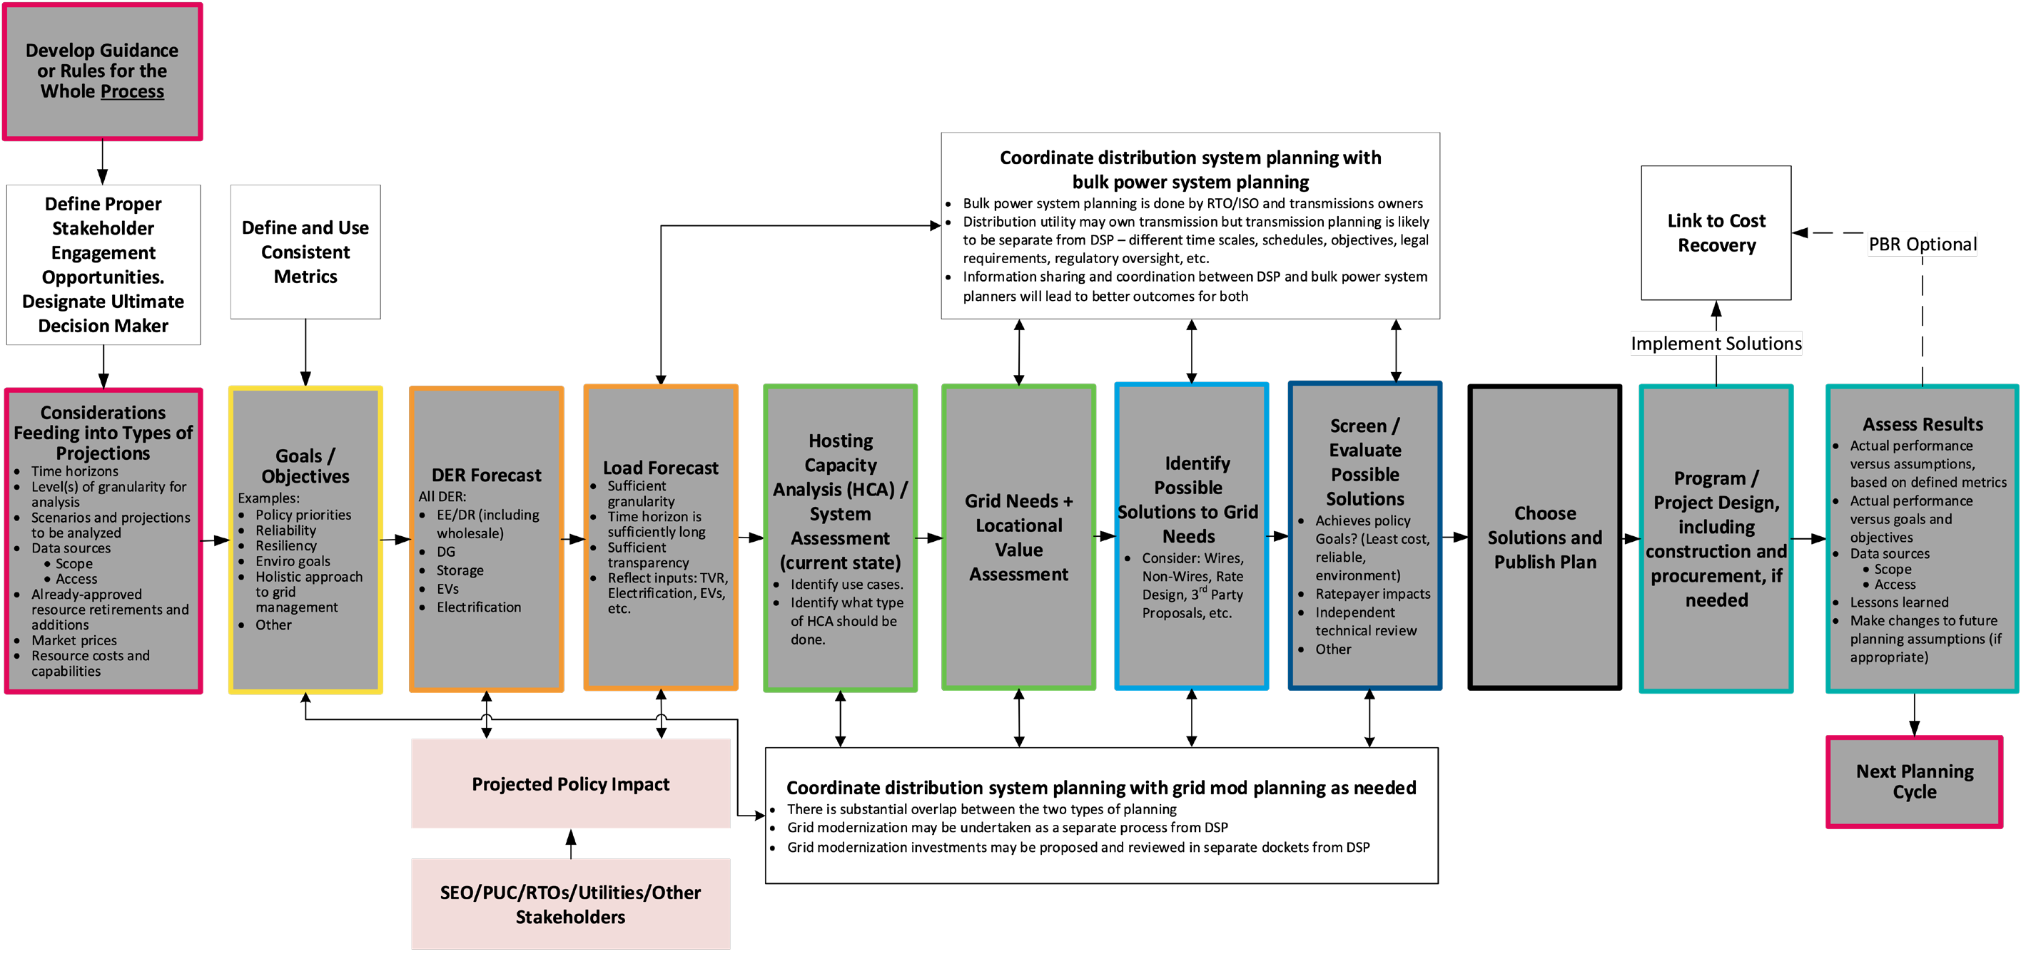
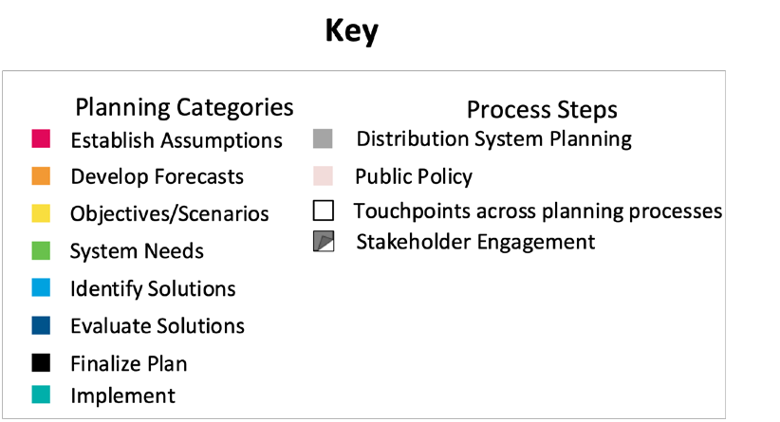
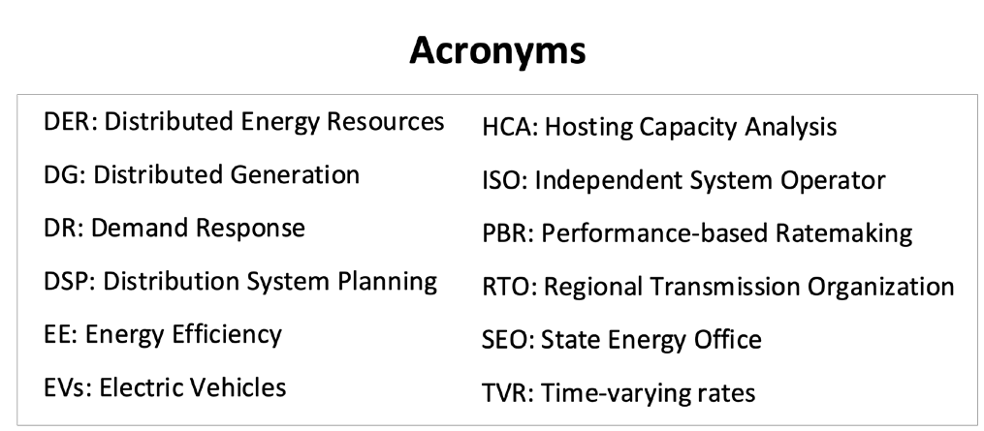
Jade Cohort Flowchart of Idealized Comprehensive Electricity Planning Process
A Distinct Grid Mod Process Is Not Necessary!
Jde Cohort Roadmap — NARUC-NASEO Task Force on Comprehensive Electricity Planning | 5

Slide 12
“RIDS” Benefit Calculation Example
Reduction in Risk of an Outage (%)
Customer Consequence of an Outage ($)
Customer Value
Annual Risk before Investment: 5%^
- Annual Risk after Investment: 3%^
Risk Reduction from Investment: 2%
Res (8000) x Cost per Outage ($6.10*)
+ Large C&I (500) x Cost per Outage ($21,277*) Consequence of Outage: $10,687,300
Customer Value per Year = $213,746 ($10.687 million x 2% risk reduction)
$213,746/yr. over 40 years, inflated at 2%/year, discounted into PV at 10.5%
Present Value over 40 Years = $2,412,330
^Both risk before and risk after should be informed by actual historical or pilot data
*Cost to customers of a 1-hour outage per 2013 DOE Study (used in DOE’s online Interruption Cost Estimator tool) inflated 9 years at 2% per year. With pre/post SAIDI/SAIFI inputs, and other utility & program or project inputs, ICE can compute the present value to customers of reliability improvements.
SEE proposed California PUC decision dated 11-3-22 in R.20-07-013

Slide 13
National Venues for Advocate’s AR Concerns
NASUCA position papers/guides: Alternative Ratemaking; PBR & Metrics; Grid planning/Benefit-Cost Analyses/RIDM; etc.
Weigh-in on an outstanding FTC petition (Center for Biological Diversity, PIRG, NCLC, others)
FERC/NARUC transmission task force has identified overly-rich distribution investment incentives as an issue (NASUCA comment?)
Other opportunities to educate/advocate (NARUC, NASEO, NCSL, NGA, etc.)
NASUCA Electricity Committee webcast next week . . .

Slide 14
Thank You!
Paul Alvarez, Wired Group, palvarez@wiredgroup.net
Ken Costello, costellonewmexico@gmail.com
Dennis Stephens, Wired Group dstephens@wiredgroup.net

