Slide 1
Utility Cost Allocation
NASUCA Regulatory Basics - October 17, 2022
Corey Singletary
Director, Regulatory Affairs
Citizens Utility Board Wisconsin

Slide 2
Agenda
Framing
Embedded Cost Allocation
  Distribution Cost Allocation
  Production Cost Allocation
Wrap-up

Slide 3
Process Framing

Slide 4
What are we doing?
Input to process: Test Year revenue requirement
Output to process: Test Year revenue allocation and rates by customer class.
Problem: How to split “the bill”

Slide 5
Four attorneys walk into a bar…
Consider:
Four Attorneys go to lunch.
The bill, including tax and tip, is $200.
How much should each attorney pay?

Slide 6
Perhaps we need more information
Tax and tip is 25 % of total (Tax 5%, Tip 20%)
The four individual orders were:
  Steak
  Chicken
  Chef Salad
  2 Martinis
The same four individuals paid $150 last time for the same four orders (including tax and tip).

Slide 7
More information
The amount paid by each last time was
  Steak: $75
  Chicken: $30
  Chef Salad: 30
  Martinis: $15
Steak costs 1.5 times Chicken.
Chicken and Chef Salad cost the same.
Martinis each cost ¼ of what chicken costs.
The four attorneys are a senior partner, a junior partner, an associate, and law clerk.

Slide 8
What is the answer?
$50 each
Steak - $100, Chicken - $40, Chef Salad - $40, Martinis - $20
Steak - $75, Chicken - $50, Chef Salad - $50, Martinis - $25
Something Else
Recall
The four individual orders were:
  Steak
  Chicken
  Chef Salad
  2 Martinis
The same four individuals paid $150 last time for the same four orders (including tax and tip).
Tax and tip is 25 % of total (Tax 5%, Tip 20%)
The amount paid by each last time was
  Steak: $75
  Chicken: $30
  Chef Salad: 30
  Martinis: $15
Steak costs 1.5 times Chicken.
Chicken and Chef Salad cost the same.
Martinis each cost ¼ of what chicken costs.
The four attorneys are a senior partner, a junior partner, an associate, and law clerk.

Slide 9
Imagine a more complex scenario
Imagine a more complex scenario
10 people go out to a dinner party
Each person may order (or not)
  A soup or salad
  Water, Soft Drink, Beer or Cocktails
  An appetizer to share
Entrees have been pre ordered and are served family style
  A Whole Roast Turkey
  Pasta
  Veggies
Some diners are vegetarians
Restaurant requires a food and beverage order minimum to reserve party space

Slide 10
Regulatory Framing

Slide 11
The Supremes
Goal: “Just and Reasonable” rates
“Just and Reasonable” standard – Hope, Bluefield, FPC v. Natural Gas Pipeline
“the fixing of 'just and reasonable' rates, involves a balancing of the investor and the consumer interests” (Hope)
“The Constitution does not bind rate-making bodies to the service of any single formula or combination of formulas. Agencies to whom this legislative power has been delegated are free, within the ambit (scope) of their statutory authority, to make the pragmatic adjustments which may be called for by particular circumstances.” (FPC v. Natural Gas Pipeline)
“Just and reasonable” comes down to judgement by the commission

Slide 12
Bonbright has entered the chat…
The related, “practical” attributes of simplicity, understandability, public acceptability, and feasibility of application.
Freedom from controversies as to proper interpretation.
Effectiveness in yielding total revenue requirements under the fair-return standard.
Revenue stability from year to year.
Stability of the rates themselves, with a minimum of unexpected changes seriously adverse to existing customers.
Fairness of the specific rates in the apportionment of total costs of service among the different consumers.
Avoidance of “undue discrimination” in rate relationships.
Efficiency of the rate classes and rate blocks in discouraging wasteful use of service while promoting all justified types and amounts of use:
  in the control of the total amounts of service supplied by the company;
  in the control of the relative uses of alternatives types of service (on-peak versus off-peak electricity, Pullman travel versus coach travel, single party telephone service versus service from a multi-party line)

Slide 13
Bonbright on “economic” principles
He harshly criticizes those who would seek to restrict rate design to solely “economic” (i.e. quantitative) principles:
  “The significance of such statements require notice in this chapter, since they raise the puzzling question of how any public utility rates or rate-making policy could have an affect on individual or social welfare other than an economic effect…
  “the most frequently made use of this self-imposed restriction to “economic” principles is to absolve the economist from any professional concern for considerations of fairness or equity as between investors and consumers, or as among different classes of customers…“ (Bonbright p.31, emphasis in original)
Bonbright goes on to critique a contemporary economist writing on the subject of cost allocation who declares they will analyze a problem of cost allocation solely “from an economic point of view. Whether or not the various methods proposed could give results that are ‘just’ or ‘equitable’ will not be discussed.” Bonbright states:
  They are omitted, presumably, because they raise ethical questions, as to which an economist has no professional competence.” (Bonbright p.32)
Bonbright’s treatise includes chapters on “Social Principles of Rate Making” and “Fairness versus Functional Efficiency as Objectives of Rate-Making Policy.”

Slide 14
Embedded Cost of Service Studies

Slide 15
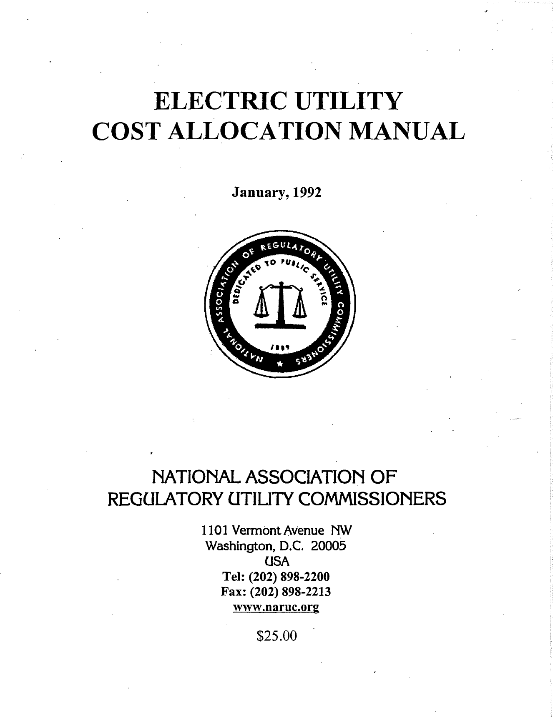
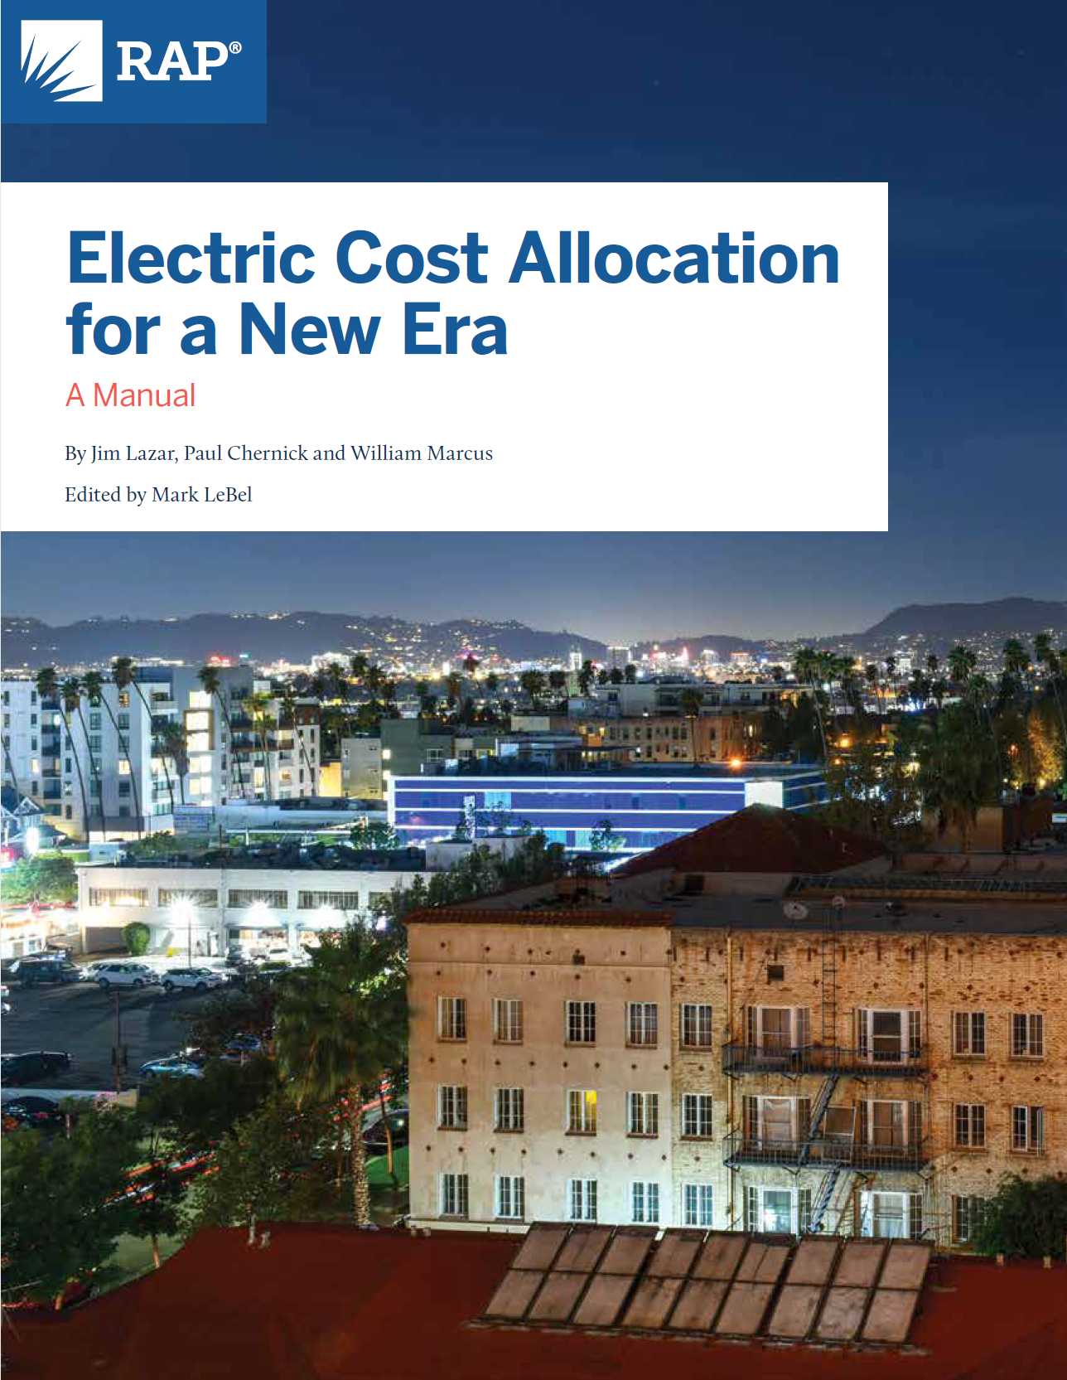
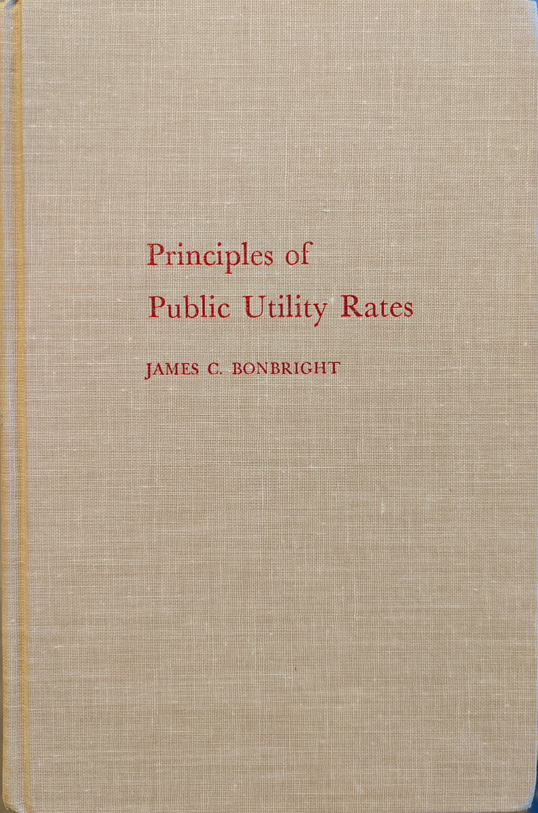
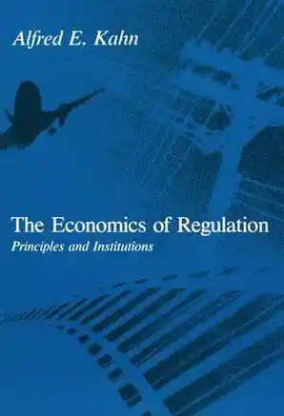
Required Reading
Extra Credit: The Economics of Regulation, Alfred E. Kahn

Slide 16
The Cost of Service Study as a Guide
Cost allocation or cost of service studies (COSS) have historically been accepted as a tool to aid in assigning class revenue responsibility and designing utility rates in a manner that reflects the utility’s cost to serve its customers.
Cost-Causer/Cost-Payor principle
Beneficiary Pays?
What is your cost-causation framework?

Slide 17
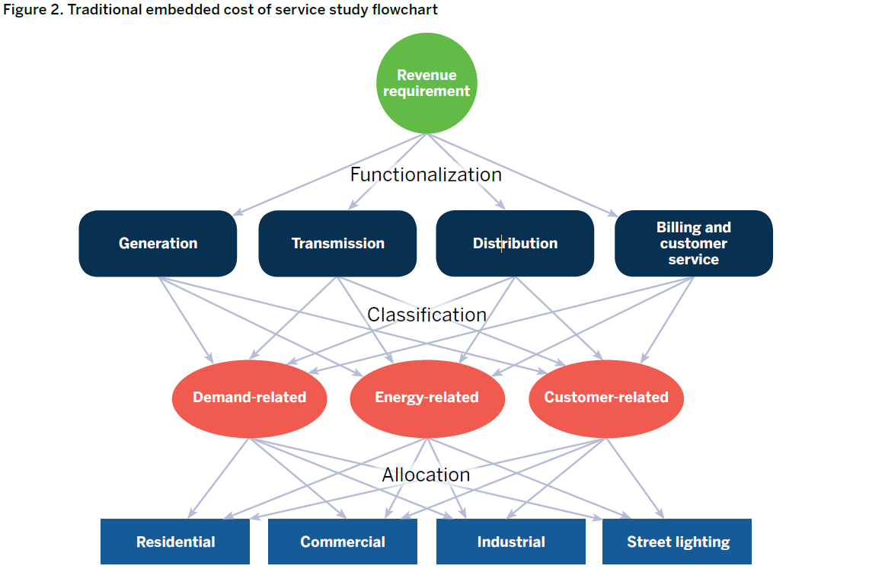
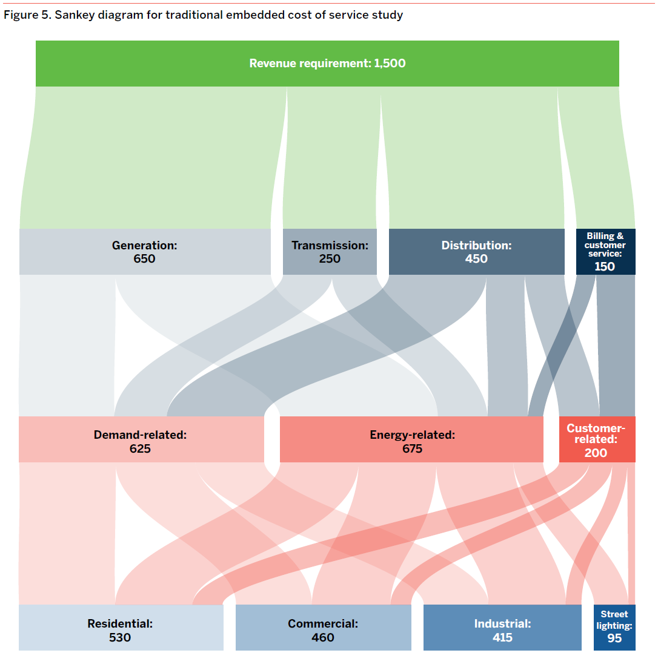
Traditional Cost Allocation Process
Source: RAP Cost Allocation Manual

Slide 18
Distribution System Cost Allocation
Traditional Primary Tension point:Cost Classification
Minimum system or zero-intercept method
Vs.
Basic Customer method
Implications for class cost allocation and rate design

Slide 19
Methods in Brief
Minimum System/Size
  Calculate cost of “minimum system” based on cost of minimum-sized unit of each type of equipment.
    E.g. Poles
  The value of the “minimum system” represents the customer classified portion
Zero Intercept
  Impute the cost of hypothetical equipment that carries zero load via statistical regression.
  Intended to identify the amount of equipment required to connect existing customers that is not load-related (a zero-kVA transformer, a zero-ampere conductor or a pole that is zero feet high).
Affects costs of “shared” components of the distribution system

Slide 20
The intuitive sense of a Minimum System
Aligns with what the utility “sees”
  Short-run, accounting-centric view
Aligns with what the regulator “sees”
  Poles and wires, service area
Quantitative method to split joint costs
  Math!

Slide 21
Specific Critiques of Minimum System
Assumes the minimum system would consist of the same number of units of the different types of equipment
Assumes the minimum system would consist of the same type of equipment
Minimum system analyses tend to use the current minimum-sized unit typically installed, not the minimum size ever installed or available.
Minimum system unit still has load carrying capacity
Minimum system does not account for customer density
Not all of the distribution system is embedded in rates. Factoring in the entire length of the system, including the part paid for with customer contributions, overstates the customer component of ratepayer-funded lines.
The fundamental reason for building distribution systems is to deliver energy to customers, not simply to connect them to the grid.

Slide 22
Bonbright on Customer Costs
“the inclusion of the costs of a minimum-sized distribution system among the customer-related costs seems … clearly indefensible… to which cost function does it then belong? The only defensible answer, in my opinion, is that it belongs to none of them. Instead, it should be recognized as a strictly unallocable portion of total costs… And this is the disposition that it would probably receive in an estimate of long-run marginal costs.
“But the fully-distributed cost [i.e embedded cost] analyst dare not avail himself of this solution, since he is the prisoner of his own assumption that "the sum of the parts equals the whole." He is therefore under impelling pressure to "fudge" his cost apportionments by using the category of customer costs as a dumping ground for costs that he cannot plausibly impute to any of his other cost categories.”
(Bonbright p.348-349, Emphasis added)
Are we manufacturing precision?

Slide 23
Basic Customer Cost
Counts only customer-specific plant as customer-related and the entire shared distribution network as demand- or energy related.
  Meters
  Services
  Meter Reading and Billing?
  Customer Service?
  Uncollectible expense?
Screening Question: A piece of equipment (e.g., conductor, pole, service drop or meter) should be considered customer-related only if the removal of one customer eliminates the need for the unit.
Costs are instead allocated on the basis of demand and/or energy

Slide 24
Considerations
Which Method
  Analytical arguments for or against
  Fairness
Implications for Retail Rates
  Customer classified costs often → Customer fixed charges

Slide 25
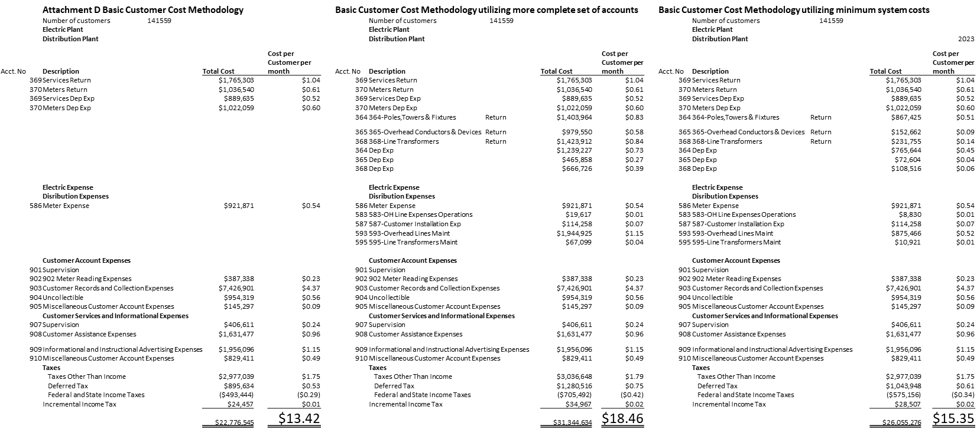
Customer Charge Functionalized Cost Example

Slide 26
Other Distribution Cost Allocation Considerations
Primary and secondary voltage separation
Line Losses
Multifamily
AMI
  Multi-function aspect

Slide 27
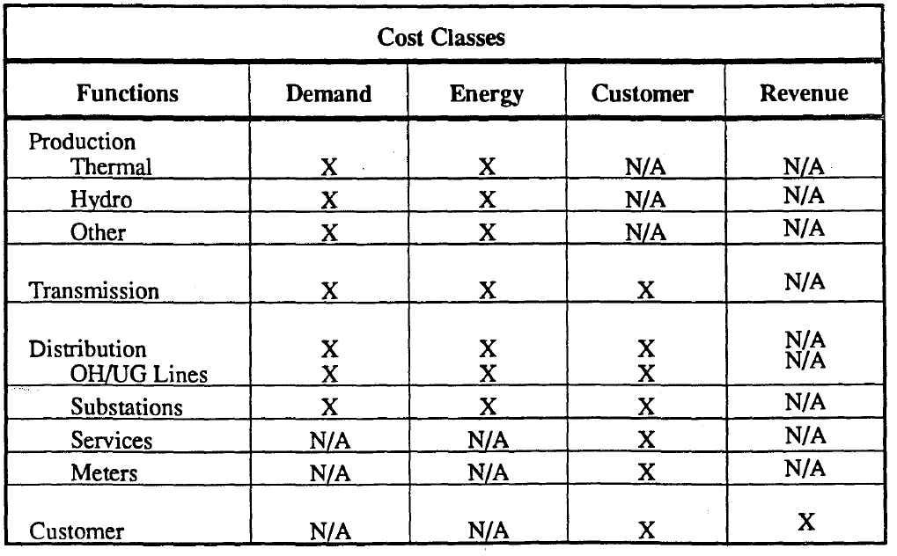
Production Cost Allocation
Source: NARUC Cost Allocation manual

Slide 28
Production Cost Classification
“Traditional” 100% Demand
Demand/Energy Classification
  Average-and-Peak Method
  Base-Peak Method
  Equivalent Peaker Method

Slide 29
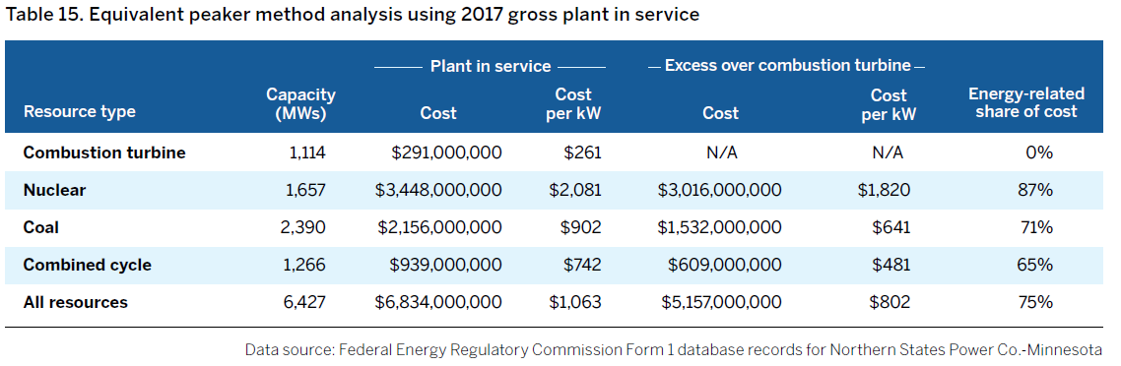
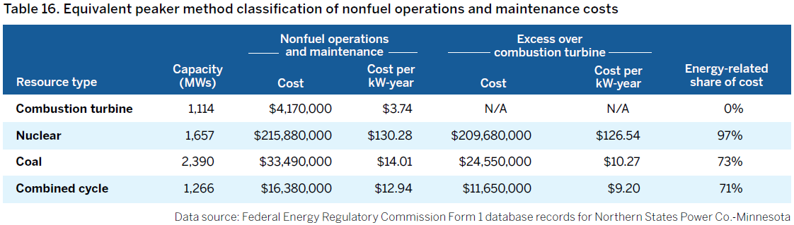
Example: Equivalent Peaker

Slide 30
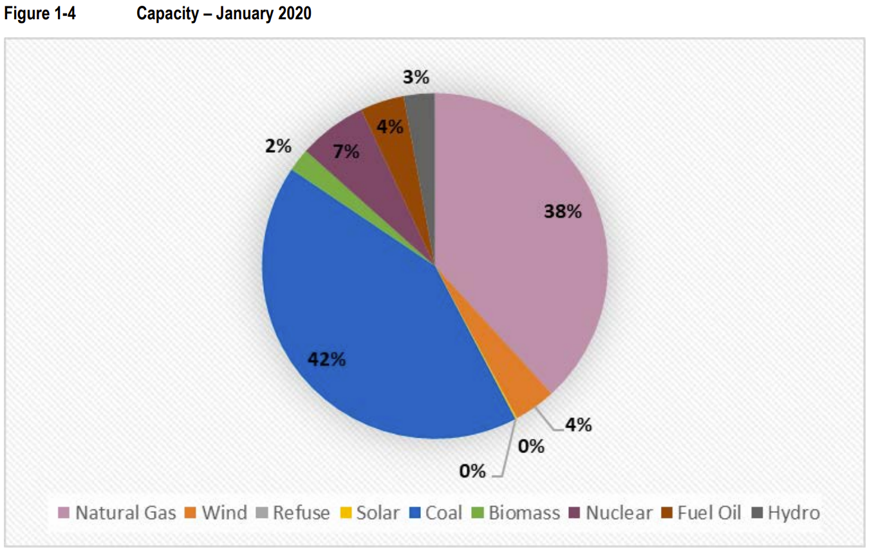
What does the utility’s fleet tell us?
Consider production capacity cost causation
Traditionally least cost capacity resource ($/MW): CT
  High energy cost ($/MWh)
Traditionally least cost energy resource ($/MWh): Coal or CC Gas
  Hight capital cost ($/MW)
Energy and Demand: Two sides of the same coin - Electricity
Image Source: Wisconsin SEA 2026, 5-ES-110

Slide 31
Demand Allocation Factor
Typically a consideration of which and how many peak demand periods are as the basis for allocating demand related costs
1-Coincident Peak (CP)
4-CP (e.g. summer months)
12-CP
8760-CP

Slide 32
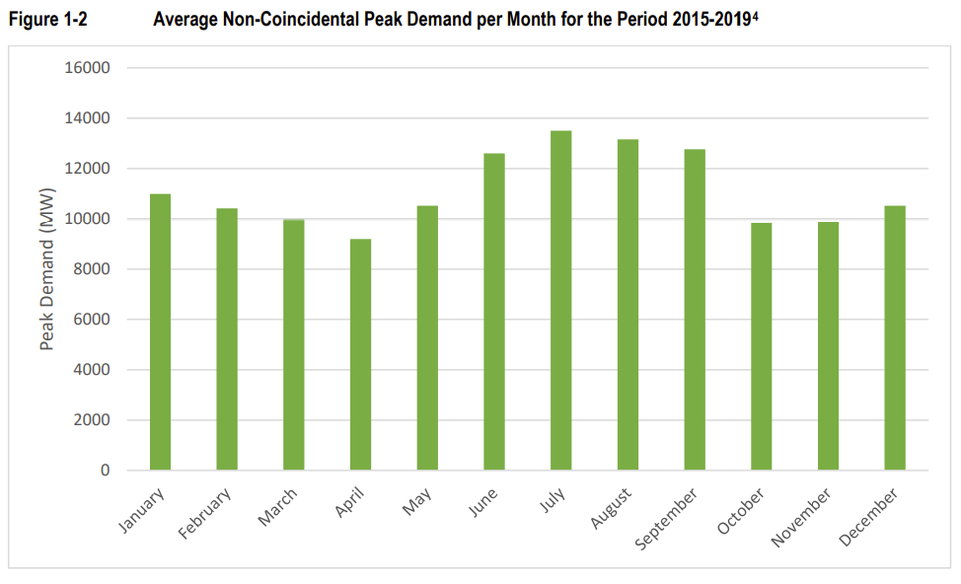

Slide 33
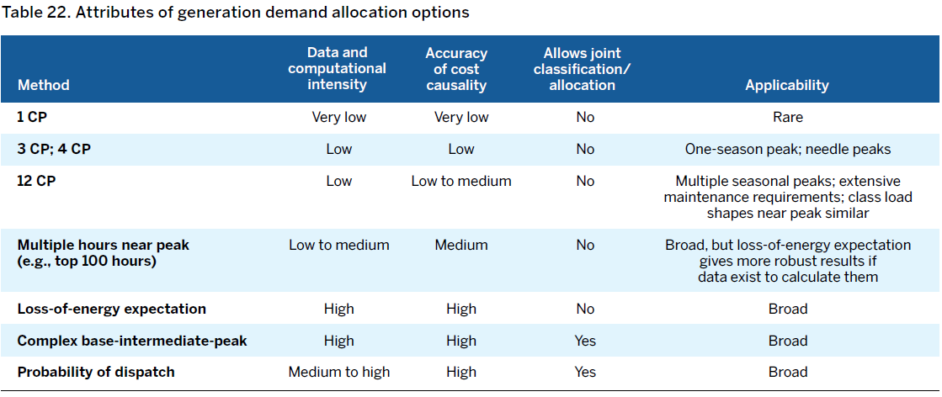

Slide 34
Reliability and Year-Round Capacity Needs
Capacity isn’t simply a function of the utility’s needs on the highest month or a small subset of months in the year
Resource scarcity isn’t always a function of peak demand
Demand allocation should reflect system operational realities
Example: Recent MISO work on revised resource adequacy construct
  “all hours matter” framework

Slide 35
Treatment of Non-Firm Load
Non-Firm: Interruptible, Curtailable Load
  Typically subject to multi-year contracts and are charged lower rates
Demand allocator based on total or firm demand?
  “Traditional” approach allocated demand costs on the basis of firm demand
Consider what happens:
  100% Demand + Firm Demand allocator +100% interruptible load
Issue largely tied to production cost classification (demand/energy)
  Compounding of “errors”
“Blunt instrument” of simply excluding all non-firm demand from cost allocation
  Is an explicit interruptible credit based on the avoided cost of capacity “better?”

Slide 36
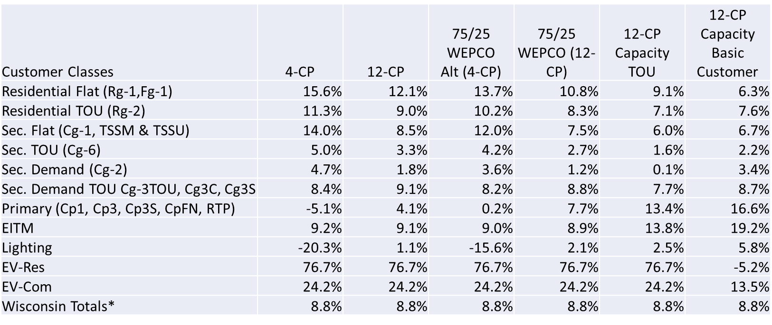
Is this“Reasonable People Disagreeing?”

Slide 37
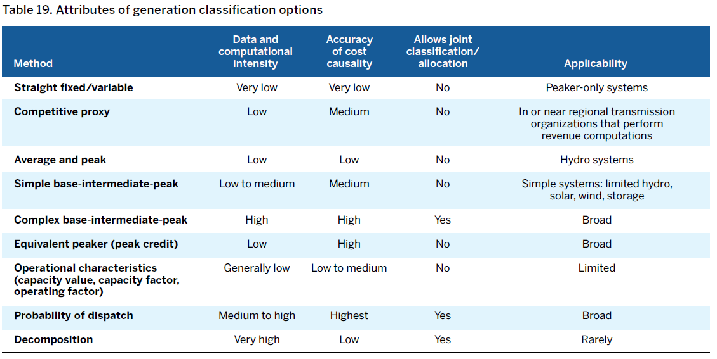
New Technology – New Methods
Traditional allocation methods aren’t well suited to newer production resource technologies
Time becomes more important
Resources such as storage serve multiple functions

Slide 38
Judgement, revisited
Are methods defensible? Consistent with observed facts?
Desire for reliance on model outputs for the answer is understandable
  Having models that can’t “give us the answer” is a difficult concept.
  Exercising judgement means having to make hard calls on essential, life-sustaining services, and who will be able to afford those services and who might not.
Supreme Court – Just and Reasonable Standard
Balancing customer and utility/shareholder risk is a public policy decision.
Cost allocation is a tool mean to support rate design
  Art vs. Science

Slide 39
Questions?
Corey Singletary: singletary@cubwi.org

