Slide 1

Some (not-so-new) ideas about setting utility rates of return
NASUCA TRAINING
July 21, 2022
Steve Kihm, DBA, CFA
Citizens Utility Board of Wisconsin
Michigan State University
Institute of Public Utilities

Slide 2
“Finance is just common sense.”
Regulator telling me why he’s skipping my training session at Michigan State
True?

Slide 3
Regulator’s score on my quick finance quiz.
0 out of 3

Slide 4
To be clear
This presentation is highly critical of regulatory processes
That is not meant to be critical of regulators per se; they are provided with information that on its face seems reasonable but upon closer inspection is not

Slide 5
Regulatory processes tend to:
Look at risk the way utility executives do, not how utility investors do (investors, not executives, supply capital)
Put trust in information that research shows is unreliable
Conflate the return on equity and the cost of equity
Believe that high returns on equity attract capital
Rarely conduct reality checks on their decisions using outside information (outside of that traditionally offered in regulatory proceedings)

Slide 6
Risk, so misunderstood
Gale Klappa, CEO of WEC Energy Group owns 250,000 shares of the company’s stock
Value = $25,000,000

Slide 7
Risk, so misunderstood
WEC Energy Group represents 0.09% of the S&P 500 index
If Mr. Klappa sold his WEC Energy Group stock and invested the proceeds in the S&P 500 his position in his company would be worth $23,000

Slide 8
WEC Energy Group loses 20% of its value
Mr. Klappa maintains his WEC-only position: he loses $5,000,000
If Mr. Klappa held the index: he loses $4,600

Slide 9
WEC Energy Group loses 20% of its value
Mr. Klappa maintains his WEC-only position: he loses $5,000,000
If Mr. Klappa held the index: he loses $4,600
Average daily volatility of S&P 500 in this context is $185,000

Slide 10
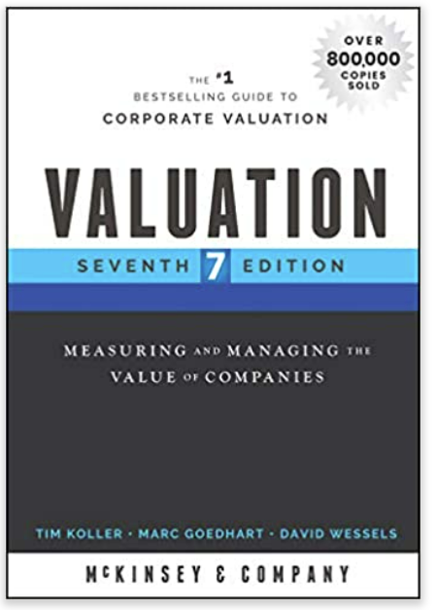
Most risks a firm faces have no effect on the returns their investors require.
Only exposure to macro risks that affect all stocks matter.

Slide 11
Utility executive: We face increasing risks due to potential technological obsolescence and competitive threats to our core business model.

Slide 12
“The unique risk that any company faces—say product obsolescence and new competition—are not priced into the cost of capital.”

Slide 13
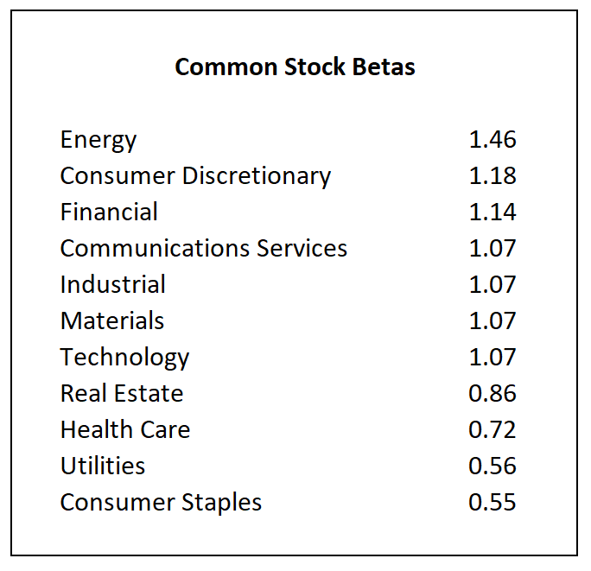
It’s all about sensitivity to broad market movements—and utilities aren’t very sensitive.

Slide 14
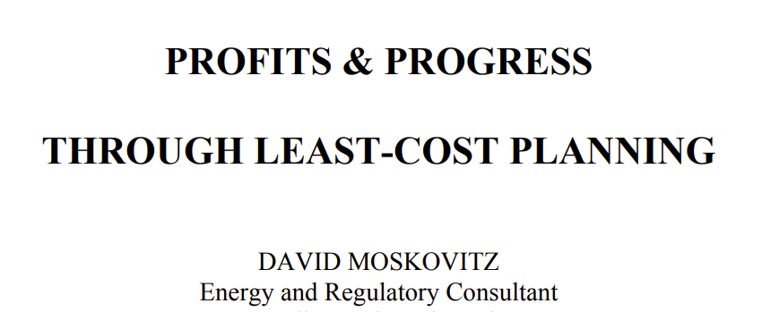
“Identifying a profit-maximizing strategy is the most important test of any incentive proposal.”
True?

Slide 15
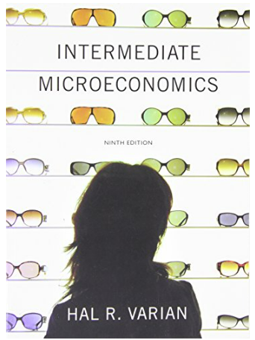

Profits—what do the experts say?

Slide 16
Profits—what do the experts say?
“If there is uncertainty about
a firm’s stream of profits then
instructing managers to
maximize profits has no
meaning.”

Slide 17
Profits—what do the experts say?
“Profit maximization makes
no sense as a corporate
objective.”

Slide 18
Firms maximize their stock prices, not their profits.

Slide 19
Stock prices!!!
“In a world of uncertainty,
maximizing stock market
value still has meaning.”

Slide 20
Stock prices!!!
“Thus maximizing stock market
value gives a well-defined
objective function to the firm
in nearly all economic
environments.”

Slide 21
Profits—what do the experts say?
“How can the financial manager
help the firm’s stockholders?
There is only one way: by
increasing the market value of
each stockholder’s stake in
the firm.”

Slide 22
Profits up; investor value destroyed
From 1969 to 1987 utilities that
had the fastest growth in profits
(earnings per share) had the
worst stock price performance
in the sector.

Slide 23
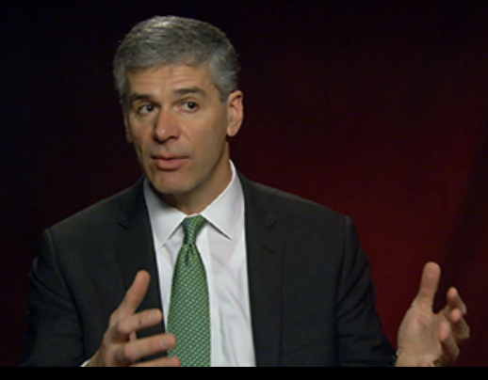
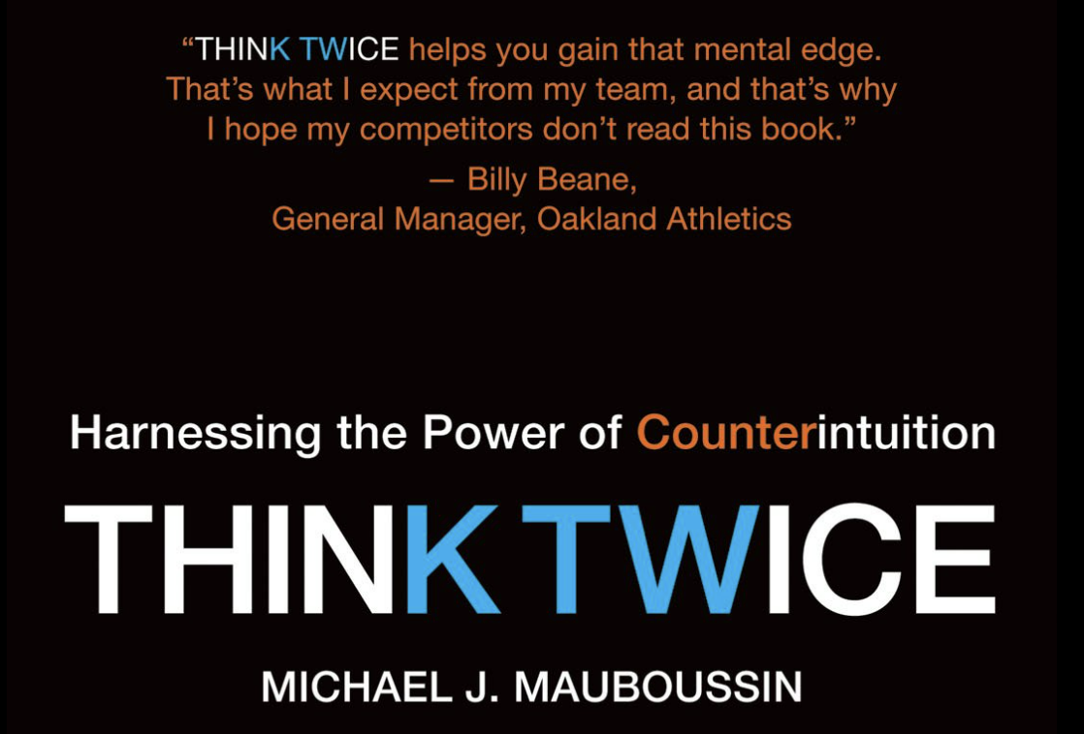
Michael J. Mauboussin is Head of Consilient Research at Counterpoint Global, Morgan Stanley Investment Management. Previously, he was Director of Research at BlueMountain Capital, Head of Global Financial Strategies at Credit Suisse, and Chief Investment Strategist at Legg Mason Capital Management. He is also chairman emeritus of the board of trustees of the Santa Fe Institute, a leading center for multi-disciplinary research in complex systems theory.

Slide 24
consilience: agreement between the approaches to a topic of different academic subjects, especially science and the humanities

Slide 25
“An inside view considers a
problem by focusing on the
specific task and by using
information that is close at
hand, and makes predictions
based on that narrow and
unique set of inputs.”

Slide 26
“These inputs may include anecdotal evidence and fallacious perceptions.”

Slide 27
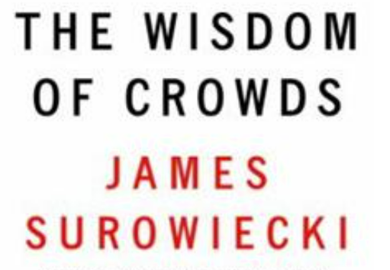
The most accurate forecasts come from large groups with diverse opinions.

Slide 28
Total market value of stocks = $48 trillion
Total market value of bonds = $46 trillion

Slide 29
Who will be more accurate?
50 economists, all of whom have the same training
Millions of people buying and selling $46 trillion worth of securities

Slide 30
?
The number of times in the past 21 years professional forecasts of interest rates were too high (bad for consumers if regulators use those forecasted rates to set returns on equity)

Slide 31
21
The number of years in a row that professional forecasts of interest rates have been too high

Slide 32
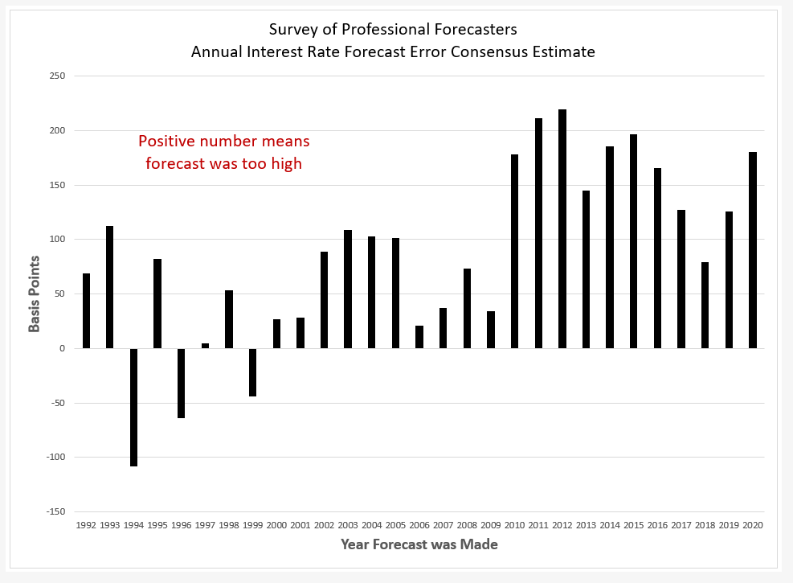
21 years

Slide 33
Why are professionals so bad at forecasting?
They are competing against the most powerful forecasting engine in the world—the bond market.
The market has all the advantages a forecaster needs (breadth and diversity).

Slide 34
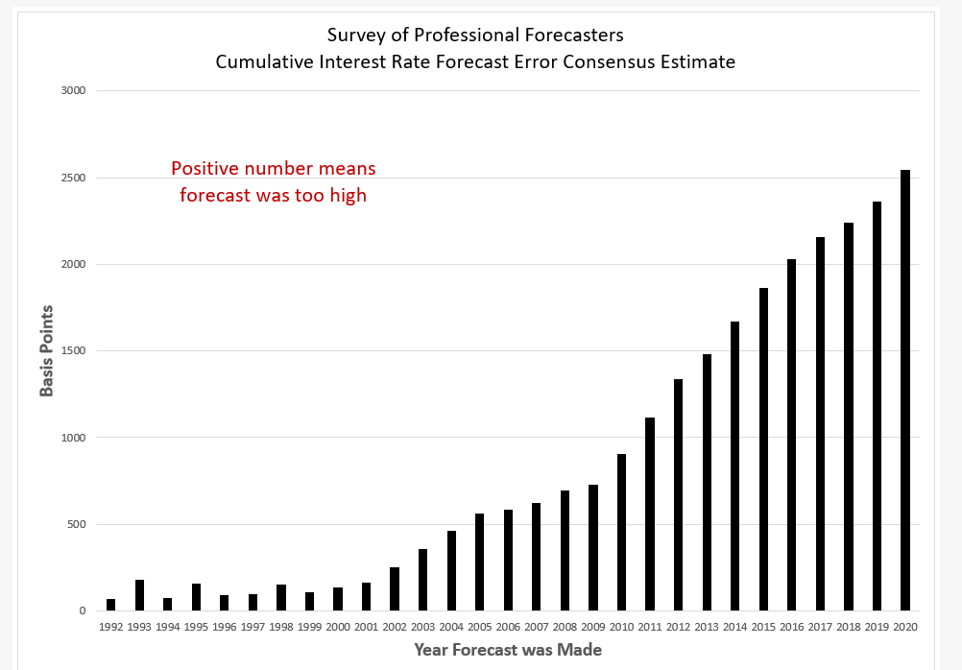

Slide 35
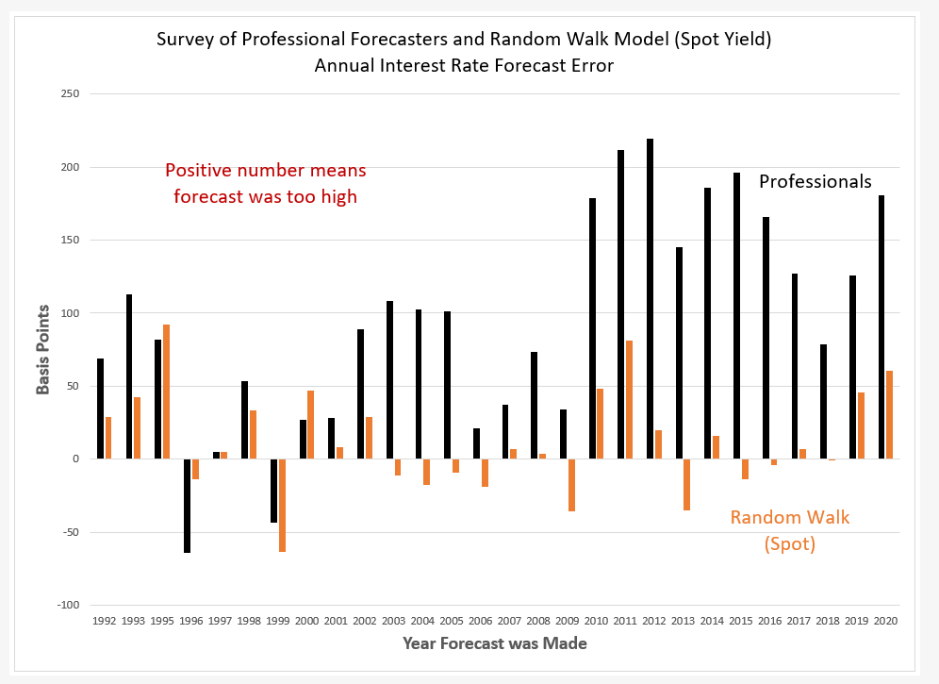

Slide 36
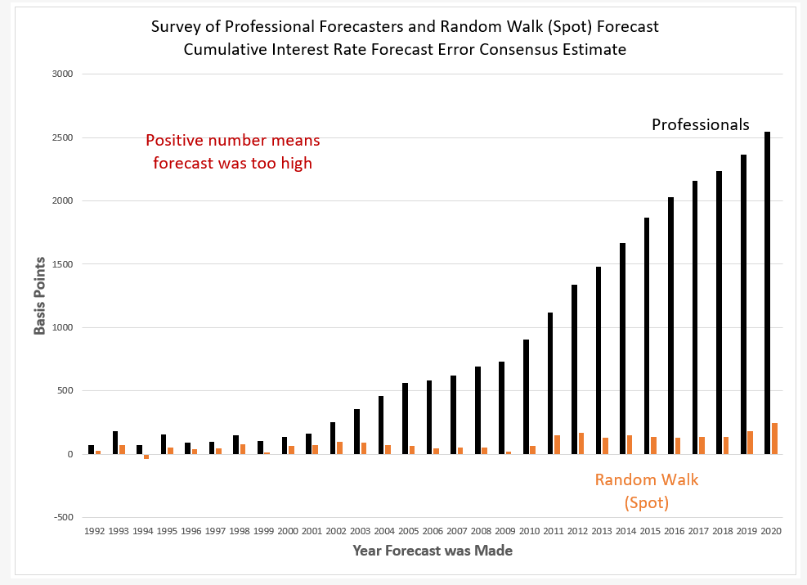

Slide 37
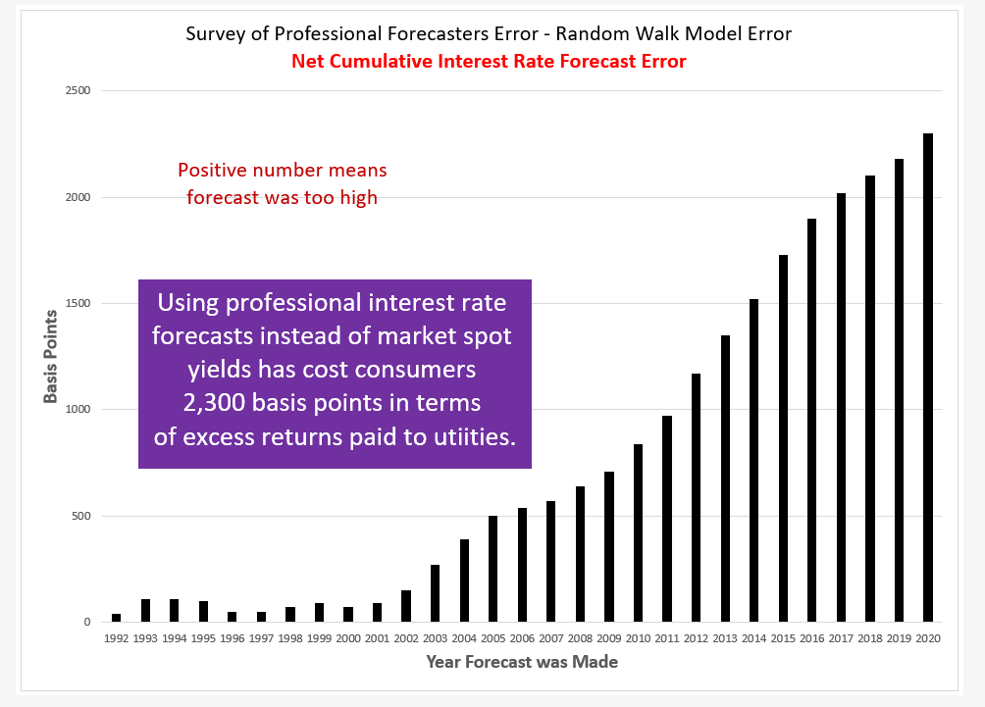

Slide 38
Estimating the cost of equity for the S&P 500
Commonly used approach in regulation (not elsewhere)
k = S&P dividend yield + sell-side analyst growth rates
k = 1.9% + 12.0% = 13.9%

Slide 39
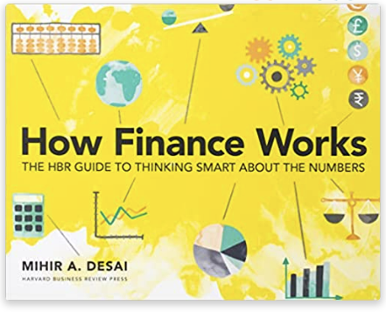
Estimating the cost of equity for the S&P 500
Sell-side analysts tend to be
positively biased, some herd
by copying others, while
others say extreme things.

Slide 40
Estimating the cost of equity for the S&P 500
Commonly used approach in regulation (not elsewhere)
k = S&P dividend yield + sell-side analyst growth rates
k = 1.9% + 12.0% = 13.9%
Long-term nominal GDP growth = 4.0%

Slide 41
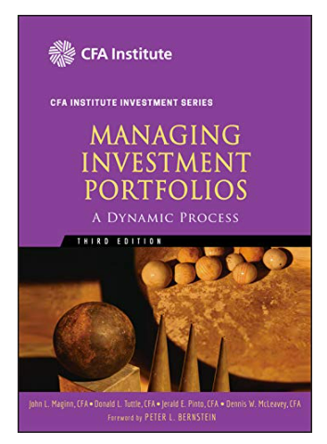
Portfolio manager approach
Grinold-Kroner (2002) approach

Slide 42
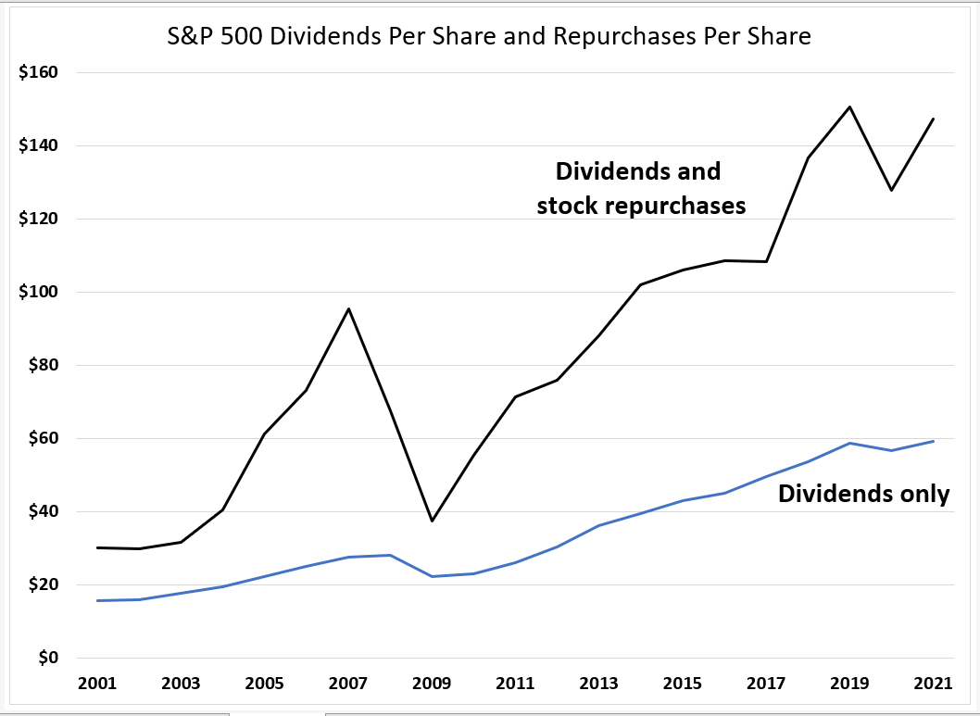
Portfolio manager approach

Slide 43
Portfolio manager approach
k = S&P dividend yield + stock repurchase yield + GDP growth
k = 1.9% + 2.4% + 4.0% = 8.3%

Slide 44
“The outside view asks if there are similar situations that can provide a statistical basis for making a decision.”

Slide 45
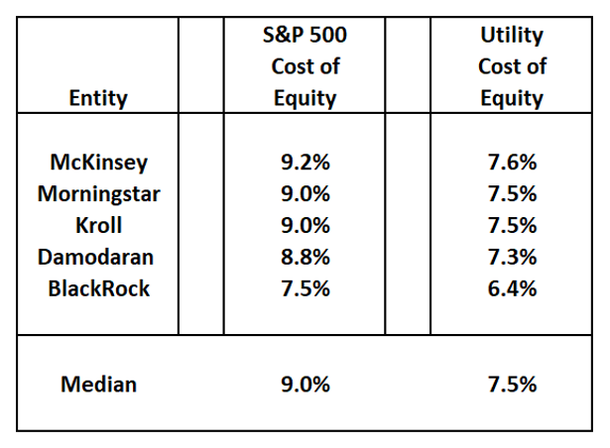
Cost of equity estimates

Slide 46
“The outside view can often create a very valuable reality check for decision makers.”

Slide 47

Note: Morningstar is not an investment bank.
WEC Energy Group
“In Wisconsin, the company enjoys rates based on two-year forward test years and an earnings-sharing mechanism over its allowed return on equity. Its average allowed ROE tops 10% at the company's subsidiaries in the state and is consistently above peers’... In our discounted cash flow valuation, we use a 6.1% cost of capital based on a 7.5% cost of equity. This is lower than the 9% rate of return we expect investors will demand for a diversified equity portfolio, reflecting WEC Energy Group's lower sensitivity to the economic cycle and lower degree of operating leverage.”

Slide 48
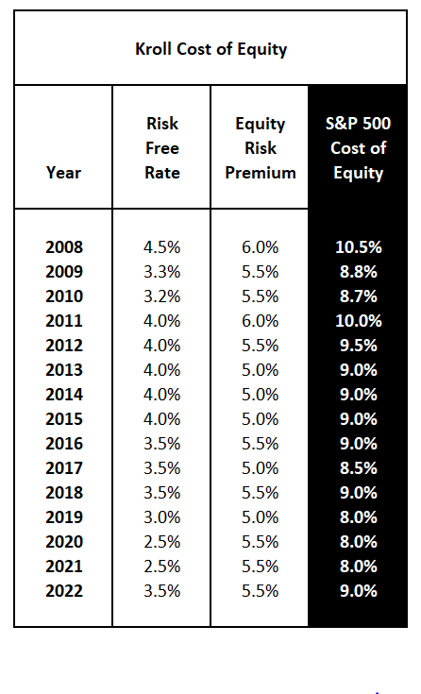
Kroll routinely assists clients with the valuation of businesses and business interests, as well as tangible and intangible assets and complex, hard to value securities. Kroll is the largest independent provider of business valuation services in the world. With over 2,000 professionals operating out of more than 70 offices worldwide, we have performed valuations of businesses and business interests, both large and small, spanning all industries for a wide variety of purposes.

Slide 49
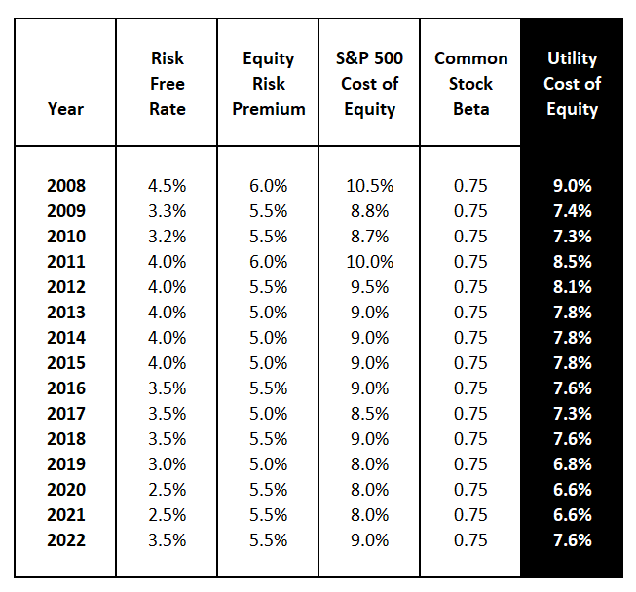

Slide 50
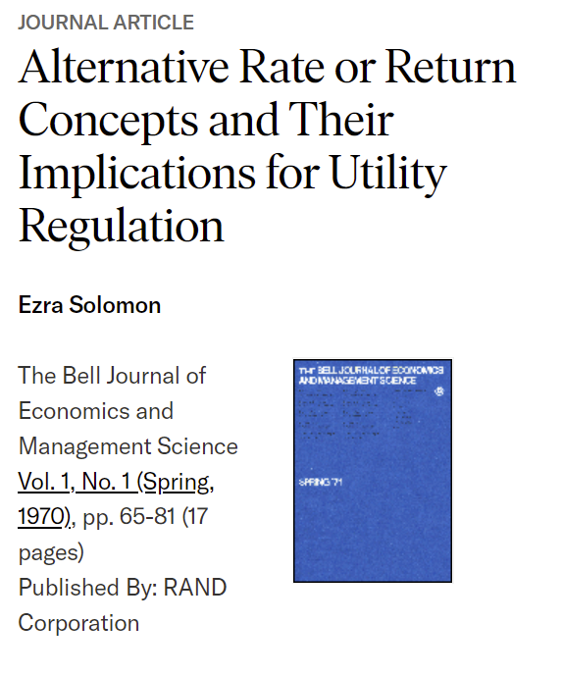
Let’s go back to 1970
of

Slide 51
Ezra Solomon, 1970
“Understanding that book rate measures [return on equity] and DCF rate measures [cost of equity] are not different estimates of the same thing but rather estimates of different things should eliminate at least part of the confusion surrounding ‘rates of return on investment.’”

Slide 52
Ezra Solomon, 1970
The return on equity is what the utility makes on its books.
The cost of equity is what investors require to hold the utility’s stock.

Slide 53
Profits up; investor value destroyed
From 1969 to 1987 utilities that
had the fastest growth in profits
(earnings per share) had the
worst stock price performance
in the sector.

Slide 54
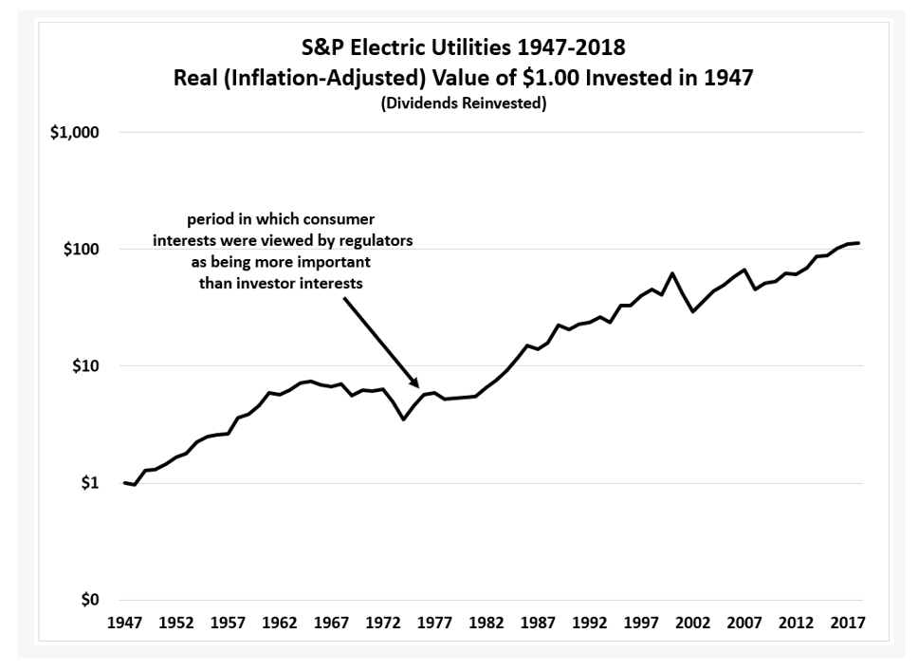
?
Period covered in the Jones study.

Slide 55
Period covered in the Jones study.
The problem here was profitable investment destroyed investor value

Slide 56
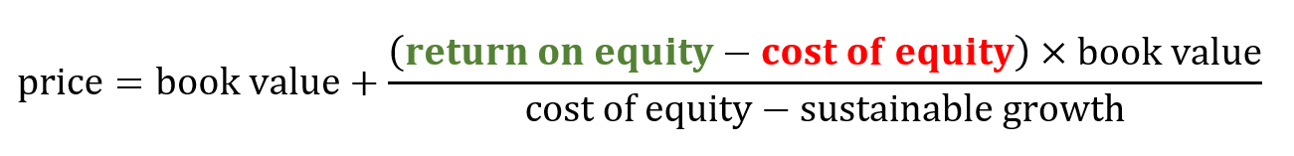
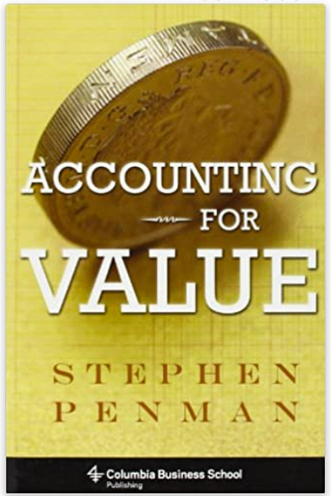
residual earnings model

Slide 57
residual earnings model
return on equity and cost of equity are opposing value forces

Slide 58
residual earnings model
These returns aren’t the same, unless
the stock price equals book value

Slide 59
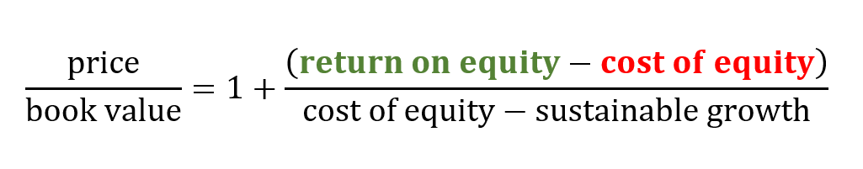
residual earnings model
Expressing the equation this way allows
us to compare relative prices across utilities.

Slide 60
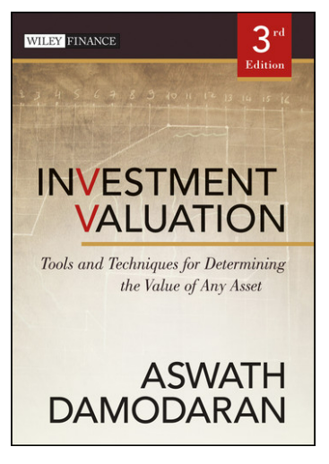
The price-book value ratio of a stable firm is determined by the differential between return on equity and its cost of equity. If the return on equity exceeds the cost of equity, the price will exceed the book value of equity; if the return on equity is lower than the cost of equity, the price will be lower than the book value of equity.

Slide 61
Profits up; investor value destroyed
From 1969 to 1987 utilities that
had the fastest growth in profits
(earnings per share) had the
worst stock price performance
in the sector.

Slide 62
residual earnings model
11%
14%
under these conditions investing capital:
increases profits (11% x book value)
decreases stock price (-3% x book value)

Slide 63
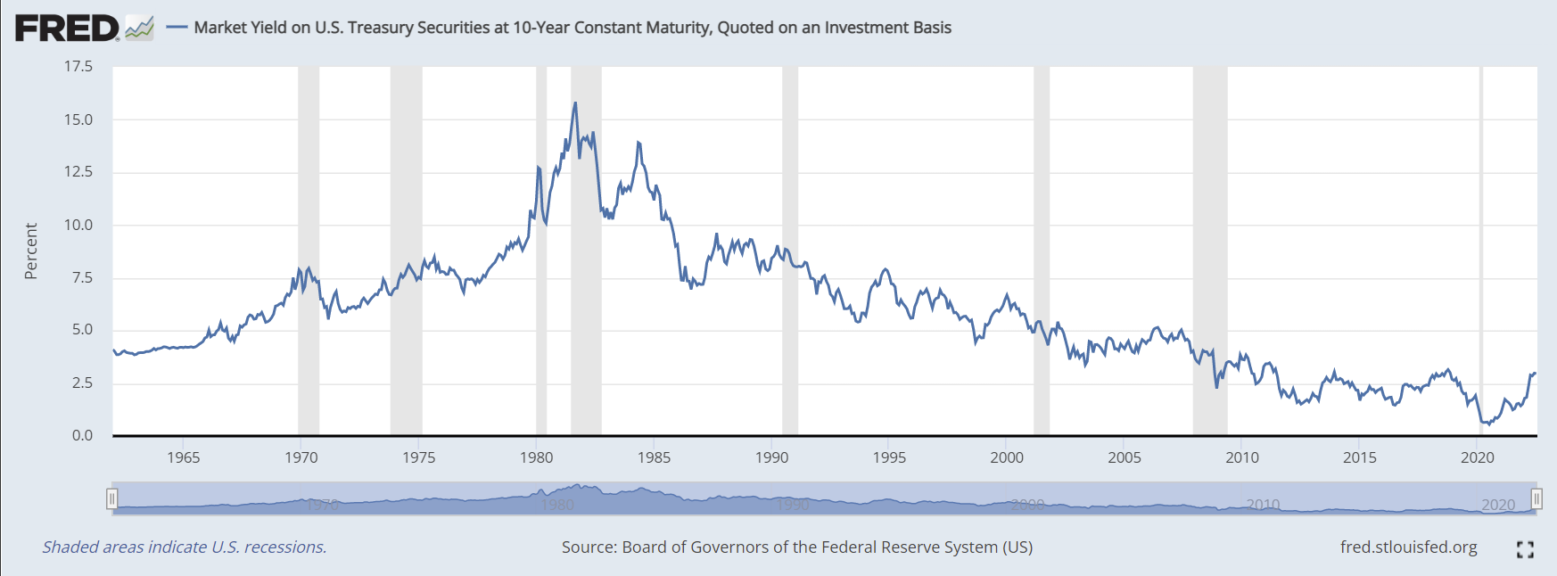
period Jones studied

Slide 64
period worked by a utility executive who
started at age 24 and is now 60
much of utilities’ financial
recent success was due to a
macroeconomic tailwind

Slide 65
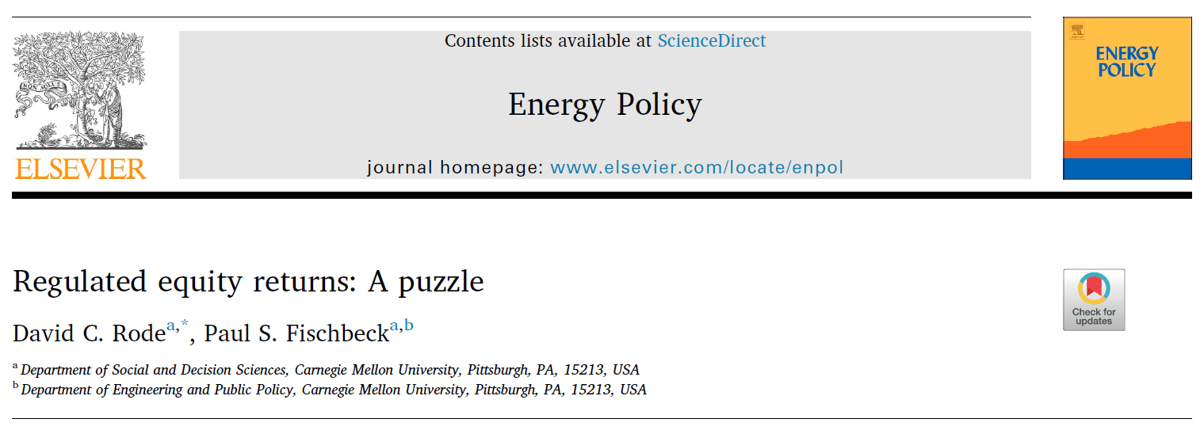
A big problem regarding utility rates of return (over the past 40 years)

Slide 66


A big problem regarding utility rates of return (over the past 40 years)
“Based on a database of U.S. electric utility rate cases spanning nearly four decades, the returns on equity authorized by regulators have exhibited a large and growing premium over the riskless rate of return. This growing premium does not appear to be explained by traditional asset-pricing models [cost of equity models], often in direct contrast to regulators’ stated intent.”
Rode & Fischbeck, 2019

Slide 67

A big problem regarding utility rates of return (over the past 40 years)
“If regulator judgment is impaired or subject to bias, then minimizing the influence of judgment by deferring to models may be prudent. In the end, we may observe
simply that what regulators should do, what regulators say they’re doing, and what regulators actually do may be three very different things.”
Rode & Fischbeck, 2019

Slide 68
The price-book value ratio of a stable firm is determined by the differential between return on equity and its cost of equity. If the return on equity exceeds the cost of equity, the price will exceed the book value of equity; if the return on equity is lower than the cost of equity, the price will be lower than the book value of equity.

Slide 69
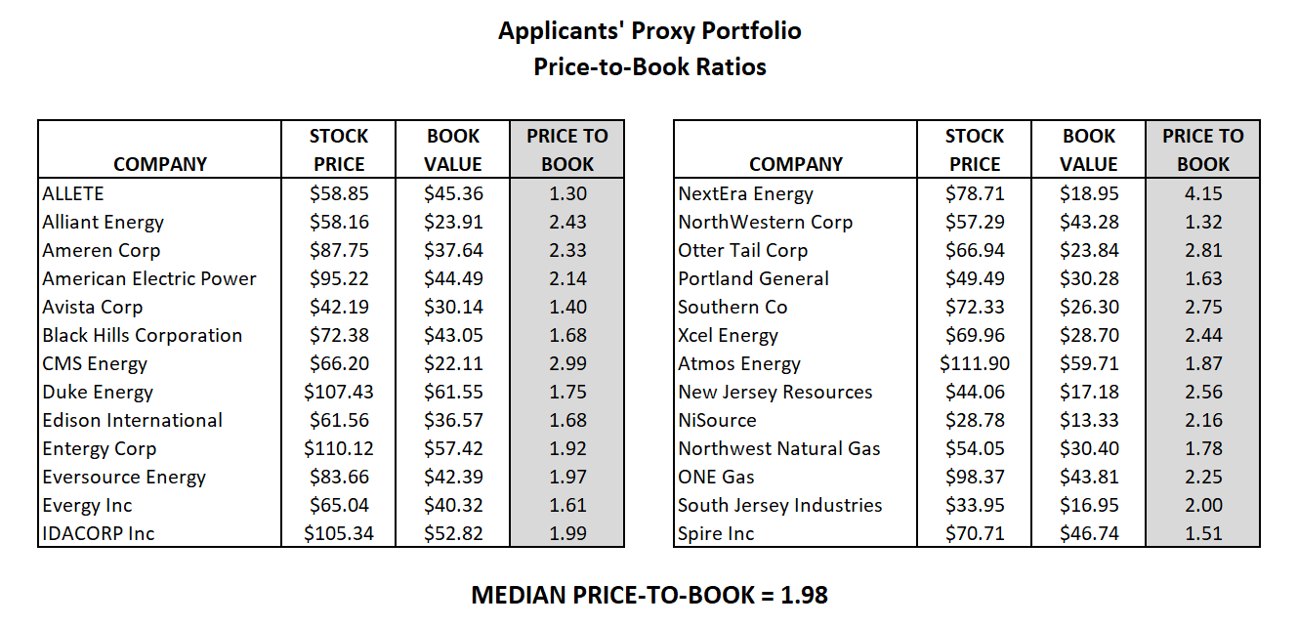

Slide 70
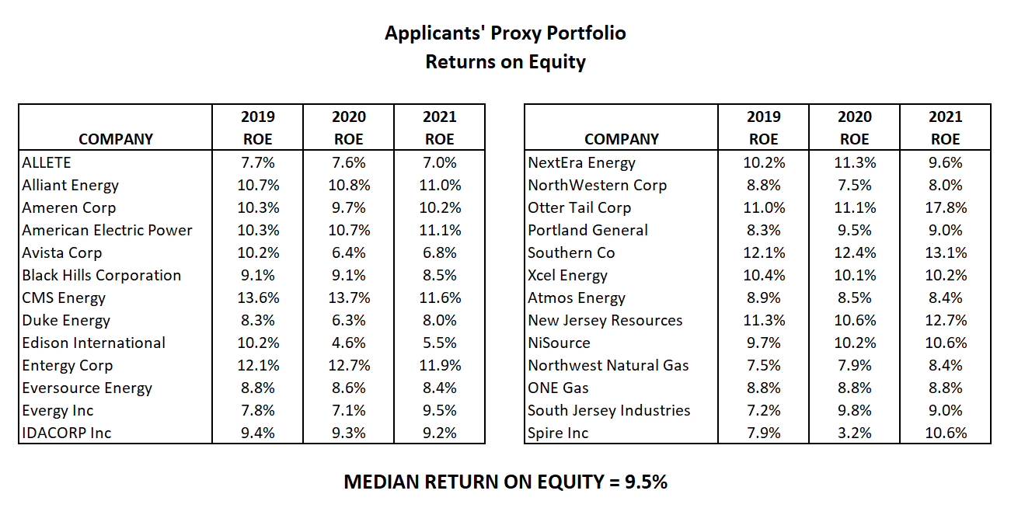

Slide 71
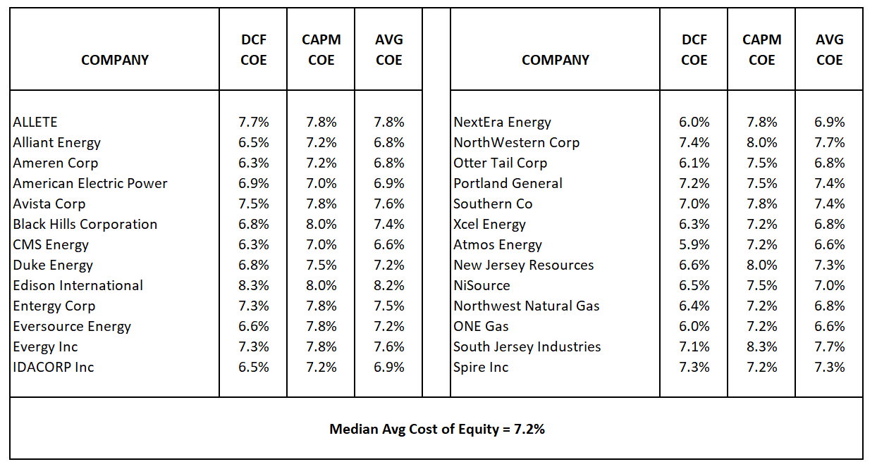

Slide 72
First impressions
We can observe the price-to-book ratio of 1.98
We can observe the returns on equity the utilities
have earned, which is 9.5%
What does this tell us?

Slide 73
First impressions
We can observe the price-to-book ratio of 1.98
We can observe the returns on equity the utilities
have earned, which is 9.5%
What does this tell us? If utility investors needed
a 9.5% return, they could expect to earn that by
paying book value for utility stocks.

Slide 74
First impressions
We can observe the price-to-book ratio of 1.98
We can observe the returns on equity the utilities
have earned, which is 9.5%
What does this tell us? But the fact they pay almost
twice book value for utility stocks, they must be content
with a much lower market return.

Slide 75
First impressions
We can observe the price-to-book ratio of 1.98
We can observe the returns on equity the utilities
have earned, which is 9.5%
What does this tell us? The financial model tells us that
market return is 7.2%

Slide 76
Ezra Solomon, 1970
“Understanding that book rate measures [return on equity] and DCF rate measures [cost of equity] are not different estimates of the same thing but rather estimates of different things should eliminate at least part of the confusion surrounding ‘rates of return on investment.’”

Slide 77
WEC Energy Group
“In Wisconsin, the company enjoys rates based on two-year forward test years and an earnings-sharing mechanism over its allowed return on equity. Its average allowed ROE tops 10% at the company's subsidiaries in the state and is consistently above peers’... In our discounted cash flow valuation, we use a 6.1% cost of capital based on a 7.5% cost of equity. This is lower than the 9% rate of return we expect investors will demand for a diversified equity portfolio, reflecting WEC Energy Group's lower sensitivity to the economic cycle and lower degree of operating leverage.”

Slide 79
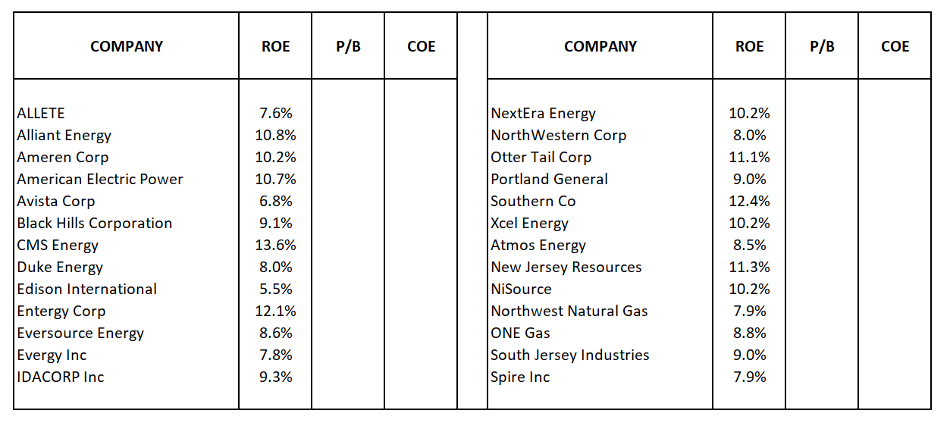
1. Start with ROEs for companies

Slide 80
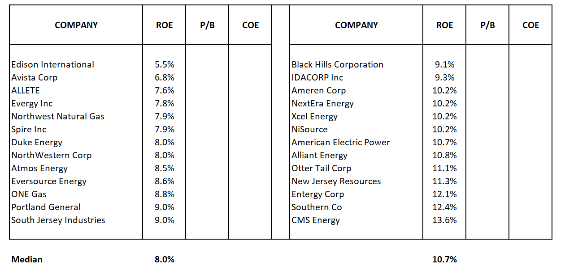
2. Sort by ROEs from low to high

Slide 81
High ROEs do not attract capital
“Even when ROE measures management performance it may not be synonymous with a high return on investment to shareholders. Thus, it is not enough for investors to find companies capable of generating high ROEs;”
Higgins, Mitton, Koski, 2019, Analysis for Financial Management, p. 56.

Slide 82
High ROEs do not attract capital
“...those companies must be unknown to others because once they are known, the possibility of high returns to investors will melt away in higher stock prices.”
Higgins, Mitton, Koski, 2019, Analysis for Financial Management, p. 56.

Slide 83
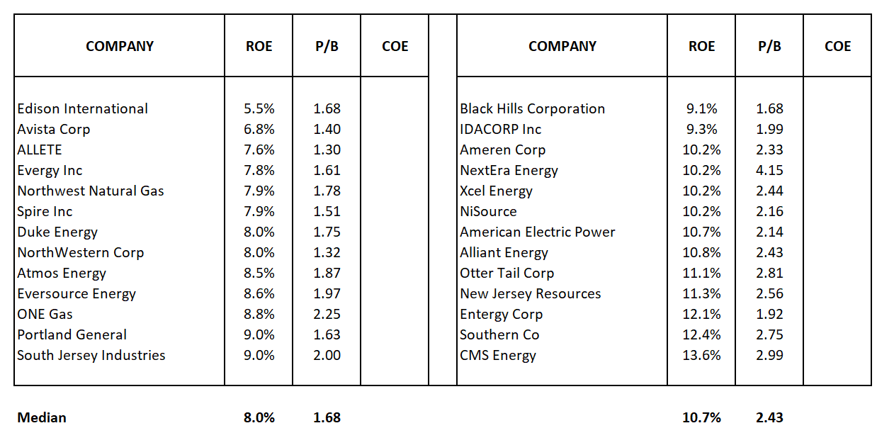
3. Observe price-to-book ratios

Slide 84
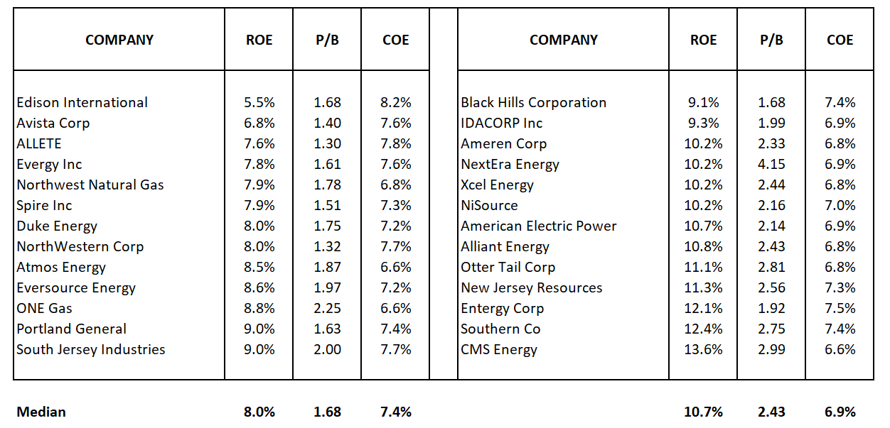
4. The cost of equity is the expected investor return

Slide 85
If investors want to invest in companies with high
returns on equity (10.7%), they must pay 2.43 times
book value. This dilutes the return investors expect to
earn to about 7%.
If investors are willing to invest in companies with low
returns on equity (8.0%), they have to pay only 1.68
times book value (a 30% discount relative to the price
the must pay for high ROE companies). This produces an
investor expected return of about 7%.

Slide 86
Rational estimates
With a price-to-book ratio of 1.98
and recent returns on equity of 9.5%...

Slide 87
Rational estimates
...cost of equity in the 7.2% to 7.6% range
seem reasonable.
A 10% cost of equity estimate can be
rejected out of hand.
Could the return on equity be 10%?

Slide 88
What do we do with this information?

Slide 89
Key policy implication
Not all utilities should have returns on equity set equal to the cost of equity.
Some utilities deserve higher returns based on exemplary performance for consumers.
Which ones?

Slide 90
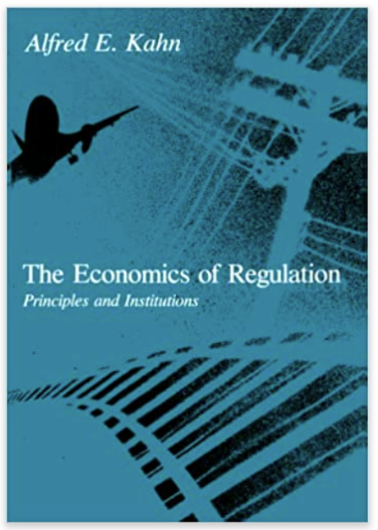
Merely permitting all regulated companies as a matter of course to earn rates in excess of the cost of capital does not supply the answer.

Slide 91
There has to be some means of seeing to it that those supernormal returns are earned...

Slide 92
...some means, for example, of identifying the companies that have been unusually enterprising or efficient...

Slide 93
...and offering the higher profits to them while denying them to others.

Slide 94
Regulation was always supposed to be performance based.
(Kahn wrote this in 1970.)

Slide 95
Now, what do we do with a 7.5% cost of equity?
Poorly performing utilities should receive 7.5%
Other utilities should receive 7.5% + performance reward
This has nothing to do with investors,
nothing to do with risk!

Slide 96

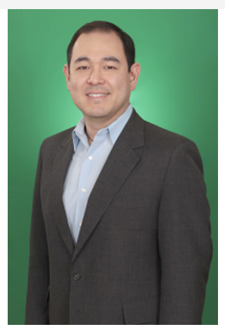
The Citizens Utility Board Approach
Steve Kihm
Regulatory Strategist
Corey Singletary
Director of Regulatory Affairs
cost of equity
utility performance
for consumers
return on equity

Slide 97

Contact info
Steve Kihm
kihm@cubwi.org

