Slide 1
Utility resource, asset, and contingency planning with climate variability
Juliet Homer (with research support from Alan Cooke and Kamila Kazimierczuk)
Pacific Northwest National Laboratory (PNNL)
Training Webinar for National Association of State Utility Consumer Advocates
June 27, 2022

Slide 2
Agenda
Introduction
Resource planning
Asset planning
Contingency planning
Weather data sources
Downscaling climate models
Decision-making under uncertainty
Other considerations
Questions consumer advocates can ask

Slide 3

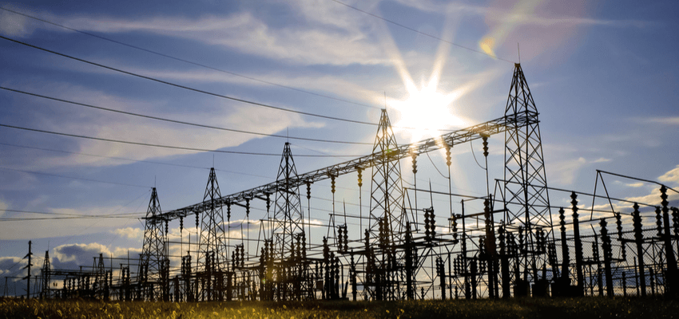
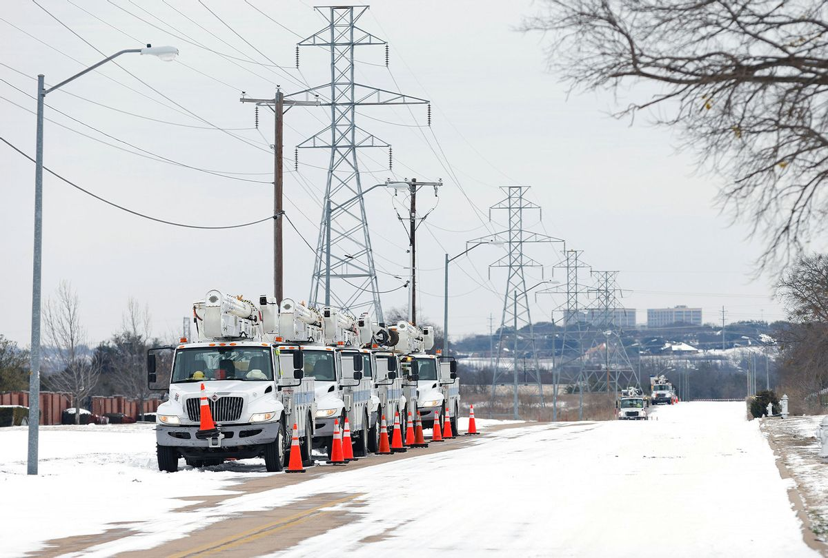
Introduction
Climate variability has implications for:
  Resource planning
    Resource adequacy and integrated resource planning
  Asset planning
    Supply infrastructure and physical delivery
  Contingency planning
    Climate-related vulnerabilities for assets, markets, and operations

Slide 4
Resource planning

Slide 5
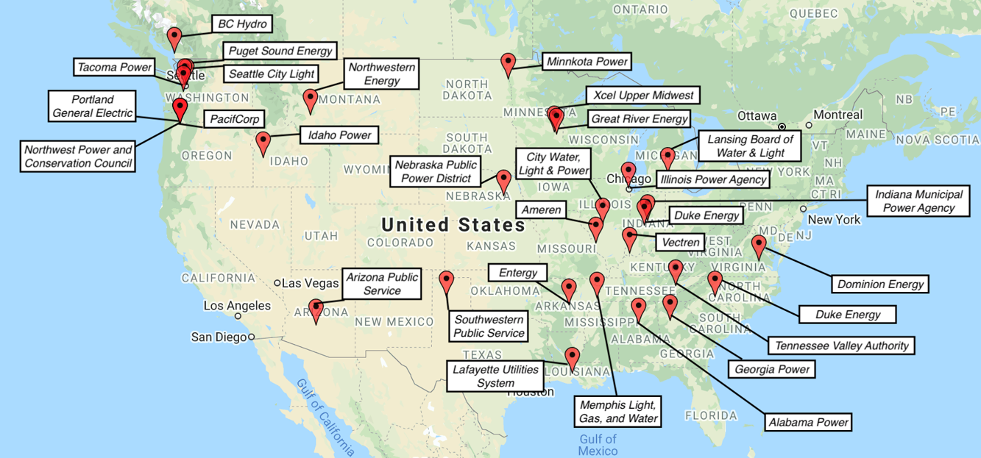
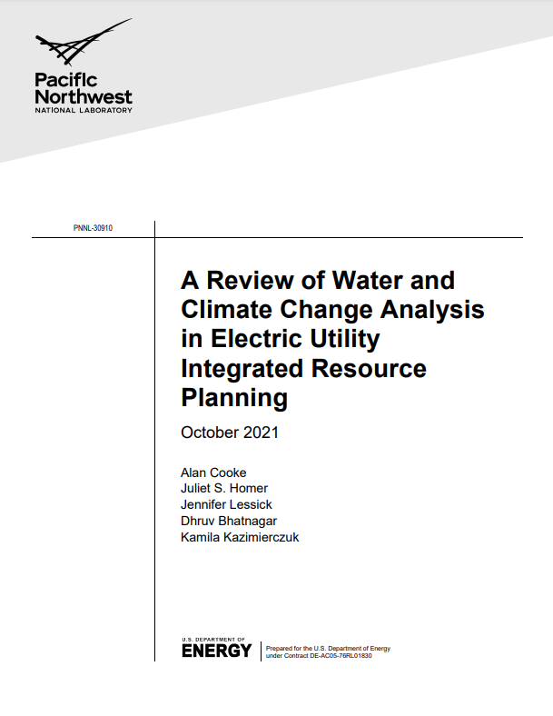
Water and climate change analysis in electric utility integrated resource planning (1)
Reviewed 30 electric integrated resource plans (IRPs) to summarize best practices for analyzing and reporting on potential water-based and climate change risks within the integrated resource planning process - White Paper (funded by DOE Water Power Technologies Office)

Slide 6
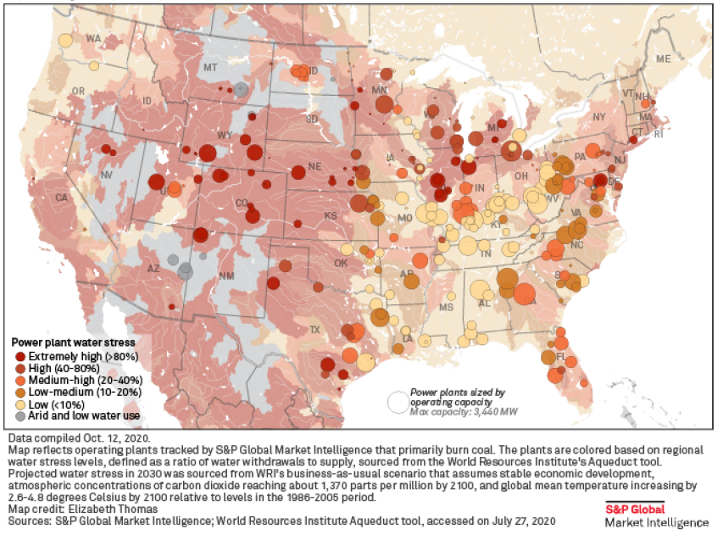
Water and climate change analysis in electric utility integrated resource planning (2)
Thermal generating facilities are having challenges with water availability:
  Shortage of cooling water
  Incoming cooling water too warm for optimal operation
  Water discharge temperatures exceeding permit limits
  Example: S&P Global Market Intelligence report identified 98.2 gigawatts (GW) of coal capacity at risk due to water stress in 2030
Climate change effects on hydrological cycles may adjust the timing, temperature, and volume of water availability for thermal electric cooling and hydropower generation
Climate change can also impact the timing and intensity of electric loads that utilities must serve, most notably for heating and cooling

Slide 7

Water and climate change analysis in electric utility integrated resource planning (3)
Water availability can impact amount and timing of power generation (thermal & hydro)
Changing temperatures can lead to changes in loads and demand side resources
Wholesale power markets and prices are impacted by changing generation and loads
Reliability is also impacted by extreme events, changing loads, and generation
Interregional climate change effects exist and can impact generating resource availability and market conditions
Taken together, these represent cumulative areas of significant potential uncertainty and impact

Slide 8
IRP Review Findings
Only three of 30 IRPs studied water availability issues
    Southwestern Public Service’s 2018 IRP studied groundwater availability for cooling a coal plant, leading to a change in running the plant for peaking operation only.
    TVA’s 2019 IRP noted the potential for additional cooling capacity costs or deration of thermal plants.
    Arizona Public Service presented considerable data on plans to ensure sufficient water for plants
Northwest Power and Conservation Council, Tacoma Power, and Seattle City Light used downscaled climate data to identify impacts on loads and hydroelectric resources
Puget Sound Energy, Vectren, and Entergy Mississippi IRPs analyzed historical data and identified trends for use in models
  Vectren and Entergy Mississippi used cooling and heating degree day trends for load forecasting
  Puget asked stakeholders whether they should use downscaled or trended historical data
  Vermont Gas 2021 IRP included declining heating loads, increasing design temperatures
Best practices:
  Use historical data for screening
    With trends rather than a fixed average
    Focused on recent history, not last 40 years or longer term
  Use downscaled global climate model weather data (NW utilities, Con Edison, LADWP, others)
Notes:
2021 Northwest Power and Conservation Council’s 8th Power Plan studied impacts of changes in Columbia River power output on the region’s summer loss of load probability
Tacoma Power’s 2020 IRP studied impacts on wholesale purchases due to potentially changed Columbia River power output
Most IRPs discuss water only in terms of Clean Water Act compliance issues
NPCC projections show resource deficiencies shifting from winter to summer periods
Reliance on historical data could lead to plans that fail to address future issues

Slide 9
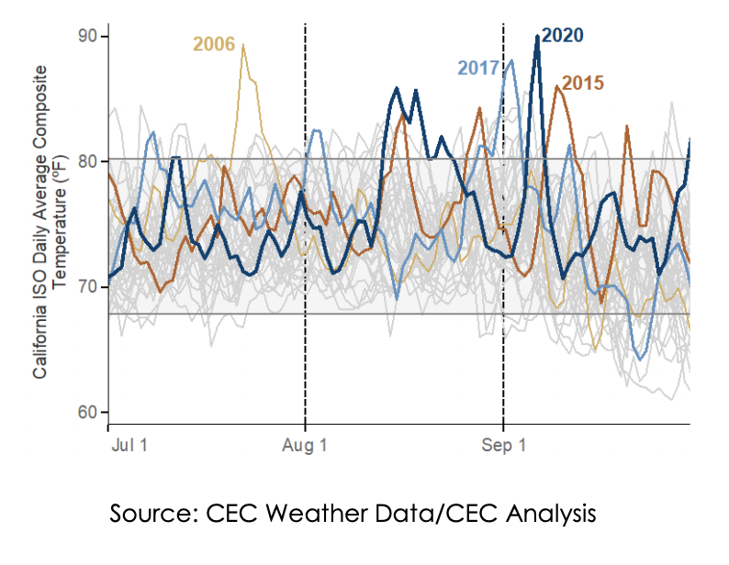
Resource planning for system-wide climate resilience: Lessons learned
Case study: CAISO outages, August 14 and 15, 2020
Extreme heat storm across the western US resulted in electricity demand exceeding electricity resource planning targets
CA utilities forced to initiate temporary rolling service cuts due to shortage of electricity supplies
Analysis of the incident by CAISO determined that existing resource planning processes do not adequately account for climate change impacts
  Electricity demand forecasts used for resource adequacy requirements are based on average historic peak demand
  Even with an added 15% “planning reserve margin” not sufficient for 2020 heatwaves
Demand was the result of a historic West-wide heat wave. http://www.caiso.com/Documents/Final-Root-Cause-Analysis-Mid-August-2020-Extreme-Heat-Wave.pdf

Slide 10
Asset planning

Slide 11
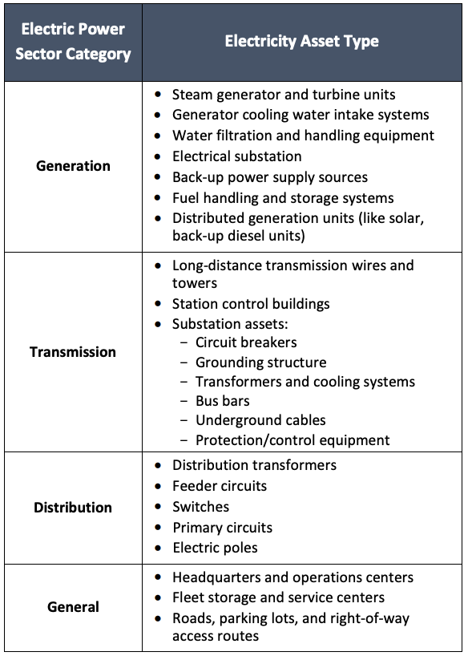
Climate vulnerability assessment
A climate vulnerability assessment looks at where and how utility assets are at risk from the impacts of climate change, how those risks will manifest, and what the consequences will be to the system
The assessment ultimately considers:
  the exposure of critical assets or operations to an adverse climate event
    Critical assets are inventoried by category (to the right) and attributes
  the probability of damage to assets or disruption to operations as a result of exposure to those climate threats (risks posed by threat)
  the likely consequences if the event were to occur (severity of impacts).
List of potentially vulnerable utility operations, from DOE 2016

Slide 12
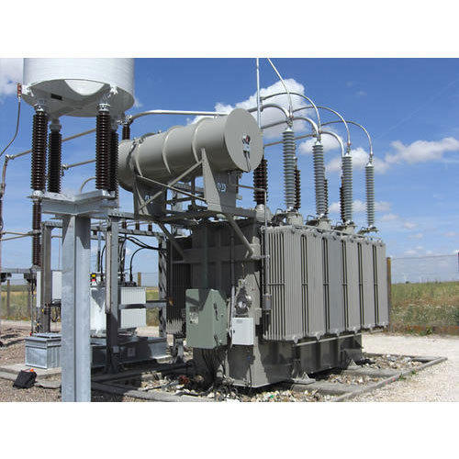
Asset planning and operations (1)
Many utility assets are predicated on specific temperature maximums (or minimums) and load ranges
Temperatures above or below the specified max or min can lead to derating, damage and failure
Existing equipment (transformers, conductors, etc.) may not be designed for temperatures being experienced
Higher temperatures can reduce equipment capacity and increase maintenance requirements
Higher temperatures also correspond to higher loads
In some cases, utility assets now find themselves located in FEMA floodplains
Layers of utility assumptions need to be reevaluated. Utilities have traditionally used guidelines and rules of thumb for asset planning and operations, developed and adjusted over time based on the history of how things have operated
Utilities need to assess and potentially adjust their assumptions. Regulators can encourage them to do so and ask for updates on how they are doing this

Slide 13
Asset planning and operations (2)
Maintenance cycles may also need to be adjusted. Increased maintenance cycles may be needed to keep transformers going.
  More emphasis on vegetation management is required in some areas.
  Utilities may also change the amount and types of spares kept on hand.
Some utilities now want more observability in the system to more actively monitor systems, including more sensors and more advanced distribution management systems.
Standards may need to be reconsidered. Many design requirements come from standards. Standards vary based on region.
Equipment vendors need to adapt equipment ratings and specifications.
Regulators can be flexible with utilities as they move into operational regions they haven’t seen before. There will inevitably be false starts. Some investments will not demonstrate value right away.
Utilities can learn from others and don’t have to start from scratch.
  Can identify planning analogs and learn from other regions that have adapted their design requirements
  Utility networking events can help (DistribuTECH, NRECA, APPA, Edison Institute). Regulators can support opportunities for networking.

Slide 14
Contingency planning

Slide 15
Contingency planning
Contingency planning refers to disaster or emergency response planning. It focuses on utilities’ preparedness for one-off weather-related or other events (e.g., cyber-attacks), which could lead to service interruptions or safety issues.
Asset and contingency planning often happens under the same umbrella – climate resiliency planning.
Asset and contingency planning are typically part of a two-pronged process that involves the development of (1) climate vulnerability assessments and (2) climate resilience plans.
Following are some tools for bringing climate change into utility planning:
  Asset risk screening tools
  Weather data sources
  Guides/tools to aid in assessing climate related impacts and addressing the impacts

Slide 16

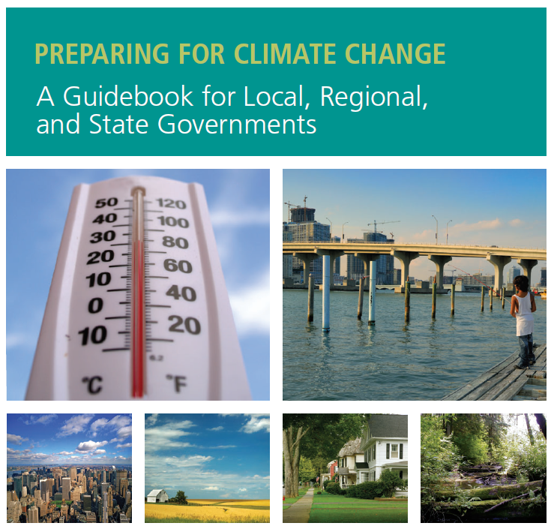
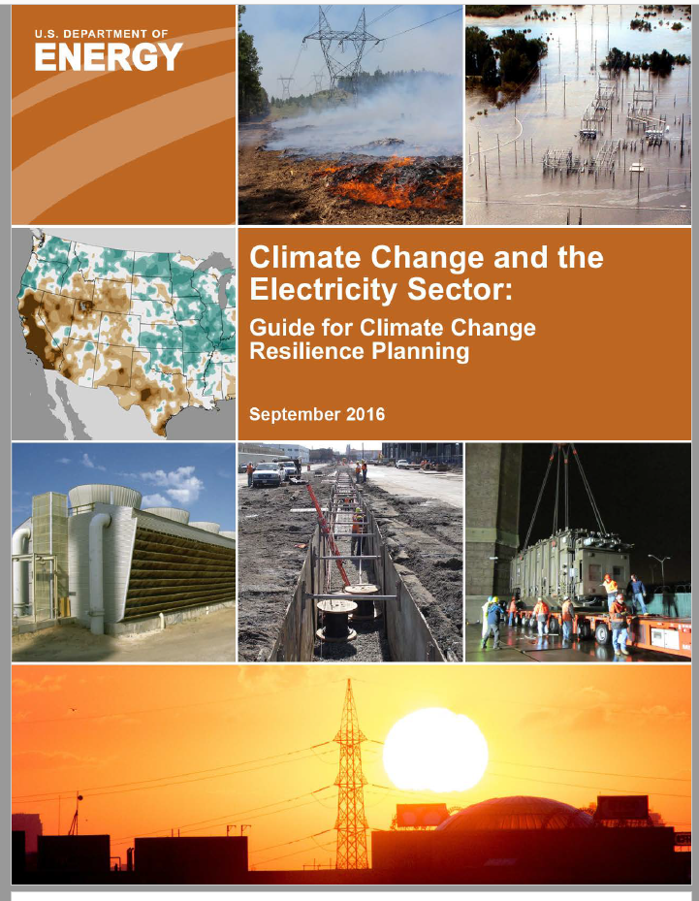
Risk screening tools
NOAA US Climate Resilience Toolkit: Steps to Resilience
University of Washington Climate Impacts Group
US DOE Resilience Planning Guide
  Additional resources
    Georgetown Adaptation Clearinghouse
    CPUC Climate Adaptation in the Electric Sector
    NREL Power Sector Resilience Planning Guidebook

Slide 17
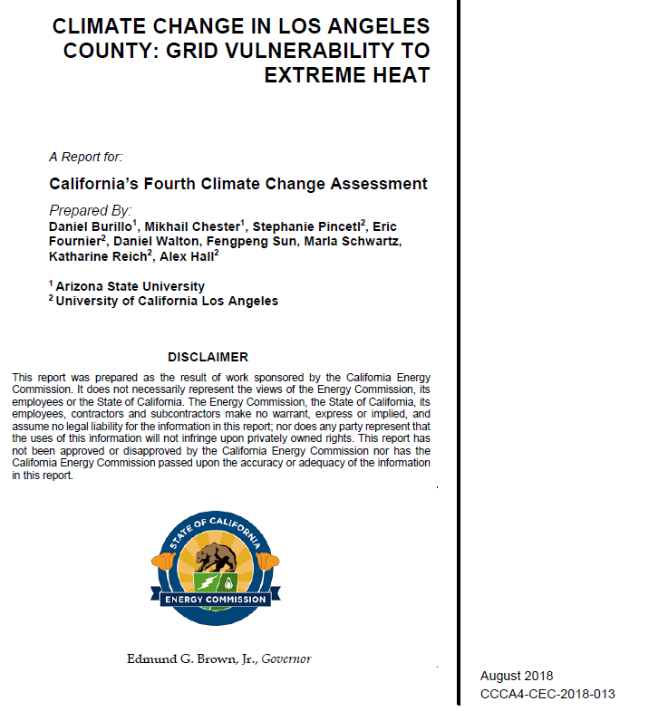
Screening example: Southern California Edison/LA County
California Energy Commission – Climate Change in Los Angeles County: Grid Vulnerability to Extreme Heat
One of many such reports
Identifies future climate trends via downscaled climate data, especially future heat events
Estimates future loads
Identifies the capacity ratings of electrical assets in LA County, including the temperatures equipment is rated for
Identifies the impact on capacity if temperature ratings are exceeded
  All grid components expected to lose 2–20% of capacity by 2060
  Peak demand projected to increase between 0.2 and 6.5 GWh depending on population growth scenario, building efficiency, other factors, and warming case
  Gives area-specific implications, including estimates of the portion of the problem that could be solved by aggressive energy efficiency

Slide 18

Screening example: ConEdison
ConEdison Climate Change Vulnerability Study
Response to several major weather events including Superstorm Sandy
Downscaled climate change data, identified portions of their system at risk due to:
  Heat
  Severe precipitation events
  Sea level rise
Identified new planning criteria for construction and hardening existing facilities
Led directly to a climate change implementation plan to implement hardening measures over the next 5, 10 and 20 years

Slide 19
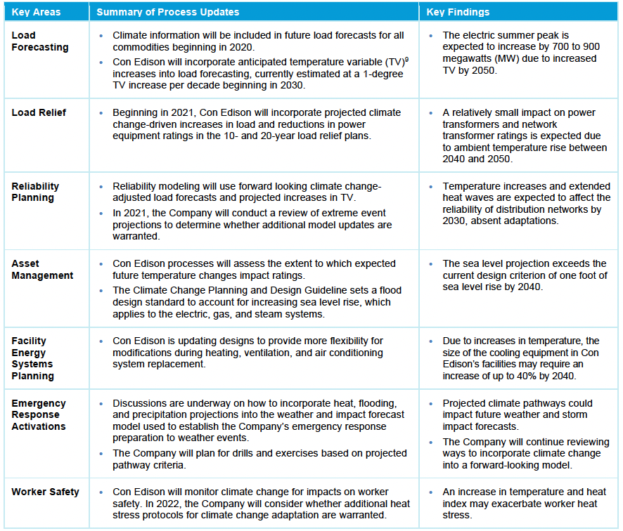

Summary of Climate Change Resilience and Adaptation Activities of 2020
Climate Change Vulnerability Study

Slide 20
Summary of Climate Change Resilience and Adaptation Activities of 2020
Climate Change Vulnerability Study

Slide 21
Summary of Climate Change Resilience and Adaptation Activities of 2020
Climate Change Vulnerability Study

Slide 22
Summary of Climate Change Resilience and Adaptation Activities of 2020
Climate Change Vulnerability Study

Slide 23
Summary of Climate Change Resilience and Adaptation Activities of 2020
Climate Change Vulnerability Study

Slide 24
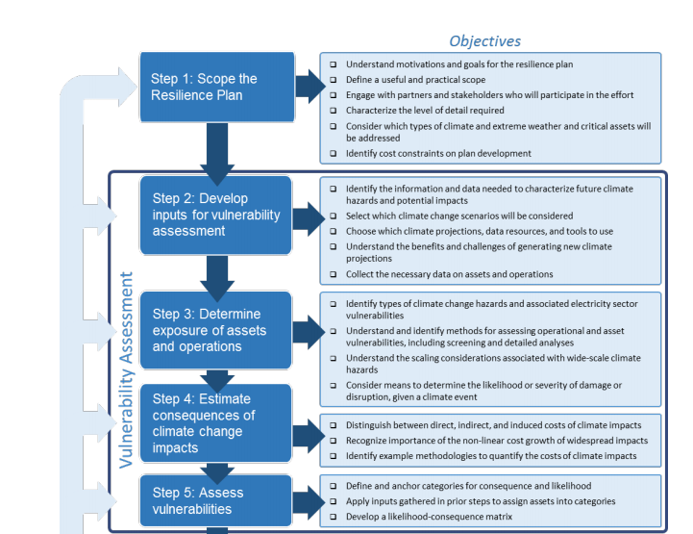
Steps in developing a climate change resilience plan - DOE, 2016* (1)
* This is illustrative.
Steps in the DOE process are similar to, but different than, steps used by CEC, ConEd and in other examples

Slide 25
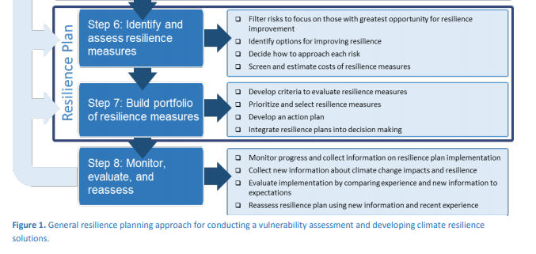
Steps in developing a climate change resilience plan - DOE, 2016 (2)

Slide 26
Weather data sources

Slide 27
Weather data (1)
IRPs typically use historical data in load forecasting and other processes requiring weather data.
Future climate is not observable; only have models
From what models tell us and from recent extreme weather events, not clear we can afford to plan to the weather of the past
How do you make it documentable?
  Use a credible, third party to downscale data
  Cross-check data against other sources
  Compare to analogs – Con Ed’s 2019 climate resilience plan notes that with expected climate changes, New York City’s temperature and precipitation in 2080 would resemble that of Little Rock, AR.

Slide 28
Weather data (2)
Aggregated data summarizing potential future impacts available from on-line sources for screening, regulator oversight, and other analyses not needing hourly data
  NOAA State Climate Summaries
  The Climate Explorer, part of U.S. Climate Resilience Toolkit
State-level / regional projects (examples)
  North Carolina Climate Science Report
  Cal-Adapt
NOAA with regional universities and others
  NOAA Regional Integrated Sciences and Assessments Program (NOAA RISA)
  NOAA National Centers for Environmental Information, Regional Climate Centers
Global climate models (NOAA) (IPCC)
  NOAA dataset gallery

Slide 29
Downscaling climate models

Slide 30
Downscaling climate models
Downscaling climate models is labor intensive and expensive; potentially not feasible or cost effective to do in isolation
Work with others to pool resources
Regional pooling – Shared data / pooled resources offer cost-effective option
  Bonneville Power Administration, Corps of Engineers, and Bureau of Reclamation downscaling study for joint operations of the PNW federal system – used by Northwest Power and Conservation Council, Tacoma Power, and Puget Sound Energy (maybe others)
  New York City – Con Edison worked with Columbia University and ICF to perform their own downscaling and screening, expanding on methods used by New York City Panel on Climate Change
Statewide forum for utilities / stakeholders to plan for climate adaptation — for example:
  Cal-Adapt by California Energy Commission and partners contains statewide downscaled climate data and other research
  California Energy Commission Climate Change Assessments (4th assessment)

Slide 31
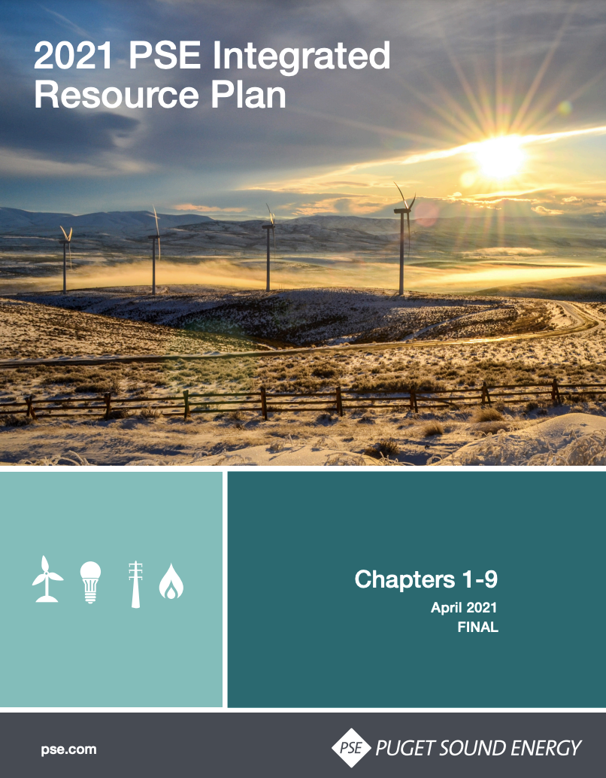
Stakeholder engagement – Climate change projections
Climate change impacts can also be addressed through stakeholder processes
  Puget Sound Energy offers a good example of this in their 2021 IRP
  Stakeholder discussions were used to reconcile uncertainties surrounding global modeling
Puget Sound Energy’s 2021 IRP presented stakeholders with three climate projection modeling options
  Redefine the “normal weather” period to include only the most recent 15 years
  Use historical trended temperatures
  Use the Northwest Power and Conservation Council downscaled climate model
Stakeholders ultimately selected option 3

Slide 32
Decision-making under uncertainty

Slide 33
Traditional risk assessment vs. decision making under deep uncertainty (DMDU)
“Predict then Act”
Deep uncertainty occurs when the parties to a decision do not know or do not agree on the likelihood of alternative futures or how actions are related to consequences
What will future conditions be?
What is the best near-term decision?
How sensitive is the decision to the conditions?
Deep uncertainty:
Traditional Risk Assessment (Optimization Methods)
Future regulatory requirements
Future technology capabilities
Today’s return period for extreme events
“Agree on Decisions”
Under conditions of deep uncertainty:
Propose strategy & decision context
Use analytics to stress test strategy
Identify new & revised strategies that are more robust
Uncertainties are often underestimated
Competing analyses can contribute to gridlock
Misplaced concreteness can blind decision makers to surprise
Decision Making Under Deep Uncertainty (DMDU)
Slide adapted from Rob Lempert​, Rand Corp. presentation to National Council on Electricity Policy November 2021​

Slide 34

DMDU principles
Consider multiple futures, not one single future, in your planning. Choose these futures to stress test your organization’s plans.
Seek robust plans that perform well over many futures, not optimal plans designed for a single, best-estimate future.
Make your plans flexible and adaptive, which often makes them more robust.
DMDU can generate robust and adaptive plans that:
Perform well over a wide range of plausible climate futures
Meet other goals
Provide accountability to the public
Rather than seeking confidence in a specific model, DMDU supports building confidence in a decision.
Slide adapted from Rob Lempert​, Rand Corp.​
Kalra, N., S. Hallegatte, R. Lempert, C. Brown, A. Fozzard, S. Gill and A. Shah (2014). Agreeing on Robust Decisions: A New Process for Decision Making Under Deep Uncertainty. WPS-6906, World Bank.

Slide 35
Other considerations

Slide 36

Other considerations
What is the responsibility of ratepayers and what is the responsibility of society/taxpayers?
  A blend of ratepayer and taxpayer investments in preparedness and investments in spare parts may be appropriate because a resilient grid has a lot to do with societal value and community benefit, not just ratepayer and utility benefit.
    Benefit-cost analyses of resilience investments can include many hard to quantify benefits, such as the value of preventing lost gross regional product within a utility service territory.
    It may make sense to share costs and benefits of investments that improve resilience.
  Examples of cost sharing
    State of New Jersey paid to relocate electric equipment out of flood zone.
    District of Columbia is paying half the cost to underground lines.

Slide 37
Questions consumer advocates can ask
Are utilities accounting for potential changes to water availability and temperature/loads in resource planning?
Have utilities developed climate resilience plans?
How are utilities assuring they are planning for the weather of the future and not just the weather of the past?
  Are utilities using downscaled climate models to inform temperature, generation, and load projections?
  Are utilities working with third parties on downscaling and cross-checking against other sources?
  Are utilities weighting more recent weather patterns in forecasts?
Have utility asset operating assumptions been adjusted to account for changing weather conditions (temperature ranges and expected loads)?
Are stakeholders being included in planning activities related to potential climate futures?
How can knowledge sharing of “lessons learned” be facilitated to help utilities learn from one another in planning for climate change impacts?

Slide 38
Tools for identifying responses to climate risks
DOE, Climate Change and the Electricity Sector: Guide for Assessing Vulnerabilities and Developing Resilience Solutions to Sea Level Rise, 2016
ORNL, Extreme Weather and Climate Vulnerabilities of the Electric Grid: A Summary of Environmental Sensitivity Quantification Methods, 2019 – models to estimate climate impact on equipment life and capacity
Grid hardening suggestions
  DOE, Climate Change and the U.S. Energy Sector: Regional Vulnerabilities and Resilience Solutions, 2015
  National Academies, Enhancing the Resilience of the Nation's Electricity System
Example assessments
  California Energy Commission - Climate Change in Los Angeles County: Grid Vulnerability to Extreme Heat, 2018
  ConEdison Climate Change Vulnerability Study

Slide 39
Resources
DIRECT CLIMATE MODEL OUTPUTS
Downscaled CMIP3 and CMIP5 Climate and Hydrology Projections (DCHP): https://gdo-dcp.ucllnl.org/downscaled_cmip_projections/dcpInterface.html
MACA Downscaled CMIP5 Projections: https://toolkit.climate.gov/tool/maca-cmip5-statistically-downscaled-climate-projections
NATIONAL AND GLOBAL ASSESSMENT RESOURCES
USGCRP Fourth National Climate Assessment (NCA): Summarizes climate change hazards for 10 regions across the United States as well as for 13 sectors or ecosystems. NCA5 is currently under development. https://nca2018.globalchange.gov/
NOAA Regional Climate Trends and Scenarios for the U.S. National Climate Assessment: When used in conjunction the NCA report, this resource can provide locally detailed climate projections as well as useful deployment information. https://www.nesdis.noaa.gov/about/documents-reports/technical-reports
IPCC Sixth Assessment Report (AR6): The premier assessment resource for global climate change projections. https://www.ipcc.ch/assessment-report/ar6/

Slide 40
Resources
INTERACTIVE TOOLS AND SOFTWARES
U.S. Climate Resilience Toolkit: https://toolkit.climate.gov/tools?f%5B0%5D=field_workflow_step%3A57; across U.S.
Cal-Adapt: https://cal-adapt.org/; provides a view of how climate change might affect California
Cities Impacts & Adaptation Tool (CIAT): https://toolkit.climate.gov/tool/cities-impacts-adaptation-tool-ciat; supplies localized climate projections for cities across the Midwest
DOE Sea-Level Rise (SLR) and Storm Surge Effects on Energy Assets: https://www.arcgis.com/home/item.html?id=e463abadcd9c4ef7982ae431e3fca7e7; mapping tool that allows users to view the major energy assets and coastal flooding risks along U.S. coastlines in 10 major metropolitan areas
National Climate Change Viewer (NCCV): https://www.usgs.gov/ecosystems/climate-research-and-development-program/science/national-climate-change-viewer-nccv?qt-science_center_objects=0#qt-science_center_objects; allows users to view both graphical and tabular presentations of high-resolution, downscaled CMIP5 projections for four different scenarios
NOAA Sea-Level Rise (SLR) Viewer: https://coast.noaa.gov/digitalcoast/tools/slr.html; allows users to identify potential inundation risks

Slide 41



Contact
Juliet Homer
Juliet.homer@pnnl.gov
Alan Cooke
Alan.Cooke@pnnl.gov
Kamila Kazimierczuk
Juliet.homer@pnnl.gov

