Slide 1
Integrated Electricity System Planning
Paul De Martini – Newport Consulting Group
Alan Cooke¹ (with thanks to Juliet Homer,¹ Brittany Tarufelli,¹ and Rui Yang²)
¹Pacific Northwest National Laboratory
²National Renewable Energy Laboratory
Training Webinar for National Association of State Utility Consumer Advocates
June 29, 2022
This presentation was funded by the U.S. Department of Energy’s Grid Modernization Laboratory Consortium.

Slide 2
Topics for Discussion
Overview of Integrated System Planning - Key Elements
Focus on Areas for Alignment Across Resource, Transmission & Distribution Planning
Deeper Look at Forecasting Load, Resources and Climate Impacts
The process framework for integrated system planning provided here should not be considered a prescriptive approach. Rather, it is most useful as a guide that provides a set of considerations regarding specific processes and methods that may serve the unique circumstances and objectives of individual jurisdictions and utilities.

Slide 3
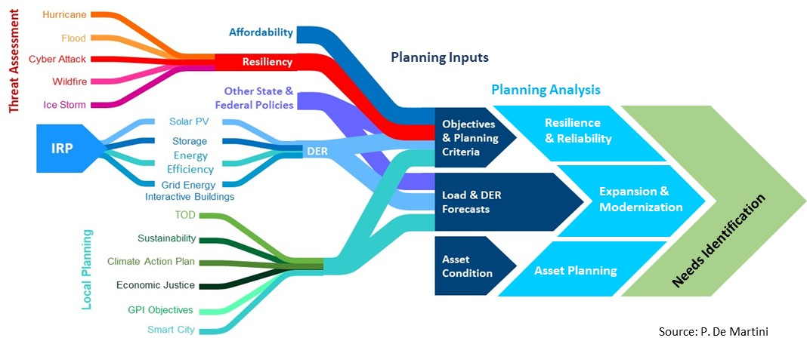
Integrated System Planning
System planning is increasingly dependent upon Integrated Resource Planning (IRP)/bulk power use of distributed energy resources (DER) and local sustainability and resilience plans.

Slide 4
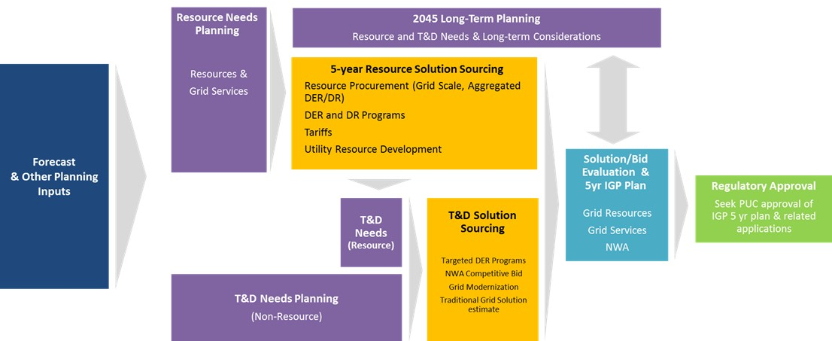
Integrated System Planning
Conceptually the elements can fit into a logical, aligned sequence.
Source: Hawaiian Electric

Slide 5
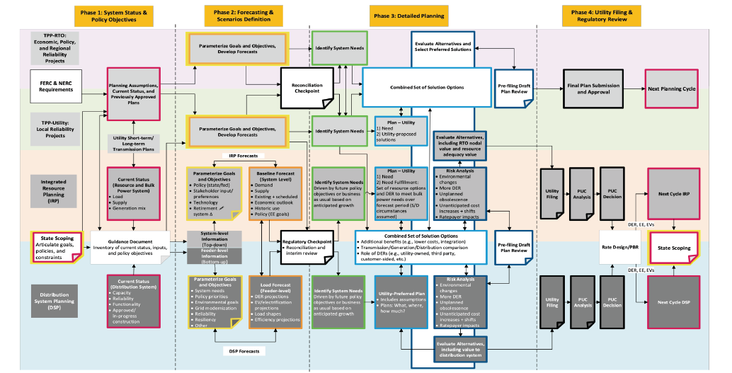
Integrated System Planning Multi-Entity Example
However, in practice there is significant complexity when integrating multiple processes and entities operating on different planning cycles.
https://pubs.naruc.org/pub/150AB451-155D-0A36-31AD-816A88F64B67

Slide 6
Integrated System Planning
Phase 1.
Planning Objectives & System Status
A fully integrated system planning process for any state would be a highly complex undertaking, if at all possible.
However, it is possible to identify key points in the respective resource, transmission and distribution planning processes to ensure:
Consistent inputs and assumptions
Transparency regarding respective processes and key points of interdependency/alignment
Consistent consideration of operating criteria and conditions (e.g., weather)
Optimization of solutions to potentially address a greater set of needs
There are opportunities for state commissions to consider the interdependencies of various dockets that inform and/or are informed by integrated system planning.
Phase 2. Forecasting & Scenarios Definition
Phase 3.
Detailed Planning
Phase 4.
Utility Filing & Regulatory Review

Slide 7
Phase 1. Policy Objectives & System Status
Policy Objectives
An objective is a desired outcome with an associated timing and/or performance criteria.
For example, objectives may include (a) specific customer, policy, and/or business outcomes and (b) associated timing and/or performance requirements. Objectives inform what is needed, by when, and guide the subsequent steps in the process.
System Status
Assessment of the current asset condition and operational performance of a system is essential to determine compliance with planning criteria and service standards.
Assessment includes determining the current condition of grid assets, asset loading, asset utilization, and feeder and substation reliability. These assessments are done in relation to standards and operational performance criteria.
Determining asset condition requires effective data on distribution infrastructure, including relative age, current condition, and stress conditions experienced (e.g., faults and overloads), among other aspects.

Slide 8
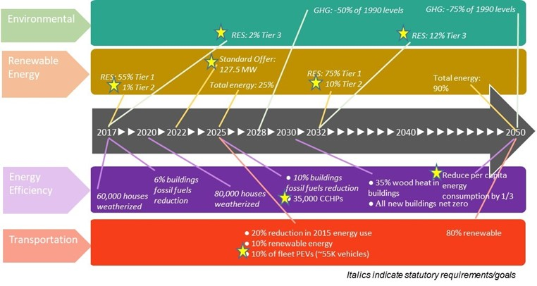
Vermont Example (c. 2019)
State policy goals inform system planning objectives.

Slide 9
Phase 2. Forecasting
Load & DER forecasts: Distribution planning requires a closer examination of the potential changes to load and DERs at the level of a substation, feeder, and in some cases sections of a feeder.
System forecasts of DER adoption and use inform the development of more “bottom-up” granular locational forecasts that are applicable to the specific distribution planning areas under assessment. The aggregate results are typically compared with system-level projections.
Ideally, the granular distribution forecasts in aggregate comport with the system-level forecasts.
Climate Forecasts: Policymakers and planners need to understand changes in local weather to assess grid risks.
Climate is a description of a long-run average over a large area, and weather is the realization of climate in a small geographic and time scale.
“Downscaling” is required to transform low-resolution environmental information into high-resolution spatial and temporal scales to assess grid infrastructure impacts.

Slide 10
Phase 2. Scenario Development
Scenarios generally address specific policy questions, or a range of plausible physical or operational constraints or changes in the existing system.
Scenarios may include several policy choices or constraints:
Transmission constraints or elimination of transmission constraints
Availability or lack of availability of specific types of resources (onshore wind, offshore wind, imports)
Higher or lower levels of behind-the-meter (BTM) generation, numbers of electric vehicles (EVs), or levels of electrification of currently fossil-fueled end uses
Seeking life extension for nuclear or other major generating facilities (alternatively, making a policy choice to prevent the premature retirement of facilities)
Early retirement of natural gas and other fossil fuel plants
Climate change impacts should also be included.

Slide 11
Phase 3. Detailed Planning
Grid engineering analyses are based on the laws of physics that ultimately dictate the physical operation of the electric system.
These analyses inform grid needs identification and changes, upgrades and solutions that may be needed.
Grid needs identification involves identifying specific substations and circuits where planning criteria are already violated, or forecasted to become violated over the planning period.
Solution Identification: Identify utility, customer, and third-party solutions that address multiple planning objectives to provide the greatest relative value.
This step is a key opportunity to identify solutions that address more than one need, including needs across resource, transmission and distribution planning.
Long & Short Term Planning: Requires taking a holistic view to address both normal conditions and resilience needs to optimize solution expenditures equitably.

Slide 12
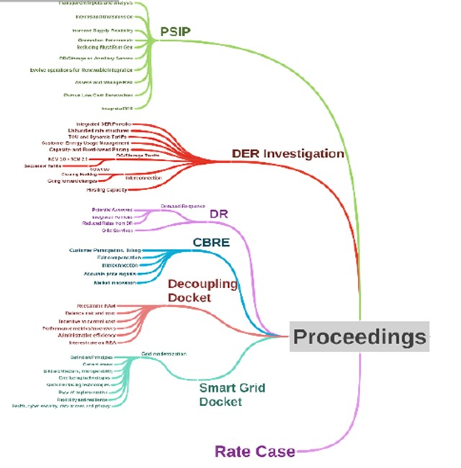
Phase 4. Utility Filing & Regulatory Review
Planning integration considerations include the interdependency of typically separate commission dockets in relation to planning steps and timing.
Opportunities for state commissions to consider the interdependencies of various dockets that inform or are informed by integrated system planning.
Resource Dockets
Resilience Docket

Slide 13
Takeaways on Key Elements of Integrated System Planning
Integrating system planning processes is aspirational, but may not be practical writ large.
However, key interdependent aspects of resource, transmission and distribution planning are ripe for alignment:
Planning Objectives and Criteria
Load, Resource, and Climate Forecasts and Assumptions
Grid Needs and Solution Evaluation
Identifying regulatory docket interdependencies can enhance system planning and outcomes.

Slide 14



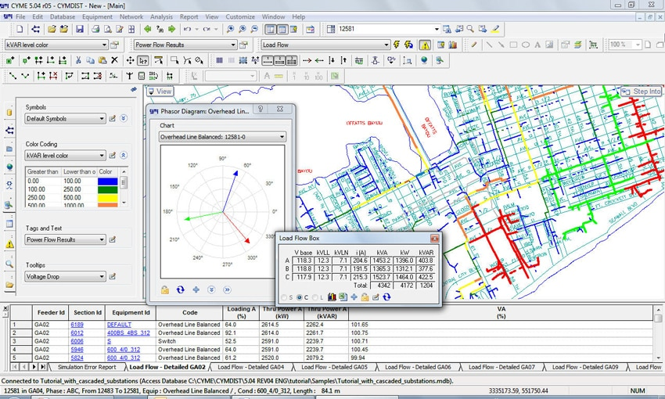
Load Forecasting – Current Best Practices
Load Forecast advanced practices are granular load forecasts
Granular in time – Forecasts for all 365 days x 24 hours = 8,760 hours per year
Feeds into advanced modeling of resources
Granular in space – Forecasts at the circuit and transformer level
A diverse set of tools are used to create these forecasts
LoadSEER
CYMEDIST
SYNERGI
GridLab-D
Econometric models
Probabilistic forecasting techniques
End-use models
Judgement and company projections can form basis of forecasts
Notes:
From: From Homer and Yang, 2021, Load forecasting with climate variability for transmission and distribution system planning, Innovations in Electricity Modeling Training for National Council on Electricity Policy, National Renewable Energy Laboratory (Boulder, CO) and Pacific Northwest National Laboratory (Richland, WA).

Slide 15
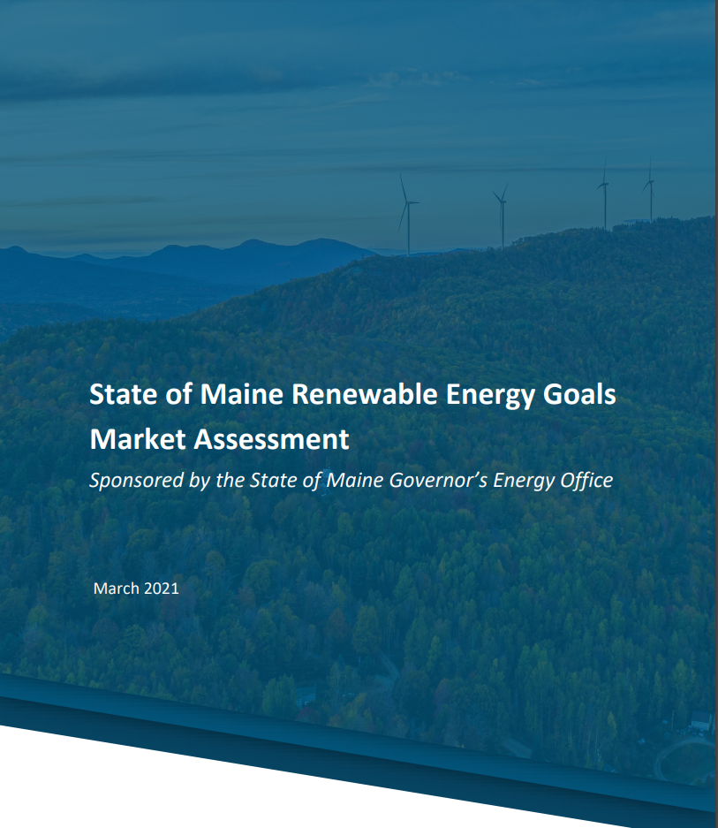
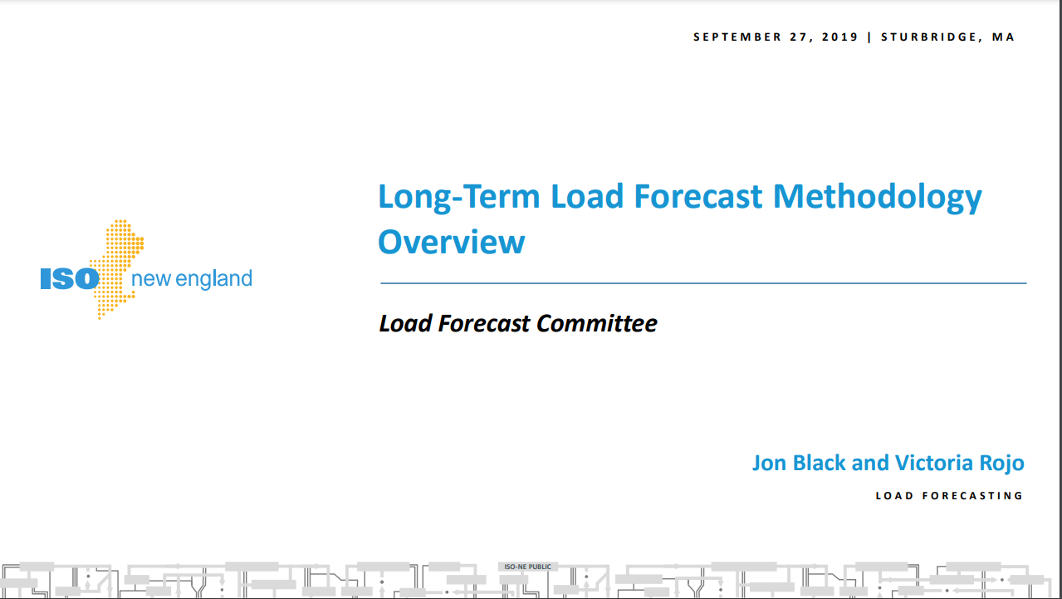
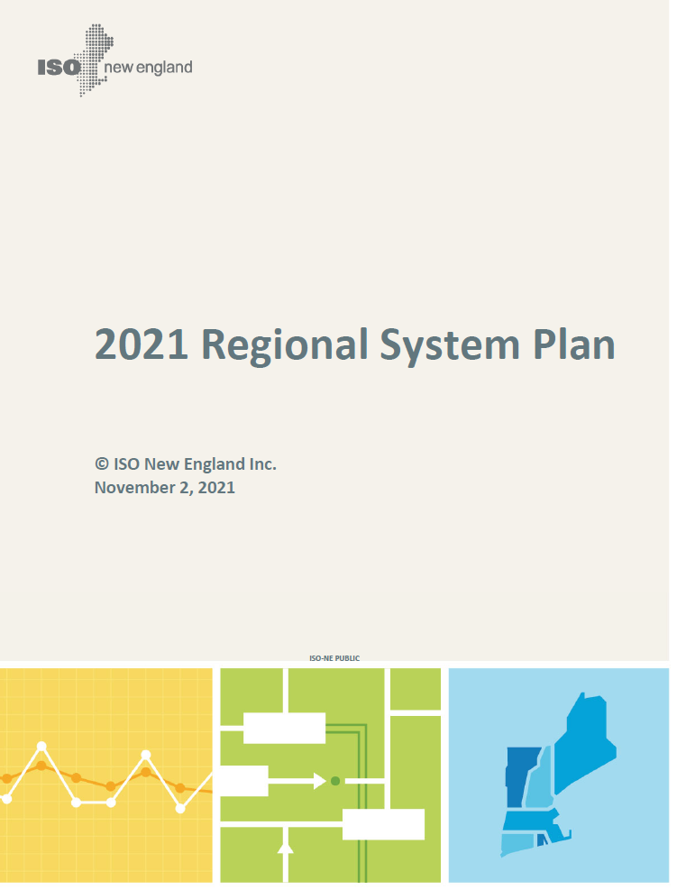
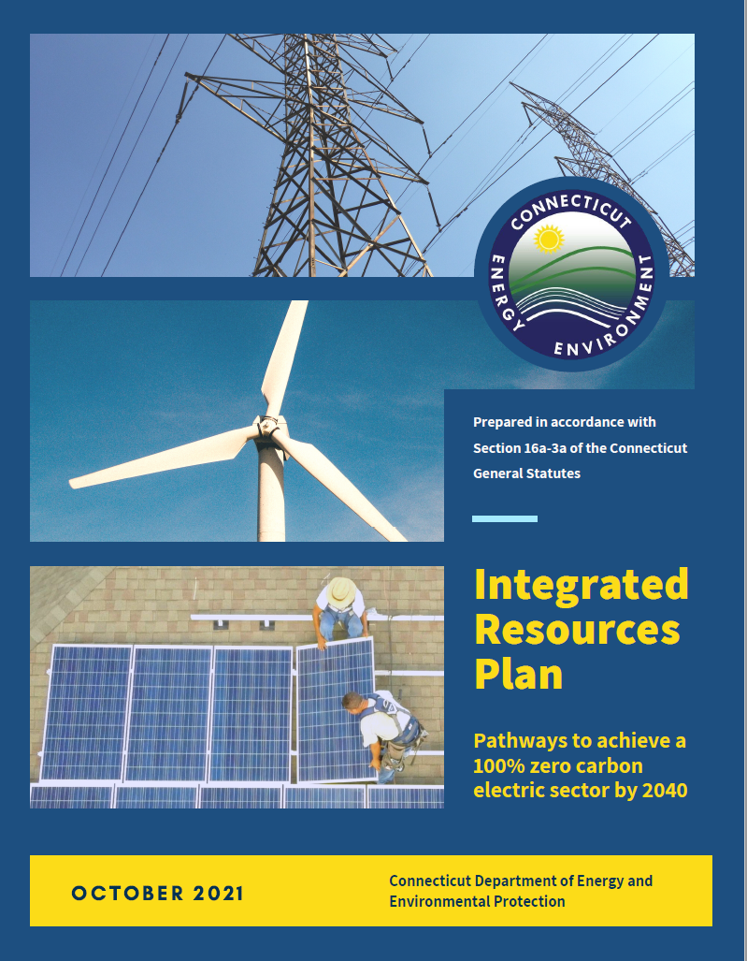
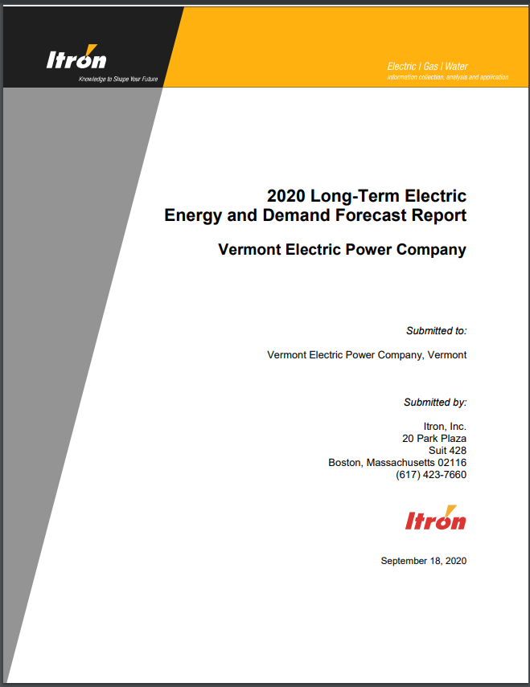
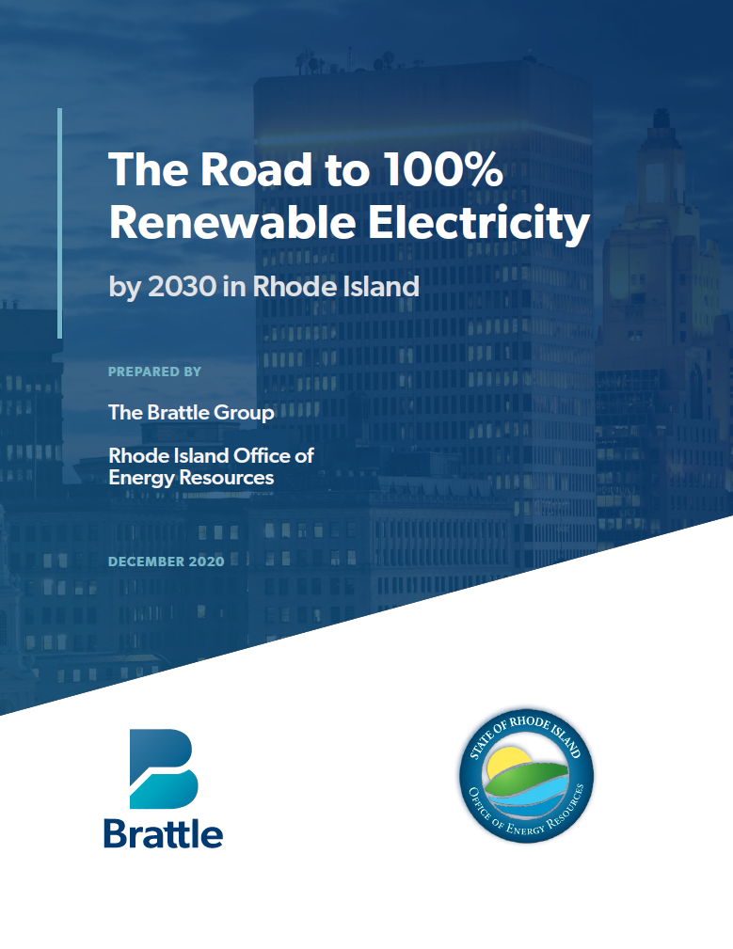
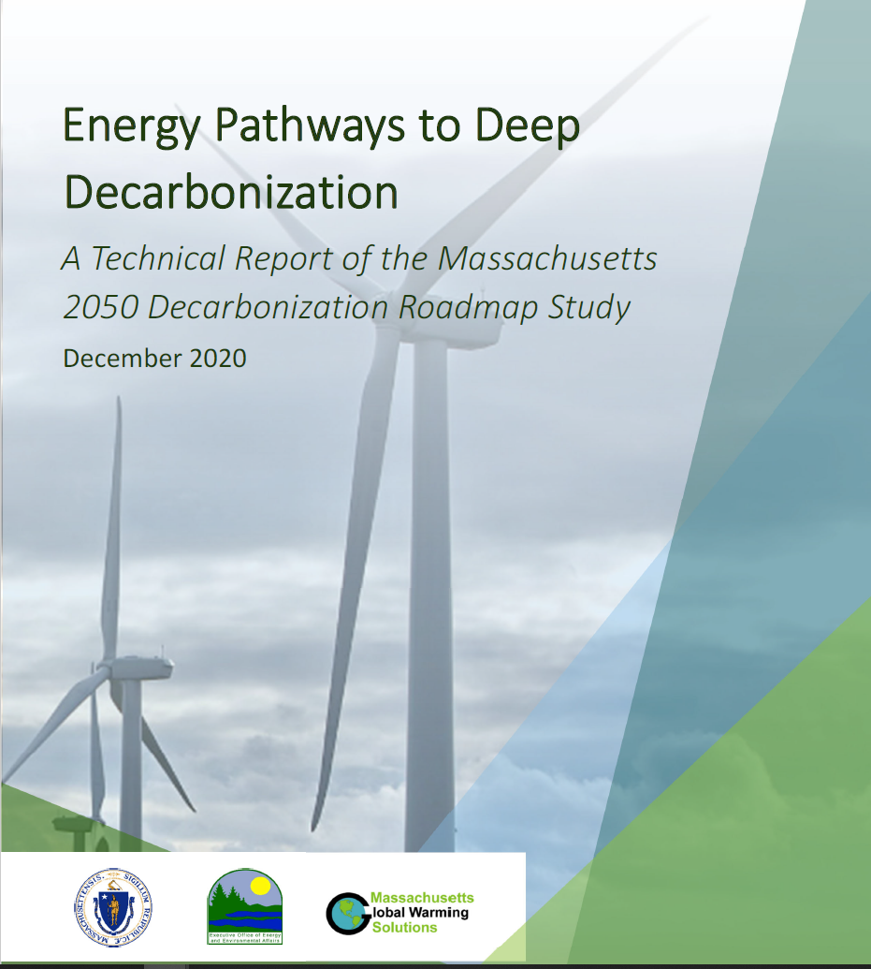
Load Forecasting in Resource Plans
Documentation of load and DER forecasts in electricity system plans (New England examples):
Mix of econometric and end-use models
Several plans included granular load forecasts
Several plans included granular DER forecasts
ISO-NE’s forecast underlies some plans’ projections

Slide 16
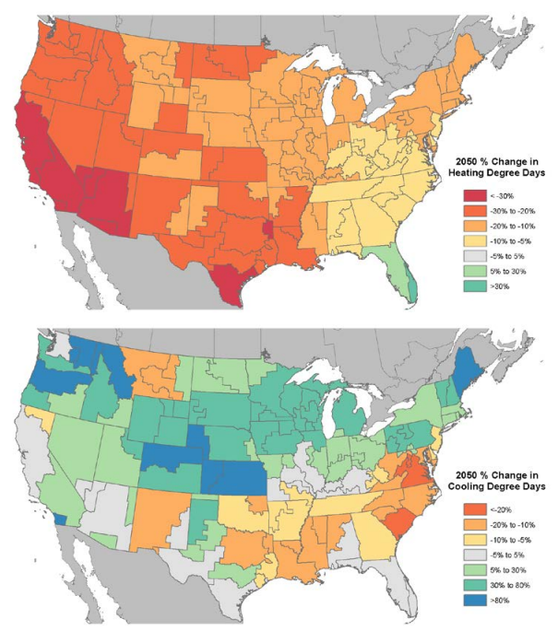
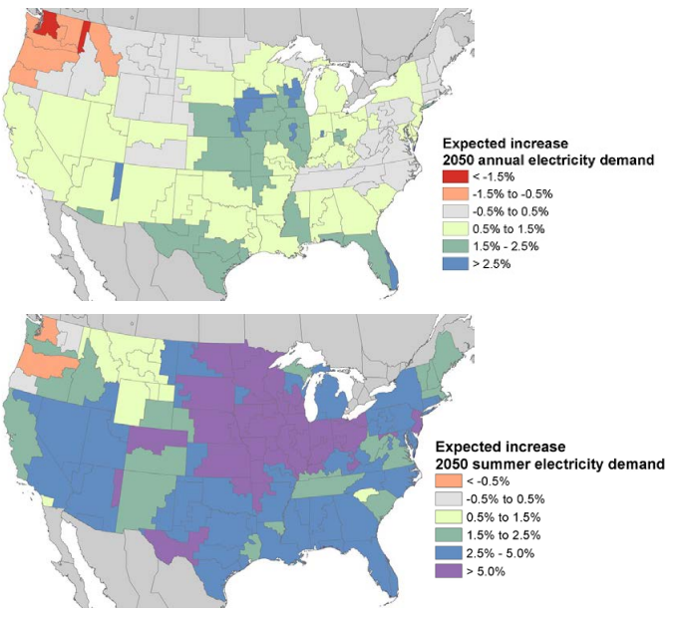
New Challenges for Load Forecasting – Climate Change
Load Projection in 2050 ^{[1]}
Impact of climate change
Temperature increase
Precipitation patterns
River flows and hydro electric generation
Load forecasting
Demand
Peak load
Example studies
Demand projection ^{[1]}
Peak load forecasting ^{[2]}
[1] P. Sullivan, J. Colman, and E. Kalendra, “Predicting the Response of Electricity Load to Climate Change,” NREL Technical Report, NREL/TP-6A20-64297, 2015.
[2] D. Burilloa, M. V. Chester, S. Pincetl, E. D. Fournier, and J. Reyna, “Forecasting Peak Electricity Demand for Los Angeles Considering Higher Air Temperatures Due to Climate Change,” Applied Energy 236 (15): Feb. 2019.

Slide 17
NW Power Plan Example – Downscaled Climate Data (Rather than Historic Data) Shifts System Peak
Dashed line represents monthly average peak-hour demand based on historic temperatures from 1949-2018.
Solid line represents monthly average peak-hour demand based on forecasted climate change temperatures for 2020-29.
¹ Because this chart was created in 2019, historic temperatures (and therefore demand forecasts) for that year were not available.
From John Fazio, Northwest Power and Conservation Council, November 2021, Presentation to the National Council on Electricity Policy.

Slide 18
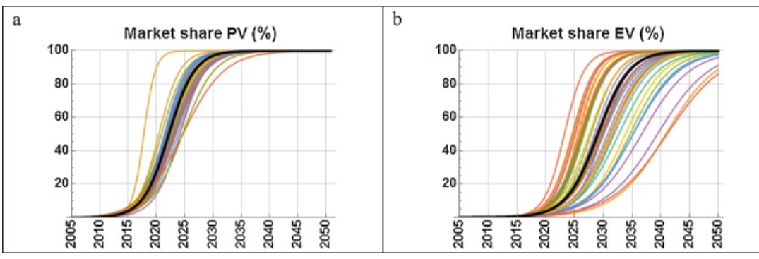
Current Forecasting Best Practices (1)
DER forecasts
Some utilities use econometric methods to analyze the historical relationship between DER adoption and other economics variables to forecast future adoption.
Some utilities forecast DER adoption by fitting innovation diffusion curves to historical data, typically using the Bass diffusion model.
Requires a sufficient history of adoption
Not always feasible for DERs in nascent stage or those experiencing truly disruptive innovation
Bass diffusion optimizes three parameters (P - innovators, Q - imitators, and M – potential adopters) to explain monthly adoption patterns
Utilities can use tools such as Gridlab-D, WattPlan Grid, and LoadSEER.
Source: van der Kam et al. 2018
Notes:
WattPlan Grid is used for solar PV
Central Hudson - An innovation diffusion curve was used to predict community solar new applications, while for the residential and non-residential solar segments – which have experienced multiple years of steady growth in installations – time-series models were used instead.

Slide 19
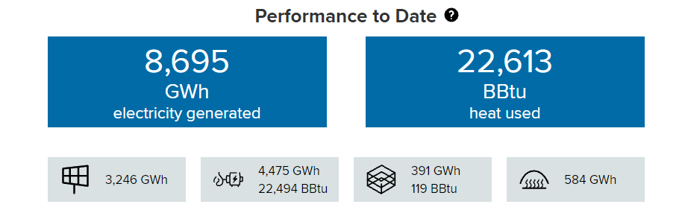
Current Forecasting Best Practices (2)
DER forecasts, cont.
Some utilities start with top-down, system-wide DER forecasts that they disaggregate between substations.
California’s Distribution Forecasting Working Group Final Report describes three classes of disaggregation techniques:
Proportional allocation - Disaggregates the DER forecast to circuits based on utility data for the circuit (load, energy, or number of customers)
Propensity models - Base disaggregation on customer characteristics that are used to compute a propensity score. Propensity models could be estimated using ZIP code data, where models relate historical adoption to customer characteristics in each ZIP code
Adoption models - Use a bottom-up adoption forecast based on observed adoption patterns and estimated adoption model parameters; includes S-Curve/Bass Diffusion Models
Utilities with granular data can predict where customers have a higher propensity for DER adoption based on characteristics such as energy use, weather, number of customers, and geographic location.
For example, NYISO is relying on the NYSERDA DER database as an interim source for its forecasts. The database includes DER locations across the state, aggregate DER data, and current and past performance data from New York DER projects.

Slide 20
Current Forecasting Best Practices (3)
EV forecasts
Utilities using best practices forecast customers’ propensity to adopt EVs with propensity models (using regression techniques or machine learning to identify key variables correlated with customer adoption) or Bass diffusion models (to fit diffusion curves) at a granular (ZIP code) level based on characteristics such as energy use, weather, number of customers, and geographic location.
EVs are then allocated to the circuit level based on factors such as load, energy, or number of customers.
Other tools are also being explored, including transportation modeling to simulate EV charging behaviors using POLARIS (Planning and Operations Language for Agent-based Regional Integrated Simulation), an agent-based model developed by Argonne National Laboratory.
Hawaiian Electric Integrated Grid Planning example:
Integral Analytics developed the EV forecast adoption model by combining macro-level Bass Diffusion models with geospatial customer-level, agent-based models through its proprietary load forecasting tool, LoadSEER.
Total number of vehicles was segmented into charging profile segments. Hourly changing profiles were developed using charging station telemetry, load research, and AMI data.
Hourly load modeling and statistical sampling were used to develop a core set of EV charging profiles
Some utilities are working with Electric Vehicle Supply Equipment companies to develop EV load profiles for various EV charging use cases.

Slide 21
System Level vs. Distribution Level Forecasts
Resource planning is usually at system level
Integrated planning is at multiple levels
Loads forecasted at a system level
Generation meeting load at the system or other high aggregation level — e.g., state level
BTM generation included in IRPs often at an aggregated system level
Distribution system and BTM generation tend to be areas of low visibility
Load forecasting models (listed earlier) can help with visibility
A significant portion of new generation is connecting to the distribution system.
To encourage more new generation to connect requires knowledge – where there is available capacity and where there are bottlenecks.
Distribution-level data needed to assess:
What is happening BTM – PV, EV, and electrification
What is happening BTM is uneven for many reasons, but equity concerns are better addressed if spatial disaggregation is improved.
Some of the load forecasting tools help provide spatial visibility.

Slide 22
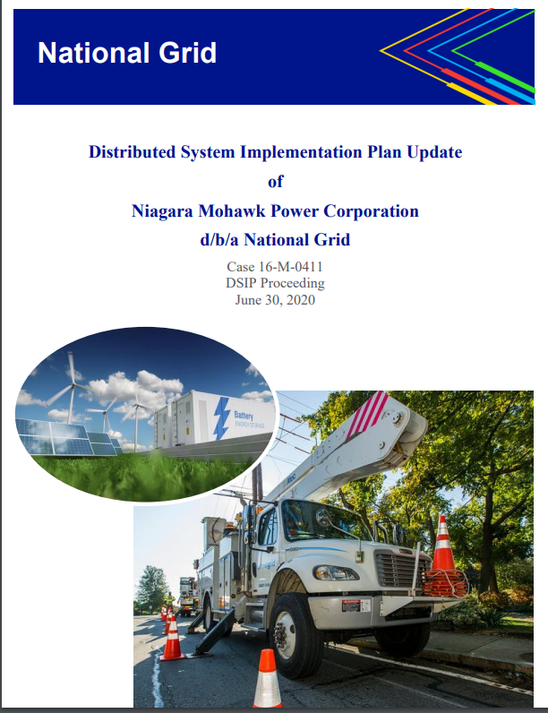
Advanced Forecasting Example – National Grid
Since 2018, National Grid has generated and published 8,760-hour feeder level forecasts.
Forecasts are used for local area planning assessments and non-wires alternative evaluations.
A Marginal Avoided Distribution Capacity study is used to quantify the value of DER in targeted locations.
In-house modeling combined with GridLAB-DTM, an open-source, simulation-based modeling environment that enables detailed power flow solutions, generates 8,760 load profiles for every feeder.
High-performance cloud computing, such as Amazon Web Services, improves the overall computational process.
EV charging behaviors of both residential and non-residential customers are simulated using the POLARIS model.
Annual peak load forecasts incorporate projected economic and demographic impacts and anticipated technological advances and policy objectives.
Future enhancements will incorporate probabilistic forecasting techniques.
https://jointutilitiesofny.org/sites/default/files/NG_2020_DSIP.pdf

Slide 23

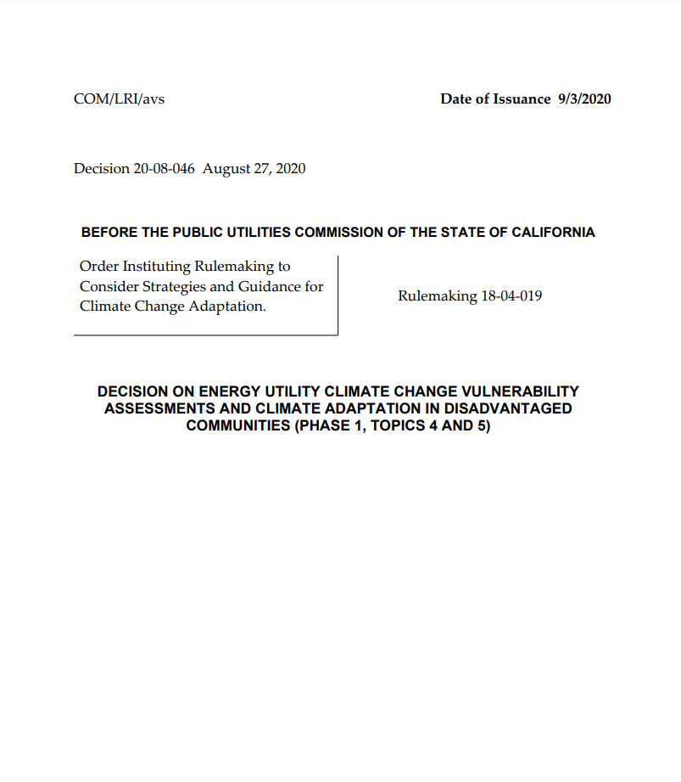
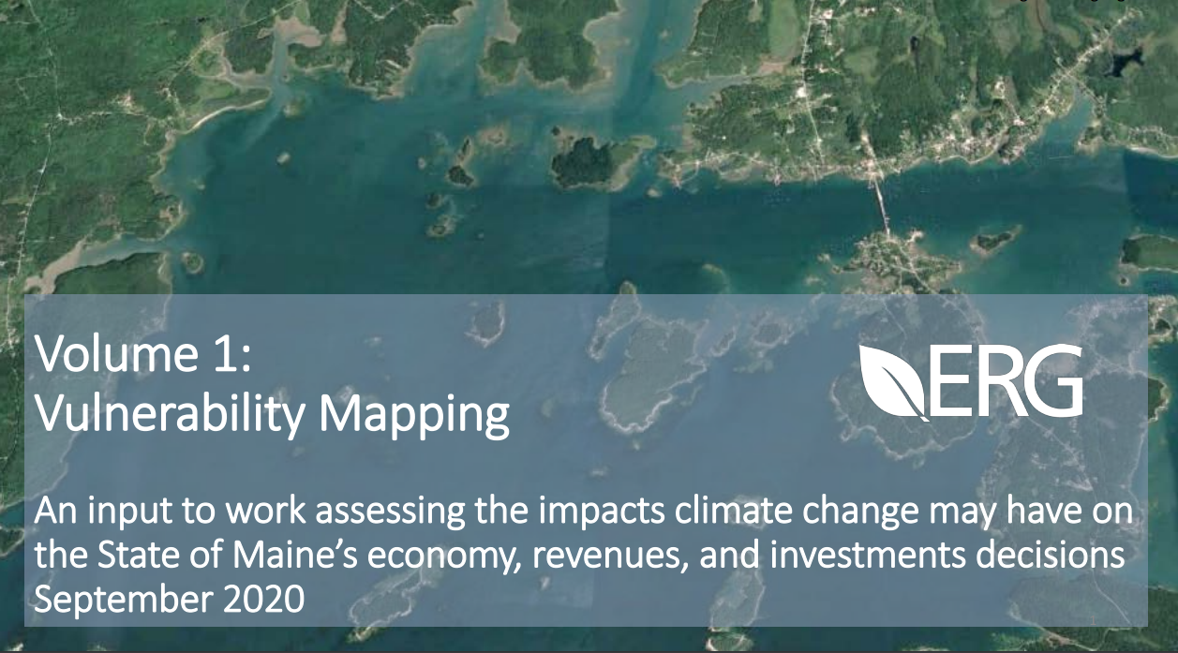
Intersection of Integrated Planning and Resilience
Distribution utilities are also beginning to plan for resilience to climate impacts, which affect planning resources and infrastructure funding.
Con Edison’s study is often cited as the gold standard for assessing and addressing climate vulnerabilities.
The California PUC has ordered utilities to develop similar plans.
Florida’s Storm Hardening Plans and PSE&G’s Energy Strong offer examples of utilities planning to address tropical storm and other intense storm impacts.
The State of Maine issued a climate vulnerability assessment that is related and potentially instructive.

Slide 24
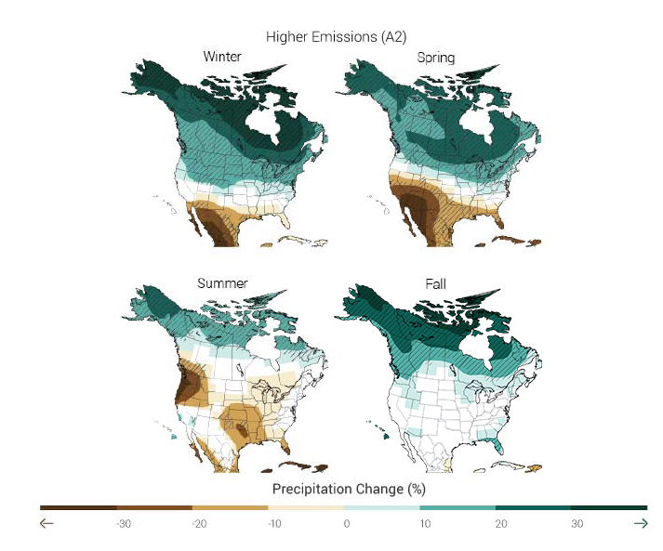
Intersection: Climate Projections and Integrated Planning, Plus Resilience
Best-practice resource plans investigate the impact of climate change on resource availability (and loads)
Large thermal generation uses water for cooling
Higher incoming water temperatures can lead to reduced efficiency and curtailments, or make it harder to meet effluent requirements
Climate change can affect seasonal hydroelectric generation.
Some examples:
TVA’s 2019 IRP noted the potential for additional cooling capacity costs or deration of thermal plants.
Southwestern Public Service’s 2018 IRP studied groundwater availability for cooling a coal plant, leading to a change in running the plant for peaking operation only.
Pacific Northwest projecting changes in operation of hydro system
2021 Northwest Power and Conservation Council’s 8th Power Plan studied impacts of changes in Columbia River power output on the region’s summer loss of load probability
Tacoma Power’s 2020 IRP studied impacts on wholesale purchases due to potentially changed Columbia River power output
Maps show percent change in precipitation in each season for the higher emissions case in the 2071–2099 time period compared to 1970–1999. Source: The Third National Climate Assessment.

Slide 25
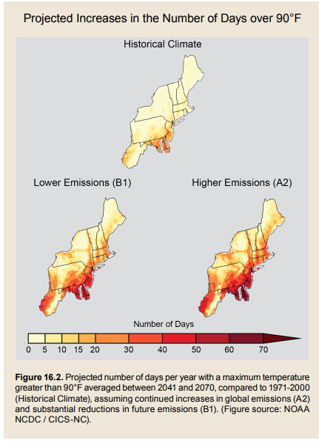
Takeaways on Distribution and Integrated Planning
Distribution planning historically focused on:
Operating safely – utility workers & general public
Meeting customer power needs
Meeting customer power quality needs
Meeting customer reliability needs
Cost – service for a fair and reasonable cost
All of these focuses remain valid! But now:
Generation also at distribution voltages
Planning processes include new feedback loops
Planning goal – extract value from customers’ DERs
Climate variability is increasingly straining the system
Assessing climate vulnerabilities
Planning to harden the system
Source: Horton, R., G. Yohe, W. Easterling, R. Kates, M. Ruth, E. Sussman, A. Whelchel, D. Wolfe, and F. Lipschultz, 2014: Ch. 16: Northeast. Climate Change Impacts in the United States: The Third National Climate Assessment, J. M. Melillo, Terese (T.C.) Richmond, and G. W. Yohe, Eds., U.S. Global Change Research Program, 16-1-nn.

Slide 26
Questions State Utility Consumer Advocates Can Ask
What models are being used?
How does the utility forecast DER adoption?
How does the utility quantify the impact of DER adoption?
Are models derived from proven theoretical methods?
What are the modeling inputs?
What forecasts are utilities using as inputs to other forecasting models and how were those developed?
Are potential climate change impacts to forecasts being considered and, if so, how?
Are the assumptions reasonable?
Are the assumptions objective (based on objective data, for example) or subjective (based on expert opinion, for example)?
Are assumptions valid (do parameter estimates align with those found in existing research, for example)?
Are proper methods and data used?
Are methods disclosed?
Are they understandable?
Is the data reliable and valid?
What kind of data limitations exist?
Is the data readily accessible?

