Slide 1
Automated DER Response
Michael Ingram, Xin Jin, and Rui Yang
National Renewable Energy Laboratory
Technical Training on Contemporary Electricity System Issues for National Association of State Utility Consumer Advocates
November 19, 2021
This presentation was funded by the U.S. Department of Energy’s Office of Electricity and Building Technologies Office.

Slide 2
Agenda
Context
Distributed energy resource (DER) response under IEEE Standard 1547
Coordinated DER response
Load disaggregation
Questions utility consumer advocates can ask
Resources for more information

Slide 3
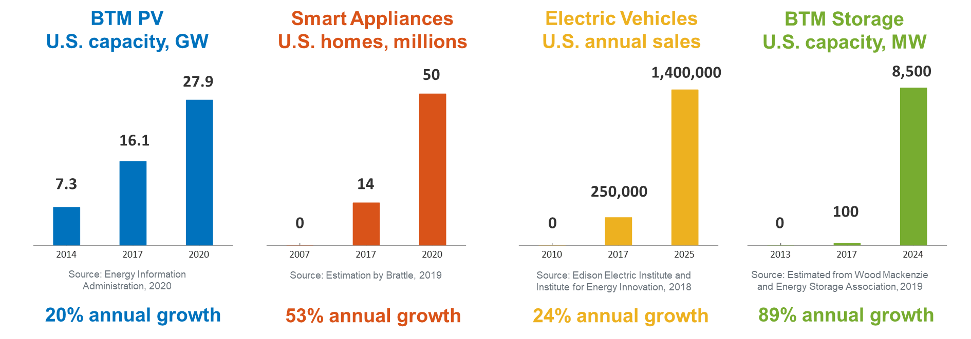
Context
Rapid growth of DERs
200 GW (20% peak load) flexibility potential in U.S. by 2030 [1]
[1] R. Hledik, A. Faruqui, T. Lee, and J. Higham, “The National Potential for Load Flexibility: Value and Market Potential through 2030” (The Brattle Group, 2019).

Slide 4
DER Response under IEEE Standard 1547
Notes:
Before I introduce IEEE Standard 1547 and the “automated” response capabilities baked-into it, let’s agree on an operational definition of “Automated.”
First, we can agree that automated excludes manual intervention from a human operator or remote-control system.
Automated might not be “automatic” —that is, some response delay may occur.
Finally, default or “out of the box” performance is not exclusive to automation as some pre-planned scheduling, configuration or settings will likely be involved before “automation” occurs.

Slide 5
IEEE Standard 1547 Scope and Purpose
Title: Standard for Interconnection and Interoperability of Distributed Energy Resources with Associated Electric Power Systems Interfaces
Scope: This standard establishes criteria and requirements for the interconnection of DERs with electric power systems (EPS) and associated interfaces.
Purpose: This document provides a uniform standard for the interconnection and interoperability of DERs with EPS. It provides requirements relevant to the interconnection, interoperability performance, operation, and testing, as well as safety, maintenance, and security considerations.
Interconnection System
DER
Electric
Power
System
(Area EPS)
Communications Interface
Power Interface
A technical standard—functional requirements
A single (whole) document of mandatory, uniform, universal, requirements that apply at the point of common coupling (PCC) or the point of DER connection (PoC)
Technology neutral (i.e., it does not specify any particular equipment or type).
A design handbook
An application guide (see IEEE Std 1547.2)
An interconnection agreement
Prescriptive (i.e., it does not prescribe other important functions and requirements, such as cyber-physical security, planning, designing, operating, or maintaining the area EPS with DERs).
1547 IS
1547 IS NOT
Notes:
If allowed by agreement, unscheduled intentional islands are formed autonomously from local detection of abnormal conditions at
the interconnection(s) with the Area EPS.

Slide 6
Active Voltage Regulation Capabilities
“The DER shall provide voltage regulation capability by changes of reactive power. The approval of the Area EPS Operator shall be required for the DER to actively participate in voltage regulation.”
Capability required for all DERs (Cat A, B):
Constant power factor mode
Constant reactive power mode
Voltage–reactive power mode (volt-VAR).
“State-of-the-art” DERs: Cat B
Active power–reactive power mode (watt-VAR)
Voltage–active power mode (volt-watt).
IEEE Std 1547-2003
Shall NOT actively regulate voltage
IEEE Std 1547-2018
Shall be capable of actively regulating voltage
Capability to provide voltage regulation—maintenance of a voltage level between established set points—is mandatory, but the performance is at the utility’s discretion and the authority governing interconnection requirements (AGIR).
The area EPS operator (utility) shall specify the required voltage regulation control modes and the corresponding parameter settings. Modifications of the settings and mode selected by the EPS operator shall be implemented by the DER operator.
Settings can be adjusted locally or remotely.

Slide 7
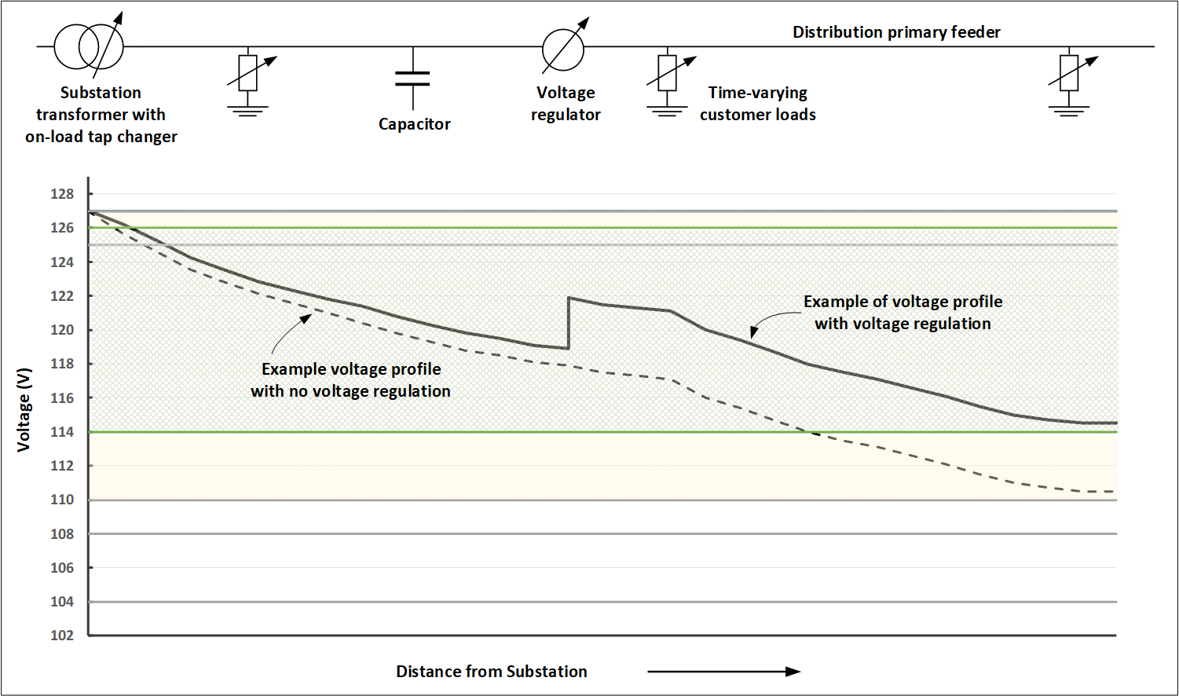
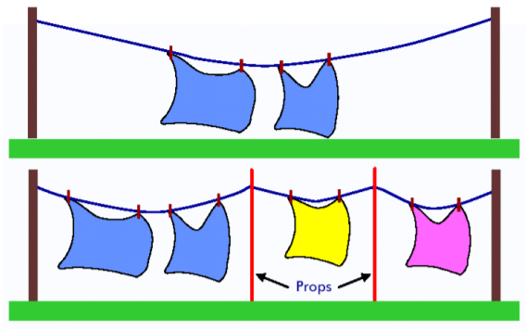
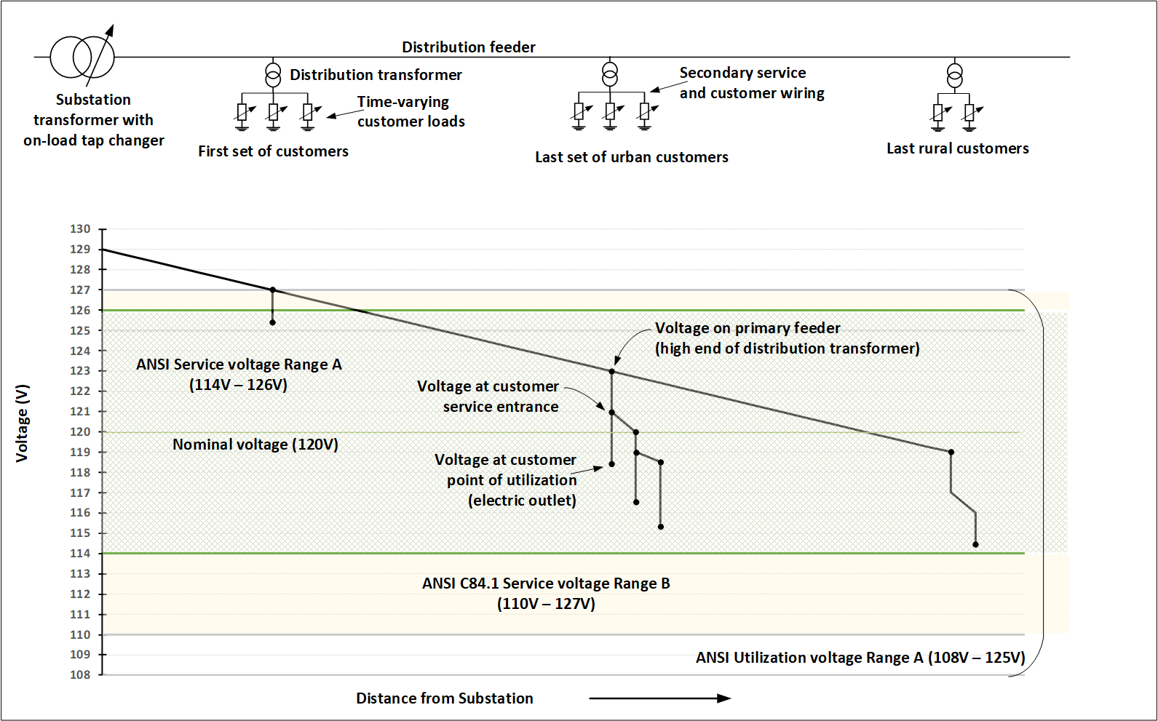


Real Power and…Imaginary Power?
Terminology time-out
Maintaining delivery voltage is one of the fundamental drivers of distribution system reliability.
kva
kva = “kilo” (1000) volt-ampere [apparent power]
kw = kilowatt [real power]
kvar = kiloVAR, volt-ampere reactive [“imaginary” power]
kvar
kw
θ

Slide 8
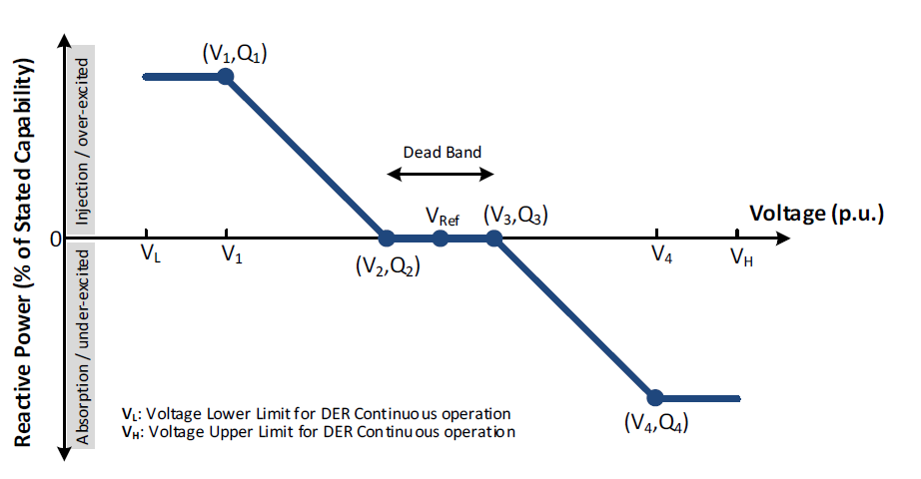
Voltage–Reactive Power (Volt-VAR)
When in this mode, the DER shall actively control its reactive power output as a function of voltage following a voltage-reactive power piecewise linear characteristic.
The DER measures grid voltage at the terminals and absorbs or produces reactive power.
It is intended to supply VAR only when needed, push local voltage back toward nominal.
The DER shall be capable of autonomously adjusting the reference voltage (V_{Ref}). The volt-VAR curve shall be adjusted autonomously as V_{ref} changes.
Implementation of the autonomous V_{Ref} adjustability and the associated time constant shall be specified by the area EPS operator.

Slide 9
Active Power–Reactive Power (Watt-VAR, P-Q)
(P′₃, Q′ ₃)
Reactive Power
When in this mode, the DER shall actively control the reactive power output as a function of the active power output following a target piecewise linear active power–reactive power characteristic, without intentional time delay.
Injection
Active Power
Dead Band
(P₁, Q ₁)
Active Power
Absorption
(P′₂, Q′ ₂)
Generation
(P₃,Q₃)
Absorption

Slide 10
Voltage–Active Power (Volt-Watt)
(P₁,V₁)
When in this mode, the DER shall actively limit the DER maximum active power as a function of the voltage following a voltage-active power piecewise linear characteristic.
Can reduce the prevalence of very high voltages.
Generation
(P₂,V₂)
Active Power (% of rating)
Voltage (p.u.)
V₁
V₂
V_{H}
Absorption
(P′₂,V₂)
V_{H} Voltage upper limit for DER continuous operation

Slide 11
Response to Area EPS Abnormal Conditions
“DER shall be designed to provide the voltage disturbance ride-through capability specified…”
“DER shall be designed to provide the frequency disturbance ride-through capability specified…”
IEEE Std 1547-2003
Shall TRIP on abnormal voltage/frequency
IEEE Std 1547-2018
Shall be capable of frequency response
Shall ride through abnormal voltage/frequency
May provide inertial response.
Voltage and frequency ride-through capability is mandatory, but the execution of each is dependent upon the selection of the performance categories (i.e., A,B and I, II, III) as well as the trip settings established in cooperation with the regional reliability coordinator (RRC) and the authority governing interconnection requirements.
The area EPS operator (utility) and the DER operator should mutually agree to use DER inertial response, and the performance requirements should be coordinated with the regional reliability coordinator.
Notes:
“Synthetic” inertial response is where the DER active power is varied in proportion to the rate of change of frequency.
Natural inertia is a physical characteristic of large, rotating machines like generators and motors.

Slide 12
Voltage Ride-Through
The area EPS operator, as guided by the authority governing interconnection requirements, in coordination with the regional reliability coordinator, shall specify which abnormal operating performance category (I, II, or III) is required.
Key takeaways:
Performance categories
Modes of operation
Trip settings

Slide 13
Frequency Ride-Through
Key takeaways:
Performance categories
Modes of operation
Trip settings
Requires coordination with the bulk power system (regional reliability coordinator)

Slide 14
Coordinated DER Response

Slide 15
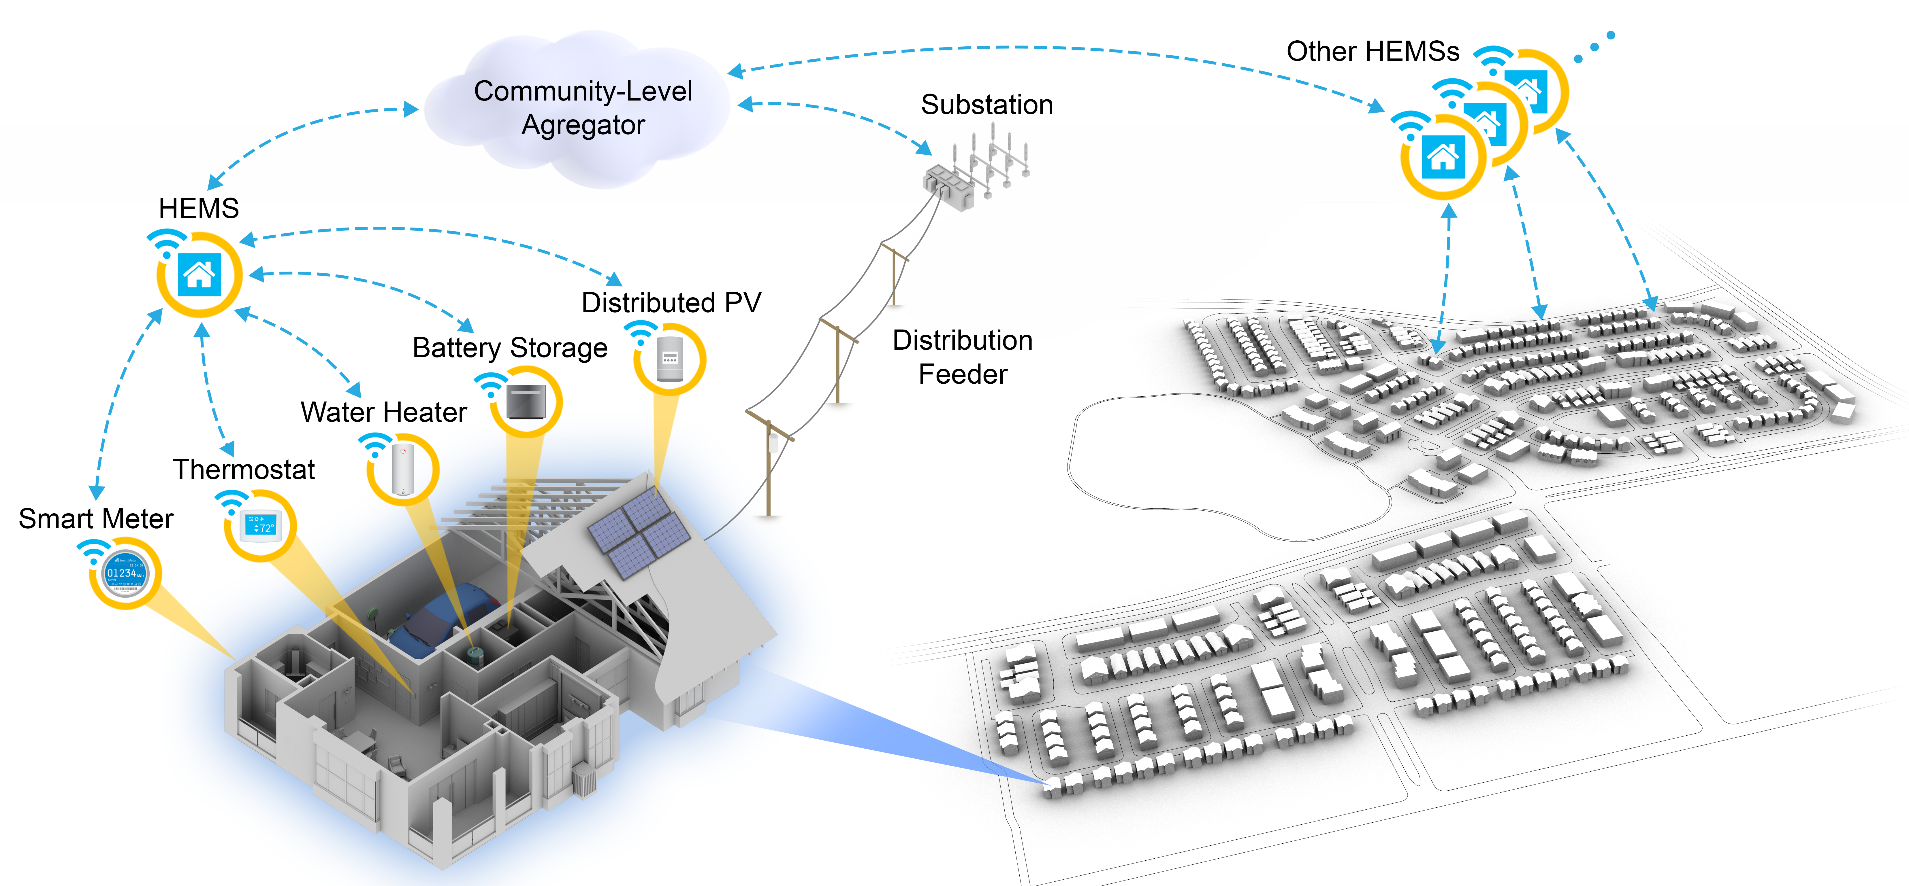
A Scalable, Hierarchical Approach for DER Management
Utility direct load control may not work for every household and may face scalability challenges.
A home energy management system (HEMS) coordinates the behind-the-meter loads and DERs on behalf of the occupants to reduce utility bills and thermal discomfort while interacting with utilities.
Coordinated control of homes can help utilities:
Improve demand flexibility
Host more renewables
Improve grid reliability and resilience
HEMS: Manages behind-the-meter devices on behalf of homeowners
Aggregator: Coordinates homes in a community and responds to utility control

Slide 16

Demonstrate Enhanced Load Flexibility, Grid Reliability, and Resilience in an All-Electric, Low-Income Residential Community in a Cold Climate
The local electric utility (Holy Cross Energy) needs a scalable control solution to help residential customers reduce their utility bills, address potential overvoltage issues caused by high-penetration PV, and enhance resilience in the event of emergencies such as wildfire.
Basalt Vista is an affordable housing development project led by Habitat for Humanity and Holy Cross Energy with 27 all-electric, energy-efficient homes built for local schoolteachers and professionals.
NREL is performing a field pilot study using cloud-based advanced control systems to enhance load flexibility, grid reliability, and resilience.

Slide 17
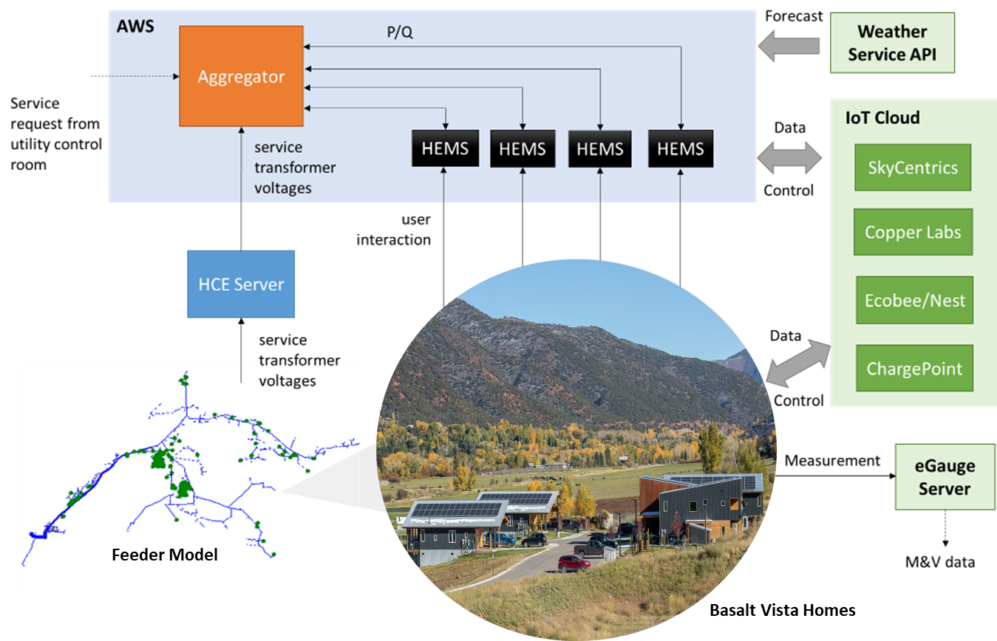
Cloud-Based DER Management for Grid Reliability and Resilience
Goals:
Utility bill savings
Demand flexibility
Renewable integration
Grid reliability (overvoltage mitigation)
Grid resilience (critical load support during emergencies).
Photo credit: Habitat for Humanity Roaring Fork Valley

Slide 18
Best Practices and Lessons Learned
Enthusiastic utility customers, highly collaborative electric utility and builder partners, and supportive vendors are the key to a successful field pilot.
Interoperability of connected devices is a challenge for the large-scale deployment of energy management systems.
Every home is different in terms of installed equipment, household preference, and how much load flexibility can be provided. HEMS can provide a more tailored solution than direct load control.
Key takeaways:
Scalable energy management solution benefits both utility customers and electric utilities.
Template for electrifying and decarbonizing low-income communities in cold climates.

Slide 19
Load Disaggregation

Slide 20
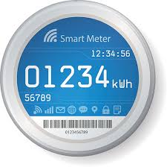

Load Disaggregation
Smart Meter
Whole-House Power Consumption
Rooftop PV
Individual Appliances
No real-time monitoring of behind-the-meter resources

Slide 21
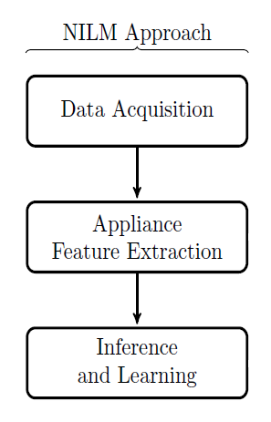
Non-Intrusive Load Monitoring
Overview of non-intrusive load monitoring (NLM)
First proposed in the 1980s
Uses a single point of monitoring, such as a utility smart meter
Estimates the electrical consumption of individual appliances from aggregate power measurements
Low-cost alternative to installing individual sensors on each appliance
Key ideas
Extract features for characteristic appliance signatures
Identify what appliances are used in the house
Estimate appliance consumption
NILM Approach ^{[2]}
[2] A. Zoha, A. Gluhak, M. A. Imran, and S. Rajasegarar, “Nonintrusive Load Monitoring Approaches for Disaggregated Energy Sensing: A Survey,” Sensors 12, no. 12 (2012): 16838–16866.

Slide 22
Benefits and Applications
Better understand end-use patterns
Quantify energy use and load shapes of individual appliances
Replace expensive submetering
Provide actionable information for homeowners, building operators, service companies, and utilities
Inform controls in building management systems
Predict and plan for appliance maintenance and replacement
Enable demand response and energy-efficiency programs
Applications
Energy monitoring
Fault detection
Load-shedding verification

Slide 23
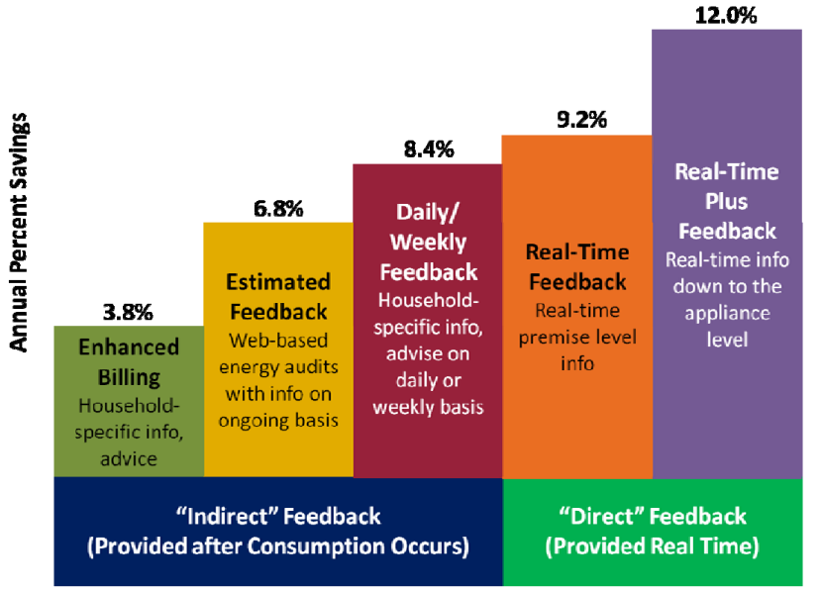
Impact
Estimated savings ^{[3]}
12% savings in annual U.S. electricity consumption
Average ~1,300kWh savings per home per year.
With wide deployment of NILM ^{[4]} (assuming NILM reaches half U.S. homes)
Total annual energy savings: 80 billion kWh
Total annual dollar savings: $9.9 billion.
Estimated Savings ^{[3]}
[3] K. Ehrhardt-Martinez, K. Connelly, and J. Laitner, Advanced Metering Initiatives and Residential Feedback Programs: A Meta-Review for Household Electricity-Saving Opportunities, Report number E105 (Washington, D.C.: American Council for an Energy Efficient Economy, 2010).
[4] M. C. Baechler and H. Hao, Business Case for Nonintrusive Load Monitoring, No. PNNL-25425 (Richland, WA: Pacific Northwest National Laboratory, 2016).

Slide 24
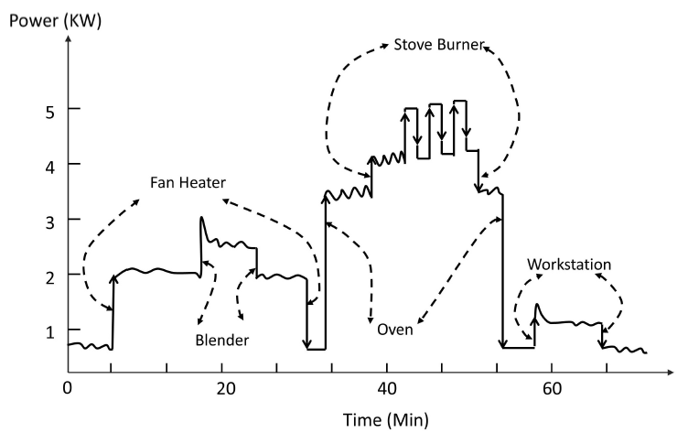
Characteristics
Steady-state features
Active and reactive power
Voltage and current
Transient features
Frequency domain transformations
Switching transients
Steady-state power data ^{[2]}
Waveform vs. steady state [5]
[2] A. Zoha, A. Gluhak, M. A. Imran, and S. Rajasegarar, “Nonintrusive Load Monitoring Approaches for Disaggregated Energy Sensing: A Survey,” Sensors 12, no. 12 (2012): 16838–16866.
[5] B. Lundstrom, G. Saraswat, and M. V. Salapaka, “High-Frequency, Multiclass Nonintrusive Load Monitoring for Grid-Interactive Residential Buildings,” Presented at the Eleventh Conference on Innovative Smart Grid Technologies, Washington D.C., February 2020.

Slide 25
Challenges
Rooftop PV systems
Different characteristics than appliances
High correlation with solar irradiance
Heterogeneity of appliances
Category, make, size, and manufacturer
Difficult to form generic appliance models
Performance enhancement
Label data in the training data sets
Update the signature database
Improve the robustness of NILM algorithms

Slide 26
Questions Utility Consumer Advocates Can Ask
What impacts do DERs have on utility costs?
What costs do DERs impose on all utility customers (i.e., costs DER hosts do not pay directly)?
Are DERs reducing grid losses?
Are DERs reducing the utility’s cost of installing new voltage regulation devices?
Have utilities quantified the potential benefits of DERs?
How are utility customers compensated for grid services that DERs can provide?
What DER programs can consumers participate in?
Are consumers compensated for providing voltage support and reactive power?
Are incentives provided for consumers to deploy new sensing and control technologies?
How are utilities managing the privacy concerns of consumers regarding DER controls?
What consumer data do utilities obtain and store?
What is the minimally sufficient information that utilities must collect to enable automated DER controls?
How is consumer information protected?

Slide 27
Resources for More Information
NREL. 2021. “IEEE 1547-2018 Resources” (website)
D. Narang, R. Mahmud, M. Ingram, and A. Hoke. 2021. An Overview of Issues Related to IEEE Std 1547-2018 Requirements Regarding Voltage and Reactive Power Control (Golden, Colorado: National Renewable Energy Laboratory).
North American Electric Reliability Corporation. 2020. Reliability Guideline: Bulk Power System Reliability Perspectives on the Adoption of IEEE 1547-2018. Atlanta, Georgia.
K. Utkarsh, F. Ding, X. Jin, M. Blonsky, H. Padullaparti, and S. P. Balamurugan. “A Network-Aware Distributed Energy Resource Aggregation Framework for Flexible, Cost-Optimal, and Resilient Operation. IEEE Transactions on Smart Grid. https://doi.org/10.1109/TSG.2021.3124198.
NREL. 2021. “Colorado Mountain Homes Prepare To Pilot Autonomous Energy Management.” November 1, 2021.
A. Zoha, A. Gluhak, M. A. Imran, and S. Rajasegarar. 2012. “Non-Intrusive Load Monitoring Approaches for Disaggregated Energy Sensing: A Survey.” Sensors 12. https://doi.org/10.3390/s121216838.
M. C. Baechler, and H. Hao. 2016. Business Case for Nonintrusive Load Monitoring . Washington, D.C.: U.S. Department of Energy.

Slide 28
Contacts
Michael Ingram, Michael.Ingram@nrel.gov
Xin Jin, Xin.Jin@nrel.gov
Rui Yang, Rui.Yang@nrel.gov

