Slide 1
Planning for Retirement of Baseload Resources
David Hurlbut, National Renewable Energy Laboratory, with research support by Rui Yang
Juliet Homer, Pacific Northwest National Laboratory, with research support by Devyn Powell
Training for National Association of State Utility Consumer Advocates
November 23, 2021
This presentation was funded by the U.S. Department of Energy’s Office of Electricity and Building Technologies Office.

Slide 2
Agenda
Framing the issue
Important modeling types
Key modeling issues and assumptions that impact resource decision-making
Resource adequacy considerations
Inertia and system reliability
Just transition and environmental justice
Timing and stranded costs
Questions utility consumer advocates can ask
Resources

Slide 3
Framing the Issue

Slide 4
Resource replacement is linked to a bigger picture of power sector evolution
Not just about replacing one plant, nor is it just about replacing one type of fuel source
Schumpeter’s process of “creative destruction”
Capitalism is a continuous roil of new consumer goods and preferences, new methods of production, new markets, new forms of industrial organization
Embrace of new, efficient tools requires giving up old, inefficient tools
Politics can’t stop the evolution, but policy can ease the transition
The opening up of new markets, foreign or domestic, and the organizational development from the craft shop and factory … illustrate the same process of industrial mutation—if I may use that biological term—that incessantly revolutionizes the economic structure from within, incessantly destroying the old one, incessantly creating a new one.
Joseph Schumpeter

Slide 5
What does the evolution look like?
Resource side
Load side
Increased diversification of consumer preferences
Demand for clean energy content
More pricing options
Increased opportunities for competition
Natural monopoly no longer natural in many parts of the supply chain (e.g., generation, many ancillary services, retail programs and load management)
More “defections” from utility
Load can participate in the market as virtual supply
5-minute dispatch with co-optimization of energy, ancillary services, and load
Better forecasting
Decline of large central station power plants
Legacy transmission network can be a resource constraint
Limits wind and solar siting
Policies for decarbonization and clean energy
Regional grid operators and utilities alike are affected, but the modalities can differ.

Slide 6
Indicator: coal plant retirements hit record levels from 2017-20 despite policies beneficial to coal
Conventional Steam Coal Capacity by Year Retired
37 GW
48 GW
Source: US Energy Information Administration, Form EIA 860

Slide 7
Traditional bulk power system resources had simple baseload, non-baseload functions

Slide 8
Today’s bulk power system operates more dynamically. “Baseload” is less relevant

Slide 9

Implications of a changing fuel mix on planning and operating the bulk power system
Grid is more complex, so utilities and regional grid operators have to be smarter about operating it
Critical functions are managed by minutes and seconds, rather than days and hours
Day-ahead, hour-ahead forecasts for load, wind, solar are integral parts of grid operation
Flexible resources are more important—and more valuable—than they were in the past
Smarter operation releases additional value, resulting in lower customer rates
By accommodating more wind and solar, the grid operates with lower emissions (and at lower cost)

Slide 10
Important Modeling Types

Slide 11
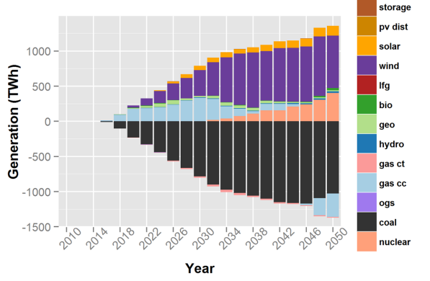
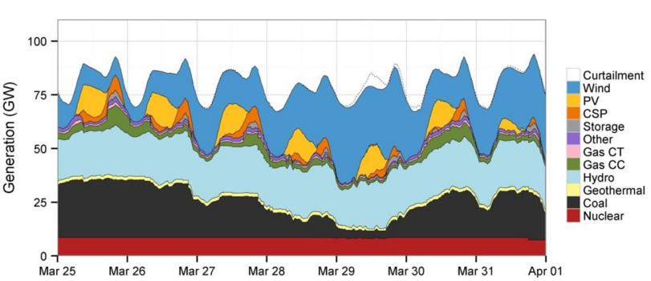
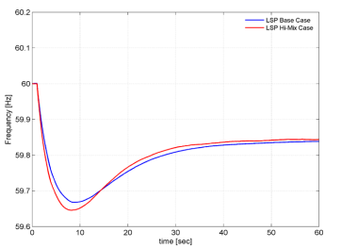
3 model types: Capacity expansion, production cost, power flow
Power flow/reliability models
Simulate the power system physics to ensure voltage and frequency requirements are met
Production cost models
Capacity expansion models
Simulate generation and transmission capacity investments, given assumptions about future conditions
Answers the question: What mix of resources should we build to meet load?
Analysis in the range of years to decades
Typical time step is 30 seconds to 1 minute or even shorter for dynamic/transient simulations
Can simulate the transmission network to check operational feasibility and simulate dynamic events to examine reliability under fault conditions
Simulate operation of power system to answer the question: What is the least cost dispatch of resources to reliably meet load in every hour at every location?
Typical analysis: 1-week to 1-year at higher temporal resolution (hours to minutes)
DOE Power Sector Modeling 101
Notes:
Capacity expansion models –
• What do these models do particularly well? Examine the impacts of power sector policies (or alternative technology/fuel trajectories) on the generation and capacity mix in the mid- to long-term
• What don't they do? Many do not have chronological unit commitment (i.e., every hour of the year chronologically); some use aggregate (model) plants for dispatch; transmission and power flow are a stylized representation (pipe flow or DC)
• What kinds of questions/analyses can the model answer/address? Quantifying the impacts of environmental policies on generation and capacity? What are the cost implications of alternative pathways to a low greenhouse gas emissions future? How will alternative future prices of natural gas impact capacity investment? What is the change in consumption and expenditures? What are the efficiency and distributional effects of various policy designs?
Production cost models (PCM) What do these models do particularly well? Simulate detailed (hourly to sub-hourly) operation of a given system; Assess resource adequacy and other aspects of reliability of a system; Analyze the impact of changes in the system (e.g., retirement/addition of capacity) on system operation; Assess transmission congestion and locational marginal prices; Describe the daily pattern of emissions
• What don't these models do? Build/invest in new generation or transmission capacity; Typically cannot model the entire US simultaneously - regional focus is required; Do not address all aspects of reliability
• What kinds of questions/analyses can the model answer/address? What are the operations, emissions, and resource adequacy impacts of retirement of coal or nuclear units in a given region? What is the maximum potential for redispatch from coal steam units to NGCCs? What is the value of storage, demand response, and solar power to the power system?

Slide 12
Key Issues and Assumptions that Impact Capacity Expansion Planning

Slide 13
Key modeling issues and assumptions that impact resource decision-making
Load projections
Fuel price forecasts
Capital expenditure forecasts
Non-traditional replacement resources

Slide 14
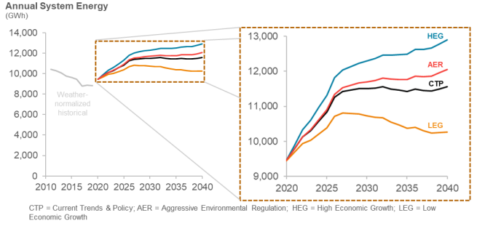
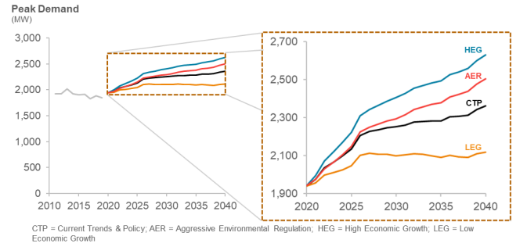
Load projections
Load growth projections are a key driver of resource needs and a source of uncertainty
Annual system energy (GWh)
Peak demand (MW)
In reviewing capacity expansion modeling results:
Understand range of load growth projections used
Understand assumptions behind projections
Understand specialized software used in modeling
Consider economic growth assumed in projections
Consider how electrification is being approached
Look at projected growth trends by sector and basis for those assumptions; look at past trends by sector
Potentially request additional model runs of low load growth sensitivities
Source: PNM 2020 Integrated Resource Plan
HEG = High Economic Growth; AER = Aggressive Environmental Regulation;
CTP = Current Trends and Policy; LEG = Low Economic Growth
High load projections can lead to overspending, increased rates, and stranded assets; low projections can lead to capacity shortfalls and reliability issues
Notes:
Could also have a “Managed” growth scenario; managed to meet resource availability. Manage EVs.

Slide 15
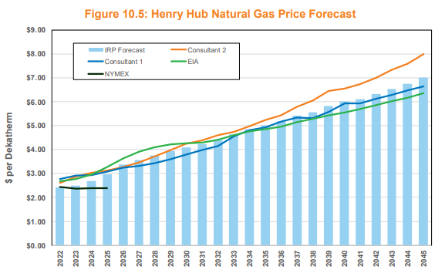
Fuel price forecasts
Fuel price forecasts impact what resources are selected in capacity expansion planning and dispatch assumptions in production cost modeling
When reviewing capacity expansion modeling results:
Understand fuel prices used in modeling
Consider existing gas and coal supply contracts, including: a) contract duration, b) nearest source hubs, c) suppliers, and d) forward positions
Consider what resource prices were used in each year to calculate the preferred resource mix going forward
Overly optimistic fuel price forecasts can bias the model toward fossil resources.
Overly pessimistic fuel price forecasts can favor non-fossil resources.
Source: Avista 2021 IRP

Slide 16
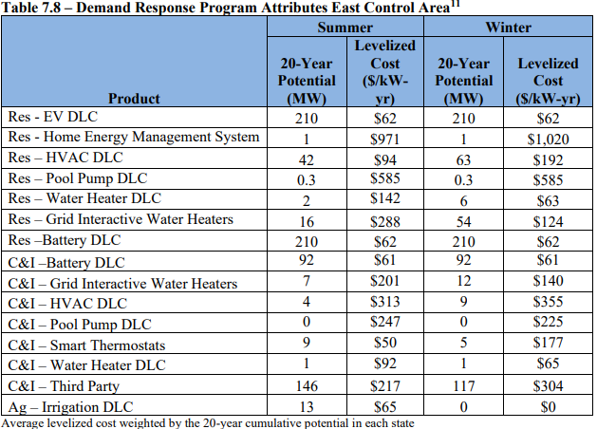
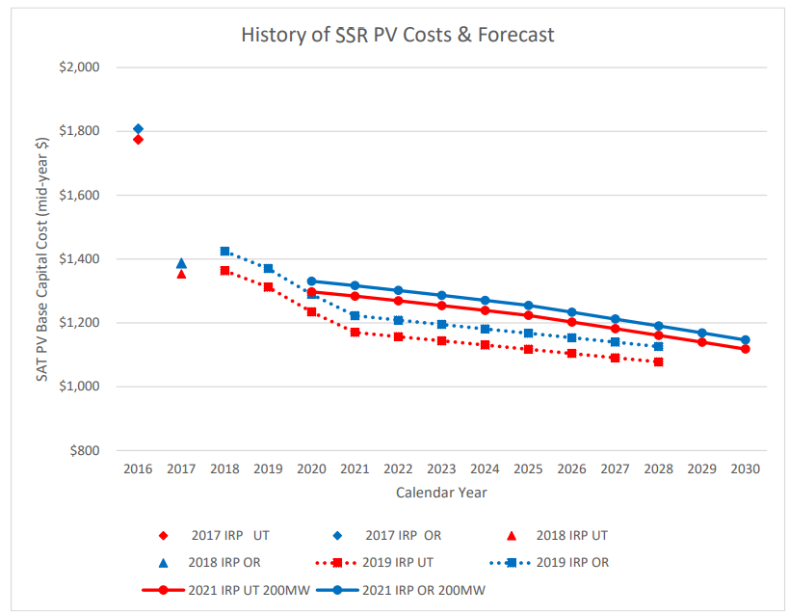
Capital expenditure forecasts
Capital cost assumptions for new resources can impact the resources selected in capacity expansion modeling
When reviewing modeling results:
Review capital cost assumptions for various generation and transmission resources, understand the basis of assumptions and compare to other information sources
Some utilities redact capital cost assumptions and others don’t
Review capital cost assumptions for pollution control equipment to meet clear air goals
Consider what energy efficiency, distributed generation, storage, and demand response costs are being included and compare to other resources
Requests for Proposals (RFPs) can be a good source of cost information
If modeling capital costs for a given resource are too high, models will not select those resources. If capital costs for some resources are too low, models will select those resources over others that are more optimal.
Source: PacifiCorp 2021 IRP
Notes:
RFPs can provide current and accurate cost information.

Slide 17
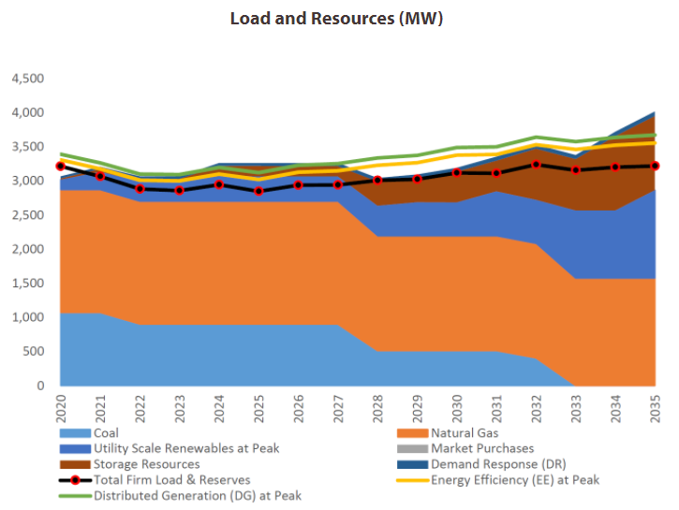
Non-traditional replacement resources (1)
Consider treatment of energy efficiency (EE), demand response (DR)—including direct load control and time-of-use rates, renewables, energy storage, combined heat and power, and distributed generation in capacity expansion planning
Did the utility treat EE as a resource that models can select, like supply-side resources, or were load projections simply reduced by the amount of planned EE?*
Did the utility include flexible capacity planning in its analysis? What is the projected need for flexible capacity and how did the utility consider non-traditional sources of flexibility, such as DR and energy storage, in its modeling?
What assumptions did the utility make for curtailment of wind and solar?
Did the utility consider options, such as renewable energy zones, to strategically direct future utility-scale wind and solar development to areas that increase flexibility, increase utilization of transmission, and improve the combined capacity value of co-located wind and solar?
Source: Tucson Electric Power 2020 IRP
*See Mims Frick et al. 2021, Methods to Incorporate Energy Efficiency in Electricity System Planning and Markets

Slide 18
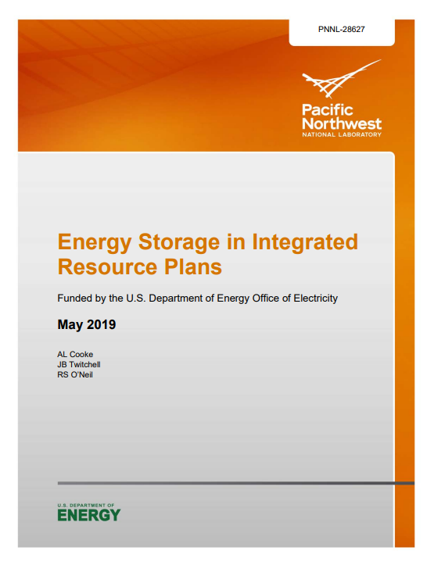
Non-traditional replacement resources (2)
To what extent did the utility consider peak demand reduction options such as demand response and time-of-use rates?
Did the utility use third-party resource potential studies (EE, DR, DG) in developing inputs to capacity expansion models?
What energy storage assumptions did the utility use in modeling? Were limits to total energy storage additions included? If so, what are the sources of those limits?
Did the utility consider in resource planning decisions the various benefit streams that energy storage can provide — e.g., using the net cost approach described in PNNL’s report, Energy Storage in Integrated Resource Plans?

Slide 19
Resource Adequacy Considerations

Slide 20
Resource adequacy, reliability, and resilience: Defining and distinguishing the concepts
Resource adequacy
Reliability
Resilience
The ability of the electric system to always supply the aggregate electrical demand and energy requirements of the end-use customers, considering scheduled and reasonably expected unscheduled outages of system elements
Operating the bulk power system so that instability, uncontrolled separation, or cascading failures will not occur as a result of a sudden disturbance, including a cybersecurity incident, or unanticipated failure of system elements.
The ability of the bulk power system to recover promptly from a disruption of service caused by natural disaster, cyberattacks, or terrorism.

Slide 21
Classic approach to resource adequacy: system reserve margin at peak load
When dispatchable generators were the prevalent resource, resource adequacy meant having enough installed capacity on hand to meet load during the hour of the year with the highest demand, plus a sufficient margin for contingencies
If resources were adequate during peak demand, they were assumed adequate for all other times
Reserve margin

Slide 22
Wind and solar generation cannot be controlled to deliver their full operating capacity at peak
Peak load
Wind output at peak less than maximum wind output

Slide 23
Classic approach can also overestimate solar’s capacity contribution as solar penetration grows
Effective peak (net of solar) moves to later in the day as the amount of solar increases
A peak later in the afternoon decreases solar’s capacity contribution during peak demand hours
Requires more availability and scheduling of flexible resources

Slide 24
New problem: adequacy of flexible resources to address high, sustained ramping requirements
With very high penetrations of solar, afternoon net load can require high, extended ramping
If the system does not have a sufficient number of flexible resources, shortages could occur during the ramping period rather than at peak load
Traditional resource adequacy metric—reserve margin at peak load—will fail to detect the risk, especially if the system contains large amounts of inflexible resources like coal and nuclear
3-hour ramping:
15 GW

Slide 25
Operational challenge, but also a measurement challenge: traditional resource adequacy metrics miss the picture
Historical statistics generally underestimate peak capacity contributions of wind and solar
Technology improvements are increasing the amount of energy obtainable from one MW of capacity
Inverter controls are making wind and solar more controllable
Better forecasting enables better scheduling of flexible resources
Storage technologies are adding more controllability
Consequences:
Over-procurement of capacity from conventional thermal resources
Is it just and reasonable for customers to pay for capacity that is not really necessary?
Over-estimation of how much the reserve margin will shrink if renewables replace a coal unit
Today, adequacy means enough of the right kind of resources at all operating hours of the year
Enough flexible resources during times of high, extended ramping in net load

Slide 26
Research frontier: probabilistic approaches to estimating resource adequacy
Run Monte Carlo simulations for 8,760 hours to estimate the probability that load will be lost due to insufficient resources
Takes into account the unique operating characteristics of each technology
Can include different scenarios
Can be computationally unwieldy for large bulk power systems
Useful middle ground?
Peak reserve margin: tractable, but increasingly wrong
Probabilistic methods: best, but computationally unwieldy

Slide 27
Middle ground approaches to measuring resource adequacy
Include thermal generators, but use unforced capacity (UCAP) rather than installed capacity (ICAP)
UCAP is the ICAP adjusted by the technology’s expected forced outage rate
Accounts for the possibility that a thermal unit might be unavailable at peak due to an unplanned outage
Loss of load expectation (LOLE): Number of days when capacity is insufficient to meet load (any time, any reason)
Can also be expressed as a probability (LOLP)
Can also be estimated by event or by hours
Common LOLE standard: one day out of 10 years
Expected unserved energy (EUE): MWh not delivered due to insufficient resources, including transmission limits
Unlike LOLE, EUE measures the quantity of a shortfall
In modeling, EUE is a function of a mathematical penalty
Question: Will EUE change if the penalty value is set higher or lower?

Slide 28
Inertia and System Reliability

Slide 29
System inertia and reliability
Large synchronous generators (e.g., coal and nuclear plants) naturally support both voltage stability and frequency response/dynamic stability.
Unlike synchronous generators, inverter-based resources (IBRs) like solar and wind do not contribute to system inertia.* This can impact voltage stability and frequency response.
Voltage stability
Rotating machines naturally provide reactive power that helps with voltage stability. Static VAR** compensators and synchronous condensers can be used with inverter-based resources when voltage support is needed.
Frequency response/dynamic stability
Storage and IBR can provide primary frequency response. IBR can respond quickly, but not as fast as synchronous generator inertia.
Inertia is an interconnection-wide characteristic of all the machines operating together. Removing one synchronous generator in a large interconnection won’t impact reliability and inertia much. However, as a higher percentage of synchronous machines are removed, inertia can become more of an issue.
Electricity system size impacts inertia. For example, ERCOT is smaller and may be more susceptible to inertia challenges due to loss of baseload plants than the Western or Eastern interconnections.
Grid-forming inverters connected to storage or renewables can help with primary frequency response.
*Inertia is the rate of change of frequency on the grid.
**VAR = Volt-Amps Reactive

Slide 30
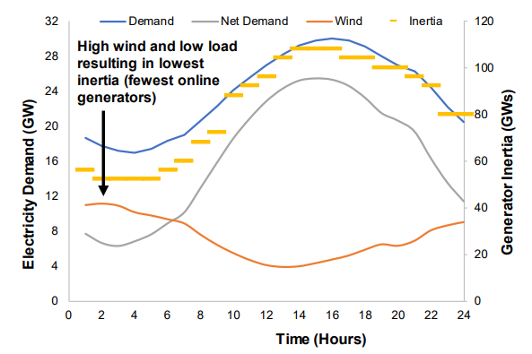
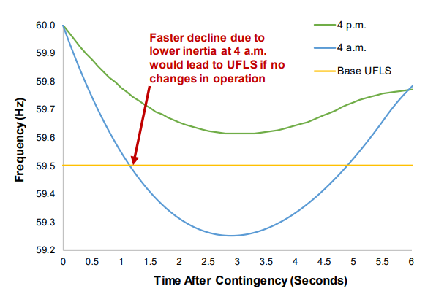
System inertia
Retiring baseload resources can reduce system inertia and increase frequency instability
Impact of IBRs on Inertia
Frequency Decline
UFLS – underfrequency load shedding
Source: P. Denholm, T. Mai, R. W. Kenyon, B. Kroposki, and M. O’Malley, “Inertia and the Power Grid: A Guide Without the Spin,” National Renewable Energy Laboratory. NREL/TP-6120-73856.

Slide 31

How to know if you will have enough inertia?
Standard transmission network reliability models run by Independent System Operators and Regional Transmission Organizations (ISOs/RTOs), reliability organizations, large utilities and consultants can assess grid stability relative to voltage and frequency.
PSLF (Positive Sequence Load Flow)
PSSE (Power System Simulator for Engineer)
PowerWorld
In standard mode, these models consider power flow/voltage.
These models can be operated in a different way to consider inertia through a dynamic (or transient) stability analysis.
Dynamic stability analysis is typically used where stability constrained transmission paths are present. Otherwise, more traditional power flow analysis is all that’s needed.
Example: The Western Electricity Coordinating Council (WECC) has developed reliability models for systemwide dynamic stability analysis for the Western Interconnection. WECC provides the models to utilities for their planners’ use.

Slide 32
Just Transition and Environmental Justice

Slide 33
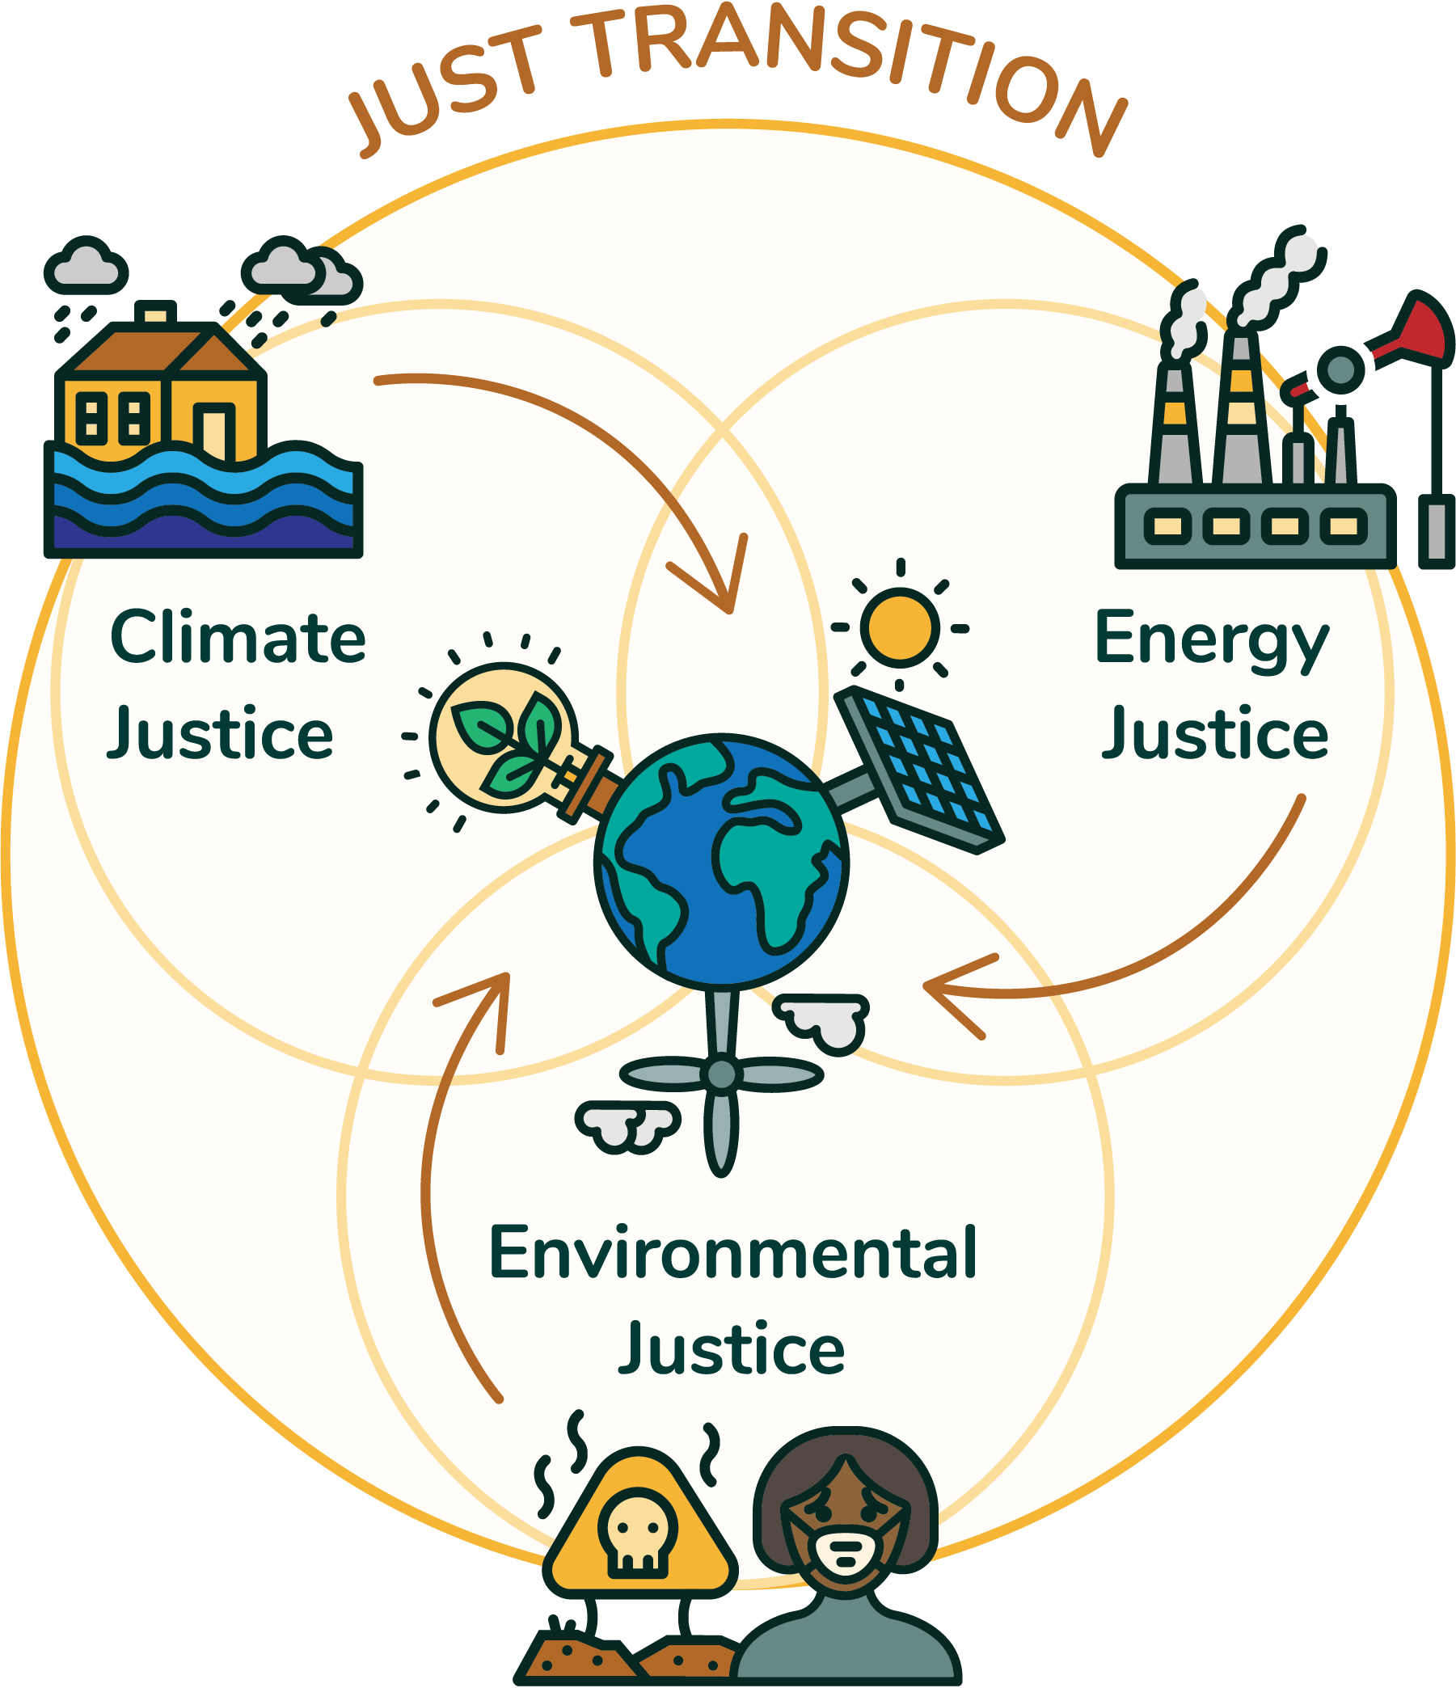
Just transition for impacted communities: defining key terms
These frameworks can inform the process of ensuring that a power plant retirement minimizes adverse impacts to local communities, especially for those who have been historically marginalized.
Environmental injustice: The disproportionate exposure of communities of color and the poor to pollution, and its concomitant effects on health and environment, as well as the unequal environmental protection and environmental quality provided through laws, regulations, governmental programs, enforcement, and policies. (Maantay 2002)
Environmental justice: The fair treatment and meaningful involvement of all people regardless of race, color, national origin, or income with respect to the development, implementation and enforcement of environmental laws, regulations and policies. (EPA)
Energy justice: Equity in both the social and economic participation in the energy system, while also remediating social, economic, and health burdens on those historically harmed by the energy system … Energy justice explicitly centers the concerns of marginalized communities and aims to make energy more accessible, affordable, and clean and democratically managed for all communities. (Initiative for Energy Justice)
Just transition: A shift in the energy industry from consuming fossil fuels to using alternative energy sources, in a way that ensures workers’ rights and offers economic opportunities and environmental health benefits for affected communities. (Climate Justice Alliance)
Equity: When the distribution of social, economic, and environmental benefits and burdens are not disproportionately shouldered by any one community group (Tarekegne 2021)
Source: Initiative for Energy Justice
Notes:
EJ: this is the definition the EPA and DOE currently use
Defining environmental injustice as well bc “EJ” often used to refer to addressing the disproportionate impacts on marginalized communities.
- To translate into plainer language – communities of color and low-income communities are disproportionately harmed by pollution, including from fossil-fueled power plants, and that unequal burden is heightened, sometimes inadvertently and sometimes on purpose, by the way policies and regulations are designed and enforced.
JT: commonly cited definition from CJA
Equity: useful framing in energy/EJ context from Bethel’s coal transition report

Slide 34
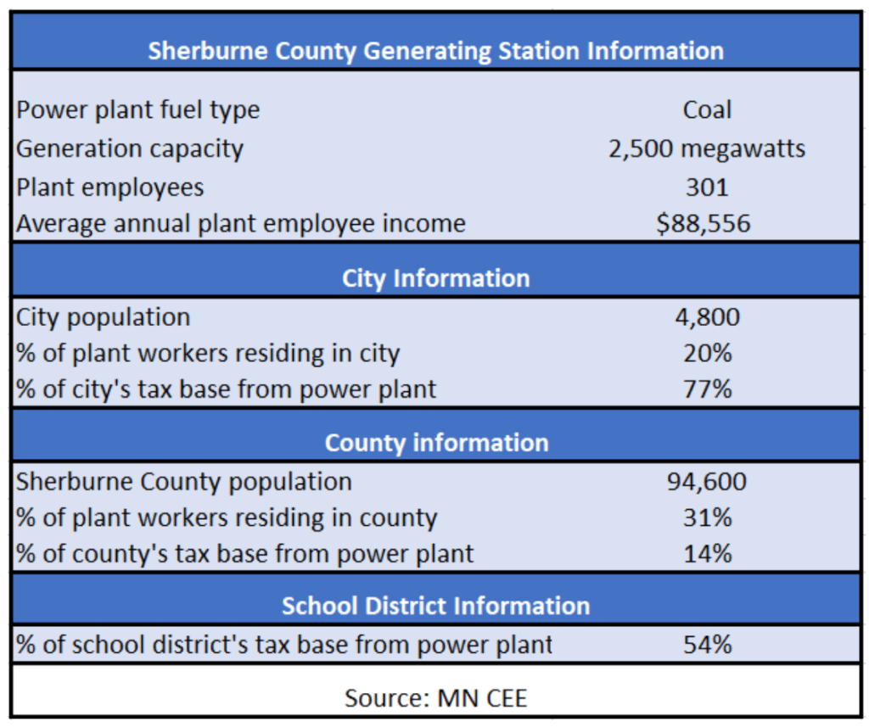
Economic losses from plant retirements
Plant retirements can directly cause significant job losses.
In many communities, especially rural areas, power plants are a major local employer.
Job losses impact not only plant workers, but indirect support jobs (mining, transportation, etc.).
Beyond direct loss of employment, plant retirements can also have major impacts on local tax revenue.
Tax revenue from Dominion Energy’s coal plant in Wise County, Virginia, provided 15% of county’s budget
Cobb coal plant in Muskegon, Michigan, provided 17% of city’s tax revenue
Sherco plant in Becker, Minnesota, provided 75% of city’s tax base and 54% of area school districts’ funding*
Revenue from coal plant operation and mining provided 85% of the total public services budget for the Hopi tribe in Arizona.
Employment and revenue statistics from the Sherburne County Generating Station in Becker, Minnesota
Chart source: https://ilsr.org/coal-closure-communities-just-transition/
*See Extra Slides
Notes:
Key points:
Power plants can be huge economic drivers in often economically marginalized communities/areas (often provide big or primary source of employment, creates indirect/supporting jobs, and large tax revenue base)
Plants often largest source of employment, and drivers of local economic activity
Major source of tax revenue – see case studies from Bethel Tarekegne’s recent paper
Chart shows some statistics on the Sherco (short for Shelburne County…) plant re: employment, local residency, and tax revenue
Pointing out the last part because the pollution and health concerns noted in previous slide and the employment/revenue concerns noted here do not always impact the same people, and interests can be in tension
School funding can also be impacted. State school funding is based on the number of students.
Note: Chart from ILSR, but they cite MN CEE as data source; same data is shared in Bethel’s PNNL report

Slide 35
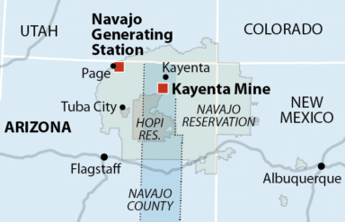
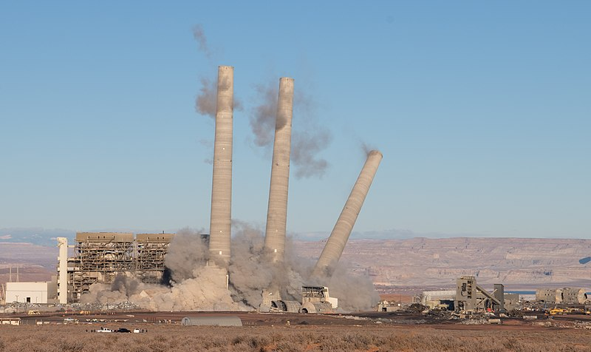
Case study: Navajo Generating Station and Kayenta Mine—Page and Kayenta, Arizona
Navajo and Hopi community engagement with utilities and regulators after coal plant retirement spurred the largest “just transition” proposal from an American utility. However, the final scale of the investment remains uncertain due to ratepayer cost concerns.
Plant closure and impacts:
Navajo Generating Station, operated by the utility Salt River Project, opened on Navajo Nation land in 1974. It was largest the coal plant in the Western US until its closure in 2019, driven by competition from gas and renewables.
The plant’s retirement spurred the closure of the Kayenta mine on Hopi and Navajo land, which supplied coal to the plant. Peabody operated the mine.
Coal revenue had provided ~85% of the Hopi tribe’s public services budget. About 38% of Navajo Nation households have incomes below the federal poverty line.
Utility engagement in transition efforts:
The utility Arizona Public Service, co-owner of the Navajo Generating Station and operator of other area coal plants facing retirement, included in its rate case a $144 million proposed investment in economic development, job transition support, and large-scale renewable energy development after dialogue with Navajo and Hopi community organizers. The utility proposed that ratepayers would provide cost recovery for approximately 75% of this investment.
In November 2021, the Arizona Corporation Commission rejected the utility’s rate increase proposal, cutting community assistance to about 10% of the proposed amount. Many stakeholders, including Arizona’s Residential Utility Consumer Office, had expressed concern about the proposed rate increases in the case, which also included proposals for ratepayer recovery of high-cost pollution controls at the utility’s Four Corners coal plant.
The Commission may authorize additional community assistance through a separate docket.
Map of Navajo Generating Station, Kayenta Mine, Navajo Nation and Hopi land. Source: IEEFA
The implosion of the Navajo Generating Station. Source: Alan Stark
Notes:
Hopi reservation is an enclave within the Navajo Nation reservation land
Lines of responsibility/incentives are complicated here between utility voluntary actions, community organizing, and regulator action >
APS’s just transition proposal voluntary, but shaped by advocates and regulators: Navajo groups first intervened in Arizona Corporation Commission (ACC) rate case, leading ACC to direct APS to fund a tribal energy efficiency program. In response, APS established dialogue with community advocates. APS’s just transition proposal exceeds this requirement in scope.
Peabody as contrast: has not engaged despite similar advocacy > Meanwhile, Kayenta mine operator Peabody has not offered any community funding, and has proposed delaying start of site reclamation efforts until 2022.
------
Notes on rate case from ACC final decision re: tribal EE program:
Coal Community Transition (CCT) funding discussed on page 135
APS describes plan for fund:
APS proposed for the first time a CCT that would provide the Nation cash and noncash benefits and would provide cash benefits to Navajo County Communities and the Tribe in anticipation of APS's transition away from coal-fired generation by 2031 and the affected communities' need to transition away from coal-based economies… (p. 143)
APS will, over a period of 10 years, pay to the Nation $100 million, provided that the Commission approves and authorizes APS to recover this amount from its retail customers through a dedicated cost-recovery mechanism. To the extent that the Commission does not approve such a mechanism or cost-recovery from retail customers, the $100 million will be reduced or eliminated, but APS will continue to work with the Nation in good faith to secure full funding through a costrecovery mechanism in future proceedings, a different Commission-approved cost recovery method, or securitization. (p. 144)
APS is requesting Commission approval to recover through the AEM that portion of the CCT funding to be paid by ratepayers ($19.25 million) and to modify its Service Schedule 3 to allow for the free distribution line extensions for Navajo applicants located within APS's service territory within the Nation. (Ex. APS-2 at 20.) APS acknowledges that it does not need approval to expend the funds proposed to be paid by shareholders (approximately $27.7 million) (p. 147)
- “Decision No. 77763 also ordered APS, "as part of its corporate obligations to support a just and equitable transition of communities impacted by early power plant closure," to develop and file for Commission review and approval a Tribal Energy Efficiency Program proposal and budget to implement energy efficiency projects with Navajo and Hopi tribal communities impacted by the closure of Navajo Generating Station, 4CPP, and Cholla Power Plant. (Decision No. 77763 at 38-39.) In addition, APS was ordered to seed-fund the Tribal Energy Efficiency Program with at least $457,000 annually and cost effectiveness requirements for the program were waived.” (decision p. 114)
-

Slide 36
Case study: Edwards Power Station—Bartonville, Illinois
Community investment outcomes after plant retirement were praised as a strong example of a “just transition” by community members and environmental groups, but results came from litigation, not a collaborative planning process.
Merchant generator Dynegy purchased the coal-fired Edwards Power Station in 2013. (Vistra Energy later bought Dynegy.)
Bartonville residents were concerned that the plant would be mothballed or retired without any community transition support, as with closures of other Dynegy-owned coal plants in Illinois.
Separately, the Edwards plant had been found to be in violation of Clean Air Act provisions. Bartonville residents and environmental groups sued the plant owners in 2013, before the Dynegy purchase. Dynegy (and then Vistra) inherited the lawsuit after the purchase of the plant.
The lawsuit was ultimately settled in 2019. A U.S. District Court judge approved a requirement for Vistra to provide $8.6 million in community compensation and commit to closing the plant in 2022.
Community groups have allocated settlement funding for transit and public-school bus electrification and charging equipment, energy efficiency upgrades for low-income homes, solar panels on selected public buildings, lung health program investments, and job training for displaced workers.
Notes:
Additional context if helpful: original owner, Ameren, spun off all their merchant coal plants to Dynegy to focus on regulated markets, citing low power prices.

Slide 37
Threshold questions public utility commissions may consider
Community just transitions
What are the projected economic impacts that plant retirement will have on the local community, in terms of job losses and reduced tax revenue? Do those losses make up a significant portion of the community’s overall employment or budget?
Are replacement generation resources (e.g., solar and storage) needed to replace the capacity of the retiring plant? If so, could replacement resources be sited in the community that hosts the retiring power plant? Further, should this community be given preference for siting those resources?
What are the potential employment and tax revenue benefits from potential replacement resources?
What non-energy site redevelopment or alternative economic opportunities could be available?
What types of EE investment opportunities are available in the community that hosts the retiring power plant and what is their cost-effectiveness? Could EE investments help mitigate economic harm?
How does the utility or plant operator plan to manage the employment transition? Is the utility offering transfers to other facilities, retirement benefits, retraining, or other worker support?
Are there differing preferences among community stakeholder groups or other tensions present in the impacted community? How will those tensions be resolved in order to move forward with transition planning? What role does the public utility commission have, if any, in resolving those tensions?

Slide 38
Timing and Stranded Costs

Slide 39
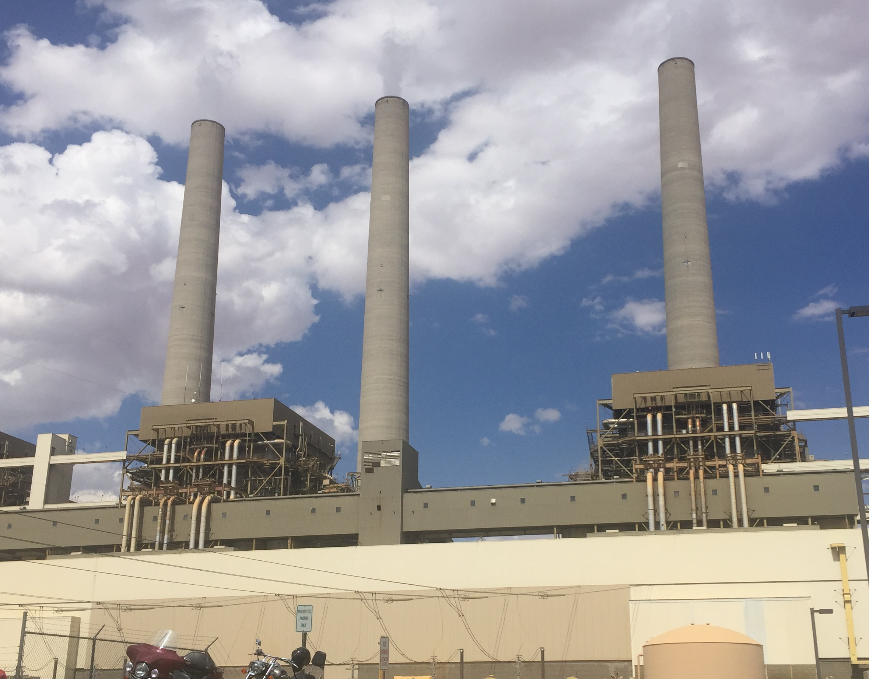
Salt River Project’s retirement strategy for Navajo Generating Station
Plant owners announced a retirement schedule in February 2017
From February 2017 to November 2019:
New hiring was held to a minimum
Older employees were offered retirement packages
Younger employees were offered transfers to other plants
By November 2019, when the plant closed, the workforce consisted entirely of short-term contractors and a few senior managers

Slide 40
No MW-for-MW replacement of Navajo Generating Station with new resources
Generation from natural gas units (mostly combined cycle) has offset most of the loss of production
Arizona has added very little new natural gas capacity
Combined capacity factor of all natural gas generators operating in Arizona increased from 27% in 2017 to 44% in 2020
Average retail rates fell from 10.64 cents/kWh in 2017 to 10.44 cents/kWh in 2020
Planning for future years includes growth in solar and storage
Approach is to reconfigure and optimize the portfolio, not to replace the Navajo Generating Station MW-for-MW

Slide 41
Securitization: Financial approach to reducing the burden of stranded costs from assets included in rate base
Steps in securitization
Determine the remaining value for which a public guarantee has been provided (i.e., approval by regulatory authorities to recover costs through rate base)
Market value vs. book value
Prudence of incurred costs
Eligible costs are removed from the utility’s rate base for separate refinancing
Determine other costs related to early retirement for which a public interest exists
Example: worker re-adjustment, loss of future local tax revenues
Select an underwriter to package approved costs into a combined security offering
Compare the cost to ratepayers of continuing to carry the retired asset in rate base with severing the asset from rate base and financing the debt separately
Securitize if the cost is less than carrying the asset in rate base
Examples
Texas (cost of transition to competition in 2001)
Colorado and New Mexico securitization statutes

Slide 42
Questions Utility Consumer Advocates Can Ask

Slide 43
Questions utility consumer advocates can ask (1)
Balancing the interests of today’s consumers against the interests of tomorrow’s consumers
Path dependence: Do investment decisions made today for replacement resources unreasonably limit the ability of future customers to exercise their preferences for electricity services?
Do benefit-cost analyses use a range of discount rates to test sensitivity?
Resource adequacy
Does the approach used by the utility (or other intervenors) to measure the impact of unit retirement and a replacement portfolio on resource adequacy:
account for current capabilities of renewables, storage, and non-wires alternatives?
account for unplanned or forced outages at the remaining thermal plants?
assess adequacy for all hours of the year, and not just the peak demand hour?
What happens with existing facilities (e.g., the use of combined cycle natural gas units), and is there a change to the system’s ability to handle a major forced outage or other contingency?
Timing and stranded costs
What is the utility’s workforce transition plan?
Does the utility have the option to refinance stranded costs related to retiring the plant?

Slide 44
Questions utility consumer advocates can ask (2)
Load forecasts, fuel costs and capital costs in capacity expansion modeling
What is the basis of load growth projections used in capacity expansion modeling? How do those projections compare to recent load growth by sectors?
What software is used for developing load projections?
What is the source of fuel price forecasts used in capacity expansion modeling? How were those prices developed and how do they compare with third-party forecasts?
What is the basis of capital cost assumptions used in capacity expansion modeling?
EE and other DERs
How are energy efficiency and demand response being considered in capacity expansion modeling?
What assumptions about energy storage are used in modeling?
Are non-energy value streams of energy storage being considered in modeling and resource selection? If so, how? If not, why not?
Reliability and system stability
What types of reliability and system stability analyses have been evaluated for proposed or planned plant retirement? Were reliability and system stability impacts of different retirement scenarios tested?

Slide 45
Questions utility consumer advocates can ask (3)
Retirement process and community engagement
What is the planned timeline for retirement? Will there be sufficient time and transparency between consideration or announcement of plant retirement and actual plant decommissioning to enable a just transition for the impacted community?
Have specific community stakeholder groups been identified for engagement in the planning process? Who are those stakeholder groups? (e.g., ratepayers, low-to-moderate income communities, workers, local environmental justice groups, Native tribes?)
What opportunities for community engagement will be offered in the planning process? Will a variety of engagement opportunities (e.g., in-person and virtual meetings, written comment period) be provided in order to maximize community accessibility?
Community input in site repurposing
Are there plans to remediate and repurpose the power plant site and the mine? What repurposing options are currently being considered?
Will community input be solicited, and community preferences incorporated, in developing repurposing plans?
Ensuring a just transition for impacted communities
What will the estimated economic losses be to the community from the plant closure? How many direct and indirect jobs will be lost? How much tax revenue will be lost?
What support will be offered to workers whose jobs will be impacted by the plant closure? Will there be retraining opportunities or other worker compensation?
What steps will need to be taken to remediate the plant site? What are the estimated costs of remediation? Who will bear the remediation costs? How will water freed up by plant retirements be allocated?
What are the demographics of the impacted community? Have low-income households or communities of color been disproportionately impacted, either by pollution or by potential economic losses?

Slide 46
Sources and Additional Resources
PNNL Reports
Tarekegne, Bethel W., Kazimierczuk, Kamila, & O'Neil, Rebecca S. 2021. “Coal-dependent Communities in Transition: Identifying Best Practices to Ensure Equitable Outcomes.” https://www.pnnl.gov/main/publications/external/technical_reports/PNNL-31909.pdf.
Lessick, Jennifer D., Tarekegne, Bethel W., and O'Neil, Rebecca S. 2021. “Business Models for Coal Plant Decommissioning.” https://www.pnnl.gov/main/publications/external/technical_reports/PNNL-31348.pdf.
Just Transition Resources
Climate Justice Alliance. “Just Transition.” https://climatejusticealliance.org/just-transition/
Milton-Lightening, Heather. 2019. “What’s in a just transition?” Briarpatch Magazine. https://briarpatchmagazine.com/articles/view/whats-in-a-just-transition
Initiative for Energy Justice. “Defining Energy Justice: Connections to Environmental Justice, Climate Justice, and the Just Transition.” https://iejusa.org/section-1-defining-energy-justice/
Connections Between Power Plant Pollution, Race, and Income
US Environmental Protection Agency. “Power Plants and Neighboring Communities.” https://www.epa.gov/airmarkets/power-plants-and-neighboring-communities
US Environmental Protection Agency. “Coal Ash Basics.” https://www.epa.gov/coalash/coal-ash-basics
Wilson et al. 2012. “Coal blooded: Putting profits before people.” https://climateaccess.org/system/files/Coal%20Blooded.pdf
Thind, M., Tessum, C. W., Azevedo, I. L., & Marshall, J. D. 2019. “Fine Particulate Air Pollution from Electricity Generation in the US: Health Impacts by Race, Income, and Geography.” Environmental science & technology, 53(23), 14010–14019. https://doi.org/10.1021/acs.est.9b02527
Maantay, Juliana. 2002. “Mapping Environmental Injustices: Pitfalls and Potential of Geographic Information Systems in Assessing Environmental Health and Equity.” Environmental health perspectives, 110(suppl 2):161–171. https://ehp.niehs.nih.gov/doi/pdf/10.1289/ehp.02110s2161
Regulators’ Role in a Just Transition
The Role of State Utility Regulators in a Just and Reasonable Energy Transition. https://pubs.naruc.org/pub/952CF0F2-1866-DAAC-99FB-0C6352BF7CB0
Regulators’ Energy Transition Primer. https://pubs.naruc.org/pub/9520FDE1-1866-DAAC-99FB-DE11821657FA
Berkeley Lab, 2021. Advancing Equity in Utility Regulation, Future Electric Utility Regulation report no. 12. https://emp.lbl.gov/publications/advancing-equity-utility-regulation

Slide 47
Sources and Additional Resources
State Policy Resources
Colorado Department of Labor and Employment. 2020. “Colorado Just Transition Action Plan.” https://cdle.colorado.gov/sites/cdle/files/documents/Colorado%20Just%20Transition%20Action%20Plan.pdf
New Mexico Department of Workforce Solutions. 2020. “Energy Transition Act Committee.” https://www.dws.state.nm.us/ETA
Power Plant Retirement and Transition Case Studies
Ambort, Lili. 2020. “Coal Plant Communities Seek a Just Economic Transition.” Institute for Local Self-Reliance. https://ilsr.org/coal-closure-communities-just-transition/
City of Becker, Minnesota. 2018. “Economic Advisory Committee.” https://www.ci.becker.mn.us/276/Economic-Advisory-Committee
Xcel Energy. 2021. “Re: Reply Comments 2020-2034 Upper Midwest Integrated Resource Plan Docket No. E002/Rp-19-368.” https://www.edockets.state.mn.us/EFiling/edockets/searchDocuments.do?method=showPoup&documentId=%7b70F0437A-0000-CF1C-96D6-E7E22CE60B9C%7d&documentTitle=20216-175386-01
Palmer, Brian. 2020. “This Is What a Just Transition Looks Like.” Natural Resources Defense Council. https://www.nrdc.org/stories/what-just-transition-looks
Union of Concerned Scientists. 2018. “Case Study: Soot to Solar.” https://www.ucsusa.org/sites/default/files/attach/2018/10/Edwards-Case-Study.pdf
Vanderpool, Tim. 2020. “After the Local Coal Mine Shuts Down, These Navajo and Hopi Communities Seek a Just Transition.” Natural Resources Defense Council. https://www.nrdc.org/stories/after-local-coal-mine-shuts-down-these-navajo-and-hopi-communities-seek-just-transition
Kutz, Jessica. 2021. “The fight for an equitable energy economy for the Navajo Nation.” High Country News. https://www.hcn.org/issues/53.2/south-coal-the-fight-for-an-equitable-energy-economy-for-the-navajo-nation
Arizona Corporation Commission. Commissioner Kennedy Proposed Amendment No. 1. 2021. Docket No(s) E-01345A-19-0088. https://docket.images.azcc.gov/E000013922.pdf?i=1635369216462
Arizona Corporation Commission. Decision No. 78052. 2021. Docket No. E-01345A-19-0088. https://docket.images.azcc.gov/0000203980.pdf?i=1635369216463
Arizona Public Service. 2020. “Heling Coal Communities Navigate the Clean Energy Transition.” http://s22.q4cdn.com/464697698/files/doc_downloads/regulatory_info/2020/Coal-Communities-Transition_Fact-Sheet_CS_Print.pdf
Arizona Corporation Commission. Notice of Filing. 2021. Docket No. E-01345A-19-0236. https://docket.images.azcc.gov/E000010444.pdf
“Utility regulators OK lower funding for transition from coal.” 2021. Associated Press. https://apnews.com/article/business-arizona-87e0693c5df48296689caa986efcc6fb

Slide 48


Contact
David Hurlbut
David.Hurlbut@nrel.gov
303-476-8874
Juliet Homer
Juliet.homer@pnnl.gov
509-375-2698

Slide 49
Extra Slides

Slide 50
Maintain system stability
Maintain inertia
Ensure mix of generators online exceeds critical inertial levels
Synchronous renewable energy
Synchronous condensers
Provide more response time
Reduced contingency size
Reduced underfrequency load shedding settings
Frequency support provided by IBRs
Frequency-watt control
Virtual inertial response
Fast frequency response
Automatic generation control and other longer time-scale controls

Slide 51
Main drivers of coal industry decline and plant closures
Policy and regulations
The Clean Air Act and Clean Water Act pollution standards impose costs on coal plant operation (less efficiency in operation, costly upgrades, steep fines for violation).
Plant operators face litigation from government agencies and environmental groups over violation of pollution standards. Litigation can force plants to close.
State energy policies (e.g., Renewable Portfolio Standards) incentivize closures of fossil-fueled power plants.
Cost competition with other fuels
Cost of coal plant operation has risen due to aging infrastructure and environmental compliance costs
Low natural gas prices have reduced economic viability of coal
Costs of renewables have also fallen, with wind and solar now cheaper than coal
Corporate emissions goals
In addition to emissions or clean energy targets set by state policy, dozens of utilities have also adopted voluntary greenhouse gas emissions reduction goals, which require decommissioning of coal plants to achieve.
As of 2021, 79 utilities operating 68% of current U.S. coal generation have adopted emissions reduction pledges.
Source: PNNL, Lessick et al. 2021

Slide 52
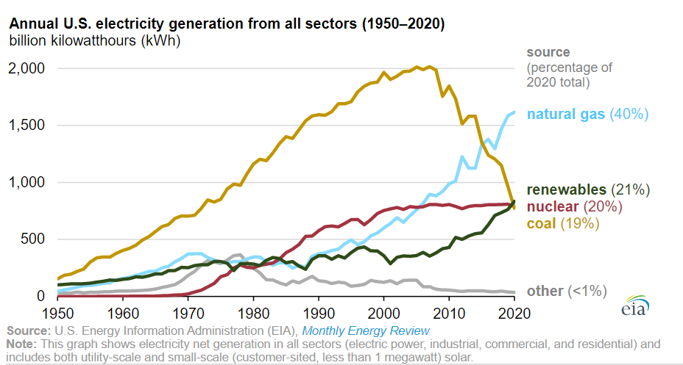
U.S. electricity generation over rime (1950–2020)
Recent years have seen a sharp decline in coal generation, combined with an increase in natural gas and renewables capacity.
2020 marked the first year that renewables and nuclear each provided more U.S. electricity than coal.
https://www.eia.gov/todayinenergy/detail.php?id=48896

Slide 53
U.S coal mining employment over time (1985–2021)
Coal industry employment fell 59% between 1985-2001 – despite a concurrent increase in coal production – due to technology improvements and geographic shifts in the industry from Appalachia to Western states.
Coal production and coal industry employment hit record lows in 2019 and continue to decline.
Source: Bureau of Labor Statistics https://data.bls.gov/timeseries/CES1021210001

Slide 54
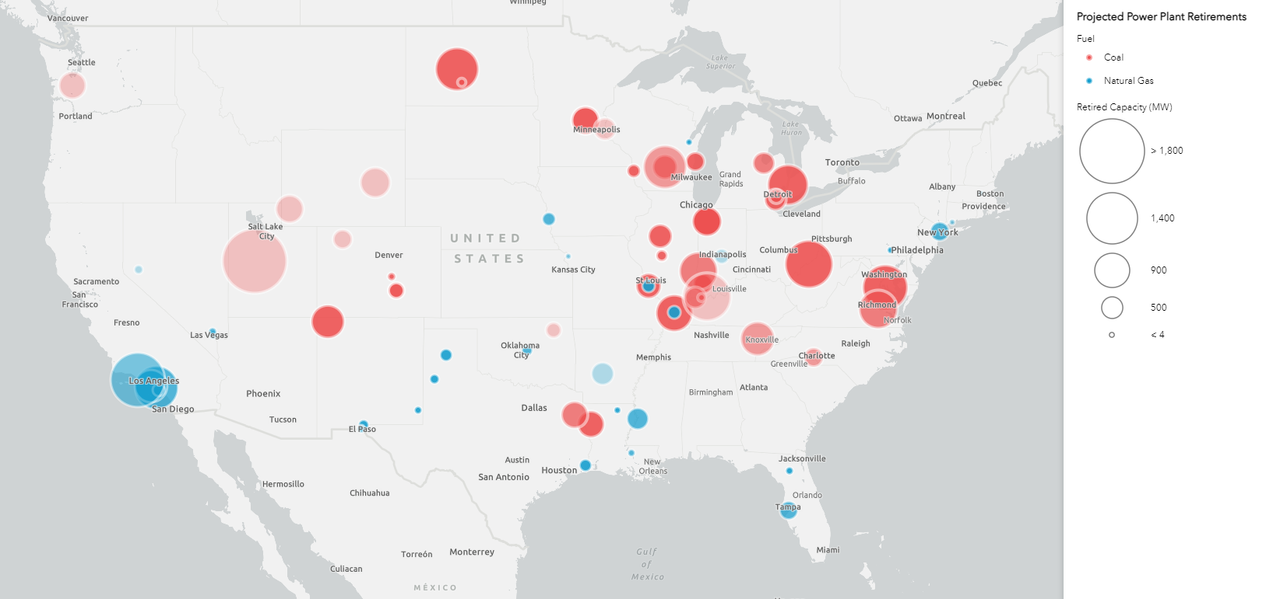
Planned coal and gas plant retirements (2021–2030)
Approximately 90 GW of coal capacity were retired or slated for retirement between 2019–2030.
Gas plant closures are also occurring, but coal accounts for the majority of recent and planned retirements.
Plants with higher operating and maintenance costs are being retired ahead of lower-cost plants.
Source: US Environmental Protection Agency, Announced Power Plant Retirement Map. https://www.epa.gov/airmarkets/announced-power-plant-retirement-map
Notes:
Map legend note: color saturation corresponds with date of retirement (dark circles are retiring earlier, lighter circles retiring later in the decade)
Source for bullet point data: EIA (https://www.eia.gov/todayinenergy/detail.php?id=42155)

Slide 55
Sherburne County Generating Station (Sherco): Becker, Minnesota
Early planning, active local government support, and community engagement have led to a transparent process and ideas to offset losses from plant closure to an economically dependent community.
The Sherburne County Generating Station (or Sherco) is the largest power plant in Minnesota, and was at one point determined to be the second-most polluting power plant in the United States.
Partially in response to Minnesota state energy policy goals, operator Xcel Energy announced plans for closure of two of the plant’s three units in 2015, and announced plans for full retirement in 2019. The plant will be fully decommissioned by 2030.
Sherco is the largest single employer and revenue generator in the Becker area, providing 75% of the municipal tax base and more than half of the county school district’s.
After Xcel’s initial announcement, city and county officials launched a collaborative planning process to develop strategy for economic transition and site repurposing.
New economic drivers for Becker include a metal recycling plant and a potential Google data center located near the Sherco site, both of which will take advantage of the available land, proximity to water and rail lines, and transmission line access.
Xcel is not directly funding these economic transition efforts, but has proposed projects for parts of the Sherco site. The utility originally proposed a natural gas plant, but is now instead planning a utility-scale solar project after the gas proposal received negative stakeholder feedback.
Notes:
Skip this slide?

Slide 56
Considerations for enabling a just transition for impacted communities facing fossil-fuel plant retirement (1)
Planning process considerations
Utilities, utility commissions, other state agencies, local governments, businesses, and community groups have different roles to play in the process of retiring, remediating, and repurposing a fossil-fuel plant site. Consideration should be given to clear, transparent communication and effective coordination between these groups in order to facilitate an equitable process and reduce negative impacts to the community.
Frequent and diverse opportunities for community engagement (e.g., a mix of in-person community meetings, virtual meetings, and written comment periods) can help enable stakeholder participation and ensure accessibility for different groups and individuals.
Residents of an area impacted by a plant retirement are unlikely to share a unified perspective. Stakeholder groups within an impacted community may be affected in different ways.
Beginning to develop plans for post-decommissioning/site repurposing early — well ahead of the plant’s planned retirement date — can help ensure adequate time and opportunity for community engagement and help minimize economic harms.

Slide 57
Considerations for enabling a just transition for impacted communities facing fossil-fuel plant retirement (2)
Site repurposing considerations
Retired fossil-fuel plant sites have characteristics (e.g., transmission access, proximity to waterways or other infrastructure) that can make them attractive sites for alternative energy generation (e.g., utility-scale solar, storage). Building generation facilities can help minimize economic losses and provide employment opportunities for affected plant workers.
The location and infrastructure opportunities at retired plant sites can also make them attractive sites for non-energy industrial development (e.g., data centers, warehouses), which can also provide revenue and employment opportunities for impacted communities.
Additional community support considerations
Minimizing economic losses and addressing public health concerns, such as undertaking site remediation, requires adequate financial resources. Identifying potential funding early can help minimize harms.
Some jurisdictions have passed legislation or established programs to provide dedicated funding for worker retraining and other economic transition (e.g., New Mexico’s Energy Transition Act, Colorado’s Just Transition Action Plan), and may impose requirements or include incentives for utilities or plant owners related to site repurposing and resource replacement.

Slide 58
How merchant generators handle stranded costs
Vistra Energy conducted a revenue analysis of three large coal plants (totaling 4.2 GW) in ERCOT and determined that:
Prices were unlikely to be high enough for the plants to operate profitably in the foreseeable future.
Low prices would limit unit dispatch in the ERCOT energy market.
Infrequent dispatch would reduce revenues below the units’ carrying cost.
Combined-cycle natural gas, solar, and storage had significantly better prospects for profitability.
The company recorded a charge of approximately $206 million related to the retirements.
Including employee-related severance costs, non-cash charges for writing off materials inventory and capitalized improvements, changes to the timing and amounts of asset retirement obligations
In the company’s statement of consolidated income, the charge was recorded to operating costs and impairment of long-lived assets, resulting in a net loss for the year.

