Slide 1
Distributed Energy Resources and FERC Order 2222
Lorenzo Kristov, PhD
Electric System Policy, Structure, Market Design
Berkeley Lab consultant
Technical Training on Contemporary Electricity System Issues for National Association of State Utility Consumer Advocates
October 29, 2021
This presentation was funded by the U.S. Department of Energy’s Office of Electricity and Building Technologies Office.

Slide 2
Outline of today’s presentation
Growth of distributed energy resources (DERs)
Drivers of customer adoption of DERs
Role of DERs in meeting decarbonization, resilience and equity goals
Benefits and services DERs can provide
Distribution and bulk power systems are complementary actors
Challenges to realizing full DER value
FERC Order 2222 overview
The central 2222 coordination problem
Order 2222 technical issues for distribution utilities
Framework for distribution system reliability
Information, communication and use cases
Costs to accommodate high DER volumes
Example: new California regulatory initiative
Questions consumer advocates can ask
Resources for more information

Slide 3
Growth of DERs
DER definition - Distribution-connected devices for production & storage of electricity and shaping of demand, including energy efficiency
Growth of DER technologies is a global phenomenon.
“Integration” of DERs where bulk power systems exist
Autonomous “microgrids” where no bulk power systems exist
Emphasis in US mainly on “behind-the-meter” (BTM) rooftop solar thus far
Growing interest in community-level & merchant “front-of-meter” DER
DER & microgrid systems are fully scalable to customer & local needs
Huge DER growth expected in the next few years
Wood Mackenzie forecasts US DER capacity of 387 GW by 2025 — compared to 330 GW combined coal + nuclear capacity today
Of which 90% will be BTM solar, residential load management, battery storage and electric vehicle (EV) infrastructure
EV infrastructure growth expected to outpace solar growth by 2025.
Portland General Electric sees DERs meeting 25% of peak demand by 2030.

Slide 4
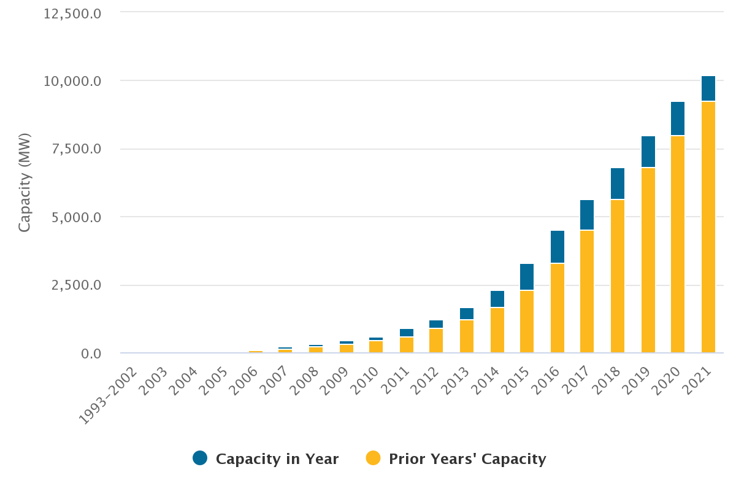
Rooftop solar growth in California (System peak <50 GW)
Source: https://www.californiadgstats.ca.gov/charts/

Slide 5
Drivers of customer adoption of DERs
Policy incentives: varieties of Net Energy Metering; EV rebates; in California, “Self Generation Incentive Program”
Autonomous customer adoption even without government incentives
DER declining costs, increasing performance, environmental attributes
Compared to increasing grid costs & vulnerability to disruption
First movers are commercial and industrial (C&I) and affluent Residential
The grid has competition for the first time in 100 years
C&I & Residential customer microgrid adoption (see Resources in this deck)
What do customers want? Conventional wisdom says they care only about price and reliability, “keep the lights on,” and low rates/bills
Problem with “keep the lights on” objective => views customers as exogenous — they only consume, don’t participate actively in the system
Problem with emphasis on “low rates/bills” => pressure to externalize costs to keep rates low => adverse health & environmental impacts on marginalized communities, plus incentive for over-consumption and waste

Slide 6
Role of DERs in achieving policy goals
Three new goals for electricity service for 2020s and beyond: decarbonization, resilience, equity
Plus traditional safety, reliability, affordability, universal access, efficiency
DERs can address these goals in ways the “utility-scale” system cannot
Urban planning initiatives to decarbonize through electrification, housing density, building codes, zoning & land use
Resilience is a local attribute, preparing for when grid service goes out
Equity is about local communities, remediating externalities, access to clean DERs not limited to first movers with financial resources
20th century electric system had all supply on the bulk system
Centrally scheduled by the bulk operator (balancing authority or ISO/RTO)
Delivered via one-way distribution service
To “consumers” at the end points who do not actively participate
Tendency today is to assimilate DERs into the central control paradigm
Alternatively, the optimal future electric system may be “bimodal” with a diverse, participatory distribution side coordinated with bulk power system

Slide 7
Benefits and services DERs can provide
Customer benefits that accrue to DER adopters
Cost-effective resilience, power quality, load management
Managing time-of-use and demand charges
Ability to transact and participate in the grid, not just consume
Distribution system and utility benefits
DERs can provide operational services to improve reliability and coordination with the bulk system
Bulk power system benefits
DERs provide flexibility services to support bulk system operations, integrate more renewables (focus of UK and EU “Open Networks” efforts)
General ratepayer benefits: reduce grid infrastructure needs
Smoothing net load profiles on a circuit, a substation, up to interfaces with the bulk system — reduces operational problems & peak infrastructure needs
Vibrant Clean Energy studies show reducing peaks at T-D interfaces increases grid capacity factors and reduces infrastructure costs
Autonomous grids to serve remote communities

Slide 8
The distribution system and bulk power system are complementary actors in a high-DER future
The distribution utility coordinates DERs to smooth local variability & facilitate transactions with the bulk system and RTO markets
Local Distribution Area (LDA) operated by distribution utility or DSO
Bulk Power System
Regional Interconnection
BAA
Balancing Authority Area or RTO
Individual Residential Customers
Multi-Customer Microgrids
Community Generation & Storage
BAA
Individual C&I, Ag & Municipal Customers
Smart Buildings
Remote & utility-scale supply & transmission networks

Slide 9
Challenges to realizing the full value of DERs
The dominant industry mindset views DERs as a problem
The “square-peg-into-round-hole” problem: DERs don’t fit legacy operational, planning, regulatory and business models
High volumes of “unmanaged” DERs can export variability and extreme production profiles (ducklings) to the bulk system
Bulk system operators have no visibility into distribution, and utilities may have very little visibility into DER activities
How to account for DER growth and behavior in transmission and distribution (T&D) planning
DERs cross the traditional federal-state jurisdictional boundary
DERs reduce grid infrastructure needs, the basis of utility profits
Hard for DERs to monetize values because we have not yet agreed on methods for valuing them
Capacity or resource adequacy value, contribution to system reliability
Deferral of T&D infrastructure needs
Value of resilient electric service when grid service goes out

Slide 10
FERC Order 2222 — issued 9/17/20
“… to remove barriers to the participation of distributed energy resource aggregations [DERA] in the capacity, energy, and ancillary service markets operated by Regional Transmission Organizations and Independent System Operators (RTO/ISO)”
Barriers addressed: Individual DERs may be too small or unable to meet performance requirements on a stand-alone basis
Main requirements for RTO/ISO
Define “DER Aggregator” as RTO/ISO market participant
Create market ”participation models” for DERA ≥ 100 kW capacity
Centrality of the DER Aggregator-RTO Relationship
Establish coordination with Distribution Utilities & Aggregators & enable voluntary engagement with state regulators
Order is optional for utilities with < 4 million MWh annual energy delivered
Compliance filings due July 2021: CAISO & NYISO filed on time; multi-state (PJM, MISO, SPP, ISO-NE) got extensions to Spring 2022
Implementation dates to be proposed by each RTO/ISO

Slide 11
FERC Order 2222 — ongoing efforts & issues
CAISO & NYISO had FERC-approved DERA participation models before Order 2222 was issued, but multi-state RTOs did not
All RTOs had models for aggregating demand response (DR); real aim of Order 2222 was to aggregate “injecting” DERs
Order does not apply to homogeneous aggregations of DR — these are governed by prior FERC Orders 719 and 745
Order allows “heterogeneous” DERAs that include some DR resources and some injecting DERs — some 719 & 745 provisions apply to the DR members of a heterogeneous DERA
The multi-state RTOs have working groups in progress with distribution utilities, aggregators, regulators & other stakeholders
In some RTOs, utilities and regulators have separate collaborative efforts
Industry efforts by Electric Power Research Institute and Advanced Energy Economy
A major issue is “double counting” and “double payment” for services DERA may provide to customer, retail and wholesale

Slide 12
FERC Order 2222 — need for new coordination procedures between utility, aggregator & RTO
RTO/ISO – Transmission Grid
Order 2222 para 129: “… we … require each RTO/ISO to have tariff provisions that allow distributed energy resource aggregations to participate directly in RTO/ISO markets.”
(PNNL-29117): “Tier bypassing occurs when a device, system, or agent at one level of a grid hierarchy connects to, directs, or controls an element more than one tier away.”
Under 2222, market transactions bypass the distribution system, where electric power must flow to move between DERs and the transmission grid. This is how 2222 creates tier bypassing and causes a coordination gap.
Distribution System (Utility or DSO)
DER Aggregator
DERs, Customers
Electric power flows
Market transactions
With physical performance

Slide 13
Technical issues for distribution utilities
Operations => How to ensure safe & reliable operation, while enabling DERA participation in wholesale markets
Key distinction between injecting and non-injecting DERs
Interconnection procedures for individual DERs establish requirements (e.g., inverter settings) and operating limits (e.g., maximum injection)
60-day reliability review of a proposed DERA — Order 2222 requires utility sign-off for DERA to participate in RTO markets
Aggregation Agreements between utility and aggregator define each entity’s roles and responsibilities
Order 2222 requires “Transparent, non-discriminatory” procedures for a utility to over-ride RTO dispatch of DERA for distribution reliability
Three-way coordination between utility, aggregator and RTO
Distribution conditions can constrain DERA operation. How are changing system conditions communicated?
How does the utility decide when DER/DERA curtailment is necessary?
How is limited grid capacity allocated among multiple DERAs?

Slide 14
Framework for distribution system reliability and operational coordination
DERA Set-up & Registration
Market & Operational Timeframe
1. Individual DER Interconnections & Interconnection Agreements
2. Utility Review of Proposed DERA and “Aggregation Agreement” (AA) with Aggregator
3. Procedures for Utility to Convey Distribution System Conditions to Aggregator & DERs
4. Aggregator Actions in Response to Dx Constraints
Principle: Conduct studies, establish procedures & agreements upfront (1, 2, 3) to minimize reliability impact of unexpected events in operational time
DER interconnection: Establish DER performance parameters (e.g., inverter settings) & utility right to curtail DER operation in Interconnection Agreement
Utility may not have standardized interconnection procedures for injecting DERs
60-day review: Utility studies DERA for impacts on the network, and individual DER eligibility to participate; utility consent required to register DERA with RTO
Utility may study simultaneous maximum output of all DERs in the DERA
Establish procedures to inform Aggregator or RTO of distribution constraints
Abnormal configurations, planned or unplanned, may constrain DERA operation
Aggregator is responsible to inform RTO of current DERA capability and is responsible for deviations from RTO dispatch instructions

Slide 15
More technical issues for distribution utilities
Distribution planning
Long-term forecasting of DER adoption and performance impacts
Identifying and implementing DER solutions to upgrade needs
Uses of energy storage locally to manage variability
Short-term forecasting of net load at T-D interfaces
Key input for running RTO markets
Affected by the activities of participating and non-participating DERs
Double counting and double payment
RTO can limit participation of DERs that are compensated for the “same service” under another program
DER can be ineligible to participate in a DERA if it “is included in a retail program to reduce a utility’s or other load-serving entity’s obligations to purchase services from the RTO/ISO market.”
Utility can review the DERA in the 60-day review period to determine eligibility of individual DERs to participate

Slide 16
Information, communication and use cases
RTO, Aggregator, Utility — each has different objectives:
RTO wants certainty that the DERA will deliver as instructed, to support bulk system operation
Aggregator wants to participate in and earn reliable revenue streams from the RTO markets
The Distribution Utility wants to maintain a reliable, efficient system without compromising its own or its regulator’s other objectives
Information
Utility needs visibility to immediate network conditions to monitor impacts of load variation and DER activity
Communication
Each entity has information the others need to meet their objectives; communication must be timely and accurate
Use Cases
Complex questions can’t be solved at the abstract level; define use cases that capture realistic scenarios & focus on outcomes of concern

Slide 17
Costs to accommodate high DER volumes
Growth of DERs will require new capabilities of distribution utilities, even without Order 2222 and wholesale market participation
Refinements to interconnection procedures
Database for tracking all connected DERs by location, type, size, etc.
Visibility to DER real-time performance
Tariffs and controls to align DER performance with distribution grid needs
“Grid modernization” investments depend on state’s goals, customers’ needs and interests, DER growth rate
Incremental needs under Order 2222 may be small part of DER-driven enhancements
Cost responsibility of DER owners
Interconnection-related grid upgrades — depends on interconnection type
Metering, telemetry, interconnection facilities
Internal utility costs will depend on DER volume & growth rate
Communication & control systems; staff enhancements
Utility may apply “wholesale market access charge” to Aggregators

Slide 18
Example: new California regulatory initiative
Order Instituting Rulemaking to Modernize the Electric Grid for a High Distributed Energy Resources Future (R.21-06-017)
Intended to “…capture as much value as possible from DERs as well as mitigate any unintended negative impacts.”
Assumes high DER growth, especially transportation electrification
Emphasis on environmental and social justice goals
Three parallel tracks
Distribution system operator roles and responsibilities, utility and aggregator business models
Near-term improvement of distribution planning framework, tools and processes into a more holistic distribution planning process
Grid modernization investments in near-to-medium term, alignment with distribution planning and general rate cases, operationalizing smart inverters
Companion “DER Action Plan” mapping interrelated proceedings
Three-year time frame

Slide 19
Questions utility consumer advocates can ask
What are your state’s objectives for the future electricity system?
What is the current status of distribution utilities’ capabilities?
Database of all DER installations (location, type, size)
Interconnection procedures (transparency, time & cost, risk mitigation)
Circuit “hosting capacity” studies and access to data
Forecasting of DER growth and behavior
Integration of DER into distribution planning
How can incentives and opportunities for customers with on-site DERs be modified to encourage contributions to grid performance & reliability?
How can resilience and other local benefits of DERs be valued?
How can marginalized community voices be brought into regulatory proceedings?
Given the cost trends of DERs, what is the potential for financially capable customers to defect (C&I & affluent Residential)?
Is there a need to shift utility incentives from capex to performance?
What are the optimal roles for the regulated monopoly and competitive market actors in a high DER grid?

Slide 20
Resources for more information (1)
United States Distributed Energy Resources Outlook: DER Installations and Forecasts 2016-2025E. Wood Mackenzie, July 2020 https://www.woodmac.com/news/editorial/der-growth-united-states/
Portland General Electric DER Forecast: https://www.utilitydive.com/news/by-2030-portland-general-sees-distributed-resources-meeting-up-to-25-of-p/608376/
Customer microgrid adoption by luxury home owners: https://microgridknowledge.com/cleanspark-luxury-home-microgrids/
Vibrant Clean Energy study: https://www.vibrantcleanenergy.com/wp-content/uploads/2020/12/WhyDERs_ES_Final.pdf
De Martini & Kristov, Distribution Systems in a High-DER Future, Berkeley Lab: https://emp.lbl.gov/publications/distribution-systems-high-distributed
UK Open Networks Project: https://www.energynetworks.org/creating-tomorrows-networks/open-networks/

Slide 21
Resources for more information (2)
NARUC-NASEO Task Force on Comprehensive Planning (2019-2020): https://www.naruc.org/taskforce/
More Than Smart, 2017, Coordination of Transmission and Distribution Operations in a High-DER Electric Grid: https://gridworks.org/wp-content/uploads/2017/01/Gridworks_CoordinationTransmission.pdf
Kristov, 2019, The Bottom-up (R)Evolution of the Electric Power System: https://ieeexplore.ieee.org/document/8643617
CPUC Rulemaking (R.21-06-017) to Modernize the Electric Grid for a High-DER Future: https://docs.cpuc.ca.gov/SearchRes.aspx?DocFormat=ALL&DocID=390664433
CPUC Environmental and Social Justice Action Plan: https://www.cpuc.ca.gov/news-and-updates/newsroom/environmental-and-social-justice-action-plan

Slide 22
Contact
Lorenzo Kristov, PhD
Electric System Policy, Structure, Market Design
Email LKristov91@gmail.com

