Slide 1
Utility Transportation Electrification from a Consumer Advocate Perspective
Caroline Palmer | June 13, 2022

Slide 2
Potential Costs to Ratepayers
Transportation electrification can benefit ratepayers
Reduced GHG emissions
Decreased local air pollution
Downward pressure on rates (if EV load is properly managed)
Transportation electrification can also incur outsized ratepayer costs, with significant equity impacts
Utility charging infrastructure investment (utility-owned or not)
Rate designs that cause cross-subsidies
Need for power system upgrades due to EV grid impact

Slide 3
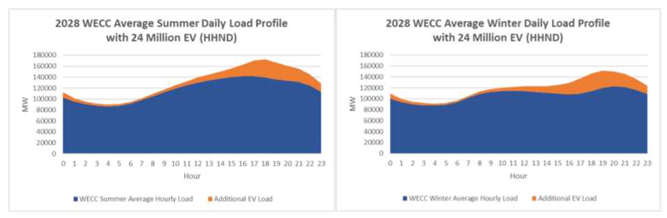
EV Grid Impacts
If unmanaged, a majority of EV charging could occur during peak periods
Distinction between distribution and system-level peaks
Source: Pacific Northwest National Laboratory. https://www.pnnl.gov/sites/default/files/media/file/EV-AT-SCALE_1_IMPACTS_final.pdf

Slide 4
Mitigating EV Grid Impacts
Program Type | Approach | Examples
Passive managed charging | Rely on customer behavior to affect charging patterns | TOU and CPP rates Dynamic rates Monthly incentives for avoiding on-peak charging Subscription rate for off-peak charging
Active managed charging | Direct load control (i.e., dispatch signals) from a utility or aggregator to control charging in a predetermined manner | Throttle/stop charging during demand response events Stagger charging sessions to avoid timer peaks Align charging sessions with periods of low energy costs or high renewable energy production
Automated Load Management (ALM) | Limiting a site’s grid demand to lower than its nameplate capacity | Software: power sharing if a site exceeds a certain amount of demand Hardware: co-locating EVs with storage to reduce grid demand

Slide 5
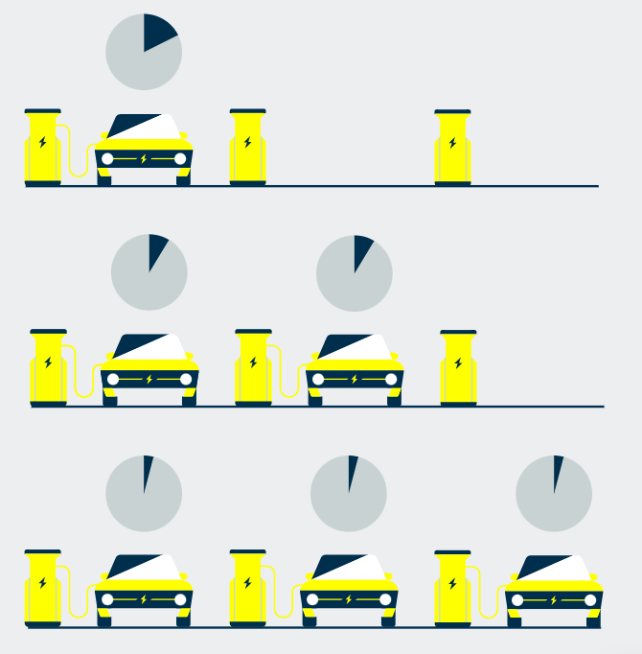
Automated Load Management/EV Energy Management Systems
Limits the charging site capacity to a predetermined level, reducing the size of the required connection
When a station’s total nameplate load would otherwise exceed the rated capacity of the customer connection
Benefits of ALM:
Reduce the need for (and costs of) make-ready infrastructure on both sides of the meter
Allow for charger deployment at locations with physical limitations
Stretch investment dollars further in support of transportation electrification goals
Image source: Virta. https://www.virta.global/blog/what-is-dynamic-load-management

Slide 6
Supporting EV EMS/ALM Deployment
Allow for the use of ALM to avoid upgrades under line extension policies
Adding on-site storage to a maximum charging capacity reduces required connection size by the storage capacity
Include ALM in customer education and outreach efforts
Ensure potential site hosts are informed about ALM
Incorporate ALM into site assessment process
Evaluate each site to determine suitability for and potential ratepayer benefits of ALM
Incentivize customers installing charging infrastructure to adopt ALM
Exposure to customer- and utility-side make-ready costs

Slide 7
Best Practices in Load Management Implementation
A robust load management plan must accompany any ratepayer-funded EV charging investments
Avoid over-building and over-spending
Provide diverse load management offerings
Including active and passive managed charging and EV EMS/ALM
Ensure that utility has process for iterating on LM plans rapidly
Not just in a rate case
Demonstrate to regulators how load management offerings integrate with distribution system planning processes
Importance of load forecasting
Notes:
(e.g., New York VGI Working Group, Connecticut Managed Charging Working Group)

Slide 8
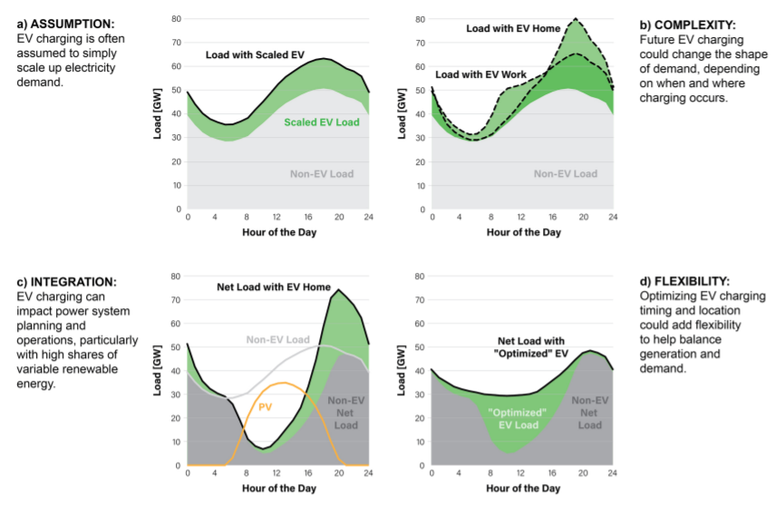
Implications for Distributed System Planning
Which load profile is the utility assuming for distributed system planning?
Figure source: National Renewable Energy Laboratory. https://www.nrel.gov/docs/fy21osti/73762.pdf

Slide 10
Networked EVSE and Vehicle Telematics
Direct load control can be done by networked EVSE and/or vehicle telematics
Programs should be tech-agnostic to maximize customer eligibility and enrollment
Networked EVSE and/or vehicle telematics can also serve as submeters for EV charging
Using the metering capability of smart chargers in lieu of a separate meter
Technology | Benefits
Networked EVSE | Allow some older vehicle models without telematics functionality to participate Suitable for charging sites with many users (e.g., public & workplace chargers)
Vehicle telematics | Functionality already embedded in vehicle Allow drivers without a dedicated charger/parking space to participate Allow drivers with L1 chargers or non-networked L2 chargers to participate

Slide 11
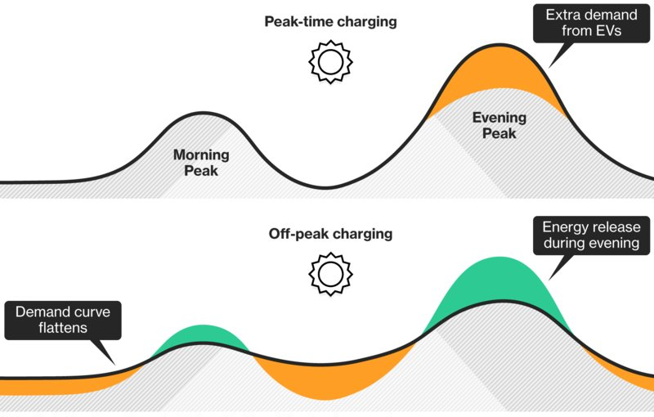
Benefits of Managed Charging
With 1.5 million EVs in California by 2025:
Unidirectional managed charging can provide an equivalent of 1 GW/2.9 GWh of stationary storage capacity, avoiding up to $1.75 billion in capital investments
Bidirectional managed charging can provide an equivalent of 5 GW/30 GWh of stationary storage capacity, avoiding up to $15.4 billion in capital investments
Data: Lawrence Berkeley National Laboratory. https://www.researchgate.net/publication/325164093_Clean_vehicles_as_an_enabler_for_a_clean_electricity_grid.
Image: Bloomberg. https://www.bloomberg.com/news/articles/2018-02-25/why-charging-your-electric-car-at-night-could-save-the-world

