Slide 1

Presenters:
Richard Berkley (he/him)
https://linktr.ee/pulpny
Follow us @utilityproject on social media!
Email: info@utilityproject.org
Hotline: (877) 669-2572
Fax: (877) 669-2572
USPS Mail: 194 Washington Ave.
Suite 320
Albany, NY 12210

Slide 2
What we will talk about today:
NYS Arrears & Data
NYS Energy Burdens & Data
Solving NY’s Arrears Crisis with Data

Slide 3
NY’s Energy Utility Consumer Arrears Crisis
NY’s energy utilities have been required to report their monthly collections details – residential & business customer arrears, accounts eligible for termination, amounts of arrears, etc. – since 1991
  (See next slide)
No other utilities have been required to report arrears/collections whether they are jurisdictional or not
  An exception may begin this year; see A.7554/S.5454 “data collection”
PULP began using the collections reports (aka CARS reports) in Feb/2020 to focus attention at the PSC/Legislature on the crisis

Slide 4
PULP Monthly Arrears Report

Slide 5
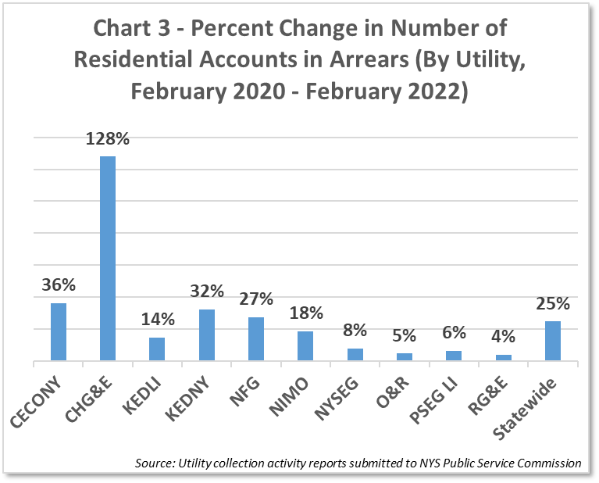
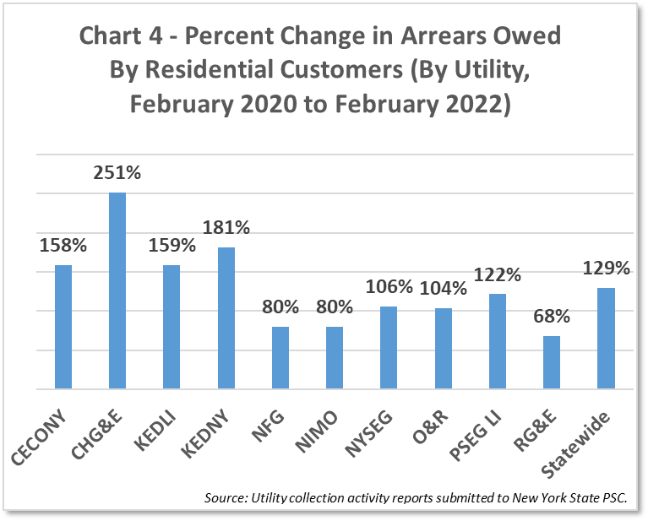
PULP Arrears Report pg. 2

Slide 6
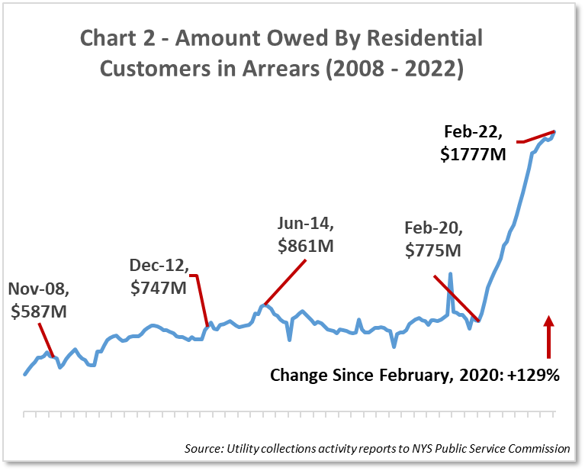
PULP Arrears Report pg 2b

Slide 7
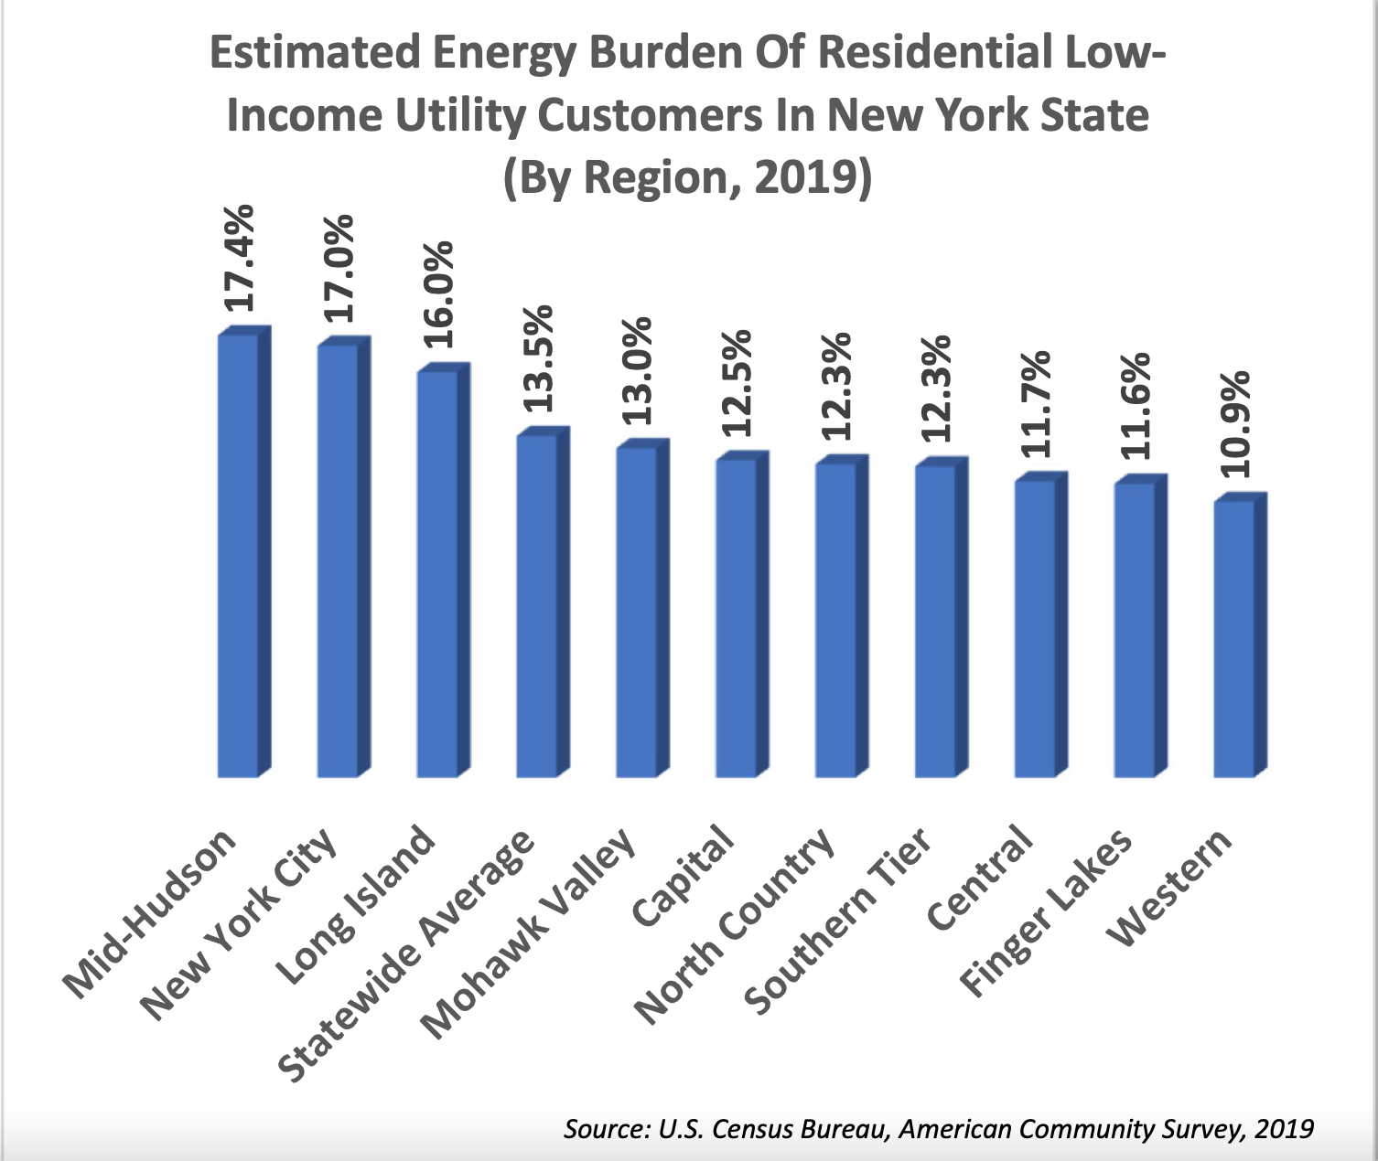
Energy Burden via Census ACS PUMA data

Slide 8
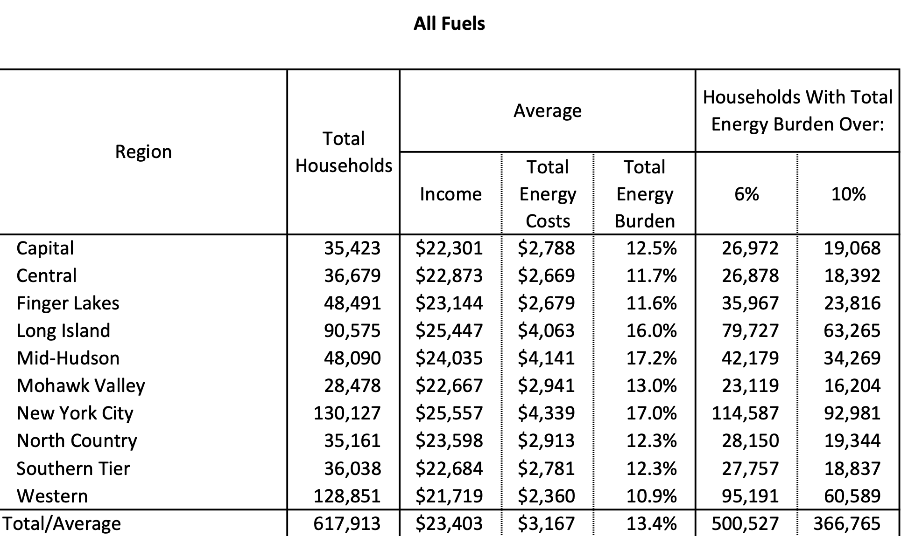
Energy Burdens All Fuels – Low Income

Slide 9
COVID-19 RELATED FINANCIAL ASSISTANCE PROGRAMS
Emergency Rental Assistance Program (“ERAP”)– federal funding has been received to help provide rent and utility relief
  Note: money is in the Senate One-House to re-fund ERAP
The Regular Arrears Supplemental Benefit (“RAS”) –up to $10,000 in electric or gas utility arrears relief through HRA.
  Applications closed on March 15, 2022, but we will keep an eye out for a second round!

Slide 10
Cases 20-M-0266 & 14-M-0565
With allies (AARP & NYC), PULP was able to get a reform order in the NYS Low-Income Affordability Program, now called the EAP
To resolve the arrears crisis, PULP was able to push for an open stakeholder workgroup to study and create an arrears resolution plan & program; a report was issued in May 2022
  An implementation order will be issued Thursday, June 14, 2022
What we found was that normal CARS data was not sufficient to put together an arrears resolution plan; also, AMPs were not possible in the short term (see, Central Hudson I.T. crisis, etc.)

Slide 11
Arrears Resolution Plan: High Level
The plan will proceed in two phases: phase I will retire/payoff all low-income program participant arrears to $0, not just incremental arrears
Phase II will payoff all low-/fixed-/moderate-income residential consumers and “small business” consumers to $0
Note: this includes the $700+ million in Pre-Covid arrears
Phase II should complete by end of 2022; PULP wanted Oct 1.
More to Come…

