Slide 1


The Coming GETs Transition and Fun Tidbits from across the Pond
NASUCA Mid Year Meeting I June 14, 2022

Slide 2













We help optimizing the power grid through easily deployable sensors and software
Established 2016
Norwegian based, 38 employees
ISO 9001, 14001, 27001
Installations in 9 European countries (TSO&DSO)
“If you cannot measure it, you cannot improve it”
Notes:
As a side step, For those of you who are not familiar with us as a company,; Heimdall Power is a technology and service provider helping grid compaines optimize their operations and use of current infrastructure. We do this both using proprietary IOT sensors and software solutions.
As we all know – a key to optimalization is measurability – and DLR is very much a key enabler in this respect, as it allows to monitor and measure the true capacity of the lines, and to monitor and measure the effects from incremental design changes you do in the grid along the way. So DLR is very much a helpful tool to grid optimization.
We are seeing much traction in the market for our solutions and we are currently involved in projects in 9 different European countries.

Slide 3


Part of a Broader Community of Innovators

Slide 4









The power grid faces 21st century problems
Current challenges for the power grid
Why is this an issue?
The grid operators have limited real-time data from the lines about:
Increasing failures and costly identification
Line capacity
Line
faults
Extreme weather
Failures
Assets are underutilized, creating artificial capacity constraints
Renewables
Fluctuations
Line condition
Line forecast
Congestions and bottlenecks in the grid as a result of more complex systems and electrification of society
Electrification
Bottlenecks
HEIMDALL POWER | 4

Slide 5
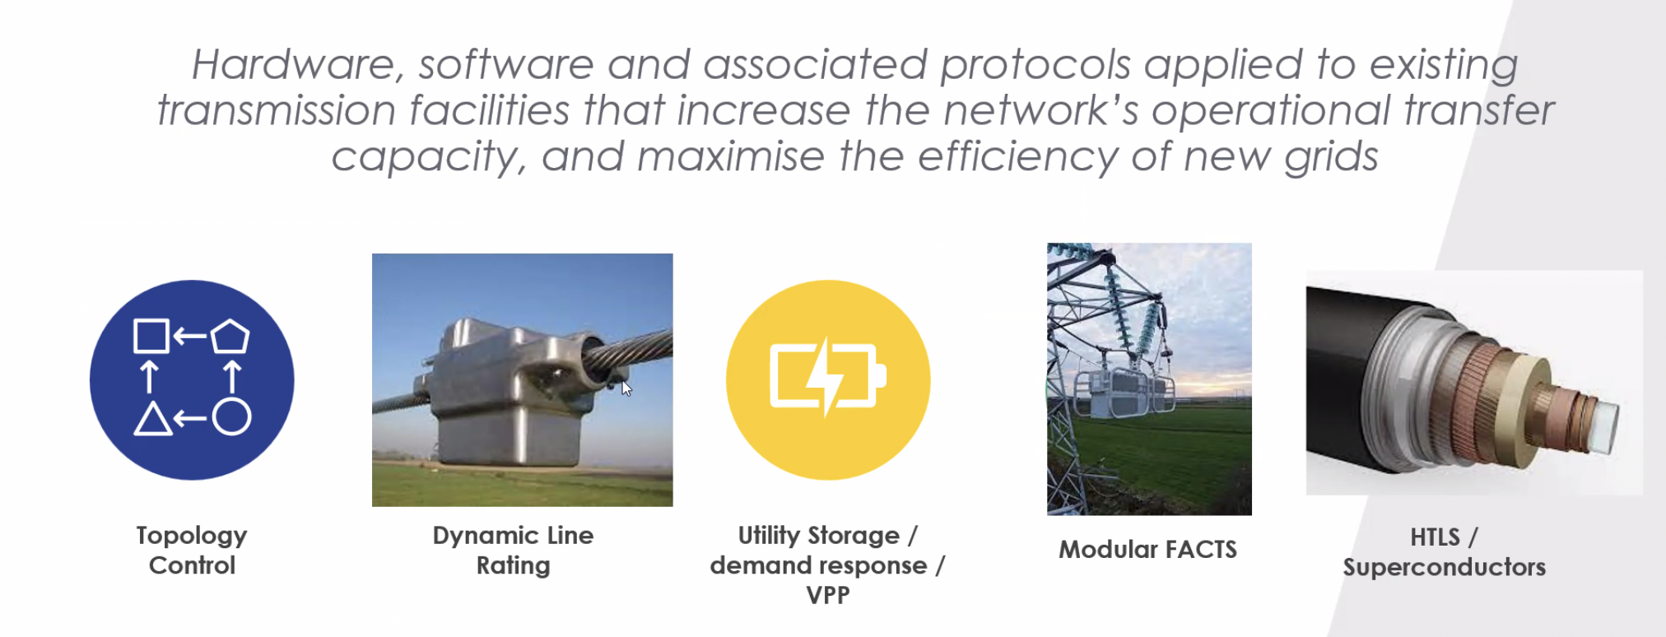
Grid Enhancing Technologies (GETs)

Slide 6
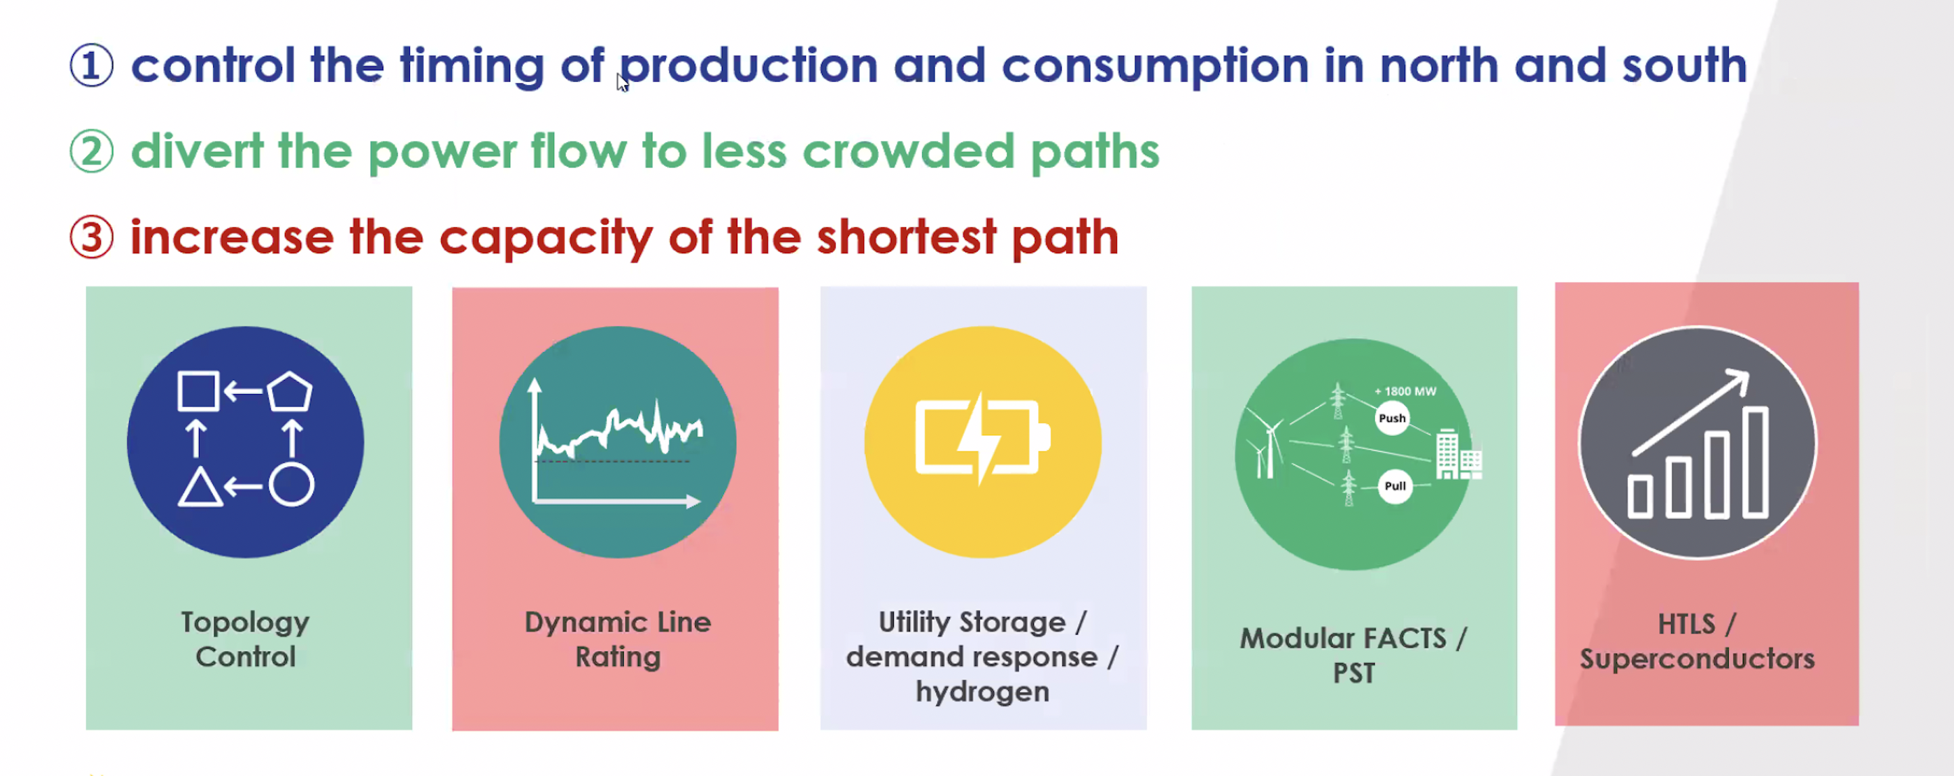

But what can GETs actually do?

Slide 7
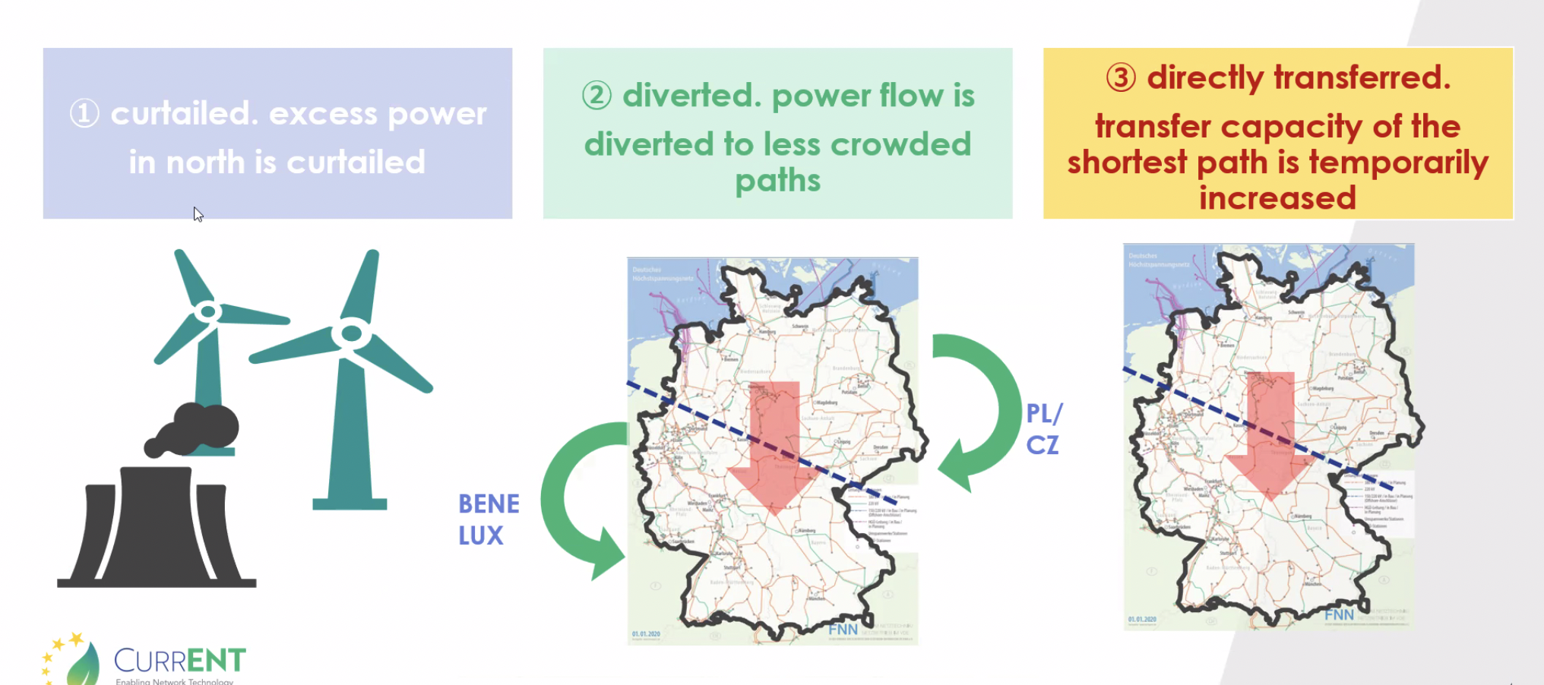

Nice theory, but what does it look like?

Slide 8
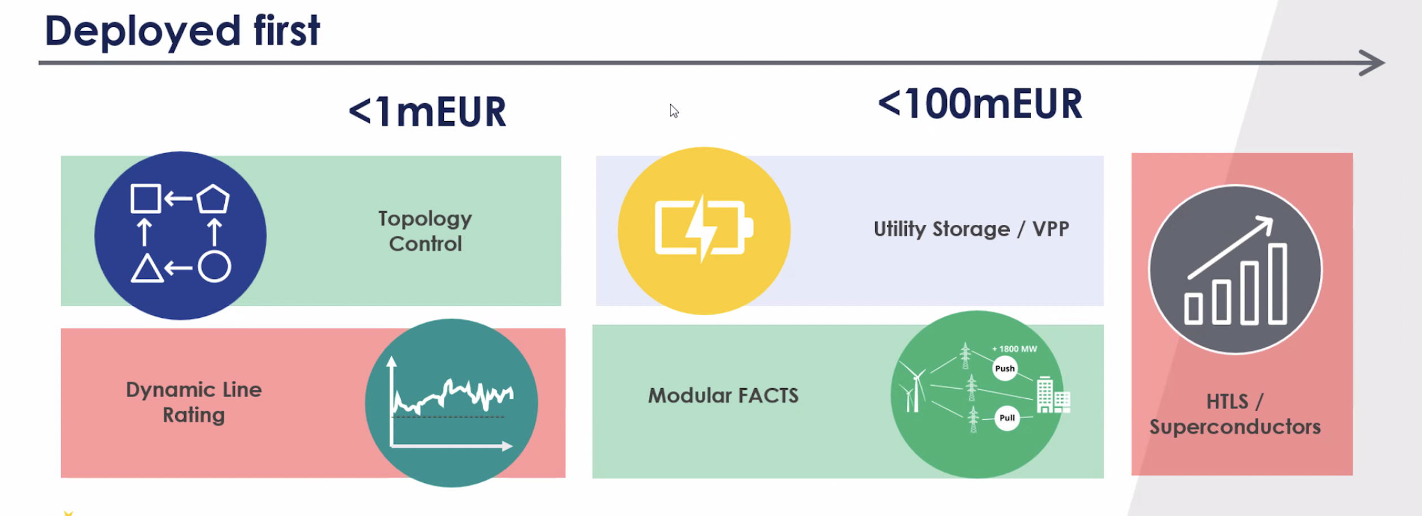
Priorities, priorities . . .

Slide 9
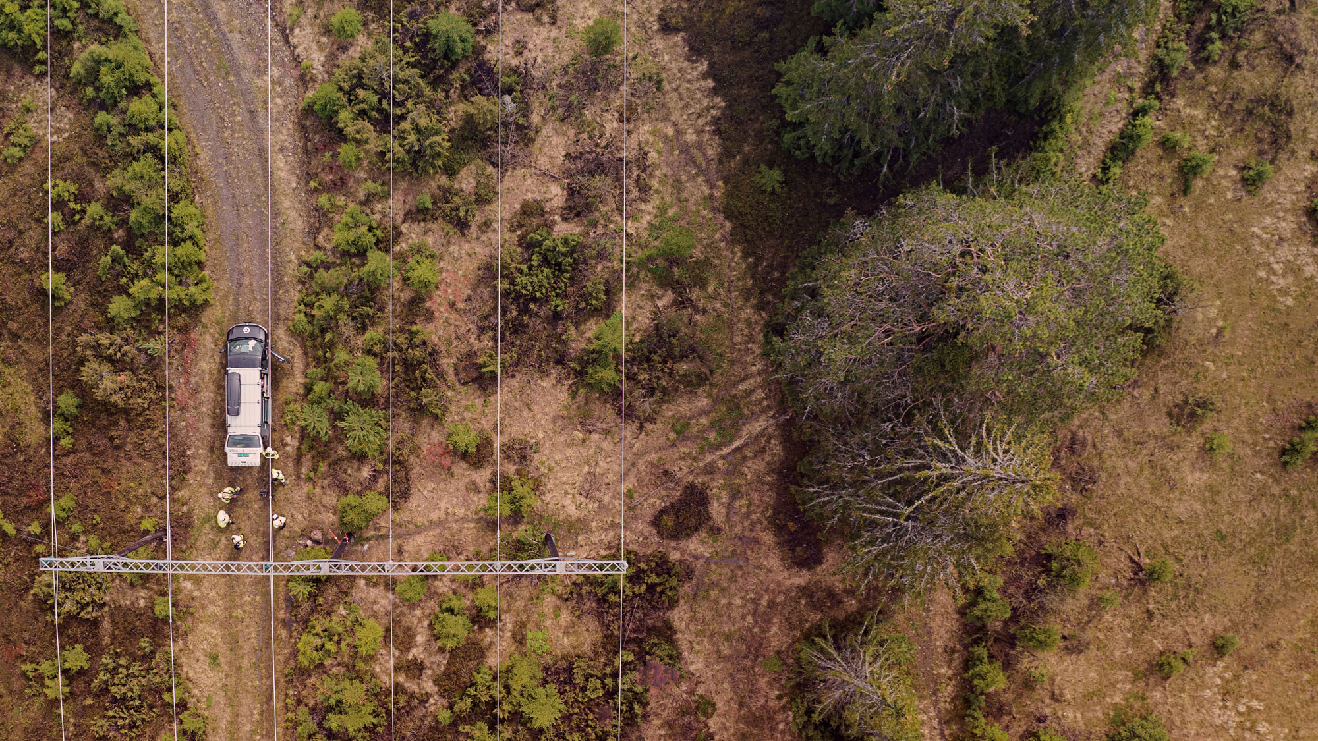
Our experience – DLR can
increase grid capacity by
33%

Slide 10
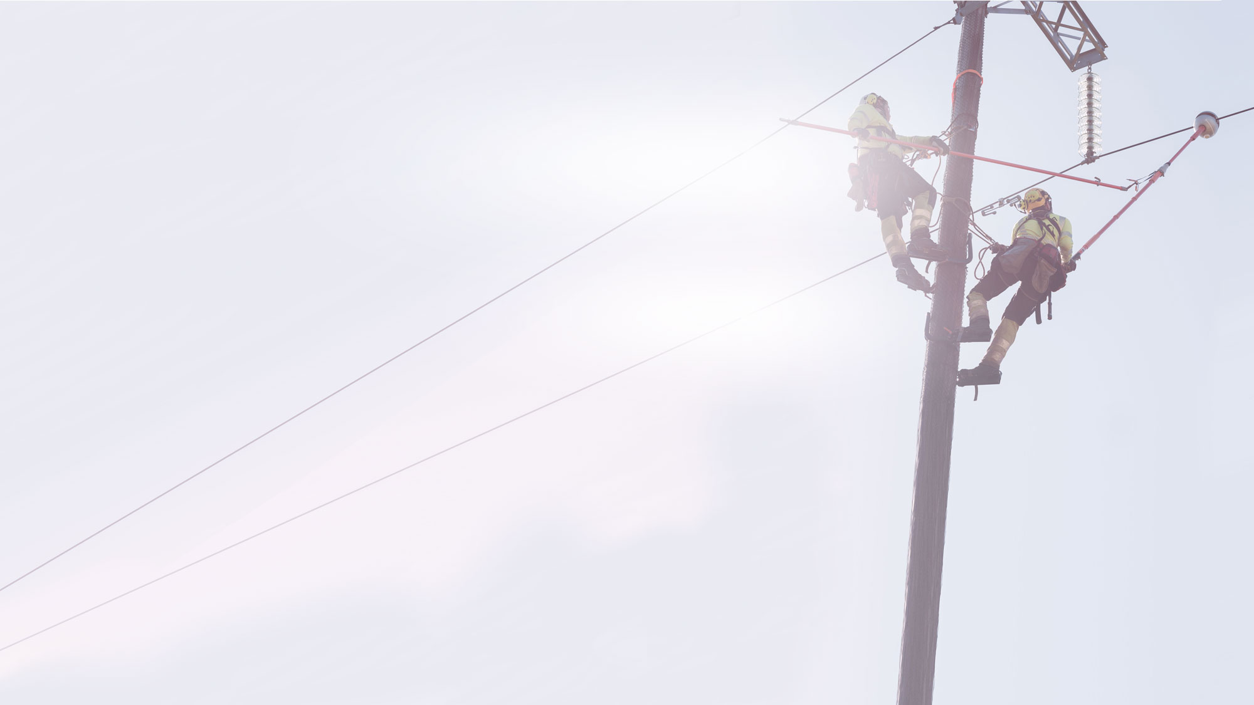
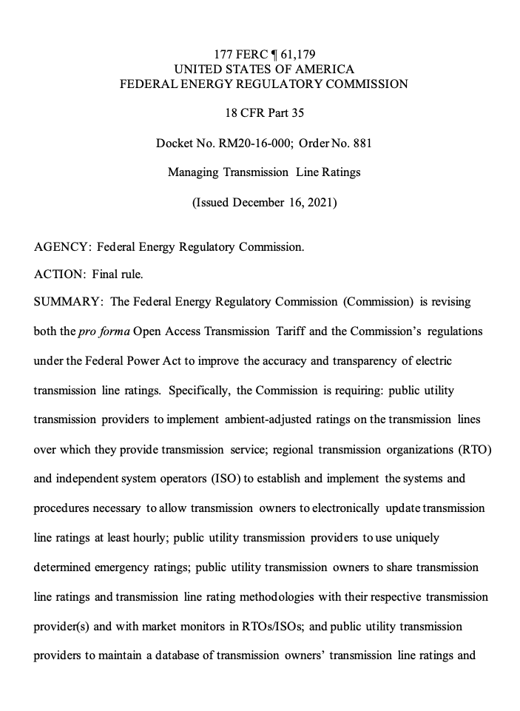
FERC Order No. 881
“
…Specifically, the Commission is requiring: public utility transmission providers to implement ambient-adjusted ratings on the transmission lines over which they provide transmission service; regional transmission organizations (RTO) and independent system operators (ISO) to establish and implement the systems and procedures necessary to allow transmission owners to electronically update transmission line ratings at least hourly…
”
Source: https://www.ferc.gov/media/e-1-rm20-16-000

Slide 11
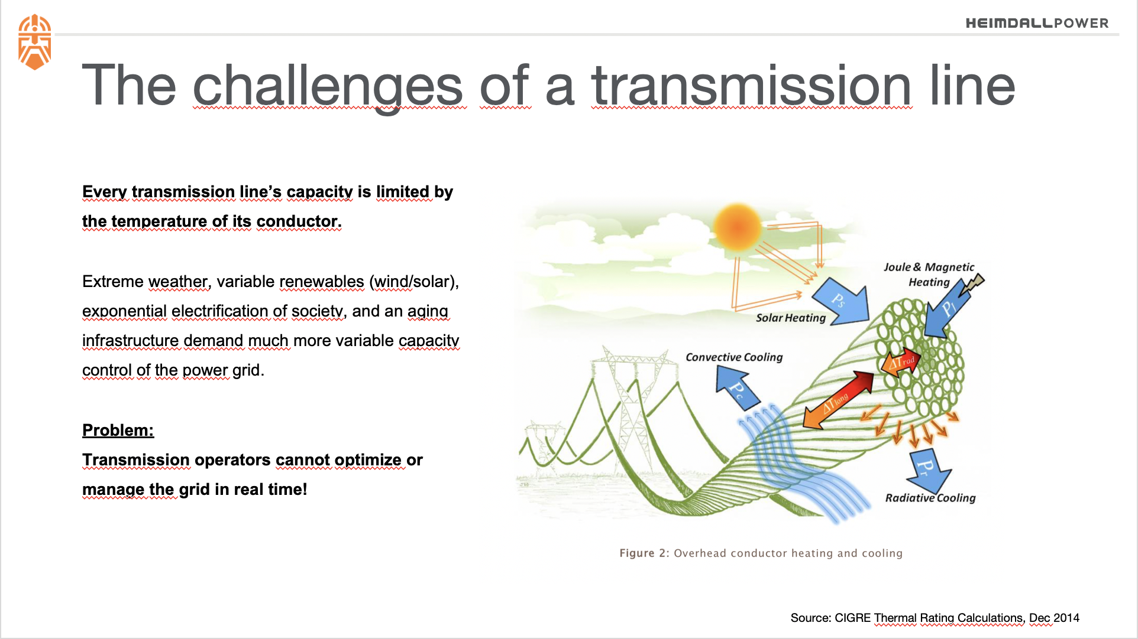

Slide 12
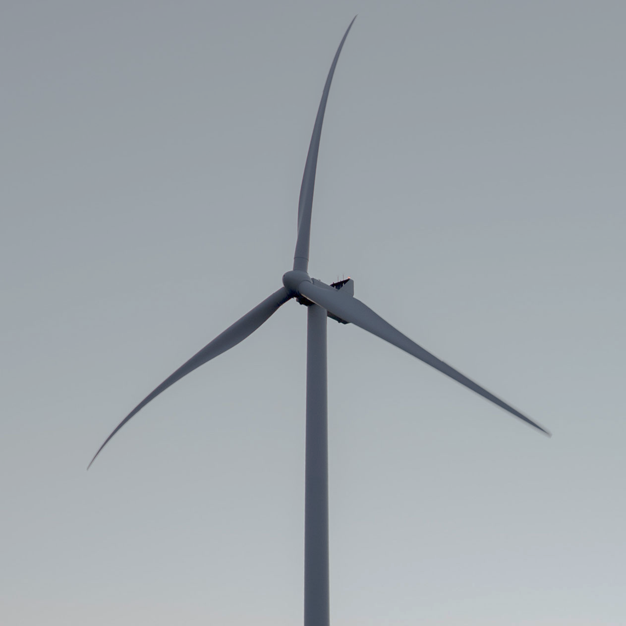
Knowing the true grid capacity is a gamechanger
Capacity Challenges
Sensor
based Dynamic Line Rating (DLR)
Weather Station
based Dynamic Line Rating (DLR)
Ambient
Adjusted Rating (AAR)
Seasonal
Line Rating (SLR)
Static
Line Rating
(SLR)
Considers actual line temperature
Maximum capacity
Line safety with real-time measurements and alerts
Reliability ensured with complete asset visibility
Considers air temperature cooling
Limited capacity increase
Operational risk from assumptions
Considers local weather, but no measurement of actual impact on power line
Limited capacity increase
Risk mitigation for model assumptions
Field verification with advanced monitor
Considers seasonal worst case
Unused capacity
Lack of any asset visibility
Considers worst case: least cooling
Unused capacity
Lack of any asset visibility
HEIMDALL POWER | 12
Notes:
HARDWARE
A unique low-cost sensor-package called Heimdall Neuron
Diverse set of sensors such as temperature, inclination, power
No need for battery, gets energy from magnetic field
Fast, safe and solid installation method. Can be installed on live wires
Communication module supports LoRa, NB IoT and node-to-node
SOFTWARE
A secure cloudbased software called the Heimdall brain
APIs for other systems such as Scada and ADMS
New insightful ways of visualizing the grid
Artificial intelligence and machine learning methods to manage and study the grid
PROCESS
A digitized electric grid enables new work processes and value creation
Day to day operations
Maintenance process
Investment process
Energy trade

Slide 13

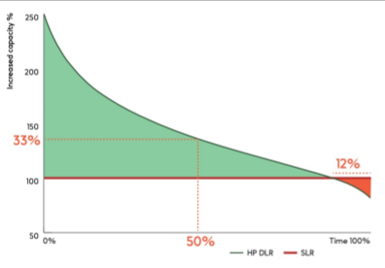
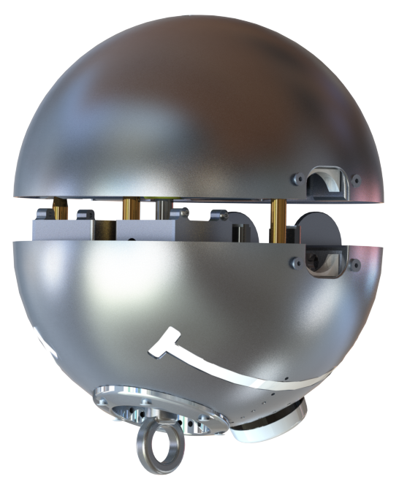
Knowing the true grid capacity is a gamechanger
Capacity Challenges
SENSORS AND SOFTWARE
USE GRIDS MORE ... BUT SOMETIMES LESS
REALISE EFFICIENCY GAINS
Less congestion:
30% more grid capacity available to the market
Risk with Static Line Rating
Increased safety:
unknown periods of high operational risk will be identified
the Power of Knowing: a substantial contribution to the energy transition
HEIMDALL POWER | 13

Slide 14
Modern sensor and communications platforms
The Heimdall Neuron in brief
Heimdall Neuron is an advanced monitoring device for high voltage power lines that leverages various sensor technologies and a patented system design.
Years of R&D – and testing through Norwegian winters – have culminated in a device that is self-sustained and robust.
Communication over multiple wireless IoT Network Protocols to cover even the most remote locations.
Engineered to be installed safely and quickly on live power lines.
KEY FEATURES
Sensor “fusion”
Power harvesting
Redundant communication
Easy to install
No maintenance
PRODUCTS

Slide 15
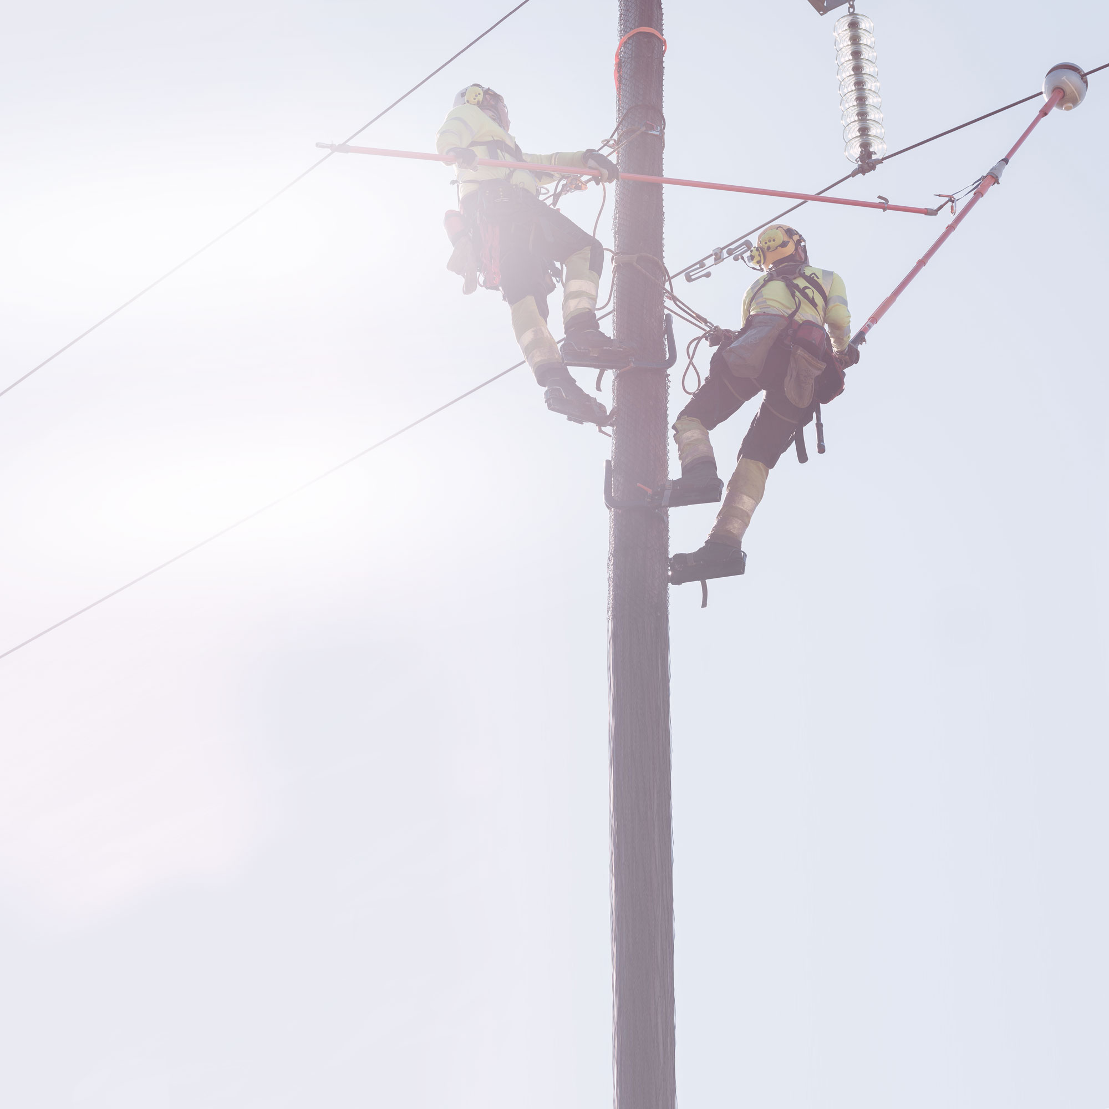
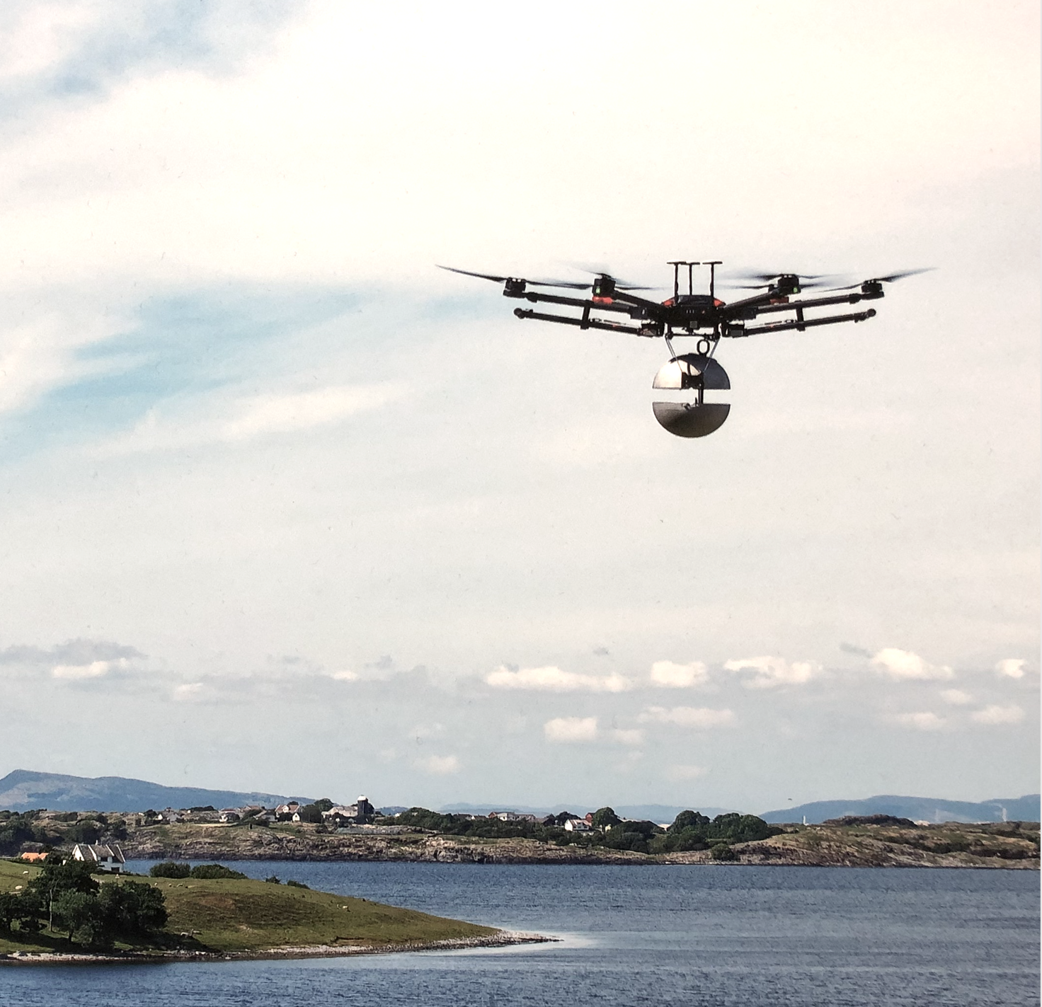
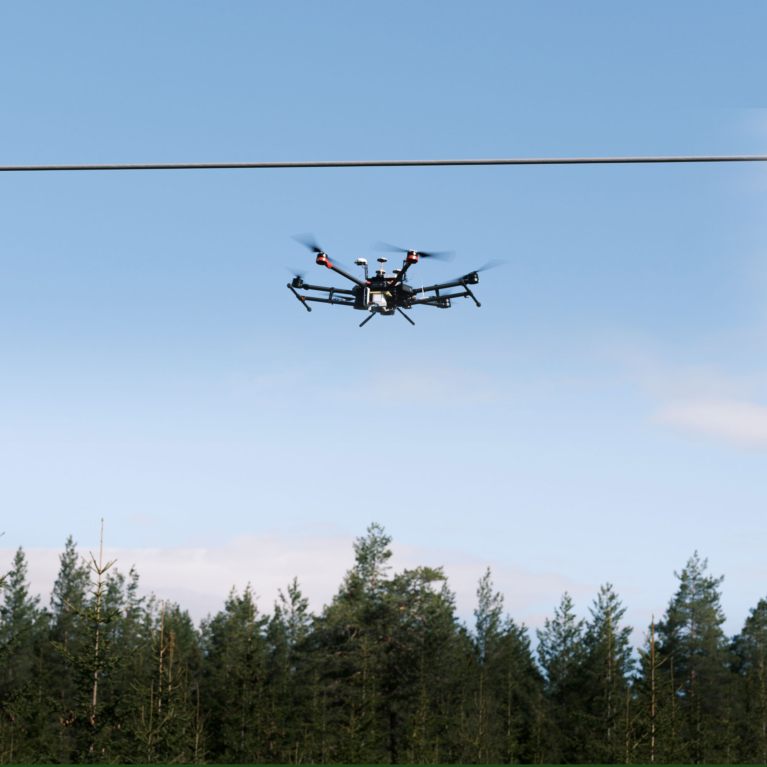
Engineered for easy, large scale deployment
“
Autonomous drone installation
on powered lines from Q2 2022.
Patent pending.
From when I received the Neuron, it took me less than 5 minutes to install it on the wire. It will be easy to install lots of these.
T.A. Midtlie, Elvia (largest distribution operator in Norway)

Slide 16
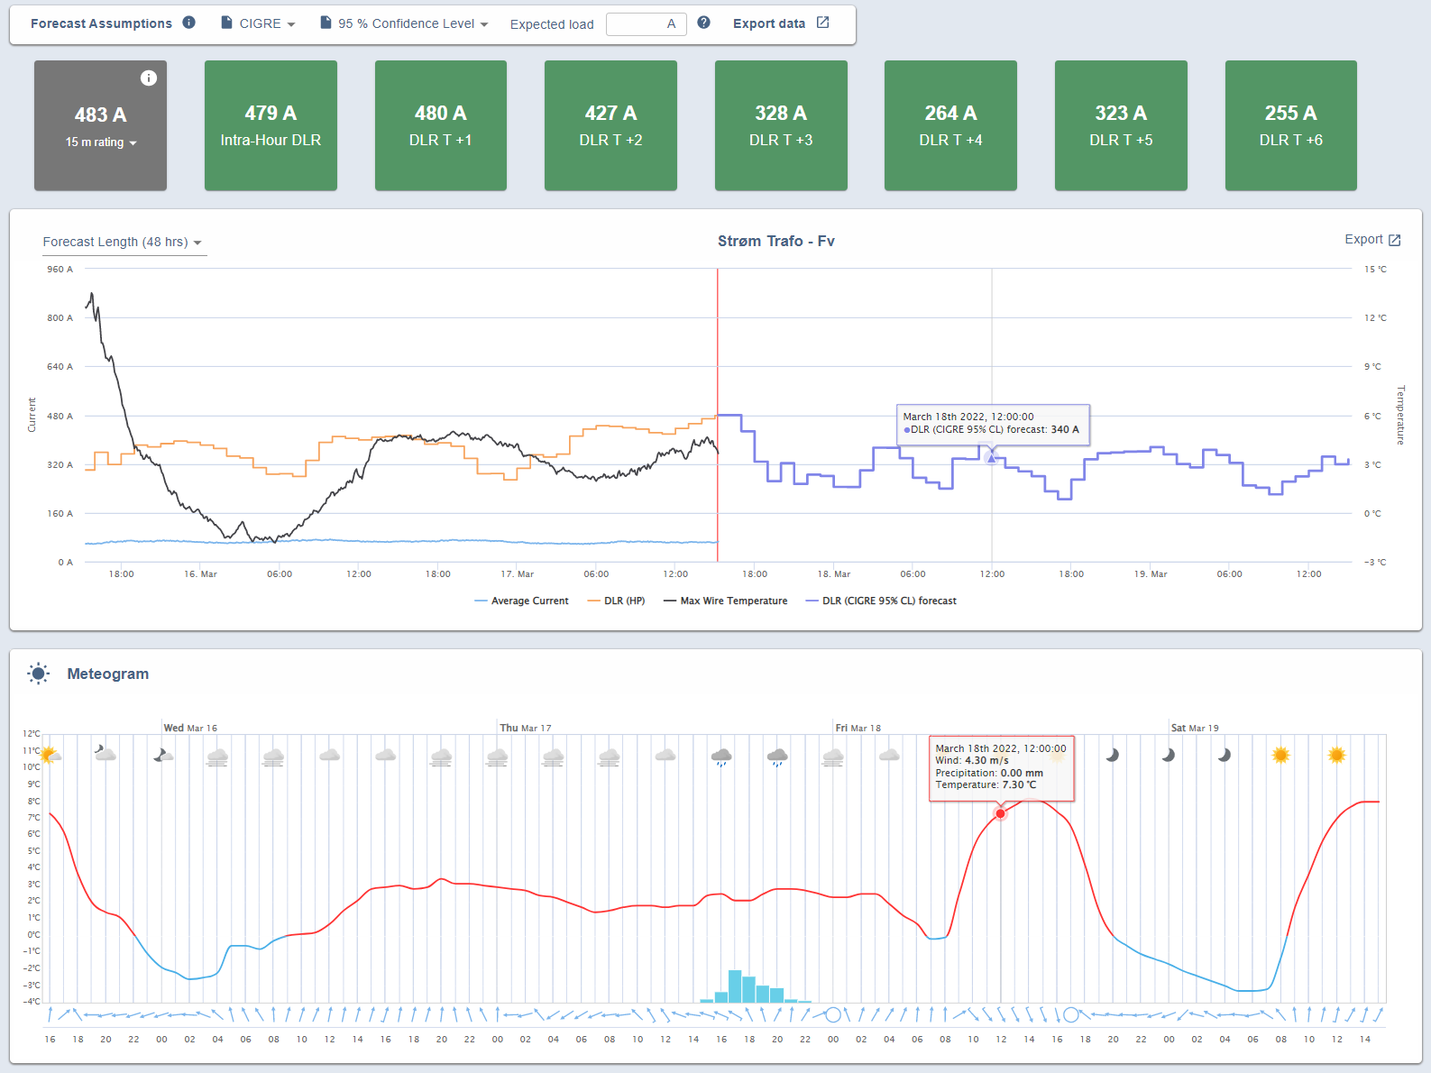
In combination with software solutions
Real time data of actual line temperature
Real time clearance for critical spans
Actual current on the line
Current capacity of the line
Future predicted capacity – up to 48 hrs
N – 1 monitoring & preparedness
Emergency Rating
Thermal predictions
Alarms and Alerts
Aggregated data & reports
Notes:
As the main operational pain points for the DSO and the TSO in this particular grid is related to:
Determining the actual true capacity of the lines
And in particular related to maintaining N – 1 criteria
I want to spend some minutes to highlight how we in particular will apporach those challenges.

Slide 17
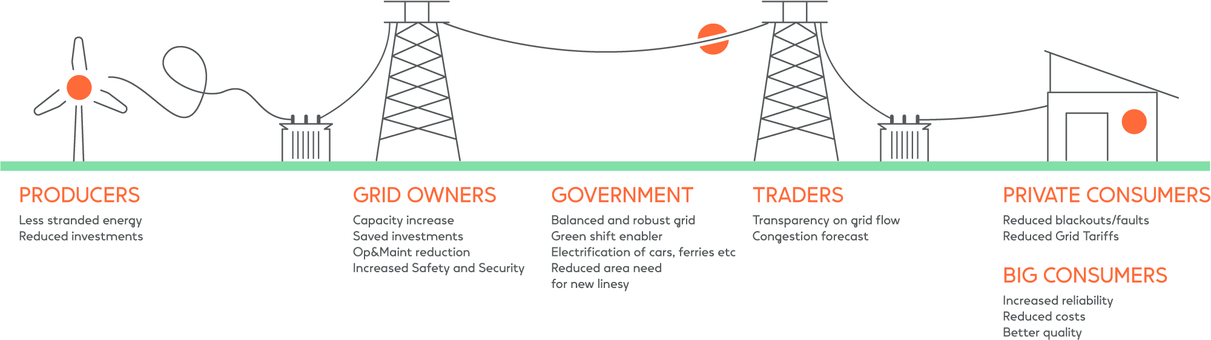
Collecting new insights from the grid will affect us all
BENEFITS

Slide 18
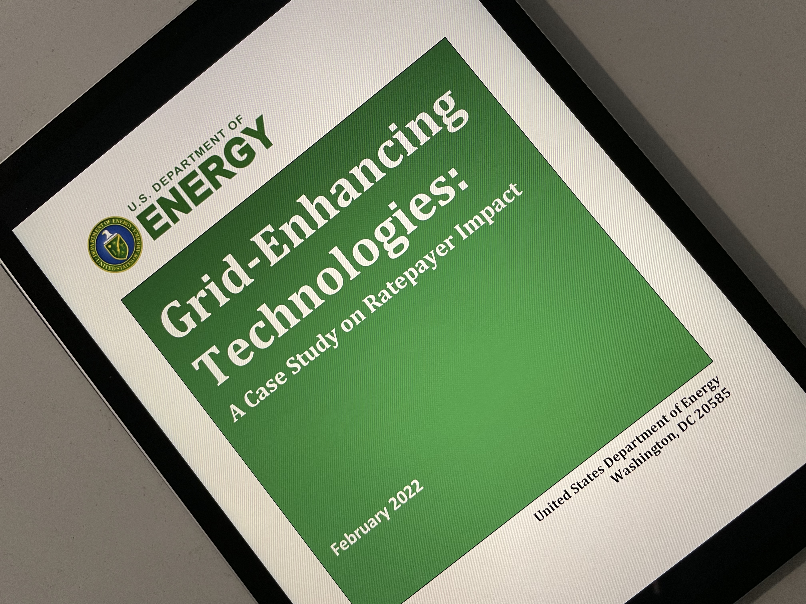
Benefits for Consumers
“The results of this study suggestion that GETs could prove cost-effective across the country in the short-term and remain useful to facilitate the interconnection of future generation resources, while also providing situational awareness and flexibility in the long run.”
https://www.energy.gov/oe/articles/doe-study-shows-maximizing-capabilities-existing-transmission-lines-through-grid

Slide 19



WATT-Brattle study of how renewable deployment can be improved by GETs
BENEFITS OF GETS IN KANSAS AND OKLAHOMA
Dynamic Line Rating (DLR) technology as a major contributor to the study benefits
Heimdall Power leverages the power of digitalization with its highly advanced DLR software and sensors.
2x
$175
6
the renewable energy capacity
annual production cost savings (MILLION)
Paid for in 6 months
POTENTIAL NATIONALWIDE OVER
$5 BILLION
Production cost savings
Source: https://watt-transmission.org/2021/02/22/unlocking-the-queue/
Notes:
2x renewables deployment (in Oklahoma & Kansas from 2.58 to 5.25 GW)

Slide 20
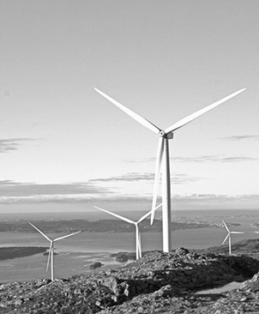
Using true capacity …
Troms in Northern Norway
Windpark
Maximum generation
250 MW
Powerline
Static line rating
190 MW
CHALLENGE
NEED FOR GRID INVESTMENTS
... to connect wind power
9 neurons with software services
Minor grid enhancements
Powerline
True capacity limit
240 MW
SOLUTION
Cost savings
20 MEUR
Implemented in
2 DAYS
Notes:
For instance, for one of the projects, they had a very common problem at hand, and a problem well suited for DLR applications, [klikk] they had a request from a wind power plant to increase the production capacity by 30%. 132 kV
With the information they had about the line, the DSO thought they only had capacity for an additional10 MW and that they had to build new grid infrastructure to accommodate for the plant’s new needs.
[Klikk] However, after using our solution to monitor the actual capacity of the line, they realized that they did in fact have much more capacity available than they thought. The temperatures on different aperage levels were lower than they anticipated – probably due to built in security margins, and after removing some ground on two spans, they could immediately allow for increased production.
In this case their alternative was estimated to cost 20 MEUR and postpone the wind project several years.

Slide 21

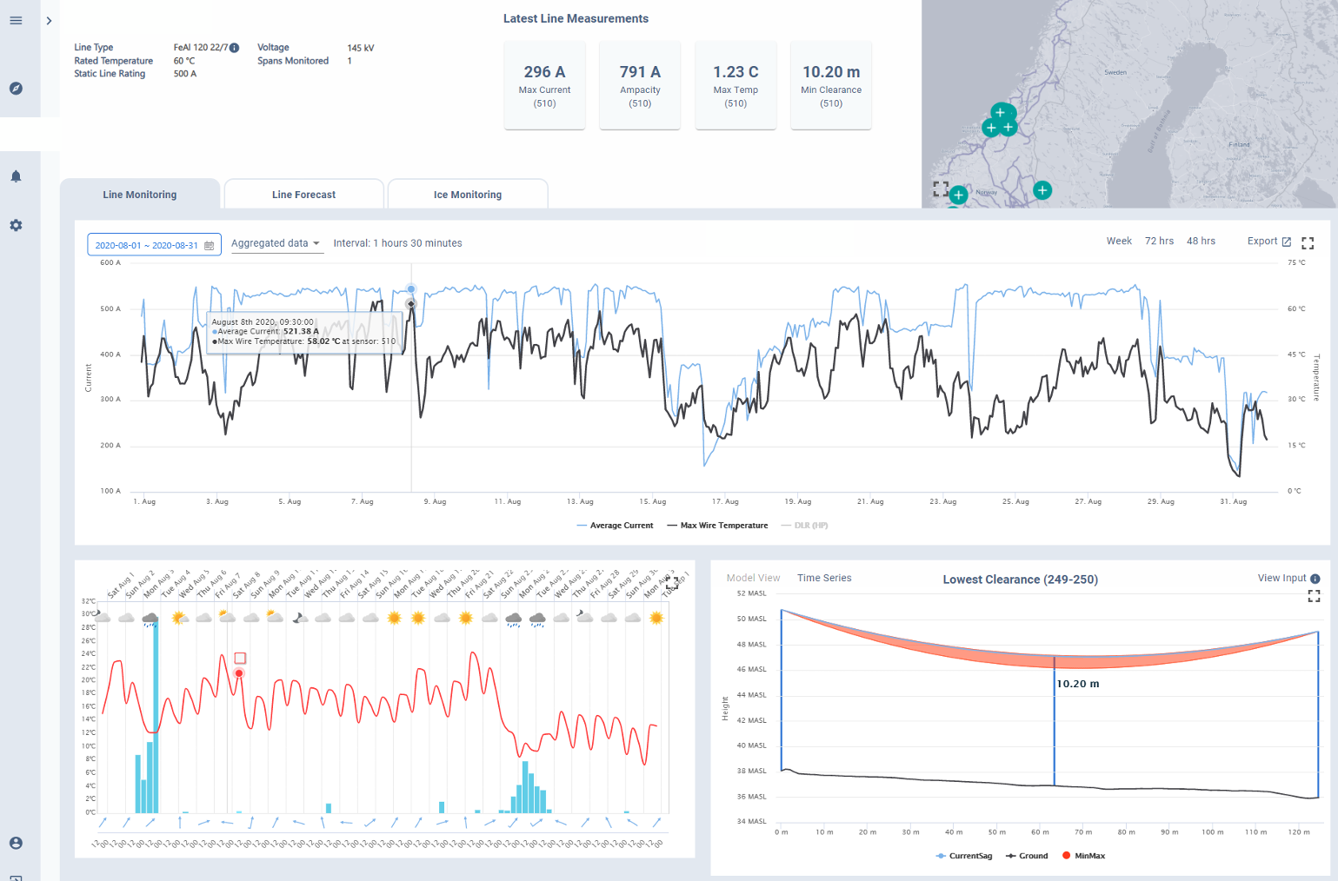
Increasing capacity without grid reinforcement
Capacity Challenges
Business Case
INDUSTRIAL PLANT | THE VALUE OF LINE-TEMPERATURE MONITORING
CHALLENGE
An industrial plant needed to increase capacity by 30 MW. A new line would take 3-5 years
A few spans on the line are critical both due to clearance to ground and temperature limits
SOLUTION
Increasing line temperature from 50 to 60°C was enough to meet the industrial plant’s needs. Instrumenting with neurons gave the DSO control over conductor temp, clearance to ground and load. BENEFIT
Instrumenting made it possible for the DSO to increase temperature limits, and the industrial plant could increase the load by 30 MW without reinforcement of the grid infrastructure
DIGITAL TWINS OF CRITICAL SPANS FOR THE DSO IN HEIMDALL CLOUD
Real-time line temperature monitoring on the most critical span
Forecasting:
How much power can be accepted in 6, 12, 24, 48
hours
Real-time visualization of clearance to ground
HEIMDALL POWER | 21

Slide 22
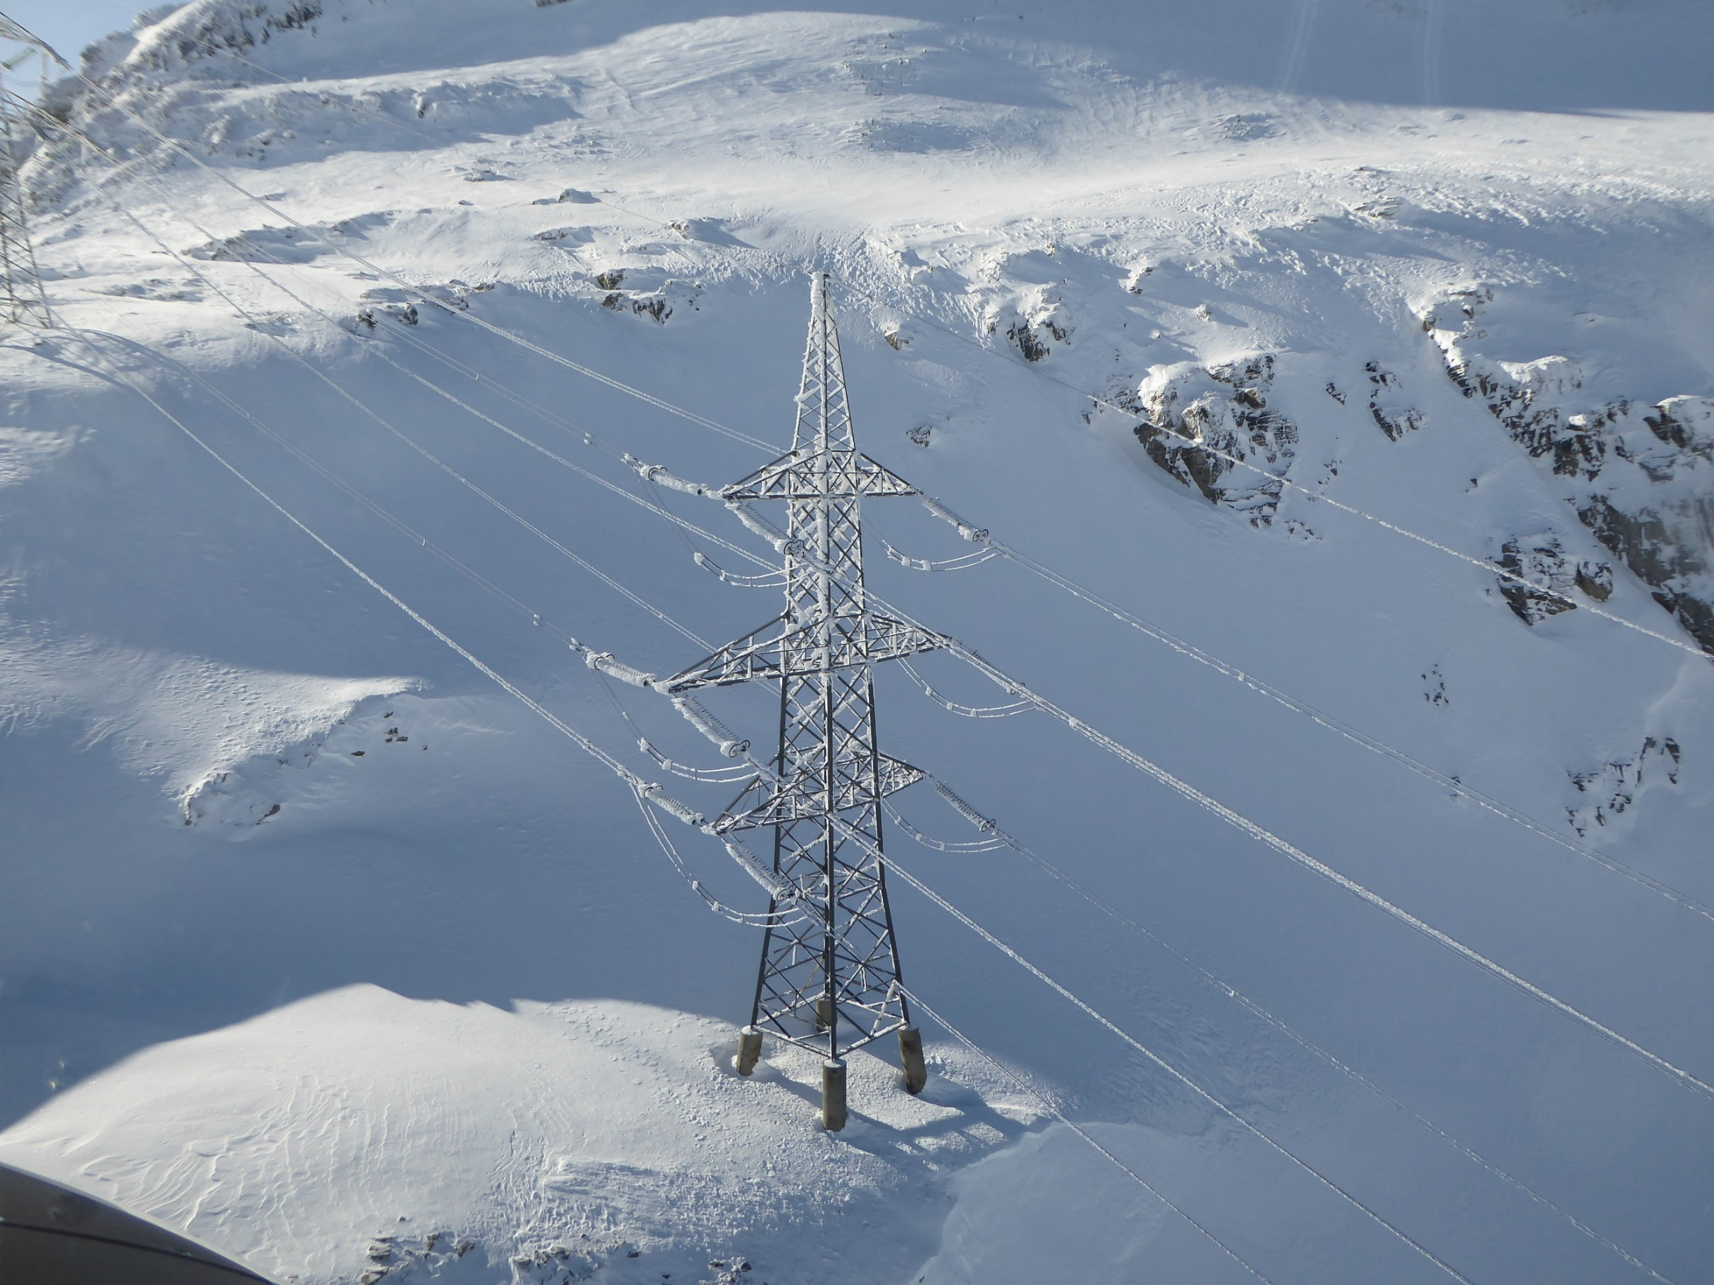
Ice monitoring
Grid Health
Ice
CHALLENGE
Excessive ice loads, typically in conjunction with strong winds damage masts and ultimately lead to failure of power lines. In some cases, also lead to vibrations with extreme amplitude.
SOLUTION
Contract awarded on quality (30%) and price (70%), in global competition with other vendors 110 kV – 420 kV | 50 A →
Conductor diameter: 20 mm - 36 mm Min. detection of ice thickness: 5 mm (2 mm) ice weight: 0.5 kg/m (0.15 kg/m)
BENEFIT #1
Early detection and measurement of ice loads Alarms at the start of icing events BENEFIT #2
1-48 hour forecasting of icing events, so that operational measures can be activated to mitigate risks BENEFIT #3
Gather measured ice load for statistical data analysis
CUSTOMER QUOTE
“The operational people are very convinced by the Heimdall Power solution. The software usability is much better than we’ve seen in competing products. It is so simple and easy to use. We are very happy with your solution!”
Ice Monitoring Programme Lead
HEIMDALL POWER | 22

Slide 23
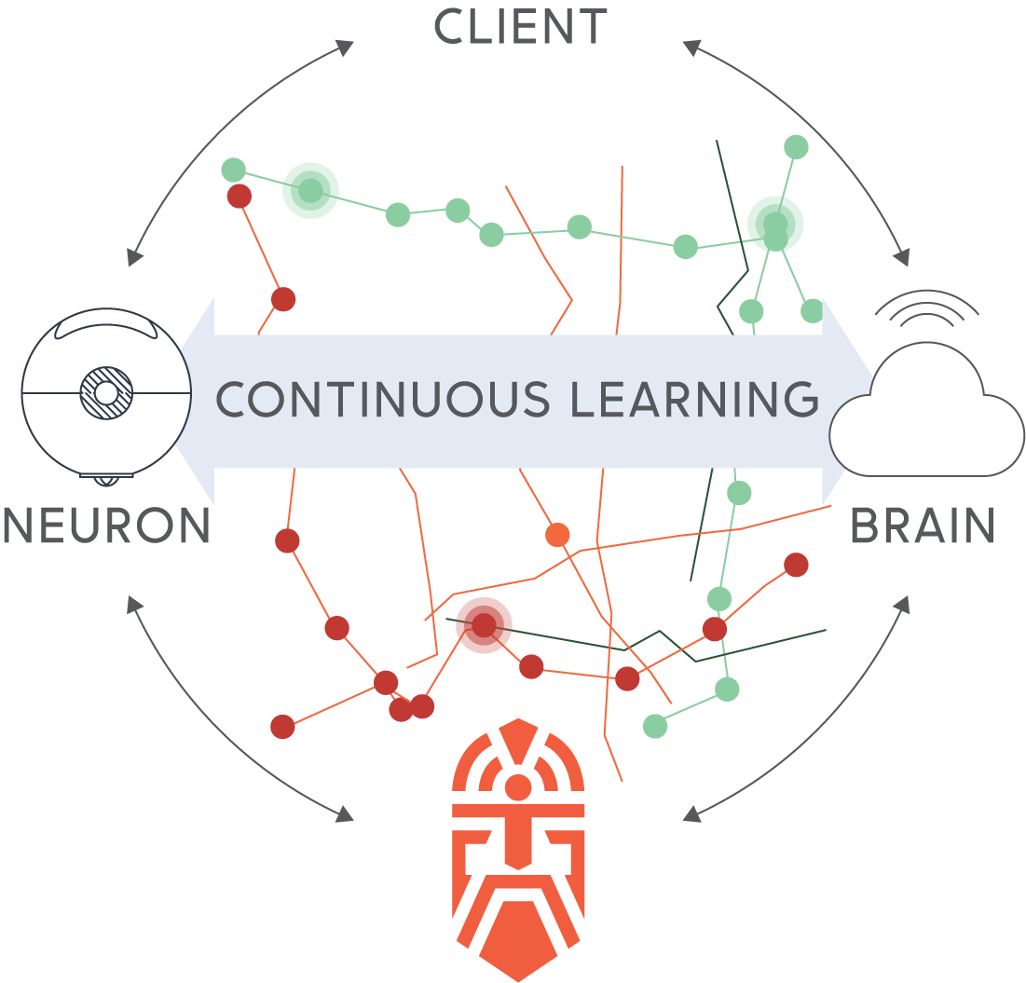
From line to grid perspective
Capacity Challenges
Dynamic Line Rating (DLR)
Dynamic System Rating (DSR)
Heimdall Brain
System-wide approach
A secure software solution
DLR from sensors on critical lines for full control (measuring = knowing)
DLR combining sensors and weather-data to monitor and control less critical lines
Easy-to-install sensors. Combine sensor/software data, machine learning and leading-edge topology optimization to optimize grid from system perspective
Heimdall Neuron
A unique low-cost
sensor unit
HEIMDALL POWER | 23

Slide 24


Enabling a more Autonomous Grid
Autonomous Grid
Rule sets and thresholds defined for most grid scenarios
Direct integration between grid OT systems and RES OT systems
203Z
Heimdall Power
monitoring solution
for OHLs
Piloting
monitoring solutions for OHLs
202Y
Monitoring solutions for underground cables
Monitoring solutions for substations
2022
202X

Slide 25
Thank you
Robert Gordon Mork (robert@heimdallpower.com I 612 424-3851)
heimdallpower.com

