Slide 1
Disparities in energy affordability: Measures, data, and key findings
Prepared for NASUCA Mid-Year Meeting
David Konisky, Lynton K. Caldwell Professor (dkonisky@indiana.edu)
June 14, 2022

Slide 2
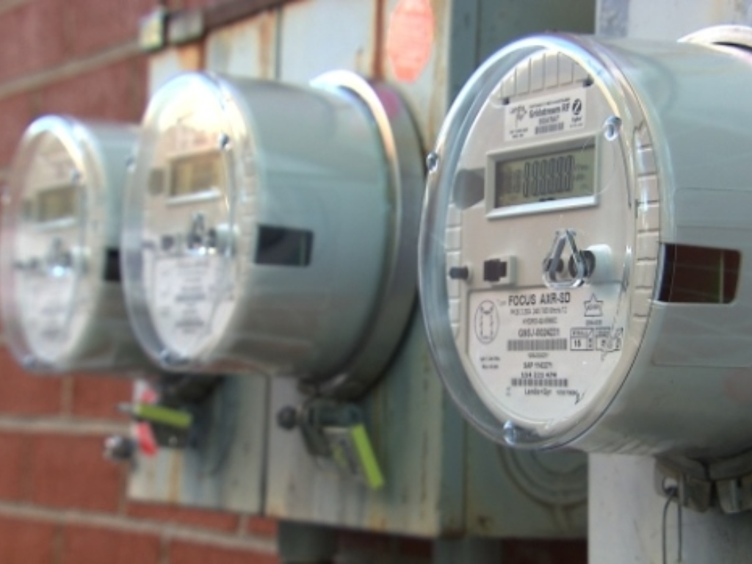
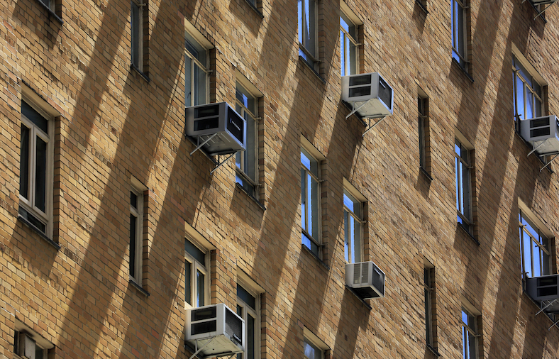
Energy burden
Definition: the percentage of household income spent on energy bills.*
Indicator of energy affordability that can be calibrated to local income.
Generally, households with a 6% energy burden or higher are considered to have a high burden.
*ACEEE, Understanding Energy Affordability

Slide 3
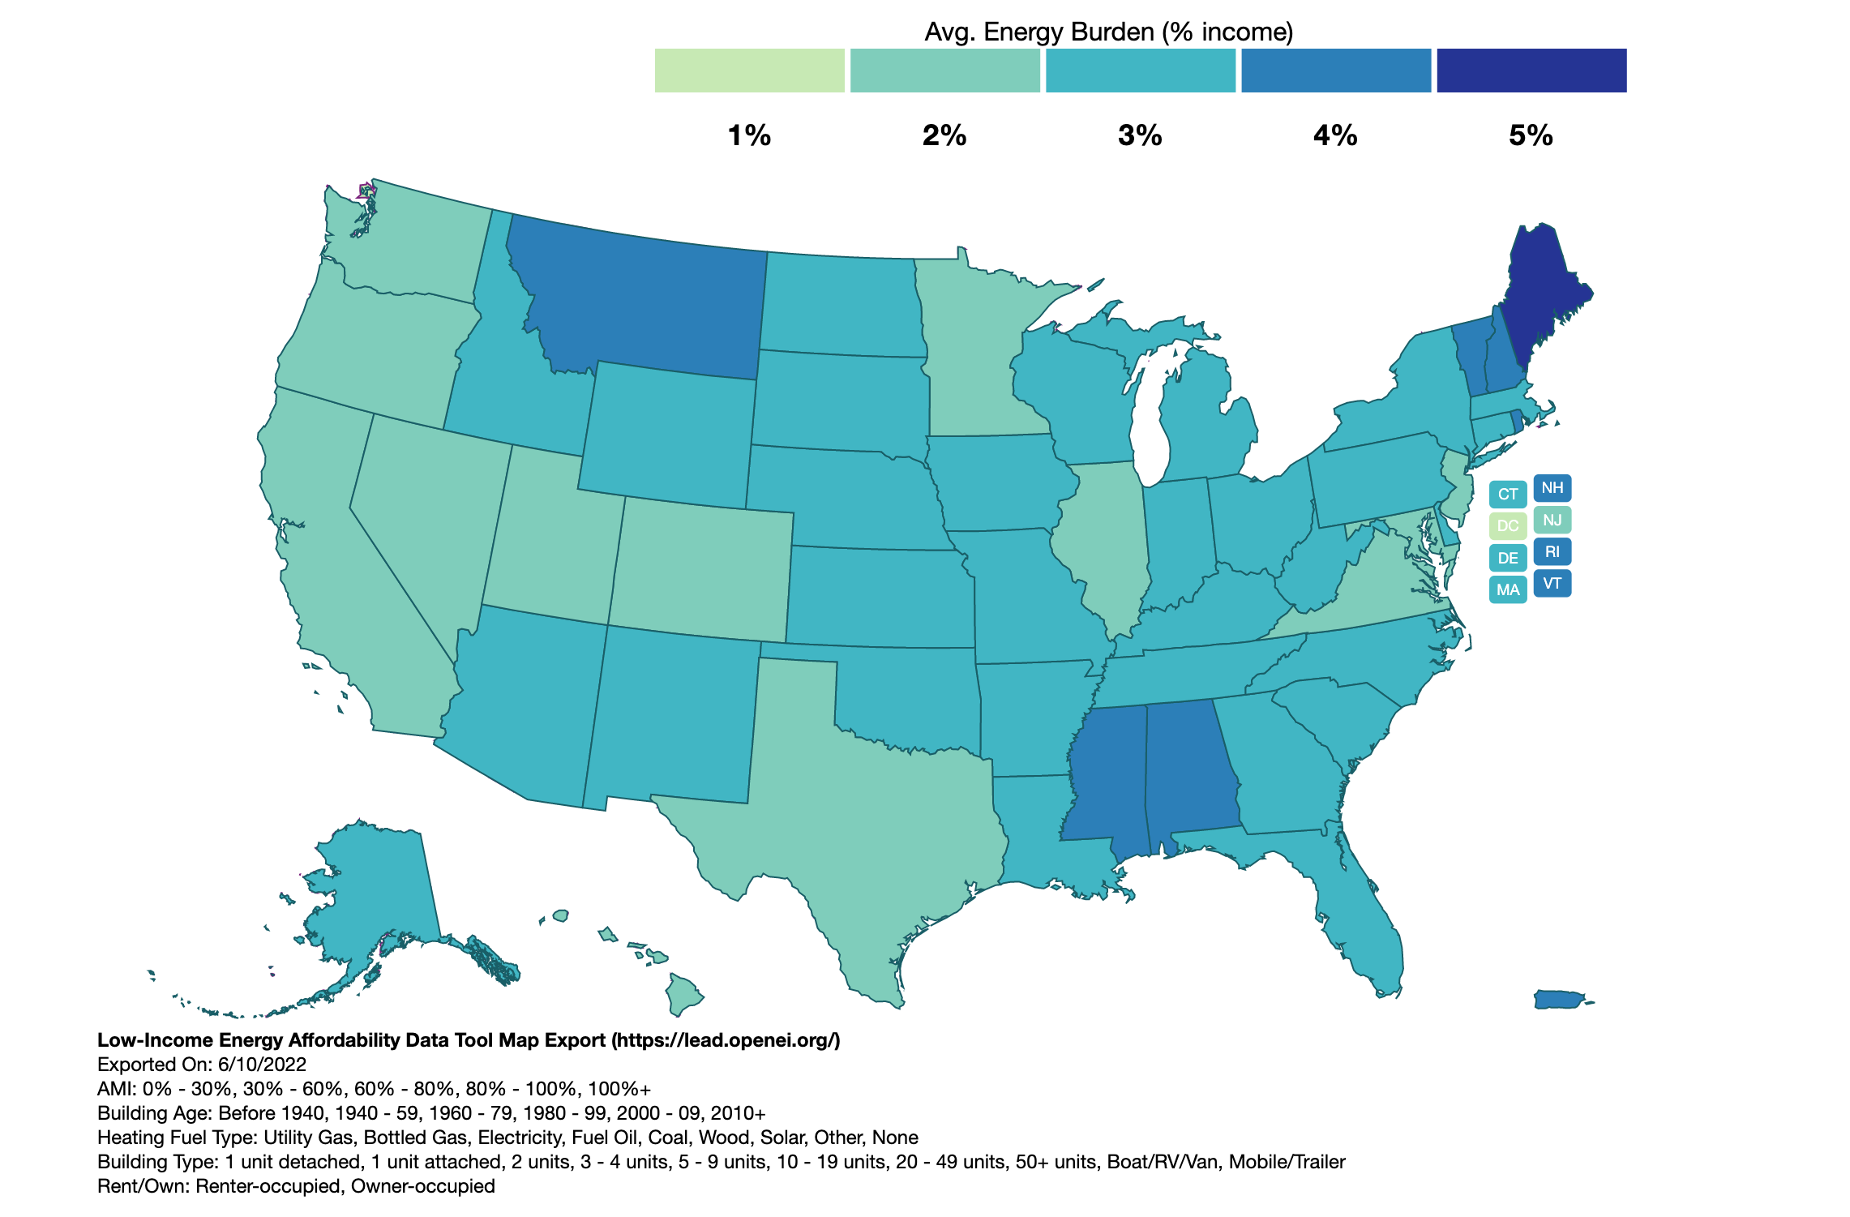
Disparities in energy burden
U.S. DOE, Low-Income Energy Affordability Data (LEAD) Tool
Data by nation, state, counties, cities, and census tracts.

Slide 4
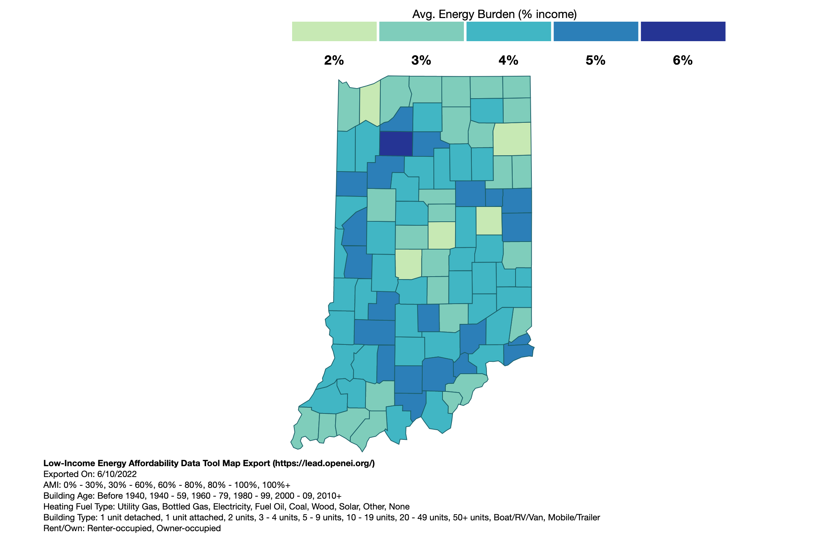
Disparities in energy burden
U.S. DOE, Low-Income Energy Affordability Data (LEAD) Tool
Data by nation, state, counties, cities, and census tracts.

Slide 5
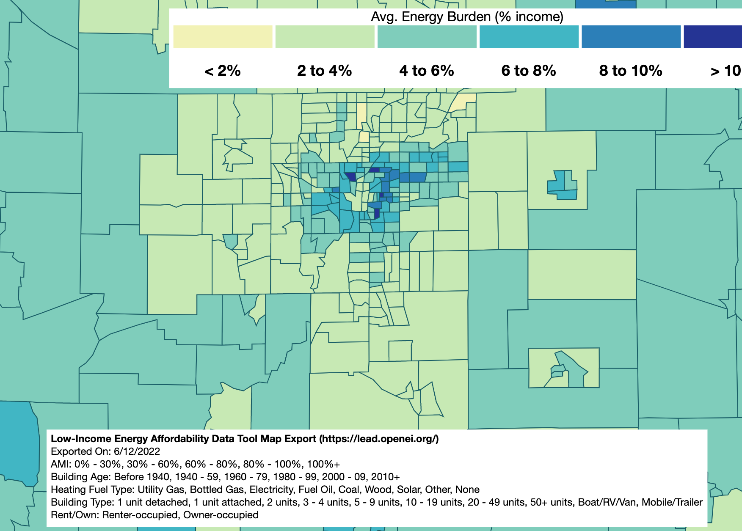
Disparities in energy burden
U.S. DOE, Low-Income Energy Affordability Data (LEAD) Tool
Data by nation, state, counties, cities, and census tracts.

Slide 6
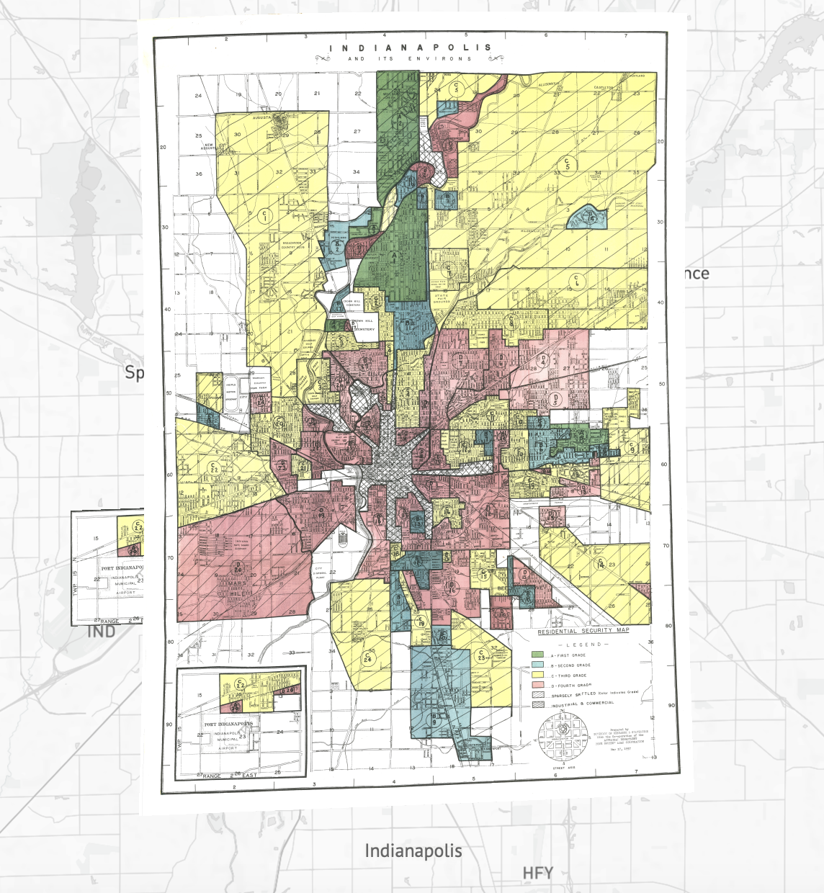
Disparities in energy burden
Mapping Inequality
USDOE, LEAD Tool

Slide 7
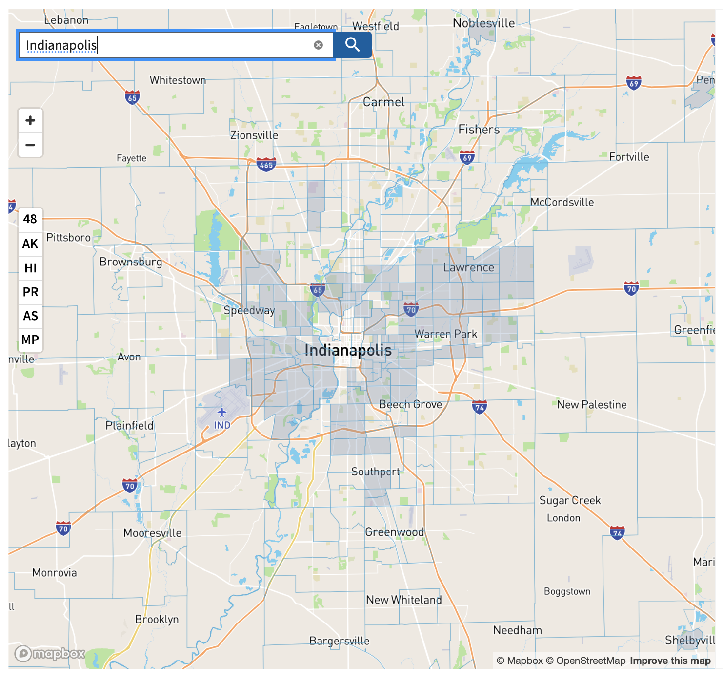
Disparities in energy burden
Climate and Economic Justice Screening Tool
USDOE, LEAD Tool

Slide 8
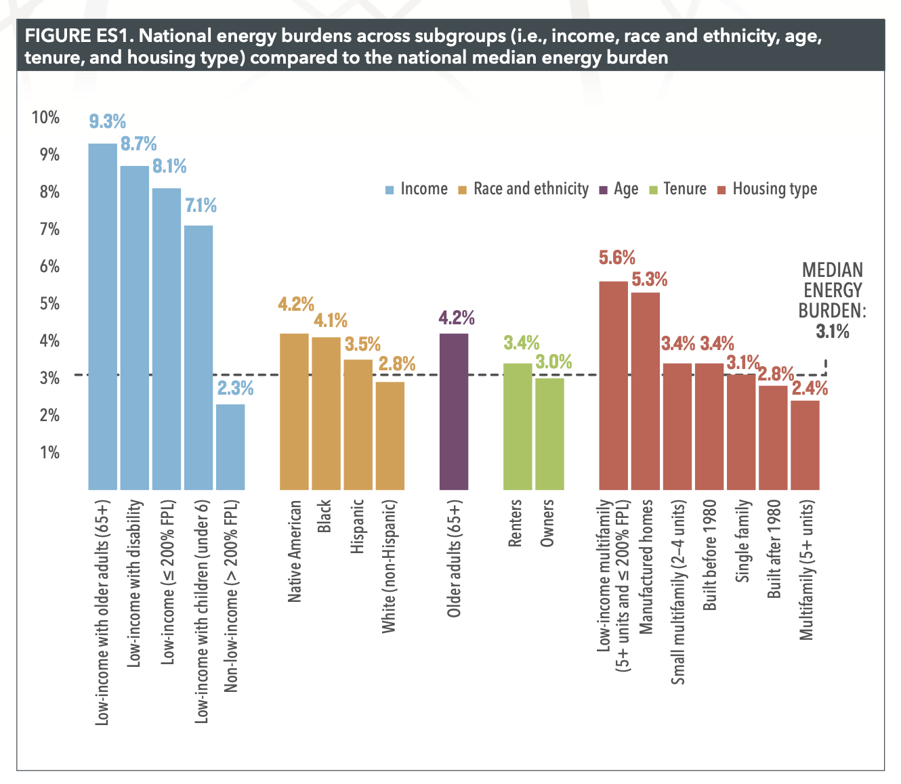
Disparities in energy burden
ACEEE, How High are Household Energy Burdens
Energy burdens among vulnerable populations are much higher.
Analysis show that, controlling for income household size, and city of residence, Black renters and homeowners pay much more for energy.*
$273/year for renters
$408/year for homeowners
*Lyubich, 2020, The Race Gap in Residential Energy
Expenditures.

Slide 9
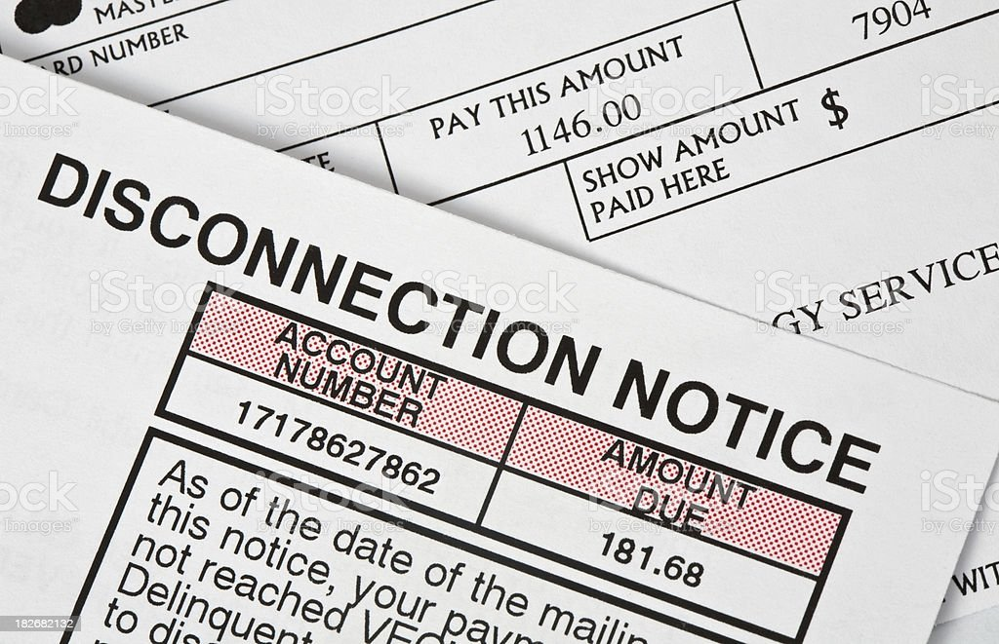
Energy insecurity
Definition: inability of a household to financially meet its basic energy needs.
Households with 10% of energy burden or higher.*
Additional indicators: inability to pay an energy bill; forgoing other basic needs (e.g., food, medical care) to pay an energy bill; utility disconnection.**
*National Center for Children in Poverty, Energy Insecurity among Families with Children.
*Memmott, Carley, Graff, and Konisky, “Sociodemographic disparities in energy insecurity
among low-income households before and during the COVID-19 pandemic,” Nature Energy.

Slide 10
Disparities in energy insecurity
EIA, Residential Energy Consumption Survey
Significant racial and ethnic disparities in energy insecurity.
Other disparities:
Renters; income; homes with children; housing conditions.

Slide 11
IU surveys on energy insecurity
Quantitative analysis of a nationally-representative sample of Americans under 200% of the federal poverty line (~ 2,000 households).
Longitudinal survey design (May 2020, August 2020, January 2021, May 2021)
Pre-pandemic baseline and impact of the COVID-19 pandemic.
Multiple measures of energy insecurity, ranging in severity.
Cannot pay energy bill
Receive disconnection notice
Disconnected from utility provider

Slide 12
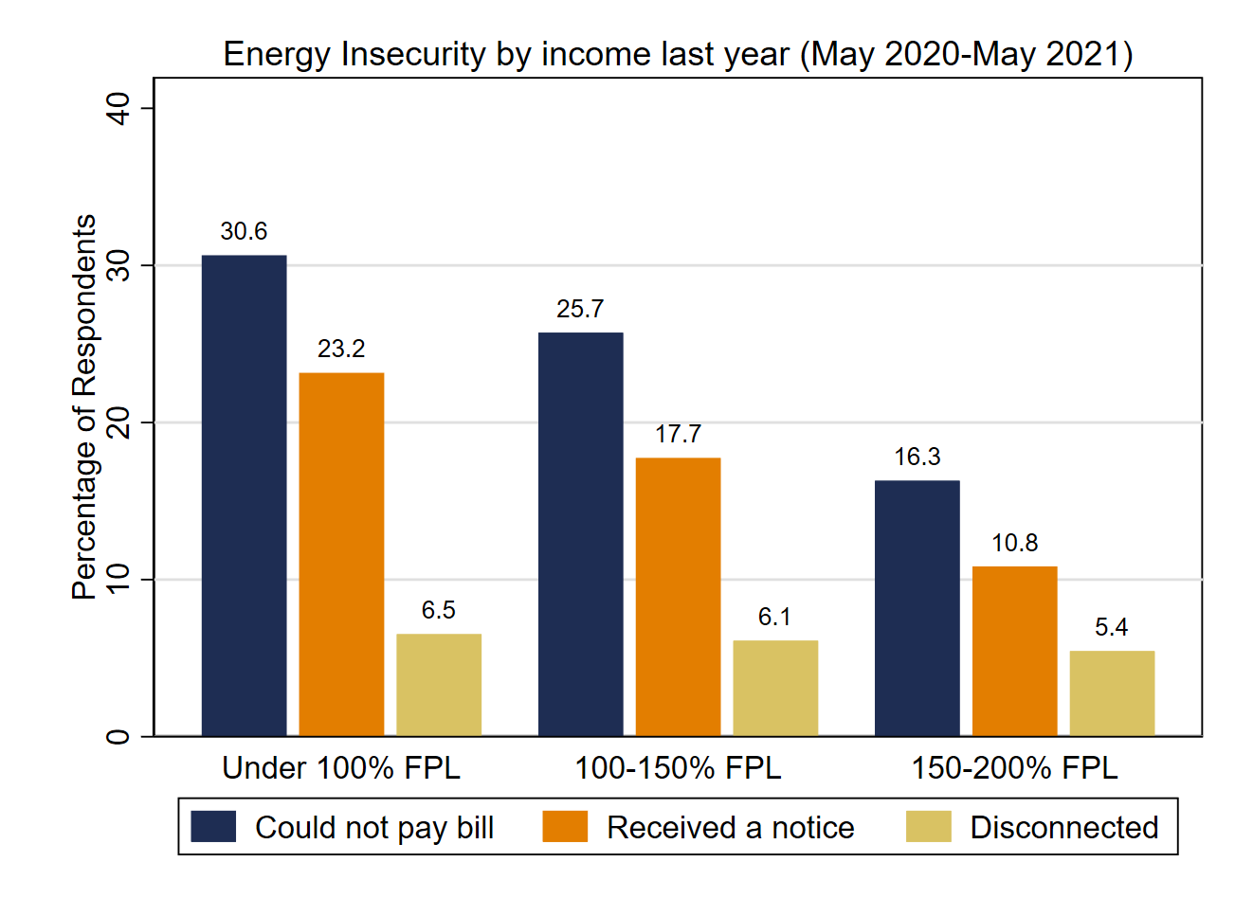
IU surveys on energy insecurity

Slide 13
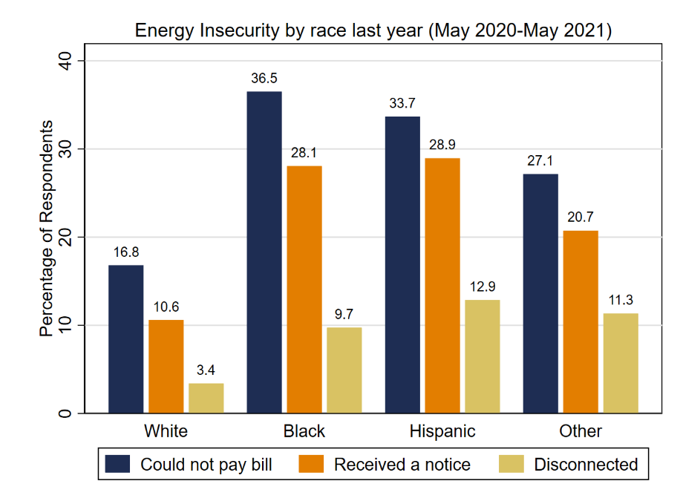
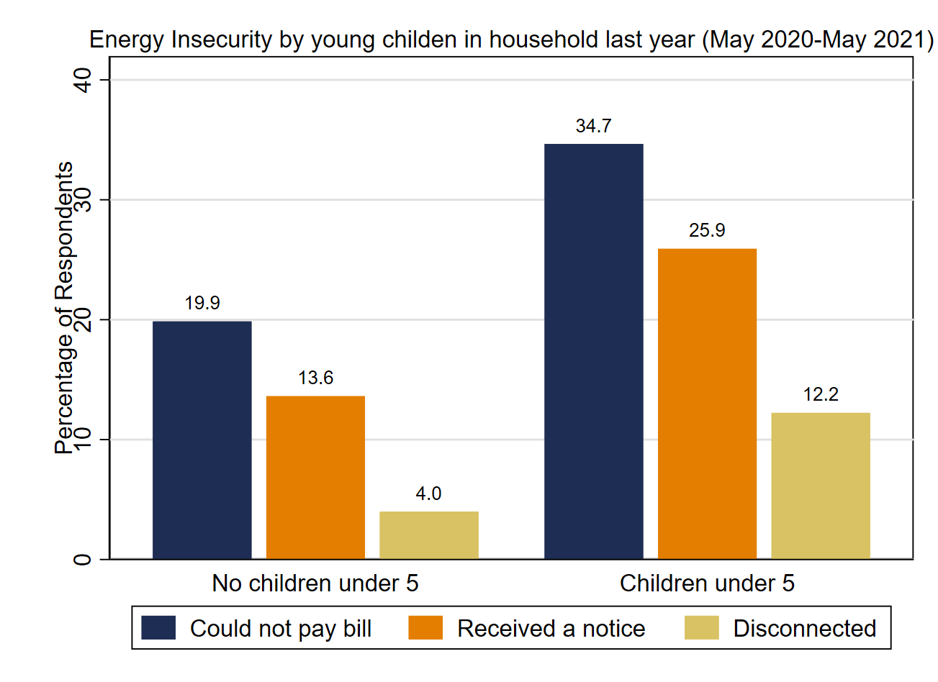
IU surveys on energy insecurity

Slide 14
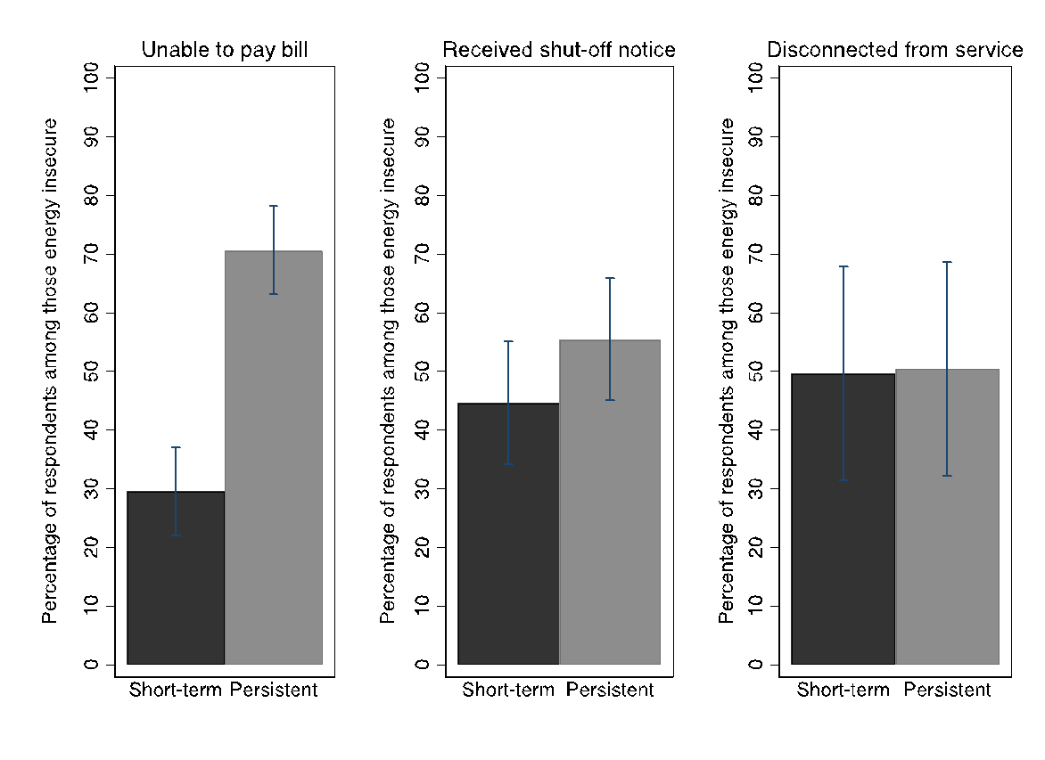
IU surveys on energy insecurity

Slide 15
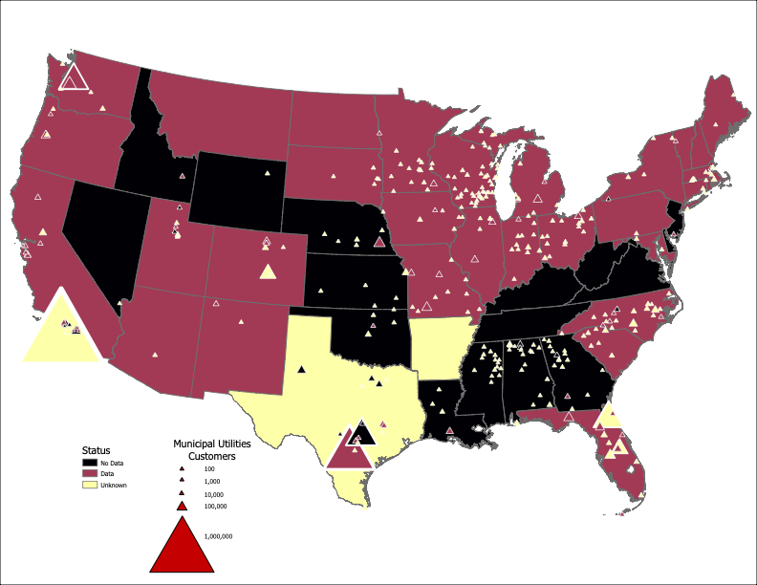
IU project on disconnections
Our Energy Justice Lab is developing a web-based, interactive dashboard with two main data features:
Utility disconnections (electricity and gas)
State-level policy protections.
Expect to release in 2023.

Slide 16
Funding sources

Slide 17
Resources and contact information
Laura Helmke-Long, Sanya Carley and David M. Konisky, 2022, “Municipal Government Adaptive Capacity Programs for Vulnerable Populations during the U.S. Energy Transition,” Energy Policy, 167.
Shalanda Baker, Sanya Carley, and David M. Konisky, 2021, “Energy Insecurity and the Urgent Need for Utility Disconnection Protections,” Energy Policy 159, 112663.
Michelle Graff, Sanya Carley, David M. Konisky, and Trevor Memmott, 2021, “Which Households are Energy Insecure? An Empirical Analysis of Race, Housing Conditions, and Energy Burdens in the United States,” Energy Research & Social Science 79, 102144.
Michelle Graff, David M. Konisky, Sanya Carley and Trevor Memmott, 2021, “Climate Change and Energy Insecurity: A Growing Need for Policy Intervention,” Environmental Justice.
Trevor Memmott, Sanya Carley, Michelle Graff, and David M. Konisky, 2021, “Sociodemographic Disparities in Energy Insecurity among Low-income Households Before and During the COVID-19 Pandemic,” Nature Energy 6: 186-193.
https://energyjustice.indiana.edu
IU Collaborators: Sanya Carley, Michelle Graff, Laura Helmke-Long, and Trevor Memmott.
Research assistants: Jacob Alder, Harsh Atha, Alexander Gordon-Sandweiss, Himanshu Joshi, Emmanuel Kwakye, Rohit Gampa, Emily Nash, Victor Peters, Tushar Samantaray, and Brie Warwick.

Slide 18
Thank You!

