Slide 1

Transmission policy for low delivered energy costs
Rob Gramlich

Slide 2
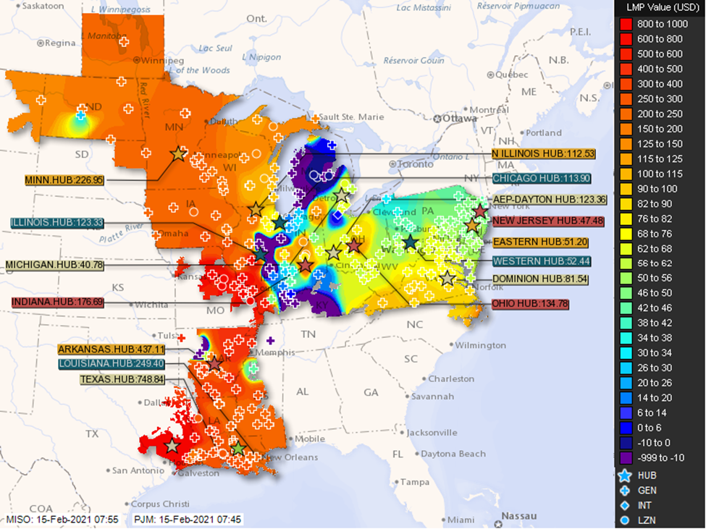
Interregional Transmission Keeps the Lights On in Winter Storm Uri Feb 2021 MISO imported 13 GW, ERCOT only 0.8 GW (East to West flow) Eastern polar vortex incidents in 2014, 2018 served by Midwest power (West to East flow) For transmission planning and cost allocation—beneficiaries are on both sides

Slide 3
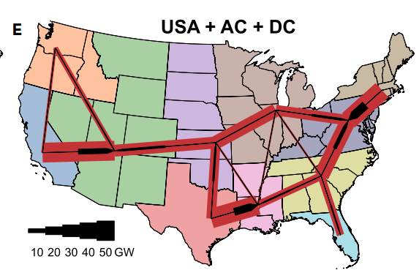
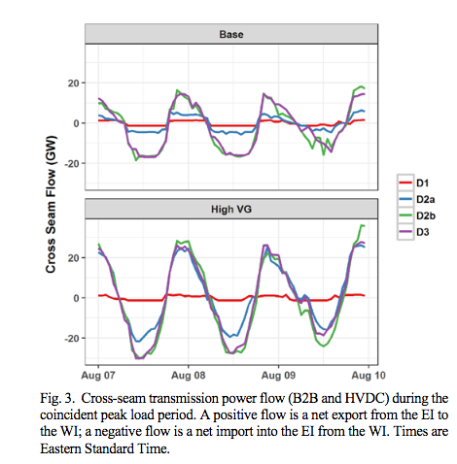
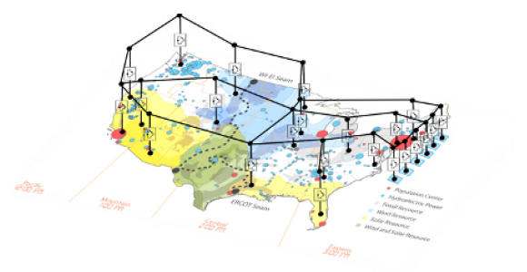
Connecting areas with net load diversity reduces cost 10s of GWs of power transfer back and forth across and between regions Benefit > cost with 2-3x increase in national transmission capacity
Modeled flows NREL Seam study
https://www.cell.com/joule/fulltext/S2542-4351(20)30557-2
https://cleanenergygrid.org/wp-content/uploads/2020/11/Macro-Grids-in-the-Mainstream-1.pdf

Slide 4
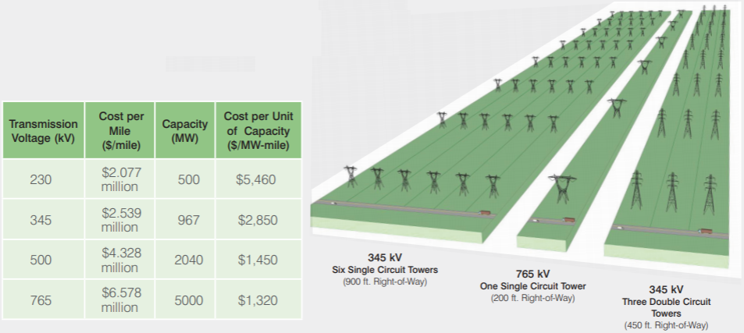
Bigger transmission uses less money and land
765kv lines have ~1/6 the losses as 345 kV
Bigger lines
Lower $/MW-mile
p. 4 https://web.ecs.baylor.edu/faculty/grady/_13_EE392J_2_Spring11_AEP_Transmission_Facts.pdf

Slide 5
Cost containment #1 Get the most out of the existing grid
Regional power markets—EIMs and RTO spot energy markets reduce artificial congestion
Grid-Enhancing Technologies
Power Flow Control
Push and pull power, modular, scalable, movable
Dynamic Line Ratings
Adjust path rating based on ambient conditions, allows capacity forecasting
Topology Optimization
Software to optimize transmission assets, eg circuit breakers
Storage as Transmission
Maximize capacity on existing rights of way
Reconductor with advanced, more resilient and efficient conductors

Slide 6
Cost containment #2 Plan efficient infrastructure expansion
Balance trade-off between transmission and generation cost
Proactively plan for future generation and load
Capture economies of scale
Plan network portfolios, not single purpose lines
Capture economies of scope
Incorporate realistic scenarios including severe weather
At these times, 40 year investments can pay for themselves in a few days
Maximize net benefits to consumers and assign costs to wholesale consumers considering all benefits
Review local upgrades for more efficient regional solutions
Plan through planning process, not interconnection process
Transparent inclusive process
Review benefits, costs, alternatives

Slide 7
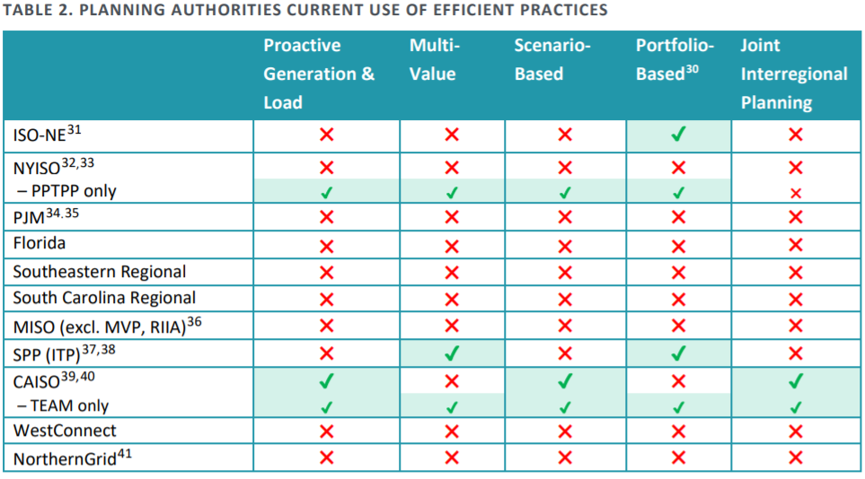
Widespread lack of effective transmission planning
Brattle, Grid Strategies: https://www.brattle.com/insights-events/publications/transmission-planning-for-the-21st-century-proven-practices-that-increase-value-and-reduce-costs/

Slide 8
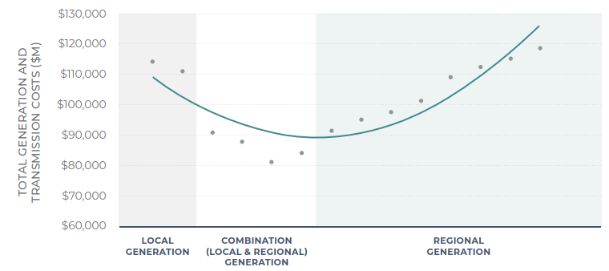
Seek lowest delivered cost of energy (generation + transmission)
https://cdn.misoenergy.org/MTEP17%20MVP%20Triennial%20Review%20Report117065.pdf at p. 31.

Slide 9
Cost containment #3 other policies
Set ROE based on competitive rates to attract sufficient capital
Independent Transmission Monitors
Identify efficient options
Federal support
IIJA Bipartisan Infrastructure Law
Tax credit for regionally significant transmission
FERC oversight
Increase transparency, staff expertise, review

