Slide 1

GTI Energy develops innovative solutions that transform lives, economies, and the environment
Notes:
Our recent brand refresh and update from GTI to GTI Energy was intended to preserve the integrity of our 80-year legacy while reflecting the evolution of the organization’s business offerings to new and existing customers.
GTI Energy is a leading research and training organization focused on developing, scaling, and deploying energy transition solutions. We leverage the expertise of our trusted scientists, engineers, and partners in collaborations that deliver the innovations needed for low-carbon, low-cost energy systems.
We will offer research into more areas that could impact our customers through the ongoing energy transitions.

Slide 2

Our strategic initiatives
Hydrogen
Storage, delivery
and end use
Methane
Mitigating methane
emissions at scale
Carbon
Reducing and
managing
carbon emissions
Integrated
energy
systems
Digital
transformation
The dual
Imperative:
Protecting environments
and communities
while supporting
economic growth

Slide 3
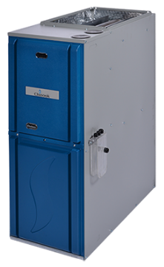
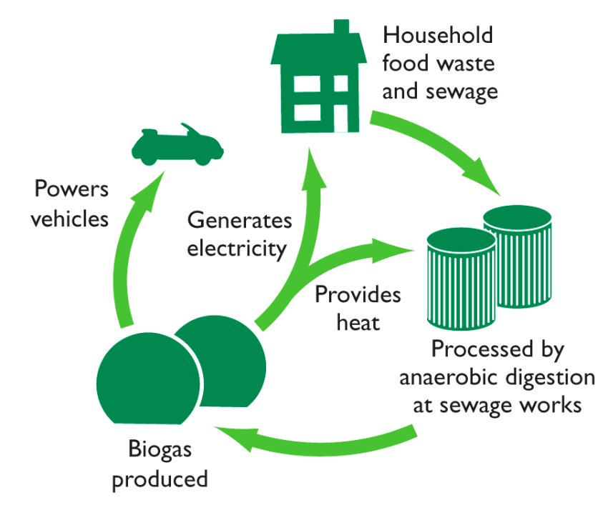
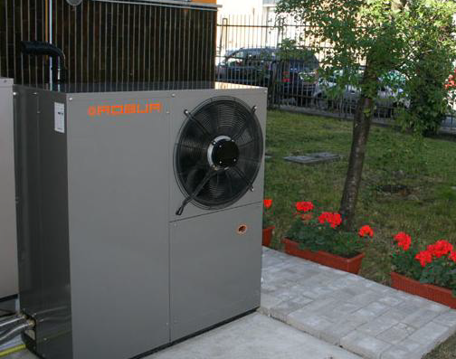

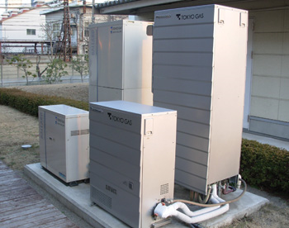

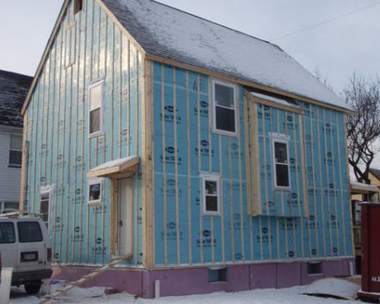

Natural Gas Low Greenhouse Gas Pathways
Near-Term
(25-50+%)
Expanded use of high-efficiency gas equipment
Hybrid natural gas furnace/
boilers and electric heat pump systems
Next-Gen
(40-60+%)
Gas heat pumps for space &
water heating
Micro CHP systems
Renewables (Added 10-30+%)
Building envelope improvement
RNG & Hydrogen
blends
Solar thermal/
gas space & water heating systems
Deep
building retrofits
Lower Methane Emissions
(5-10%)
Reducing full-cycle gas system methane emissions
* Numbers indicate nominal GHG reduction potential

Slide 4
Hydrogen…
is an energy carrier that can be used to store energy over long periods of time and to transport energy over large distances
provides a low-carbon emissions fuel
offers a beneficial use of excess electricity produced by renewables
enables new zero emission transportation applications like heavy-duty and light duty vehicles and use at ports
supports zero emission distributed power applications with fuel cells and lower GHG emissions with turbines

Slide 5
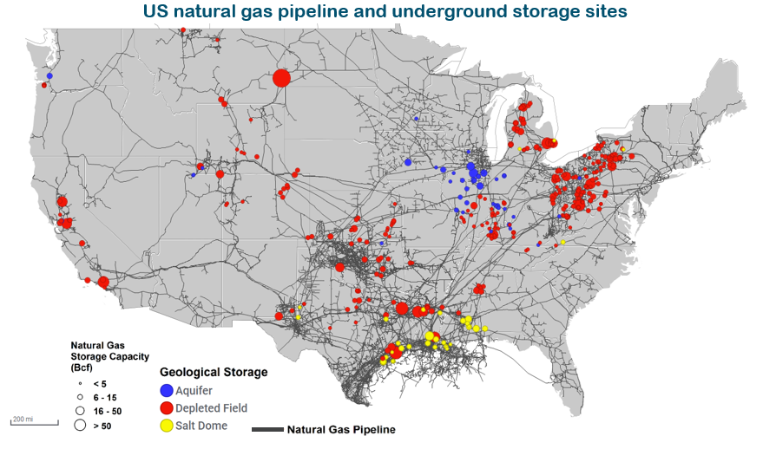
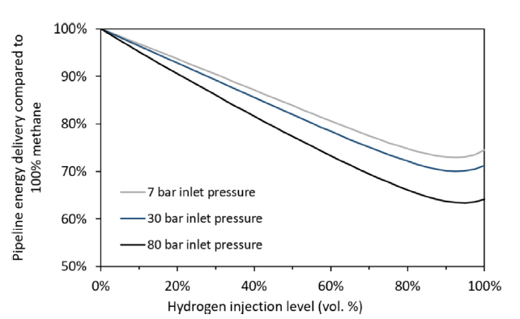
Leveraging Gas Infrastructure for Hydrogen
Risk Assessments
System Compatibility
Engineering and Safety Tools
Standards and Codes
Customer Focus, Outreach, Education
Source: EIA
5

Slide 6













Enabling Hydrogen use for Residential/Commercial Applications
Engagement with Industry
Current GTI Energy Projects
Demonstrate high hydrogen blends in residential and commercial combustion equipment
Performance testing of appliances with varying hydrogen blends
Quantify the ability of appliances to retain normal operations (emissions, efficiency, cycling)
Hydrogen sensor development for “behind the meter” applications and in-situ sensing
30% H2 / 70% CH4
100% Natural Gas
6
Source: Bekeart

