Slide 1
FERC Update National Association of State Utility Consumer Advocates Mid-Year Meeting Indianapolis, Indiana June 13, 2022
Jason Gray
Matthew Bly
Duncan & Allen LLP
1730 Rhode Island Avenue, NW, Suite 700
Washington, DC 20036
(202) 289-8400
jtg@duncanallen.com | mlb@duncanallen.com

Slide 2
Overview
Return on Equity Updates
Cost Allocation
Transmission NOPR and Generator Interconnection Planning
Order 2222 Compliance and Implementation

Slide 3
ROE Updates?
Base Methodology
- D.C. Circuit Oral Arguments in MISO Appeals on November 18, 2021
- Decision in Mid-2022?
- March 17, 2022 Order in ER20-2320-002
Danly, dissenting
Clements, concurring and dissenting
Incentives
- September 10, 2021 Technical Conference
- January 2022 Comments
- May 31, 2022 Order on Docket No. ER22-1525
Christie, concurring

Slide 4
Cost Allocation
MISO Subregional Proposal for MVPs, Docket No. ER22-995
- Christie, concurring
Supports more granular cost allocation but justification for postage stamp allocation within subregions was “weak” and “underwhelming”
FERC needs to conduct more robust reviews of evidence supporting proposals to allocate billions of dollars
“State regulators and consumer advocates need to be paying very close attention to such claims of alleged benefits and alleged ‘free riders’ before agreeing to billions of dollars in new spending and any formula to allocate those costs.”

Slide 5
Transmission NOPR, RM21-17
Centerpiece: Long-Term Regional Transmission Planning process using (1) scenario planning over (2) a 20-year planning horizon
Requirement to seek the agreement of state officials concerning cost allocation for transmission facilities selected in new Long-Term Regional Transmission Planning process
Requirement to consider Dynamic Line Ratings and advanced power flow control devices in the regional transmission planning process (i.e., not just in Long-Term Regional Transmission Planning process)
Eliminating the availability of Construction Work in Progress recovery for projects selected in Long-Term Regional Transmission Planning process
Allowing incumbent transmission providers to exercise a Right of First Refusal where they enter joint ownership arrangement
Increased transparency and coordination requirements in “local” transmission planning processes
Danly dissenting: It’s a “boondoggle”

Slide 6
Generator Interconnection Reform, RM22-14
Split out from Docket No. RM21-17
To be addressed at June 16, 2022 open meeting

Slide 7
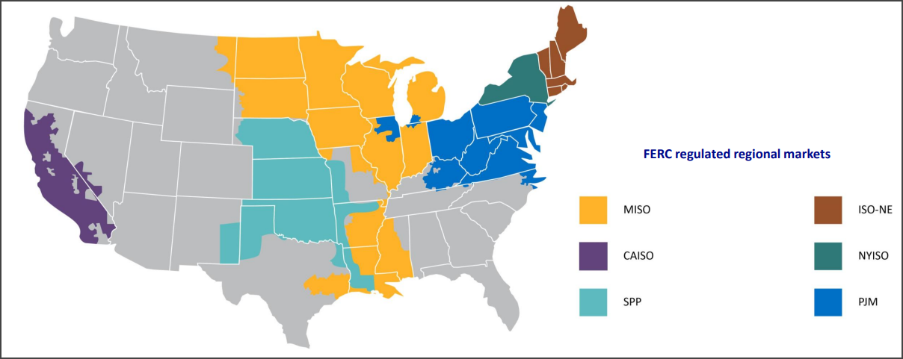
Order 2222
Participation of Distributed Energy Resource Aggregations in Markets Operated by Regional Transmission Organizations and Independent System Operators, Order No. 2222, 172 FERC ¶ 61,247 (Sept. 2020).
FERC issued Order No. 2222 on September 17, 2020, to facilitate participation of Distributed Energy Resources (DERs) in the capacity, energy, and ancillary service markets operated by ISO/RTOs.
ISO/RTOs must revise tariffs to establish DERs as a category of market participant.
Revised tariffs shall allow DER Aggregators (DERAs) to register resources under one or more participation model that accommodate(s) the resources’ physical and operational characteristics

Slide 8
Compliance Timeline
Implementation timing across regional markets is varied depending on existing regulation within each region pertaining to DER participation.
FERC proposed to give each ISO/RTO from Sept. 2020 to July 2021 to submit their compliance filing.
PJM, ISO-NE, MISO, and SPP all requested compliance filing extensions.
Most of the ISO/RTOs submitted comments suggesting that they would need to make substantial changes to existing rules to integrate DERAs into their markets.

Slide 9
Implementation Timeline(s)
Rather than specifying the implementation date, FERC allowed each RTO/ISO to propose a final implementation date in its compliance filing.
CAISO and NYISO already had FERC approved DERA tariff rules prior to the issuance of Order 2222, and therefore will likely have shorter implementation estimates compared to PJM, ISO-NE, MISO, and SPP.

Slide 10
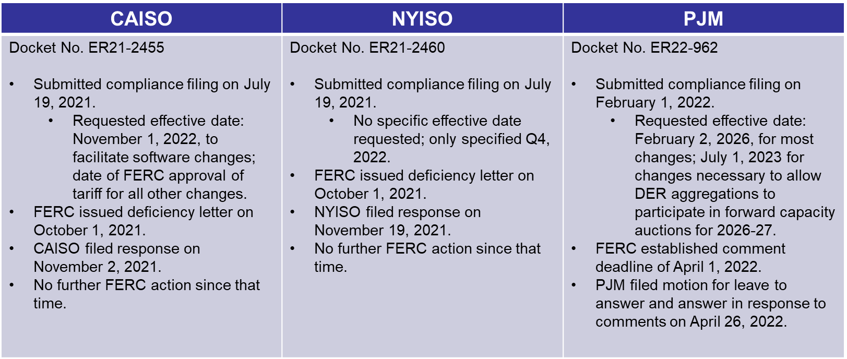
Compliances/Implementation Timeline(s)

Slide 11
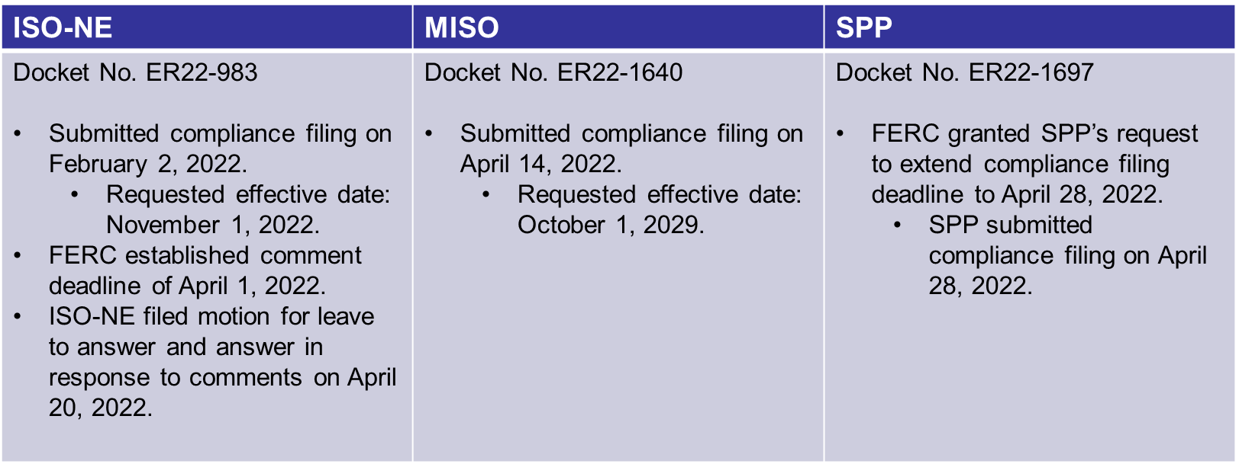
Continued

Slide 12
Questions and Discussion

