Slide 1
Federal Energy Regulatory Commission Update
Elin Swanson Katz, Director
Office of Public Participation
Rob Thormeyer, Director
State, International, and Tribal Affairs Division
NASUCA Mid-Year Meeting
June 13, 2022
Notes:
Thank you—glad to be here
Thanks to David…
Good to be here with Elin—we joined around the same time and actually worked closely on some issues in our last jobs, so it is an honor to share the stage with her
I will kick us off this afternoon with a brief overview of FERC itself and my division within the Office of External Affairs, the State, International and Tribal Division; then will turn it over to Elin, whom I know you are more interested in hearing from, so I will be brief

Slide 2
DISCLAIMER: Speaking on my own behalf and my comments do not necessarily reflect the views of the Commission, individual Commissioners, or other Commission staff members
Notes:
First the disclaimer: Speaking on my own behalf and my comments do not necessarily reflect the views of the Commission, individual Commissioners, or other Commission staff members

Slide 3
About FERC
FERC regulates natural gas wholesale facilities
Approves/denies applications to build interstate pipelines, onshore LNG facilities and underground storage facilities that are tied to the wholesale market
Regulates the rates/tariffs of pipelines on a contract carriage basis
FERC regulates the wholesale electric market
Sets rates/tariffs for wholesale transactions on interstate lines (100 KV and higher)
Siting for transmission lines is primarily done at the state level
Backstop siting and IIJA
FERC oversees NERC reliability standards, including cybersecurity
FERC provides licenses for non-federal hydro facilities (about half of all hydro in the U.S.)
Notes:
Very quickly, since I know most of you are familiar with us, I wanted to give a short overview of the Commission
The key distinction between what we do and what happens on the state level is the word “wholesale”
FERC regulates wholesale electric markets and sites natural gas pipelines/LNG facilities used for wholesale sales
Draft policy statements—issued in Feb; seeking to update 1999 Nat Gas Policy statement by revising now the Commission determines need; separate statement on GHG emissions—comments were due late last month; decision pending
Electricity—FERC sets rates/tariffs for wholesale transactions on interstate tx lines (100 kV or higher); also oversees so-called “organized markets”—markets operated by RTOs—where the price for electricity is set by the market;
Reliability—FERC oversees North American Electric Reliability Corporation’s process for setting reliability standards, including cybersecurity

Slide 4
Commissioners
Five Commissioners, appointed by the President, confirmed by the Senate for staggered five-year terms
Chairman Richard Glick (D)
Commissioner James Danly (R)
Commissioner Allison Clements (D)
Commissioner Mark Christie (R)
Commissioner Willie Phillips (D)

Slide 5
Federal and State Regulation
FEDERAL
FERC
Wholesale transactions (sales for resale)
Rates, terms and conditions of transmission service in interstate commerce
Corporate transactions, mergers, securities issued by public utilities
Grid reliability standards
Backstop siting authority for transmission
STATE Public Utilities Commissions
Retail transactions (sales to the ultimate user)
Rates, terms and conditions of local distribution and bundled retail transmission services
Terms and conditions of retail utility service
Certificates for construction and siting of new electric generation, transmission and distribution facilities

Slide 6
About OEA
FERC’s primary contact point with Congress, the States, Tribal governments, International governments, the public, and the media
Three divisions
Congressional Affairs
Media Relations
State, International, Tribal Affairs (SITA)
SITA
Newly renamed! Formerly State, International, and Public Affairs Division
Responsible for communicating Commission activities/decisions/events to state, Tribal governments
Briefings, emails, conferences, meetings assistance
Notes:
Briefings, emails—please let me know if you are not on our distribution list
Distinction between OEA/OPP: We deal solely with government officials—this means we are your main point of contact if you have questions about orders, would like a briefing on particular items, or are looking to meet with commissioners/staff
My team sends out notices regularly about important commission activities, orders, initiatives to inform you of our work—please let me know if you are not on my email distribution list and we will add you
Tribal—new! Also some overlap with OPP—again the distinction is tribal officials/leaders would come to us, while citizens would go to OPP

Slide 7
Upcoming Events
June 16, 2022
Open Commission Meeting
June 23, 2022
Summer Market/Reliability Assessment Briefing for States
July 20, 2022
Fourth Meeting of Joint Federal-State Task Force on Electric Transmission
July 28, 2022
Open Commission Meeting
Sept. 8, 2022
New England Winter Gas-Electric Forum

Slide 8
Contact Information
Rob Thormeyer
Director, State, International, and Tribal Affairs Division
Federal Energy Regulatory Commission
Robert.Thormeyer@ferc.gov
202-502-8694 (office)
202-465-5717 (cell)

Slide 9
FERC Office of Public Participation
Elin Swanson Katz, Director
NASUCA – June 14, 2022

Slide 10

Note: The views expressed herein are the author’s, and do not necessarily reflect the views of the Federal Energy Regulatory Commission, individual Commissioners, or other Commission staff members. Nothing herein should be viewed as a prediction or prognostication of how the Commission will act on any matter, nor will this presentation address any pending matter.

Slide 11
OPP: A Conduit for Public Engagement at FERC
Mission: To empower, promote, and support public voices at the Federal Energy Regulatory Commission.
Enabling Statute: Section 319 of the Federal Power Act, 16 U.S.C. Sec. 825q-1.
Created in statute in 1978
Not stood up until 2021 – with lots of support from NASUCA and other allies

Slide 12
Former advocates abound in OPP!
First permanent Director Elin Swanson Katz (Connecticut Consumer Counsel 2011 – 2019)
First Deputy Director Nicole Sitaraman (Former attorney with DC Office of the People’s Counsel)
Senior Policy Advisor Joseph Rosenthal (Former attorney with CT OCC)

Slide 13
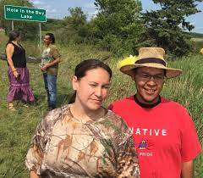
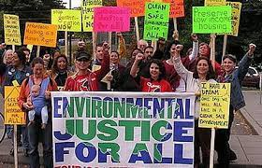
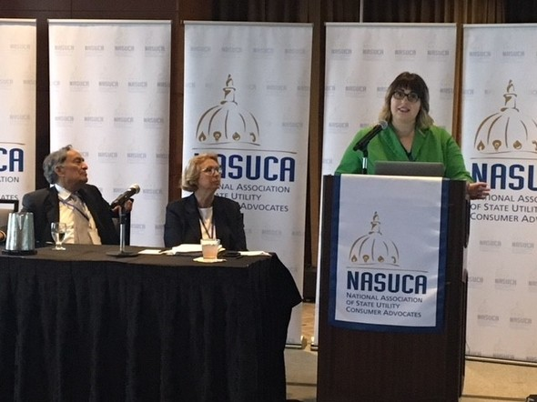
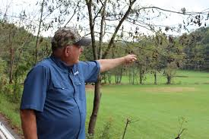
Focus: Outreach, Education and Constituent Services
Four key constituencies for OUTREACH
Environmental Justice communities; Tribal citizens; Landowners; Consumer advocates, environmental, and community organizations.

Slide 14

Assistance to Members of the Public
Assisting constituents with FERC “how to” questions
OPP has fielded over 325 constituent communications

Slide 15

The Never-Will-End Listening Tour
Public stakeholders, communities, industry groups, utilities

Slide 16





Ongoing Priorities
Assistance
Outreach
Education and technical assistance
Metrics of success
Social media
Pushing out key info
Intervenor funding model
Hiring to meet the mission
Notes:
Deeper dive on some of these issues in next slides
Need to determine “What does success look like?”

Slide 17
Empowering Communities and Individuals to Speak for Themselves
Developing resources and educational materials to enable members of the public, including under-represented constituencies and those unfamiliar with FERC processes, to participate and bring their voices forward.
Facilitators, not advocates…although we advocate vigorously for more public participation at the Commission!

Slide 18

The Questions on the Table
What do we need to know to help members of the public?
What are the barriers to participation at FERC?
What resources or educational materials can we provide to the public?
What does success look like?

Slide 19

FERC Office of Public Participation
Email: OPP@ferc.gov
Phone: (202) 502-6595
Twitter: @ElinKatzFERC & @FERC_OPP

