Slide 1
Economic Assessment of Grid Modernization Plans
Tim Woolf & Ben Havumaki
Synapse Energy Economics
DOE/LBNL Technical Training National Association of State Utility Consumer Advocates 2022 Mid-Year Meeting
June 14, 2022
This presentation was funded by the U.S. Department of Energy’s Grid Modernization Laboratory Consortium.

Slide 2
Overview
Review of several utility Grid Mod Plans
General guidance on economic evaluation of Grid Mod Plans
Benefit-cost analysis (BCA) versus least-cost/best-fit (LCBF)
Accounting for interdependencies between grid mod components
Accounting for hard to quantify benefits
Accounting for customer equity
Based on two recent studies
T. Woolf, B. Havumaki, D. Bhandari, M. Whited and L. Schwartz, Benefit-Cost Analysis for Utility-Facing Grid Modernization Investments: Trends, Challenges, and Considerations, Berkeley Lab, 2021.
Minnesota Department of Commerce, Review and Assessment of Grid Modernization Plans: Guidance for Regulators, Utilities, and Other Stakeholders, prepared by Synapse Energy Economics, 2022. (Docket No. E002/M-21-814, available through eDockets)

Slide 3
Review of Benefit-Cost Analyses
in Grid Modernization Plans

Slide 4
Review of BCAs in 21 Grid Mod Plans
Utility | State | Year |  | Utility | State | Year
National Grid | NY | 2016 |  | DTE Energy | MI | 2018
NYSEG & RGE | NY | 2016 |  | APS | AZ | 2016
Unitil | MA | 2015 |  | PSE&G | NJ | 2018
National Grid | MA | 2016 |  | LGE | KY | 2018
Eversource | MA | 2015 |  | Consumers Energy | MT | 2018
Public Service Co. | CO | 2016 |  | Central Hudson G&E | NY | 2018
SDGE | CA | 2016 |  | Hawaiian Electric Cos | HI | 2017
Xcel | MN | 2017 |  | Southern CA Edison | CA | 2016
FirstEnergy | OH | 2017 |  | CT Light & Power | CT | 2010
Vectren | IN | 2017 |  | Entergy | AR | 2016
National Grid | RI | 2018
Source: Woolf et al., Benefit-Cost Analysis for Utility-Facing Grid Modernization Investments, prepared for Berkeley Lab, 2021.

Slide 5
Review of Grid Mod Plans: Themes
Key items that were generally lacking:
An overarching rationale for grid modernization investments and an explanation of how individual components will help meet overall goals
Identification of which cost-effectiveness test was used for the BCA
Identification of which discount rate was used to determine present values
Methodologies to account for the interdependencies of grid modernization components
Methodologies to account for unmonetized benefits of grid modernization components
Robust definitions of grid modernization metrics and how they will be used to monitor grid modernization costs and benefits over time
Methodologies and discussions for addressing customer equity issues
Source: Woolf et al., Benefit-Cost Analysis for Utility-Facing Grid Modernization Investments, prepared for Berkeley Lab, 2021.

Slide 6
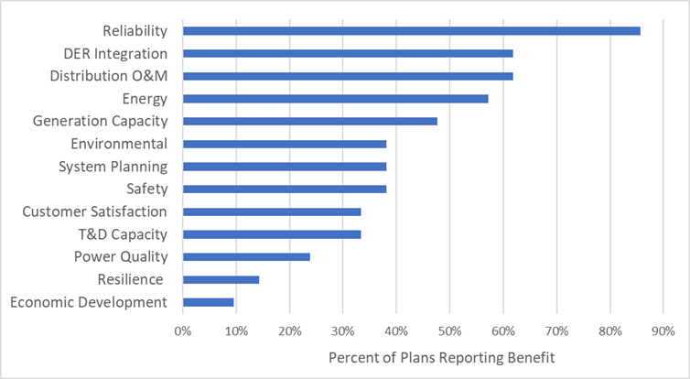
Type and Frequency of Claimed Benefits
Source: Woolf et al., Benefit-Cost Analysis for Utility-Facing Grid Modernization Investments, prepared for Berkeley Lab, 2021.

Slide 7
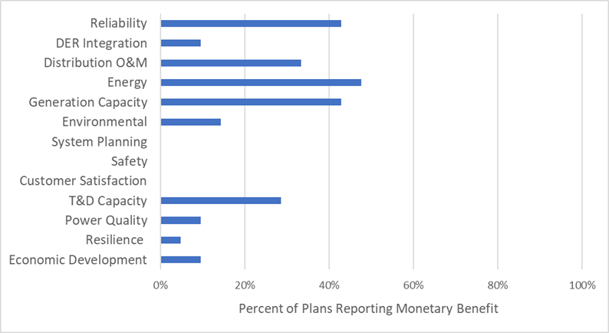
Type and Frequency of Monetized Benefits
Source: Woolf et al., Benefit-Cost Analysis for Utility-Facing Grid Modernization Investments, prepared for Berkeley Lab, 2021.

Slide 8
Economic Evaluation of
Grid Modernization Plans

Slide 9
Grid Mod Regulatory Contexts
Utility seeking review of costs before spending
Typically, in a case dedicated to review of proposed investments
Allows for focused review of proposal (outside rate case)
Sometimes initiated by commission, sometimes by the utility
Utility often asks for some form of regulatory guidance or approval
Implications of regulatory guidance or approval vary by state
Utility seeking recovery of costs after spending
Typically, in a rate case
Allows for retrospective prudence review
Allows for review in context of other utility costs
Grid modernization issues might be one of many contentious issues
Difficult to modify, reduce, or disallow costs after they are spent
Most grid modernization plans are submitted before spending

Slide 10
Examples of Grid Mod Benefits
Benefit | Utility System | Society
Reduced O&M costs
Reduced generation capacity costs
Reduced energy costs
Reduced T&D costs and losses
Reduced ancillary services costs
Increased system reliability
Increased safety
Increased resilience
Increased distributed energy resource (DER) integration
Improved power quality
Reduced customer outage costs
Increased customer satisfaction
Increased customer flexibility and choice
Reduced environmental compliance costs
Environmental benefits
Economic development benefits

Slide 11
Examples of Grid Mod Costs
Cost | Utility System | Society
Incremental capital costs for grid modernization equipment |  | -
Incremental O&M costs for grid modernization equipment |  | -
Incremental costs for T&D upgrades needed to support the grid modernization equipment |  | -
Program administration costs |  | -
Grid modernization costs are typically recovered from all customers.
But the benefits might not be experienced by all customers.
Grid modernization costs are relatively easy to quantify and monetize.
But the benefits are sometimes hard to quantify and monetize.

Slide 12
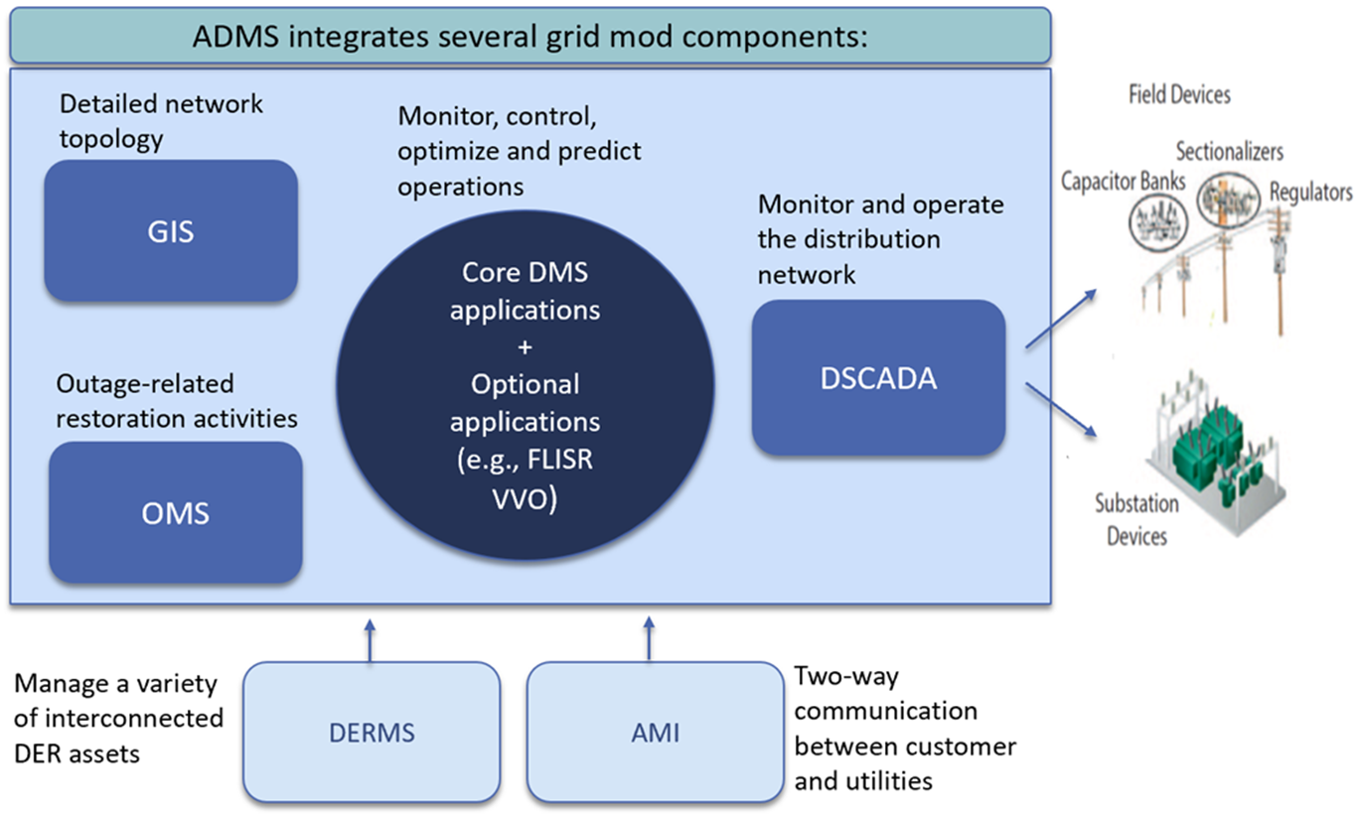
Interdependence of Components
Source: Adapted from World Bank, Practical Guidance for Defining a Smart Grid Modernization Strategy: The Case of Distribution, 2017. For definition of terms, see glossary in US DOE, Modern Distribution Grid: Strategy & Implementation Guidebook, 2020
Synapse Energy Economics

Slide 13
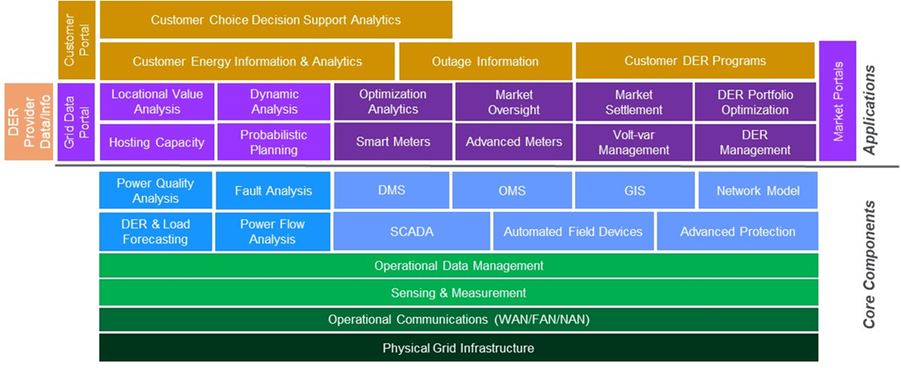
Core Components Versus Applications
Source: US DOE, Modern Distribution Grid: Strategy & Implementation Guidebook, 2020, page 59.

Slide 14
Principles for Grid Mod Economic Analysis
Compare consistently with traditional resources or technologies
Clearly account for state regulatory and policy goals
Account for all relevant costs and benefits, including those difficult to monetize
Consider interdependencies between components where feasible
Consider customer equity issues
Provide symmetry across relevant costs and benefits
Apply a full life-cycle analysis
Provide a sufficient incremental and forward-looking view
Ensure transparency
Avoid combining or conflating different costs and benefits
Address locational and temporal values
Source: Minnesota Department of Commerce, Review and Assessment of Grid Modernization Plans: Guidance for Regulators, Utilities, and Other Stakeholders, prepared by Synapse Energy Economics, Attachment to Department of Commerce Letter. Docket No. E002/M-21-814, February 9, 2022

Slide 15
Articulate Grid Modernization Goals
Sample Goal | Sample Objectives and Targets | Sample Metric and Reporting
Accommodate higher capacities of DERs | DER capacity 50% of minimum recorded load on 25% of circuits by 2025 | Annual report by circuit: DER capacity Minimum recorded load
 | DER capacity 100% of minimum recorded load on 50% of circuits by 2030
 | DER capacity 100% of maximum recorded load on 50% of circuits by 2035 | Annual report by circuit: DER capacity Maximum recorded load
Avoid interconnection delays | Interconnection decisions rendered on systems under 10 kW within 5 business days on circuits with available distributed energy resource capacity. | Annual reports: Interconnection requests by size Date of each request Date on which decision was communicated for each request
 | Interconnection decisions rendered on systems between 10 and 100 kW within 30 days on circuits with available distributed energy resource capacity
 | Interconnection decisions rendered on systems over 100 kW within 90 days
Source: Minnesota Department of Commerce, Review and Assessment of Grid Modernization Plans: Guidance for Regulators, Utilities, and Other Stakeholders, Attachment to Department of Commerce Letter. Docket No. E002/M-21-814, February 9, 2022

Slide 16
Example performance metrics
Example benefit | Example performance metrics
DER deployment | Number of DER installations
Customer satisfaction | Customer ratings, customer engagement metrics
Reliability | System-wide or targeted SAIDI, SAIFI, CAIDI, CAIFI
Resilience | Restoration time after extreme weather events
Safety | Number of safety events, injuries, deaths
Network and data access | Interconnection times, data access times, developer satisfaction
Retail competition | Number of customers choosing a competitive option
Performance metrics can be used to indicate the extent to which purported benefits will be achieved.

Slide 17
Benefit-Cost Analysis versus
Least-Cost/Best-Fit Analysis

Slide 18
Description of BCA and LCBF
Least-Cost/Best-Fit
For investments where the “need” has been established
Ex: A new distribution line is needed to provide service to a new residential development.
Different options might be considered for how to meet the need.
Ex. Different paths, different combinations of transformers, substations, etc.
LCBF is used to determine the option that meets the need at the lowest cost
Does not necessarily require quantifying or monetizing the benefits
Benefit-Cost Analysis
For determining whether to make an investment
BCA used to determine whether the investment will result in net benefits
Typically includes monetizing, or at least quantifying, all costs and benefits
The line between these two approaches is not always clear.

Slide 19
BCA Versus Least-Cost/Best-Fit
 | Need | Purpose | Application | Costs | Benefits
Least-Cost/ Best-Fit | Need for the investment has been established | To identify the investment that meets the need at lowest cost | Which option is the lowest-cost way to meet the need? | Included Typically includes only utility system costs | Not Required Benefits are not necessarily accounted for; presumed to be worth the costs
BCA | Need for the investment has not been established | To determine whether to make the proposed investment | Do the benefits of the investment outweigh the costs? | Included Extent of costs depends upon BCA test chosen | Included Extent of benefits depends upon BCA test chosen

Slide 20
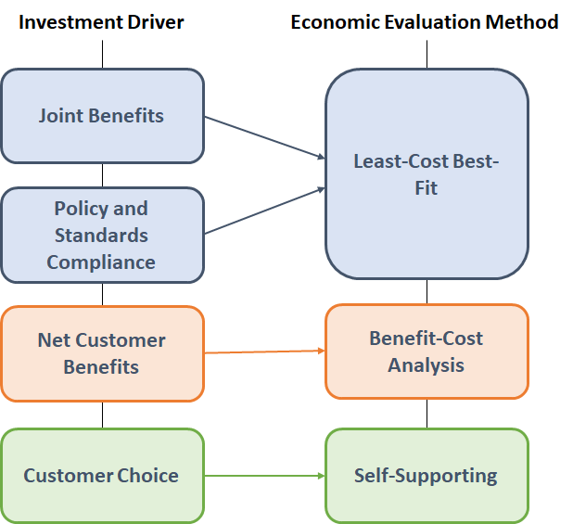
Economic Evaluation Options (from DOE)
Joint and interdependent benefits — core platform investments needed to enable new capabilities and functions
Standards compliance and policy mandates — utility investments needed to comply with safety and reliability standards or to meet policy mandates
Net customer benefits — utility investments from which some or all customers receive net benefits in the form of bill savings
Customer choice — customer-driven projects paid for by individual customers
Source: US DOE, Modern Distribution Grid: Strategy & Implementation Guidebook, 2020, page 113.

Slide 21
BCA Versus Least-Cost/Best-Fit
The main difference
LCBF presumes that the utility investment is needed.
Therefore, the benefits of the investment are not necessarily monetized.
BCA is used to justify the investment.
Benefits are monetized to demonstrate that the investment will have net benefits.
LCBF has been used for distribution planning for many years.
Because it was applied to investments that were clearly needed to maintain reliability
Ex: A new substation needs to be upgraded to serve an increasing customer demand.
What is the least-cost technology for upgrading the substation?
Now, there are more options to consider.
Ex: A non-wires alternative could be implemented instead of a substation upgrade
A BCA should be conducted to determine which has greater net benefits.

Slide 22
Is There a “Need” for the Investment?
For grid mod investments, the need is often not clear
Is an automated distribution management system (ADMS) necessary?
Is advanced metering infrastructure (AMI) necessary?
Is Volt-Var Optimization (VVO) necessary?
Grid modernization is sometimes described as necessary, but some components might not be, and some components might have costs that exceed the benefits.
A better question to ask:
Will the grid mod investment result in net benefits?
This is the key question for Commissions, Commission staff, and consumer advocates
This question can be answered only by a BCA
Therefore, BCA should be given priority over LCBF for grid mod evaluations
BCAs provide value even if the need for grid mod investment seems clear
The BCA information on benefits is helpful (a) at the time of the investment decision, and (b) after the investment has been made, to monitor performance over time.

Slide 23
When Should BCA Be Used Instead of LCBF?
Reasons Not to Conduct a BCA | Responses
Some benefits are too hard to monetize. | There are ways to account for benefits without monetizing them.
Some grid mod components are necessary to support other elements, and it is difficult to isolate, quantify, or monetize the benefits. | BCAs can be used to assess interdependencies between components.
Some grid mod components work jointly with other components, and it is difficult to isolate, quantify, or monetize the benefits. | BCAs can be used to assess interdependencies between components.
A BCA might be expensive and burdensome. | This reason is not sufficient to justify LCBF, given the utility is proposing to spend millions of dollars on grid modernization.
Answer: BCA should be the default approach. An LCBF may be appropriate in certain situations.

Slide 24
BCA Provides More Information than LCBF
BCAs provide more transparency, even if all the benefits are not quantified.
Costs / Benefits (mil PV$) | Type of Cost or Benefit | LCBF | BCA #1 | BCA #2
Costs | Capital, O&M, administration | 20 | 20 | 20
Benefits monetized | Energy, capacity, O&M, T&D | ? | 18 | 12
Benefits not monetized | Reliability & resilience | ? | ? | ?
Net benefits | --- | ? | -2 | -8
Benefit-cost ratio | --- | ? | 0.9 | 0.6
Result #1: This component might be deemed to be cost-effective because the reliability and resilience benefits are worth the $2 million net cost.
Result #2: This component might be deemed to be not cost-effective because the reliability and resilience benefits are not worth the $8 million net cost.

Slide 25
Accounting for Interdependencies, Hard to Quantify Benefits, and Customer Equity

Slide 26
Accounting for Interdependences
Apply LCBF if necessary.
The use of LCBF must be justified in the Grid Mod Plan.
Apply BCA tests for each component in isolation.
Using a BCA test appropriate for your state
Apply BCA to several scenarios where components are bundled in different ways.
Start with just platform components
Add layers of application components on top of platform components
Assess how the BCA results change with different combinations of components

Slide 27
Accounting for Interdependences: Example
 | Scenario 1: Platform Components Only | Scenario 2: Platform Plus FLISR and VVO | Scenario 3: Scenario 2 Plus AMI and DERMS
Costs (Mil PV$) | 24 | 28 | 32
Benefits (Mil PV$) | 22 | 36 | 38
Net Benefits (Mil PV$) | -2 | 8 | 6
Benefit-Cost Ratio | 0.9 | 1.3 | 1.2
Findings | not cost-effective | cost-effective | potentially cost-effective
Scenario 3 has two potential interpretations:
AMI and DERMS are deemed cost-effective, because the portfolio is cost-effective.
AMI and DERMS are deemed not cost-effective, because they reduce the net benefits relative to scenario 2.

Slide 28
Accounting for Non-Monetized Benefits
Put as many benefits as possible in monetary terms.
Define benefits in such a way that they can be monetized.
Provide as much quantitative data as possible.
Ex: For reliability use SAIDI, SAIFI, MAIFI, CAIDI values
Provide as much qualitative description as possible.
Can be used to inform the economic decision
Establish metrics to report benefits.
Monitor metrics (benefits) over time
Use quantitative methods to address non-monetized benefits.
Assign proxy values for significant non-monetized benefits
Use a point system to assign value to non-monetized benefits
Source: Woolf et al., Benefit-Cost Analysis for Utility-Facing Grid Modernization Investments, prepared for Berkeley Lab, 2021.

Slide 29
Accounting for Non-Monetized Benefits: Example
 | Scenario 1: Platform Components Only | Scenario 2: Platform Plus FLISR and VVO | Scenario 3: Scenario 2 Plus AMI and DERMS
Monetary Impacts | -- | -- | --
Costs (Mil PV$) | 24 | 28 | 32
Benefits (Mil PV$) | 22 | 36 | 38
Net Benefits (Mil PV$) | -2 | 8 | 6
Benefit-Cost Ratio | 0.9 | 1.3 | 1.2
Non-Monetized Benefits | -- | -- | --
Resilience | 1 | 1 | 3
Customer choice & flexibility | 1 | 2 | 3
Findings | not cost-effective | cost-effective | cost-effective
Scenario 3 is deemed to be cost-effective because of the high value of non-monetized benefits.

Slide 30
Addressing Customer Equity
Fully document the purpose and role of each grid mod component
Traditional, Platform, Application
Articulate the beneficiaries of grid modernization components
Which types of customers?
How many of those types of customers?
Over what time period?
Consider results of the Utility Cost test
Provides the best indication of impacts on customer bills
Present estimates of long-term customer bill impacts
Helps to put the grid modernization costs in context
Consider implications for target populations

Slide 31
Ensuring Net Benefits to Customers
Regulators can use cost recovery approaches to ensure that customers experience net benefits from grid modernization proposals.
Limit the amount of grid modernization costs that the utility can recover to the costs proposed in the grid modernization plan.
Utilities required to absorb cost over-runs
With allowances for contingencies
Limit the amount of grid modernization costs that the utility can recover over time based on achievement of purported grid mod benefits.
Require utilities to absorb a portion of costs if benefits are not achieved
Use metrics to assess achievement of benefits
Provide allowances for contingencies

Slide 32
Questions Public Utility Commissions Can Ask (1)
Initial Grid Mod Plan filing requirements:
Are grid mod goals clearly articulated, and is their relationship to policy goals clear?
Are there metrics with concrete measurable outcomes?
Does the Grid Mod Plan demonstrate consistency with the utility’s distribution, transmission, and resource plans?
Are the roles and relationships of each grid mod component identified?
Is the scope of the economic analysis identified?
Utility Cost test, Societal Cost test, Jurisdiction Specific test?
Does the plan indicate the cost-effectiveness approach used — BCA or LCBF?
Is any use of LCBF justified?
Is there a thorough evaluation of alternatives to utility distribution investments?
Does the plan clearly document how non-monetary impacts are accounted for?
Does the plan clearly document how interrelated impacts are accounted for?
Does the plan clearly present results of all economic analyses?
Source: Minnesota Department of Commerce, Review and Assessment of Grid Modernization Plans: Guidance for Regulators, Utilities, and Other Stakeholders, 2022.

Slide 33
Questions Public Utility Commissions Can Ask (2)
Ongoing annual Grid Mod Plan reporting requirements:
Does the plan specify what updates will be filed to project scope, functions, or outcomes?
How will the utility regularly report on progress on implementation and integration of grid mod components?
How and when will the utility provide updates on capital costs and operating expenses?
Total to date, percent of total budgeted costs, potential budget over-runs
How will the utility document performance of grid mod projects?
Using actual data from previous year
Using all metrics established in Grid Mod Plan
Comparing actual performance to metrics established in the Grid Mod Plan
Did the utility include a well-defined action plan?
To describe whether and how the next year’s grid mod implementation might be modified to account for information from the previous year
Source: Minnesota Department of Commerce, Review and Assessment of Grid Modernization Plans: Guidance for Regulators, Utilities, and Other Stakeholders, 2022.

Slide 34
Resources for more information
US DOE Grid Modernization Laboratory Consortium website: https://www.energy.gov/gmi/grid-modernization-lab-consortium
US DOE, Modern Distribution Grid: Strategy & Implementation Guidebook, Volume IV, 2020
US DOE Grid Mod Laboratory Consortium, A Valuation Framework for Informing Grid Modernization Decisions: Guidelines on the Principles and Process of Valuing Grid Services and Technologies, prepared for the National Association of Regulatory Utility Commissioners, 2019
US DOE, Modern Distribution Grid: Decision Guide, Volume III, 2017
T. Woolf, B. Havumaki, D. Bhandari, M. Whited and L. Schwartz, Benefit-Cost Analysis for Utility-Facing Grid Modernization Investments: Trends, Challenges and Considerations, Berkeley Lab, 2021
Minnesota Department of Commerce, Review and Assessment of Grid Modernization Plans: Guidance for Regulators, Utilities, and Other Stakeholders, prepared by Synapse Energy Economics, 2022. (Docket No. E002/M-21-814, available through eDockets)
National Energy Screening Project, National Standard Practice Manual for Benefit-Cost Analysis of Distributed Energy Resources, 2020

Slide 35
Contact
Synapse Energy Economics is a research and consulting firm specializing in technical analyses of energy, economic, and environmental topics. Since 1996 Synapse been a leader in providing rigorous analysis of the electric power and natural gas sectors for public interest and governmental clients.
Tim Woolf Senior Vice-President Synapse Energy Economics 617-453-7031 twoolf@synapse-energy.com www.synapse-energy.com

