Slide 1
Standard Practices in Distribution Planning and Operations and Their Increasing Abuses
Unleashing Latent Value in Distribution Utility Businesses
NASUCA Annual Meeting
November 9, 2021
Dennis Stephens, Sr. Technical Consultant, Wired Group

Slide 2
Risk Informed Cost Benefit Analysis
Probability of Event Occurrence X Cost of event Consequences = Risk Cost
If Risk Cost exceeds Solution cost, proceed with project.

Slide 3
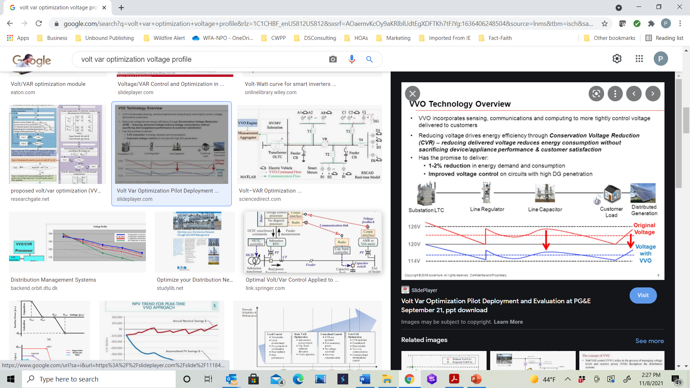
Volt VAR Regulation Profile

Slide 4
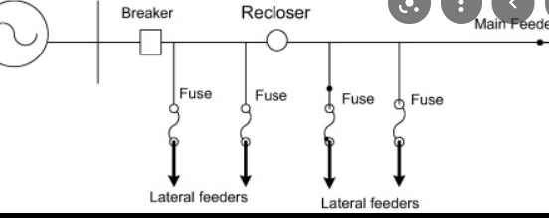
Simple feeder protection diagram
Feeder Profile

Slide 5
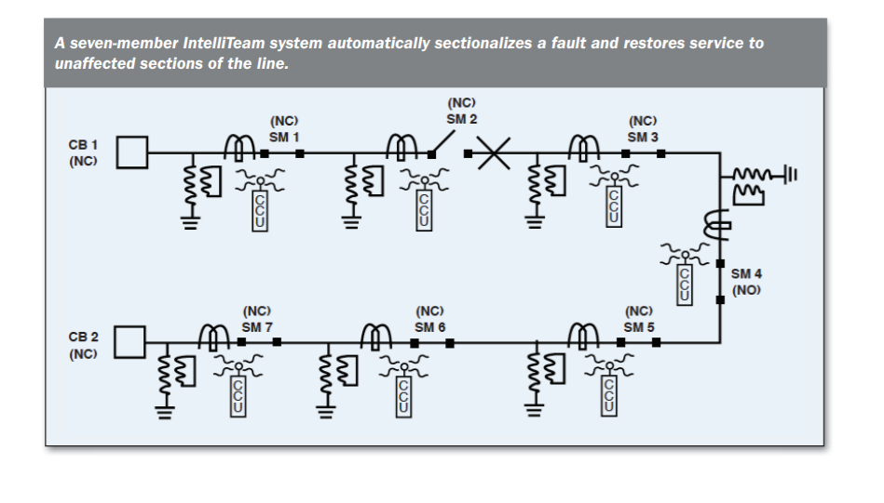
IntelliTeam auto-restoration diagram

Slide 6
Standard Utility Practices
Issue | Standard Practice
In-service Failure of High-Consequence Assets Substation Equipment Utility Poles | Periodic, objective testing programs to identify assets in need of replacement
In-service Failure of Low-Consequence Assets | Run-to-Failure (for overhead) 3 strikes and replace (for underground)
Circuits with Poor Reliability | Worst Performing Circuit Program

Slide 7
Standard Practices and Common Abuses
Standard Practice | Common Abuse
Periodic, objective testing programs to identify assets with high consequence of failure in need of replacement | Indiscriminate asset replacement due to age (prospective replacement)
Run-to-Failure for assets with low consequence of failure | Circuit Rebuild programs
Worst Performing Circuit Programs | Circuit Rebuild programs
Distribution Planning | Separate, distinct grid modernization efforts Electric Vehicles, oh my! Two-way Power Flow, oh my!

Slide 8
So, What has changed
Utilities Insist | Reality
That even low penetrations of DER will cause problems on the system | HECO in Hawaii has the highest penetration of DER in the country at 35% and they are just starting to implement some of these systems.
They need to implement large interactive system like ADMS and DERMS | These systems may not be needed for years because of the slow implementation of DERs on the system
They need to implement equipment system wide | Equipment should only be implemented on circuits when cost justified.
They need to replace distribution equipment in advance of failures | They should only replace significant equipment based on testing and allow distribution equipment to “Run to Failure”

Slide 9
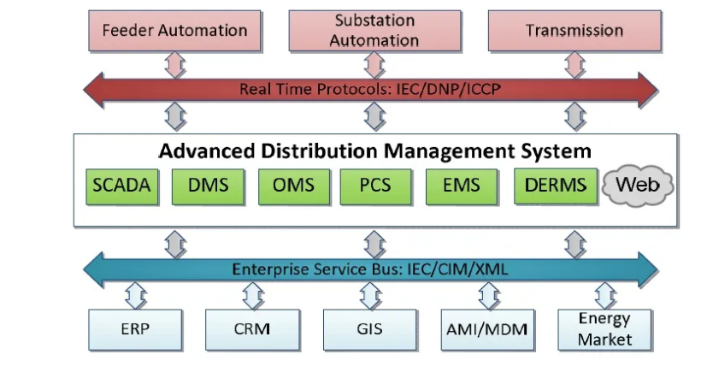
ADMS

Slide 10
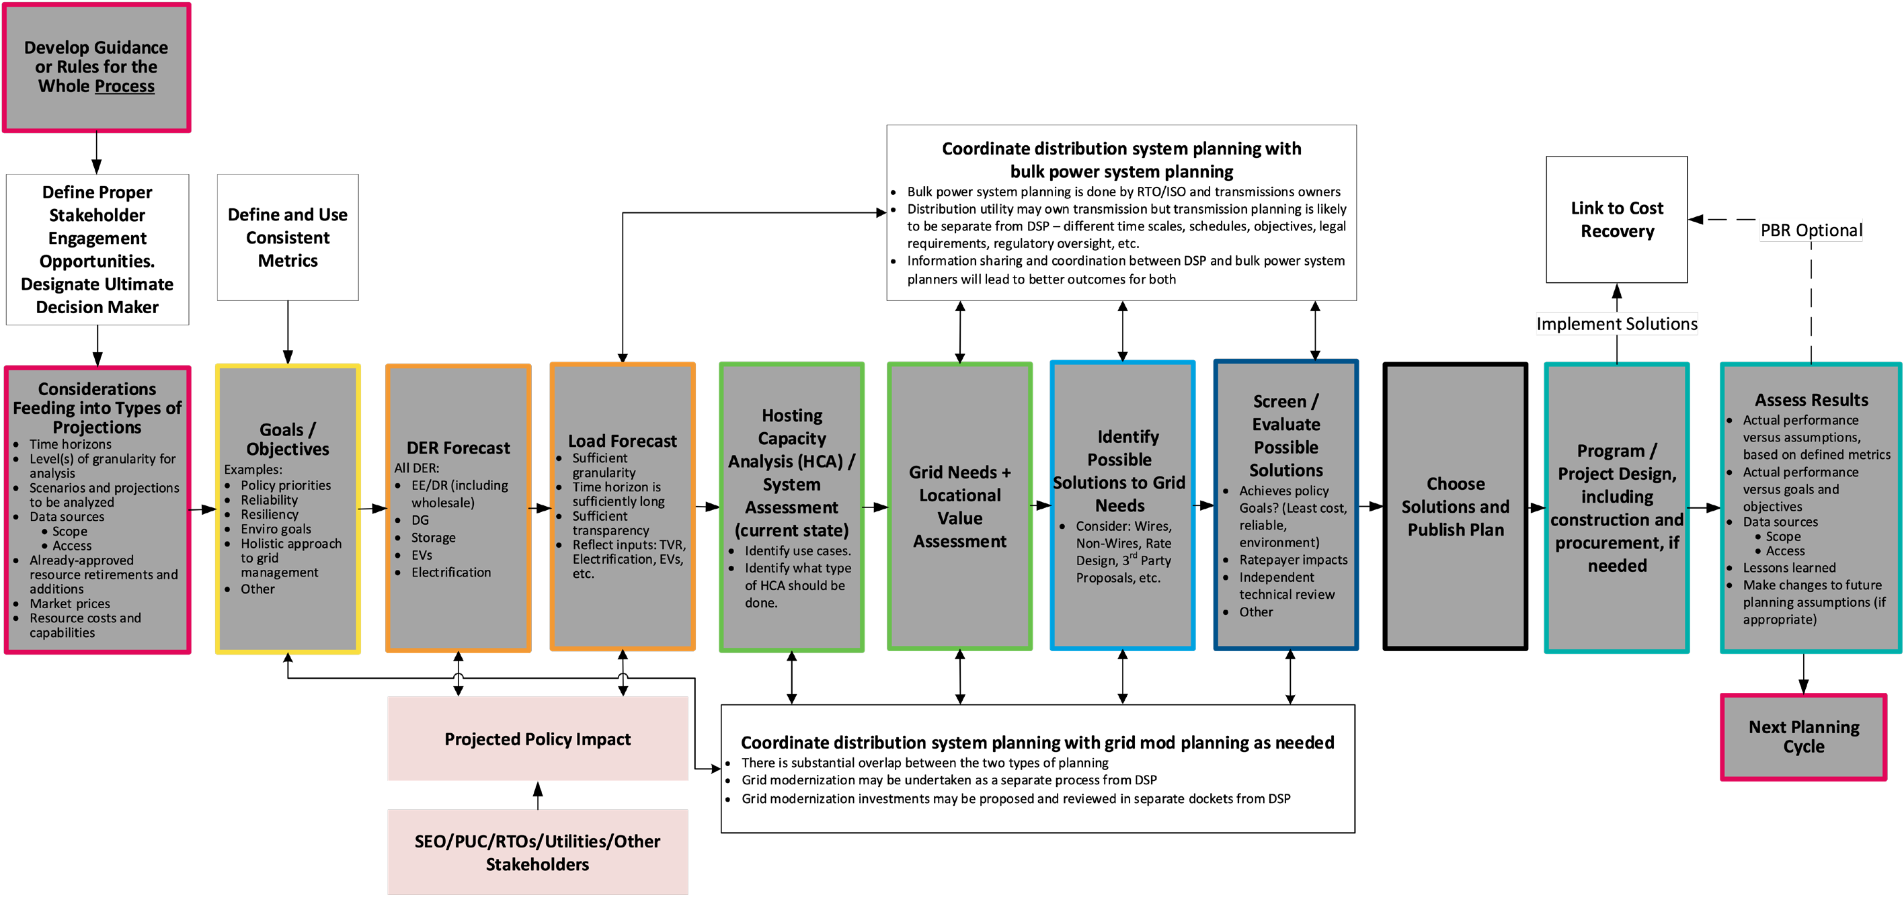
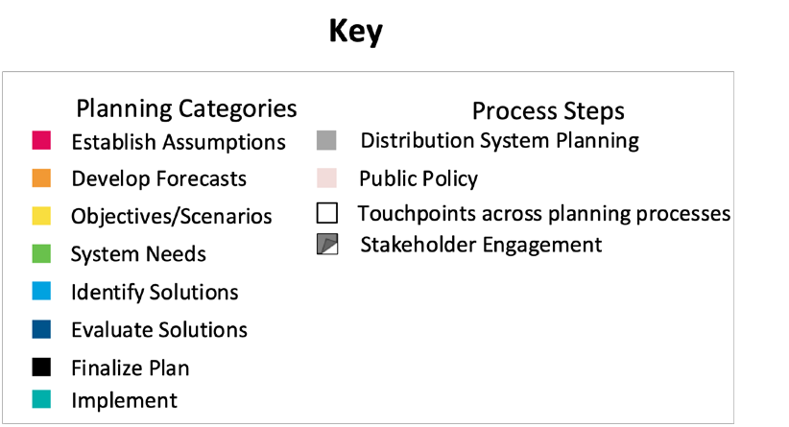
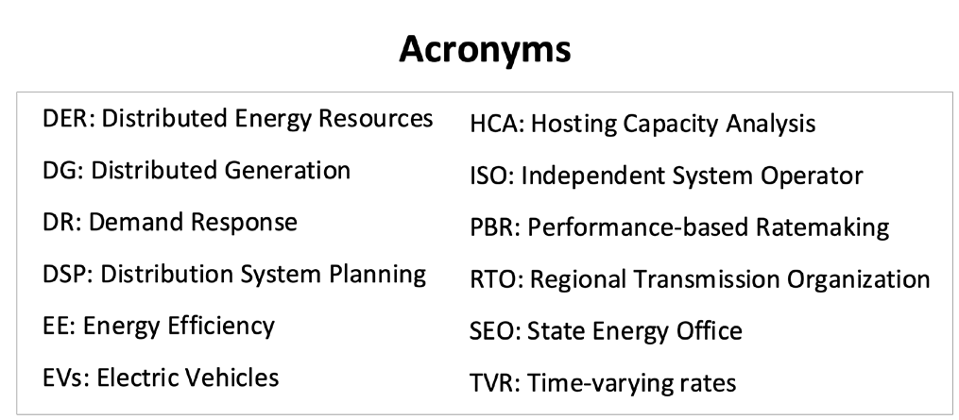
Jade Cohort Flowchart of Idealized Comprehensive Electricity Planning Process
A Distinct Grid Mod Process Is Not Necessary!
Jde Cohort Roadmap — NARUC-NASEO Task Force on Comprehensive Electricity Planning | 5

Slide 11
Thank You!
Dennis Stephens, Wired Group
Dstephens@wiredgroup.net
Mobile 303-434-0957
Office 303-997-0317, x-701
www.wiredgroup.net
www.utilityevaluator.com

