Slide 1
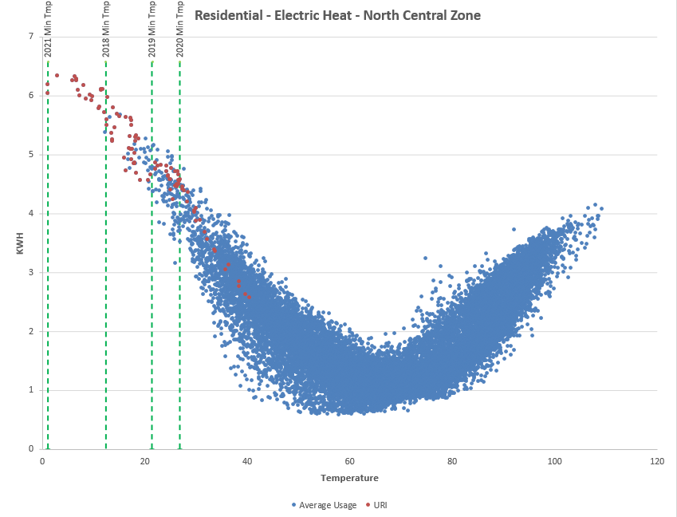
Reliant (NRG) sampled four (4) years of hourly historical data for 5,000 residential electric-heat customers who were not interrupted during Winter Storm Uri.
Each dot represents a measurement of the hourly usage per avg customer in the sample. Purple dots represent samples taken for hours during Winter Storm Uri.

Slide 2
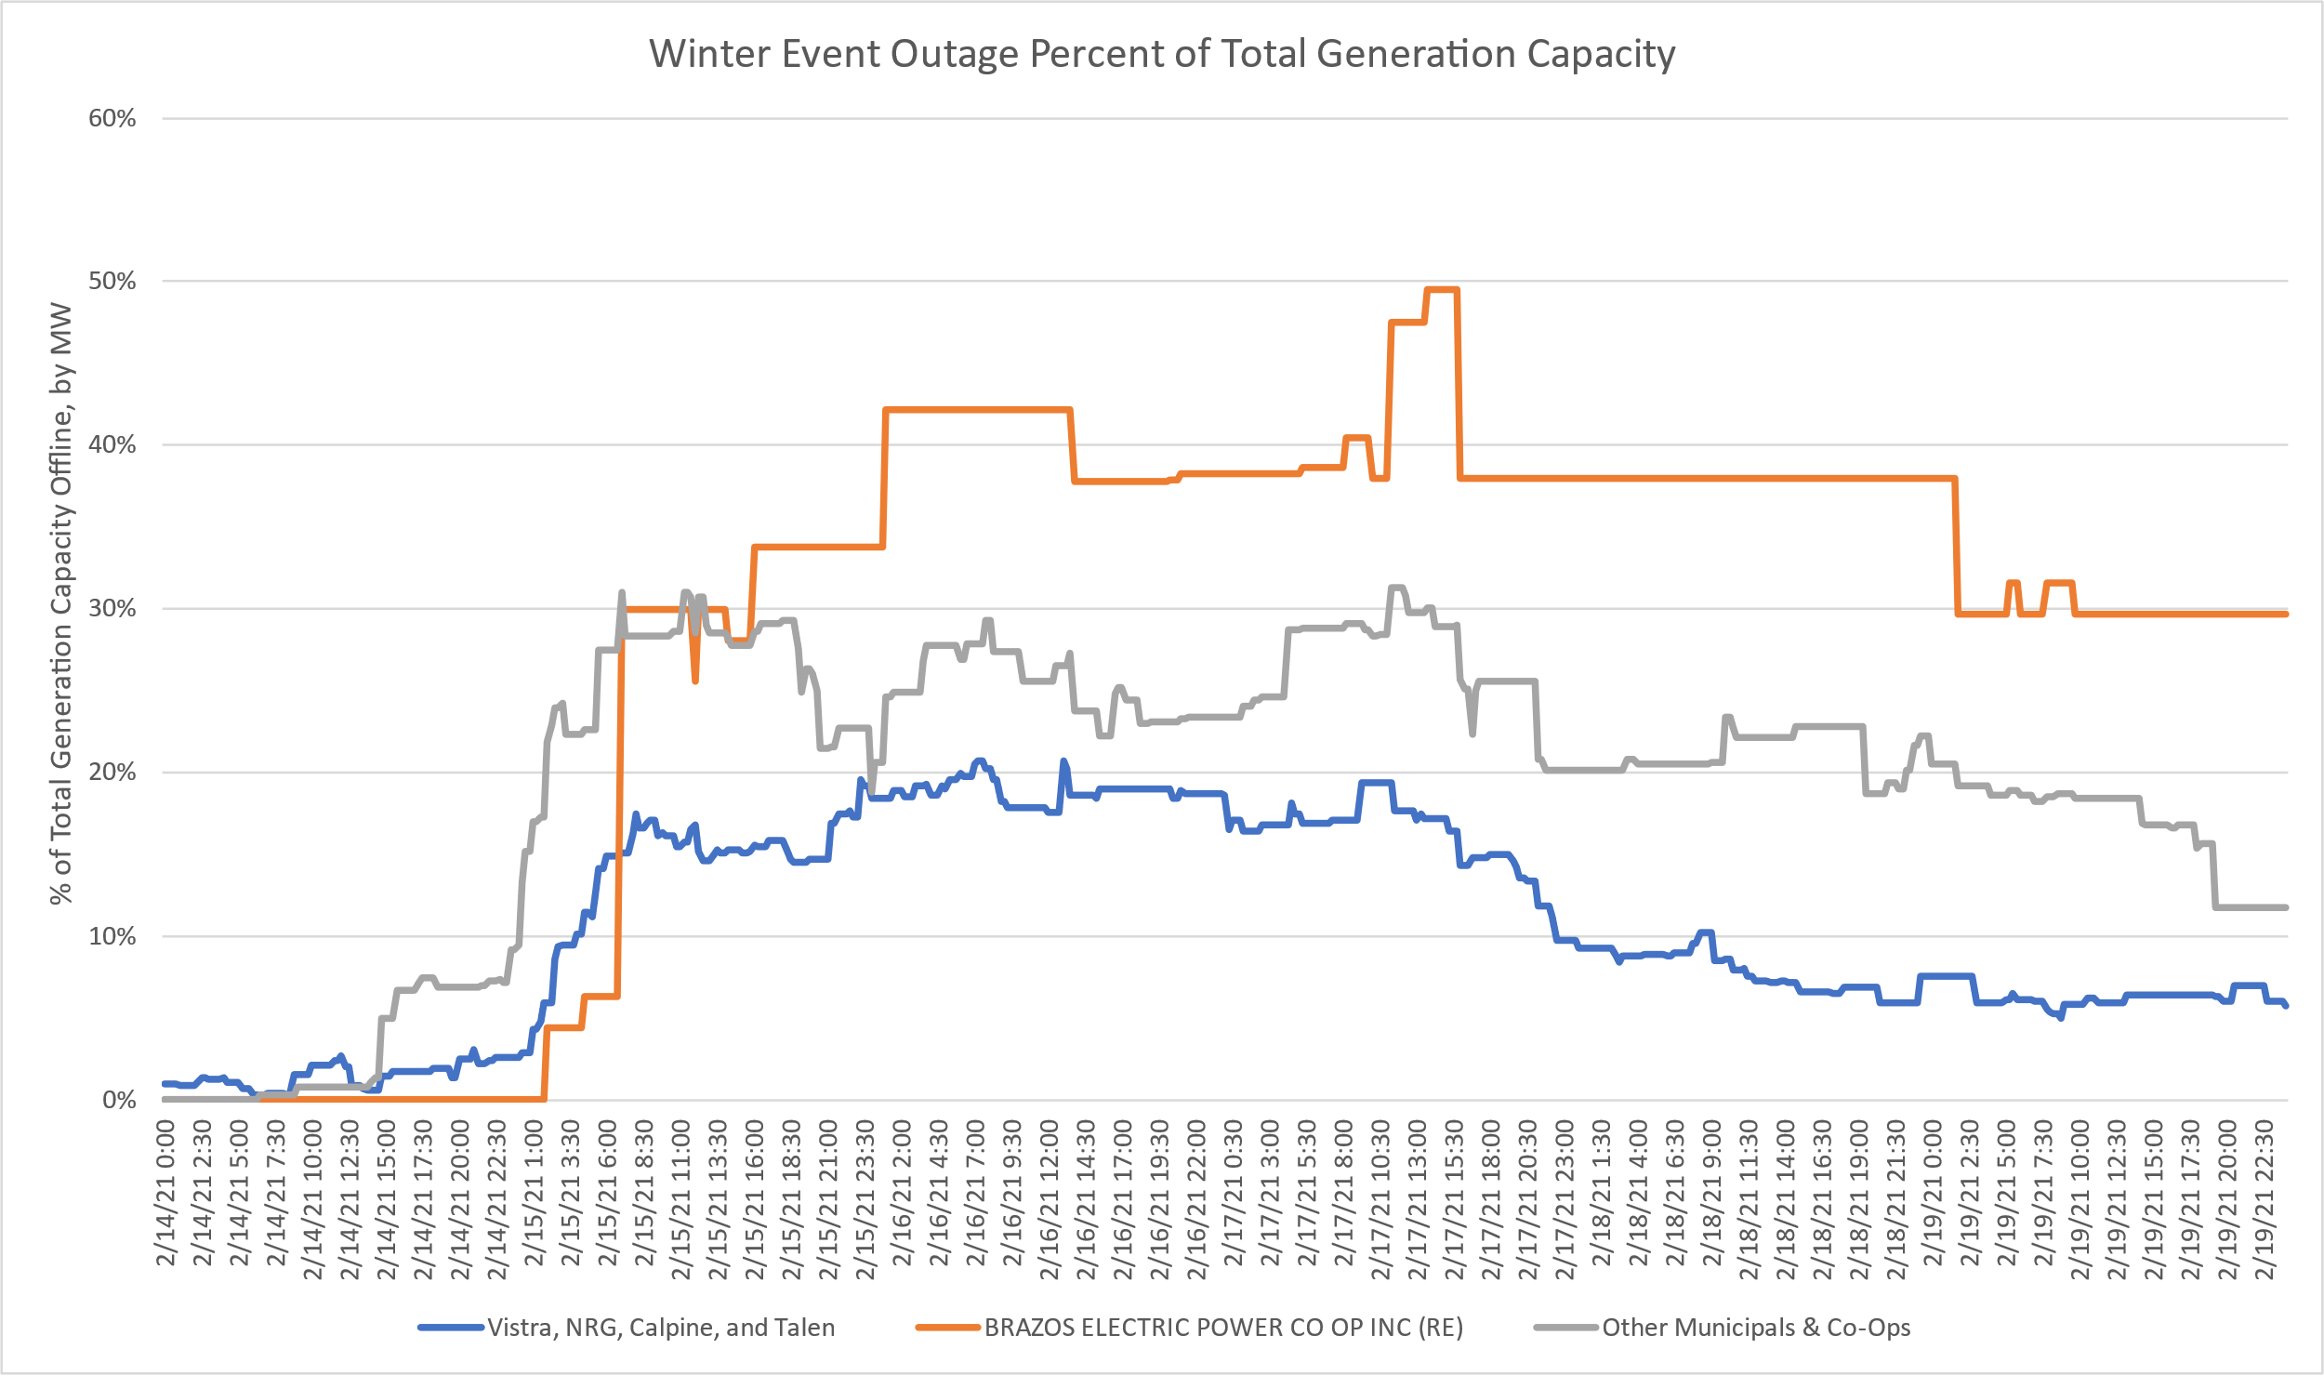

Slide 3
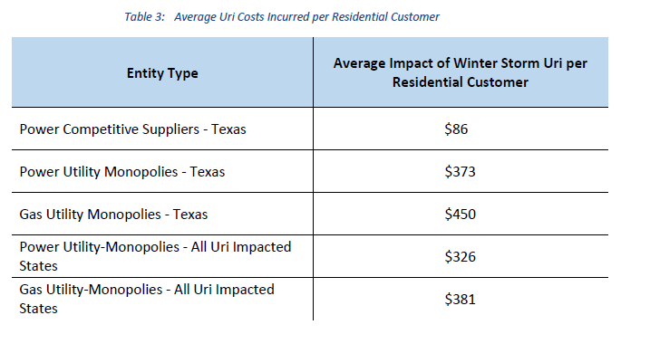
Guy Sharman & Jeffrey Merola, “Beyond Texas: Evaluating Customer Exposure to Energy Price Spikes—A Case Study of Winter Storm Uri, February 2021” (Intelometry: Oct. 2021).

Slide 4
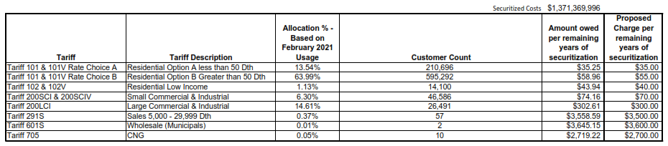
Consumer Impacts will Linger for Decades
ONEGas’s operating company Oklahoma Natural Gas proposing an $875-1,375 fee tied to cost per residential customer of Uri gas purchases, to be paid over time.
ONEGas spent approx. $2.1B in gas costs during Winter Storm Uri. Its total rate base (across all jurisdictions) is $2.3B

Slide 5
PUCT considering a re-design of ERCOT market, including:
Market price cap, VOLL, and ORDC
Ancillary services (e.g., Non-Spin)
Winter fuel reserve product
Mandatory hedging or reliability-purchase requirements (e.g. the LSE Reliability Obligation)
PUCT plans to publish a ‘blueprint’ for market design in late December.

