Slide 1
FERC Update
National Association of State Utility Consumer Advocates
Annual Meeting
Louisville, Kentucky
November 8, 2021
Jason Gray
Partner
Duncan & Allen LLP
1730 Rhode Island Avenue, NW, Suite 700
Washington, DC 20036
(202) 842-8197
jtg@duncanallen.com

Slide 2
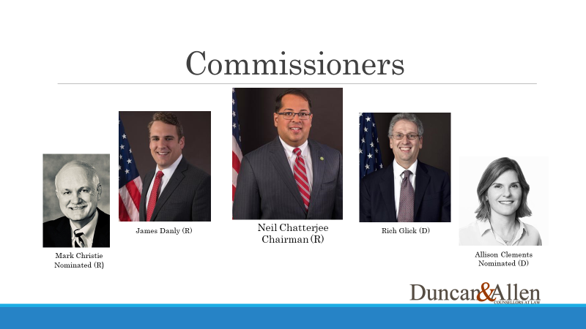
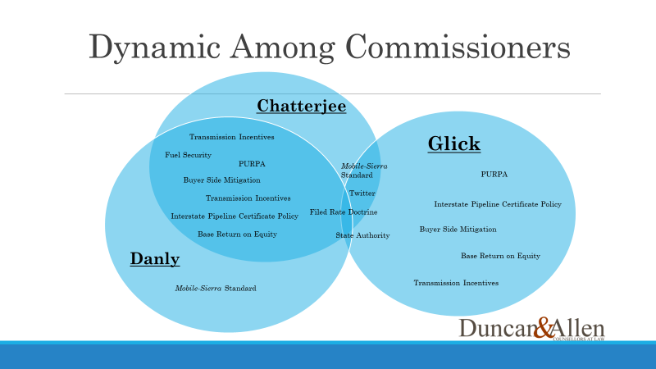
Same Time Last Year

Slide 3
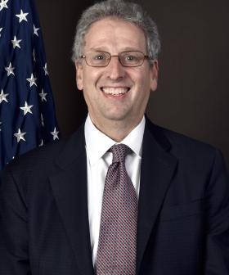
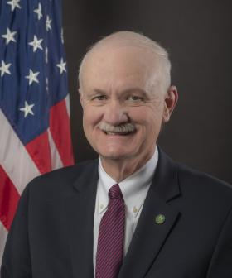
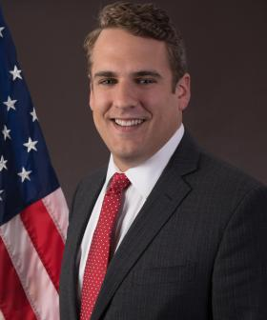
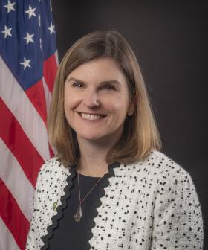
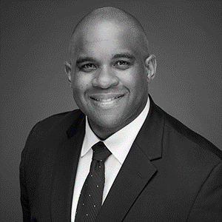
New Lineup
Richard Glick
Chairman (D)
Mark Christie (R)
James Danly (R)
Allison Clements (D)
Willie Phillips (D)
Nominated

Slide 4
New Dynamic
Danly
Regulatory Worldview: “Humble Regulator” and Strict Constructionist
Glick
Maintaining Status Quo on Base ROEs*
Regulatory Worldview: Address Changing Landscape/Facilitate Modernization
Environmental Justice
Pipeline Certificate Policy
Transmission Incentives
Transmission Build Out to Facilitate DER Deployment
Expanding or maintaining FERC/federal Authority
PURPA
Transmission Incentives including maintaining RTO Participation Adder
Pipeline Certificate Policy
States’ Rights and Limited
Role of FERC
PURPA
Mobile-Sierra Doctrine
Limiting RTO Participation Adder
Christie
Revisiting Base ROE Methodology*
Regulatory Worldview: Practical and Traditional “State PUC” Approach
Clements
Skeptical of RTOs/ISOs and restructuring
*See next slide for details

Slide 5
New Administration’s
Policy Initiatives
Transmission Expansion to Support Deployment of Distributed Energy Resources
- ANOPR on Transmission Planning and Generator Interconnection, RM21-17
- Managing Friction Between Policy Goal and Rate Increases, RM20-10
- Order 2222 Compliance and Further “Opt Out” Provision, RM21-14
Environmental Justice and Climate Change
- Creating Office of Public Participation
- Revising Pipeline Certificate Policy Statement, PL18-1, CP17-40, et al.
Inherited/Imposed Issues
- Winter Storm Uri

Slide 6
Docket No. RM21-17 ANOPR
Broad ANOPR issued July 15, 2021
- Lack of clear consensus among commissioners
- Initial comments filed October 2021
- Technical Conference on November 15, 2021
- Reply Comments due December 2021
- Anticipated NOPR by end of 2022

Slide 7
Return on Equity
Oral Argument on MISO Complaints
- November 18, 2021
- Decision in mid-2022?
Supplemental Technical Conference on Incentives
- September 10, 2021 Technical Conference
- January 2022 Comments

Slide 8
Specific Example:
*Base ROE Methodology
Commissioner | Position on Approach Established in Opinion 569 | Recent Public Statements on Durability of Opinion 569 Approach
Glick | Opposed results-driven tweaks and internal inconsistencies | Emphasizes “need for certainty” over prior criticisms
Clements | Not a commissioner at the time | Shares Glick’s original criticisms and supports re-opener to address/fix DCF and CAPM methodologies
Christie | Not a commissioner at the time | Shares Clements’ view on re-opener but emphasizes discretion and judgment over “rote application of pre-set formulae”
Danly | Fully supported | No discernible change in position
Phillips | Not a commissioner at the time | N/A

