Slide 1

Equity, Affordability, and Connecting Customers with Assistance
Obtaining and Using
Utility Collections Data
NASUCA National Meeting, November 8, 2021
Susan L. Satter, Chief
Charles “Trey” Murphy, Assistant Attorney General
Public Utilities Bureau
Illinois Attorney General's Office

Slide 2
Focus on Affordability
2009-2010 – General Assembly adopts Percentage of Income Payment Plan and approves Uncollectible Rider for gas and electric utilities
PIPP funding = $23,305,404
Number of customers on PIPP = 22,226
LIHEAP funding = $147,979,298
Number of customers receiving LIHEAP = 251,433
(typical year)

Slide 3
Uncollectible Expenses as % of Residential Revenues Over Time
 | Ameren Gas | Ameren Electric | ComEd | Peoples Gas
2013 | 1.22% | 1.27% | 2.03% | 9.28%
2014 | 1.75% | 1.13% | 1.21% | 6.70%
2015 | 1.52% | 1.34% | 1.30% | 8.14%
2016 | 1.01% | 1.43% | 1.39% | 7.64%
2017 | 1.00% | 1.23% | 1.22% | 7.11%
2018 | 1.16% | 1.19% | 1.26% | 6.50%
2019 | 1.04% | 1.14% | 1.14% | 7.54%

Slide 4
Continuing Affordability Issues
Uncollectibles = disconnection, so we intervened in the uncollectible reconciliations to question whether consumers were given enough of a chance to pay and not be disconnected/uncollectible
We challenged PG infrastructure plan as increasing rates to unaffordable levels.
Late 2019, we presented the Commissioners with the NASUCA/NARUC resolution
Led to interest from several commissioners, and opening of an NOI on affordability
COVID hit, we encouraged the Governor’s office to both adopt a utility disconnection moratorium and to adjust credit and collection policies for at least 6 months
Consumer Utility Stipulation

Slide 5
New Tools and Protections
Joint Consumer Parties acted together
Stipulation required 24 month payment plans, extended multiple times
Increased assistance from consumers – utilities refused to contribute
Staggered disconnection notices/disconnections
Established extensive reporting by zip code
Shout out to NCLC for pushing utilities to do what they claimed they couldn’t do
New statute continues monthly zip code reporting- 220 ILCS 5/8-201.10 (b)

Slide 6
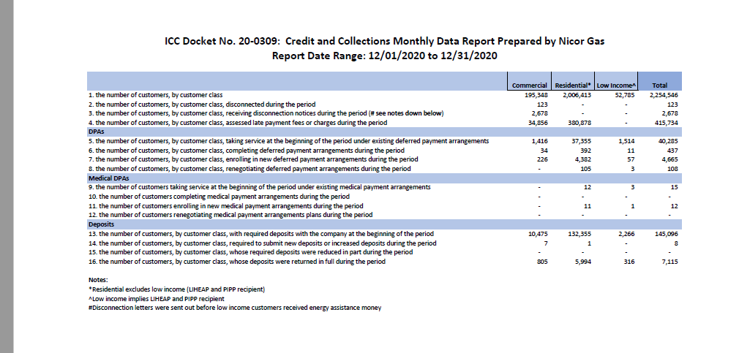
Sample Summary Report

Slide 7
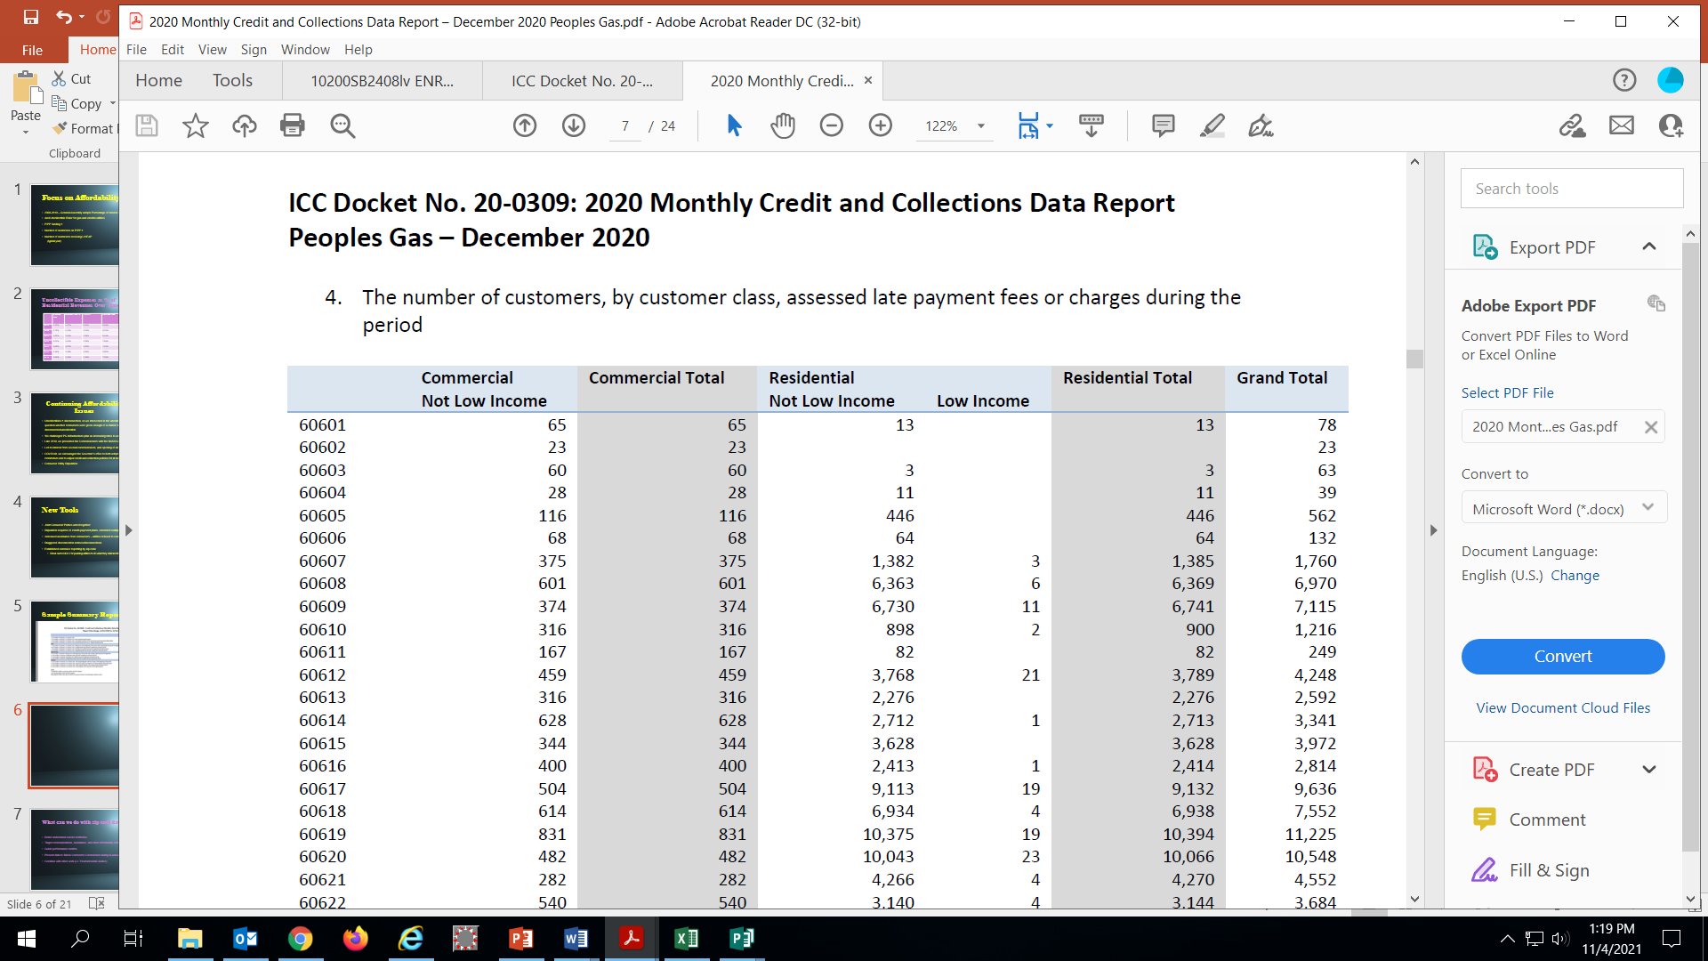
Sample Zip Code Data

Slide 8
What can we do with zip code data?
Better understand service territories
Target communications, assistance, and other affordability initiatives
Guide performance metrics
Present data to Illinois Commerce Commission during bi-annual policy sessions
Combine with other work (i.e. Environmental Justice)

Slide 9
Clean Energy Jobs Act (CEJA)
Public Act 102-0662 (passed Sept. 2021)
956-page bill that included nuclear plant bailouts, beneficial electrification, electric vehicles, performance metrics, removed late fees and deposits for low-income customers, and more.
Codified 22 datapoints that utilities must report at a zip-code level each month
While the utilities have been reporting much of this data throughout the COVID moratorium, they reported their first data under the Act on October 15th (September data)

Slide 10
Overall
Used data to find 10 zip codes with the highest number of disconnection notices for each of the four largest utilities in Illinois (Commonwealth Edison, Ameren Illinois, Nicor Gas, and Peoples Gas)
To avoid skewed data, we looked at zip codes with at least 500 residential customers in Ameren’s territory, and at least 1,000 customers in other territories
7/10 of ComEd’s zip codes overlapped with zip codes in the top 10 for either Nicor or Peoples Gas –resulting in 33 unique zip codes between the four major utilities
Race and Ethnicity - 29 zip codes were majority Black; 2 were majority Hispanic; and 2 were majority white. In comparison, Illinois is 76.8% white, 17.5% Hispanic, and 14.6% Black, overall.
Notes:
I added the ”skewed data” assumptions, because there were some zip codes with only 1 customer and that customer received a disconnection notice, leading to a 100% disconnection notice rate. I used 500 for Ameren, because it serves more zip codes with fewer residential customers than the other utilities

Slide 11
Overall (Continued)
Income – All 33 zip codes were below the state median income of $65,886; and 28 were below 80% of the state median income
Poverty – 30 of the 33 zip codes had poverty levels higher than the state poverty level of 11.5%
29 of 33 were largely filled with Environmental Justice Communities
Notes:
I return to environmental justice communities later.

Slide 12
Commonwealth Edison
Zip Code | Location | # Res. Cust. | # Notices | % Notices | Median HH Income | Poverty Level | Race & Ethnicity
60827 | Calumet Park/ Riverdale | 8,970 | 1,072 | 11.95% | $23,329 | 27.2% | Black (89.8%); Hispanic (5.2%); White (3.0%)
60466 | University Park | 11,834 | 1,400 | 11.83% | $54,155 | 7.9% | Black (65.5%); White (25.2%); Hispanic (5.0%)
60419 | Dolton | 8,509 | 990 | 11.63% | $46,658 | 18.0% | Black (92.3%); White (3.5%); Two or more (1.9%)
60426 | Harvey | 12,354 | 1,356 | 10.98% | $33,182 | 24.8% | Black (68.4%); Hispanic (24.1%); White (3.7%)
60478 | Tinley Park | 6,003 | 644 | 10.73% | $61,929 | 6.2% | Black (89.7%); White (3.9%); Hispanic (3.7%)
60624 | Garfield Park | 14,910 | 1,584 | 10.62% | $23,429 | 37.6% | Black (90.1%); Hispanic (5.1%); White (3.2%)
60411 | Chicago Heights | 20,717 | 2,138 | 10.32% | $47,769 | 18.3% | Black (50.2%); Hispanic (27.6%); White (18.6%)
60636 | W. Englewood | 11,952 | 1,224 | 10.24% | $26,724 | 29.5% | Black (87.8%); Hispanic (9.4%); White (1.5%)
60644 | S. Austin | 17,884 | 1,823 | 10.19% | $26,900 | 28.7% | Black (88.3%); Hispanic (6.9%); White (3.8%)
60621 | Englewood | 12,828 | 1,300 | 10.13% | $22,158 | 38.7% | Black (94.6%); Hispanic (3.2%); White (1.0%)

Slide 13
Ameren Illinois
Zip Code | Location | # Res. Cust. | # Notices | % Notices | Median HH Income | Poverty Level | Race & Ethnicity
62206 | East St. Louis | 5,338 | 1,202 | 22.52% | $36,196 | 25.0% | Black (58.3%); White (35.8%); Asian (2.7%)
61605 | Peoria | 5,707 | 1,219 | 21.36% | $21,276 | 43.2% | Black (58.1%); White (30.7%); Hispanic (7.9%)
62060 | Madison | 1,759 | 352 | 20.01% | $30,461 | 28.4% | Black (53.3%); White (42.0%); Two or More (2.4%)
62207 | Centreville | 2,987 | 564 | 18.88% | $20,273 | 36.5% | Black (94.8%); White (3.2%); American Indian (1.3%)
62204 | East St. Louis | 2,116 | 370 | 17.49% | $22,264 | 35.4% | Black (93.5%); Hispanic (3.4%); White (1.7%)
61603 | Peoria | 6,386 | 1,061 | 16.61% | $32,458 | 30.1% | Black (41.0%); White (40.6%); Hispanic (10.6%)
62205 | Centreville | 3,126 | 513 | 16.41% | $25,821 | 26.5% | Black (94.5%); White (2.8%); Hispanic (2.0%)
62087 | S. Roxana | 797 | 116 | 14.55% | $45,200 | 27.4% | White (85.1%); Black (9.9%); Hispanic (2.9%)
62201 | East St. Louis | 2,169 | 311 | 14.34% | $15,408 | 50.4% | Black (63.8%); Hispanic (26.2%); White (9.2%)
62203 | Centreville | 2,599 | 350 | 13.47% | $39,216 | 16.0% | Black (93.9%); White (4.1%); and Asian (0.9%)

Slide 14
Affordability – Performance Metrics
As part of the performance metrics process, the Act requires at least one performance metric, addressing affordability, defined as:
Achiev[ing] affordable customer delivery service costs, with particular emphasis on keeping the bills of lower-income households, households in equity investment eligible communities, and house in environmental justice communities within a manageable portion of their income and adopting credit and collection policies that reduce disconnections for those households specifically and for customers overall to ensure equitable disconnections, late fees, or arrearages as a result of utility credit and collection practices, which may include consideration of impact by zip code. 220 ILCS 5/16-108.18(e)(2)(A)
Emphasis on lower-income households; equity investment eligible communities; and environmental justice communities is repeated throughout the Act.

Slide 15
Environmental Justice Communities
Environmental Justice is:
“the principle… that no segment of the population, regardless of race, national origin, age, or income shall bear disproportionately high or adverse effects of environmental pollution.” 415 ILCS 155.
Environmental Justice Communities are:
Targeted census blocks groups (average of 40 census blocks), typically consisting of between 600-2,000 people, that are experience disproportionately high levels of environmental pollution
Illinois Power Agency (“IPA”) and Illinois Solar For All (“ISFA”) find these areas using a calculation that multiplies environmental exposure levels by socioeconomic factors (next slide)
Also, a self-certification process

Slide 16
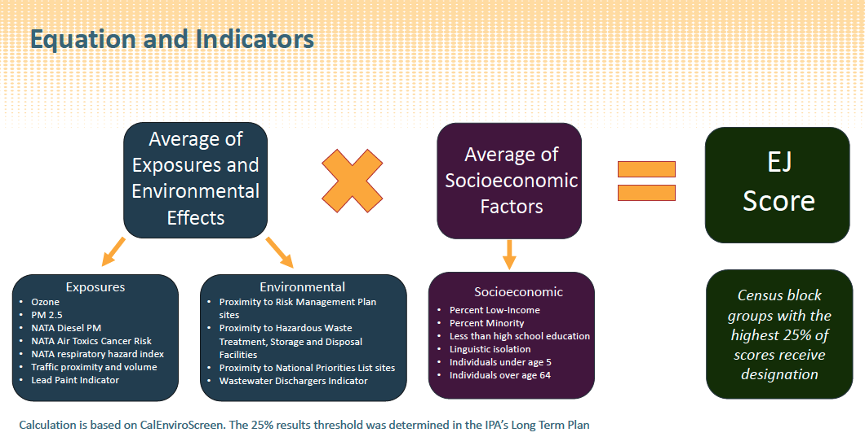
Environmental Justice Communities

Slide 17
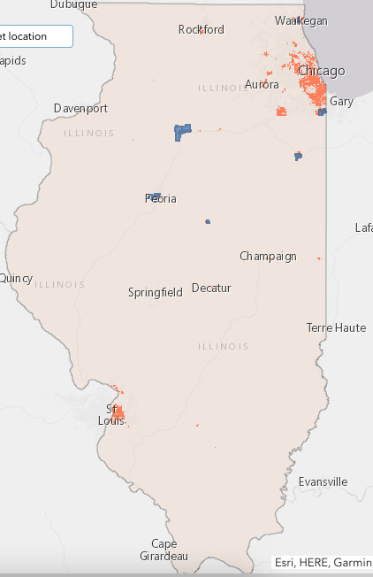
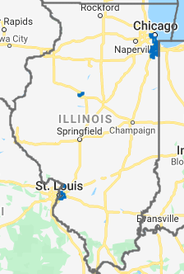
Environmental Justice Communities
Zip Codes w/ Highest Disconnection notices (9/21)

Slide 18
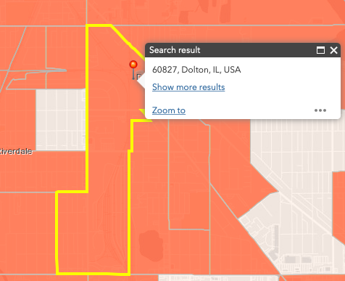
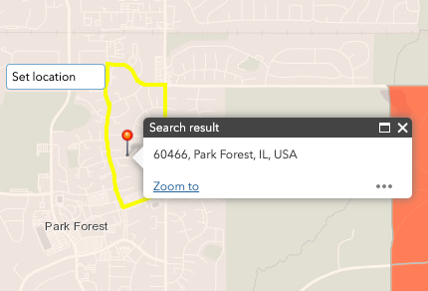
Commonwealth Edison
1 - 60827
2 - 60466
Notes:
While 60466 is not filled with EJ Communities, it is an outlier – ComEd’s other 9 zip codes are overwhelmingly filled with EJ communities

Slide 19
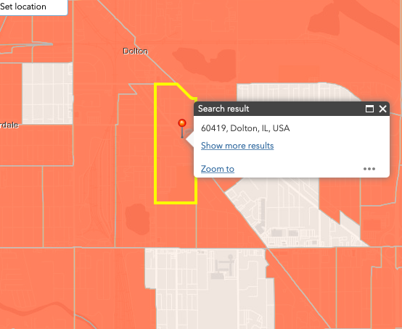
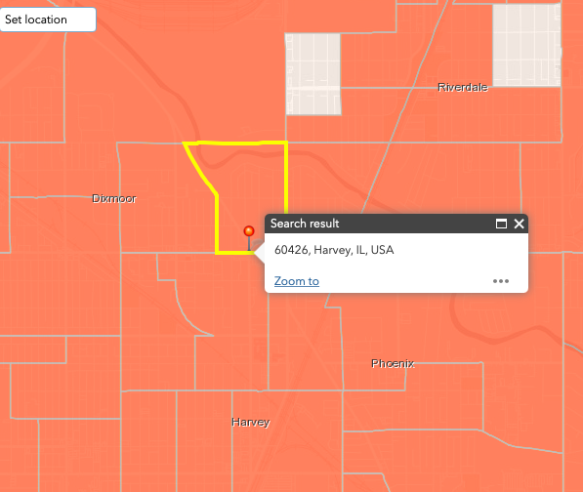
Commonwealth Edison
3 - 60419
4 - 60426

Slide 20
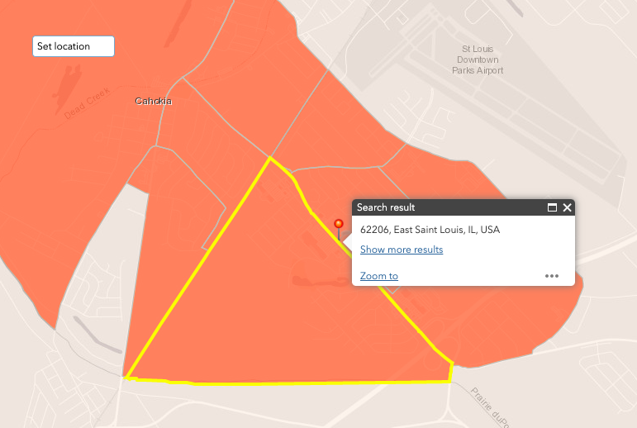
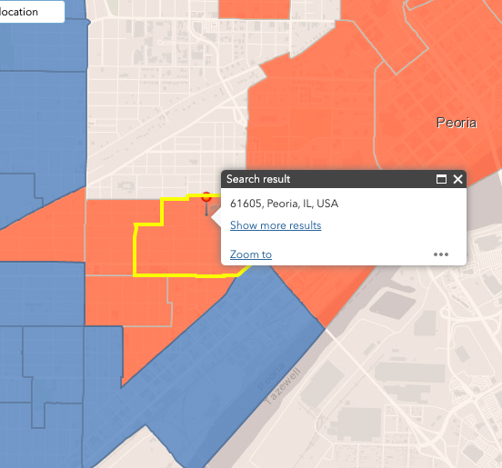
Ameren Illinois
1- 62206
2- 61605

Slide 21
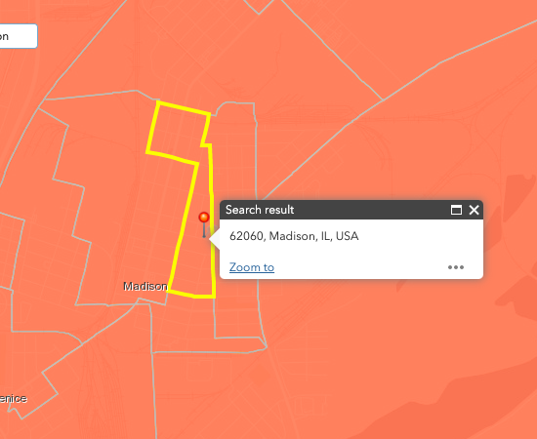
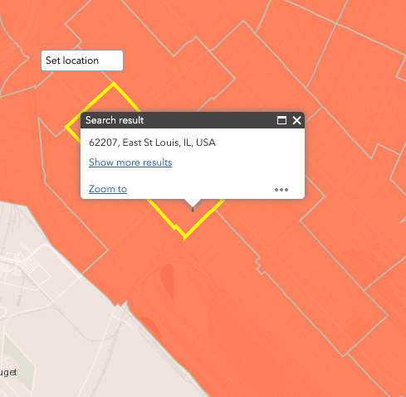
Ameren Illinois
3 - 62060
4 - 62207

Slide 22
Where do we go from here?
We’ve been discussing potential uses for the zip code data and overlap with EJ Communities with other stakeholders, for advice on how to guide affordability initiatives, moving forward.
CEJA offers many opportunities to use the data, including performance metrics, additional low-income protections, grid investment and enhancements, and the possibility of discount rates.
We welcome input from others and would love to hear whether other states are receiving similar data and how they are using it.

Slide 23
Thank you for your attention
Susan L. Satter, Chief
Charles “Trey” Murphy, Assistant Attorney General
Public Utilities Bureau
Illinois Attorney General's Office
100 West Randolph Street, 11th Floor
Chicago, Illinois 60601
Susan.Satter@ilag.gov
Charles.Murphy@ilag.gov

