Slide 1
Federal Update
The Infrastructure Bill, Budget Reconciliation, and Appropriations
Lola Infante
Executive Director, Government and External Affairs
November 2021

Slide 2





American Jobs Plan
Biden’s $2 Trillion Infrastructure Plan
MAJOR PROVISIONS RELEVANT TO ENERGY
Electric Vehicles ($174 billion)
500,000 EV chargers by 2030
Electrify the federal fleet
Renewed Electric Grid ($100 billion)
100% carbon-free electricity by 2035
Grid Deployment Authority
24/7 clean power for federal buildings
Energy Efficiency and Clean Electricity Standard (EECES)
Efficiency and Buildings
Build/ retrofit two million efficient homes and buildings
$100 billion school energy efficiency, clean energy, resilience
$27 billion Clean Energy and Sustainability Accelerator
R&D Investments
$35 billion technology breakthroughs, ARPA-C—utility-scale storage, CCS, H2, nuclear, floating wind, biofuels, EVs
$46 billion in federal buying power for electric vehicles, charging ports, electric heat pumps.
$100 billion in workforce development
Equity and Justice
40% of benefits directed to underserved and disadvantages communities
Executive Orders
Appropriations—
FY22 and FY23
Infrastructure Bill
Budget Reconciliation—
Directed Spending

Slide 3

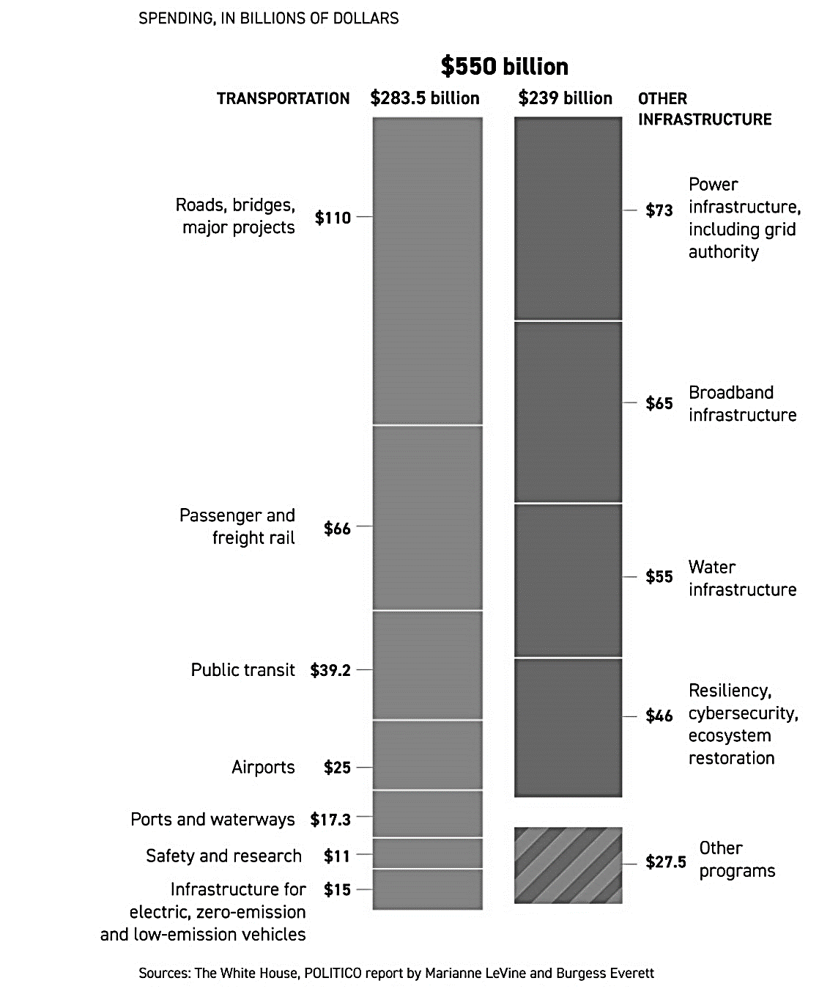








Infrastructure Bill – Infrastructure Investment and Jobs Act (HR 3684)
SPENDING
$1T total
KEY PROVISIONS
$15B for electric vehicles and associated infrastructure
$73B for electric grid infrastructure
$9.5B+ for hydrogen-related R&D activities
$6B credit program for nuclear competitiveness in electricity markets
Senate
House
President signature
(Reconciliation)
Available to Agencies
NEXT STEPS
Aug 10
Passed infrastructure bill + budget resolution
House passed $3.5 trillion Budget Resolution
Aug Senate passed BIF
Nov 5. House passed BIF
H and S write and pass budget reconciliation bill, can take months
BIF awaiting signature
Updated 8/16/2021

Slide 4
Infrastructure Bill
Breakdown by DOE Applied Energy Office
Fossil $7.5B
Nuclear $6B
CCS, LCRI, Net-zero Industrial hub
Credit Program
CESER $550M
Cybersecurity, Critical Infrastructure
Clean Energy Demonstrations
$21.4B
EERE
$16.26B
Advanced Reactors, CCS, H2 Hubs, Storage
EVs, Battery Recycling, Clean H2
Electricity
$8.1B
Resilience, Transmission, Smart Grid

Slide 5
Infrastructure Bill Agency/ Office Breakdown
Office | Additional $ | Key Provisions ($ amounts over several years)
DOE Office of Energy Efficiency and Renewable Energy (EERE) | $16.26B | Grants for implementing updated building energy codes ($225M) Energy Efficiency Grants ($550M), facilities ($250M), schools ($500M), loans ($250M) Energy efficient transformer rebates ($10M) Battery Material Processing Grants ($3B) Clean Hydrogen Manufacturing Recycling ($500M), Electrolysis ($1B) AMO ($750M) and Electric Drive Vehicle Battery Recycling ($200M) State Energy program ($500M), WAP ($3.5B) Hydroelectric incentives ($553.6M)
DOE Cyber, Energy Security, Emergency Response (CESER) | $550M | Cybersecurity for the energy sector RD&D program ($250M) Energy sector operational support for cyber resilience program ($50M) Rural/ Municipal Utility Cybersecurity Grant Program ($250M)
DOE Office of Electricity (OE) | $8.1B | Grants to prevent outages and enhance grid resilience ($5B) Transmission Facilitation Program ($50M) Smart Grid Investment Matching Grant Program ($3B)
DOE Nuclear Energy (NE) | $6B | Civil Nuclear Credit Program ($6B)
DOE Office of Fossil Energy and Carbon Management (FE) | $7.5B | Carbon Utilization Program ($310M) Front-end engineering and design program ($100M) Carbon storage validation and testing ($2.5B) Developing 4 regional clean direct air capture hubs ($3.5B) Carbon Dioxide Transportation Infrastructure Finance and Innovation Program ($2.1B)
Notes:
This could be a backup slide

Slide 6
Infrastructure Bill Agency/ Office Breakdown continued
Office | Additional $ | Key Provisions ($ amounts over several years)
DOE Office of Clean Energy Demonstrations | $21.4B | Advanced Reactor Demonstration Program ($2.5B) CCS demonstration ($2.5) and Pilot Projects ($937M) Regional Clean Hydrogen Hubs ($8B) Grid Reliability and Resiliency Grants ($5B) Energy Storage Demonstration Pilot Grant Program ($355M) and Long Duration Demonstration ($150M) Industrial Emissions Demonstration Projects ($500M) and Clean Energy Demonstration Projects on Former Mine Land ($500M)
Environmental Protection Agency (EPA) | $5B | Clean School Bus Program ($5B)
Department of Transportation (DOT) | $13B | National Electric Vehicle Charging Program ($5B) Low-to-no emission transit buses and ferries ($5.5B) Port infrastructure electrification and development ($2.25B) Strengthening Mobility and Revolutionizing Transportation Grant Program ($500M)
Department of Homeland Security (DHS) | $213M | Cybersecurity Response and Recovery Fund ($100M) Critical infrastructure security and resilience RD&D ($157.5M)
Department of the Interior (DOI) | $1.5B | Wildfire risk mitigation ($1.1B)
Complete breakdown available on Inside EPRI [link]
Notes:
This could be a back up slide

Slide 7



Budget Reconciliation
OVERVIEW
STATUS
PROSPECTS
$1.75 T (down from $3.5 trillion)
$555 billion in investments in clean energy, energy efficiency, and climate provisions
Clean Energy Payment Program eliminated ($150 B)
  Build Back Better (HR 5376)
  Procedural vote in House
  Tentative vote in House mid-November
  Senate vote unknown
  Resolution Passed Senate Aug 11
  (50-49)
  Resolution Passed House Aug 24
  (220-212)
  Committees tasked with crafting legislation
Energy Provisions
Funding
Clean Energy Tax Credits ($320B)
Resilience Investments ($105B)
Investments and Incentives for Clean Energy Technology, Manufacturing, and Supply Chains ($110B)
Clean Energy procurement ($20B)
The package is funded via an array of measures, including a 15% Corporate Minimum Tax on Large Corporations, a Stock Buybacks Tax, surcharges on wealthy individuals, and more

Slide 8
HR 5376 Climate provisions
Clean Energy Tax Credits ($320 billion)
o Ten-year expanded tax credits for utility-scale and residential clean energy, transmission and storage, clean passenger and commercial vehicles, and clean electricity manufacturing.
o Enhancement and expansion of existing home energy and efficiency tax credits.
o Creation of a new, electrification-focused rebate program.
o Allows rural communities to tap into targeted lean energy grants and loans via the Department of Agriculture.
Resilience Investments ($105 billion)
o Investments and incentives to address extreme weather (wildfires, droughts, and hurricanes, including forestry, wetlands, and agriculture), legacy pollution in communities, and a Civilian Climate Corps.
Investments and Incentives for Clean Energy Technology, Manufacturing, and Supply Chains ($110 billion)
o Targeted incentives to spur new domestic supply chains and technologies, like solar, batteries, and advanced materials, while boosting the competitiveness of existing industries, like steel, cement, and aluminum.
o Clean Energy and Sustainability Accelerator with 40 percent of benefits to disadvantaged communities.
o Funds port electrification; cleaner transit, buses, and trucks; and includes grants to environmental justice communities.
Clean Energy procurement ($20 billion)
o Provide incentives for the government to be purchaser of next generation technologies, including long-duration storage, small modular reactors, and clean construction materials.

