Slide 1

NASUCA Annual Meeting November 9, 2021
Emmitt Carlton Acting Chief Consumer & Governmental Affairs Bureau Office of Intergovernmental Affairs

Slide 2

Outline
Overview of CGB, IGA and IAC
Emergency Connectivity Fund
Emergency Broadband Benefit Program

Slide 3
FCC’s CONSUMER AND GOVERNMENTAL AFFAIRS BUREAU (CGB)
10 Divisions and Offices – Main focuses are (i) consumer policy, information, outreach & complaints, disabilities access and (ii) governmental affairs
Consumer Issues:
Consumer Policy Division (CPD)
Consumer Affairs and Outreach Division (CAOD)
Consumer Inquiries and Complaints Division (CICD)
Disabilities Rights Office (DRO)
Governmental Affairs:
Office of Intergovernmental Affairs (IGA)
Office of Native Affairs and Policy (ONAP)

Slide 4
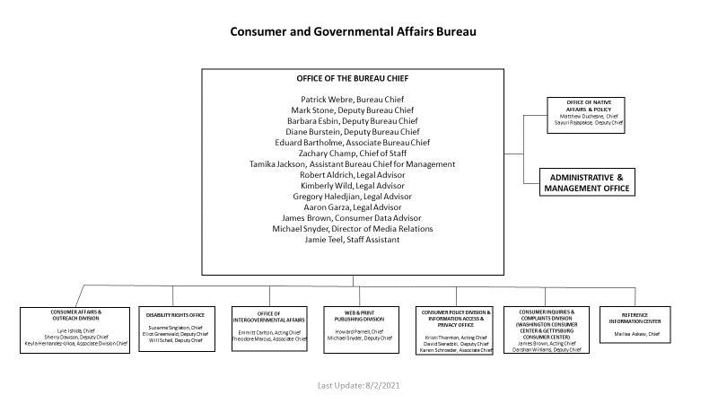
CGB ORGANIZATIONAL CHART
Notes:
This is a graphic illustrating the organization of CGB and its Offices and Divisions.

Slide 5
OFFICE OF INTERGOVERNMENTAL AFFAIRS
The Office of Intergovernmental Affairs, established in 2004, was created during an FCC re-organization to establish a primary point of contact and face of the FCC for state and local governments and their organizations
IGA staff each have responsibilities for outreach to state and local government organizations such as NATOA, National League of Cities, National Association of Counties

Slide 6
IGA ORGANIZATIONAL CHART
Consumer and Governmental Affairs Bureau
Patrick Webre, Chief
Barbara Esbin, Deputy Chief
IGA
Emmitt Carlton, Acting Chief and Deputy Chief
Theodore Marcus, Associate Chief
Donna Cyrus
Gayle Teicher
Aliza Katz
Senior Legal Advisors
Barbara Britt
Yvette Cage
Kamala Hart
Michelle Jones
Outreach Advisors
Notes:
Again, a graphic illustrating the organization of IGA and its members.

Slide 7
IGA’s MISSION
IGA is the portal for receiving and processing questions and referrals from state and local governments
If IGA can’t answer questions directly, it finds FCC subject matter experts who can
IGA is the portal providing information and outreach to state and local governments, as well as other federal regulatory agencies, for the purpose of fostering an understanding of FCC programs, policies, rules and decisions
Regularly attending and participating in conferences, seminars and industry meetings
Issuing informational blasts and webpage Spotlights
IGA oversees the work and activities of the Intergovernmental Advisory Committee (IAC), and ad hoc special projects like the Hospital Robocall Protection Group

Slide 8
INTERGOVERNMENTAL ADVISORY COMMITTEE
The IAC is a non-FACA advisory committee created by the FCC and governed by the Unfunded Mandates Reform Act.
Pursuant to UMRA, IAC meetings and communications with FCC staff are non-public to encourage candid exchanges.
The IAC advises the FCC on communications issues affecting state and local governments that are within the jurisdiction of the FCC and may be called upon to provide guidance on specific topics the Commission deems necessary to address matters before it.
Rules governing IAC’s operations are found at 47 CFR §0.701, which specify a minimum number of members from various categories to ensure proportional representation of state, local, municipal and Tribal governments, including executive and legislative levels.
The previous IAC submitted reports to the Commission on topics such as multilingual emergency alerting, state participation in state emergency communications committees (SECCS), intergovernmental disaster response coordination and state, local Tribal, and territorial barriers and incentives to telemedicine.

Slide 9
The Emergency Connectivity Fund

Slide 10
Overview
The $7.171 billion Emergency Connectivity Fund was created as part of the American Rescue Plan Act of 2021. Support is distributed to eligible schools and libraries to purchase eligible equipment and/or services for use by students, school staff, and library patrons with unmet needs at locations other than a school or library, during the COVID-19 emergency period.
Applicants may seek funding for (i) up to $400 for each connected device (laptops and tablets); and (ii) up to $250 for each Wi-Fi hotspot provided to a student, school staff or library patron.

Slide 11
ECF Award Activity
The FCC and the program administrator, USAC, opened two windows for schools and libraries to apply for the ECF Program.
During the first application filing window (June 29 to August 13, 2021), the program received requests for $5.137 billion. During the second application filing window (September 28 to October 13, 2021), the program received requests for nearly $1.3 billion.
As of October 25, 2021, the Commission has committed $2.63 billion in program funding to school and library applicants. With the first three waves, the FCC is providing support for over 6.1 million connected devices and nearly 2.9 million broadband connections to support 6,028 schools, 512 libraries, and 49 consortia.

Slide 12
Eligible Entities
Eligible Entities include:
Schools, libraries, and consortia of schools and libraries that are eligible for support under the E-Rate Program.
Elementary and secondary schools – as defined by states under the Elementary and Secondary Education Act (ESEA).
For-profit schools are not eligible for support
Schools with an endowment of $50 million or more are not eligible.

Slide 13
Eligible Entities (cont’d)
Libraries eligible for support under Library Services and Technology Act (LSTA).
Tribal libraries are eligible for support under LSTA and are therefore eligible for Emergency Connectivity Fund Program support.
Schools and libraries do not need to be participants in the E-Rate Program to participate in the Emergency Connectivity Fund.
Eligibility will be verified during the application review process.

Slide 14
Eligible Equipment and Services
Eligible equipment includes:
Connected devices (laptop computers and tablet computers)
Desktop computers and smartphones are not eligible for funding.
Wi-Fi hotspots
Modems (including aircards)
Routers
Devices that combine a modem and router

Slide 15
Eligible Equipment and Services (cont’d)
Eligible services include:
Commercially available fixed or mobile broadband Internet access services
Dark fiber is ineligible for support.
Construction of broadband networks and customer premises equipment for receiving datacasting services are also ineligible, except in the limited case where there is no commercially available Internet access service sufficient for students, school staff and library patrons to engage in remote learning.

Slide 16
ECF Program Resources
For additional information on the ECF Program, please visit:​
https://www.emergencyconnectivityfund.org/​
For the most Frequently Asked Questions about the ECF Program, please visit:​
https://www.fcc.gov/emergency-connectivity-fund-faqs​
For all other ECF-related inquiries, you can contact the Emergency Connectivity Fund Customer Support Center at (800) 234-9781, Monday through Friday, 8 a.m. to 8 p.m. E.T.

Slide 17
The Emergency Broadband Benefit Program

Slide 18
What Is The Emergency Broadband Benefit Program?
The Emergency Broadband Benefit Program is a Federal Communications Commission (FCC) program that provides a temporary discount on monthly broadband bills for qualifying low-income households.
Under the present EBB, eligible households can receive:
Up to $50/month discount for broadband service and associated equipment rentals;
Up to $75/month discount for households on Tribal lands; and
A one-time discount of up to $100 for a laptop, desktop computer, or tablet purchased through a participating provider.
The infrastructure bill currently being debated in Congress would make the EBB permanent, increase its appropriation (from $3.1 billion to $14 billion), and rename it the “Affordable Connectivity Program,” among other proposed changes.

Slide 19
EBB Enrollment Activity
Since the EBB’s inception in May 2021, over seven million low-income households have enrolled in the EBB, and over 1200 broadband providers have chosen to take part in the program.
As of October 31, 2021, of the $3.136 billion in funding appropriated for EBB, roughly $859 million in total support has been claimed, leaving roughly $2.3 billion available for disbursement.
https://www.usac.org/about/emergency-broadband-benefit-program/emergency-broadband-benefit-program-enrollments-and-claims-tracker/

Slide 20
Who Qualifies for the Benefit?
A household is eligible if any member:
Received a Pell Grant in the current award year;
Is approved to receive benefits under the free and reduced school lunch program or school breakfast program in the 2019-2020, 2020-2021, or 2021-2022 school year;
Experienced a substantial loss of income, due to a job loss or furlough since 2/29/20 and the household had a total income in 2020 below $99,000 (single filers) or $198,000 (joint filers); or
Meets the eligibility criteria for a participating provider’s existing low-income or COVID-19 program.

Slide 21
Who Qualifies for the Benefit? (cont’d)
A household is eligible if any member qualifies for Lifeline
Household income is less than 135% of the Federal poverty guidelines
or
A member of the household participates in one of these programs:
Supplemental Nutrition Assistance Program (SNAP), formerly known as Food Stamps
Medicaid
Supplemental Security Income (SSI)
Federal Public Housing Assistance (FPHA)
Veterans Pension and Survivors Benefit
Certain Tribal programs (and the household lives on qualifying Tribal lands)

Slide 22
How to Enroll
There are three ways to apply for the Emergency Broadband Benefit
Option 1: A consumer can contact a participating broadband provider directly to learn about their application process.
Option 2: Go to GetEmergencyBroadband.org
to apply online and to find participating providers through the Companies Near Me tool.
Option 3: Send a mail-in application, along with proof of eligibility to the Emergency Broadband Support Center.

Slide 23
EBB Program Resources
FCC EBB Program Information (Answers to FAQs, become an outreach partner)
https://www.fcc.gov/broadbandbenefit
FCC EBB Program Outreach Toolkit (flyers, PSAs, social media content in multiple languages) https://www.fcc.gov/emergency-broadband-benefit-outreach-toolkit
USAC EBB Program Consumer Webpage (Program and provider info; application)
https://www.getemergencybroadband.org
Enrollment and Claims Tracker (enrollment data by ZIP code available) https://www.usac.org/about/emergency-broadband-benefit-program/emergency-broadband-benefit-program-enrollments-and-claims-tracker/

Slide 24
FOR MORE INFORMATION
Barbara Esbin, Deputy Bureau Chief, Consumer & Governmental Affairs Bureau, Barbara.Esbin@fcc.gov
Emmitt Carlton, Acting Chief and Deputy Chief, Office of Intergovernmental Affairs and Policy, Emmitt.Carlton@fcc.gov
Theodore Marcus, Associate Chief, Office of Intergovernmental Affairs, Theodore.Marcus@fcc.gov
https://www.fcc.gov/general/consumer-and-governmental-affairs-bureau
https://fcc.gov/consumer-and-governmental-affairs/office-intergovernmental-affairs
https://www.fcc.gov/about-fcc/advisory-committees/general/intergovernmental-advisory-committee

