Slide 1
Natural Gas Industry Update
2021 NASUCA Annual Conference
Juan Alvarado
Director, Energy Analysis | November 9, 2021
jalvarado@aga.org

Slide 2
Notice
In issuing and making this publication available, AGA is not undertaking to render professional or other services for or on behalf of any person or entity. Nor is AGA undertaking to perform any duty owed by any person or entity to someone else. Anyone using this document should rely on his or her own independent judgment or, as appropriate, seek the advice of a competent professional in determining the exercise of reasonable care in any given circumstances. The statements in this publication are for general information and represent an unaudited compilation of statistical information that could contain coding or processing errors. AGA makes no warranties, express or implied, nor representations about the accuracy of the information in the publication or its appropriateness for any given purpose or situation. This publication shall not be construed as including, advice, guidance, or recommendations to take, or not to take, any actions or decisions regarding any matter, including without limitation relating to investments or the purchase or sale of any securities, shares or other assets of any kind. Should you take any such action or decision; you do so at your own risk. Information on the topics covered by this publication may be available from other sources, which the user may wish to consult for additional views or information not covered by this publication.

Slide 3
The American Gas Association (AGA) represents companies delivering natural gas safely, reliably, and in an environmentally responsible way to help improve the quality of life for their customers every day. AGA’s mission is to provide clear value to its membership and serve as the indispensable, leading voice and facilitator on its behalf in promoting the safe, reliable, and efficient delivery of natural gas to homes and businesses across the nation.
Committed to utilizing America’s abundant, domestic, affordable and clean natural gas to help meet the nation’s energy and environmental needs.

Slide 4
Energy Markets, Analysis, and Standards Overview
Analyses and Insights to Support Association & the Industry
Data Collection and Statistics – Industry Performance, Economic, and Environmental
End-use Codes and Standards
Energy and Economic Modeling
Natural Gas Utility Market Growth Initiatives
Major Study Projects
Natural Gas Supply and Demand Fundamentals

Slide 5
Some Key Natural Gas Topics in 2021
Winter Storm Uri
Natural Gas Market Conditions
Role of Natural Gas in Net-Zero Carbon Future
Energy System Resilience
Role for Low-Carbon Gases

Slide 6
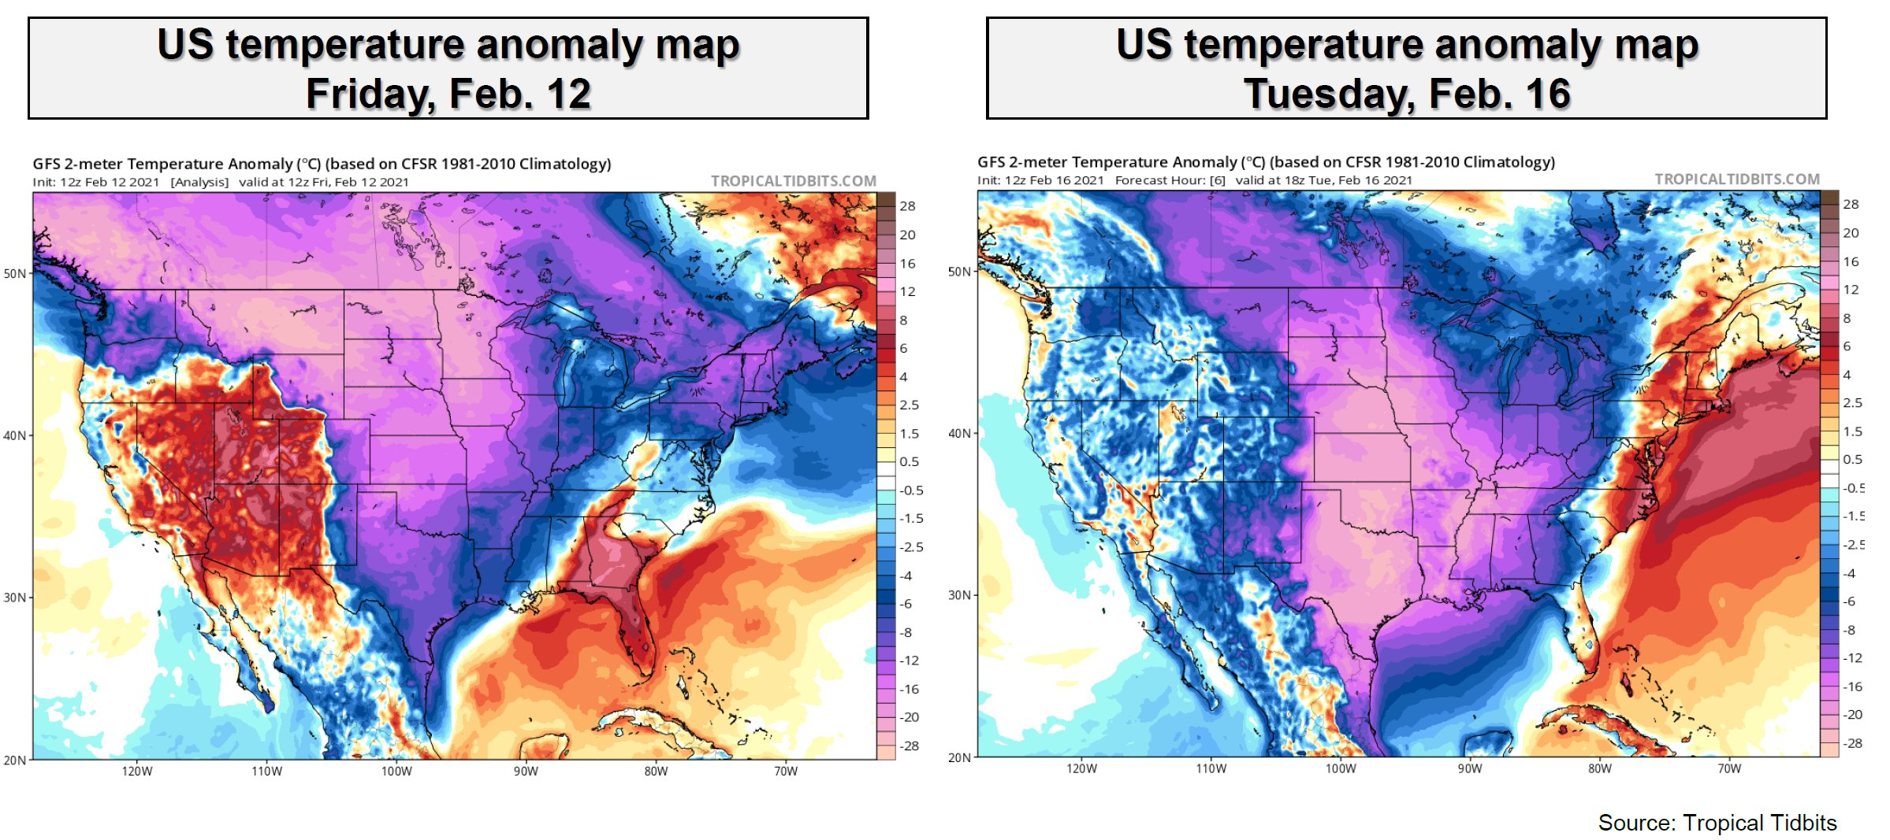
An arctic air mass led to colder-than-normal conditions in all but six states

Slide 7
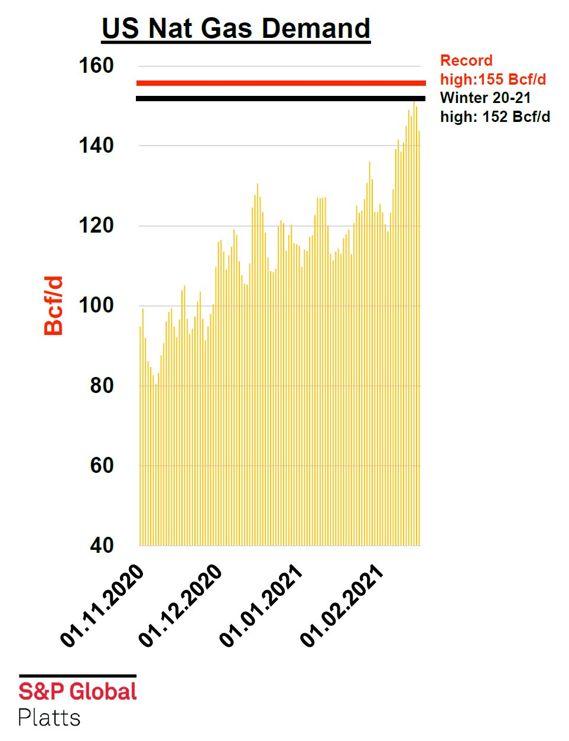
US natural gas demand set a two-day record on February 14 and 15.

Slide 8
Data: S&P Global Platts

Slide 9
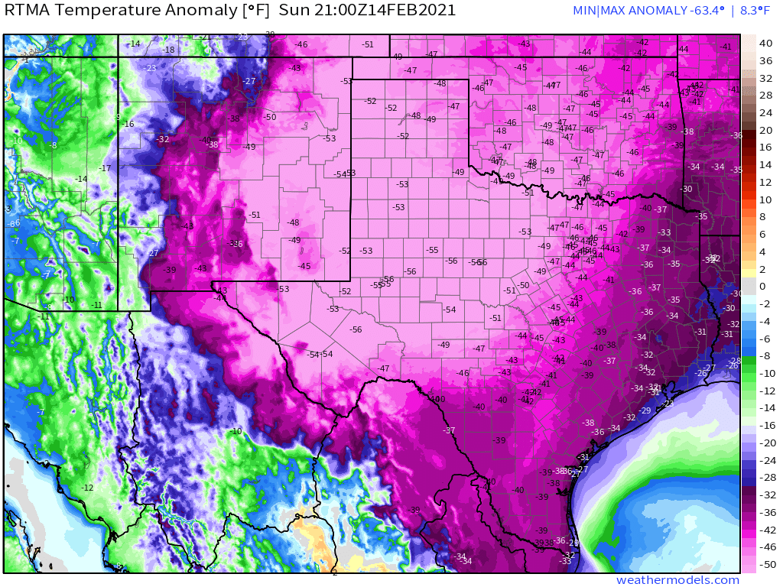
Texas set a new demand record for natural gas consumption during the cold event.
Temperature Deviation from Normal, Feb 14, 2021

Slide 10
Natural gas served to all Texas customers increased dramatically during the coldest days.

Slide 11
Natural gas demand ramped up—and down. Feedgas for LNG exports declined during the peak of the cold.

Slide 12
Natural gas production declined sharply as temperatures dropped, and then rebounded quickly.
S&P Global Platts

Slide 13
This is what that dip looks like compared to history.
Data: S&P Global Platts Analytics

Slide 14
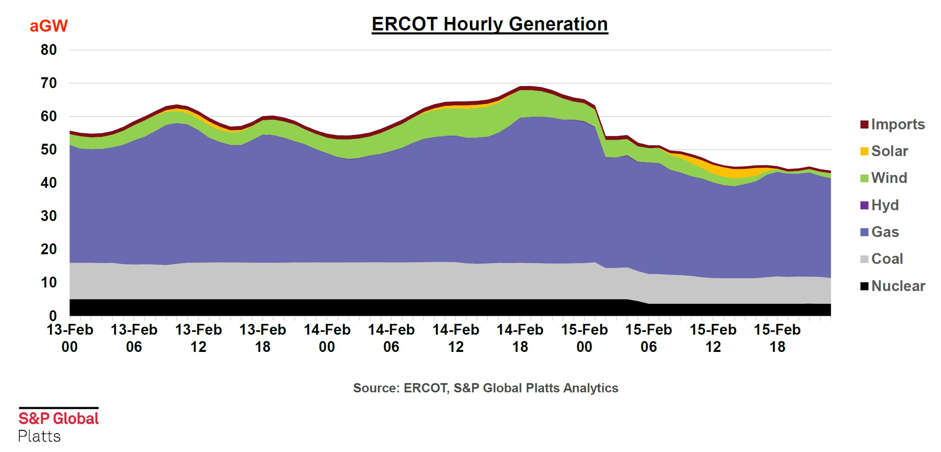
The largest declines in Texas (ERCOT) generation were due to gas-fired units. But, as you can see, natural gas continued to do the heavy lifting even as the grid was stressed under unprecedented demand.

Slide 15
Wind generation in Texas (ERCOT) was well below levels at prevailing wind speeds only days and weeks before the cold event, suggesting severe temperatures were affecting equipment operation.

Slide 16
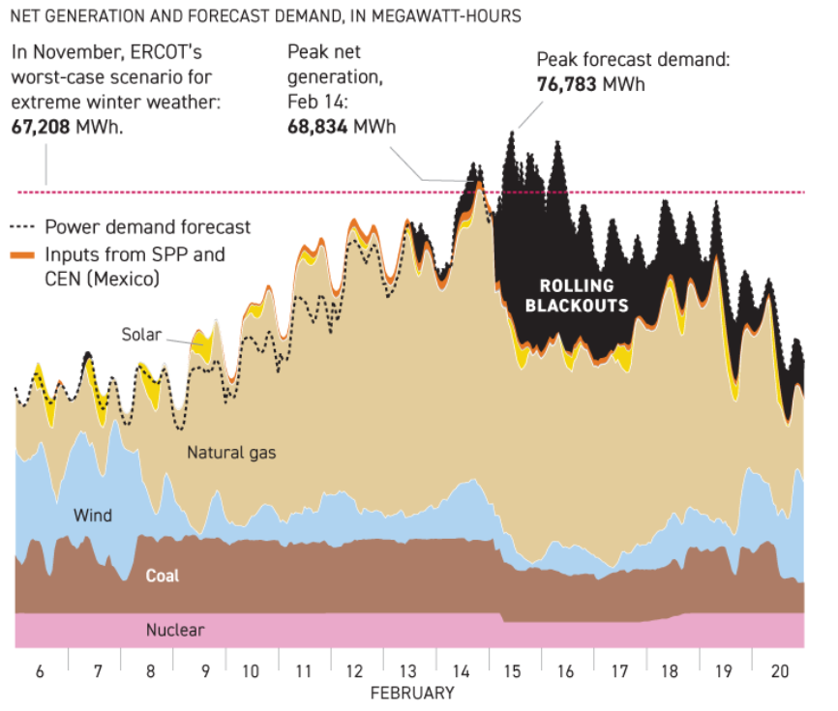
Graphic: Politico

Slide 17
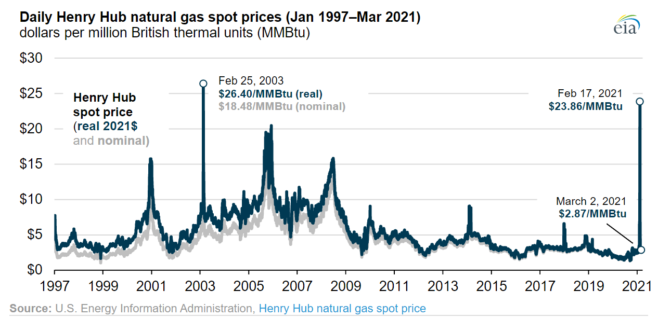

Slide 18
US natural gas prices surged due to supply constraints and record demand

Slide 19
Despite the sharp increases in daily cash prices, futures contracts faced moderate pressure.
Data: Energy Information Administration

Slide 20
Natural gas prices remained relatively low.
Data: Energy Information Administration

Slide 21
Natural gas storage stepped up in a big way to meet demand across the country.

Slide 22
The Canadian gas market played a key role.

Slide 23
Lessons from the 2021 Cold Event
Natural gas utility operations were largely uninterrupted during the cold event.
Energy systems with heavy dependence on electricity for space heating will be challenged by exceptionally cold temperatures.
Energy system resilience is likely to be achieved through a diverse set of integrated assets.
Gas storage represents the world’s biggest “battery”.

Slide 24
Demand has been strong, with growth almost entirely from LNG exports and pipeline gas to Mexico.
Source: S&P Global Platts

Slide 25
Supplies have grown from the slowdown of 2020, but have not kept pace with demand.
Avg. Supply (Bcf/d) 93.5
Avg. Supply (Bcf/d) 95.2
Avg. Supply (Bcf/d) 91.0
Source: S&P Global Platts

Slide 26
Henry Hub futures prices facing pressure headed into the winter.
Data: Energy Information Administration

Slide 27
Still, within a larger span of history, prices remain low and stable
Data: Energy Information Administration

Slide 28
At the end of 2020, EIA expected higher wholesale U.S. natural gas prices in 2021 and 2022

Slide 29
Natural gas production remains flat. Operators increasingly new activities sparingly.
Data: S&P Global Platts Analytics

Slide 30
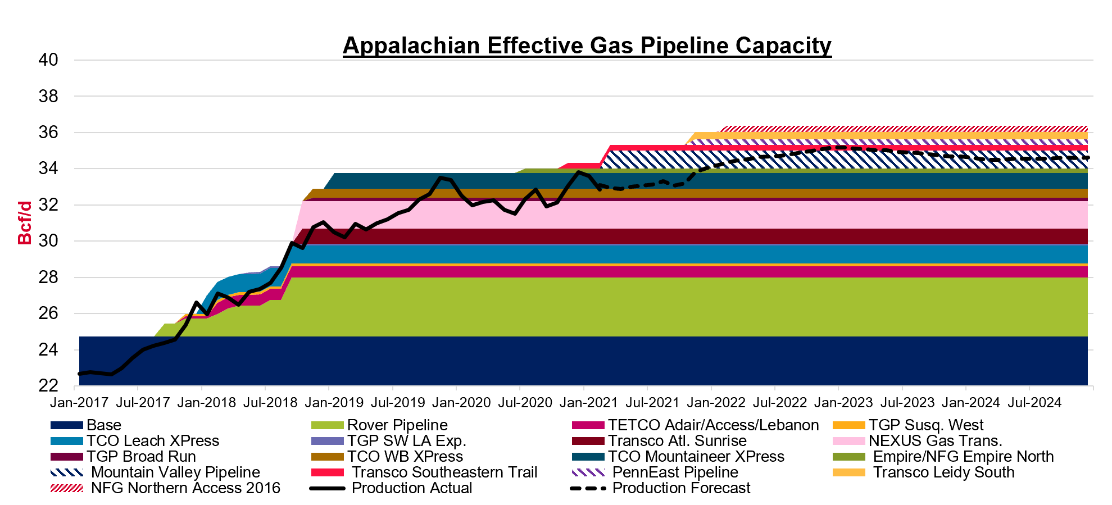
Production impacts from takeaway capacity in Appalachia

Slide 31
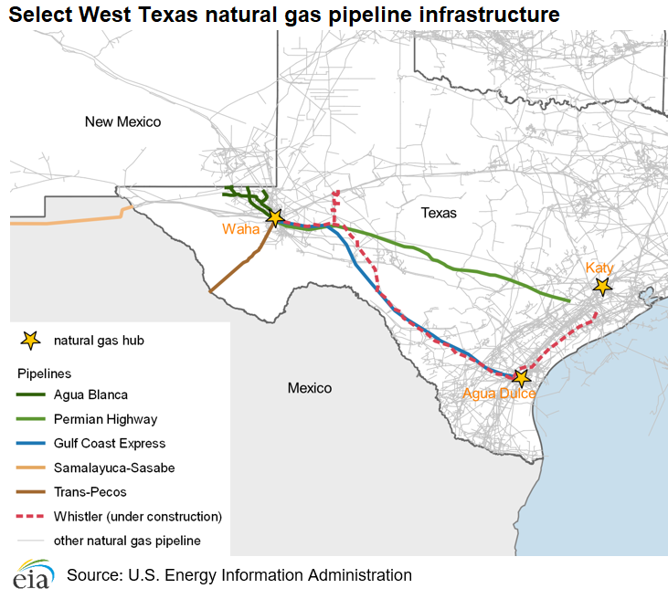
Takeaway capacity increases near areas of growing demand

Slide 32
Storage inventories are below average this injection season
Source: EIA

Slide 33
Rolling average natural gas to to power generation
Data from S&P Global Platts Analytics

Slide 34
What does gas growth look like in the power sector?
U.S. natural gas demand outlook for electric power generation
Key influences
Federal and state clean energy targets
Carbon pricing
Coal retirements
Gas-Coal switching
Nuclear power
Value of gas capacity

Slide 35
Natural gas generation was boosted by lower hydroelectric output

Slide 36
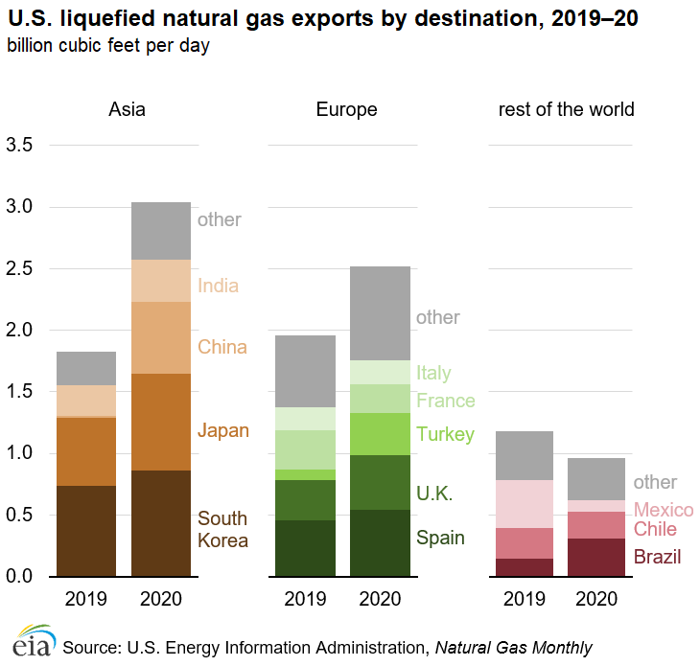
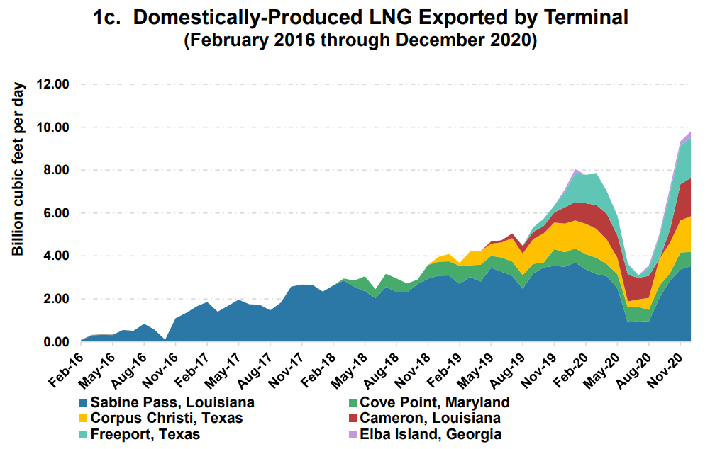
The pandemic interrupted record US LNG exports for a few months. Then flows rebounded sharply and finished the year at record levels. Asia and Europe are driving US demand growth.

Slide 37
European and Asian natural gas prices are at or near record levels.

Slide 38
Main gas suppliers to Europe in 1H of 2019, 2020, and 2021

Slide 39
A lot of factors have contributed to rising natural gas prices in Europe and Asia
Cold winter followed by a hot summer.
Declining domestic production
Consistent but not strong flows from Russia
Low European gas storage levels (less than 80% full)
Intense competition for LNG supply
South American drought/declines in production, boosting LNG demand
LNG production disruptions

Slide 40
Strong export demand on the horizon, and two new LNG plants expected to come online later this year, early 2022.

Slide 41
Conclusion
Near-Term Observations
US market is tighter than prior years, but well supplied.
Weather will be a key driver for demand.
LNG demand likely to remain strong given high overseas prices.
Gas-to-coal switching may be more limited, but some potential remains.
Will producer behavior change if domestic prices remain high?
Key long-term issues to watch
Environmental concerns – ESG pressure
Challenges to infrastructure development
International market influence

Slide 43
Thank you!
The American Gas Association, founded in 1918, represents more than 200 local energy companies that deliver clean natural gas throughout the United States. There are more than 76 million residential, commercial and industrial natural gas customers in the U.S., of which 95 percent — more than 72 million customers — receive their gas from AGA members. Today, natural gas meets more than 30 percent of the United States' energy needs. www.aga.org
TrueBlueNaturalGas.org
AGA_naturalgas
naturalgas
aga_natgas
Juan Alvarado
Director, Energy Analysis | jalvarado@aga.org

