Slide 1

THE LSL REPLACEMENT COLLABORATIVE
The Lead Service Line Replacement Collaborative is a joint effort of 28 national public health, water utility, environmental, labor, consumer, housing, and state and local governmental organizations to accelerate full removal of the lead pipes.
www.lslr-collaborative.org
Notes:
MASON

Slide 2
THE LSL REPLACEMENT COLLABORATIVE
American Public Health Association
American Water Works Association*
Association of Metropolitan Water Agencies*
Association of State Drinking Water Administrators
Blue Green Alliance
Children’s Environmental Health Network*
Clean Water Action*
Environmental Defense Fund*
Environmental Policy Information Center
Green and Healthy Homes Initiative
Justice and Sustainability Associates
Learning Disabilities Association of America
National Center for Health Housing
National Association of County and City Health Officials
National Association of State Utility Consumer Advocates
National Association of Water Companies
National Conference of State Legislatures
National Environmental Health Association
National League of Cities
National Rural Water Association
Natural Resources Defense Council
North East Midwest Institute
RESOLVE*
River Network
Rural Community Assistance Partnership
Trust for America’s Health
United Parents Against Lead
Water Research Foundation
Notes:
MASON

Slide 3
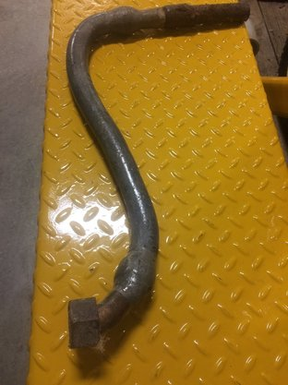
Key LSL REPLACEMENT ISSUES
Many considerations when developing a LSL replacement plan…
Inventory
Funding
Public communications
Coordinating among agencies and sectors
And more
Check out our webinars:
https://www.lslr-collaborative.org/webinars
Equity issues cut across all of these
https://www.lslr-collaborative.org/equity.html
Notes:
MASON

Slide 4
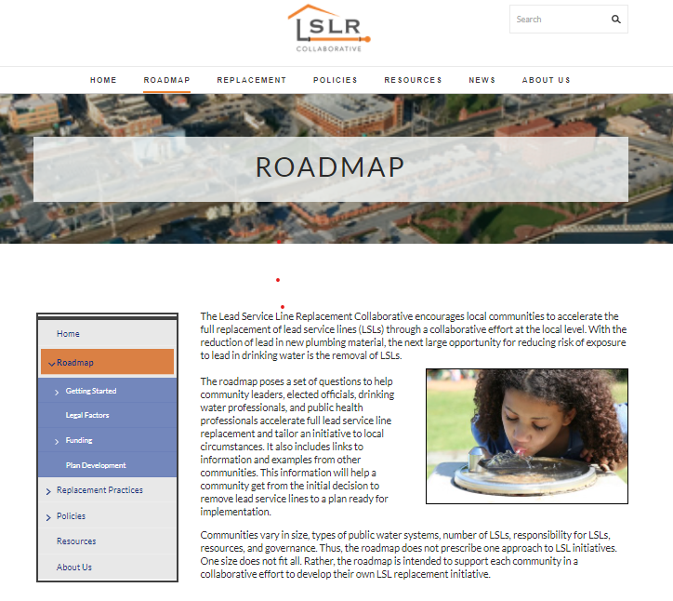
Notes:
MASON

Slide 5
Lynn Thorp National Campaigns Director
lthorp@cleanwater.org
cleanwater.org
@ltcwa
@cleanh2oaction

