Slide 1
Alternative Ratemaking Design Challenges on the Ground
NASUCA Mid-Year Meeting
June 15, 2021
Susan L. Satter
Chief, Public Utilities Bureau,
Office of Illinois Attorney General
Chicago, Illinois

Slide 2
Is it PBR?
Theory versus practice: PBR is premised on rewarding or penalizing the utility by increasing the ROE for specified performance but also on setting rates for a number of years, using an index or forecasted utility costs to increase (decrease) rates.
Definitions: What are the roles of performance rewards/penalties versus the annual rate adjustment? How much annual adjustment is acceptable? Is it PBR if the rates are subject to annual review to match revenues to actual costs without regard to performance?
Political power: What is the legal authority? Is the ratemaking plan established by statute (legislation) or by regulators? What is the role of consumer advocates and utility representatives in program design?

Slide 3
Beware of Misnomers
Illinois electric utilities currently subject to statutory ratemaking, variously referred to as:
Performance Based Rates
Energy Infrastructure Modernization Act
Smart Grid Law
Formula Rates

Slide 4
Establishment of Performance Goals
In Illinois multi-page legislation created formula rates
Included a 10 year spending plan 220 ILCS 5/16-108.5(b)
Included performance metrics 220 ILCS 5/16-108.5(f), (f-5)
Performance metrics result of legislative negotiation – not analysis
Performance metrics asymmetrical (penalty only)
Total of 10 metrics – reliability, billing, diversity
Utility selected baseline year
5, 6, or 7 basis point reduction to ROE, total capped at 30, 34 and 38 basis points/yr growing every three years 220 ILCS 5/16-108.5(f-5)(1)(A)
In 9 years, ComEd missed one metric 5 times, lost 28 basis points, in 2022 will lose $5.5 million for the miss; Ameren has missed this goal twice

Slide 5
Performance Metrics in Formula Rate
Statutory Metrics – over ten years 220 ILCS 5/16-108.5(f)
20% improvement in SAIFI systemwide and for each of two districts (9 storms excluded each year)
15% improvement in CAIDI (9 storms excluded each year)
75% improvement in customer specific reliability – pre-existing standard
90% reduction in estimated bills
90% reduction in consumption on inactive meters - average
50% reduction in unaccounted for energy - average
$30 million reduction in uncollectible expense - average
Diversity

Slide 6
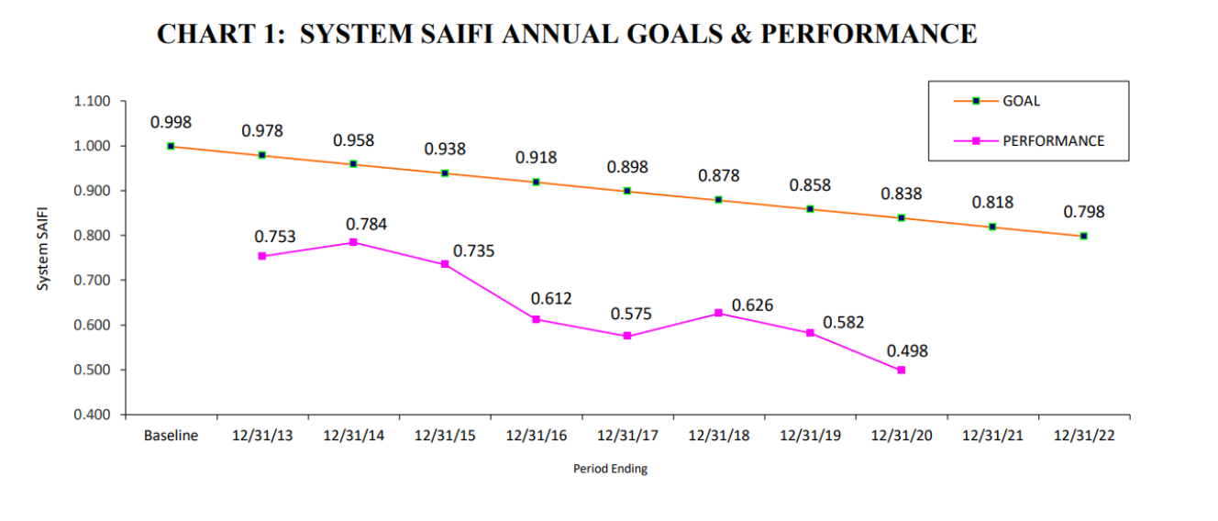
Seven of Ten Performance Metrics Look Like This
For full 2020 report: https://www.icc.illinois.gov/docket/P2011-0772/documents/310653

Slide 7
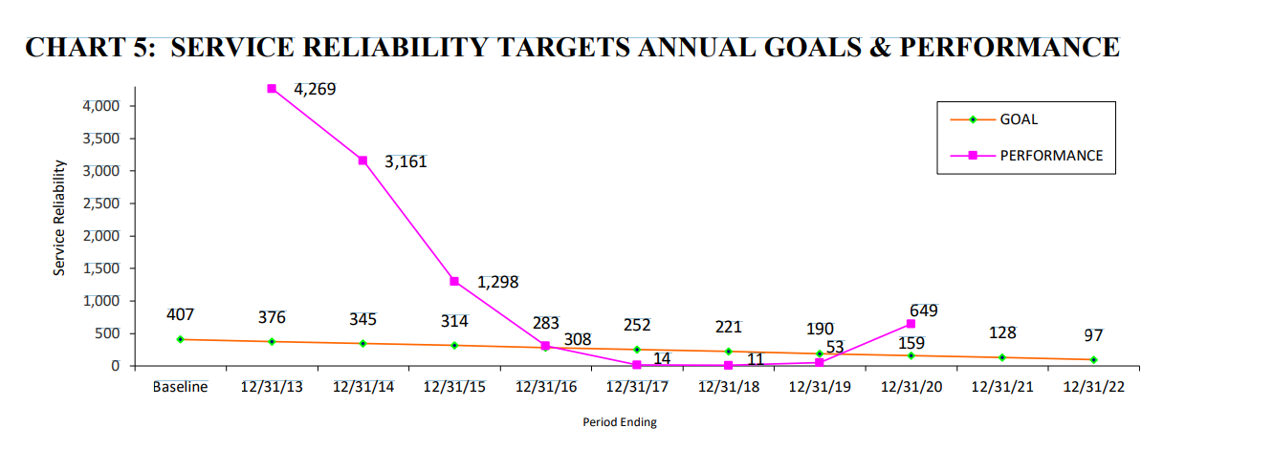
Only One Metric Resulted In A Penalty
Three of four metrics are inputs to an average, so never resulted in a penalty even if a miss 220 ILCS 5/16-108.5(f-5)(6)
One metric, based on pre-existing standard, resulted in five misses for ComEd (number of customers at three voltage levels that experience more than six outages or 18 hours out in a year) Id. at 16-108.5(f)(4)

Slide 8
A Second Try At Performance Based Rates
New statutory ratemaking structure, called Performance-Based Ratemaking 220 ILCS 5/16-108.18
Expressly authorizes multi-year rate plans, including annual rates based on projected cost of service
Targeted incentives for cost savings sharing 220 ILCS 5/16-108.20
Annual adjustment of 5% up or down for actual costs, with significant exclusions, such as storm costs, new business, investment timing changes, pension/OPEB costs, changes in interest rates
Performance Incentive Mechanisms worth 20-60 basis points
Consistent with Integrated Distribution Grid Plan 220 ILCS 5/16-105.17

Slide 9
Performance Metric Targets But No Specific Measures
Reliability and resiliency
Peak load reduction
Support for state clean energy goals
Carbon emissions reduction
Affordability
Customer service
Interconnection response
Diversity

Slide 10
The Devil Is Always In The Details
What is measured?
How is performance measured, including baseline, definition of improvement, reporting.
Are performance metrics a stretch?
Are penalties and rewards appropriate?
How is the ROE affected?
What about riders (decoupling, EE, RPS, uncollectibles, taxes, supply)

Slide 11
Recent PBR Orders-Maryland-BGE ORDER NO. 89678, PILOT APPLICATION FOR A MULTI-YEAR RATE PLAN, CASE NO. 9645
Adopted December 16, 2020 for Baltimore Gas and Electric (BGE) – Exelon Utility
Multi-year Rate Plan Terms for Electric AND Gas Delivery
Commission discussion of COVID-19 effects
“Offsets” utilized to negate increase in 2021; bigger increases 2022 and 2023 p.10-14
Allowed annual rate increases over 3 year period – through 12/31/23 p. 1-2
Annual rate increases based on utility forecasts p. 252
Allowed ROE of 9.5% “consistent with the nationwide average of awarded ROEs” but also “appropriately accounts for reduced regulatory lag and risk.” p. 153-154
Concern about information asymmetry and transparency for future review p. 251-254
Annual informational filings; reconciliation and prudency review at end of three years to evaluate differences between forecasted and actual amounts. True-up including ROE in next plan. p. 254; Order Establishing Multi-year Rate Plan Pilot, Case No. 9618, para. 8 (Feb. 4, 2020)
No PIMs or PBR b/c working group not finished with work

Slide 12
Recent PBR Orders – D.C. Pepco FORMAL CASE NO. 1156, IN THE MATTER OF THE APPLICATION OF POTOMAC ELECTRIC POWER COMPANY FOR AUTHORITY TO IMPLEMENT A MULTIYEAR RATE PLAN FOR ELECTRIC DISTRIBUTION SERVICE IN THE DISTRICT OF COLUMBIA, Order No. 20755, June 8, 2021
Performance Based Ratemaking- Multi-year Rate Plan Terms
Allowed annual rate increases over 3 year period – through 12/31/23
Annual rate escalation of 2.17% (Para. 192-195)
Includes annual true-up of projected to actual costs with two-way adjustment and 60 days for discovery, comment, and review (para. 96-98, 160-161)
Deferred accounting mechanism for costs >$1 m rev effect and the reopener provisions for extraordinary, unforeseen catastrophic events (Para. 163-164)
Only tracking PIMS – no actual incentives: Measure GHG, EE, EV, Peak Demand (including DER, DR, TOU), DER, Reliability (CEMI-3) (Para. 170)

Slide 13
DC PEPCO June 8, 2021 Order - ROE
Large rate base investment planned-$1.3 billion over 3 years. (para. 233)
ROE = 9.275% the “upper end” of the DCF range
PUC noted significant investment over three years “given uncertain capital market conditions. Therefore, to enhance the Company’s ability to raise significant capital at favorable terms over the next few years, and to help maintain the company’s current investment-grade credit rating, we place more weight on the upper end of the average DCF range.” (Para. 233.)
ROE supposed to reflect lessened regulatory lag and decoupling (Para. 4)
High end average of three ROE analysis = 9.16%
National ROE average for distribution electric utilities per Pepco witness (D’Ascenis) = 9.26% (para. 237)

Slide 14
Conclusion
Multi-year Plans, Performance Based Rates and Metrics Challenges
Creating fair rates over several years-forecasts and escalation
Effect of reconciliations, adjustments, decoupling, riders
ROE and reduced risk
Information asymmetry in ratemaking and designing PIMs
Expert and process intensive due to need to develop forecasting, performance measures, incentives, investment levels, etc.
Utilities’ political and regulatory power to set the agenda

Slide 15
Thank you
The views stated in this presentation are my own and do not necessarily represent the policy of the Illinois Attorney General.
Susan L. Satter
Chief, Public Utilities Bureau
Office of Illinois Attorney General Kwame Raoul
100 West Randolph Street, 11th floor
Chicago, Illinois 60601
Telephone: (312) 350-2769 (remote and mobile)
Susan.Satter@illinois.gov

