Slide 1

Federal Transmission Policies for a Clean Energy Grid NASUCA June, 2021
Rob Gramlich
www.gridstrategiesllc.com
@RobGramlichDC

Slide 2
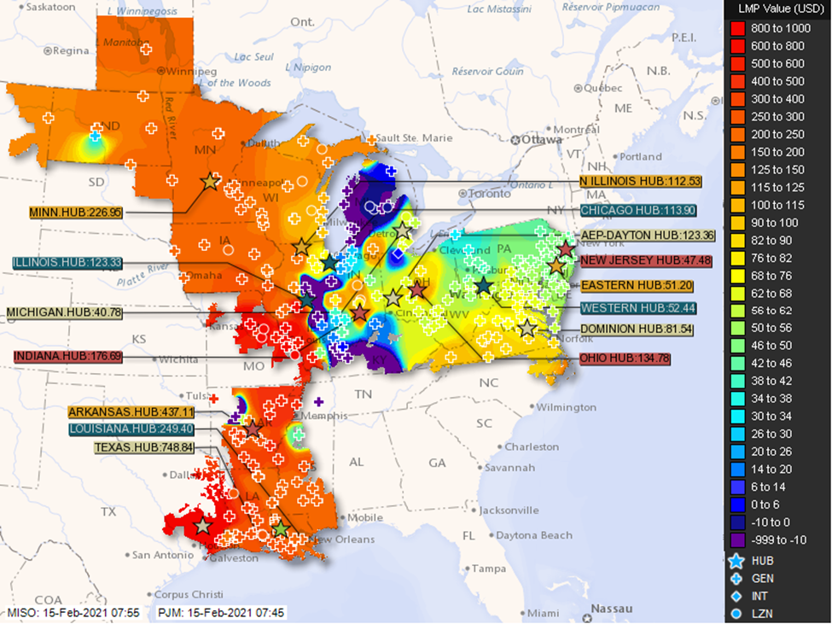
Interregional Transmission Keeps the Lights On in Winter Storm Uri Feb 2021 MISO imported 13 GW, ERCOT only 0.8 GW (East to West flow) Eastern polar vortex incidents in 2014, 2018 served by Midwest power (West to East flow) For transmission planning and cost allocation—who is the beneficiary???

Slide 3
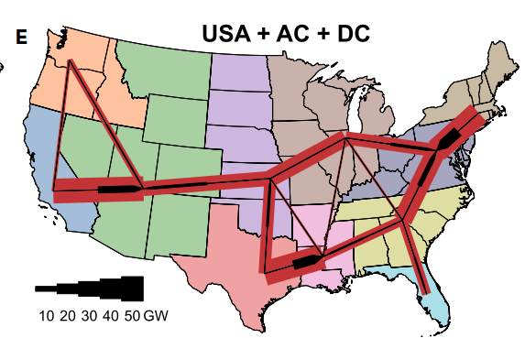
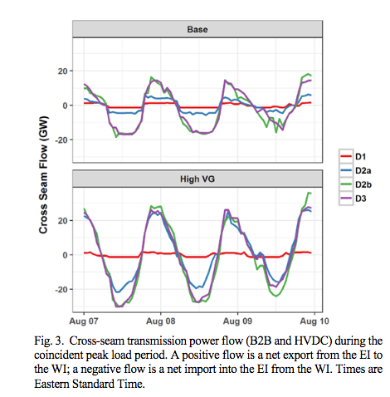
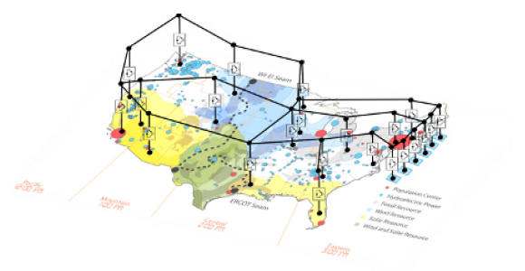
Low-cost decarbonization requires large scale transmission 10s of GWs of power transfer back and forth across and between regions 2-3x increase in national transmission capacity
Modeled flows NREL Seam study
https://www.cell.com/joule/fulltext/S2542-4351(20)30557-2
https://cleanenergygrid.org/wp-content/uploads/2020/11/Macro-Grids-in-the-Mainstream-1.pdf

Slide 4
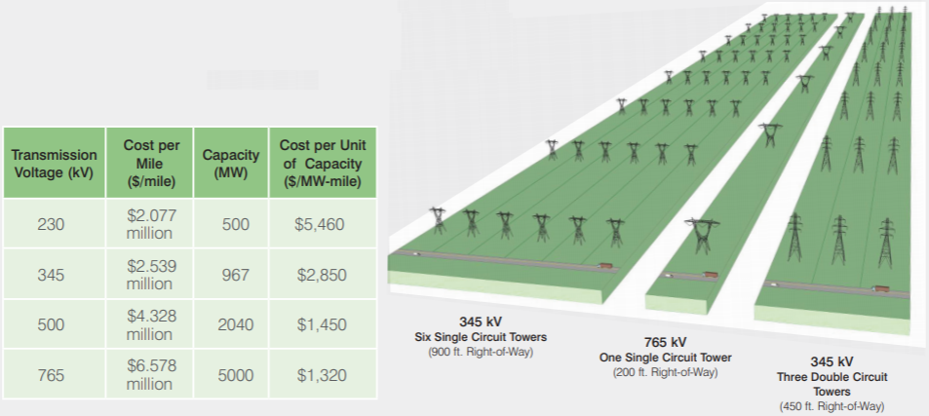
Bigger is lower cost in transmission
765kv lines have ~1/6 the losses as 345 kV
Bigger lines
Lower $/MW-mile

Slide 5
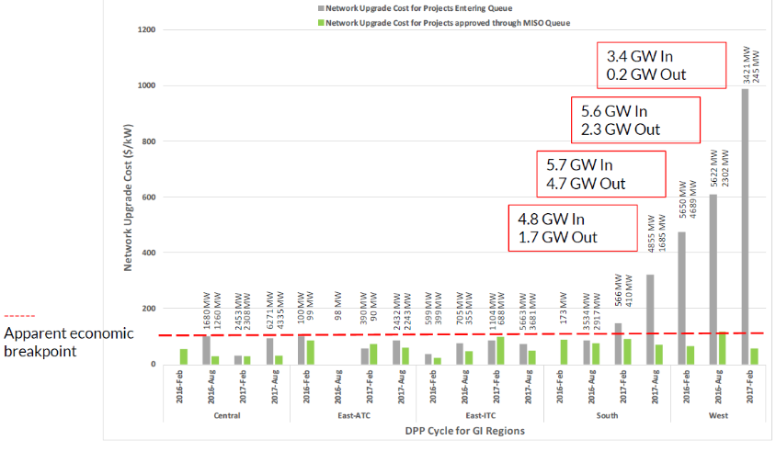
~800 GW of clean energy stuck in interconnection queues Planning a HV network through an interconnection process costs more than regional planning
More recent
Higher cost
Projects Entering
Queues
Completed
Projects

Slide 6
First, get the most out of the existing grid with Grid-Enhancing Technologies (GETs) See www.watt-transmission.org
GET some Dynamic Line Ratings, topology optimization, storage-as-transmission, power flow control
GETs are
VERY low cost, $0.5m - $25m
deployable in MONTHS
scalable
modular
mobile and re-deployable
FERC shared savings incentive conference September 2021

Slide 7
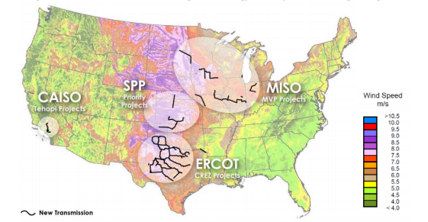
Big transmission CAN be built! Recent US Large-Scale Expansions
MISO MVP, SPP priority projects, ERCOT CREZ
3:1 Benefit-Cost ratios
Winning formula:
Pro-active multi-benefit planning
Broad, beneficiary pays cost allocation

Slide 8
FERC Initiatives For low delivered cost energy (generation + transmission)
4. Transmission planning and cost allocation
Estimate generation as well as load
Multi-benefit, de-silo—congestion, resilience, public policy
Resilience scenarios that might afflict a given region
Electrification estimates in load forecasts
Benefit-cost analysis
Inter-regional
Kill MOPR
Interconnection reforms
Grid-Enhancing Technologies incentives
Encourage markets and RTOs
Chairman Glick: revisiting the planning process for developing high-voltage power lines across the country should be “front and center” at the Commission. “That’s my goal: to have something in place at least to start the process, whether it’s rulemaking or a policy approach, before the end of the summer.”

Slide 9
Transmission Policy in the 117th Congress
Infrastructure legislation:
Transmission Investment Tax Credit
Funding for large scale transmission
Anchor tenant loans
Power Marketing Administration loan authority
DOE studies and helping with planning
Direct FERC to fix interregional planning and cost allocation
Funding for states to constructively engage in transmission planning
Consider transmission siting

Slide 10
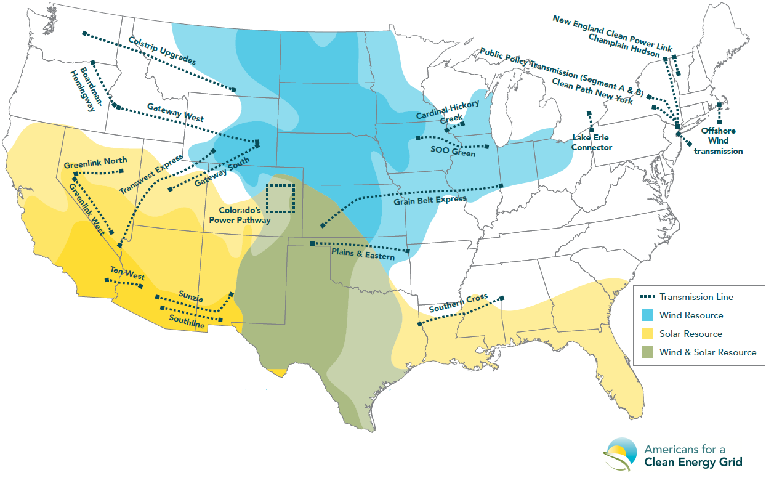
Executive Agency Transmission Initiatives Sec. Granholm: “deploy, deploy, deploy”
Improve federal permitting
DOT: highways
DOI: federal lands
Federal backstop siting
DOE and FERC
Grid Deployment Authority
WAPA Transmission Infrastructure Program loans
Loan guarantees—DOE Loan Program Office

